Slide 1
Milky Way and a sense of distance

Slide 2
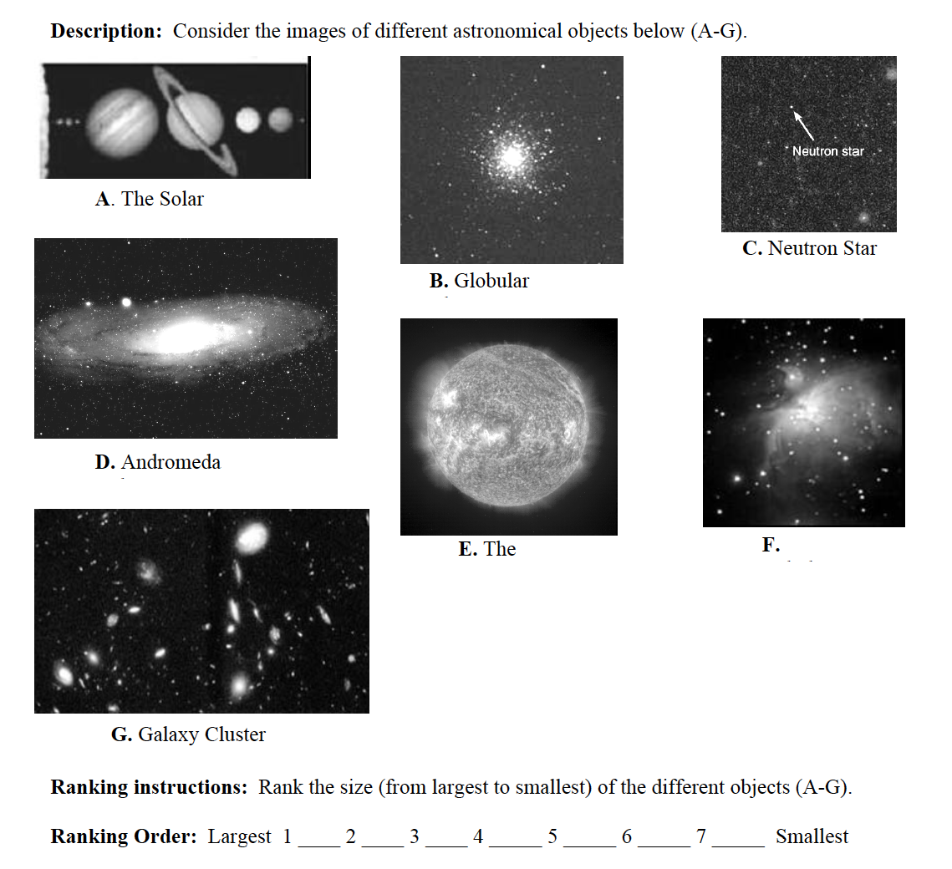
Sun
Star forming region

Slide 3
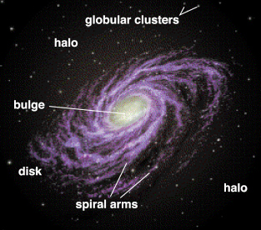
Our Milky Way Galaxy
Above average size Spiral Galaxy
Approximately 400 billion stars
Galaxy Components:
Bulge
Disk
Halo

Slide 4
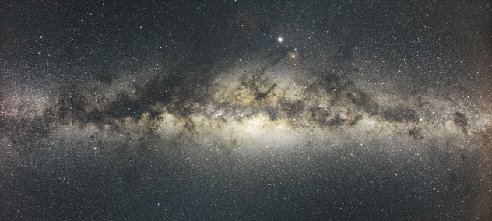
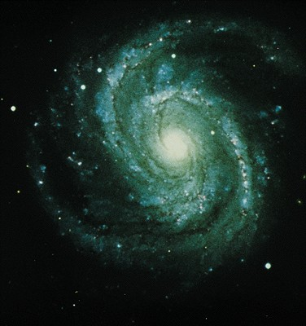
Which is our view of the Milky Way?
A
B

Slide 5
Which is our view of the Milky Way?
A
A is what we see from Earth inside the Milky Way while B is what the Milky Way “might” look like if we were far away looking back at our own galaxy from some other galaxy.
B

Slide 6
Where (in the disk) are we?

Slide 7
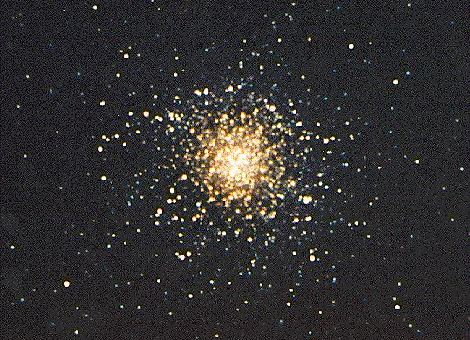
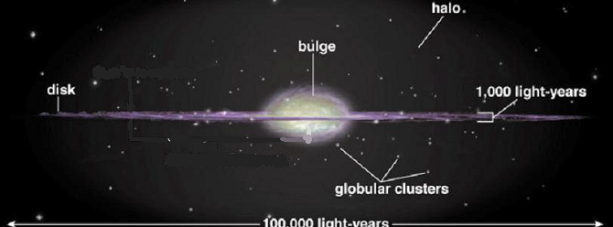
Where in the disk are we (or how far from the center are we) ?
Globular Cluster M13
Globular clusters (1000s of stars that were all born from the same cloud at the same time) are distributed uniformly around the Milky Way.
The center of this distribution is located at the galactic center.

Slide 8
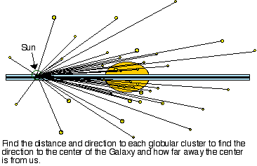
Where in the disk are we (or how far from the center are we) ?
In 1917, Harlow Shapley plotted the distribution of globular clusters in the Milky Way in an effort to learn our location within the Galaxy.
The center (maximum) of the distribution of globular cluster shows us where the center of the galaxy is.

Slide 9
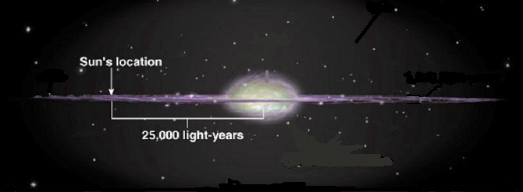
Where in the disk are we (or how far from the center are we) ?
We know we are not in the center of our solar system
AND We know we are not in the center of our galaxy
(We are also NOT in the center of the universe, but that will come later)
We are located in the disk about 25,000 ly out from the center

Slide 10
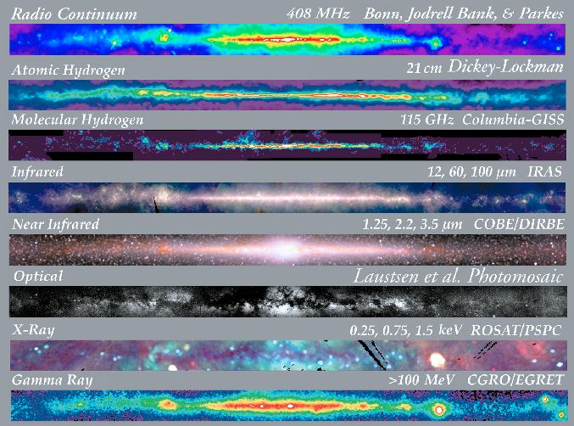
Non-visible light allow us to observe the center of the galaxy

Slide 11
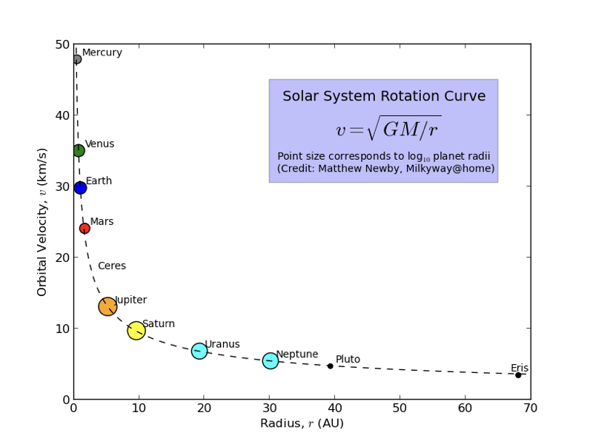

Slide 12
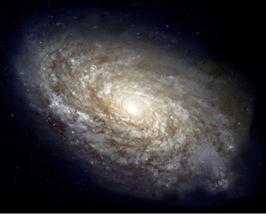
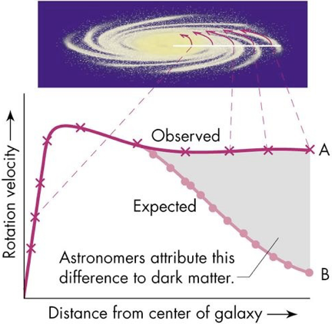
Flat rotation curve
implies dark matter
The stars in our Milky Way comprise
at most 10% of its mass!
Notes:
Do part 2 after showing the picture of the galaxy.

Slide 13
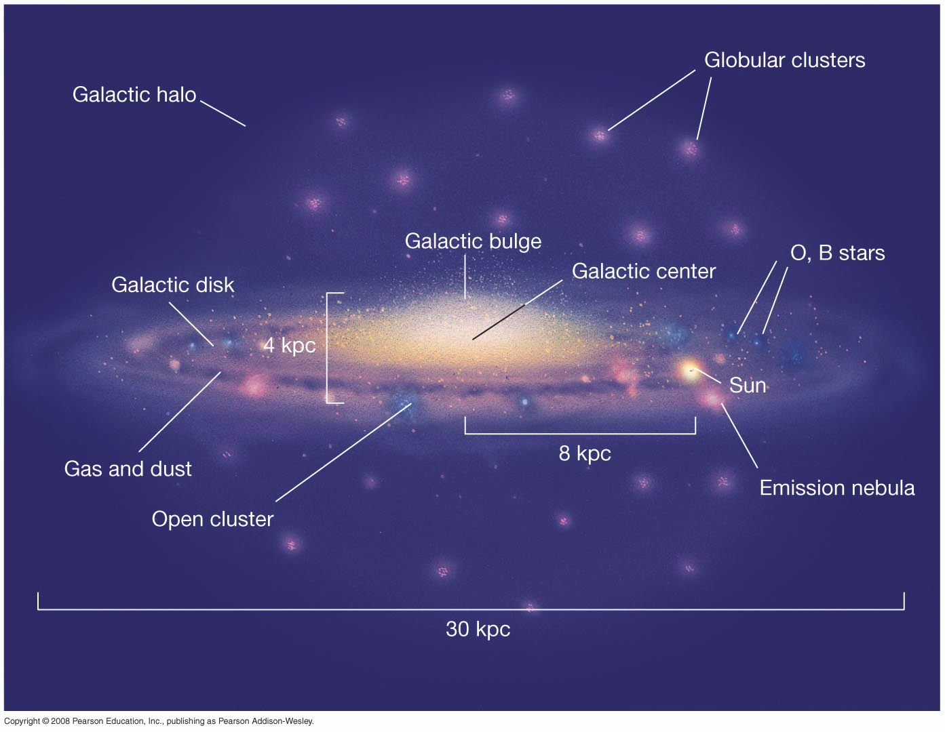
Review: Sketch and Label an Edge on View of the Milky Way
Notes:
http://lamost.us/legue/index.php?option=com_content&view=article&id=57:milky-way-halo-spheroid&Itemid=109

