Slide 1
Machine Vision Homework#2 Deadline: 2024/04/03 23:59:59
Robot Vision Lab (Room 1421)
TAs: 魏士涵 t112598058@ntut.edu.tw
賴靖嫺 t112598008@ntut.edu.tw

Slide 2
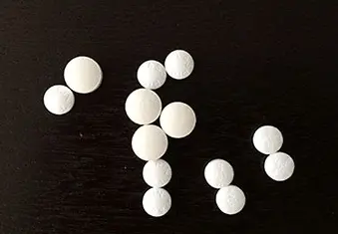
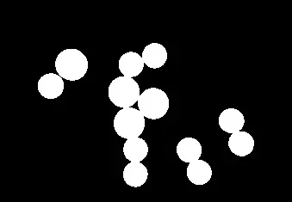
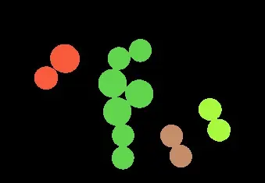
HW#2
 | p
 | p
4-connected
8-connected
Component Labeling
Convert the color image to a binary image.
Labeling components using 4-connected and 8-connected.
Output color image.

Slide 3
HW#2
Report
Student ID
Name
Describe the main part of your method
Result image

Slide 4
HW#2
Rules in using C/C++ OpenCV Lib
Use OpenCV-2.x version
Allow use:
Read, save, show image (cvLoadImage, cvShowImage, …)
Define image (Mat)
Get image size (cvSize, cvGetSize)
Not Allow use:
Cannot use the function of Lib to do the main part of homework.
Example: cvtColor(image, gray, CV_RGB2GRAY); // convert RGB to Gray

Slide 5
HW#2
Rules in using Python OpenCV Lib
Allow use:
Read, save, show image (cv2.imread, cv2.imshow, …)
Define image
Get image size
Not Allow use:
Cannot use the function of Lib to do the main part of homework.
Example: cv2.cvtColor(image, cv2.COLOR_BGR2GRAY) // convert RGB to Gray

Slide 6
HW#2
Grade
Program(80%)
Report(20%)

Slide 7
HW#2
Python
C/C++
112598008_hw1/
├─ images/
│ ├─ img1.jpg
│ ├─ img2.jpg
│ ├─ img3.jpg
│ └─ img4.jpg
├─ results/
│ ├─ img1_4.jpg
│ ├─ img1_8.jpg
│ ├─ img2_4.jpg
│ ├─ img2_8.jpg
│ ├─ img3_4.jpg
│ ├─ img3_8.jpg
│ ├─ img4_4.jpg
│ └─ img4_8.jpg
├─ 112598008_hw1.py
├─ 112598008_hw1.pdf
└─ Readme.txt (Optional)
112598008_hw1/
├─ project_hw1/
│ ├─ images/
│ │ ├─ img1.jpg
│ │ ├─ img2.jpg
│ │ ├─ img3.jpg
│ │ └─ img4.jpg
│ ├─ results/
│ │ ├─ img1_4.jpg
│ │ ├─ img1_8.jpg
│ │ ├─ img2_4.jpg
│ │ ├─ img2_8.jpg
│ │ ├─ img3_4.jpg
│ │ ├─ img3_8.jpg
│ │ ├─ img4_4.jpg
│ │ └─ img4_8.jpg
│ ├─ include/
│ │ └─ func.h
│ ├─ func.cpp
│ └─ main.cpp
├─ 112598008_hw1.pdf
└─ Readme.txt (Optional)
Folder Structure
There are 8 images in the
results folder.
Write homework on the one program.

Slide 8
HW#2
Please compress your files.
Example: 112598008_hw2.zip
Deadline: 2024/04/03 23:59:59
For each hour late, 10% of the total score will be deducted.
Don’t share your code and your report with other students. Do it by yourself.

