Slide 1
Machine Vision Homework#5 Deadline: 2024/05/29 23:59:59
Robot Vision Lab (Room 1421)
TAs: 魏士涵 t112598058@ntut.edu.tw
賴靖嫺 t112598008@ntut.edu.tw

Slide 2
HW#5
Image filtering
1. Implement Mean Filter with 3*3 and 7*7 mask.
2. Implement Median Filter with 3*3 and 7*7 mask.
3. Implement Gaussian 2D Filter with 5*5 mask.
Define your σ and describe your Gaussian kernel.
※Don’t forget the zero padding, check your image size result

Slide 3
Mean Filter
 | 8 | 10 | 21 | 17 | 35
 | 2 | 43 | 15 | 72 | 21
 | 30 | 94 | 55 | 43 | 74
 | 36 | 28 | 69 | 88 | 56
 | 45 | 75 | 42 | 47 | 20

Slide 4


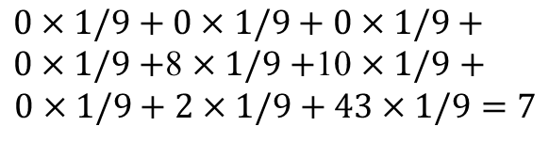
Mean Filter
$0×1/9+0×1/9+0×1/9+0×1/9+$8 $×1/9+$10 $×1/9$ $+$
$$0×1/9+2×1/9+43×1/9=7$$
0 | 0 | 0
0 | 8 | 10 | 21 | 17 | 35
0 | 2 | 43 | 15 | 72 | 21
 | 30 | 94 | 55 | 43 | 74
 | 36 | 28 | 69 | 88 | 56
 | 45 | 75 | 42 | 47 | 20
 | 7
1/9 | 1/9 | 1/9
1/9 | 1/9 | 1/9
1/9 | 1/9 | 1/9
$$×$$
$$=$$

Slide 5
Median Filter
0 | 0 | 0
0 | 8 | 10 | 21 | 17 | 35
0 | 2 | 43 | 15 | 72 | 21
 | 30 | 94 | 55 | 43 | 74
 | 36 | 28 | 69 | 88 | 56
 | 45 | 75 | 42 | 47 | 20
Neighborhood values: 0 0 0 0 8 10 0 2 43
0 0 0 0 0 2 8 10 43
 | 0

Slide 6

Gaussian 2D Filter
1. $G\left(x, y\right)=\frac{1}{2πσ^{2}}e^{−\frac{x^{2}+y^{2}}{2σ^{2}}}$
If$σ=1$,
2. Normalization
3. Convolution ：I*G
(-1,-1) | (0,-1) | (1,-1)
(-1,0) | (0,0) | (1,0)
(-1,1) | (0,1) | (1,1)
0.0585 | 0.0965 | 0.0585
0.0965 | 0.1591 | 0.0965
0.0585 | 0.0965 | 0.0585

Slide 7
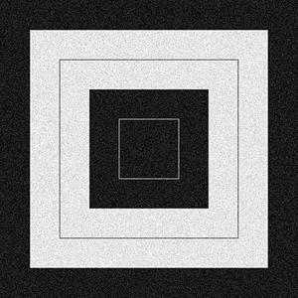
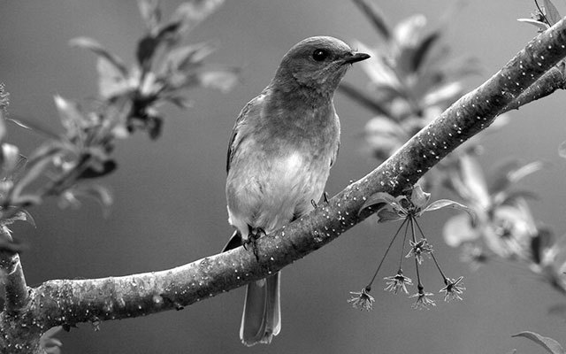
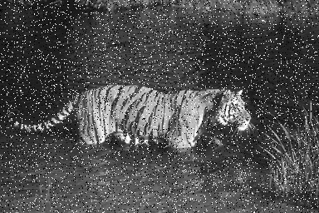
Images

Slide 8
HW#5
Report
Student ID
Name
Describe the main part of your method or explain your code
15 result images
Compare the result images that were generated by three different filters and describe what you observe

Slide 9
HW#5
Rules in using C/C++ OpenCV Lib
Use OpenCV-2.x version
Allow use:
Read, save, show image (cvLoadImage, cvShowImage, …)
Define image (Mat)
Get image size (cvSize, cvGetSize)
Not Allow use:
Cannot use the function of Lib to do the main part of homework.
Example: filter2D, medianBlur, GaussianBlur, blur
Other libs also not allow use to do the main part of homework

Slide 10
HW#5
Rules in using Python OpenCV Lib
Allow use:
Read, save, show image (cv2.imread, cv2.imshow, …)
Define image
Get image size
Not Allow use:
Cannot use the function of Lib to do the main part of homework.
Example: cv.filter2D, cv.medianBlur, cv.GaussianBlur, cv.blur
Other libs also not allow use to do the main part of homework

Slide 11
HW#5
Grade
Program(80%)
Mean Filter (25%)
Median Filter(25%)
Gaussian 2D Filter(30%)
Report(20%)

Slide 12
HW#5
112598008_hw5/
├─ project_hw5/
│ ├─ images/
│ │ ├─ img1.jpg
│ │ ├─ img2.jpg
│ │ └─ img3.jpg
│ ├─ results/
│ │ ├─ img1_q1_3.jpg
│ │ ├─ img1_q1_7.jpg
│ │ ├─ img1_q2_3.jpg
│ │ ├─ img1_q2_7.jpg
│ │ ├─ img1_q3.jpg
│ │ ├─ img2_q1_3.jpg
│ │ ├─ img2_q1_7.jpg
│ │ ├─ img2_q2_3.jpg
│ │ ├─ img2_q2_7.jpg
│ │ ├─ img2_q3.jpg
│ │ ├─ img3_q1_3.jpg
│ │ ├─ img3_q1_7.jpg
│ │ ├─ img3_q2_3.jpg
│ │ ├─ img3_q2_7.jpg
│ │ └─ img3_q3.jpg
│ ├─ include/
│ │ └─ func.h
│ ├─ func.cpp
│ └─ main.cpp
├─ 112598008_hw5.pdf
└─ Readme.txt (Optional)
112598008_hw5/
├─ images/
│ ├─ img1.jpg
│ ├─ img2.jpg
│ └─ img3.jpg
├─ results/
│ ├─ img1_q1_3.jpg
│ ├─ img1_ q1_7.jpg
│ ├─ img1_ q2_3.jpg
│ ├─ img1_ q2_7.jpg
│ ├─ img1_ q3.jpg
│ ├─ img2_ q1_3.jpg
│ ├─ img2_ q1_7.jpg
│ ├─ img2_ q2_3.jpg
│ ├─ img2_ q2_7.jpg
│ ├─ img2_ q3.jpg
│ ├─ img3_ q1_3.jpg
│ ├─ img3_ q1_7.jpg
│ ├─ img3_ q1_3.jpg
│ ├─ img3_ q1_7.jpg
│ └─ img3_ q3.jpg
├─ 112598008_hw5.py
├─ 112598008_hw5.pdf
└─ Readme.txt (Optional)
Folder Structure
There are 15 images in the results folder.
Write homework on the one program.
Python
C/C++

Slide 13
HW#5
Please compress your files.
Example: 112598008_hw5.zip
Deadline: 2024/05/29 23:59:59
For each hour late, 10% of the total score will be deducted.
Don’t share your code and your report with other students. Do it by yourself.

