Slide 1
Machine Vision Homework#1 Deadline: 2024/03/20 23:59:59
Robot Vision Lab (Room 1421)
TAs: 魏士涵 t112598058@ntut.edu.tw
賴靖嫺 t112598008@ntut.edu.tw

Slide 2
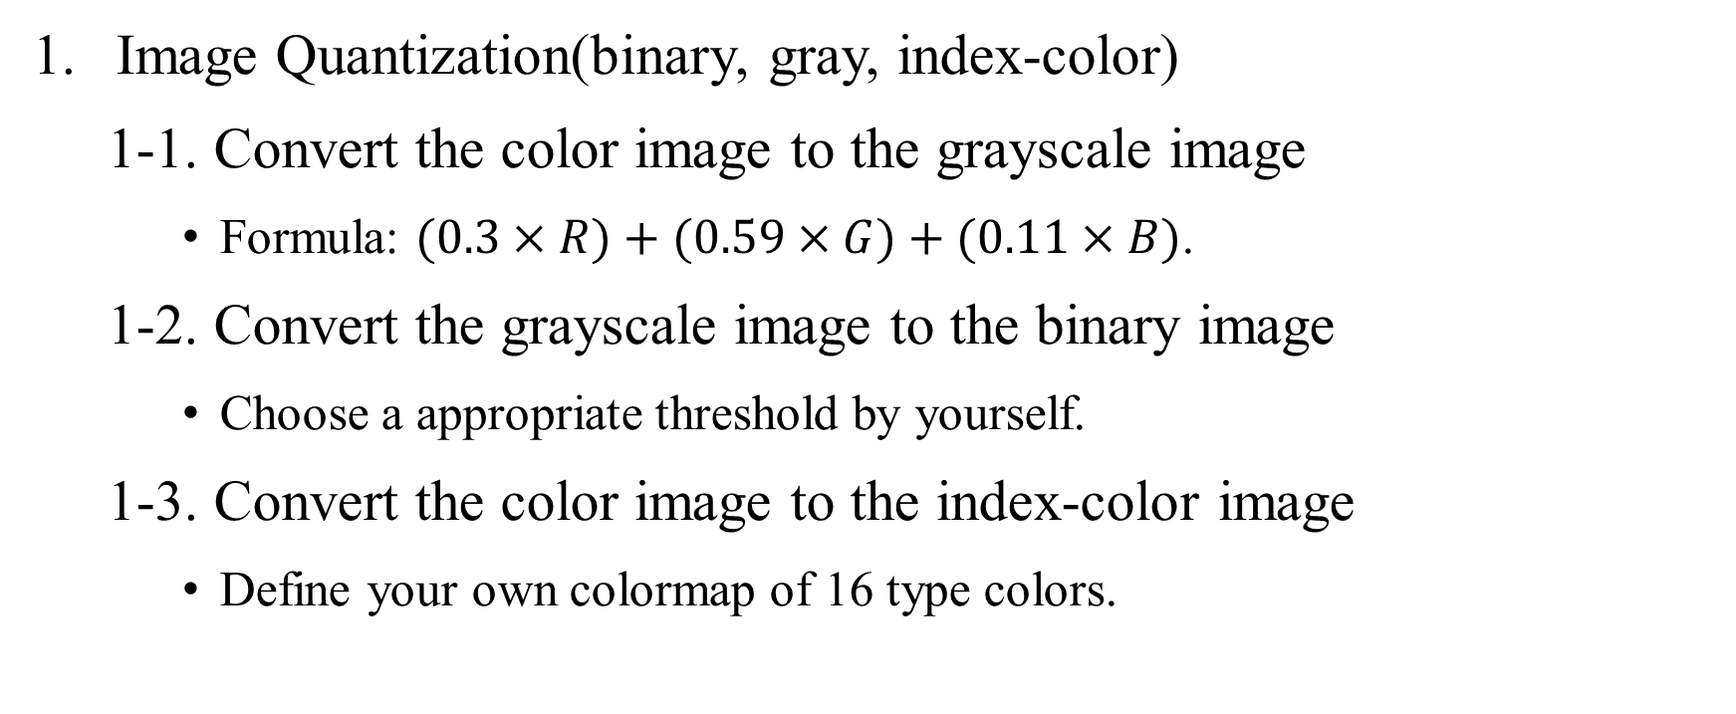
HW#1
Image Quantization(binary, gray, index-color)
1-1. Convert the color image to the grayscale image
Formula: $(0.3×R)+(0.59×G)+(0.11×B)$.
1-2. Convert the grayscale image to the binary image
Choose a appropriate threshold by yourself.
1-3. Convert the color image to the index-color image
Define your own colormap of 16 type colors.

Slide 3
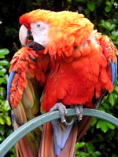
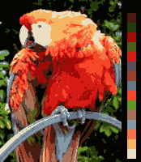
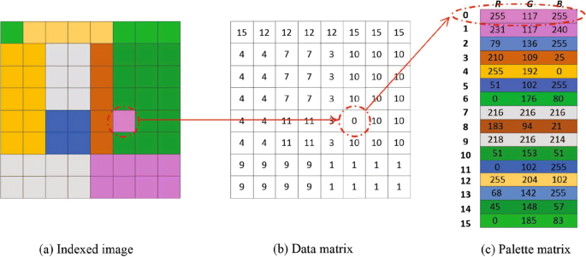
HW#1

Slide 4

HW#1
Resizing Image
2-1. Resizing image to $\frac{1}{2} and$ $2$ times without interpolation
10 | 10 | 20 | 20
10 | 10 | 20 | 20
30 | 30 | 40 | 40
30 | 30 | 40 | 40
10 | 15 | 20 | 17
19 | 21 | 14 | 16
30 | 26 | 40 | 45
39 | 35 | 36 | 37
10 | 20
30 | 40
10 | 20
30 | 40

Slide 5
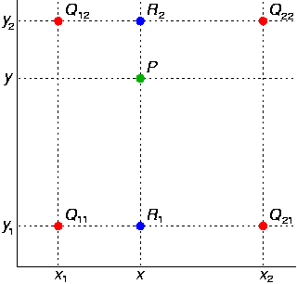
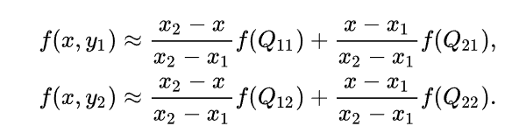
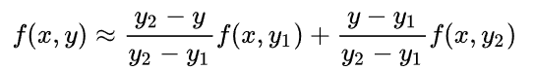

HW#1
Resizing Image
2-2. Resizing image to $\frac{1}{2} and$ $2$ times with interpolation
You can use bilinear or bicubic interpolation.

Slide 6
HW#1
Report
Student ID
Name
Describe the main part of your method
Result images and colormaps
Explain the results you get

Slide 7
HW#1
Rules in using C/C++ OpenCV Lib
Use OpenCV-2.x version
Allow use:
Read, save, show image (cvLoadImage, cvShowImage, …)
Define image (Mat)
Get image size (cvSize, cvGetSize)
Not Allow use:
Cannot use the function of Lib to do the main part of homework.
Example: cvtColor(image, gray, CV_RGB2GRAY); // convert RGB to Gray

Slide 8
HW#1
Rules in using Python OpenCV Lib
Allow use:
Read, save, show image (cv2.imread, cv2.imshow, …)
Define image
Get image size
Not Allow use:
Cannot use the function of Lib to do the main part of homework.
Example: cv2.cvtColor(image, cv2.COLOR_BGR2GRAY) // convert RGB to Gray

Slide 9
HW#1
Grade
Program(80%)
Q1-1(10%)
Q1-2(10%)
Q1-3(20%)
Q2-1(15%)
Q2-2(25%)
Report(20%)

Slide 10
HW#1
Python
C/C++
112598058_hw1/
├─ images/
│ ├─ img1.jpg
│ ├─ img2.jpg
│ └─ img3.jpg
├─ results/
│ ├─ img1_q1-1.jpg
│ ├─ img1_q1-2.jpg
│ ├─ img1_q1-3.jpg
│ ├─ img1_q2-1-half.jpg
│ ├─ img1_q2-1-double.jpg
│ ├─ img1_q2-2-half.jpg
│ ├─ img1_q2-2-double.jpg
│ ├─ …
│ └─ img3_q2-2-double.jpg
├─ 112598058_hw1.py
├─ 112598058_hw1.pdf
└─ Readme.txt (Optional)
112598058_hw1/
├─ project_hw1/
│ ├─ images/
│ │ ├─ img1.jpg
│ │ ├─ img2.jpg
│ │ └─ img3.jpg
│ ├─ results/
│ │ ├─ img1_q1-1.jpg
│ │ ├─ img1_q1-2.jpg
│ │ ├─ img1_q1-3.jpg
│ │ ├─ img1_q2-1-half.jpg
│ │ ├─ img1_q2-1-double.jpg
│ │ ├─ img1_q2-2-half.jpg
│ │ ├─ img1_q2-2-double.jpg
│ │ ├─ …
│ │ └─ img3_q2-2-double.jpg
│ ├─ include/
│ │ └─ func.h
│ ├─ func.cpp
│ └─ main.cpp
├─ 112598058_hw1.pdf
└─ Readme.txt (Optional)
Folder Structure
There are 21 images in the
results folder.
Write all questions in one program

Slide 11
HW#1
Please compress your files.
Example: 112598058_hw1.zip
Deadline: 2024/3/20 23:59:59
For each hour late, 10% of the total score will be deducted.
Don’t share your code and your report with other students. Do it by yourself.

