Slide 1
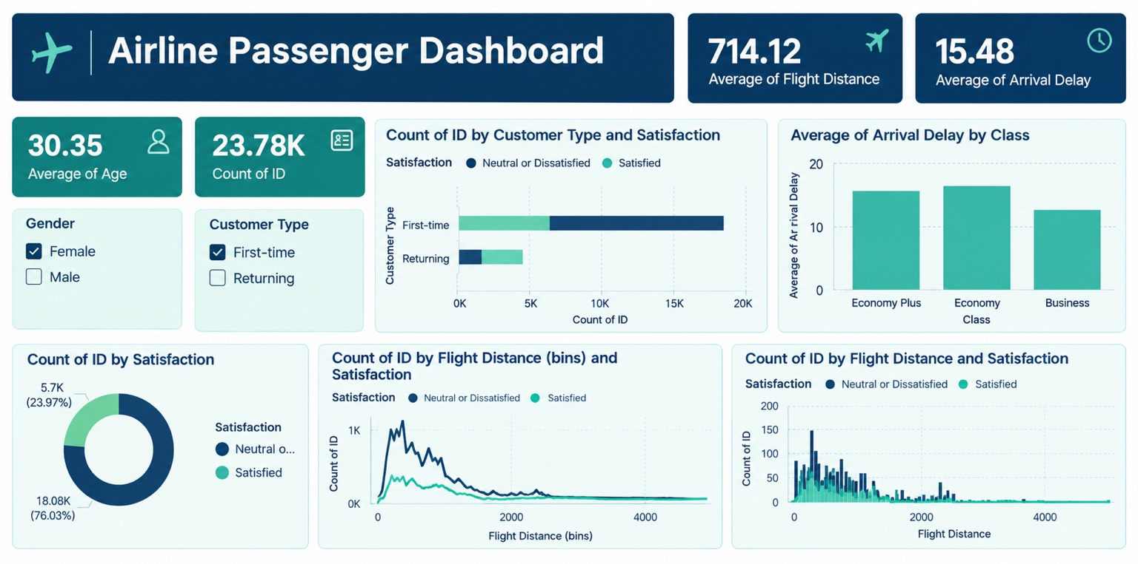
AIRLINE PASSENGER
DASHBOARD
A simple, visual explanation of the KPIs, filters and charts
What the dashboard tells us • How to read each chart • Key insights
Prepared from the dashboard image provided

Slide 2
1. Dashboard at a glance
The dashboard summarises passenger profile, satisfaction, distance and arrival delays.
Main question
How do passenger type, class and flight distance relate to satisfaction and delays?
What is included
Four headline KPIs, two filters and four visual analyses.
How to use it
Select a gender or customer type to filter the dashboard, then compare the charts.
Note: values and patterns are read from the supplied screenshot; raw data was not provided.
2

Slide 3
2. Headline KPIs
KPI cards give a quick summary before you explore the detailed charts.
30.35
Average age
23.78K
Count of ID
The average passenger age shown by the current filter selection.
Approximately 23,780 passenger records/IDs are included.
714.12
Average flight distance
15.48
Average arrival delay
The mean distance value in the dataset; the unit is not shown in the screenshot.
Average arrival delay value; likely in minutes, but confirm the source dataset’s unit.
Important: a KPI is a summary, not an explanation of why a value is high or low.
3

Slide 4
3. Filters and passenger groups
Filters help compare different groups without changing the underlying dataset.
Gender filter
Customer type filter
Class category
Female / Male. Select one or both to see whether passenger metrics differ by gender.
First-time / Returning. This separates new passengers from repeat passengers.
Economy Plus, Economy and Business appear in the arrival-delay chart.
How to read a filter
Why it matters
• Choose a filter value (for example, Female).
• All connected charts should update to reflect the selection.
• Compare the same KPI or chart before and after filtering.
• Clear the filter or select another group to return to a broader view.
Overall averages can hide differences between passenger groups. Filters let you inspect those differences.
4

Slide 5
4. Customer type vs satisfaction
A stacked horizontal bar chart compares satisfied passengers with neutral or dissatisfied passengers.
What the chart shows
Each bar represents a customer type. Segment length indicates the count in each satisfaction group.
Reading the screenshot
First-time passengers account for most records. The dark segment is larger than the satisfied segment for first-time passengers.
Use with care
The chart’s exact counts should be verified from the source data; the chart recreated here is illustrative.
Legend: dark blue = Neutral or Dissatisfied • teal = Satisfied
5

Slide 6
5. Average arrival delay by class
A column chart compares the average delay across three travel classes.
Economy
The screenshot shows the highest average delay, at roughly 16–17.
Economy Plus
Its average delay is close to Economy, around 15–16.
Business
Business has the lowest average delay in the screenshot, around 13.
These are approximate visual readings, not exact values. Delay units should be confirmed from the dataset.
6

Slide 7
6. Satisfaction split
The doughnut chart shows the share of IDs in each satisfaction group.
Neutral or dissatisfied
About 18.08K IDs, or 76.03% in the screenshot.
Satisfied
About 5.7K IDs, or 23.97% in the screenshot.
Key takeaway
The displayed sample has a much larger neutral/dissatisfied group. This is a signal to investigate, not proof of the cause.
The percentages sum to 100% after rounding.
7

Slide 8
7. Flight-distance bins and satisfaction
The line chart compares passenger counts across distance bins for the two satisfaction groups.
Main pattern
Counts peak at shorter-to-mid distances, then decline as distance increases.
Compare the lines
The neutral/dissatisfied series is above the satisfied series across most bins.
Caution
The recreated values are illustrative because the raw dataset was not supplied.
A bin groups nearby distance values together so the overall distribution is easier to see.
8

Slide 9
8. Distance distribution by satisfaction
The final chart compares counts within distance ranges using clustered columns.
What to notice
The largest bars are concentrated in shorter distance ranges.
Why use this chart?
It makes spikes and differences between satisfaction groups easier to compare.
Avoid overclaiming
A high count does not automatically mean a higher dissatisfaction rate; compare percentages within each bin.
Use counts to understand volume; use rates/percentages to compare satisfaction fairly.
9

Slide 10
9. Key insights and recommended next steps
Separate what the screenshot shows from what the business should investigate.
Insights visible in the dashboard
Questions worth investigating
• 23.78K IDs are represented.
• Average age is about 30.35.
• Satisfaction split is roughly 24% satisfied vs 76% neutral/dissatisfied.
• Business class has the lowest displayed average arrival delay.
• What drives the large neutral/dissatisfied share?
• Are delays linked to route, airport, time of day or airline?
• Do first-time and returning passengers rate experiences differently?
Recommended analysis
Recommended actions
• Compare satisfaction rates, not only counts.
• Break down delay by route, departure delay and flight distance.
• Check whether filters affect all charts as expected.
• Review the largest sources of delay.
• Gather feedback from dissatisfied passengers.
• Test service improvements, then monitor satisfaction over time.
Do not infer causation from these charts alone. Validate patterns against the full dataset before making decisions.
10

Slide 11
10. Simple presentation script
Use this short explanation if you need to present the dashboard in class.
Opening
“This dashboard gives an overview of airline passengers. It summarises passenger age, flight distance, arrival delay and satisfaction.”
Explain the charts
“The filters let us compare gender and customer type. The bar charts compare satisfaction groups and delays by class, while the doughnut chart shows the overall satisfaction split.”
Conclusion
“In the displayed data, neutral or dissatisfied passengers form the larger group, and Business class has the lowest average arrival delay. We should investigate the reasons using the complete dataset.”
Remember: the exact counts in the recreated charts are illustrative; use the original report or raw data for precise figures.
11

Slide 12
11. Quick glossary and data note
A few terms make the dashboard easier to explain accurately.
KPI
ID count
Average
Key Performance Indicator: a summary number used to monitor performance.
Number of records/IDs counted; confirm whether each ID is one unique passenger.
The sum of values divided by the number of observations.
Stacked bar
Doughnut chart
Bins
Shows total volume and how it is split between groups.
Shows the relative share of each category as parts of a whole.
Intervals that group continuous values, such as flight distance.
Data limitation
Only a screenshot was provided, not the underlying passenger data. Therefore the KPI descriptions and visual interpretations are grounded in the image, but charts rebuilt in this presentation use approximate/illustrative values and must not be treated as exact reproductions.
End of presentation
12

