Slide 1

Pineapple Growing Stage Classification
12/28/2022
吳松濤
Department of Biomechatronic Engineering National Taiwan University

Slide 2
Outline
Method
Result
Discuss

Slide 3
Method
Architecture: EfficientNet b0 vs. b3
Data Argumentation
Early Stopping
Class Stratification
Optimizer: AdamW (Weight Decay 0.001 vs. 0.02)

Slide 4
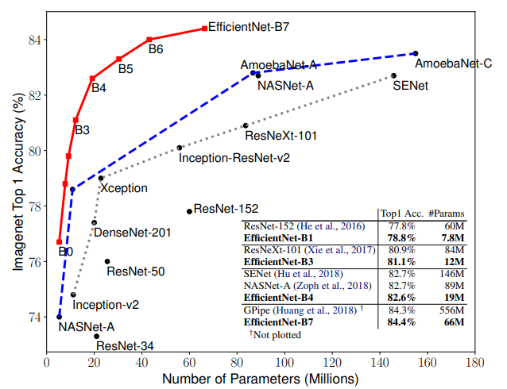
Method - EfficientNet
EfficientNet (2019)
Mingxing Tan & Quoc V. Le
Advantages:
High accuracy
Efficient & Small model size
Systematic and consistent scaling

Slide 5
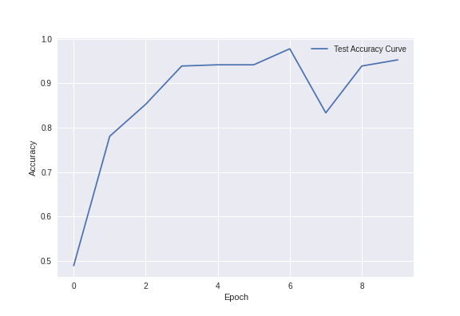
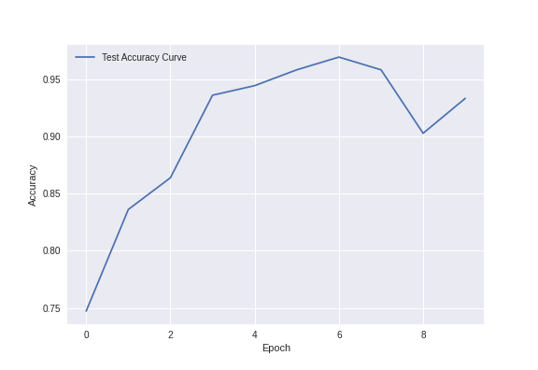
Acc. curve: EfficientNet b0 vs. b3 (Weight Decay=0.001)

Slide 6
Training Process
Data Argumentation:
Random Horizontal Flip
Random Vertical Flip
Random Rotation
Color Jitter
50% chance of being applied to the input data.

Slide 7
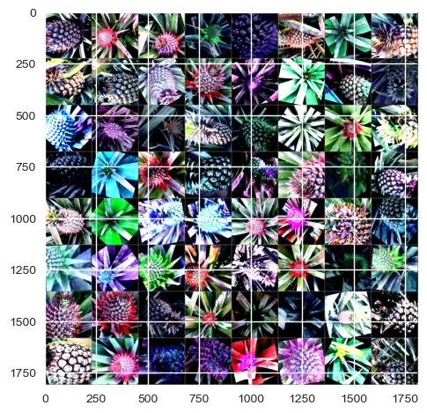
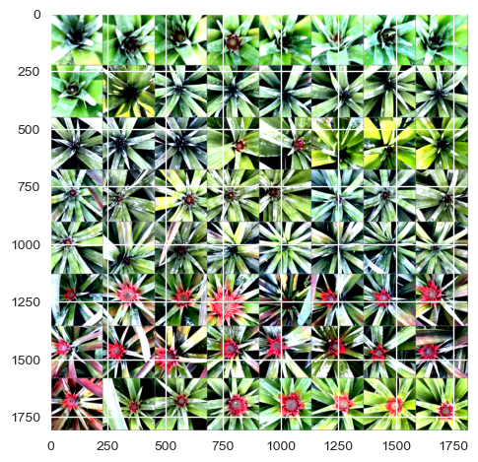
Training Process – Training set (80%) vs. Test set (20%)

Slide 8
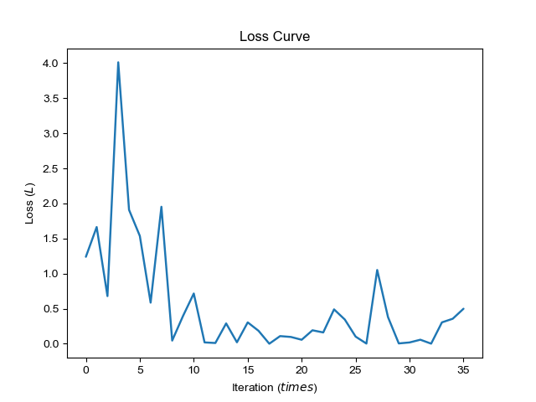
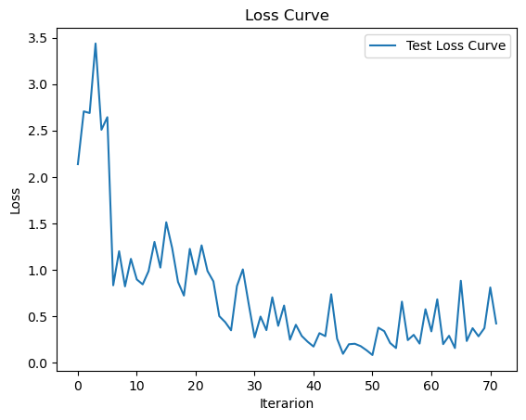
AdamW: Weight Decay 0.0001 vs. 0.02 (all in b0)

Slide 9
Result
Architecture: Efficient b3
AdamW (Weight Decay=0.02)

Slide 10
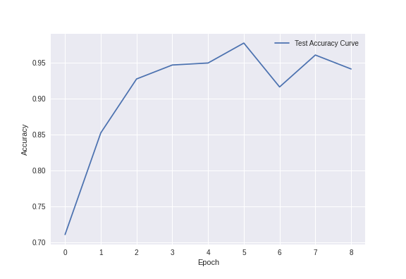
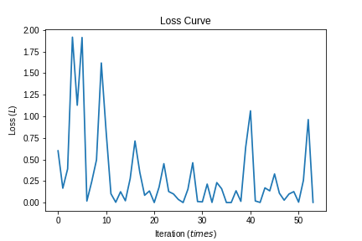
Result
Architecture: Efficient b3
AdamW (Weight Decay=0.02)
Accuracy: 94%

Slide 11
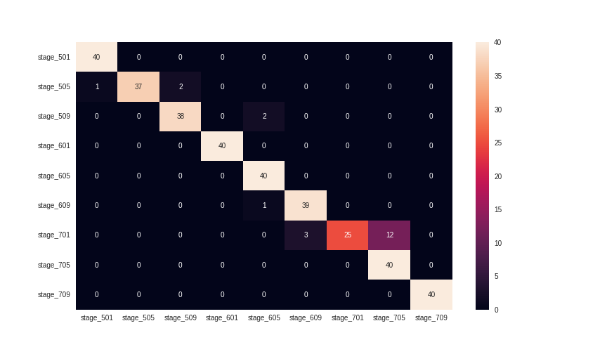
Confusion Matrix

Slide 12
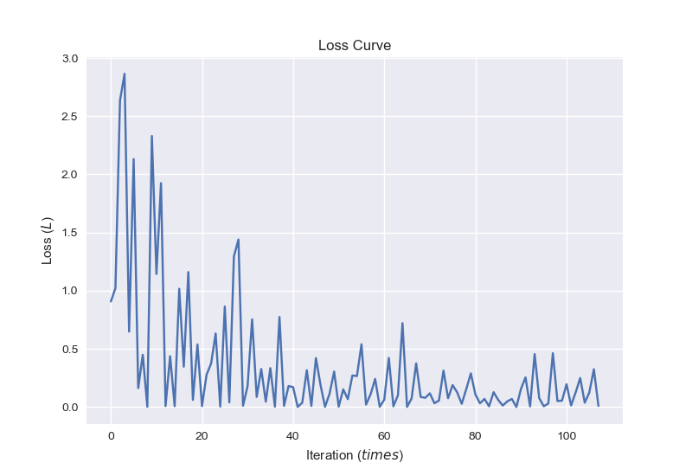
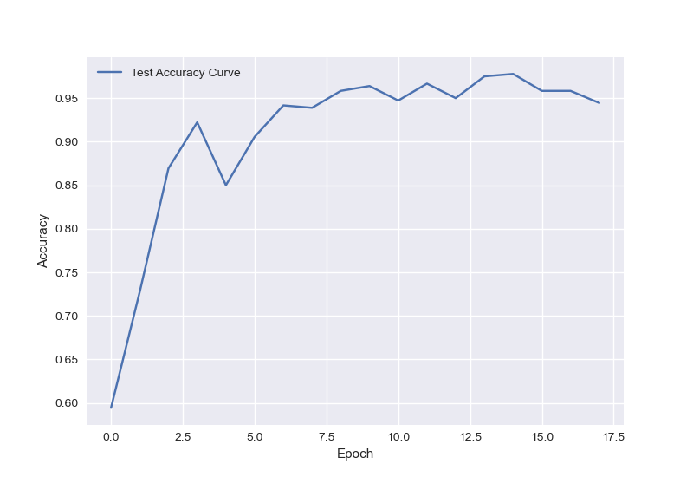
Result
Architecture: Efficient b0
AdamW (Weight Decay=0.001)
Accuracy: 95%

Slide 13
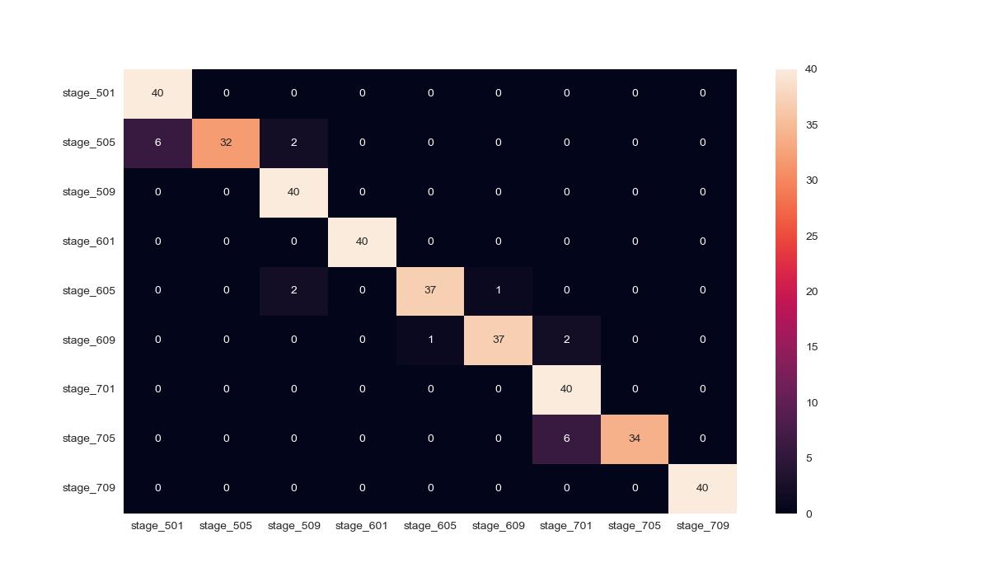
Confusion Matrix

Slide 14
Thanks

