Slide 1

Optimizing Flex Applications
David Coletta
Virtual Ubiquity, Inc.
david@virtub.com
Blog: http://www.colettas.org

Slide 2
Introduction
Developer and co-founder at Virtual Ubiquity
Career focus on collaboration software
Background in C++ and web applications
Don’t know much about optimization

Slide 3
Structure of this talk
Taxonomy of optimization
Best practices
Flex 3 Profiler
Case studies
Questions

Slide 4
Taxonomy of optimization
Improving actual performance
Improving perceived performance

Slide 5
Improving actual performance
Expensive algorithm: find a cheaper one
Precompute things that can be precomputed
Identify and refactor superfluous code
Reduce load on GC by plugging memory leaks, allocating fewer objects, etc.

Slide 6
Improving actual performance
Verify build configuration (optimization should be on)
Reduce functionality (e.g., turn down suggestions on spell checker)
Take advantage of what the platform does well, avoid what it doesn't

Slide 7
Improving perceived performance
Doing too much work up front; do some of it later
Move lengthy operations into the background
Show progress during extended operations

Slide 8
Too Much For One Talk!
Expensive algorithm: find a cheaper one
Precompute things that can be precomputed
Identify and refactor superfluous code
Reduce load on GC by plugging memory leaks, allocating fewer objects, etc.
Verify build configuration (optimization should be on)
Reduce functionality (e.g., turn down suggestions on spell checker)
Take advantage of what the platform does well, avoid what it doesn't
Doing too much work up front; do some of it later
Move lengthy operations into the background
Show progress during extended operations

Slide 9
Big Picture
Rendering-intensive tasks
(effects, scrolling, resizing)
Other tasks (startup, navigation,
data manipulation)
ActionScript
Rendering
Other
Critical areas:
Object creation Measurement/Layout Rendering

Slide 10
Optimizing Actionscript: Object Creation

Slide 11
The Birth of an Object
Create instance of ActionScript class
Assign initial property values
  <mx:TextArea text=“Hi” width=“100”/>
Wire objects together
  Add new object to display list
  Event handlers: <mx:Button click=“goNext()”/>
  Data binding: <mx:Label text=“{city}”/>
  Effect listeners: <mx:Label showEffect=“{fade}”/>

Slide 12
Solution #1: Deferred Creation
Delay object creation until the object becomes visible
Is baked into Accordion, TabNavigator, and ViewStack
Can be added to custom containers, but subclassing ViewStack is easier

Slide 13
Solution #2: Ordered Creation
During startup, stagger creation of objects
Improves perceived startup time
<mx:Application>
<mx:Panel width="250" height="100" creationPolicy=“queued” />
<mx:Label text="One" />
</mx:Panel>
<mx:Panel width="250" height="100" creationPolicy=“queued” />
<mx:Label text="Two" />
</mx:Panel>
</mx:Application>
Notes:
After showing this slide, I’ll demo brocade

Slide 14
Solution #3: Use <mx:Repeater> Carefully
Don’t allow <mx:Repeater> to create elements that are clipped
Bad:
Good:
Caveat: Repeater scrolls more smoothly
<mx:VBox>
<mx:Repeater id=“r” dataProvider=“{arr}”>
<mx:Image source=“r.currentItem.url”/>
</mx:Repeater>
</mx:VBox>
<mx:List dataProvider=“{arr}”>
<mx:itemRenderer>
<mx:Component>
<mx:Image source=“{dataObject.url}”/>
</mx:Component>
</mx:itemRenderer>
</mx:List>

Slide 15
Optimizing Actionscript: Measurement/Layout

Slide 16
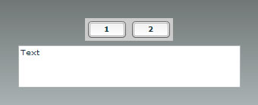
Measurement/Layout: Definition
The process of assigning a position and size to every component
<mx:Application>
<mx:HBox>
<mx:Button label=“1”/>
<mx:Button label=“2”/>
</mx:HBox>
<mx:TextArea width=“100%” height=“100%” text=“Text”/>
</mx:Application>
Notes:
The measurement/layout process is broken into two steps named … you’re not going to believe this … the measurement phase and the layout phase
During the measure phase, each object is asked “how large would you like to be”?
Each type of component has a “measure” function, which calculates the answer to that question
For example, the measure function for the Button object will respond that buttons like to be 22 pixels tall and wide enough to display their borders, their label, and some extra space around them (If time permits, change one of the labels to be longer)
After everything has been measured, it’s time for the layout phase.
During the layout phase, we choose a size and position for every object, doing our best to honor the preferences they requested earlier.
For example, there’s plenty of room for the Buttons to be 22 pixels tall, and then the TextArea is positioned below the buttons
So that’s sorta the high-level view. Now we’re going to take two more passes – the medium-level view and then a low-level view.

Slide 17
Measurement/Layout: Description
<mx:Application>
<mx:HBox>
<mx:Button label=“1”/>
<mx:Button label=“2”/>
</mx:HBox>
<mx:TextArea width=“100%” height=“100%” text=“Text”/>
</mx:Application>
Measurement Phase: traverse tree from bottom up
  Buttons and TextArea compute measured sizes
  HBox computes its measured size
  Application computes its measured size
Layout Phase: traverse tree from top down
  Application sets sizes and positions of HBox and TextArea
  HBox sets sizes and positions of Buttons
O(n) algorithm, n = number of objects

Slide 18
Solution #1: Reduce Container Nesting
Try to use HBox and VBox instead of Grid
Avoid nesting a VBox inside a Panel or Application
The root of an MXML component doesn’t need to be a Container
Use Canvas with constraints
Warning sign: a Container with a single child

Slide 19
Solution #2: Avoid Redundant Measurement/Layout
Scenario: Flickr app issues 25 image requests
  When image data arrives, corresponding Image object resizes
  For each image, whole screen does measurement/layout
Scenario: Dashboard app creates 6 portal windows
  Each portal issues web service request
  For each web service response, portal window’s size changes
Solutions:
  Delay requests until creationComplete (after incremental layout)
  Limit geometry changes when responses arrives
  Stagger requests or queue responses

Slide 20
Optimizing Rendering

Slide 21
Redraw Regions
If an object's properties are changed, its bounding box is a “redraw region”
Visualize using “show redraw region”
  Debug player only
Objects that overlap the redraw region are redrawn

Slide 22
cacheAsBitmap Protects Innocent Bystanders
If cacheAsBitmap is true then
the object and its children are rendered into an offscreen bitmap
If an object overlaps a redraw region and
the object is unchanged then
the cached bitmap is used
Example: a Move effect

Slide 23
cacheAsBitmap is a Double-Edged Sword
Objects with cached bitmaps are more expensive to change
Examples when cacheAsBitmap hurts performance
  Resize effect
  Resizing the browser window
Suggestion: cache bitmaps only for short periods of time

Slide 24
Factors that Affect Rendering Speed
Size of redraw region
  Suggestion: refactor UI
Cached bitmaps (can help or hurt)
Total number of vectors in the redraw region
  Suggestion: simplify geometry
  Suggestion: use Resize.hideChildren and hide children during state transition
Mixture of device text and vector graphics
Clip masks
Filters (e.g.: DropShadow)
Other background processing
  Suggestion: Effect.suspendBackgroundProcessing

Slide 25
Miscellaneous Optimizations

Slide 26
Reducing Memory Usage
Discard unused UI
  myViewStack.removeChild(childView);
  childView.removeEventListener(“click”, clickHandler) or
  use weak references
Clear references to unused data
  myProperty = null;
  myWebService.getAddressBook.clearResult();
Use memory profiling tools

Slide 27
Setting Styles
Changing a rule set is most expensive
  StyleManager.styles.Button.setStyle(“color”, 0xFF0000)
For inline styles, expense is proportional to the number of objects affected
  Example: myVBox.setStyle(“color”, 0xFF0000)
  Exception: setStyle is cheap during object creation
If a value will change at runtime, initialize it at authoring time
  <mx:Style> Button { color: #000000 } </mx:Style>
  <mx:VBox id=“myVBox” color=“0x000000”>

Slide 28
Flex 3 Profiler
Lets you measure:
Call frequency
Method duration
Call stacks
Number of instances of objects
Object size
Garbage collection

Slide 29
How the Profiler Works
Uses new Player APIs
10 ms sampling interval
Computes cumulative values
Records internal Player actions (e.g., [keyboardEvent], [mark], [sweep])

Slide 30
Two Kinds of Profiling
Performance profiling
  Looking for slow code
  Find slow methods and speed them up
  Find frequently called methods and reduce frequency
Memory profiling
  Looking for excessive memory consumption
  Find big objects and make them smaller
  Find numerous objects and make fewer of them

Slide 31
Profiler Scenario
Problem: Document organizer is slow to redraw after deleting a document
Tasks
  Measure (redraw operation)
  Identify (slow code)
  Fix (rewrite, reorganize, remove)

Slide 32
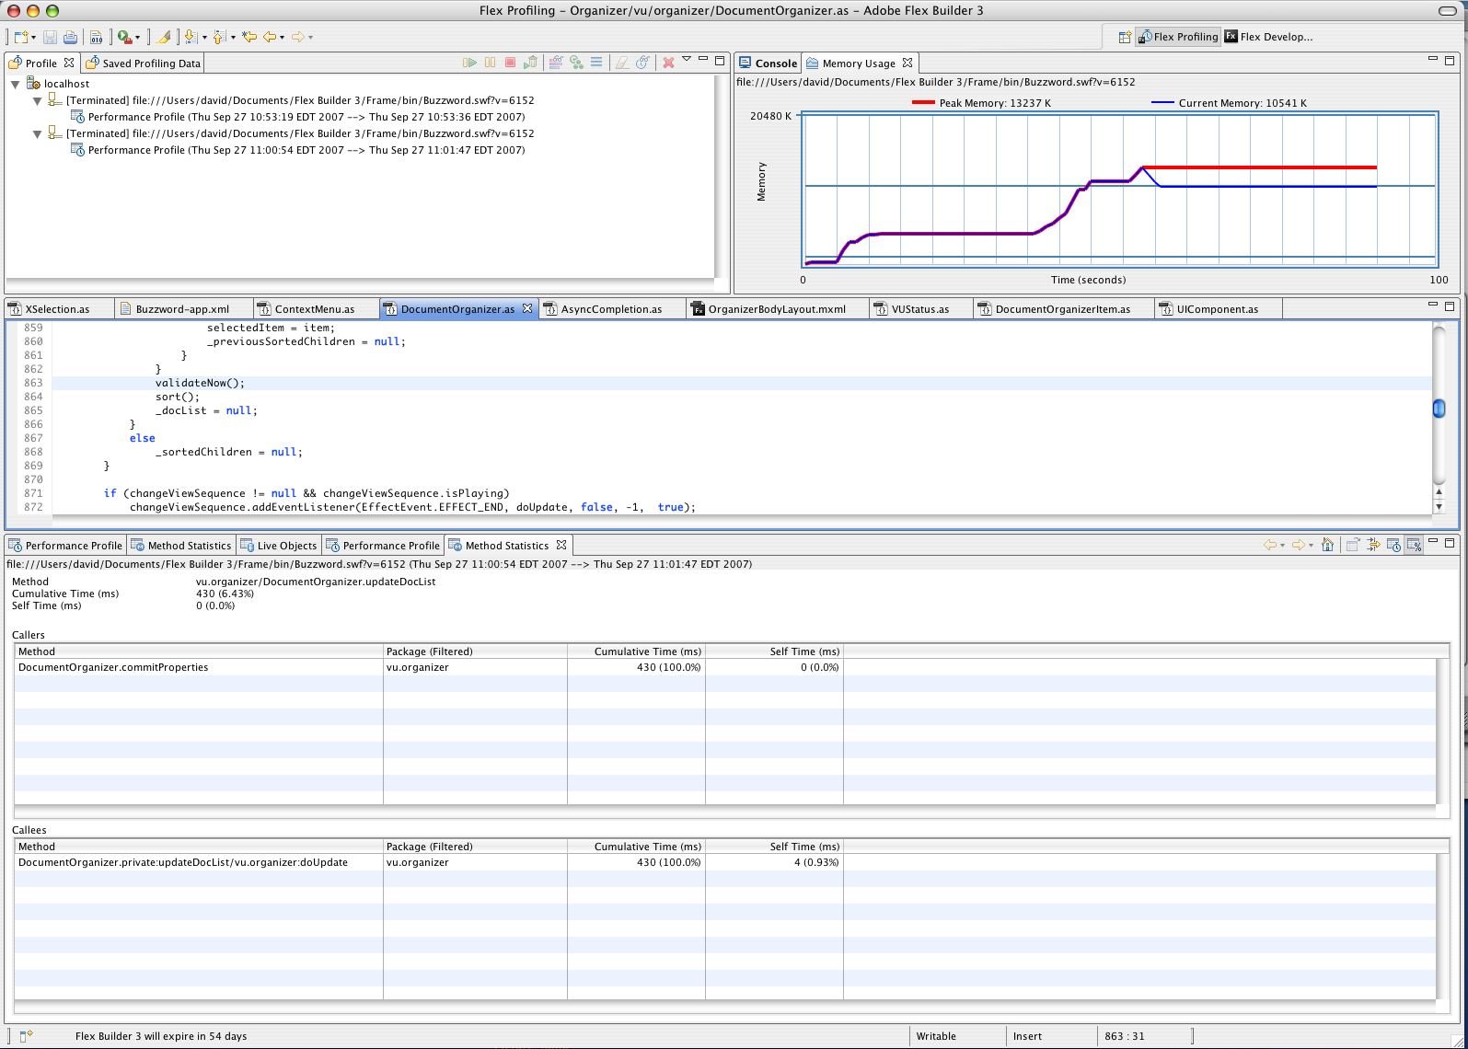
Profiler Demo

Slide 33
Case Study: Activa Live Chat
Provided by the team at Activa Live Chat
http://activalive.com
List item renderers
Reference counting
Notes:
Active Media Architects had to focus heavily on performance issues when developing their Flex-based Activa Live Chat product. This Website live help and support application was meant to run for long periods of time in an enterprise environment, and needed to update and display a very dynamic dataset — realtime visitors on a Website! Because of the demanding nature of the application, memory use and overall CPU usage was always at the top of their minds. Of course, when they were developing Activa Live Chat, they did not have the benefit of the new Flex 3 profiler, so they spent many sleepless nights rebuilding and testing, rebuilding and testing.

Slide 34
Aptiva Live Chat Screencast

Slide 35
MXML Containers
Complex layout engine
Clipping
Dynamic Instantiation
Scrolling
Borders
Styling Engine
Notes:
One of the most surprising things they found was that list item renderers were responsible for a large chunk of the overall processing time used by the application. When they first created their item renderers, they did what most Flex developers probably do -- create an MXML component based off of one of the Flex container classes. This makes for very easy development, and you get all the benefits of the Flex container -- Clipping, Dynamic Instantiation, Scroll bars, borders, styling engine, and everything else that goes with the Flex layout engine.

Slide 36
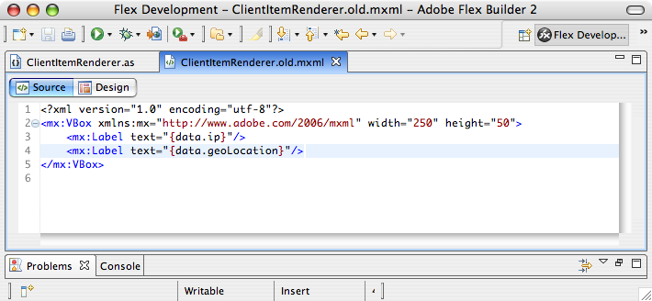
MXML Item Renderer
Notes:
Creating the MXML component is also easy. Can define everything without ActionScript. However, all this ease comes at a cost, as they found out. The extra processing time involved in using the container layout engine meant a slower and more un-responsive application then they wanted. Luckily, there was an alternative.

Slide 37
Manual Layout
More Complex
Difficult to style for non-coding designers
Better Performance
Notes:
They decided to create an ActionScript class to layout the information they needed in the item renderer. Although this meant abandoning MXML for the item renderers, the increase in performance was well worth the extra development time. This did require changing the internal workflow a bit, because their designers would not be able to come in and re-style the components as easily as they could MXML.

Slide 38
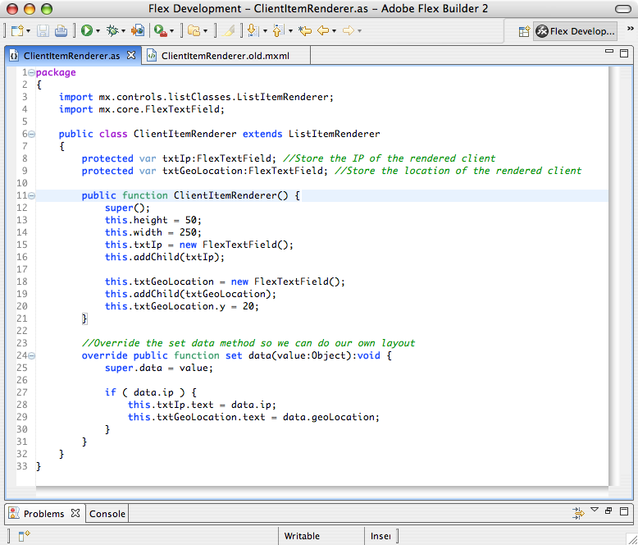
Custom Item Renderer
Notes:
Here you can see their custom item renderer. In the constructor, they’re setting up the height and width of the item renderer, and creating and adding the text fields they need to display the data. Because the list item renderers in Flex are re-used, they need to update the display when the data value is updated. When they receive new data, they 0update the text fields that they created. As you can see,working this way adds another layer of complexity, but in their case, the performance benefits were worth it. Naturally, this solution may not work in all cases, but they were lucky enough to have a fairly simple item rendererer that didn’t need all of the extra container layout. You’ll need to evaluate whether this technique is worthwhile for your own applications.

Slide 39
Garbage Collector
Every reference to an object increases the reference count
Deleting references to an object decrements the reference count
Objects with a positive reference count will not be collected
Inattention leads to memory leaks
Notes:
The other main thing they had to be aware of was the way the Flash garbage collector works. The Flash 9 garbage collector has two techniques it uses to track active objects, the simplest of which we’ll talk about here - reference counting. The important thing to keep in mind is that every time you create a reference to an object, the internal reference counter on that object is incremented. Every time you remove a reference, the counter is decremented. Any object that has a positive reference count will not be collected by the garbage collector, and the memory used by that object will not be freed. Normally, this is exactly what you want, but you need to be careful to remove ALL references to an object when that object is no longer needed. Failing to do so can cause some pretty massive memory leaks.

Slide 40
Reference Counting
Event Listeners, by default, increment the reference counter
useWeakReference = no increase in reference count
Good Practice = Remove Event Listeners
Notes:
One of the ways, which isn’t immediately obvious, that the reference counter is increased is by adding an event listener to an object. That means that an object you are listening for events on cannot be cleaned up, even if you no longer need it. There are two ways to get around this. The easiest is to pass the optional useWeakReference parameter to the addEventListener method. This keeps the reference count from being incremented. Of course, if you have no other references to the object you’re listening to, this may backfire -- the object could be deleted before you want it to. The better method, and the method dictated by best practices, is to cleanup after yourself. When you no longer need to receive events from an object, remove the event listeners. By doing this, they watched their application’s memory usage drop dramatically.

Slide 41
Case Study: eBay SDK
Provided by Adam Flater, Software Architect, EffectiveUI

Slide 42
WebWatcher Screencast
Notes:
The app is about consuming various web sites and then giving the user desktop notifications when they have new content. In terms of eBay this means, running the favorite searches (as you can see the in demo), but also giving outbid notices. In the case of myspace / facebook it means telling the user when there have a new message, friend request, etc... (you can guess what twitter does).ﾊ The future of the app is to cache all of this data for the user and provide a spotlight-type search functionality. We'll also have the ability to drag and drop a url into the app and alert the user when the diffs change.ﾊ

Slide 43
Goal: represent hierarchical data from web service as objects in Flex
Point the Axis wsdl2java at the eBay wsdl to generate a bunch of data classes
Use a custom java class to translate the java data classes to action script classes (using java introspection)
Write serializers / deserializers in AS to translate the data objects between San Dimas and the web service

Slide 44
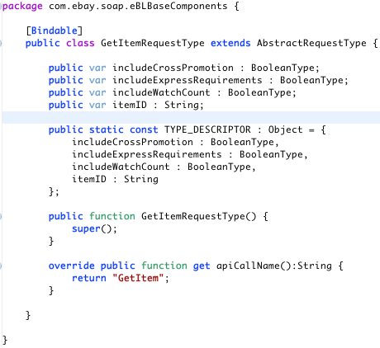
Optimizing Introspection
For serialization, used introspection initially, but recursion is very costly
Instead, did this:
Notes:
To make serialization / deserialization quick we added a TYPE_DESCRIPTOR to each object in the translation step so that our custom serializers can quickly determine the properties of an object.

Slide 45
Questions?

