Slide 1

Bioinformatics
Dr. Md. Shamsuzzoha Bayzid
Department of Computer Science and Engineering Bangladesh University of Engineering and Technology

Slide 2
Sequence Comparison
Comparing biological sequences are fundamental to
most of the domains in computational biology.
But it’s not easy!

Slide 3
Sequence Comparison
No matching
Positions
S1: ATGTCATG
S2: TGTCATGA

Slide 4
Sequence Comparison
No matching
Positions
S1: ATGTCATG
S2: TGTCATGA
Alignment
S1: ATGTCATG-
S2: -TGTCATGA

Slide 5
Multiple Sequence Alignment (MSA)
MSA
MSA reflects evolutionary processes operating
on sequences so that the homology can be inferred

Slide 6
Homology
Homology
Two letters in two sequences are homologous
if they descend from a letter in a common ancestor
S1: ACGGTGCAGTTACCA
S2: ACCAGTCACCTA
Which sites in S1 and S2 are aligned? (Meaning that they have descended from a site in their common ancestor)
?

Slide 7
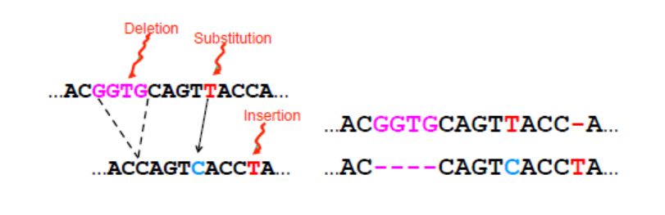
Multiple Sequence Alignment (MSA)
S1: ACGGTGCAGTTACCA
S2: ACCAGTCACCTA

Slide 8
Multiple Sequence Alignment (MSA)
Reflects historical substitution, insertion and deletion events
Evolutionary multiple sequence alignment seeks to
create a matrix in which the input sequences are the rows
and each column has
letters that are all homologous to each other.

Slide 9
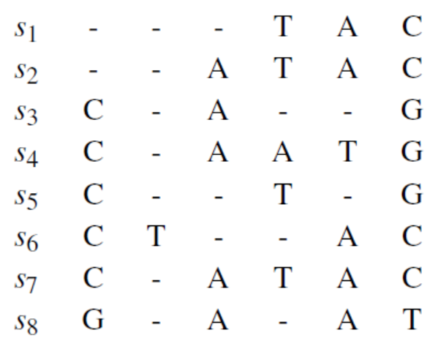
Multiple Sequence Alignment (MSA)

Slide 10
Multiple Sequence Alignment (MSA)
Not to confuse with dictionary edit distance

Slide 11
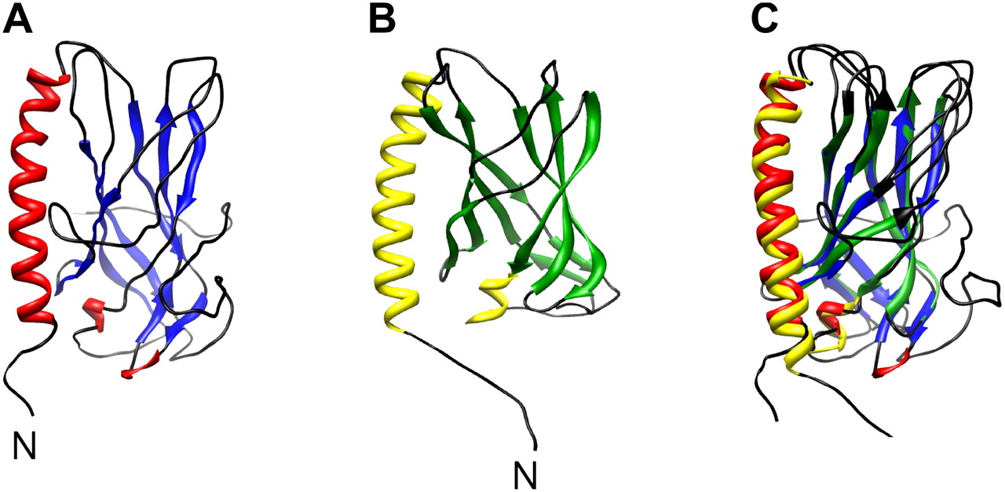
Structural Homology
Three dimensional shape similarity between proteins

Slide 12
Importance
Shared ancestry (Homology); Comparative Genomics
Prerequisite for sequence based Phylogeny
Gene finding
Genome assembly
Protein attribute prediction
Conserved regions, motifs can be identified
Highly conserved DNA sequences are thought to have functional value
Note
Conserved regions do not necessarily mean
that mutations did not happen
Lethal Mutation!

Slide 13
The Good, the Bad, and the Silent
The Good: A mutation that enhances the organism’s function
The Bad: Mutations that cause harmful traits. (Huntington disease)
HD is caused by a mutation in the gene (in Chromosome 4)) for a protein called Huntingtin.
The Silent: Mutations that cause no difference in the functions of the organism

Slide 14
Evolutionary process operating on MSA
Substitutions
Insertions and Deletions (Indels)
Rearrangement (inversions and transpositions)
Duplications of regions
Note
Most alignment methods stretch out sequences
so that they line up well,
and so only address substitutions and indels.

Slide 15
Inversion and Transposition
ACC
AGTCA
CCTA
ACC
AGTCA
CCTA
ACC
ACTGA
CCTA
ACC
CCTA
AGTCA
Inversion
Transposition

Slide 16
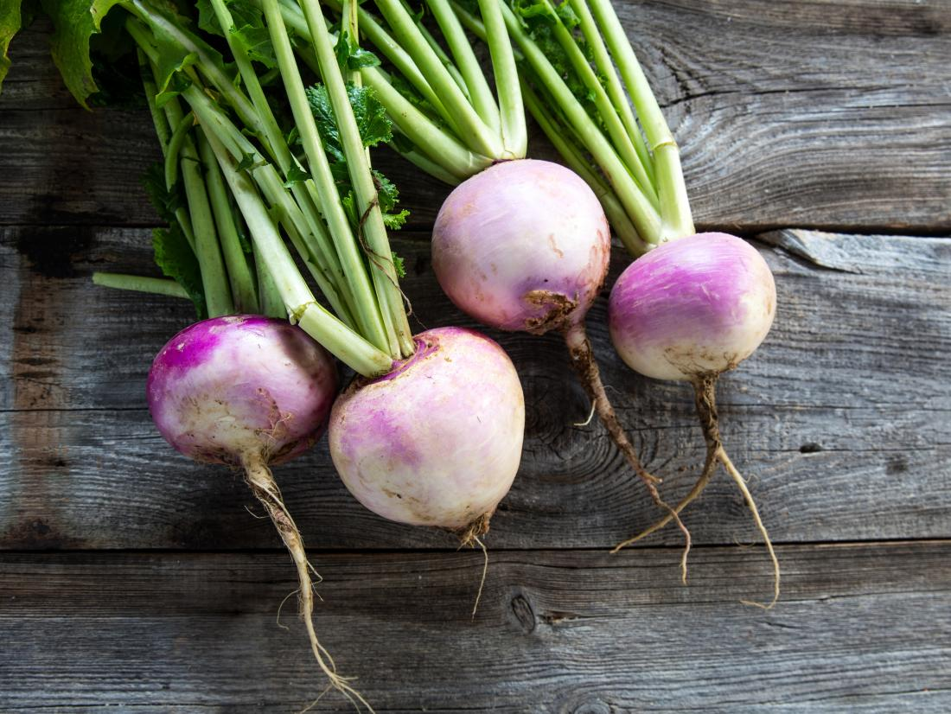
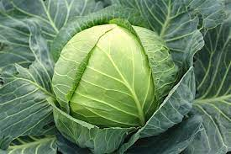
Turning Cabbage into Turnip
Turnip
Cabbage
Shares a common ancestry; but they look and taste different
99% similarity between genes
Differ in gene order

Slide 17


Turning Cabbage into Turnip
[Hannehalli and Pevzner, 1999]
Before
After
Evolution is manifested in the divergence of gene orders

Slide 18
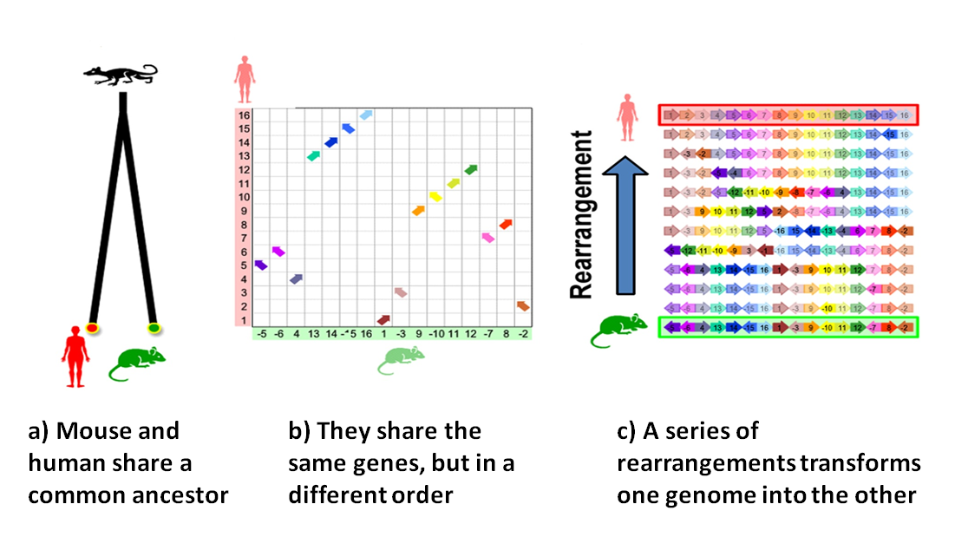
Genome Rearrangement
Transforming one genome to another

Slide 19
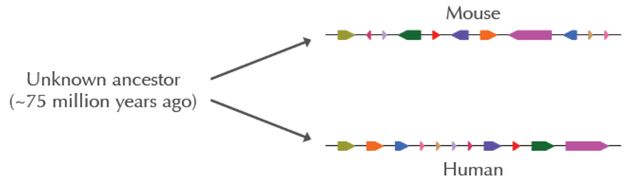
Genome Rearrangement
Mouse and human X chromosomes represented as eleven colored, directed segments (synteny blocks)
Most human genes have a mouse counterpart
But in different order
Hundreds of genes often appear one after another (as a group; synteny) but may have different order in different species

Slide 20
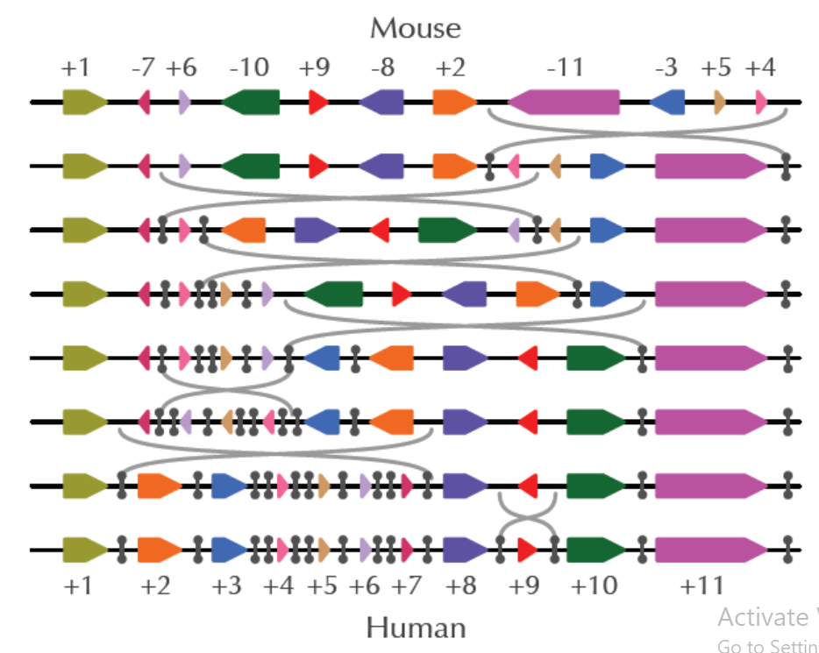
Genome Rearrangement
Transforming Mouse genome to Human genome
Sorting by Reversal

Slide 21
Sorting by Reversals
π₁ = 5 1 4 3 2 6 7 8 9 10
r(1,2)
π₂ = 1 5 4 3 2 6 7 8 9 10
r(2,5)
π₃ = 1 2 3 4 5 6 7 8 9 10

Slide 22
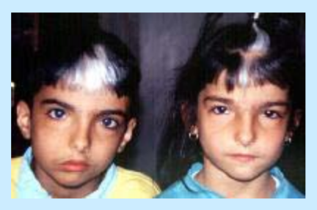
Genome Rearrangement: practical implications
Mouse Provides Insight into
Human Genetic Disorder
Waardenburg’s Syndrome

Slide 23
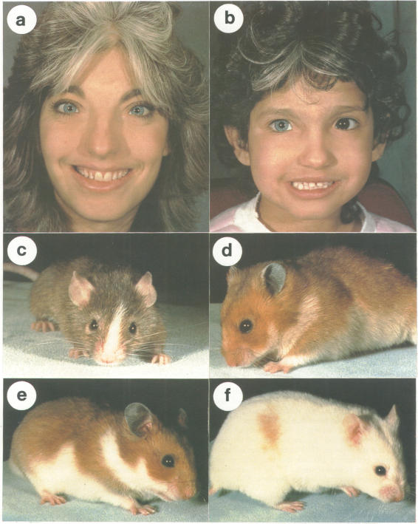
Waardenburg’s Syndrome
Gene implicated in the disease was linked to human chromosome 2 but it was not clear where exactly it is located on chromosome 2
A breed of mice (with splotch gene) had similar symptoms caused by the same type of gene as in humans
Scientists succeeded in identifying location of gene responsible for disorder in mice
Finding the gene in mice gives clues to where the same gene is located in humans
Source: https://www.ncbi.nlm.nih.gov/pmc/articles/PMC1017240/

Slide 24
Local and Global Alignment
Local Alignment – match your query with a substring (a portion) of your subject (reference).
Finds regions of similarity in parts of the regions
Searching for local similarities within large sequence
Smith-Waterman dynamic programming algorithm
Global Alignment – End-to-end alignment of input sequences
Finds the best alignment across the whole sequences
Comparing two genes with similar functions
Needleman-Wunch dynamic programming algorithm

Slide 25
Local and Global Alignment
CTGTCGCTTCACG
TGCCTGG
CTGTCGCTTCACG
─TG─C─CTG───G
CTGTCGCTTCACG
TG─C─CTGG
Global Alignment
Local Alignment

Slide 26
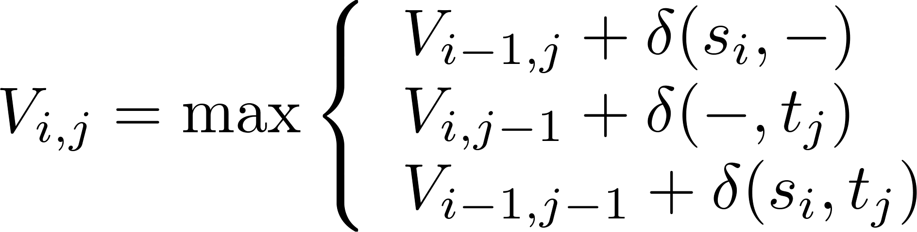
Global alignment: Needleman-Wunsch algorithms
Recurrence: For two sequences s and t

Slide 27
NW Algorithm – An Example
Alphabet:
DNA, ∑ = {A,C,G,T}
Input:
s = AAAC
t = AGC
Scoring scheme:
δ(x, x) = 1
δ(x,-) = -2
δ(x, y) = -1
Adapted from slides available at
www.bioalgorithms.info

Slide 28
NW Algorithm – An Example
 |  | A | G | C
A
A
A
C
-AGC
AAAC
0
-2
-4
-6
-2
1
-1
-3
AG-C
AAAC
-4
-1
0
-2
-6
-3
-2
-1
A-GC
AAAC
-8
-5
-4
-1
Courtesy: Dr. Atif Hasan Rahman

Slide 29
Needleman Wunsch (NW) algorithm
Needleman Wunsch (s,t)
m ← length(s)
n ← length(t)
V[0,0] ← 0
for i in 1:m
V[i,0]=V[i-1,0]+ δ(s_{i},-)
for j in 1:n
V[0,j]=V[0,j-1]+ δ(-,t_{j})
for i in 1:n
for j in 1:m
V[i,j]=max V[i-1,j-1]+ δ(s_{i}, t_{j})
V[i-1,j]+ δ(s_{i}, -)
V[i,j-1]+ δ(-, t_{j})

Slide 30
Local alignment
A “mini” global alignment
between substrings of the
original sequences
Global alignment
Adapted from slides available at
www.bioalgorithms.info

Slide 31
Local alignment
Goal: Find the best local alignment between two strings.
Input : Strings s and t as well as a scoring matrix δ
Output : Alignment of substrings of s and t whose alignment score is maximum among all possible alignments of all possible substrings of s and t.
We can again use dynamic programming to solve the Local Alignment Problem
Smith Waterman algorithm
Adapted from slides available at
www.bioalgorithms.info

Slide 32
Local alignment
Naive approach: Find the path with maximum score between every pair of vertices (i,j) and (i’,j’).
Finally, select the pair with maximum score.

Slide 33
Local alignment: Smith-Waterman algorithms
Find a path with the maximum score from (0,0) to every other vertex.
Add edges of weight 0 in the edit graph.
Smith Waterman algorithm

Slide 34
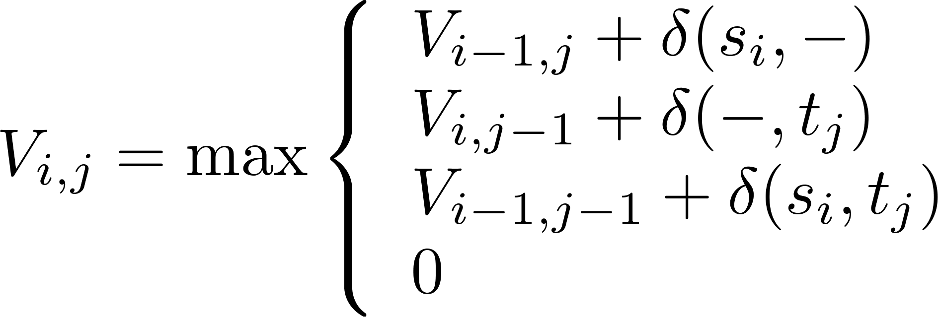
Local alignment: Smith-Waterman algorithms
Recurrence: For two sequences s and t

Slide 35
Local alignment: Smith-Waterman algorithms
S1 = CCG
S2 = ATCCG
match = +1, mismatch = -1, gap = -2
SS |  | C | C | G
 | 0 | 0 | 0 | 0
A | 0 | 0 | 0 | 0
T | 0 | 0 | 0 | 0
C | 0 | 1 | 1 | 0
C | 0 | 1 | 2 | 0
G | 0 | 0 | 0 | 3

Slide 36
Local alignment: Smith-Waterman algorithms
S1 = CCG
S2 = ATCCG
X
SS |  | C | C | G
 | 0 | 0 | 0 | 0
A | 0 | 0 | 0 | 0
T | 0 | 0 | 0 | 0
C | 0 | 1 | 1 | 0
C | 0 | 1 | 2 | 0
G | 0 | 0 | 0 | 3
S1 = --CCG
S2 = ATCCG
S1 = CCG
S2 = CCG

Slide 37
Local alignment: Smith-Waterman algorithms
S1 = TCGGT
S2 = ACCGT
match = +1, mismatch = -1, gap = -2
SS |  | T | C | G | G | T
 | 0 | 0 | 0 | 0 | 0 | 0
A | 0 | 0 | 0 | 0 | 0 | 1
C | 0 | 0 | 1 | 1 | 0 | 0
C | 0 | 0 | 0 | 0 | 2 | 0
G | 0 | 0 | 0 | 0 | 1 | 1
T | 0 | 0 | 0 | 0 | 0 | 2

Slide 38
Local alignment: Smith-Waterman algorithms
S1 = TCGGT
S2 = ACCGT
match = +1, mismatch = -1, gap = -2
SS |  | T | C | G | G | T
 | 0 | 0 | 0 | 0 | 0 | 0
A | 0 | 0 | 0 | 0 | 0 | 1
C | 0 | 0 | 1 | 1 | 0 | 0
C | 0 | 0 | 0 | 0 | 2 | 0
G | 0 | 0 | 0 | 0 | 1 | 1
T | 0 | 0 | 0 | 0 | 0 | 2
S1 = GT
S2 = GT

Slide 39
Local alignment: Smith-Waterman algorithms
S1 = TCGGT
S2 = ACCGT
match = +1, mismatch = -1, gap = -2
SS |  | A | C | C | G | T
 | 0 | 0 | 0 | 0 | 0 | 0
T | 0 | 0 | 0 | 0 | 0 | 1
C | 0 | 0 | 1 | 1 | 0 | 0
G | 0 | 0 | 0 | 0 | 2 | 0
G | 0 | 0 | 0 | 0 | 1 | 1
T | 0 | 0 | 0 | 0 | 0 | 2
S1 = CG
S2 = CG
S1 = GT
S2 = GT

Slide 40
Smith-Waterman: Example
Alphabet:
DNA, ∑ = {A,C,G,T}
Input:
s = TGTTACGG
t = GGTTGACTA
Scoring scheme:
δ(x, x) = 3
δ(x,-) = δ(-,x) = -2
δ(x, y) = -3

Slide 41
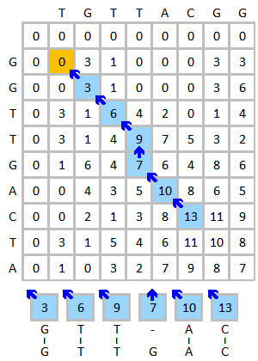
Smith-Waterman: Example
Figure source: Wikipedia

Slide 42
MSA: 2D vs 3D alignment grid
V
W
2D Grid
3D Grid

Slide 43
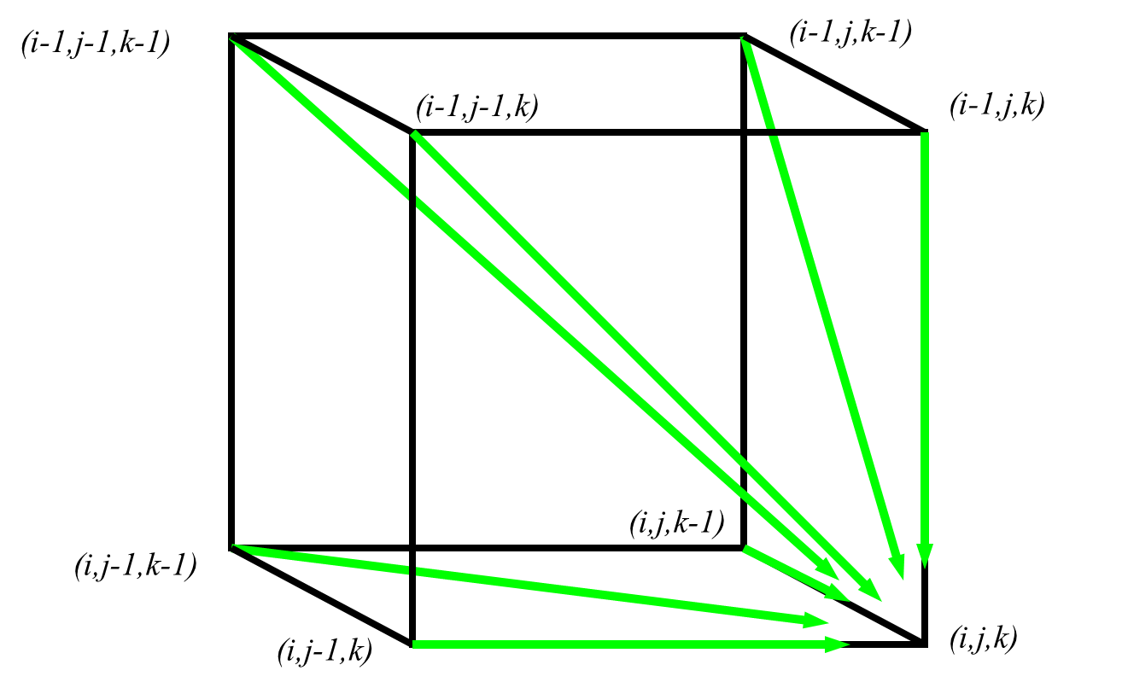
MSA: 3D grid
Figure source: Dr. Atif Hasan’s slide

Slide 44
MSA: 3D grid
Recurrence:
Try yourself

Slide 45
Optimization criteria
Sum-of-pairs (sum of edit distances on induced
Pairwise alignments)
Tree alignment (sum of costs of edges)
Maximum likelihood under a statistical model of sequence evolution
NP-hard problems!

Slide 46
SP Score
S1 = ACG--GAGA
S2 = -CGTTGACA
S3 = AC-T-GA-A
S4 = CCGTTCAC-
Assume score of match and mismatch/insert/delete are 2 and -2
For position 1,
SP-score(A,-,A,C) = 2δ(A,-) + 2δ(A,C) + δ(A,A) + δ(C,-) = -8
Total SP-score= -8+12+0+0–6+0+12–10+0 = 0

Slide 47
2D vs 3D alignment grid
V
W
2D Grid
3D Grid

Slide 48
How to evaluate methods
Given an estimated alignment and a true alignment,
compute various statistics (based on homology pair)
SPFN: sum of the false negative homology pairs
SPFP: sum of the false positive homology pairs
TC: total column score
Compression: ratio of the estimated alignment length to true alignment length

Slide 49
Basic techniques
Progressive Alignment
Iterative Alignment
Profile based Alignment
Divide and conquer

Slide 50
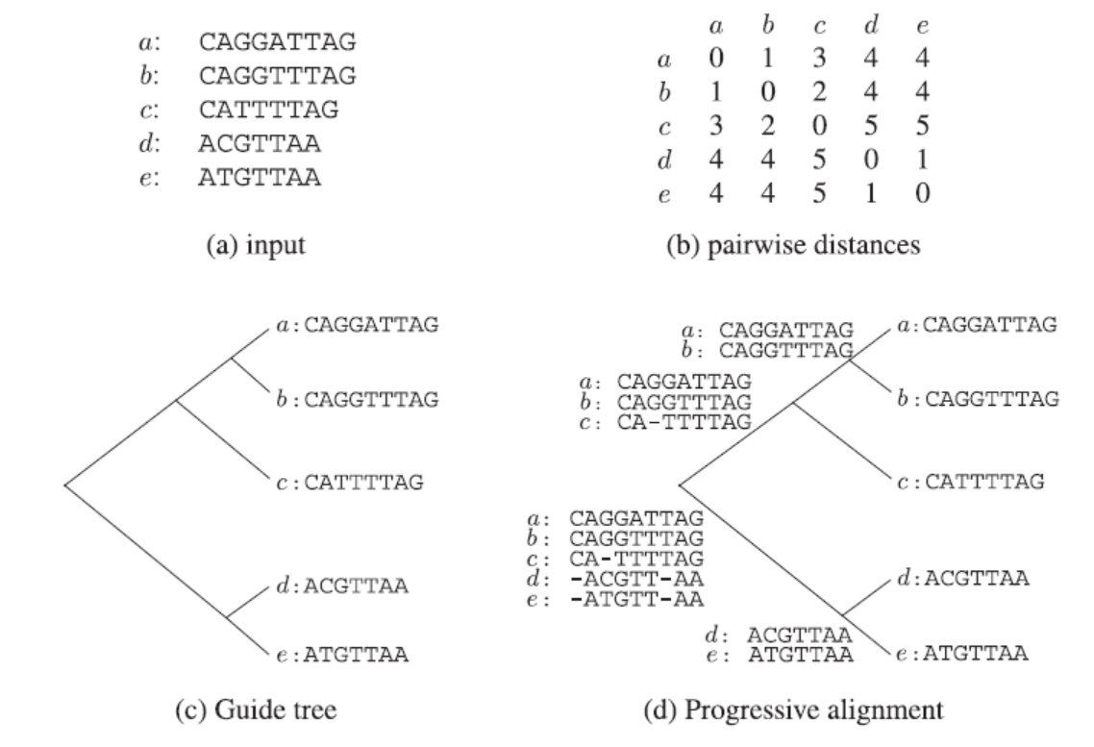
Progressive alignment
[Huson et al., 2010]

Slide 51
Progressive alignment
» Progressive alignment does not realign the sequences
The final alignment will be less accurate if we have a poor initial alignment
» Progressive alignment is not guaranteed to converge to the optimal solution

Slide 52
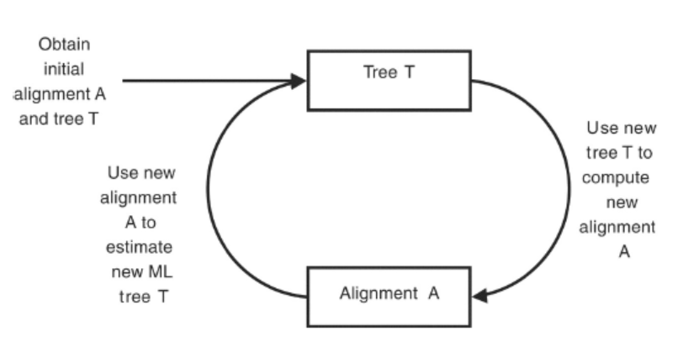
Iterative alignment
» Generate an initial MSA using a method like progressive alignment
» Iteratively improve the MSA

Slide 53
Time complexity
For N sequences, running time O(C^{2n})

