Slide 1

Introduction to Bioinformatics
Dr. Md. Shamsuzzoha Bayzid
Department of Computer Science and Engineering Bangladesh University of Engineering and Technology

Slide 2
Computational Biology
vs.
Bioinformatics

Slide 3
Computational Biology
vs.
Biological Computation

Slide 4
What will we learn?
Our old faithful friend:
Algorithms
Algorithms motivated by/initiated from/applied in problems in Biology.
How much Biology do I need to know?

Slide 5
Course Outline: Major topics
Multiple Sequence Alignment
Phylogenetic tree construction
Genome Assembly
Genome Rearrangement

Slide 6

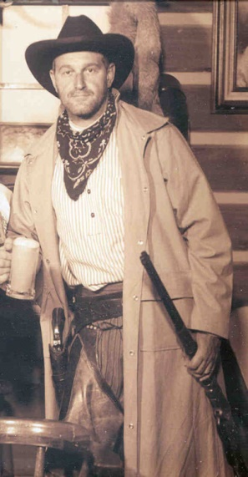
Textbooks
Computational Phylogenetics: An introduction to
designing methods for phylogeny estimation.
Tandy Warnow
An Introduction to Bioinformatics Algorithms (Jones & Pevzner)

Slide 7
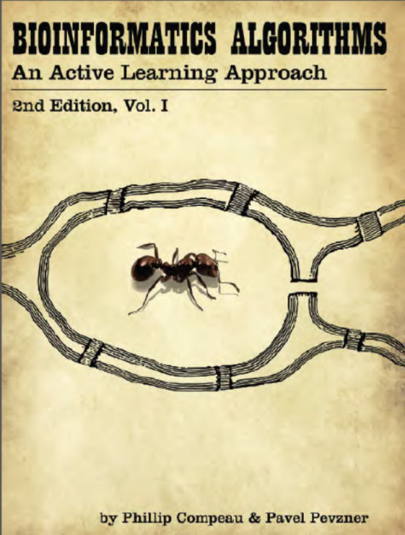

Textbooks
Bioinformatics Algorithms
An Active Learning Approach (Phillip & Pevzner)

Slide 8
Biological Sequences

Slide 9
Biological Sequences
Biological Sequence: information in a biological molecule stored as a code made up of a series of letters from some alphabet.
ATCCGTCTTACGTACGTGGTA

Slide 10
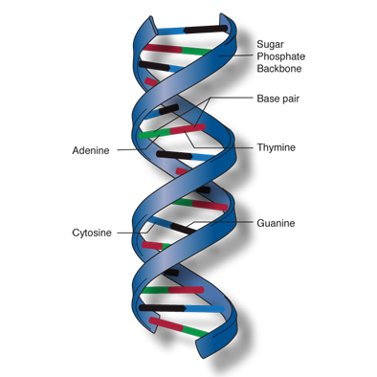
Biological Sequences
Biological Sequence: information in a biological molecule stored as a code made up of a series of letters from some alphabet.
DNA, or deoxyribonucleic acid, is the
hereditary material
Represented by alphabet = {A, T, C, G}
Adenine (A), Guanine (G),
Thymine (T), Cytosine (C)
ATCCGTCTTACGTACGTGGTA
Picture source: https://geneed.nlm.nih.gov/topic_subtopic.php?tid=15&sid=16

Slide 11
Biological Sequences
RNA, Ribonucleic acid, is represented by {A, C, G, U}.
Uracil (U)
Act as a messenger carrying instructions from DNA for synthesizing proteins.
mRNA (messenger), tRNA (transfer), rRNA (ribosomal)
Proteins (functional unit, building block of cell) are represented by an alphabet with 20 characters (sometimes more), representing various amino acids.
Alanine, Cystine, Glycine, etc.

Slide 12
Biological Sequences
Central Dogma
Flow of genetic information in a cell is from
DNA through RNA to proteins
“DNA makes RNA makes protein”
DNA
Transcription
RNA
Translation
Proteins

Slide 13
Biological Sequences
Central Dogma
Flow of genetic information in a cell is from
DNA through RNA to proteins
“DNA makes RNA makes protein”
DNA
Transcription
RNA
Translation
Proteins
Most of the regions in the whole genome are not transcribed (i.e., not “functional genes”).

Slide 14
Genetic Code
Set of rules/mapping by which information encoded in genetic material (DNA or RNA sequences) is translated into proteins (amino acid sequences).
Defines a mapping between tri-nucleotide sequences (3-mer) called codons and amino acids
4³ = 64 codons, but only 20 amino acids.

Slide 15
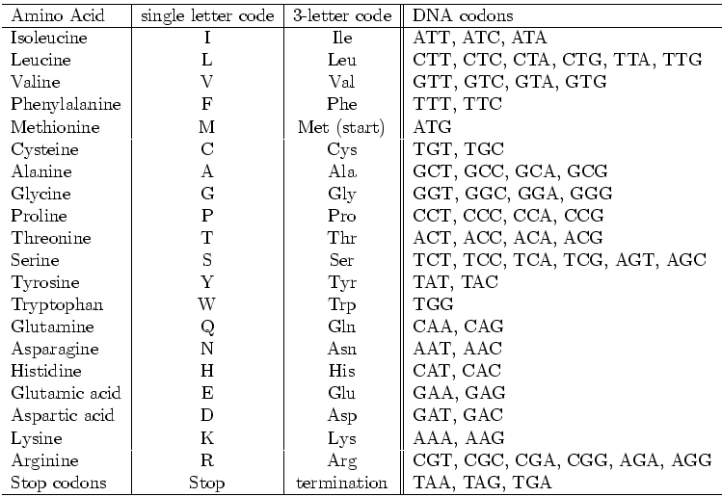
Genetic Code

Slide 16
Phylogeny
What is ?

Slide 17
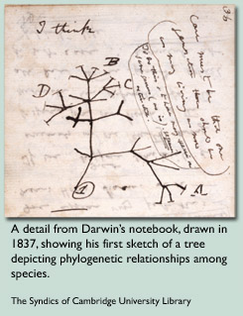
The origin and evolution of species has always been a mystery and fascinating research area to the scientific community.
In his book, The Origin of Species, published in 1859, Charles Darwin compared the lives on the planet to a tree.

Slide 18




Phylogeny
Phylogenetic tree – represents the evolutionary history of a group of organisms.
Orangutan Gorilla Chimpanzee Human

Slide 19
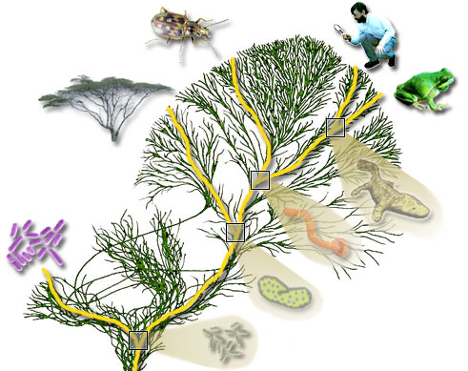
Tree of Life

Slide 20
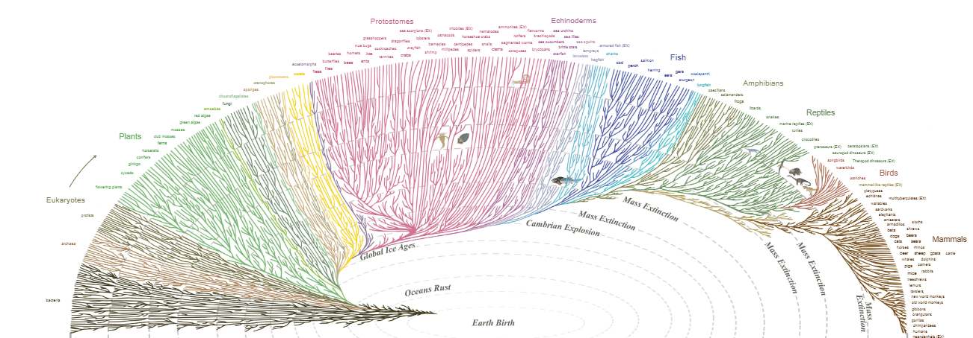
Tree of Life
Source: https://www.evogeneao.com/learn/tree-of-life

Slide 21
Phylogeny Reconstruction
Morphological data
Form and structure of organisms and their specific structural features.
Number of legs, color of the eye etc.
Biomolecular sequences
DNA, RNA, amino acids etc.
AAGACTT
a
AGGGCAT
b
TAGCCCA
AAGGCCT
TGGACTT
c
TAGACTT
d
AGCACAA
AGGGCAT
TAGCCCT
AGCACTT
e
AGCGCTT
AGGGCAT
TAGCCCA
TAGACTT
AGCACAA
AGCGCTT
a
b
c
d
e
Input Sequences
Evolutionary History

Slide 22
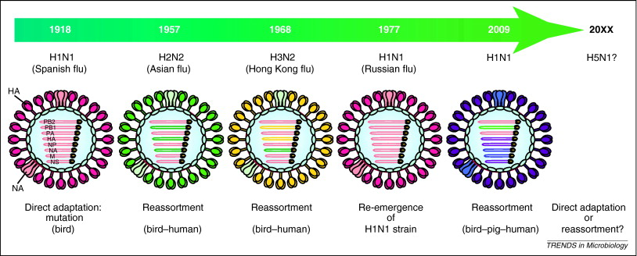
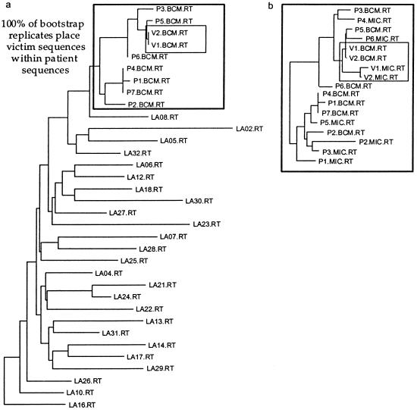


Applications
Is the whole purpose of phylogeny just to satisfy the curious minds about the evolution of species?
Gene function identification
Infer the amino acid sequence of extinct proteins
Track the evolution of disease
Investigation of criminal case.
gene
gene1
gene2
gene3
gene4

Slide 23
Gene trees and species tree
Species tree – Pattern of branching of species lineages via speciation.
Gene tree – A phylogenetic tree that depicts how a single gene has evolved in a group of related species.
Gene
@
Orangutan Gorilla Chimpanzee Human
Orangutan Gorilla Chimpanzee Human

Slide 24
Discordance
Species tree
Gene trees don’t necessarily show the same branching pattern as their containing species tree
D
C
B
A
Gene tree

Slide 25
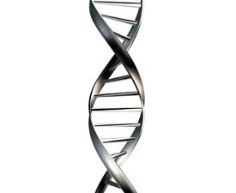
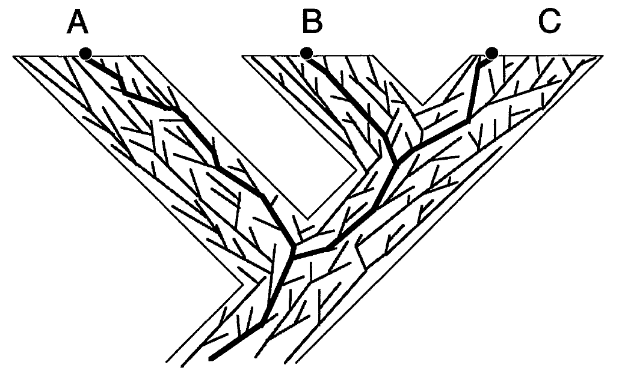
Gene trees in species tree
gene-k
…
gene-2
gene-1
[Maddison, Syst.biol., 1997]

Slide 26
Causes of gene tree discordance
Discord can arise from -
Deep Coalescence or Incomplete Lineage Sorting(ILS)
Gene Duplication/Extinction
Horizontal Gene Transfer (HGT) etc.
Estimation error may also introduce discordance.

Slide 27
Deep coalescence (ILS)
Gene copies fail to coalesce in the speciation point. Gene copies at a single locus extends deeper than the speciation events
Coalescence theory visualizes the process as if it operated backwards in time
Population size
Generation
A
B

Slide 28
Deep Coalescence (cont.)
Population size
Smaller population size and longer branch increases the possibility of coalescence.
Generation

Slide 29
Deep Coalescence (cont.)
Population size
Larger population size and shorter branch increase the chances that gene copies will fail to coalesce
Generation

Slide 30
Discordance due to Deep Coalescence (ILS)
Species tree
D
C
B
A
Gene tree

Slide 31
Gene Duplication/Loss
Duplication
A gene might get duplicated and both copies descend and evolve independently.
Discordance can occur if some sampled copies come from one locus and others come from another locus
D
C
B
A
1 Duplication and 3 losses

Slide 32
Horizontal Gene Transfer
Renegade genes somehow break the confines of the species lineages and moved horizontally across the phylogeny.
Species history – more complex?
Network instead of a tree
D
C
B
A

Slide 33
Practice: reconciliation
ST = (((A,B),C),D)
gt = (((B,D),C),A)
ST = ((A,B),((C,D),E))
gt = ((A,C),((D,E),B))
ST = (((A,C),B),(D,E))
gt = ((((A,C),B),D),E),)
How many extra lineages?
How many duplications and losses?

Slide 34
Gene tree estimation
Gene sequence
A
B
C
D
ATCGCCTACGGTCATTGT
ACTGCCTGCTACCTGTAC
GCTGCGTACTAGGATTCG
ATCCGTACCTGATGTGTA
Species
INPUT
Maximum Likelihood
A
B
C
D
Gene Tree

Slide 35
Gene tree estimation
Gene tree estimation error may cause
gene tree discordance!

Slide 36
Species tree estimation
Combined Analyses (Concatenation): Combining genes to create a “supergene”
Summary Methods: summarizing individual Gene trees.

Slide 37
Combined Analyses
g₁
g₂
g₃
g₄
g₅
g₆
g₇
g₈
g₉
Supergene alignment g*
Sequence based tree estimation method
Species Tree

Slide 38
Summary methods
g₁
g₂
g₃
g₄
g₅
g₆
g₇
g₈
g₉
Species Tree

Slide 39
Summary method: gene tree parsimony
Problem: Optimizing (maximize/minimize) cost functions
Input: A set of rooted binary gene trees with each species having a single copy of a gene.
Output: A species tree ST that optimizes a particular cost function.
A
B
C
D
A
B
C
D
A
B
C
D
gt₁
gt₂
gt_{k}
C₁
C₂
C_{k}
ST
∑C_{i} is minimized/maximized
Notes:
The optimization problem can be stated as follows.

Slide 40
Summary method
Problems:
Discordance
Anomaly zone
A
B
C
D
A
B
C
D
A
B
C
D
gt₁
gt₂
gt_{k}
C₁
C₂
C_{k}
ST
Notes:
The optimization problem can be stated as follows.

Slide 41
Statistical consistency: species tree estimation
Species tree estimation error
Amount of data
A specie tree estimation method is called statistically consistent if the probability of returning the true species tree converges to one as the amount of data increases (we usually assume both the number of sites/loci and the number of loci increase)
Gene tree estimation error

Slide 42
Evaluation procedure
Gene tree
…
True species tree
True gene trees
Gene sequences
Compare
…
Species tree
…
Estimated species tree
Estimated gene tree

Slide 43
Measure of Error
False Negative (FN): an edge in the true tree that is missing from the estimated tree
x
w
u
x
u
w
FN
v
y
v
y
True tree
Estimated tree
False Negative (FN) Rate: proportion of the missing edges (ratio between the total number of FN edges to the total number of internal edges in the true tree)

Slide 44
Reading Assignment
W. P. Maddison, Gene trees in species trees, Systematic Biology, Vol. 46, No.3, pp. 523-536, 1997.

