Slide 1

Bioinformatics
Dr. Md. Shamsuzzoha Bayzid
Department of Computer Science and Engineering Bangladesh University of Engineering and Technology

Slide 2
Tree Basics
Rooted and Unrooted trees
Branch length and branch support
Why is rooting difficult?
Outgroup
Newick representation
Clades and Clusters
Compatibility
Bipartitions

Slide 3
Tree Basics
A
B
C
D
E
((A,(B,C)), (D,E))

Slide 4
Tree Basics
A
D
B
E
C
A
B
C
D
E
Rooted tree
Unrooted tree

Slide 5
Tree Basics
A
D
B
E
C
D
E
A
B
C
E
A
B
C
D
Unrooted tree
Rooted tree

Slide 6
Compatibility
Compatibility
Two clades/clusters are compatible if they can “co-exist” in a binary rooted tree.
Two subtree-bipartitions are compatible if
one contains the other
or they are disjoint
Containment
Disjoint

Slide 7
Species trees from gene trees
Parsimony approach for minimizing certain
evolutionary events is NOT statistically consistent

Slide 8
Species trees from gene trees
Parsimony approach for minimizing certain
evolutionary events is NOT statistically consistent
Presence of Anomalous gene trees
Prevents us from considering the most likely gene tree as the species tree.

Slide 9
Species trees from gene trees
Triplets and Quartets
are statistically consistent estimates

Slide 10
Induced triplets
Triplets: Rooted tree with three leaves (species).
The most basic piece of phylogenetic information
Decompose each of the input gene trees into its induced triplets
A
B
C
D
E

Slide 11
Datasets (induced triplets)
For every three species, find the induced subtree (triplet)
A, B, C
A
B
C
D
E

Slide 12
Datasets (induced triplets)
For every three species, find the induced subtree (triplet)
A, C, E
A, B, C
A
B
C
D
E
B
C
A

Slide 13
Datasets (induced triplets)
For every three species, find the induced subtree (triplet)
A, C, E
A
B
C
D
E
B
C
A
A
C
E

Slide 14
Sketch of the proof:
Triplets are statistically consistent estimator of true species tree

Slide 15
Triplets are statistically Consistent
P
1-P
A
B
C
A
B
C
A
B
C
B
C
A
A
C
B
P + (1-P)/3
(1-P)/3
(1-P)/3

Slide 16
Consensus trees from triplets
How many triplets in a tree with n taxa?
How many triplets in a set of k trees with n taxa?
How many unique triplets in a set of k trees with n taxa?

Slide 17
Consensus trees from triplets
Conditions
True triplets (consistent)
At least one (in fact exactly one) triplet on any three leaves

Slide 18
Consensus trees from triplets
Algorithm
If the number of taxa in X is less than 3, just return the tree in X.
Else:
• Find a sibling pair a, b (that is, a pair of taxa that are
always grouped together in any triple that involves them both).
If no such pair exists, return “No tree”. Else, continue.
• Remove all rooted triples that include a from the set X
• Recursively compute a tree on the reduced set X’
of rooted triples
• Insert a into the tree by making it sibling to b.

Slide 19
Consensus trees from triplets
((a, b), c)
(a, (c, d))
((a, b), d)
(b, (c, d))

Slide 20
Datasets (induced triplets)
a|bc ac|e
a|de bc|d
ab|d bc|e
ab|e b|de
ac|d c|de

Slide 21
Datasets (induced triplets)
a|bc ac|e
a|de bc|d
ab|d bc|e
ab|e b|de
ac|d c|de
c,b
a,c
a|de
ac|d
ac|e
c|de
c|de
c
b
a
d
e

Slide 22
Datasets (induced triplets)
For every three species, find the induced triplets
a
b
c
d
e
a|bc ac|e
a|de bc|d
ab|d bc|e
ab|e b|de
ac|d c|de

Slide 23
Consensus trees from Quartets
Try yourself

Slide 24
Quartet-based tree estimation
Maximum Quartet Consistency
QFM (Reaz et al., 2014)
ASTRAL (Mirarab and Reaz et al., 2014)
wQFM (Mahbub and Wahab et al., 2021)

Slide 25
Tree Rearrangement

Slide 26
Rearrangement Operations
Typically used for exploring the tree space
Nearest Neighbor Interchange (NNI)
Subtree Prune and Regraft (SPR)
Tree Bisection and Reconnection (TBR)

Slide 27
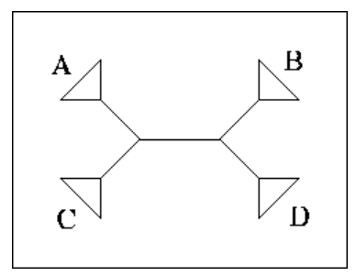
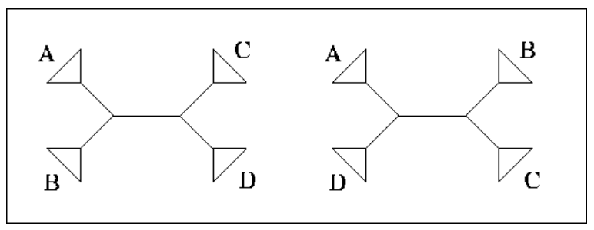
NNI
How many neighbors of a tree can be obtained by NNI moves?

Slide 28
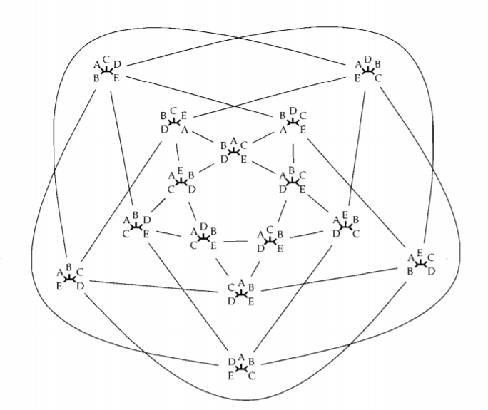
NNI tree space
Neighbor trees are one NNI move away.
Source: http://www.cs.cmu.edu/~durand/03-711/2010/37-44.pdf

Slide 29
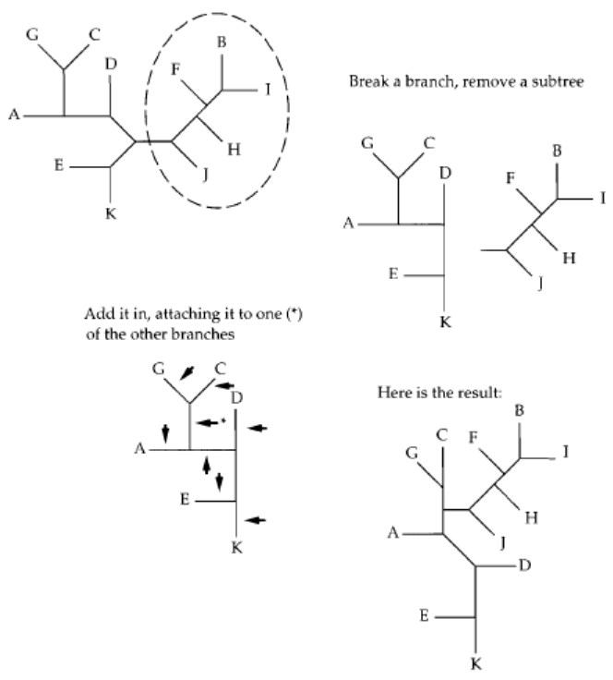
SPR
Source: http://www.cs.cmu.edu/~durand/03-711/2010/37-44.pdf

Slide 30
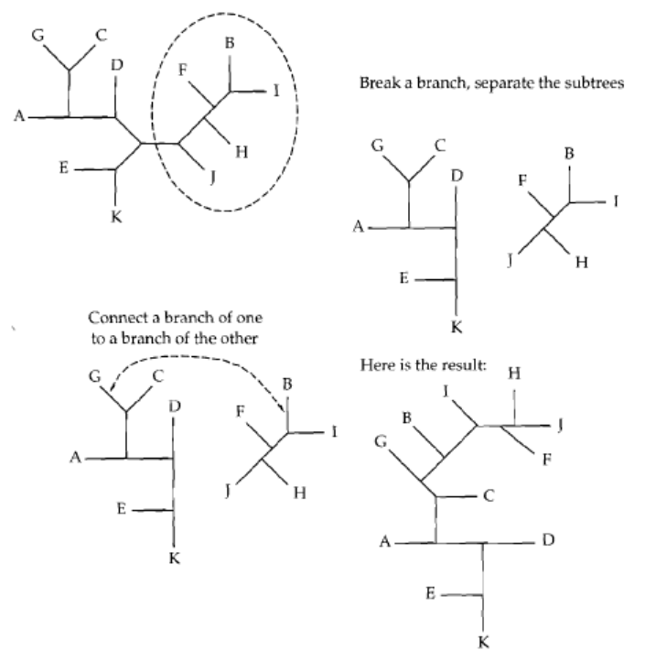
TBR
Source: http://www.cs.cmu.edu/~durand/03-711/2010/37-44.pdf

