Slide 1
CSE 471: MACHINE LEARNING
Deep Learning

Slide 2
Outline
Feedforward neural network
  Multi layer perceptron (MLP)
Convolutional neural network
Recurrent neural network

Slide 3
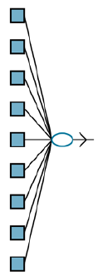
Perceptron

Slide 4
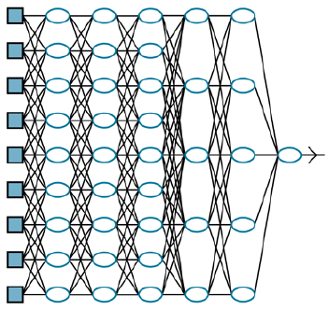
Multi layer perceptron
Deep learning network
A deep learning network has longer computation paths, allowing each variable to interact with all the others.
Notes:
Discuss:
Hidden layer
Fully connected network

Slide 5



Feedforward Network
g_{j} – Nonlinear activation function
There is an intercept b. Think of it as weight given to a fixed +1 activation node.
Nonlinearity (Sigmoid)

Slide 6

Nonlinearity
Sigmoid
ReLU(x) = max(0, x)
softplus(x) = log(1 + e^{x})
Notes:
Explain the need for non-linearity
The nonlinearity is what allows sufficiently large networks of units to represent arbitrary functions.
ReLU - Rectified linear unit
The softplus function, a smooth version of the ReLU function
The derivative of the softplus function is the sigmoid function.
Why?
The universal approximation theorem states that a network with just two layers of computational units, the first nonlinear and the second linear, can approximate any continuous function to an arbitrary degree of accuracy.

Slide 7
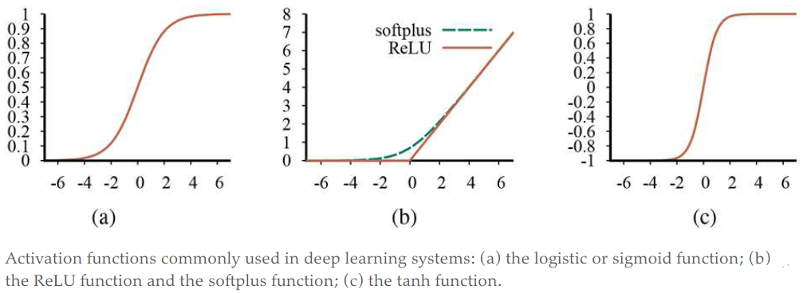
Nonlinearity
Notes:
Notice that all of them are monotonically non-decreasing,
Therefore, their derivatives are nonnegative

Slide 8
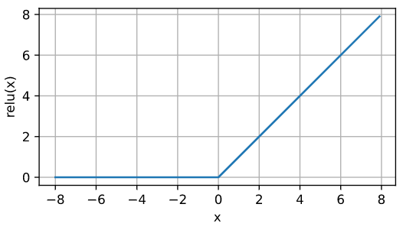
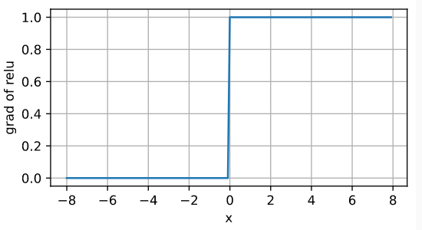
ReLU

Slide 9
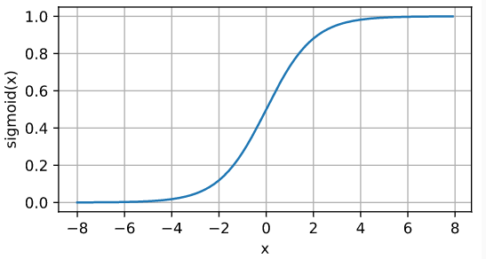
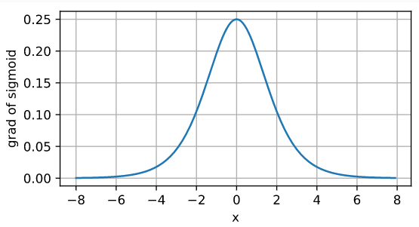
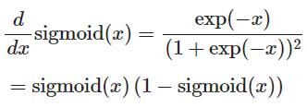
Sigmoid

Slide 10
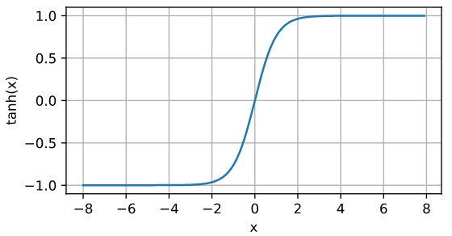

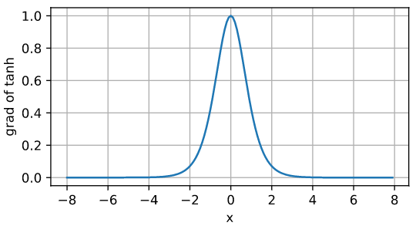

Tanh

Slide 11
Issue of ReLU not being differentiable at x = 0
https://www.mldawn.com/relu-activation-function/

Slide 12
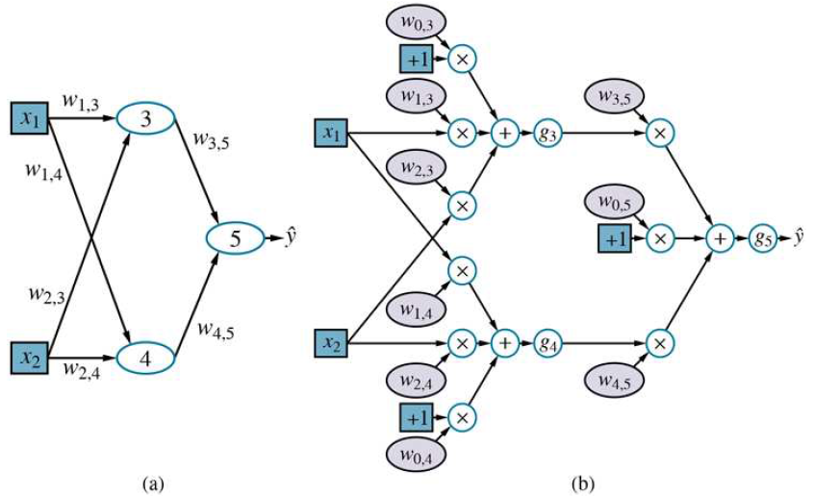
Computation Graph
Notes:
(a) A neural network with two inputs, one hidden layer of two units, and one output unit. Not shown are the dummy inputs and their associated weights.
(b) The network in (a) unpacked into its full computation graph.

Slide 13
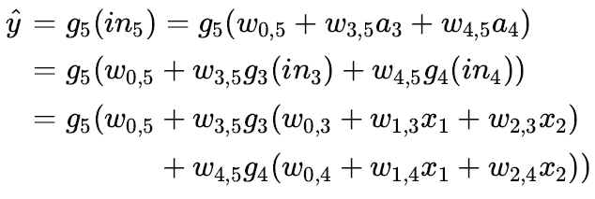
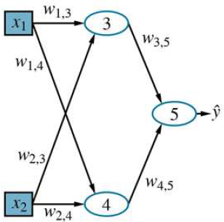

Forward computation
Notes:
W – weight matrix
W^{(i)} – weights in the i-th layer
g^{(i)} – Activation functions in the first and second layers. Then the entire network can be written as

Slide 14
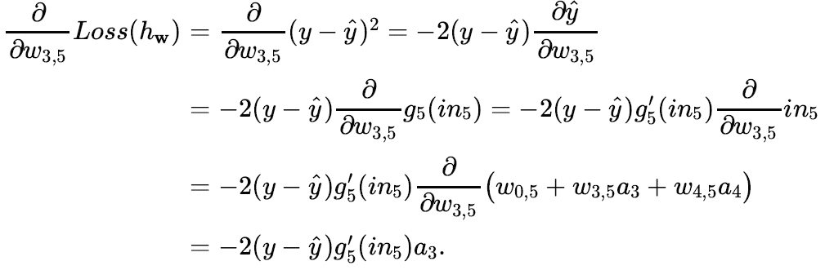
Gradients

Slide 15

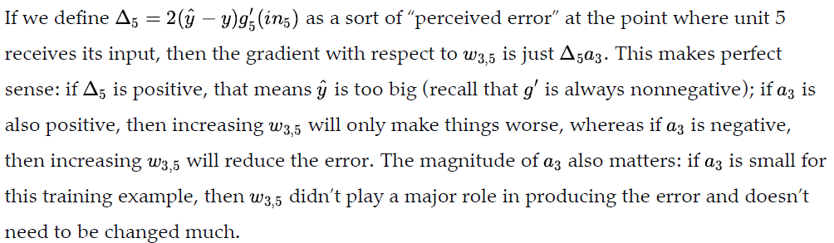
Gradients

Slide 16
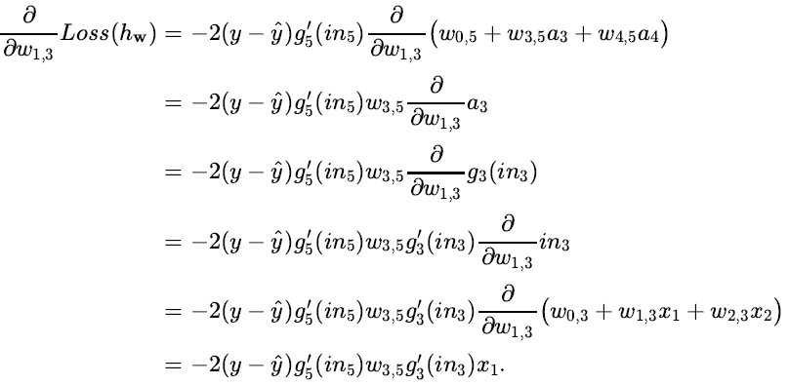
Gradients

Slide 17

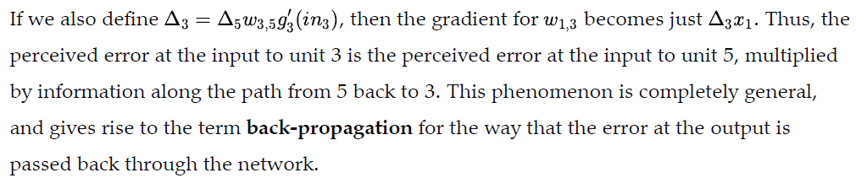
Gradients

Slide 18
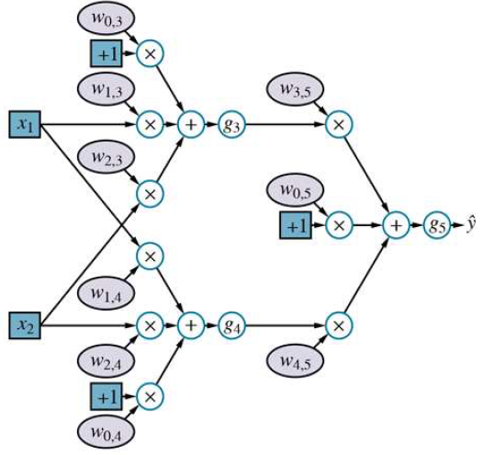
Home work
w_{0,3} = 2, w_{0,4} = -1, w_{0,5} = 1
w_{1,3} = 2, w_{1,4} = 4, w_{2,3} = 3
w_{2,4} = 1, w_{3,5} = 2, w_{4,5} = 3
x₁ = -3, x₂ = 5
y = 0
Loss = binary cross entropy
Non-linearity = ReLU
y_hat = ?
Calculate the gradients
  w.r.t the w’s.

Slide 19


Cross-entropy loss
Loss for single data point
Loss for n data point
Notes:
We want to maximize the likelihood of

Slide 20
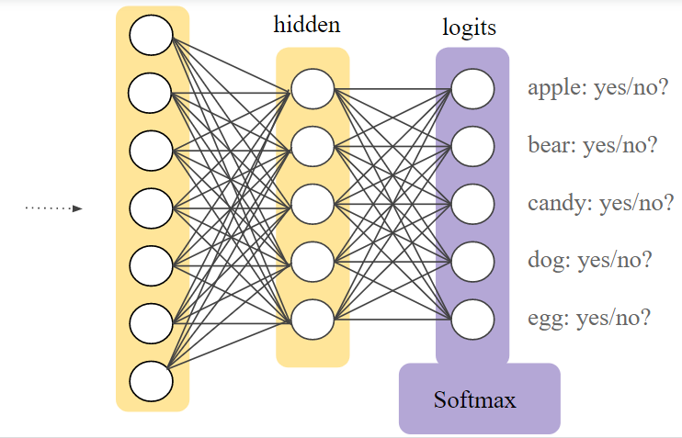
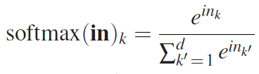
Soft-max
Notes:
Because of the exponentials, the softmax layer makes the differences in the inputs more prominent
Smooth, differentiable

Slide 21
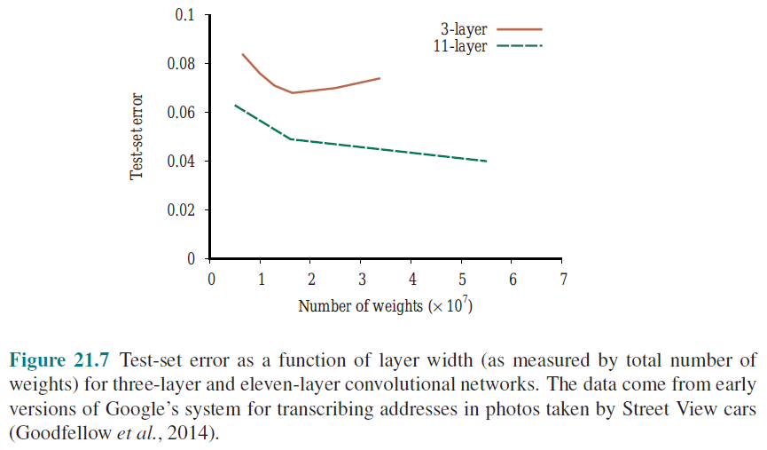
Shallow vs. Deep network’s Performance

Slide 22


Batch Normalization
Sample mean
Shift parameter
Element-wise scale parameter
Sample Standard Deviation
ϒ and β are learned parameters
Like dropout, the model sees the noise (in mean and SD) only during training
At prediction time, population mean and standard deviations are used.

Slide 23

Batch Normalization
Faster convergence
Regularization
Works best for moderate minibatch sizes in the 50–100 range.
  Large minibatch regularizes less due to the more stable estimates,
  Tiny minibatch destroys useful signal due to high variance.
Notes:
For reasons that are not yet well-characterized theoretically, various sources of noise in optimization often lead to faster training and less overfitting: this variation appears to act as a form of regularization.
While original authors placed BN before activation, later researchers have also experimented with putting it right after activation.
See section 8.5 of Dive into Deep Learning by Alex Smola

Slide 24
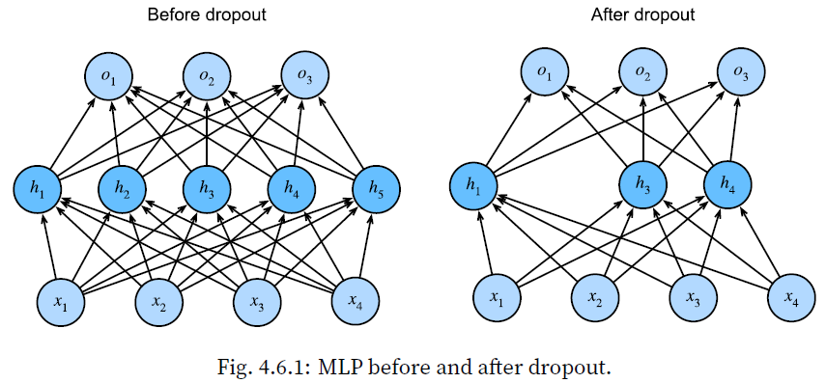
Dropout

Slide 25
Dropout
Drop out some neurons during training
  On each iteration
  Layer by layer
  Different neurons will get dropped in different iterations
Breaks up co-adaptation
Co-adaptation. Neural network overfitting is characterized by a state in which each layer relies on a specific pattern of activations in the previous layer.

Slide 26
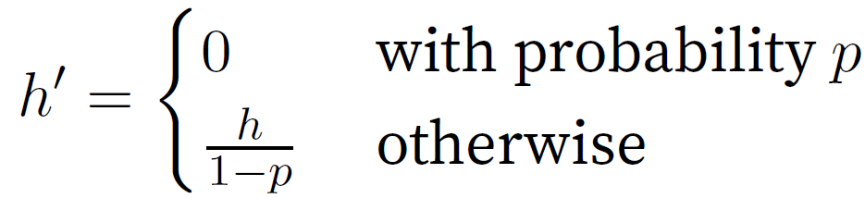
Dropout
Need to normalize the activation of the retained nodes
Each intermediate activation h is replaced by a random variable h′
Expectation remains unchanged, i.e., E[h′] = h.

Slide 27
Dropout
Used only in the training phase
Inference uses all the neurons
Exception
  Dropout at test time → heuristic for estimating the uncertainty of neural network predictions
    if the predictions agree across many different dropout outputs, then we might say that the network is more confident.

Slide 28
Gradients
Vanishing gradient
  Derivatives can be very close to 0
  Changing the weights may have negligible effects.
Sigmoid activation is succeptible to vanishing gradient
ReLU is more resilient
Notes:
See Section 5.4 of Smola’s book

Slide 29
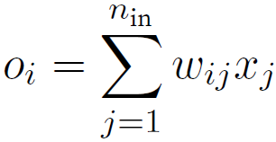
Xavier Initialization
Let
  O_{i} – output for some fully-connected layer (without nonlinearities)
  There are n_{in} inputs x_{j} with associated weights w_{ij}
  Weights are drawn independently from the same distribution, with 0 mean, σ² variance
  x_{i}’s also have 0 mean, γ² variance
    Independent of weights
    Independent of each other
Glorot, X., & Bengio, Y. (2010). Understanding the difficulty of training deep feedforward neural networks. Proceedings of the thirteenth international conference on artificial intelligence and statistics (pp. 249–256).

Slide 30
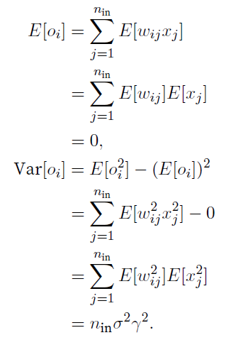
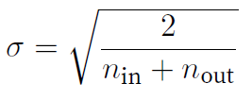
Xavier Initialization
Variance can be kept fixed if
  n_{in}σ² = 1
Following same reasoning, during backprop. Gradients’ variance can be kept fixed if
  n_{out}σ² = 1
Therefore, we try to achieve
  0.5 x (n_{in} + n_{out}) σ² = 1

Slide 31
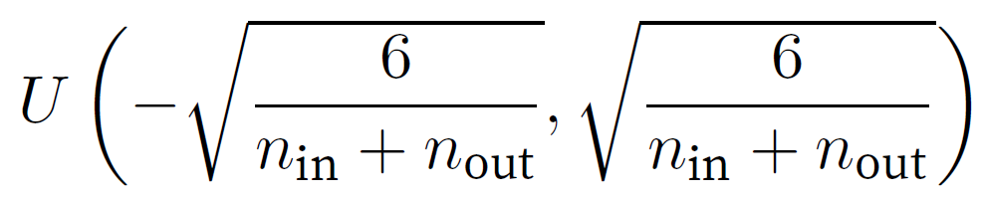
Xavier Initialization
Sampling weights from N(0, σ²)
Sampling weights from uniform distribution U(-a, a)
Though the assumption for nonexistence of nonlinearities in the above mathematical reasoning can be easily violated in neural networks, the Xavier initialization method turns out to work well in practice.
Notes:
Note that the uniform distribution U(-a,a) has variance a²/3

Slide 32
Gradient of cross entropy with softmax
https://fanzengau.com/myblog/content/machine_learning/gradient_of_categorical_cross_entropy/gradient_of_categorical_cross_entropy.html
Notes:
Reference:
https://fanzengaau.com/myblog/content/machine_learning/gradient_of_categorical_cross_entropy/gradient_of_categorical_cross_entropy.html

