Slide 1
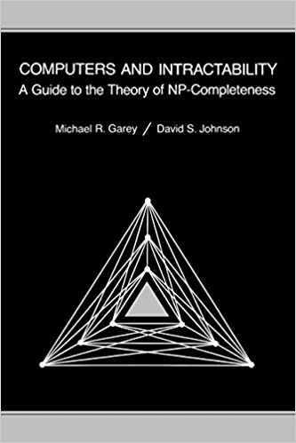


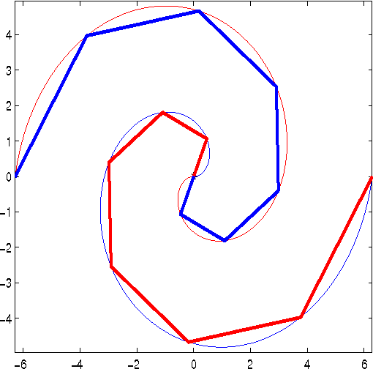
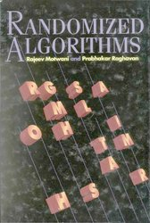

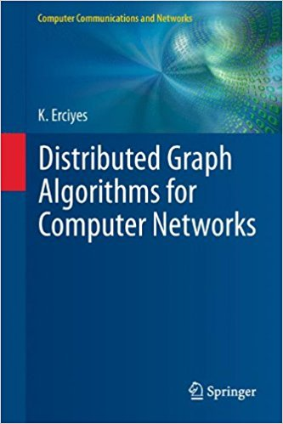
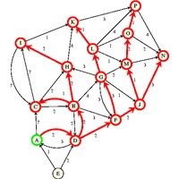
CSE 461
Algorithm Engineering

Slide 2
Computational Complexity

Slide 3
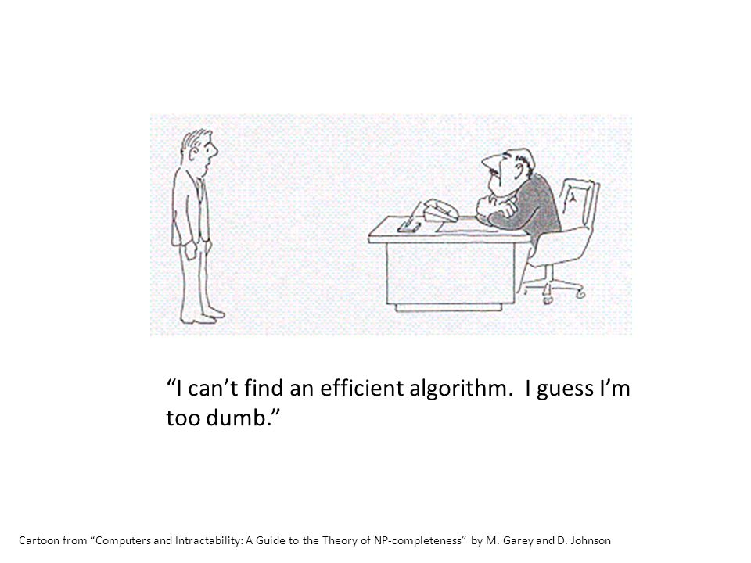
NP and Computational Intractability

Slide 4
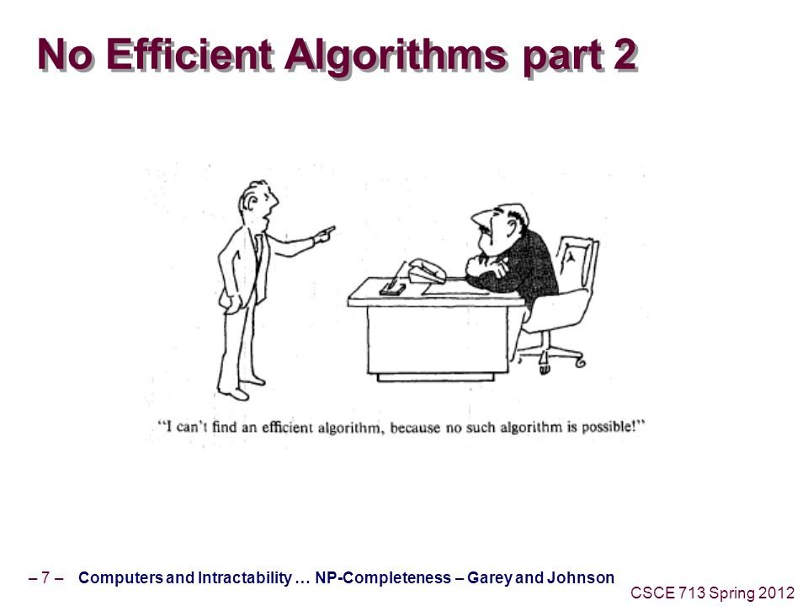
NP and Computational Intractability

Slide 5
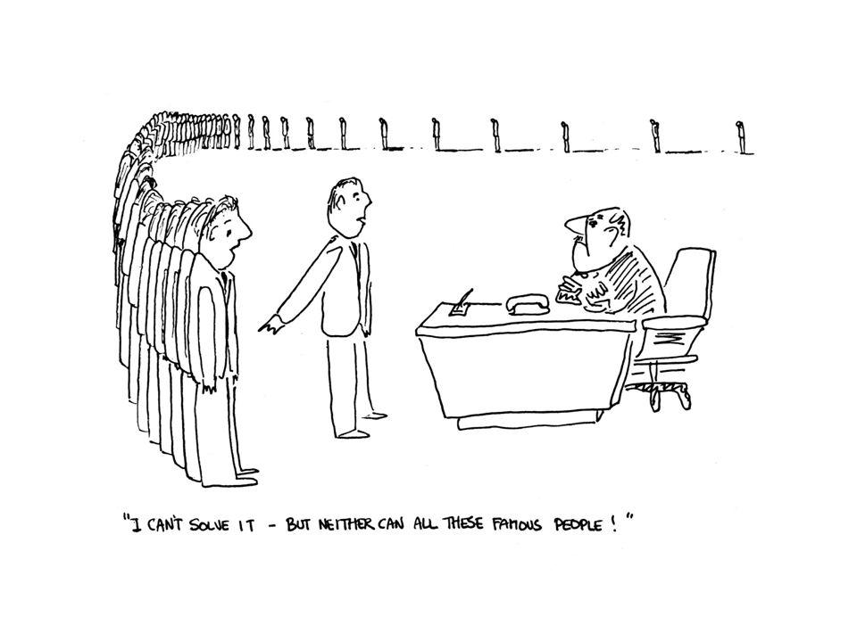
NP and Computational Intractability

Slide 6
Polynomial-Time Reductions
Problem X is at least as hard as Problem Y
If we had a “black box” capable of solving X, then we could also solve Y.
Can arbitrary instances of Problem Y be solved using a polynomial number of standard computation steps, plus a polynomial number of calls to a black box that solves Problem X?
If the answer is YES, then we write Y ≤_{P} X.

Slide 7
Polynomial-Time Reductions
Suppose Y ≤_{P} X. If X can be solved in polynomial time then Y can be solved in polynomial time.
Problem Y be solved using a polynomial number of standard computation steps, plus a polynomial number of calls to a black box that solves Problem X
Solve Bipartite matching problem using a polynomial amount of preprocessing plus a solution of the maximum flow problem.

Slide 8
Polynomial-Time Reductions
Suppose Y ≤_{P} X. If X can be solved in polynomial time then Y can be solved in polynomial time.
Contrapositive
Suppose Y ≤_{P} X. If Y cannot be solved in polynomial time then X cannot be solved in polynomial time.

Slide 9
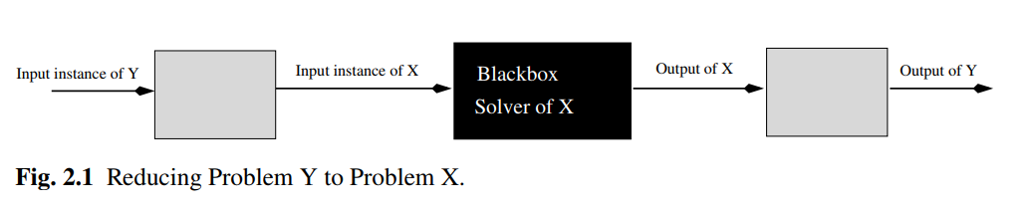

Slide 10
Polynomial-Time Reductions
Independent Set Problem.
Vertex Cover Problem

Slide 11
Independent Set Problem and Vertex Cover Problem
Independent Set Problem
1
2
Given a graph G and a number k, does
G contain an independent set of size
at least k?
3
4
5
Vertex Cover Problem
Given a graph G and a number k, does
G contain a vertex cover of size
at most k?
6
7

Slide 12
Lemma. Let G = (V, E) be a graph. Then S is an independent set if and only if V – S is a vertex cover.
1
2
Proof.
Necessity.
3
4
5
6
7
Sufficiency.

Slide 13
Polynomial-Time Reductions
Independent Set ≤_{P} Vertex Cover
Vertex Cover ≤_{P} Independent Set
The independent set problem and the vertex cover problem are equally hard.

Slide 14
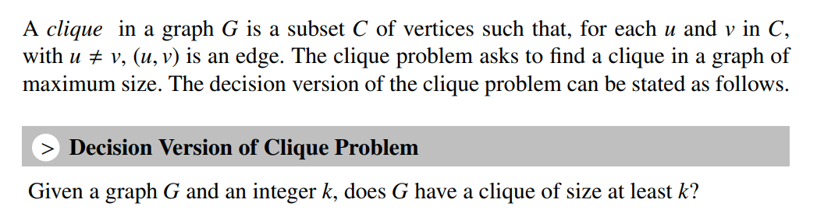
Polynomial-Time Reductions
Independent Set Problem r ≤_{P} Clique Problem

Slide 15
Polynomial-Time Reductions
Independent Set Problem r ≤_{P} Clique Problem
Clique Problem Output
Input Instance of Clique Problem
Clique Problem

Slide 16
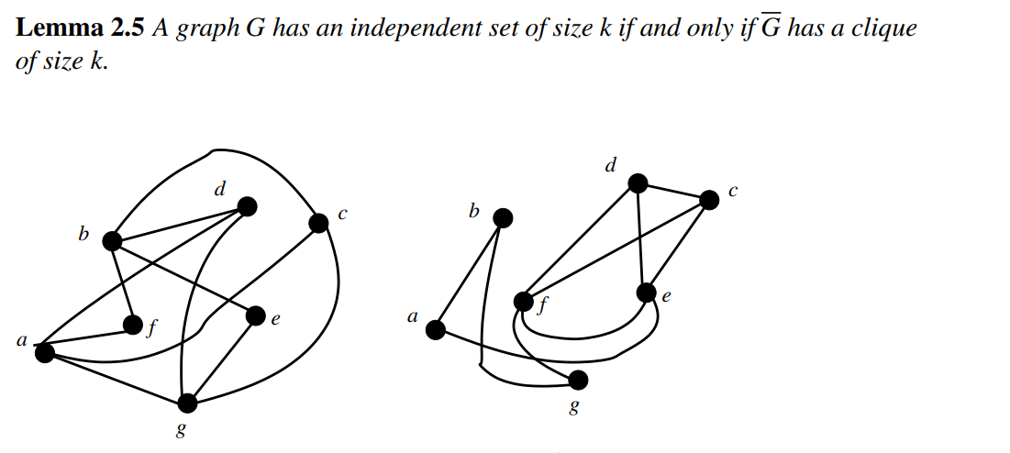
Polynomial-Time Reductions
Independent Set Problem r ≤_{P} Clique Problem

Slide 17
Polynomial-Time Reductions
Vertex Cover ≤_{P} Set Cover
Set Cover Problem
Given a set U of n elements, a collection S1, S2, …, Sm of subsets of U, and a number k, does there exists a collection of at most k of these sets whose union is equal to all of U?

Slide 18
Polynomial-Time Reductions
Vertex Cover ≤_{P} Set Cover
Set Cover Output
Input Instance
for Set Cover
Set Cover

Slide 19
Polynomial-Time Reductions
Vertex Cover ≤_{P} Set Cover
e₅
2
U = {e₁, e₂, e₃, e₄, e₅, e₆ ,e₇, e₈, e₉, e₁₀}
1
e₁
e₂
e₉
e₆
S₁ = {e₁, e₅}
3
e₃
S₂ = {e₂, e₅, e₆ ,e₉}
4
5
e₇
S₃ = {e₁, e₂, e₃, e₄}
U can be covered with at most k of the subsets S₁,S₂, …, S_{m} if and only if G has a vertex cover of size at most k
e₄
e₁₀
S₄ = {e₆ ,e₇}
6
7
S₅ = {e₉, e₁₀}
e₈
G
S₆ = {e₄, e₈}
S₇ = {e₃, e₇, e₈,e₁₀}

Slide 20
U can be covered with at most k of the subsets S₁,S₂, …, S_{m} if and only if G has a vertex cover of size at most k
U = {e₁, e₂, e₃, e₄, e₅, e₆ ,e₇, e₈, e₉, e₁₀}
e₅
S₁ = {e₁, e₅}
1
2
e₁
e₂
S₂ = {e₂, e₅, e₆ ,e₉}
e₉
S₃ = {e₁, e₂, e₃, e₄}
e₆
3
e₃
S₄ = {e₆ ,e₇}
4
5
e₇
S₅ = {e₉, e₁₀}
e₄
e₁₀
S₆ = {e₄, e₈}
7
S₇ = {e₃, e₇, e₈,e₁₀}
6
e₈
G
Necessity.
Sufficiency.
Vertex Cover ≤_{P} Set Cover

Slide 21
Polynomial-Time Reductions
Independent Set ≤_{P} Set Packing
Set Packing Problem
Given a set U of n elements, a collection S1, S2, …, Sm of subsets of U, and a number k, does there exists a collection of at least k of these sets with the property that no two of them intersect?

Slide 22
Class P and NP
P is the set of all decision problems solvable by deterministic algorithms in polynomial time.
NP is the set of all decision problems solvable by nondeterministic algorithms in polynomial time.
NP
Open Problem
P = NP?
P

Slide 23
Nondeterministic Search Algorithm
j = Choice(1,n)
if A[j] = x then { write(j); success();}
Write(0); failure();
Choice(j) arbitrarily choose one of the elements of set S.
Whenever there is a set of choices that leads to a successful completion, then one such choice is always made and the algorithm terminates successfully.
A nondeterministic algorithm terminates unsuccessfully if and only if there exists no set of choices leading to a success signal.

Slide 24
Class P and NP
P is the set of all decision problems solvable by deterministic algorithms in polynomial time.
NP is the set of all decision problems solvable by nondeterministic algorithms in polynomial time.
NP
Open Problem
P = NP?
P

Slide 25
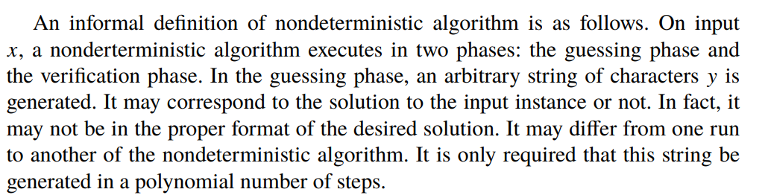

Slide 26
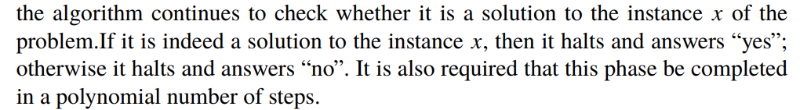

Slide 27
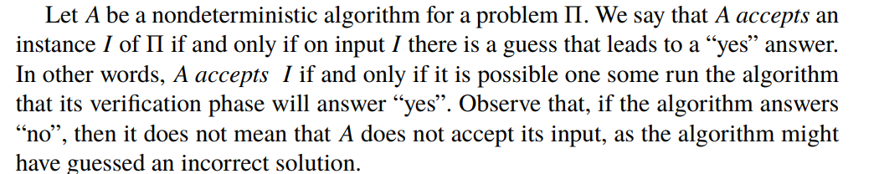

Slide 28
Cook’s Theorem
Satisfiability problem is in P if and only if P = NP.
NP
Open Problem
P = NP?
P

Slide 29
NP-hard Problem
A problem X is NP-hard if and only if satisfiability ≤_{P} X.
.
NP-Complete Problem
A problem X is NP-Complete if X is NP-hard and X є NP.
.
NP
NP-complete
P
NP-hard

Slide 30
To prove a problem X is NP-complete
Show that the problem X is in NP.
Show that the problem X is NP-hard
NP
NP-complete
P
NP-hard

Slide 31
To prove a problem X is in NP
If we can verify a solution of X in polynomial time using deterministic algorithm then the problem is in NP.

Slide 32
To prove a problem X is NP-hard
Pick a problem Y already known to be NP-hard
Show Y ≤_{P} X

Slide 33
Some NP-Complete Problems
Circuit -SAT
CNF-SAT
3-SAT
Indendent Set
Vertex Cover
Hamiltonian Cycle

Slide 34
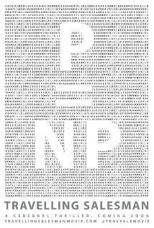

Slide 35
Independent Set Problem is NP-Complete
Independent set Problem is in NP

Slide 36
Independent Set Problem is NP-Complete
Independent set Problem is NP-hard
3-SAT ≤_{P} Independent Set
Y =( x₁ + x₂ + x₃)(x₂ + x₄ + x₅) (x₂ +x₃ + x₄)
v₁₁
v₂₁
v₃₁
v₁₃
v₂₂
v₂₃
v₃₂
v₃₃
v₁₂
G, k = q
Y (of q clauses) is satisfiable if and only if G has an independent set of size at least k

Slide 37
Graph Coloring Problem
A (vertex) coloring of a graph is an assignment of colors to the vertices so that adjacent vertices have distinct colors?
A k-coloring of a graph uses at most k-colors.
Given a graph G and a bound k, does G have a k-coloring?

Slide 38
2-Coloring Problem
Given a graph G, does G have a 2-coloring?
2-coloring problem is in P. O(n+m) time algorithm

Slide 39
3-Coloring Problem is NP-complete
3-coloring problem is in NP:
One can verify in polynomial time that at most k-colors are used, and no two pair of nodes joined by an edge receive the same color. O(n+m) time

Slide 40
3-Coloring Problem is NP-complete
3-coloring problem is in NP-hard:
3-SAT ≤_{P} 3-coloring problem

Slide 41
co-NP
co-NP is a complexity class. A decision problem X is a member of co-NP if and only if its complement X is in the complexity class NP
The complement of a decision problem is the decision problem resulting from reversing the yes and no answers. Equivalently, if we define decision problems as sets of finite strings, then the complement of this set over some fixed domain is its complement problem.
For example, one important problem is whether a number is a prime number. Its complement is to determine whether a number is a composite number (a number which is not prime).

Slide 42
co-NP
Does NP = co-NP ?
Widespread belief
NP ≠ co-NP.

Slide 43
Good Characterization: NP ∩ co-NP
Does P= NP ∩ co-NP?

Slide 44
Space Complexity: PSPACE
The set of all problems that can be solved by an algorithm with polynomial space complexity.

Slide 45
Space Complexity: PSPACE
There is an algorithm that solves 3-SAT using only a polynomial amount of space.
PSPACE
NP
P
co-NP

Slide 46

Thank You

