Slide 1
CSE 471: MACHINE LEARNING
Learning from Examples

Slide 2
Outline
Forms of learning
Model Selection and Optimization
The Theory of Learning
Linear Regression and Classification
Nonparametric Models
Ensemble Learning
Developing Machine Learning Systems

Slide 3
Machine Learning
A computer program is said to learn from
  experience E (not in traditional algorithm e.g. Dijkstra algorithm)
with respect to some class of
  task T and performance measure P if its
  performance at tasks in T
  as measured by P
  improves with experience E (not in traditional algorithm)

Slide 4
Material to cover in next 7 weeks
Book
  Artificial Intelligence A Modern Approach (4th Edition)
    Stuart J. Russell and Peter Norvig
  Misc. notes/blog posts
Content
  See course outline

Slide 5
Learning from Examples
Supervised Learning
  Labeled observations
  Classification vs. Regression
Unsupervised Learning
  Unlabeled observations
  Clustering
Notes:
Going from a specific set of observations to a general rule is called induction. The inductive conclusions may be incorrect,

Slide 6
Learning from Examples
Reinforcement Learning
  Reward & punishment scheme
  Example: Learning from a chess game
    Win → Reward
    Loss → Punishment
    Agent itself determines what actions were fruitful!
Notes:
Going from a specific set of observations to a general rule is called induction. The inductive conclusions may be incorrect,

Slide 7
Datasets & Validations
Datasets
  Training set
  Validation set
  Test set
Validations
  Validation Test
  K-fold cross validation Test
  Independent Test

Slide 8
The hypothesis space (H)
How do we choose a hypothesis space
  Prior knowledge
  Exploratory data analysis
    Visualizations
      histograms
      scatter plots
      Box plots
      Etc.
Consistent Hypothesis
  Gives correct answer for the data point

Slide 9
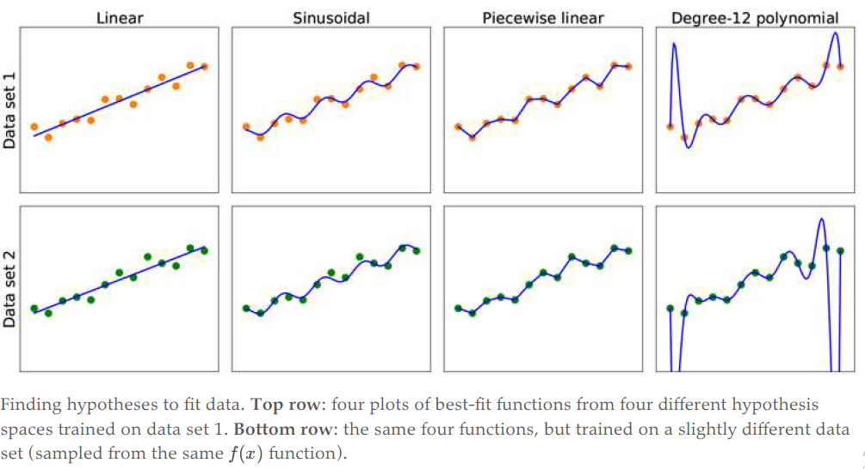
The hypothesis space (H)
Notes:
Discuss generalization and overfitting
Bias and variance of a hypothesis
Bias often results from restrictions imposed by the hypothesis space. (Underfitting)
variance means the amount of change in the hypothesis due to fluctuation in the training data (Overfitting)
Bias-variance tradeoff
Ockham’s razor

Slide 10
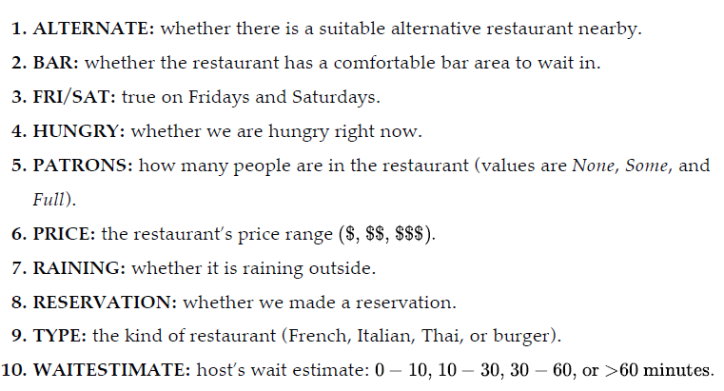
Example: Will we wait for a table?

Slide 11
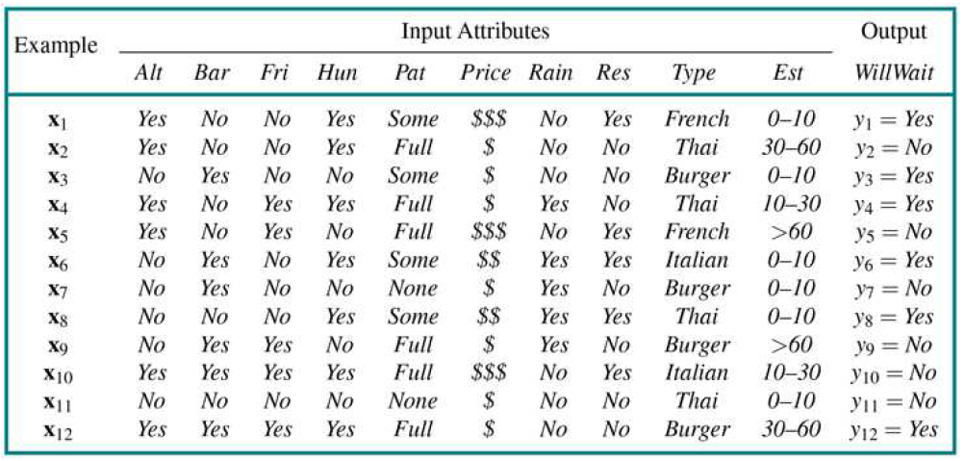
Will we wait for a table?

Slide 12
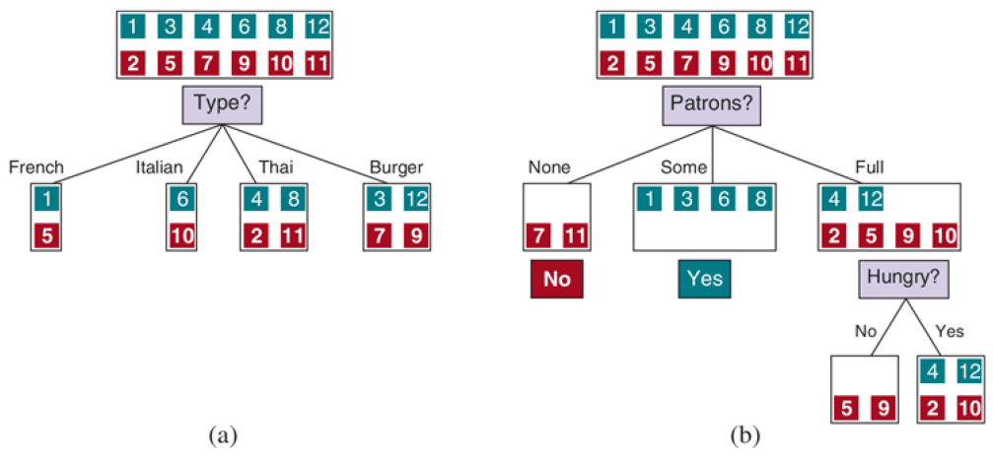
How to select the best attribute?

Slide 13
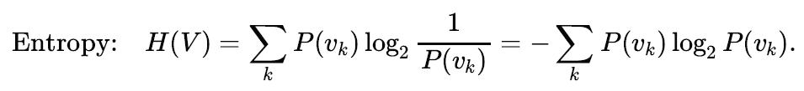
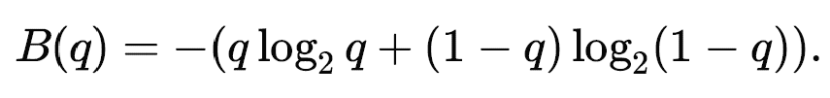

Choosing attribute tests
B(q) is the entropy of a Boolean random variable
that is true with probability q
The entropy of the output variable
on the whole set
Notes:
Information content of an event E → I(E) = -log₂(p(E))
Entropy measures the expected amount of information conveyed by identifying the outcome of a random trial

Slide 14
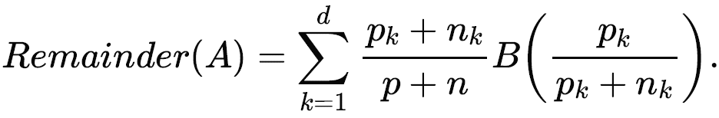
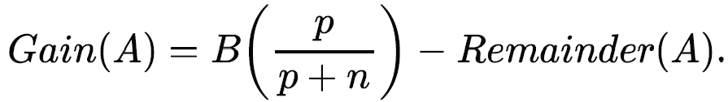
Choosing attribute tests
Information Gain

Slide 15
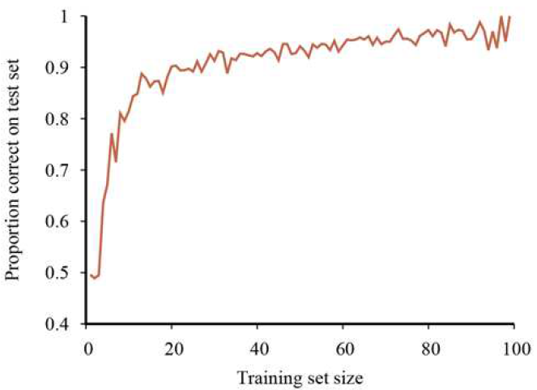
The learning curve
Notes:
A learning curve for the decision tree learning algorithm on 100 randomly generated examples in the restaurant domain.
Each data point is the average of 20 trials.

Slide 16

Confusion Matrix
Predicted Class
 | WillWait = True | WillWait = False
WillWait = True | 4 (TP) | 2 (FN)
WillWait = False | 3 (FP) | 3 (TN)
https://en.wikipedia.org/wiki/Confusion_matrix

Slide 17
Performance Metrics
Accuracy,
Sensitivity (Recall)
Specificity
Precision
F1-score
MCC
Etc.

Slide 18
Useful Resources
Learning From Data (MOOC @ CALTECH)
  Prof. Yaser Abu-Mostafa
Machine Learning (Coursera Course)
  Prof. Andrew Ng
Essence of Linear Algebra
  Grant Sanderson (3Blue1Brown)
Practice and Compete at Kaggle
Learn Python

