Slide 1
CSE 471: MACHINE LEARNING
Learning from Examples (Continued)

Slide 2
Outline
Linear Regression and Classification
Ensemble Learning
Model Selection and Optimization
The Theory of Learning
Nonparametric Models
Developing Machine Learning Systems

Slide 3
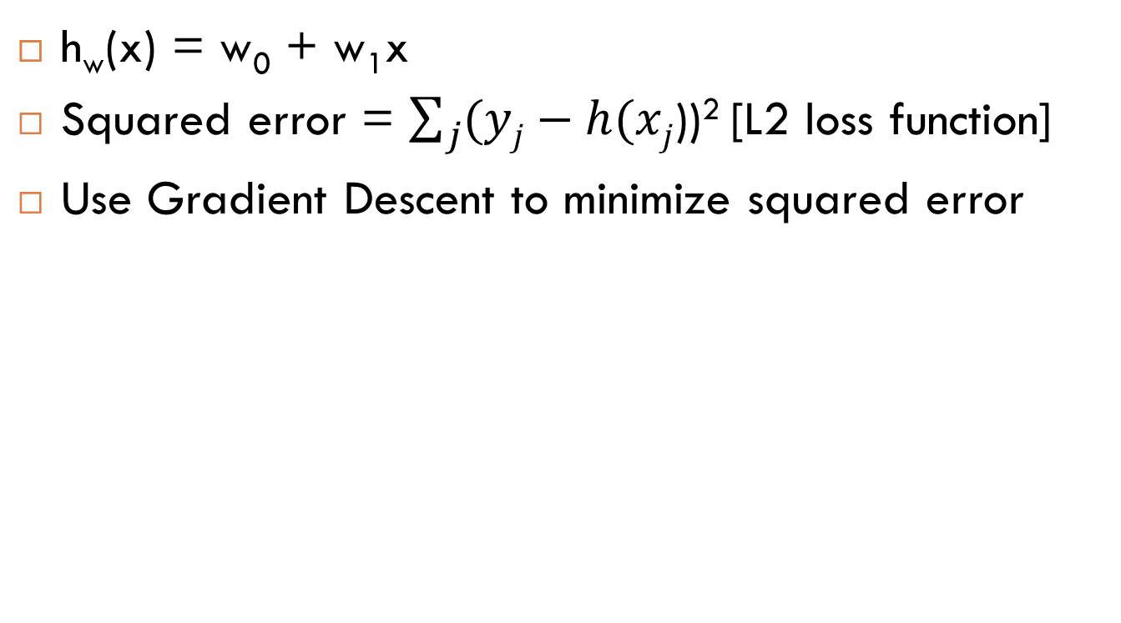
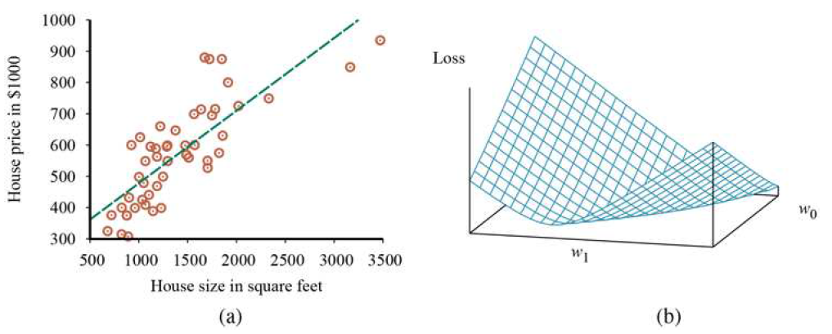
Linear Regression & Classification
Notes:
Section 19.6 of reference book
A real-valued function is called convex if the line segment between any two distinct points on the graph of the function lies above the graph between the two points.

Slide 4
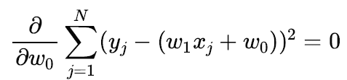
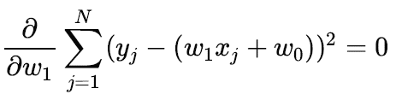
Linear Regression
w∗ = argmin_{w} Loss(h_{w})
Set partial derivatives to 0 to obtain the minima

Slide 5
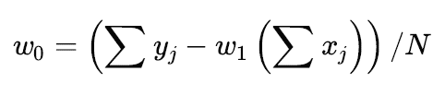
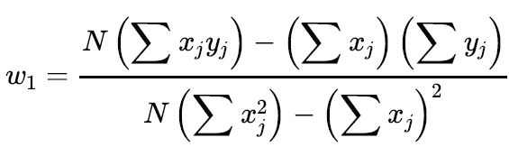
Linear Regression

Slide 6
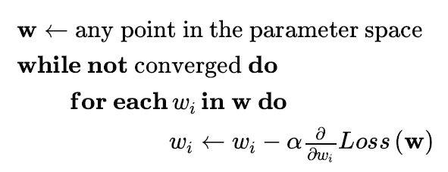
Gradient Descent
α - Learning rate
  Constant
  Decaying

Slide 7
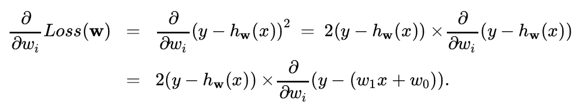


The partial derivatives

Slide 8


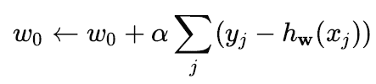

The learning rules
For single example
For Entire training set
Notes:
batch gradient descent / deterministic gradient descent
A step that covers all the training examples is called an epoch

Slide 9
Stochastic gradient descent (SGD)
Use a random sample of examples at each step
  A minibatch of m out of N samples
Convergence of minibatch SGD is not strictly guaranteed
  It can oscillate around the minimum without settling down
  Decaying learning rate can guarantee convergence
Useful in online learning

Slide 10


Multivariable Linear Regression
Gradient Descent Step
Recall
[for univariable case]

Slide 11
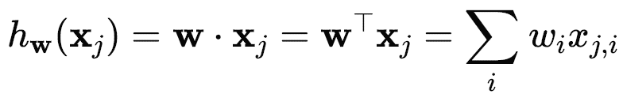
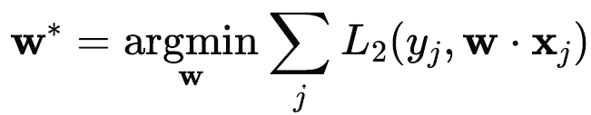
Multivariable LR Vectorized
Assuming a dummy input attribute x_{j,0} = 1, We can vectorize the formulation
The optimization Problem

Slide 12




Multivariable LR Vectorized
y hat – prediction on all examples
X - Data marix. Each row is a multivariable sample
w - Weight vector
Loss over training dataset
Set the gradient to 0
Normal Equation
Notes:
(X^{T}X)⁻¹X^{T} – Pseudo inverse of the data matrix

Slide 13
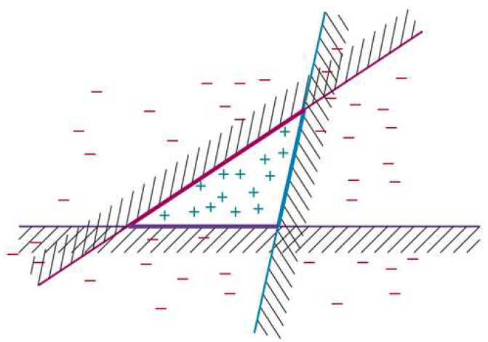
Ensemble Learning
Notes:
Base model
Ensemble model
Reduced bias
Computationally less expensive (compared to a searching a H-space of less bias)
Computation (Ensemble of n linear classifiers) = n x Computation (one linear classifier)
Reduce variance
How is ensemble reducing variance? Consider an ensemble of K=5 binary classifiers that we combine using majority voting. For the ensemble to misclassify a new example, at least three of the five classifiers have to misclassify it.
Let Acc(model trained on entire training set) = 80%
Let Acc(base model, trained on a subset of training set) = 75%
With majority voting scheme Acc(Ensemble model) ~ 89%,
* The above calculation assumes true independence of the base models. (i.e. whether one model would fail to classify a data point correctly has no bearing on the same for the other models)

Slide 14
Ensemble Learning
Boosting
Bootstrap aggregating (Bagging)
Random forests
Stacking
Notes:
Section 19.8 of reference book

Slide 15
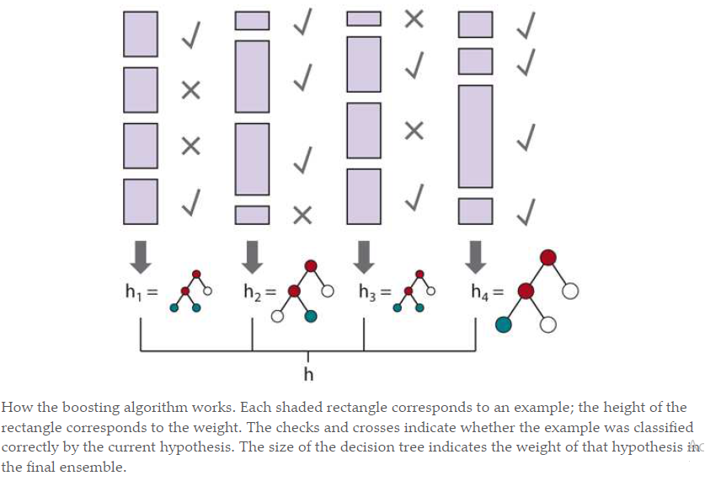
Boosting
Notes:
Weighted training set
Generate K hypotheses, where K is a hyper parameter
Examples that are difficult to classify will get increasingly larger weights until the algorithm is forced to create a hypothesis that classifies them correctly.
This is a greedy algorithm in the sense that it does not backtrack
Once it has chosen a hypothesis it will never undo that choice; rather it will add new hypotheses
It is also a sequential algorithm, so we can’t compute all the hypotheses in parallel as we could with bagging.
Ensemble model = Weighted voting of base models

Slide 16
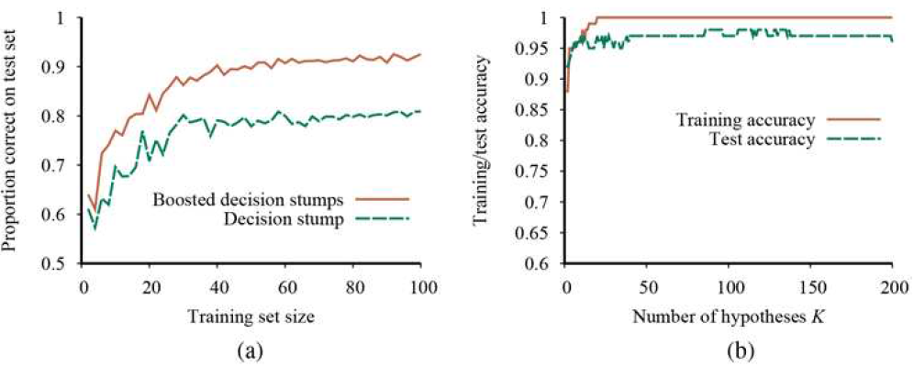
Boosting Decision Stumps
A decision stump is a DT with just one test (i.e. only the root)
Notice that the test set accuracy improves slightly even after the training accuracy reaches 1, i.e., after the ensemble fits the data exactly.
Notes:
The unboosted decision stump has a prediction performance of only 81% on 100 training examples.
When boosting is applied (with ), the performance is better, reaching 93% after 100 examples.

Slide 17
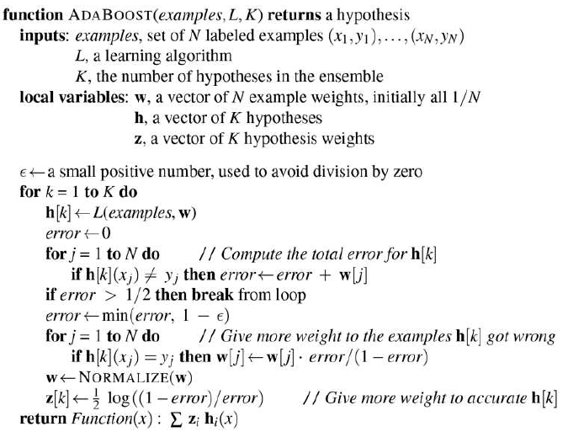
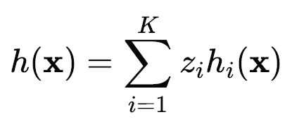
AdaBoost
Notes:
ADABOOST has a very important property: if the input learning algorithm is a weak learning algorithm—which means that always returns a hypothesis with accuracy on the training set that is slightly better than random guessing (that is, 50% + \epsilon) for Boolean classification)—then ADABOOST will return a hypothesis that classifies the training data perfectly for large enough K. Thus, the algorithm boosts the accuracy of the original learning algorithm on the training data.

Slide 18
AdaBoost
continue
Notes:
ADABOOST has a very important property: if the input learning algorithm is a weak learning algorithm—which means that always returns a hypothesis with accuracy on the training set that is slightly better than random guessing (that is, 50% + \epsilon) for Boolean classification)—then ADABOOST will return a hypothesis that classifies the training data perfectly for large enough K. Thus, the algorithm boosts the accuracy of the original learning algorithm on the training data.

Slide 19
Stacking
Base models from different model classes
  SVM
  Logistic regression
  Decision Tree
Augment feature vector with output of the base models
Train the ensemble model (say Logistic regression)
  On the Validation Set
  Cross validation can be done
Notes:
Stacking is frequently used by winning teams in data science competitions (such as Kaggle and the KDD Cup), because individuals can work independently, each refining their own base model, and then come together to build the final stacked ensemble model.

Slide 20
Stacking
Base classifier-1
Base classifier-2
New training set for meta classifier consisting of predictions from base classifiers
Training set
Meta classifier
Base classifier-3
. . . . . .
Base classifier-n
Final prediction
Taken from MSc thesis defense presentation of Qazi Farah Nawar

Slide 21
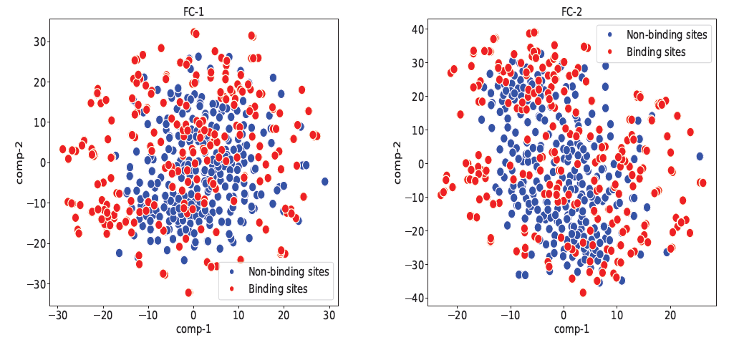
Stacking improves class separation
This is a t-SNE plot from protein carbohydrate binding site prediction problem. FC-1 to FC-5 are best 5 feature spaces. FC-6 is FC-1 augmented with prediction values from the base layer (i.e., what the meta layer of stacking ensemble will see . (Nawar et al.)

Slide 22
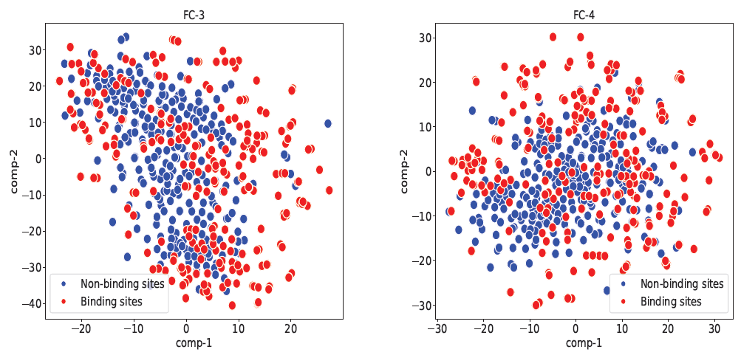
Stacking improves class separation
This is a t-SNE plot from protein carbohydrate binding site prediction problem. FC-1 to FC-5 are best 5 feature spaces. FC-6 is FC-1 augmented with prediction values from the base layer (i.e., what the meta layer of stacking ensemble will see . (Nawar et al.)

Slide 23
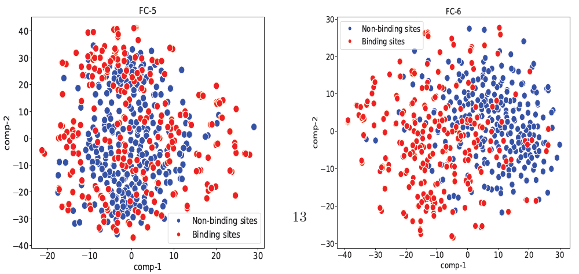
Stacking improves class separation
This is a t-SNE plot from protein carbohydrate binding site prediction problem. FC-1 to FC-5 are best 5 feature spaces. FC-6 is FC-1 augmented with prediction values from the base layer (i.e., what the meta layer of stacking ensemble will see . (Nawar et al.)

Slide 24
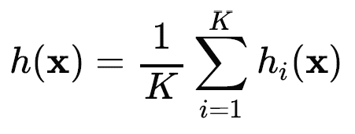
Bagging
K distinct training sets by subsampling
  With replacement
Reduces variance
Most commonly used with decision trees
  DTs are very sensitive to changes in examples
Can be applied in parallel

Slide 25
Random forests
A form of decision tree bagging
Takes extra measures to diversify the base DTs
At each split point, attributes are sampled.
  Attribute with highest IG from the sample is chosen
Extremely Randomized Tree (ExtraTree)
  For an attribute, we randomly sample several candidate values from a uniform distribution over the attribute’s range
    Choose the value that results in highest IG

Slide 26
Random forests
Can be created efficiently
  Sampled attribute space
  No need for DT pruning
  The trees can be built in parallel
Out-of-bag error
  Mean error on each example, using only the trees whose example set didn’t include that particular example
  Can be used instead of CV error
Notes:
Why does Random forest not require pruning? [See: Page 1291 of reference book PDF]

Slide 27
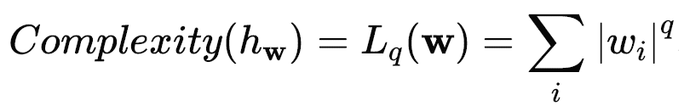
Multivariable LR Regularization
Cost(h) = EmpLoss(h) + λ Complexity(h)
L₁ regularization produces sparse model
  Easier for a human to understand
  Less likely to overfit
You can use L₁ loss with L₂ regularization and vice versa.
L1 regularization – LASSO
L2 regularization - Ridge
Notes:
With univariate linear regression we didn’t have to worry about overfitting.
But with multivariable linear regression in high-dimensional spaces it is possible that some dimension that is actually irrelevant appears by chance to be useful, resulting in overfitting.
q = 1 means L1 regularization, q = 2 is L2 regularization etc.

Slide 28
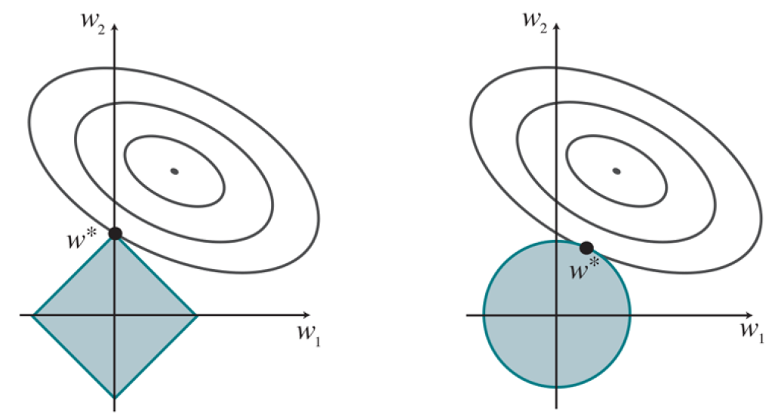
L₁ vs. L₂ regularization
L₁ regularization tends to produce a sparse model.
Notes:
Note that minimizing Loss(w) + λComplexity(w) is equivalent to minimizing Loss(w) subject to the constraint that Complexity(w) ≤ c, for some constant that is related to λ
More about contour plots: https://www.youtube.com/watch?v=WsZj5Rb6do8

Slide 29
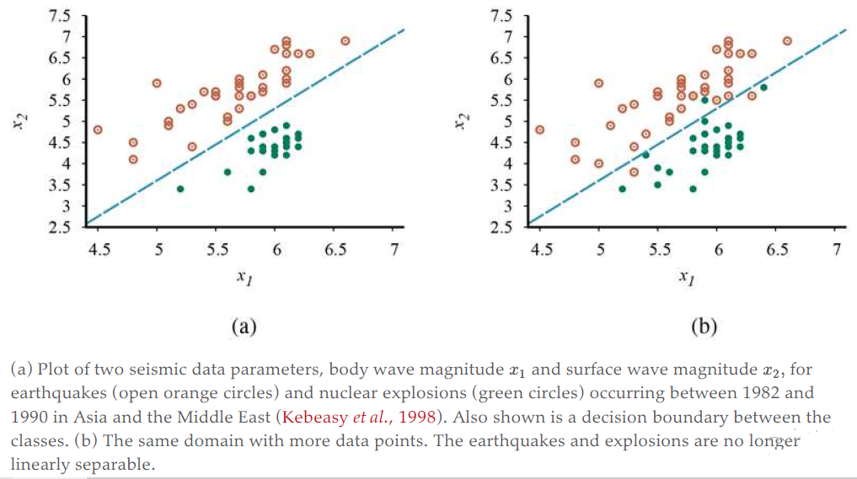
Linear Classification

Slide 30

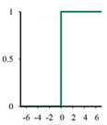


Linear Classification
Gradient is discontinuous
Gradient is zero almost everywhere in weight space except at those points where and at those points the gradient is undefined

Slide 31

Perceptron Learning Rule
If the output is correct (i.e., ) then the weights are not changed.
If y is 1 but h_{w}(x) is 0, then w_{i} is increased when the corresponding input is positive and decreased when is negative. This makes sense, because we want to make w.x bigger so that outputs a 1.
If is 0 but is 1, then is w_{i} decreased when the corresponding input is positive and increased when is negative. This makes sense, because we want to make smaller so that outputs a 0.

Slide 32
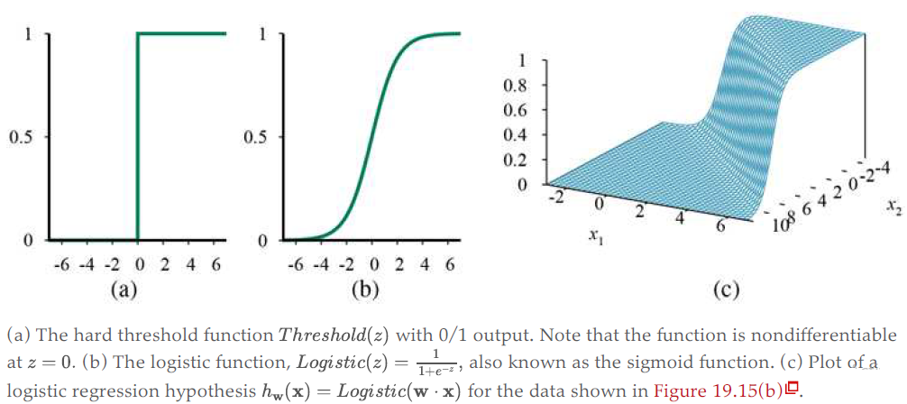
Logistic Regression

Slide 33
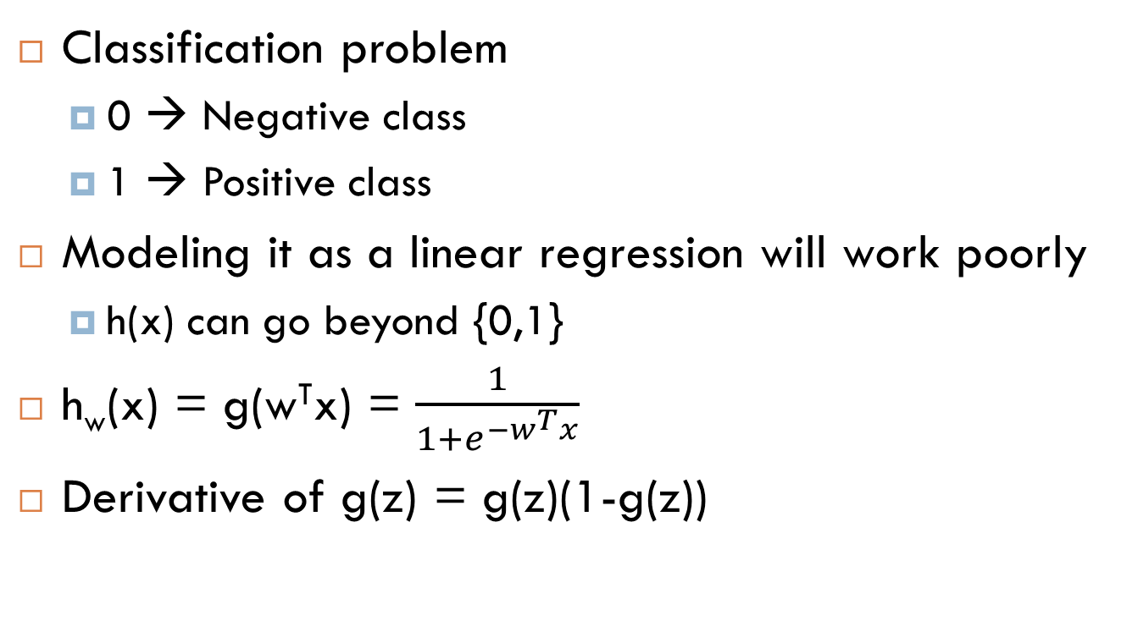
Logistic Regression

Slide 34


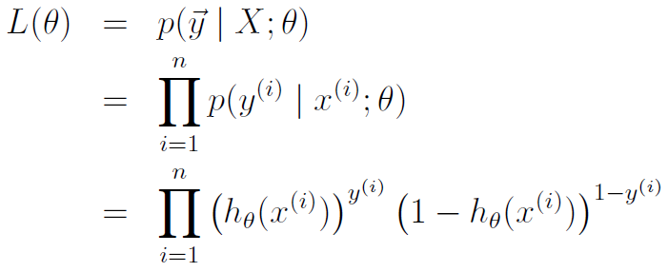
Logistic Regression
Likelihood of the parameters

Slide 35
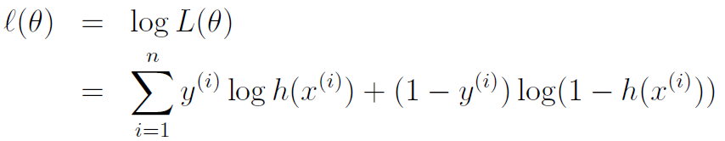
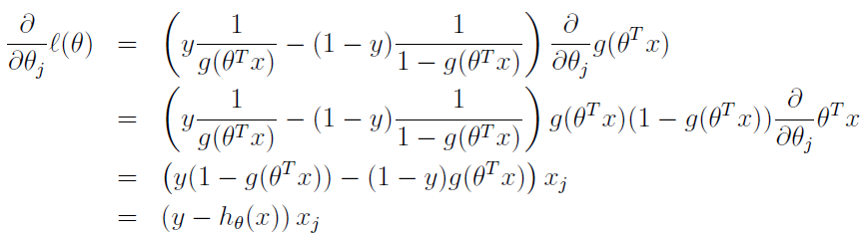
Maximizing the log Likelihood
For single data point

Slide 36
Update rule
θ_{j} = θ_{j} + α(y - h_{θ}(x))x_{j}
Identical to the update rule in linear regression

