Slide 1
CSE 471: Machine learning
Dimensionality Reduction

Slide 2
Outline
Principal Component Analysis (PCA)
Data pre-processing
PCA vs. Linear Regression
Notes:
Chapter 14

Slide 3
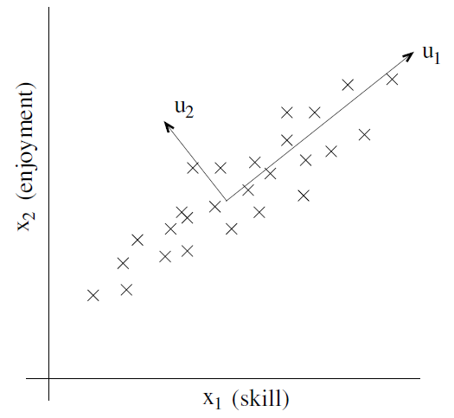
PCA motivation
Notes:
Consider a dataset resulting from a survey of pilots for radio-controlled helicopters
x₁^{(i)} is a measure of the piloting skill of pilot i,
x₂^{(i)} captures how much he/she enjoys flying.
Because RC helicopters are very difficult to fly, only the most committed students, ones that truly enjoy flying, become good pilots.
So, the two attributes x₁ and x₂ are strongly correlated.
We might posit that that the data actually lies along some diagonal axis (the u₁ direction), with only a small amount of noise lying off this axis. How can we automatically compute this u₁ direction?

Slide 4
PCA motivation
Data compression
Data visualization
Noise reduction

Slide 5
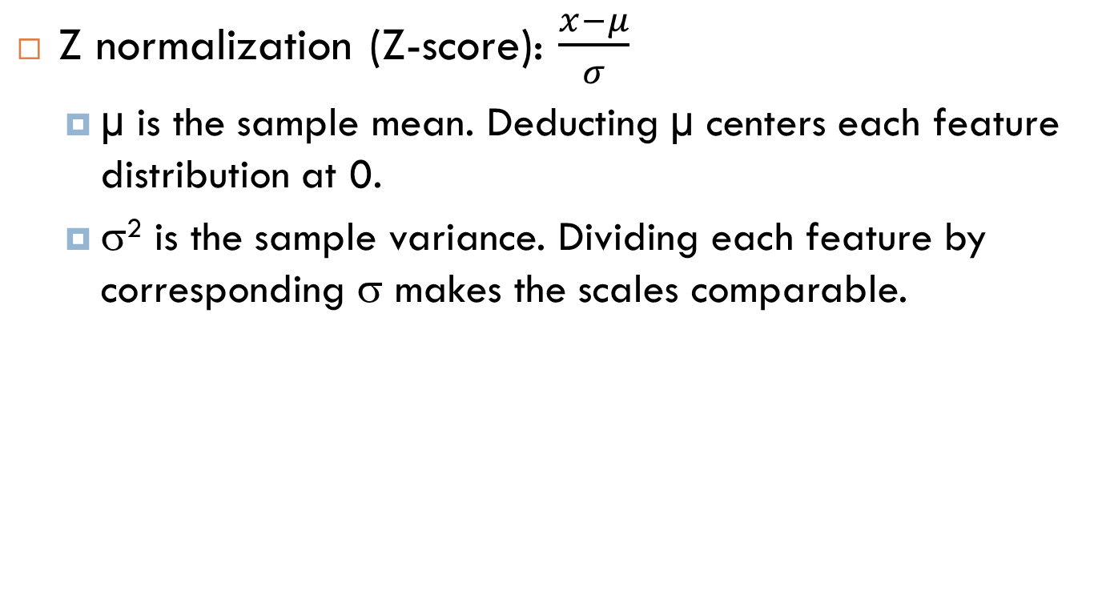
Data pre-processing
Z normalization (Z-score): $\frac{x−μ}{σ}$
µ is the sample mean. Deducting µ centers each feature distribution at 0.
σ² is the sample variance. Dividing each feature by corresponding σ makes the scales comparable.

Slide 6
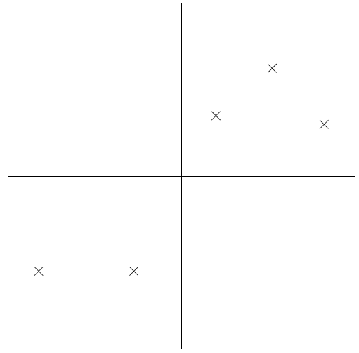
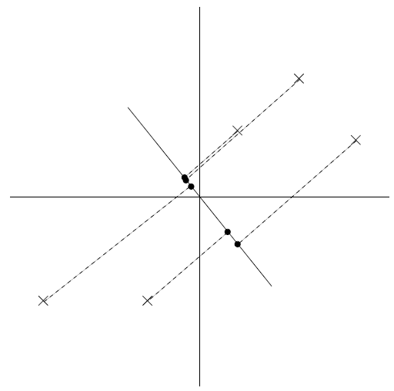
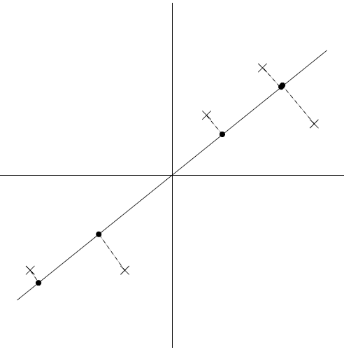
Find the direction of data
Find the direction so that the variance of the projected data is maximized.

Slide 7
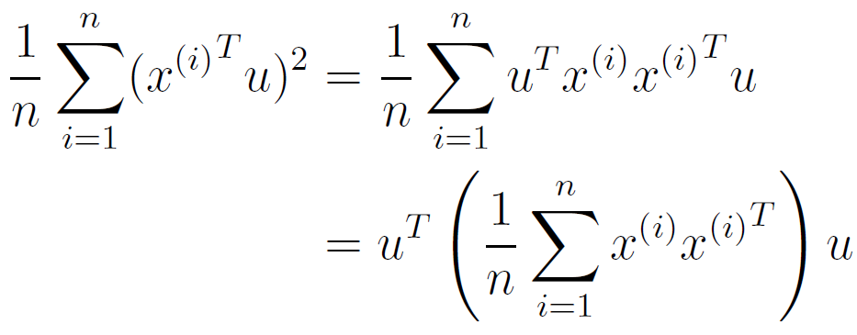
Find the direction of data
Length of projection of x on unit vector u is: x^{T}u
We want to maximize the below quantity

Slide 8
Find the direction of data
Using Lagrange multipliers to maximize u^{T}Σu subject to that u^{T}u = 1
Σu=λu for some scaler λ
Thus u is an eigenvector of sigma, with eigenvalue λ.
If we wish to project our data into a k-dimensional subspace (k < d), we should choose u₁, u₂, … u_{k} to be the top k eigenvectors of sigma.
Because sigma is symmetric, the u_{i}'s will be orthogonal to each other.

Slide 9
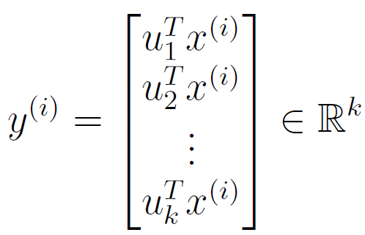
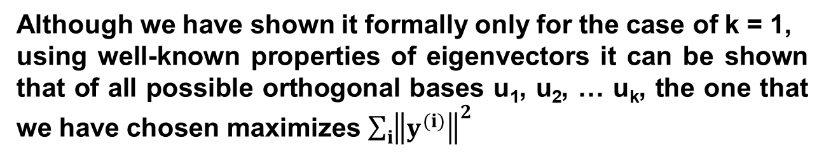
Data representation in new Basis
Although we have shown it formally only for the case of k = 1,
using well-known properties of eigenvectors it can be shown that of all possible orthogonal bases u₁, u₂, … u_{k}, the one that we have chosen maximizes $\sum_{i}{{\left\|y^{(i)}\right\|}_{}^{2}}$

Slide 10
PCA vs. Linear Regression
Linear regression tries to find a regression line to predict one particular feature (label) of the data
Minimize squared error
PCA tries to find a hyper plane to project the data onto
Reduce dimensions
Maximize variance

