Slide 1
Containers in HPC
Petascale Computing Institute 2019
Joe Allen
Biomedical Informatics Research Associate Texas Advanced Computing Center The University of Texas at Austin wallen@tacc.utexas.edu

Slide 2
Objectives for this session
What is a container?
Why are containers useful?
How to find and use existing containers
How to develop and use your own containers
How to use containers on HPC [Stampede2, Blue Waters, Cori]
Follow along: https://wjallen.github.io/petascale/

Slide 3

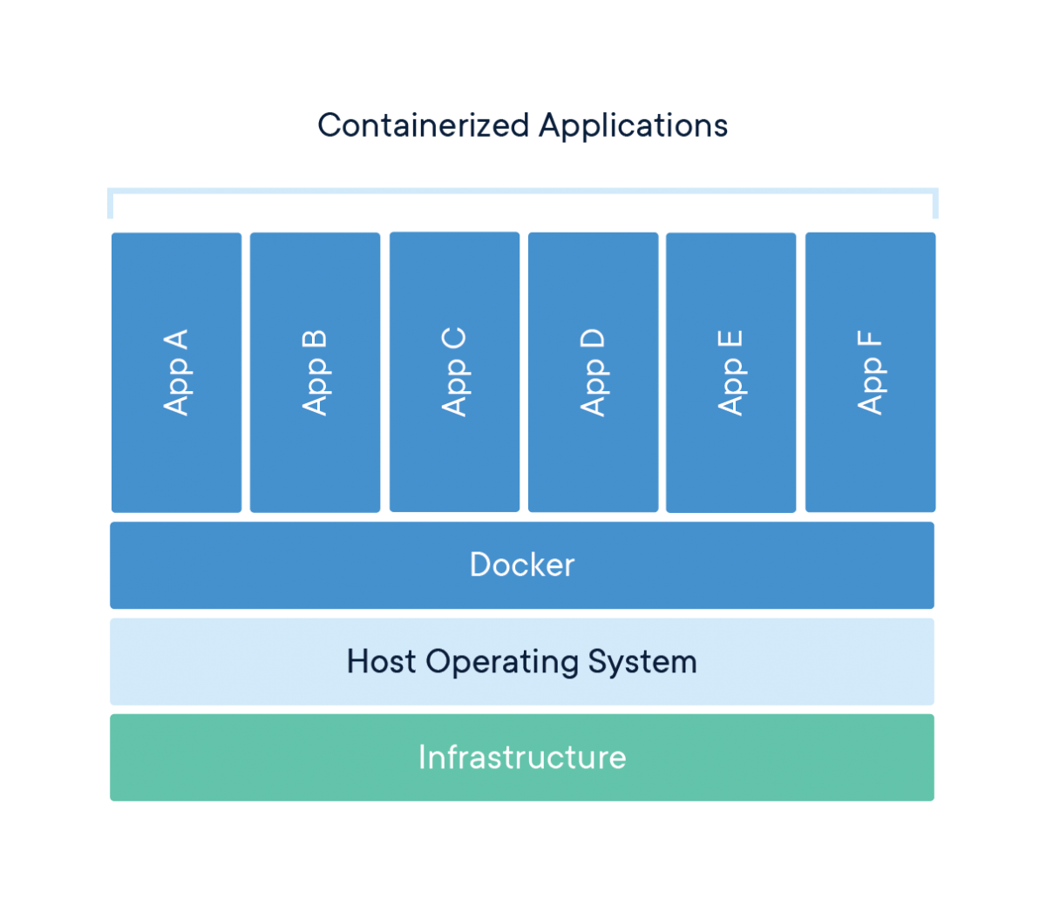
What is a container?
A standard unit of software that packages up code and all its dependencies so the application runs quickly and reliably from one computing environment to another
Isolate application from environment to ensure reproducibility and portability
Share the host OS system kernel, so relatively lightweight and low overhead
https://www.docker.com/

Slide 4
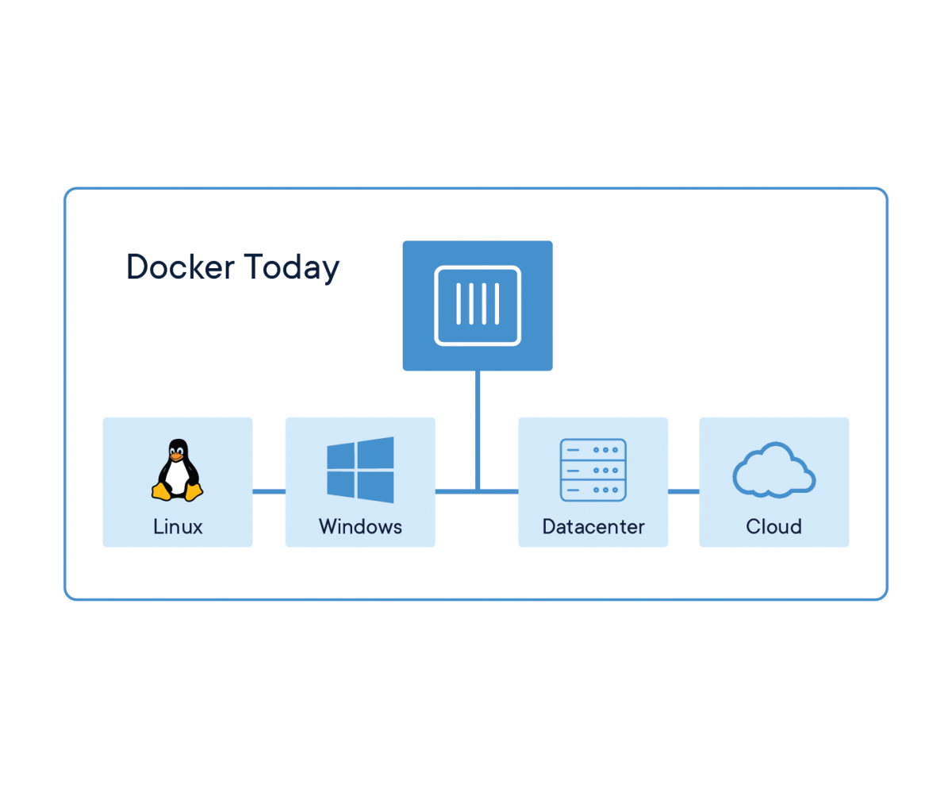


Container technologies
Docker (2013) is the gold standard
Docker containers can be deployed anywhere
BUT, Docker grants superuser privileges and some containers may allow users root access to host files ☹
Docker-compatible technologies Singularity (Stampede2) and Shifter (Blue Waters, Cori) were designed for HPC environments ☺

Slide 5
Why are containers useful?
Develop and deploy future-proof applications by creating packages that are self-contained
Distribute production ready code that can run anywhere without installation, configuration, worrying about dependencies, etc.
Mitigate portability issues related to applications
Enables reproducible science

Slide 6
SWEEPING DECLARATION
Everyone who is ...
analyzing data with scientific software …
or performing some sort of numerical simulation …
on a local resource, HPC cluster, or cloud …
should learn to develop and/or use containers

Slide 7
Objectives for this session
What is a container?
Why are containers useful?
How to find and use existing containers
How to develop and use your own containers
How to use containers on HPC [Stampede2, Blue Waters, Cori]

Slide 8
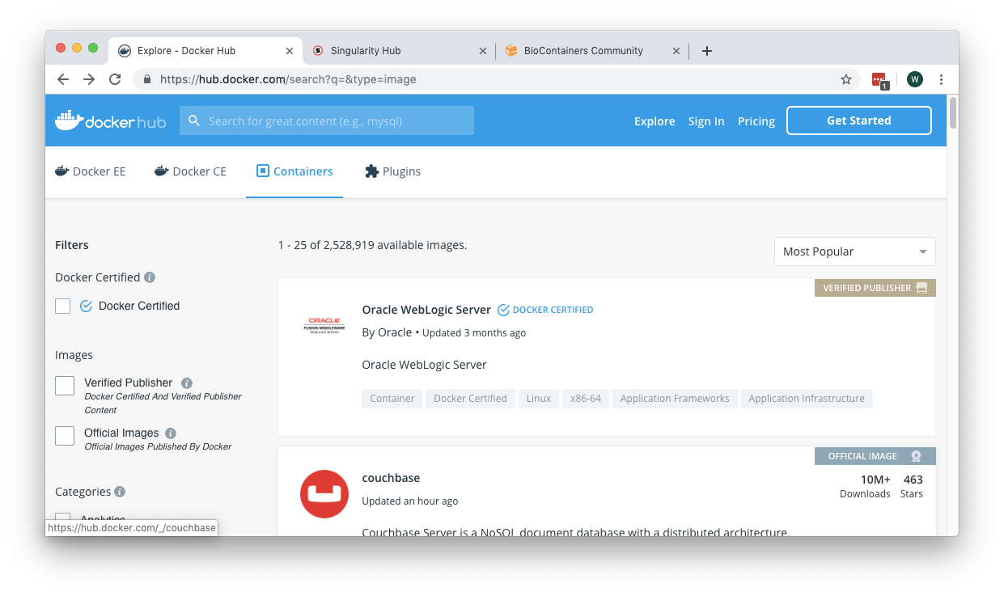
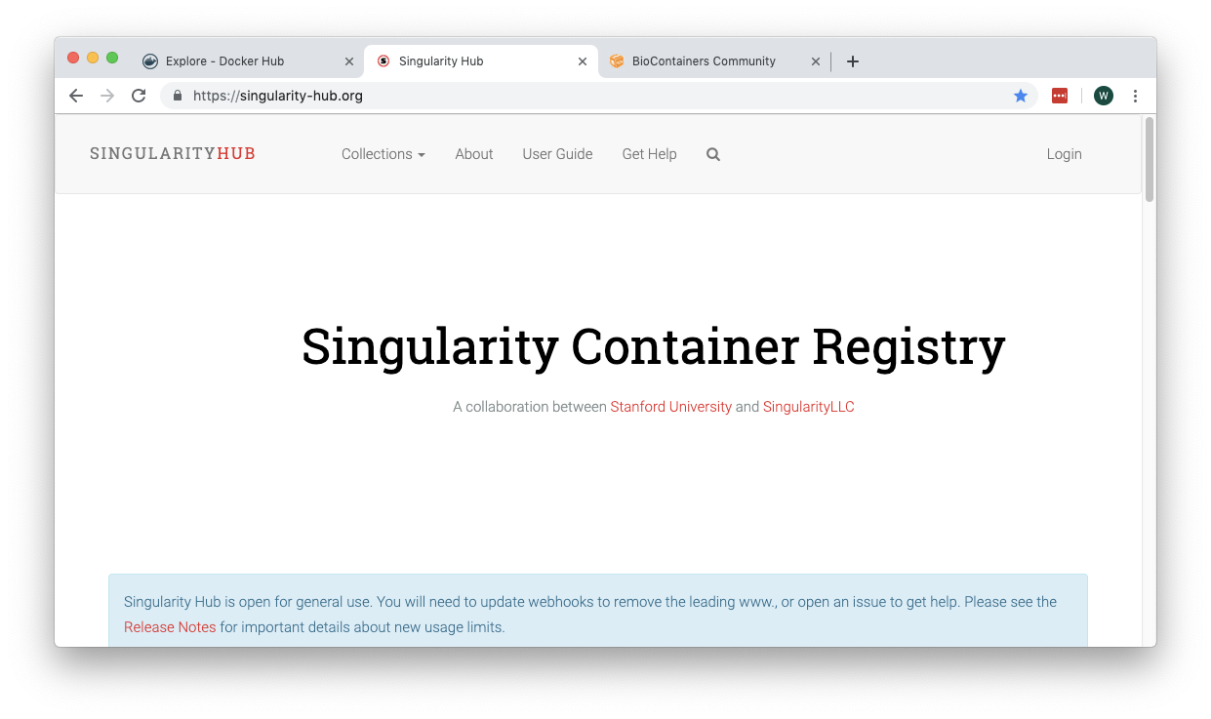
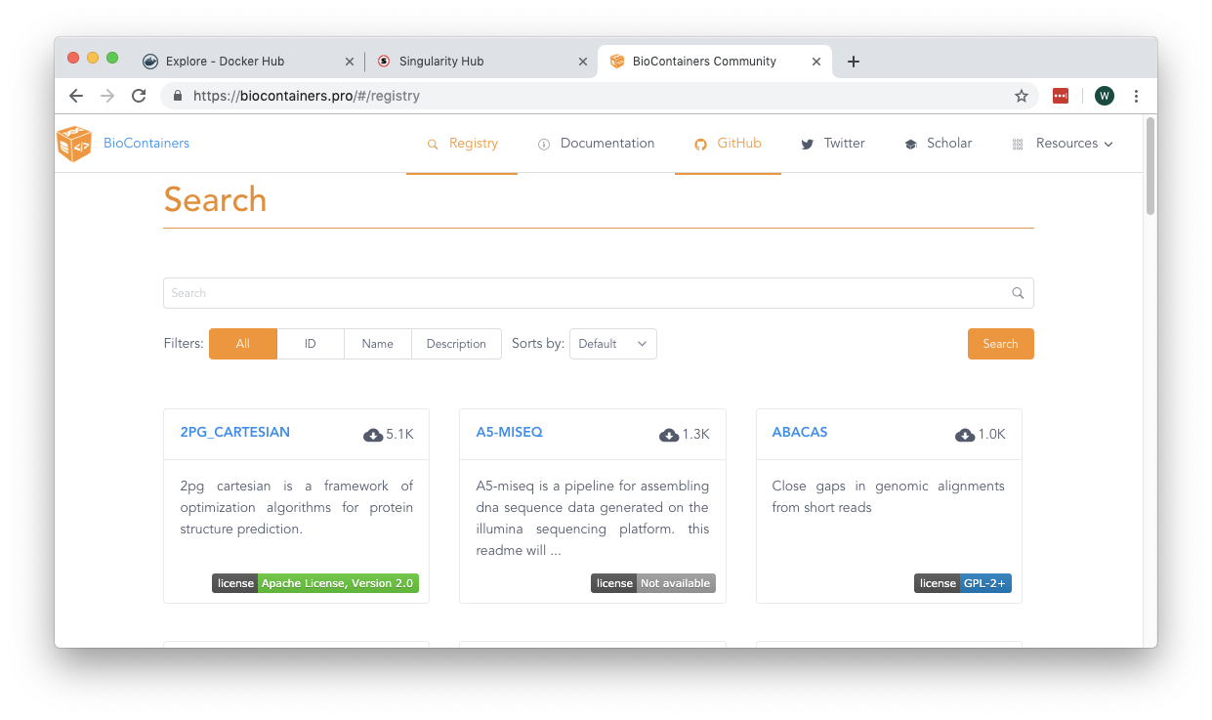
How to find existing containers
Docker Hub
https://hub.docker.com/
2.5M+ container images
You should make an account!
Singularity Hub
https://singularity-hub.org/
Still maturing
Requires GitHub account link
BioContainers
https://biocontainers.pro/
Domain focused
~8K unique containers

Slide 9
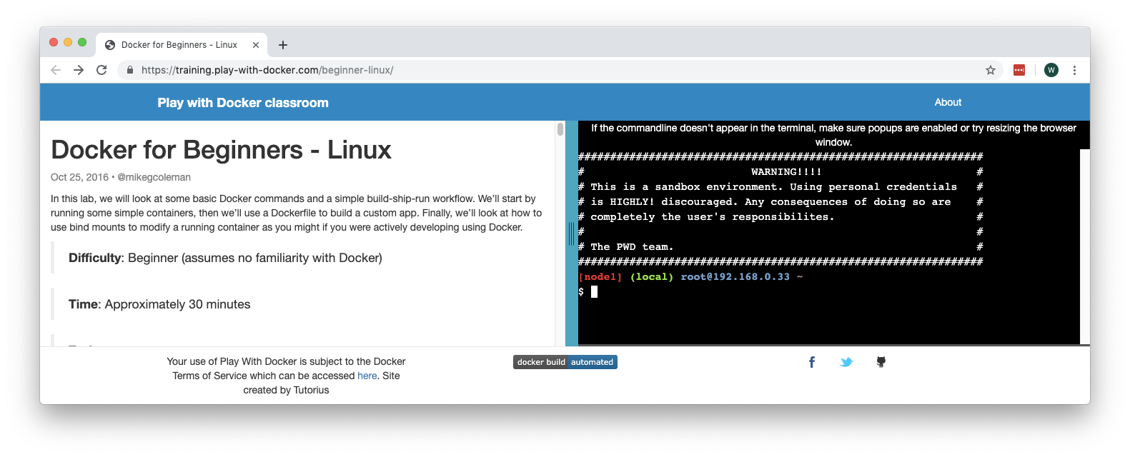
Getting started with Docker
Install local client
https://docs.docker.com/docker-for-windows/install/
https://docs.docker.com/docker-for-mac/install/
Linux users can apt-get or yum install as appropriate (Google is your friend)
Don’t want to download?
https://training.play-with-docker.com/beginner-linux/
(Docker Hub login required)

Slide 10
Getting started with Docker
Open up your favorite Terminal (Mac, Linux), or the Docker Terminal (Windows) which comes with the distribution
Try out some basic commands:
$ docker version # show version information
$ docker images # show images you have pulled
$ docker ps # show running containers
$ docker run hello-world
# ...actually don’t do this

Slide 11
$ docker run hello-world
Unable to find image 'hello-world:latest' locally
latest: Pulling from library/hello-world
1b930d010525: Pull complete
Digest: sha256:6540fc08ee6e6b7b63468dc3317e3303aae178cb8a45ed3123180328bcc1d20f
Status: Downloaded newer image for hello-world:latest
Hello from Docker!
This message shows that your installation appears to be working correctly.
To generate this message, Docker took the following steps:
1. The Docker client contacted the Docker daemon.
2. The Docker daemon pulled the "hello-world" image from the Docker Hub.
(amd64)
3. The Docker daemon created a new container from that image which runs the
executable that produces the output you are currently reading.
4. The Docker daemon streamed that output to the Docker client, which sent it
to your terminal.
To try something more ambitious, you can run an Ubuntu container with:
$ docker run -it ubuntu bash
Share images, automate workflows, and more with a free Docker ID:
https://hub.docker.com/
For more examples and ideas, visit:
https://docs.docker.com/get-started/

Slide 12
# this is a little better...
$ docker pull hello-world:latest
latest: Pulling from library/hello-world
1b930d010525: Pull complete
Digest: sha256:6540fc08ee6e6b7b63468dc3317e3303aae178cb8a45ed3123180328bcc1d20f
Status: Downloaded newer image for hello-world:latest
$ docker images
REPOSITORY TAG IMAGE ID CREATED SIZE
hello-world latest fce289e99eb9 7 months ago 1.84kB
$ docker run hello-world:latest
Hello from Docker!
This message shows that your installation appears to be working correctly.
...
$ docker inspect hello-world # more information about container image

Slide 13
# real world example
$ docker pull biocontainers/fastqc:v0.11.5_cv4
v0.11.5_cv4: Pulling from biocontainers/fastqc
34667c7e4631: Pull complete
...
c3b3dcd1b3a5: Pull complete
Digest: sha256:387748462c7fc280b7959ceda0f6251190d2e4b9ebc0585d24e7bcb58bdcf2bf
Status: Downloaded newer image for biocontainers/fastqc:v0.11.5_cv4
$ docker run --rm biocontainers/fastqc:v0.11.5_cv4 fastqc --help
FastQC - A high throughput sequence QC analysis tool
SYNOPSIS
fastqc seqfile1 seqfile2 .. seqfileN
fastqc [-o output dir] [--(no)extract] [-f fastq|bam|sam]
[-c contaminant file] seqfile1 .. seqfileN
...

Slide 14
Unpacking the ‘docker run’ command
docker run --rm biocontainers/fastqc:v0.11.5_cv4 fastqc --help
Run something
The name of the container and version tag
The command to run
Remove the container when the process completes

Slide 15
# interactive example
$ docker run --rm -it biocontainers/fastqc:v0.11.5_cv4 /bin/bash
biodocker@f195d8ee9d32:/data$ pwd
/data
biodocker@f195d8ee9d32:/data$ whoami
biodocker
biodocker@f195d8ee9d32:/data$ which fastqc
/usr/local/bin/fastqc
biodocker@f195d8ee9d32:/data$ fastqc --help
FastQC - A high throughput sequence QC analysis tool
SYNOPSIS
fastqc seqfile1 seqfile2 .. seqfileN
fastqc [-o output dir] [--(no)extract] [-f fastq|bam|sam]

Slide 16
Unpacking the interactive ‘docker run’ command
docker run --rm -it biocontainers/fastqc:v0.11.5_cv4 /bin/bash
Run something
The name of the container and version tag
The type of shell to start
Remove the container when the process completes, and connect your terminal to the container runtime

Slide 17
Quick recap
Find a container on Docker Hub and pull it to your local environment
docker pull <container:tag>
Run a command (e.g. a scientific application) inside a container
Useful for performing analysis or simulation
docker run --rm <container:tag> <command>
Start up an interactive shell inside a container
Useful for debugging, testing executables in an existing container
Useful for developing a new container from scratch
docker run --rm -it <container:tag> <shell>

Slide 18
How to develop your own containers
There are a couple ways to develop your own containers, but there is one way that is reproducible and well documented => the Dockerfile
General steps might include:
Choose a base operating system
Install dependencies, other useful packages
Install scientific application
Set any environment variables that might be helpful

Slide 19
$ pwd
/Users/username/fastqc-dev-folder
$ ls
Dockerfile
$ cat Dockerfile
FROM ubuntu:16.04
RUN apt-get update && apt-get upgrade -y \
&& apt-get install -y default-jre perl wget zip
RUN wget https://www.bioinformatics.babraham.ac.uk/projects/fastqc/fastqc_v0.11.7.zip \
&& unzip fastqc_v0.11.7.zip \
&& rm fastqc_v0.11.7.zip \
&& chmod +x /FastQC/fastqc
ENV PATH "/FastQC:$PATH"
Choose a base operating system
Update and install necessary packages
Install the application
Use environment variable to add executable to PATH

Slide 20
$ docker build -t username/fastqc:0.11.7 ./
Sending build context to Docker daemon 2.048kB
Step 1/4 : FROM ubuntu:16.04
---> 5e13f8dd4c1a
...
Successfully built 2005acfb2869
Successfully tagged username/fastqc:0.11.7
$ docker images
REPOSITORY TAG IMAGE ID CREATED SIZE
username/fastqc 0.11.7 2005acfb2869 16 minutes ago 460MB
hello-world latest fce289e99eb9 7 months ago 1.84kB
$ docker run --rm username/fastqc:0.11.7 which fastqc
/FastQC/fastqc
$ docker push username/fastqc:0.11.7
The push refers to repository [docker.io/username/fastqc]
e79142719515: Mounted from library/ubuntu
aeda103e78c9: Mounted from library/ubuntu
2558e637fbff: Mounted from library/ubuntu
f749b9b0fb21: Mounted from library/ubuntu
0.11.7: digest: sha256:9e42ab85eedec90228d7fa8ba94b4d6dfe33b2173584e88b190d size: 1575

Slide 21
Quick recap #2
Build a container image from a Dockerfile
docker build –t <container:tag> ./
Store your credentials for Docker Hub locally
docker login
Push the container image to Docker Hub
docker push <container:tag>

Slide 22
Getting more help with Docker
The command line tools are very well documented:
Find support online:
https://docs.docker.com/get-started/
$ docker --help # show all docker options and summaries
$ docker COMMAND --help # show options and summaries for a particular
# command

Slide 23
Miscellaneous Docker tips
Save your Dockerfiles – GitHub is a good place for this
You may not need ENTRYPOINT or CMD
Usually better to use COPY instead of ADD
Order of operations in the Dockerfile is important; combine steps where possible
Avoid latest tag; use explicit tag callouts
The command docker system prune is your friend
Use docker-compose for multi-container pipelines and microservices
Considerations for one tool per container vs. multiple tools per container

Slide 24
Objectives for this session
What is a container?
Why are containers useful?
How to find and use existing containers
How to develop and use your own containers
How to use containers on HPC [Stampede2, Blue Waters, Cori]

Slide 25
How to use containers on HPC
As mentioned, security concerns preclude users from running Docker containers at most HPC centers
At TACC, users can run Singularity
At NERSC and NCSA, users can run Shifter

Slide 26


Container technologies: Singularity
Singularity (2016)
Developed at LBL
Designed for HPC
Can pull Docker containers
Outside user = inside user
Can auto-mount shared filesystems
MPI aware => scalable
GPU aware => CUDA runtimes must match
https://singularity.lbl.gov/ | https://sylabs.io/

Slide 27
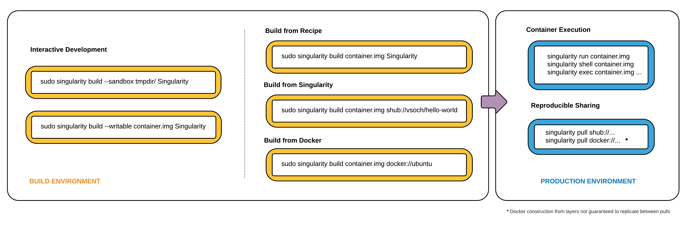
Container technologies: Singularity
Full disclosure: I don’t prefer Singularity native build methods
I prefer docker build / push followed by singularity pull
https://singularity.lbl.gov/ | https://sylabs.io/

Slide 28


Container technologies: Shifter
Shifter (2015)
Developed at NERSC
Designed for HPC
Can pull Docker containers (and other formats)
Root (user) is squashed
Can mount shared filesystems
MPI aware => scalable
Images usually need to be pre-cached on cluster
https://github.com/NERSC/shifter
https://docs.nersc.gov/programming/shifter/how-to-use/
https://bluewaters.ncsa.illinois.edu/shifter

Slide 29
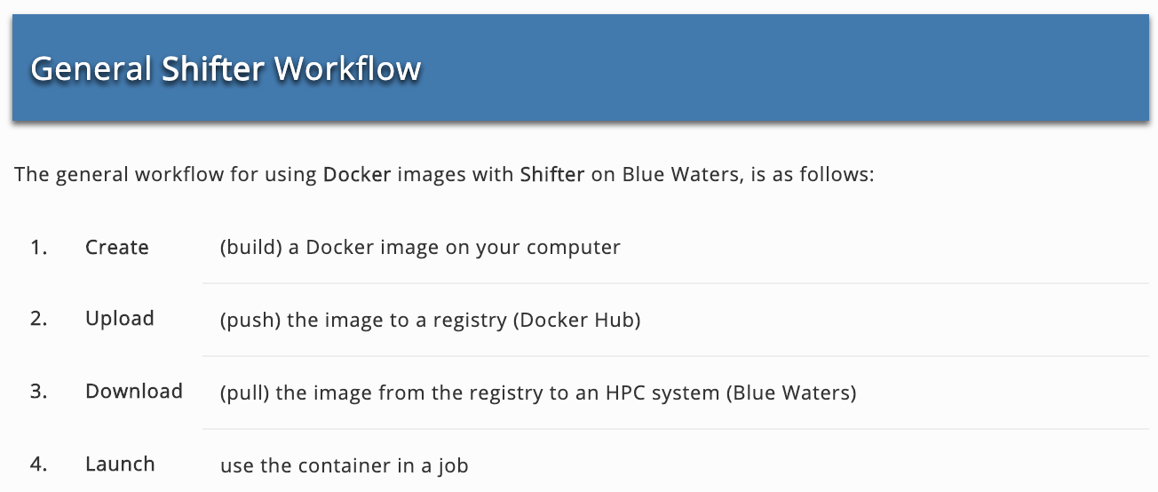
Container technologies: Shifter
Essentially identical to the recommended Singularity workflow
https://github.com/NERSC/shifter
https://docs.nersc.gov/programming/shifter/how-to-use/
https://bluewaters.ncsa.illinois.edu/shifter

Slide 30
Hands on: Run an HPC job
Scenario: You are a researcher with raw data (SP1.fq) that you need to analyze. The computation is expensive and you don’t want to tie up your local Linux workstation. However, the HPC cluster runs on CentOS and your application (FastQC) only runs on Ubuntu.
Log in to your favorite cluster
Stage your input data
Pull the container
Prepare a job template
Submit the job
Check the results

Slide 31
Hands on: Run an HPC job
1. Log in to your favorite system
Stampede2
$ ssh USER@stampede2.tacc.utexas.edu
Blue Waters
$ ssh USER@bwbay.ncsa.illinois.edu
Cori
$ ssh USER@cori.nersc.gov

Slide 32
Hands on: Run an HPC job
2. Stage your input data
Stampede2 / Blue Waters / Cori
[login]$ wget https://wjallen.github.io/petascale/SP1.fq
[login]$ head SP1.fq
@@cluster_2:UMI_ATTCCG
TTTCCGGGGCACATAATCTTCAGCCGGGCGC
+
9C;=;=<9@4868>9:67AA<9>65<=>591
@cluster_8:UMI_CTTTGA
TATCCTTGCAATACTCTCCGAACGGGAGAGC
+
1/04.72,(003,-2-22+00-12./.-.4-
@cluster_12:UMI_GGTCAA
GCAGTTTAAGATCATTTTATTGAAGAGCAAG
Sample data: Jay Hesselberth, Genome Analysis Workshop,
https://molb7621.github.io/workshop/index.html

Slide 33
3. Pull the container
Stampede2
[login]$ idev
...
[compute]$ module load tacc-singularity python3
[compute]$ singularity pull --name wallen-fastqc-0.11.7.simg docker://wallen/fastqc:0.11.7
Singularity container built: /work/03439/wallen/singularity_cache/wallen-fastqc-0.11.7.simg
[compute]$ ls $WORK/singularity_cache/
wallen-fastqc-0.11.7.simg*
Blue Waters
[login]$ qsub -I -l nodes=1:ppn=1 -l walltime=00:30:00
...
[compute]$ module load shifter
[compute]$ shifterimg pull docker:wallen/fastqc:0.11.7
2019-08-19T15:44:49 Pulling Image: docker:wallen/fastqc:0.11.7, status: READY
[compute]$ shifterimg images | grep fastqc
bluewaters docker READY 6d2726df2e 2019-08-19T15:44:14 wallen/fastqc:0.11.7
Cori
[login]$ salloc -N 1 -C haswell -q interactive -t 00:30:00
...
[compute]$ shifterimg pull docker:wallen/fastqc:0.11.7
2019-08-19T14:02:58 Pulling Image: docker:wallen/fastqc:0.11.7, status: READY
[compute]$ shifterimg images | grep fastqc
cori docker READY 6d2726df2e 2019-08-19T14:02:57 wallen/fastqc:0.11.7

Slide 34
Hands on: Run an HPC job
4-5. Prepare a job template and submit the job
Stampede2
Blue Waters
Cori
[login]$ cat singularity_job.slurm
#!/bin/bash
#SBATCH -J myjob
#SBATCH -o myjob.o%j
#SBATCH -N 1
#SBATCH -n 1
#SBATCH -t 00:10:00
#SBATCH -p skx-dev
#SBATCH -A myalloc # Allocation name
module load tacc-singularity
SIMG=$WORK/singularity_cache/wallen-fastqc-0.11.7.simg
singularity exec $SIMG fastqc SP1.fq
[login]$ sbatch singularity_job.slurm
...
Submitted batch job 4197252
[login]$ cat shifter_job.pbs
#!/bin/bash
#PBS -N testjob
#PBS -e $PBS_JOBID.err
#PBS -o $PBS_JOBID.out
#PBS -l nodes=1:ppn=1:xe
#PBS -l walltime=00:10:00
#PBS -A myalloc
#PBS -l gres=shifter16
module load shifter
IMG=docker:wallen/fastqc:0.11.7
aprun -b shifter --image=$IMG fastqc SP1.fq
[login]$ qsub shifter_job.pbs
INFO: Job submitted to account: myalloc
10240521.bw
[login]$ cat shifter_job.slurm
#!/bin/bash
#SBATCH --nodes=1
#SBATCH --time=00:10:00
#SBATCH --qos=debug
#SBATCH --constraint=haswell
#SBATCH --image=docker:wallen/fastqc:0.11.7
srun -n 1 shifter fastqc SP1.fq
[login]$ sbatch shifter_job.slurm
Submitted batch job 24000106
Expected Output (all)
[login]$ ls
SP1.fq SP1_fastqc.html SP1_fastqc.zip

Slide 35
Closing thoughts
Are reproducibility and provenance important in computational science?
(Trick question, of course they are)
How do you achieve reproducibility and provenance in computational science?
Integration between GitHub and Docker Hub
Pushing your code to GitHub automatically updates container images
Use tags and refer to tags in publications
Containers as modules (Stampede2)
module help biocontainers
module load biocontainers

Slide 36
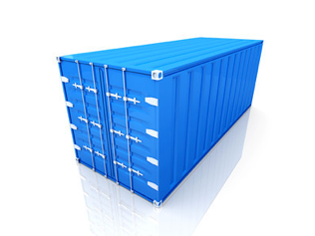
Questions?
Joe Allen
wallen@tacc.utexas.edu

