Slide 1
Estimating Fracture Size in Gas Shale Formations using Smart Proppants and GPGPU
Muhammed Kabir Hassan,
Bill Brouwer, Pierre-Yves Taunay, Raj Mittra
The Pennsylvania State University
Nvidia GTC 2013
wjb19@psu.edu

Slide 2
Outline
Introduction
    Hydraulic Fracturing
    Iteration-Free Method of Moments
Methods
    SVD decomposition
      QR algorithm on GPU
    Results
    LU decomposition
      Crout's approach on GPU
    Results
Conclusions
wjb19@psu.edu

Slide 3
Introduction
Marcellus shale natural gas is a significant force behind the economic resurgence of Pennsylvania
Driven heavily by developments in hydraulic fracturing technology, concerns remain with regards to environmental impact
Proppants are generally used for mechanical reasons eg., keeping fractures open
“Smart proppants” are minute particles used as sensor elements in a larger system; comprising both :
  the particles distributed and suspended in the hydraulic fracturing fluid
  downhole sensor equipment, whose principles of operation are founded in electromagnetics (EM)
wjb19@psu.edu

Slide 4
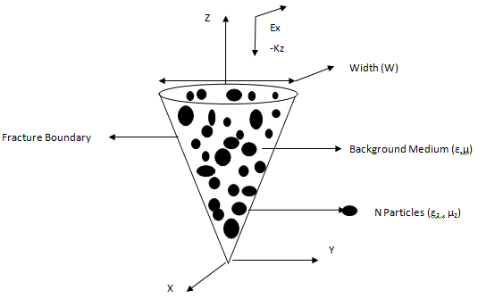
Introduction
Smart proppants are essentially electrical dipoles which may absorb and re-emit EM energy, irradiated and recorded by downhole instrumentation
This work considers an iteration-free solution to this EM scattering problem:
  Uses linear algebra including LU and SVD decomposition, algorithms readily accelerated by GPU
The advantage also of using GPUs is scaling; massive domains comprising fracture regions will be made available for examination
wjb19@psu.edu

Slide 5
Iteration Free MOM
Conventional Method of Moments (MoM) treatment of field integral equation leads to a dense, complex linear system involving :
  Impedance matrix Z for domain
  Excitations V
  Solution currents J
In this application, matrix side N is > 1e6 and there are the usual issues with iterative solvers :
  Matrices typically ill-conditioned
  Solution must be repeated for each new excitation
Solution: break into sub-domains, use LU decomposition for blocks and solve directly
  Allows for efficient solution of multiple RHS (excitations)
wjb19@psu.edu

Slide 6
Iteration Free MOM
New characteristic basis functions are created for each block through excitation from multiple angles of incidence
    Over sampling and reduction of dimensionality using SVD is employed
SVD is used to select the singular values for the currents J by thresholding
Thus key algorithms are LU and SVD across many matrices derived or decoupled from larger domain
wjb19@psu.edu

Slide 7
SVD Algorithm
Any mxn matrix A may be factored as :
A = UΣV^{T}
Where :
  U is an mxm orthogonal matrix with columns given by eigenvectors of AA^{T},
  V is an nxn orthogonal matrix with columns given by the eigenvectors of A^{T}A
  Σ is mxn matrix with r=rank(A) eigenvalue square roots of A^{T}A along the diagonal
wjb19@psu.edu

Slide 8
SVD Algorithm
Like LU, SVD has been been ported to GPU in various guises, again we are concerned with trying to calculate SVD for large batches of moderately sized matrices
If we focus on solving the two eigen-decompositions via the QR algorithm, then most ops within SVD become BLAS routines which map well to GPU
Additionally, since at least CUDA 4.0 we can take advantage of batch routines which make task of porting much easier; streams/overlapping kernels also possible
QR has been addressed previously, we focus on:
  Batch execution
  Using Givens rotations vs Householder reflections to produce upper triangular matrix R and orthogonal matrix Q (Q^{T}Q=I)
wjb19@psu.edu

Slide 9
QR algorithm
Core of the QR algorithm :
  Compute shift μ (according to one of various possible schemes)
  Perform QR decomposition A-μI = QR
  Update A = RQ+μI
This work focuses on using Givens rotations for QR which eliminate one matrix element per application eg.,
c s ai,k = r
-s c ai+1,k 0
QR decomposition works up matrix columns; each step modifies two rows, the complete sequence of rotation products is Q transpose ie.,
Q^{T} (A-μI) = R
On GPU, while updating A, can quickly build up Q^{T}
wjb19@psu.edu

Slide 10
QR using Givens
For example, consider product of Givens rotations, eg., for first column update of 6x6:
[c4 s4 0 0 0 0] [1 0 0 0 0 0 ]
[ ] [ ]
[-s4 c4 0 0 0 0] [0 1 0 0 0 0 ]
[ ] [ ]
[ 0 0 1 0 0 0] [0 0 1 0 0 0 ]
[ ] x …........ x [ ]
[ 0 0 0 1 0 0] [0 0 0 1 0 0 ]
[ ] [ ]
[ 0 0 0 0 1 0] [0 0 0 0 c0 s0]
[ ] [ ]
[ 0 0 0 0 0 1] [0 0 0 0 -s0 c0]
==
[c4 s4 c3 s4 s3 c2 s4 s3 s2 c1 s4 s3 s2 s1 c0 s4 s3 s2 s1 s0]
[ ]
[-s4 c4 c3 c4 s3 c2 c4 s3 s2 c1 c4 s3 s2 s1 c0 c4 s3 s2 s1 s0]
[ ]
[ 0 -s3 c2 c3 s2 c1 c3 s2 s1 c3 c0 s2 s1 c3 s0 ]
[ ]
[ 0 0 -s2 c2 c1 c2 s1 c0 c2 s1 s0 ]
[ ]
[ 0 0 0 -s1 c1 c0 c1 s0 ]
[ ]
[ 0 0 0 0 -s0 c0 ]
wjb19@psu.edu

Slide 11
QR using Givens
Combinations of rotations form simple expressions; consider the first row &last column; let c=='0' and s=='1'
For the most part we can encode combinations of c,s using binary :
  Use bitmasks/shifts etc, important variations in LSB &MSB only
  Take into account matrix index (i,j)
→ Each thread can work independently to build up contribution to Q^{T}
0 0 1 0 1 1 0 1 1 1 0 1 1 1 1 1 1 1 1 1
=0 =2 =6 =14 =30 =31
[c4 s4 c3 s4 s3 c2 s4 s3 s2 c1 s4 s3 s2 s1 c0 s4 s3 s2 s1 s0]
[ ]
[-s4 c4 c3 c4 s3 c2 c4 s3 s2 c1 c4 s3 s2 s1 c0 c4 s3 s2 s1 s0]
[ ]
[ 0 -s3 c2 c3 s2 c1 c3 s2 s1 c3 c0 s2 s1 c3 s0 ]
[ ]
[ 0 0 -s2 c2 c1 c2 s1 c0 c2 s1 s0 ]
[ ]
[ 0 0 0 -s1 c1 c0 c1 s0 ]
[ ]
[ 0 0 0 0 -s0 c0 ]
1 1 1 1 1 =31
1 1 1 1 0 =15
1 1 1 0 =7
1 1 0 =3
1 0 =1
0 =0
wjb19@psu.edu

Slide 12
GPU strategy for QR
Iterate for n-1 steps :
  Zero one column of R below diagonal by multiple rotations:
    Each thread calculates c,s; two rows updated per rotation:
A'i,j = c*Ai,j + s*Ai+1,j
A'i+1,j = -s*Ai,j + c*Ai+1,j
    Elements of rotation c,s cached in shared
  Once column update is complete, each thread calculates contribution to complete Q^{T},
      iterate down along columns
        one row element update each
        first row cached for reuse
        subsequent rows use update formula from shared
  Update complete Q^{T} using cublas<t>gemmBatched
wjb19@psu.edu

Slide 13
QR Results
QR using Givens rotations compares favorably to sgeqrf in MKL, roughly 4.5x-1.5x performance improvement
More work needed
  Buffer underflows
  Batch cublas kernels limited in size → use streams &regular GEMM
  GPU threads with higher indices do disproportionate amount of work
3
2
Time (s)
M2070
4 threads, Intel X5550
1
32
64
128
Matrix Side (20k matrices total)
wjb19@psu.edu

Slide 14
LU Decomposition
Used generally for multiple RHS problems, as is the case in this work
Several key approaches, here we focus on Crout's algorithm:
  (row) pivots for numerical stability
  permutations of rows stored in P (hence LUP algorithm)
Batch LU does exist in cuBLAS although limited in matrix size, at the time of writing/talk
wjb19@psu.edu

Slide 15
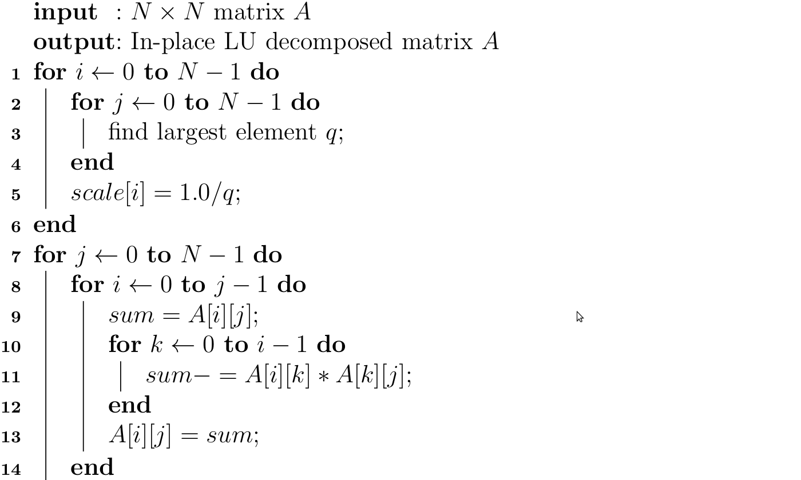
Crout's (LUP) Algorithm
wjb19@psu.edu

Slide 16
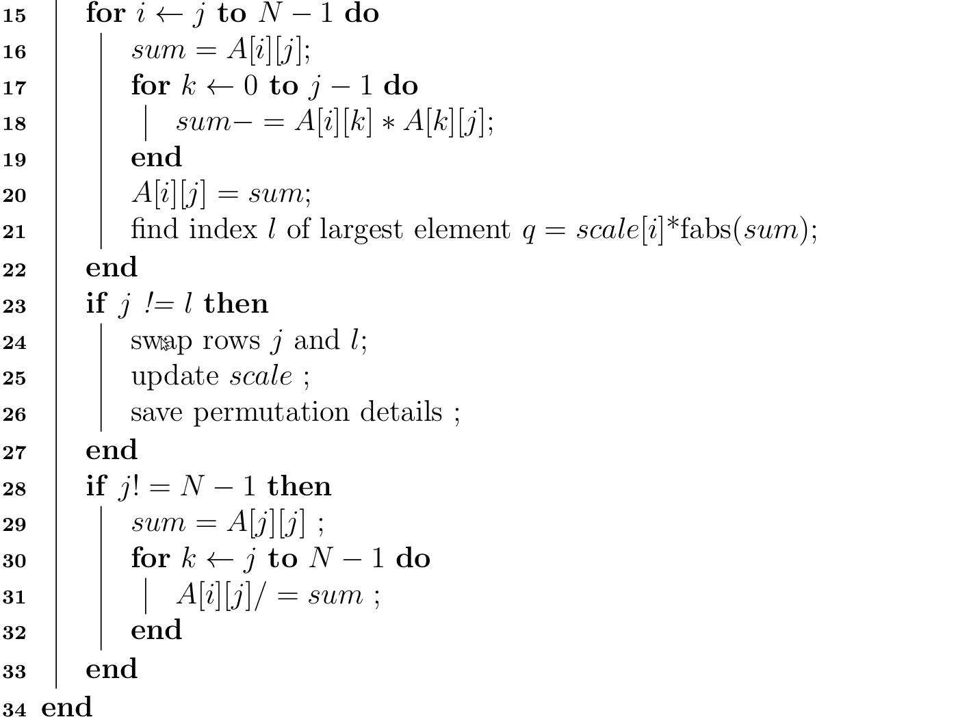
Crout's (LUP) Algorithm
wjb19@psu.edu

Slide 17
GPU strategy for LUP
Dependencies between j (column) loops break parallelization opportunities in this dimension
  Assign N threads to matrix of side N; multiple matrices per thread block
First scope lines 1-6 (scaling), and pivot search line 21, performed by parallel reduction
Last scopes (line 23 forward) maps easily to threads in this model
Second and third scopes (lines 8~22) not quite as simple; these steps update a column, cached (for each independent matrix) in shared
Some unavoidable bank conflicts, potential race conditions in these steps
wjb19@psu.edu

Slide 18
GPU strategy for LUP
Threads expect to read values from shared memory buffer updated by different threads in prior instructions → Use SIMD/warp synchronization
matrix j
vectors
j = 0 1 2 N-1 loop
matrix i
0
1
2
.
.
.
N-1
0
1
2
.
.
.
N-1
threadIdx.x
threadIdx.x
wjb19@psu.edu

Slide 19
GPU strategy for LUP
eg., lines 15-19:
if ((vectorIndex >=j) && (vectorIndex < MATRIX_SIDE)){
//shared mem
sum.x = vectors[local_index].x;
sum.y = vectors[local_index].y;
for (int k=0; k< j; k++){
//load from global
tmpl = inputMatrices [ col_k_index ];
tmpr.x = vectors [ vec_k_index ].x;
tmpr.y = vectors [ vec_k_index ].y;
sum.x -= (tmpl.x * tmpr.x - tmpl.y * tmpr.y);
sum.y -= (tmpl.y * tmpr.x + tmpl.x * tmpr.y);
//update shared
vectors[local_index].x= sum.x;
vectors[local_index].y= sum.y;
}
}
wjb19@psu.edu

Slide 20
Results
Compilation is straightforward :
nvcc -arch sm_20 -O3 -Xcompiler -fopenmp src/*.cu -o bin/main.x -I inc/
However LU in particular plagued with races initially, used new racecheck tool (Cuda 5.0); output is voluminous and overwhelming :)
Much easier to use if visualizing/binning data instead eg., here the output is grepped for text containing source code (vec)Product.cuh, looking for Write errors, and picking threadIdx.x (field $5) & source code line number (field $15)
[wjb19@tesla1 bin]$ cuda-memcheck --tool racecheck ./app.x 1 -10 testLu64.bin 1 &> foo.txt
[wjb19@tesla1 bin]$ more foo.txt | grep vec | grep Write | sed 's/(/\ (\ /g' | sed 's/:/\ :\ /g' | sed 's/,/\ ,/g' | awk '{print $5,",",$15}' | more > data.txt
wjb19@psu.edu

Slide 21
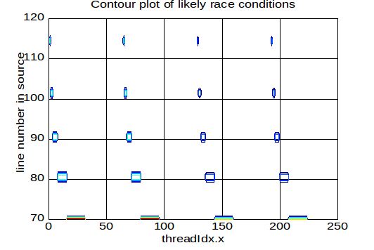
Cuda-memcheck/racecheck
Plot and investigate with your favorite scripting language eg., Octave
load data.txt
[x y z]=hist2d(data,1:1:240,70:1:130)
contour(y,z,x)
grid
set(gca,'fontsize',20);
xlabel('threadIdx.x');
ylabel('line number in source');
title('Contour plot of likely \
race conditions')
wjb19@psu.edu

Slide 22
Raw LUP Results
Batch LU maps well to GPU :
  global memory throughput is reasonable (~14/72 GB/s DRAM write/read on M2070) considering unfavorable patterns
  Average improvement 25x for matrix/batch sizes below
  Best improvement 35x using K20 for 16x16 matrices/10k batch size
70
50
Time (s)
M2070
1 thread, Intel X5550
30
10
32
64
128
256 Matrix Side
100k
100k
20k
100k Batch Size
wjb19@psu.edu

Slide 23
Optimization strategy for LUP
Majority memory accesses in Crout's algorithm can not be coalesced
Memory accesses for the GPU:
  Caching load: attempts to hit L1 cache, then L2 cache, then DRAM
  Non caching load: attempts to hit L2 cache , then DRAM
  Store: invalidates L1 cache, writes-back for L2 cache
On a Tesla M2070:
  L1 cache per multiprocessor: 16KB or 48KB
  L2 cache: 768 KB
wjb19@psu.edu

Slide 24
Optimization strategy for LUP
NVVP Profiler results for the batch LU kernel (100k 16x16 matrices) with caching loads
The access pattern is not scattered enough to completely disable the L1 cache with -Xptxas -dlcm=cg
Solution 1: texture memory can be used for non-coalesced loads
Solution 2: if the GPU memory is not a limiting factor, the transpose of the matrix can be updated in lieu of the matrix itself
Total execution time (ms) | 89.6
L1 global hit rate (%) | 33.2
L2 hit rate (from L1 reads) (%) | 88.9
Number of L1 requests | 170M
Number of L2 requests (load) | 453M
Number of L2 requests (store) | 50M
Instruction Per Cycle | 0.68
wjb19@psu.edu

Slide 25
Optimization strategy for LUP
NVVP Profiler results for the batch LU kernel (100k 16x16 matrices)
Solution 2 improves the access pattern which falls into a higher number of L1 cache lines of 128B
Solution 2 therefore decreases the total number of L1 and L2 load requests, thus decreasing the total execution time
 | Original | Texture | Transpose
Total execution time (ms) | 89.6 | 72.2 | 69.0
L1 global hit rate (%) | 33.2 | 38.3 | 34.6
L2 hit rate (from L1 reads) (%) | 88.9 | 31.6 | 29.1
Texture hit rate (%) | 0 | 50.7 | 0
L2 hit rate (from texture reads) (%) | 0 | 76.6 | 0
Number of L1 requests | 170M | 110M | 71M
Number of L2 requests (load) | 453M | 293M | 187M
Number of L2 requests (store) | 50M | 50M | 52M
Instruction Per Cycle | 0.68 | 0.78 | 0.86
wjb19@psu.edu

Slide 26
Optimization strategy for LUP
Overall, a large number of L1 requests are missed
  Try increasing the L1 cache to 48KB by using cudaDeviceSetCacheConfig(cudaFuncCachePreferL1)
NVVP Profiler results (bold numbers are for an L1 cache of 16KB)
 | Original | Texture | Transpose
Total execution time (ms) | 68.6 (89.6) | 67.2 (72.2) | 62.0 (69.0)
L1 global hit rate (%) | 74 (33.2) | 63 (40.9) | 61.9 (34.6)
L2 hit rate (from L1 reads) (%) | 75.3 (88.9) | 74.6 (84.3) | 29.1 (76.7)
Texture hit rate (%) | 0 | 50.7 (46.6) | 0
L2 hit rate (from texture reads) (%) | 0 | 76.6 (79.3) | 0
Number of L1 requests | 169M | 110M | 71M
Number of L2 requests (load) | 176M (453M) | 124M (293M) | 113M (187M)
Number of L2 requests (store) | 49M (50M) | 49M (50M) | 51M (52M)
Instruction Per Cycle | 0.88 (0.68) | 0.84 (0.78) | 0.94 (0.86)
wjb19@psu.edu

Slide 27
Optimization strategy for LUP
Kepler architecture
L1 cache for Kepler architecture
  Used only for local memory accesses
  Previous L1 cache optimization for Fermi architecture are therefore useless
L2 cache for Kepler architecture
  Used for global loads
On a Tesla K20m:
  L1 cache per multiprocessor: 16KB, 32KB, or 48KB
  L2 cache: 1536KB
CudaDeviceSetCacheConfig is set to cudaFuncCachePreferShared
wjb19@psu.edu

Slide 28
Conclusions
Accurately modeling hydraulic fracturing is a difficult problem attracting attention from both supporters and opposition
Traditional EM scattering using smart proppants one approach; large matrix equations unwieldy, poorly conditioned
Non-iterative MoM one promising solver technique, relies heavily on LU and SVD decomposition for large batches of moderately sized matrices
GPUs show great promise in accelerating and scaling these important algorithms
New approaches to batch LU and QR algorithm take advantage of shared memory, promote thread independence
Currently putting all the pieces together, investigating numerical differences between compiler versions (open64/Cuda 4.2 vs Cuda 5.0)
wjb19@psu.edu

Slide 29
References
NETLIB http://www.netlib.org/
MKL http://software.intel.com/en-us/intel-mkl
Numerical Methods for Large Eigenvalue Problems (Y. Saad)
Matrix Computations, Golub & Van Loan
Linear Algebra Lecture Notes of Peter Arbenz (ETH)
On computing Givens Rotations Reliably and Efficiently - Bindel et al
Numerical Recipes in C – Press et al
An Iteration-Free MoM Approach Based on Excitation Independent Characteristic Basis Functions for Solving Large Multiscale Electromagnetic Scattering Problems -Lucente et al
Acknowledgements
Hewlett Packard for a Donation of 50 M2070 devices
Jason Holmes & Penn State Research Computing http://rcc.its.psu.edu/
TACC/Stampede http://www.tacc.utexas.edu/resources/hpc/#stampede
XSEDE https://www.xsede.org/
wjb19@psu.edu

