Slide 1
Mining Data from Images and Video for Indexing and Analysis
Bill Brouwer 01/14/13
wjb19@psu.edu

Slide 2
Computational Scientist, Research Computing and Cyberinfrastructure (RCC), Penn State 06/2011-present
-Consultant, High Performance Computing (HPC)
-Teaching & Personal Research
-CUDA, C/C++ programming, code profiling/optimization
-Co-writer/recipient of awards
-Local XSEDE Campus Champion
-Publication & Presentations
-Maintain/use ~ 100 open source examples in software stack
Current Role at PSU
wjb19@psu.edu

Slide 3
Objective
-Knowledge Discovery & Data Mining (KDD)
-Machine vs Humans
Example Problem
-Quantification in root structures
Methods
-Computer Vision Algorithms
-H.264/AVC codec
Solution
-Avpipe
Overview
wjb19@psu.edu

Slide 4
Goal: simply put, to learn things from data; first need to get it in a database/usable state
Hard enough for text documents, much harder for images/video because it's binary data
Even with meta from tagging allowing indexing and retrieval, still difficult to analyze large amounts of image data
Want to make both indexing and analysis easier through software; we can create useful data from binary using machines or humans
Knowledge discovery& Data Mining (KDD)
wjb19@psu.edu

Slide 5
SKYTree
-Startup recently secured ~18M series A funding, provide solutions to 'big data' problems, deriving value from disparate data using machine learning (ML)
Roistr
-Startup dedicated to 'meaning discovery'
-Good for product recommendation problems eg., take a customers twitter feed, and on this basis recommend some books to read
Plot2txt
-Personal start-up devoted to mining technical content from images using unsupervised ML
-Works well on spectroscopic, oil+gas data
Machine: Examples
wjb19@psu.edu

Slide 6
Crowd sourced solution to hard problems for machines, referred to as Human Intelligence Tasks (HIT)
Turkers are the masses, to whom other users can submit tasks, via web interface
Task examples including image tagging, comparison, writing product descriptions
Not really scalable; humans are expensive, bad at accurate measurement eg., quantitative data from images
Humans:Amazon Mechanical Turk
wjb19@psu.edu

Slide 7
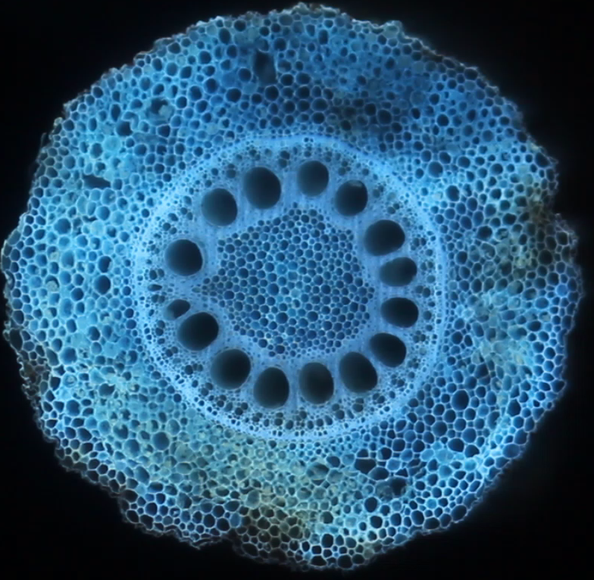
Extract frames and for each:
-Detect edges for structures of interest
-Create VTK of volumes for subsequent visualization &measurement
Problem provided by J. Yang (Brown/Lynch lab)
Quantifying Root Structure
wjb19@psu.edu

Slide 8
Edge Detection
Connected Components
Binarization/thresholding
Threaded computation &synchronization
Ubiquitous H.264/AVC codec common to HD format playback and transmission
-Associated IP issues made development/deployment of software tricky/expensive
-Cisco recently open-sourced an implementation : http://blogs.cisco.com/collaboration/open-source-h-264-removes-barriers-webrtc/
Methods
wjb19@psu.edu

Slide 9
Takes AVI stream from stdin, decodes and sends frames to threads
Data output extracted from frames may be saved to file/sent to stderr
Frames after operation may be re-encoded and sent to stdout
Cat avpipe instances together using pipes
Solution: avpipe
stdin
decode
out
threads
avpipe
encode(?)
stdout
wjb19@psu.edu

Slide 10
Basic framework released on github
-https://github.com/wjb19/avpipe
Currently incorporating :
-Codec
-Binarization &CCL
-VTK output using library devloped by Burak Korkut http://liberlocus.blogspot.com/
Other applications??
Project Status
wjb19@psu.edu

