Slide 1
Accelerating and Scaling Lanczos Diagonalization with GPGPU
Bill Brouwer, Filippo Spiga,
Pierre-Yves Taunay, Sreejith GJ
Nvidia GTC 2013
wjb19@psu.edu

Slide 2
Outline
Introduction
Applications
    QE
    FQHE
Theory
  Diagonalization
    Lanczos algorithm
    QR algorithm
Implementation
  CuBlas &MKL
  Distributed GPUs
    MPI + GPUdirect
Results
Conclusions
wjb19@psu.edu

Slide 3
Introduction
Diagonalization or computation of eigenvalues is arguably the most important step in condensed matter calculations; generally arises from solution to Schrödinger's equation
Myriad systems with different Hamiltonians H are studied, with a view to understanding the energy spectrum or range of values for εi where i ranges from 1 to N particles, levels, electrons etc
New and fascinating science takes place with increasing N; GPUs give us the opportunity to scale and accelerate key algorithms in condensed matter and thus push the boundaries
The Hamiltonian operator models the total energy for a particular physical model in an abstract way, whereas the spectrum represents predicted measurable (real) quantities
wjb19@psu.edu

Slide 4
Introduction
Often H is incredibly complicated and one resorts to approximations; regardless one can expand the wavefunctions using a basis over a field with defined inner product, giving rise to an eigenvalue problem
For symmetric (Hermitian) matrices, we can solve this by diagonalizing the Hamiltonian using the Lanczos algorithm.
In this work we are concerned with two key application areas:
  The self-consistent field cycle steps with a plane wave DFT code, Quantum Espresso
    Moderately large, dense matrices of order <<1e6
    Generally need many eigenvalues & eigenvectors
  Producing spectra in studies of the Fraction Quantum Hall Effect
    Massive, less dense matrices of order > 1e6
    Generally need few eigenvalues & eigenvectors
wjb19@psu.edu

Slide 5
Application : Quantum Espresso
Initial Guess for n
QE allows us to solve the ground state electronic structure problem in order to calculate and study material properties from first principles
This includes solving the Kohn-Sham equations of Density Functional Theory (DFT), approximation to many body (electron) problem → diagonalization and FFT are bottlenecks for computation
The current parallel Davidson algorithm for diagonalization is based on SCALAPACK (sans GPU)
Calculate Effective Potential V[n]
Solve KS equations
(
−
1
/
2
∇
2
+
V
[
n
]
)
Ψ
i
=
i
Ψ
i
Calculate Density
NO
Self
Consistent?
YES
wjb19@psu.edu

Slide 6
Application : Fractional Quantum Hall Effect
FQHE gives a fascinating example of strongly correlated electronic system. Many examples of FQHE are well understood (1/3,2/5,3/7 etc), many are not (5/2,12/5,6/13 etc)
Computational study of small systems provides new insights into properties of the quantum state describing the phenomena – such as the quantum numbers of ground state, excitations
Also helps in better testing of the theories
Bottleneck step in numerical studies involve Lanczos diagonalization of large Hamiltonians.
Ability to diagonalize larger Hamiltonians immediately translates to far better understanding of the Physics.
wjb19@psu.edu

Slide 7
Outline
Introduction
Applications
    QE
    FQHE
Theory
  Diagonalization
    Lanczos algorithm
    QR algorithm
Implementation
  CuBlas &Mkl
  Distributed GPUs
    MPI + GPUdirect
Results
Conclusions
wjb19@psu.edu

Slide 8
Theory
Diagonalization by QR algorithm is expensive for even moderate N, since compute scales as O(N³)
In condensed matter, often we don't care about the whole spectrum since Probability(higher energies) < Probability(lower energies) cf Boltzmann distribution
Lanczos (symmetric form of Arnoldi) is an iterative, power method that is less expensive than QR; storage costs can be kept to a minimum as well
Worst calculation throughout iterations is GEMV
  Based on earlier statement, often suffices to calculate just a few e-vectors/e-values
  Can periodically restart from last calculated lanczos vector, throwing out earlier vectors in basis
wjb19@psu.edu

Slide 9
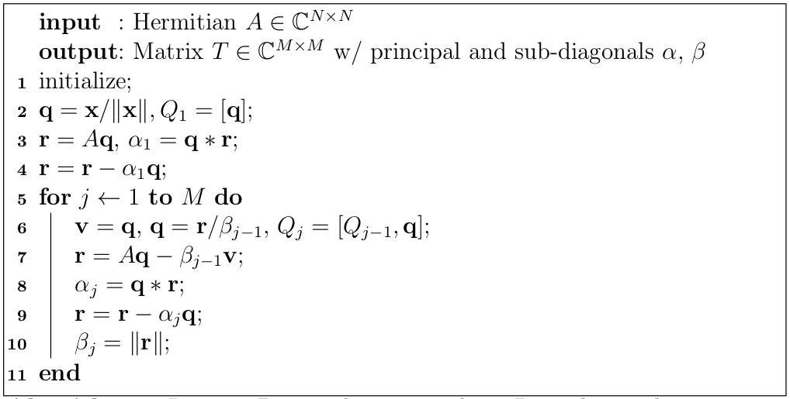
Basic Lanczos Algorithm
wjb19@psu.edu

Slide 10
Lanczos Algorithm : Other steps
Lanczos vectors q aren't exactly orthogonal; schemes abound for correcting, at this stage code monitors the dot product of qj-1 * qj and periodically applies Gram-Schmidt throughout iterations
The Lanczos algorithm creates a tridiagonal matrix T, with principle α0 and minor β-1 = β+1 diagonals, which must be solved for the (Lanczos) eigenvalues and eigenvectors
These are the same e-values as those for A, however eigenvectors for A if required need to be reconstructed from the Lanczos vectors
We could use a GPU version of the QR algorithm for the final tridiagonal matrix (details in another talk), however the implicit tridiagonal algorithm is ~ O(N²) so for now this final step is performed strictly on CPU
wjb19@psu.edu

Slide 11
(Implicit) Tri-Diagonal QR Algorithm
while ( m > 1){
// calculate wilkinson shift mu
mu = f(alpha_m,alpha_m-1,beta_m);
// apply to first beta,alpha elements
x = alpha[0]-mu;
y = beta[0];
for k=1:m=1
//calculate givens rotations eg., see Bindel et al
if (m>2)
[c,s] = givens(x,y)
else
// For the last iteration, we need to diagonalize the remaining 2x2 exactly
th = 0.5*atan2(2*beta[0], (alpha[1] - alpha[0]));
s = sin(th);
c = cos(th);
end
// update alpha & beta
alpha_k+1 = g(alpha_k,beta_k,c,s);
beta_k+1 = h(alpha_k,beta_k,c,s);
// update e-vectors Q if necessary
Q_new = Q_old * [c s; -s c];
end
if (tol) m--;
end
wjb19@psu.edu

Slide 12
Outline
Introduction
Applications
    QE
    FQHE
Theory
  Diagonlization
    Lanczos algorithm
    QR algorithm
Implementation
  CuBlas &Mkl
  Distributed GPUs
    MPI + GPUdirect
Results
Conclusions
wjb19@psu.edu

Slide 13
Implementation
Serial version of basic Lanczos is comprised of MKL or cublas routines
New API as of cuda 4.0 (use header cublas_v2.h), can still use legacy
Introduction of handle allows for easier use of threads
Scalars can be passed by reference on host or device, allows for asynchronous operation of routines
CublasSetAtomicsMode()
  Several routines have alternate implementations that allow for the use of atomics
  Faster, but potential numerical differences between results
wjb19@psu.edu

Slide 14
Implementation
Routines currently used from cublas in basic lanczos:
cublas<t>nrm2()
  Euclidean norm of vector
cublas<t>gemv()
  Matrix vector/multiply, r update
cublas<t>gemm()
  For orthogonalization
Working to incorporate:
cublas<t>symv()*
  Symmetric matrix/vector multiply
cublas<t>hemv()*
  Hermitian matrix/vector multiply
cublas<t>hbmv()
  Hermitian banded matrix/vector multiply
cublas<t>hpmv()
  Hermitian packed matrix/vector
*Faster implementation using atomics that can be enabled with cublasSetAtomicsMode()
wjb19@psu.edu

Slide 15
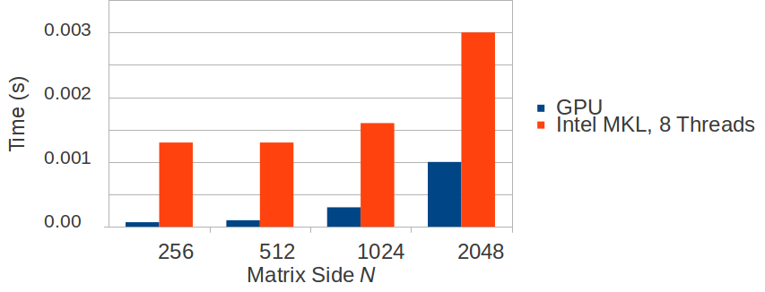
Implementation
GPU (M2090) provides excellent results for basic Lanczos; as much as 3x vs 8 threads running MKL routine (Intel x5550)
Obviously need to transfer data across PCIe + network in MPI enabled Lanczos will degrade this performance
wjb19@psu.edu

Slide 16
GPUDirect
In moving to distributed memory/MPI, we can take advantage of GPUDirect → improved interactions with third party devices, in particular PCIe & Inifiband
Under MPI, IB and GPU drivers share the same pinned memory (since GPUDirectv2/CUDA 4.0)
MPI calls can use device pointers directly; must be 64 bit/ RH Linux Kernel >= 2.6.18 and NVIDIA Driver >= v270 (*Earlier kernels may work with patch, but communication probably routed through host ala GPUDirectv1)
As of GPUDirectv3/CUDA 5.0, RDMA has been introduced improving communication between GPUs on network even further (*Need appropriate IB driver)
Support has existed in OpenMPI since 1.7(?), although must still build from trunk (at time of talk/writing this); many (but not all) MPI calls are supported (see refs at end of talk)
wjb19@psu.edu

Slide 17
GPUDirect : Tuning
Build openMPI from trunk with cuda support --with-cuda(=DIR) ; link against a –-enable-debug build & check operation of application with gdb etc
1138 in common_cuda.c
(gdb) bt
#0 mca_common_cuda_is_gpu_buffer (pUserBuf=0x200000200) at common_cuda.c:1138
#1 0x00002b0cc6b4ac42 in mca_cuda_convertor_init (convertor=0xd2dd50, pUserBuf=0x200000200) at opal_datatype_cuda.c:57
#2 0x00002b0cc6b37c1f in opal_convertor_prepare_for_recv (convertor=0xd2dd50, datatype=0x613460, count=32, pUserBuf=0x200000200)
at opal_convertor.c:548
/* If not enabled, then nothing else to do */
if (!opal_cuda_enabled) {
return;
}
if (ftable.gpu_is_gpu_buffer(pUserBuf)) {
convertor->cbmemcpy = (memcpy_fct_t)&opal_cuda_memcpy;
convertor->flags |= CONVERTOR_CUDA;
}
}
wjb19@psu.edu

Slide 18
GPUDirect : Operation
Use cudaMallocHost for MPI+GPU buffers, make sure pinned memory is supported by device
struct cudaDeviceProp p;
cudaGetDeviceProperties(&p,0);
int support = p.canMapHostMemory;
if(support == 0){
fprintf(stderr,"%s does not support mapping host memory\n",hostname);
MPI_Finalize();
exit(1);
}
cerror = cudaHostAlloc((void**)&r,sizeof(cuDoubleComplex)*matSize,cudaHostAllocMapped);
cerror = cudaHostGetDevicePointer(&d_r,r,0);
wjb19@psu.edu

Slide 19
GPUDirect : Benchmarking
Initial results encouraging for performing network transfers on simple payloads between devices:
[wjb19@lionga scratch]$ mpicc -I/usr/global/cuda/4.1/cuda/include -L/usr/global/cuda/4.1/cuda/lib64 mpi_pinned.c -lcudart
[wjb19@lionga scratch]$ qsub test_mpi.sh
2134.lionga.rcc.psu.edu
[wjb19@lionga scratch]$ more test_mpi.sh.o2134
Process 3 is on lionga7.hpc.rcc.psu.edu
Process 0 is on lionga8.hpc.rcc.psu.edu
Process 1 is on lionga8.hpc.rcc.psu.edu
Process 2 is on lionga8.hpc.rcc.psu.edu
Host->device bandwidth for process 3: 2369.949046 MB/sec
Host->device bandwidth for process 1: 1847.745750 MB/sec
Host->device bandwidth for process 2: 1688.932426 MB/sec
Host->device bandwidth for process 0: 1613.475749 MB/sec
MPI send/recv bandwidth: 4866.416857 MB/sec
wjb19@psu.edu

Slide 20
Parallel Strategy for Lanczos
Simply stripe A across GPUs; each calculates a portion of the r update (line 7 of algorithm) and then MPI_Allgather collects to each
GPU
Device
0
N
A0:x,j
q
r0:x
r
An-x:n,j
rn-x:n
A x q = r
wjb19@psu.edu

Slide 21
Parallel Results
Using two devices, GPU (M2070) is ~5-6x over CPU (Intel x5550), when running Lanczos with limited (re)orthogonalization
Dense matrices, 256 eigenvalues calculated, gemv for r update
180
140
Time (s)
2 GPUs, cublas only routines
100
2 CPUs, MKL only routines
60
20
5k 10k 20k 40k Matrix Side
wjb19@psu.edu

Slide 22
Conclusions/Directions
Initial results promising ~ 24x in serial, 5-6x in parallel, over using similar routines on CPUs, scaling to more cores needs some work
Need to handle compression particularly for FQHE application, currently investigating CUSP for sparse matrices
Introducing more sophisticated tiling to allow use of symmetric cublas routines w/ atomics
Better approaches to maintaining orthogonality
  advantage of using Gram Schmidt is BLAS type ops which map well to GPU
How does this compare to other approaches in electronic structure eg., subspace filtering?
Shortly will integrate and test with QE
wjb19@psu.edu

Slide 23
References
NETLIB http://www.netlib.org/
MKL http://software.intel.com/en-us/intel-mkl
Implicitly restarted Arnoldi/Lanczos Methods for Large Scale Eigenvalue Calculations (D. Sorensen)
Numerical Methods for Large Eigenvalue Problems (Y. Saad)
Matrix Computations, Golub & Van Loan
Linear Algebra Lecture Notes of Peter Arbenz (ETH)
Mellanox/GPUdirect : http://www.mellanox.com/pdf/whitepapers/TB_GPU_Direct.pdf
OpenMPI/CUDA details http://www.open-mpi.org/faq
GPUDirect https://developer.nvidia.com/gpudirect
Quantum Espresso http://www.quantum-espresso.org/
Numerical methods for electronic structure calculations of materials (Saad et al)
Quantum Algorithms for Complex Materials (XSEDE 2012) https://www.xsede.org/documents/234989/378230/chelikowsky_xsede.pdf
Acknowledgements
Hewlett Packard for a Donation of 50 M2070 devices
Jason Holmes & Penn State Research Computing http://rcc.its.psu.edu/
TACC/Stampede http://www.tacc.utexas.edu/resources/hpc/#stampede
XSEDE https://www.xsede.org/
wjb19@psu.edu

