Slide 1
Using Machine Learning to Accelerate Complex Atomic Structure Elucidation
Bill Brouwer, Lazaro Calderin
Research Computing and Cyberinfrastructure
Penn State
Jorge Sofo
Department of Physics
Penn State
wjb19@psu.edu
wjb19@psu.edu
wjb19@psu.edu
wjb19@psu.edu
wjb19@psu.edu

Slide 2
Motivation
Spectroscopy provides structural insight, for short (eg., NMR) and long range (eg., X-Ray) orderings
Well known techniques exist for simple crystals (Rietveld refinement), proteins (solution 3D NMR) etc
NMR and X-Ray spectra are complicated for solid solutions, amorphous materials etc
In these cases, materials characterization requires intensive work including simulation, ab initio calculations
The elucidation of complex materials structures has recently garnered a large scale initiative and associated funding opportunities
Experiment
Simulation
Calculation
Structure
wjb19@psu.edu
wjb19@psu.edu

Slide 3
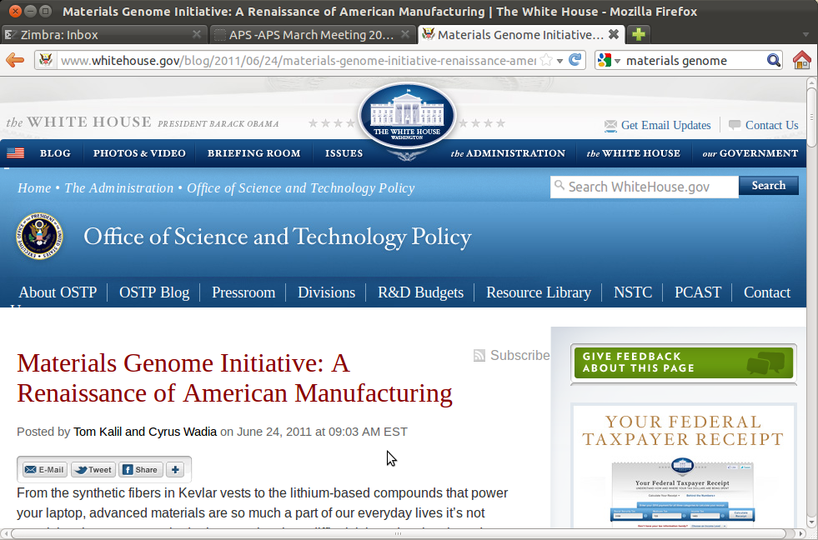
Materials Genome Initiative
Announced June 2011, ~ 100 million dollars towards reducing time from materials discovery to distribution
Document data
wjb19@psu.edu

Slide 4
Towards a Solution
The task of complex materials characterization will be supported by :
  Generation of computational data in an automated/semi-automated fashion
  Creation of collaboratory for said data or contribution to existing eg., ChemXSeer
The data will be used in conjunction with machine learning methods to :
  determine explicit structural details using supervised machine learning eg., support vector machines
  classify new materials eg., provide insight into constituent atoms using unsupervised machine learning eg., k-means
Experiment
Simulation
ML
Calculation
Structure
wjb19@psu.edu

Slide 5
The Chem_{X}Seer Collaboratory
Wiki,
forums etc
Idea
exchange
User data
Comp.
Tools
Model
Ab-initio
Exp.
data
Browse,
upload
Doc
input
Doc
source
Solr Index
Search
table
Access
Control
Extract
figure
formula
Server side Client side
Document data
wjb19@psu.edu

Slide 6
Structure Determination using Machine Learning
Structure determination using machine learning requires :
  Features extracted from experimental data of known materials → input
  structural data giving rise to these experimental details → output
Alternatively, we may also go forward from structures and :
  Calculate experimentally measurable parameters and thus
  Simulate experimental spectra, providing features for training
Either way, ML methods can be used to learn the complex mapping between experimental spectra and underlying structure
Suitably trained ML kernels can be presented with spectra for new materials as input and underlying structures deduced in greatly accelerated timeframes
wjb19@psu.edu

Slide 7
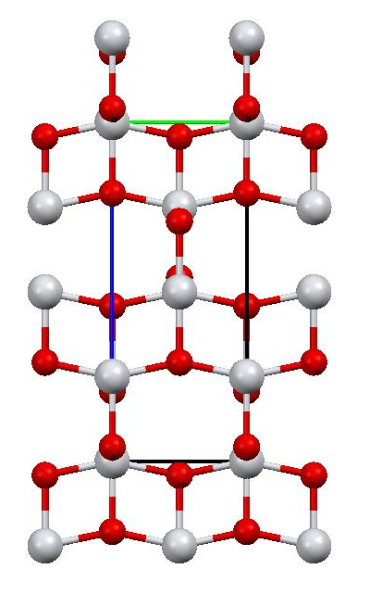
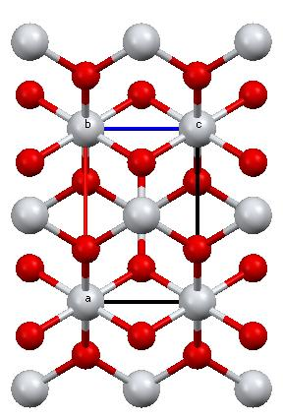
Example : TiO2 polymorph structure directly from NMR spectra
Popular materials in a variety of industries, much experimental (eg., NMR) and computational data exists; consider ⁴⁷Ti as probe nuclei
Rutile P4_2/mnm
Anatase I4_1/amd
wjb19@psu.edu

Slide 8

Solid State NMR
Many nuclei of interest have half integer spin I > ½ (eg., ⁴⁷Ti, I = 5/2), with a quadrupole moment that couples with electric field gradient
Subsequently spectra for powdered solids are broadened due to presence of many crystallite orientations α,β in sample
Alleviated somewhat by Magic Angle Spinning (MAS) which (on time average) removes first order effects
Spectra must be simulated to determine tensor parameters (eg., Cq ), the latter are sensitive measures of local structure
Frequency ω
wjb19@psu.edu

Slide 9
Computational Approach
Create pseudopotentials (Quantum Espresso/ld1.x)
Perform as batch process :
  Generate TiO2 structure between anatase and rutile by perturbing atomic positions and cell dimensions
  Determine electronic structure via Density Functional Theory using plane waves + pseudopotentials (Quantum Espresso/pw.x)
  Determine Ti & O NMR parameters δISO ,Cq and η using GIPAW :
All-electron magnetic response with pseudo potentials: NMR chemical shifts; Chris J Pickard, Francesco Mauri, Phys. Rev. B 63 (2001) 256101
*or newer converse approach :
An ab-initio converse NMR approach for pseudopotentials; D. Ceresoli, N. Marzari, G. Lopez, and T. Thonhauser, Phys. Rev. B 81 (2010) 184424
  Simulate NMR MAS spectra using calculated parameters
Use spectra as support vector machine input features, atomic positions/cell parameters output
wjb19@psu.edu

Slide 10

Support Vector Machines (SVM's)
Machine Learning for overlapping decision regions traditionally used back propagation Artificial Neural Networks
SVM → given set G of input xi and output ai data, non-linear (eg., radial basis) functions ψi map input data to higher dim feature space
SVM regression function has weights wi and constants b, adjusted via regularized risk minimization:
Using input features extracted from NMR spectra (normalized amplitude) in conjunction with output structural details (cell parameters a,c, O coordinates) :
  Train svm kernels on the basis of the generated computational data
  Present new examples of input spectra for recognition, providing output structural details automatically
wjb19@psu.edu

Slide 11
Results for TiO2
Good correspondence between *experimental and calculated values for anatase (first Cq,h value pairs) and rutile (last value pairs)
0.8
0.6
η
0.4
0.2
0
Cq (MHz)
-2
-4
-6
2 4 6 8 10 12 14 16 18 20 22
Batch #
Batch #
*A comparison of NMR spectral parameters of 47Ti and 49Ti nuclei in rutile and anatase, L. V. Dmitrieva, L. S. Vorotilova, I. S. Podkorytov, M. E. Shelyapina, Phys. Solid State, 41(7) 1999
wjb19@psu.edu

Slide 12
Results
SVM's trained on simulated data reproduce correct cell parameters for new input with small errors, particularly for more 'rutile-like' structure (higher batch #)
'Anatase-like' structure NMR lineshape has larger distribution of features than rutile-like, larger errors, will benefit from better feature selection
6
4
2
% Error
Cell Parameter a
O fractional
y-coordinate
2 4 6 8 10 12 14 16 18 20 22 24
Batch #
wjb19@psu.edu

Slide 13
Obstacles : NMR tensor traces
NMR measurements are related to tensor traces eg., isotropic chemical shift; sign changes in atomic displacements difficult to discern
Total NMR chemical shifts in ppm:
Atom 1 Ti pos: ( -0.050000 0.000000 0.000000) sigma: 268.8017
649.8918 0.0000 -345.5018
0.0000 736.7212 0.0000
-297.9141 0.0000 -580.2081
Total NMR chemical shifts in ppm:
Atom 1 Ti pos: ( 0.050000 0.000000 0.000000) sigma: 268.8017
649.8920 0.0000 345.5014
0.0000 736.7212 0.0000
297.9140 0.0000 -580.2081
Same chemical shift, different
Ti displacement
wjb19@psu.edu

Slide 14
Obstacles : sensitivity to PP
Good correspondence with experimental values relies on accurate and appropriate pseudopotential eg., Anatase ⁴⁷Ti Cq=5.9 MHz
PP Valence configuration:
nl pn l occ Rcut Rcut US E pseu
3S 1 0 2.00 1.100 1.100 -4.603475
3P 2 1 6.00 1.200 1.200 -2.856230
3D 3 2 2.00 1.082 1.082 -0.313009
GIPAW->
Ti 1 eig= -0.792908 0.396454 0.396454
Ti 1 Q= 0.30 10e-30 m^2 Cq= -0.5589 MHz eta= 0.00000
---
PP Valence configuration:
nl pn l occ Rcut Rcut US E pseu
4P 2 1 0.00 2.600 2.600 -0.107768
3D 3 2 2.00 1.300 1.300 -0.313017
4S 1 0 2.00 3.212 3.212 -0.328298
GIPAW->
Ti 1 eig= -7.247798 3.623899 3.623899
Ti 1 Q= 0.30 10e-30 m^2 Cq= -5.1088 MHz eta= 0.00000
wjb19@psu.edu

Slide 15
Summary
Materials genome initiative will be supported by systematic production of experimental, simulation and ab initio data, appropriately indexed and stored in collaboratories
Ab initio calculations are more computationally tractable via the use of pseudopotentials, need to construct the latter carefully
Machine learning kernels may be trained on simulated and experimental data, to learn relationships between experimental spectra (eg., solid state NMR) and underlying structure
Experimental data for new materials may be presented to networks of unsupervised and supervised kernels in order to classify underlying elements (atoms, species, coordination) and determine specific atomic positions in unit cell (focus of this talk)
This approach may be extended to many more data examples eg., Scanning Tunneling Microscopy & DOS
wjb19@psu.edu

