Slide 1
HPC Essentials
Part IV : Introduction to GPU programming using CUDA
Bill Brouwer
Research Computing and Cyberinfrastructure (RCC), PSU
wjb19@psu.edu

Slide 2
Outline
Introduction
Nvidia GPU's
CUDA
  Threads/blocks/grid
  C language extensions
  nvcc/cuda-gdb
  Simple Example
Profiling Code
Parallelization Case Study
  LU decomposition
Optimization/Performance
  Tools
  Tips
wjb19@psu.edu

Slide 3
Introduction
A modern CPU handles a number of 'heavy' computational threads concurrently; Intel MIC devices might have as many as 32 cores running 4 threads each in the near future (Knights Corner)
As of writing it's not uncommon to find 16-24 cores on a CPU motherboard; the smallest compute unit on recent Nvidia series devices handle 32 threads concurrently (a warp)
As many as 1536 threads run actively on a streaming multiprocessor (SM), and some devices contain as many as 16 multiprocessors, permitting upwards of 24k threads to run on a device at a given time
GPU threads are 'lightweight', cheap to run; no context switches in the traditional sense, scheduler runs all and any available warps, no swapping of state, registers etc
GPU (device) is separated from CPU (host) by a PCIe bus
wjb19@psu.edu

Slide 4
Typical Compute Node
CPU
RAM
memory bus
QuickPath Interconnect
GPU
IOH
volatile storage
PCI-express
Direct Media Interface
ICH
ethernet
PCI-e cards
NETWORK
SATA/USB
BIOS
non-volatile storage
wjb19@psu.edu

Slide 5
Introduction
Host and device have physically distinct memory regions*; recently support introduced for Unified Virtual Addressing (UVA) which makes development easier; host/device can share same address space
GPU's are suited to data parallel computation; same program on different data elements, benefits from data coherency
This computational model maps data elements to parallel processing threads, also benefits from running as many threads as possible
SM receives groups of threads, split into warps and scheduled with two units (Fermi); instruction from each warp goes to a group of sixteen cores, sixteen load/store units, or four SFUs.
Warps execute one common instruction at a time (each thread), may diverge based on conditional branches, in which case execution becomes serial or disabled until the branch is complete
*Occasionally they may share memory eg., Mac
wjb19@psu.edu

Slide 6
Fermi Streaming Multiprocessor
Warp scheduler
Warp Scheduler
Dispatch unit
Dispatch unit
32768x32 bit registers
Special Function Unit x4
Load/Store Unit x16
Core x 16 x 2
CUDA core
Dispatch Port
Operand Collector
FPU
Int U
Result Queue
interconnect
64kB shared mem/L1 Cache
Adapted from Nvidia Fermi Whitepaper
wjb19@psu.edu

Slide 7
Warp Schedulers
Warp Scheduler
Warp Scheduler
Instruction Dispatch
Instruction Dispatch
x32
x32
Warp 8 instruction 11
Warp 2 instruction 42
Warp 14 instruction 95
Warp 8 instruction 12
Warp 14 instruction 96
Warp 2 instruction 43
Adapted from Nvidia Fermi Whitepaper
wjb19@psu.edu

Slide 8
Outline
Introduction
Nvidia GPU's
CUDA
  Threads/blocks/grid
  C language extensions
  nvcc/cuda-gdb
  Simple Example
Profiling Code
Parallelization Case Study
  LU decomposition
Optimization/Performance
  Tools
  Tips
wjb19@psu.edu

Slide 9
CUDA threads
CUDA or Compute Unified Data Architecture refers to both the hardware and software model of the Nvidia series GPU's; several language bindings are available eg., C
GPU's execute kernels, special functions which when called are executed N times in parallel by N different CUDA threads
Defined by use of the __global__ declaration specifier in source code
Number of threads required given in <<<...>>>, more on C language extensions shortly
Fermi and onward allows for the execution of multiple kernels simultaneously
wjb19@psu.edu

Slide 10
CUDA threads
threadIdx is a 3-compt vector used to reference threads with a 1D,2D or 3D index within a kernel
A first approach porting serial code to CUDA may simply require flattening loops and apportioning work to individual threads
Threads can cooperate via shared memory, a small region (~48kB) with much lower latency than global memory
 | Thread Index | ID | Size
1D | x | x | Dx
2D | (x,y) | (x+y*Dx) | (Dx,Dy)
3D | (x,y,z) | (x+y*Dx+z*Dx*Dy) | (Dx,Dy,Dz)
wjb19@psu.edu

Slide 11
CUDA blocks
A kernel is executed by multiple equally shaped thread blocks, with multiple blocks organized into a grid
Each block in grid can be identified via index in kernel function, using blockIdx variable; blocks have dimension blockDim
Thread blocks execute independently; any order, parallel or series
Allows for scalable, multi-core/processor code; threads within a warp execute SIMD style
Execution must be synchronized via barriers in the kernel using __syncthreads() where communication between threads in a block is required, although this introduces overhead and should be used sparingly
No global synchronization available, use multiple kernel invocation
wjb19@psu.edu

Slide 12
CUDA grid
Threads have multiple memory options
  Per thread
    Registers → fastest
  Per block
    Shared → fast & limited
  Global DRAM → slowest & largest
Two additional memory resources; constant (64k) and texture, the latter allows for faster random access, also permits cheap interpolation on load, more in the intermediate seminar
Initial step in heterogeneous program execution is to transfer data from host to device global memory across PCIe bus; pinned host memory is fastest but limited
Global memory lasts for application, shared/constant/texture only kernel lifetime
wjb19@psu.edu

Slide 13
CUDA grid
registers
Per-Block
Shared mem
Block(0,0)
Grid0
Per-
Application
Global
memory
Block(0,0)
Block(n,0)
Grid1
Block(0,0)
Block(n,0)
Adapted from nVidia Fermi Whitepaper
wjb19@psu.edu

Slide 14
Outline
Introduction
Nvidia GPU's
CUDA
  Threads/blocks/grid
  C language extensions
  nvcc/cuda-gdb
  Simple Example
Profiling Code
Parallelization Case Study
  LU decomposition
Optimization/Performance
  Tools
  Tips
wjb19@psu.edu

Slide 15
CUDA C language extensions
CUDA provides extensions to C, targets sections of code to run on device using specifiers
Also comprises a runtime library split into separate host component (on CPU) and device components, as well as a component common to both
Uses function and variable type specifiers :
  __device__ fn executed and called from device
  __global__ fn executed on device, called from host
  __host__ fn executed and called from host
  __constant__ constant memory
  __shared__ thread block memory
wjb19@psu.edu

Slide 16
Heterogeneous Execution
__host__
__device__
  __global__
  __shared__
  __const__
Host
Serial
Parallel
Kernel0
Serial
Parallel
Kernel1
Grid0
Block(0,0)
Block(n,0)
Host
Grid1
Block(0,0)
Block(n,0)
Adapted from CUDA programming guide
wjb19@psu.edu

Slide 17
CUDA C Language Extensions
Call to __global__ must specify execution configuration for call
Define dimension of the grid and blocks that will be used to execute the function on the device, and associated stream(s)
Specified by inserting:
<<<Dg,Db,Ns,s>>>
btwn function name and args
Dg is of type dim3, specifies the size and dimension of the grid
wjb19@psu.edu

Slide 18
CUDA C Language Extensions
Db is of type dim3, specifies the size and dimension of each block, such that Db.x*Db.y*Db.z is number of threads / block
(optional, default=0) Ns is of type size_t, no. of bytes in shared memory that is dynamically allocated / block for this call, in addition to statistically allocated mem.
(optional, default=0) s is of type cudaStream_t, specifies associated stream
Examples; function declared as:
__global__ void Func(float* parameter);
must be called as:
Func<<<Dg,Db>>>(parameter);
at a minimum
wjb19@psu.edu

Slide 19
Compilation with NVCC
nvcc separates device & host code, compiles device code into assembly or binary
Onemust compile with compute capability suited to device
Generated host code output as C or object code via host compiler
#pragma unroll → by default compiler unrolls small loops, control via #pragma unroll x ← times to unroll
Use cuda-gdb to debug or dump output using printf in kernels (compute capability 2.x)
wjb19@psu.edu

Slide 20
Practicalities
CUDA is available as a module on lion-GA; once loaded all the tools and libraries will be in your PATH and LD_LIBRARY_PATH respectively
When getting started it's always a good idea to report any CUDA errors in your code to stdout/stderr using the various methods eg., a little wrapper around cudaGetLastError():
void reportCUDAError(const char * kern)
{
fprintf(stderr,"fired kernel %s\n",kern);
fprintf(stderr,"kernel result : %s\n", \ cudaGetErrorString(cudaGetLastError()));
}
The nvidia-smi utility gives useful information too with regards to device(s) and any running applications eg., running processes, memory used etc
wjb19@psu.edu

Slide 21
Practicalities
Remember that there are various devices available per node, you can select them with cudaSetDevice()
At the time of writing lion-GA has three per node ie., in a shared or distributed memory implementation you have the liberty use all three if available :
MPI_Init(&argc, &argv);
MPI_Comm_size(MPI_COMM_WORLD, &mpi_size);
MPI_Comm_rank(MPI_COMM_WORLD, &rank);
//TESTME
//use devices with best bandwidth
int myDevice = (rank % 3);
cudaSetDevice(myDevice);
Set and possibly force the topology you require in your PBS script, devices are set to exclusive, one process per GPU
wjb19@psu.edu

Slide 22
Simple CUDA program I
#include <cuda.h>
#include <stdio.h>
#include <math.h>
#define M_PI 3.14159265358979323846
//unimaginative demo for accuracy and scaling test
__device__ float trivialFunction(float theta){
return M_PI * (cos(theta)*cos(theta) + sin(theta)*sin(theta));
}
__global__ void trivialKernel(float* input, float* output){
//my index
const int myIndex = blockDim.x * blockIdx.x + threadIdx.x;
//load data
float theta = M_PI * input[myIndex];
//do some work and write out
output[myIndex] = trivialFunction(theta);
} //end kernel
wjb19@psu.edu

Slide 23
Simple CUDA program II
extern "C"{
__host__ void trivialKernelWrapper(float* input, float* output, int size){
//device pointers
float *devInput, *devOutput;
cudaMalloc((void**) &devInput, size * sizeof(float));
cudaMalloc((void**) &devOutput, size * sizeof(float));
// Load device memory
cudaMemcpy(devInput, input, size*sizeof(float), cudaMemcpyHostToDevice);
//setup the grid
dim3 threads,blocks;
threads.x=512;
blocks.x= size / 512;
//run
trivialKernel<<<blocks, threads>>>(devInput, devOutput);
//transfer back to host
cudaMemcpy(output, devOutput, size * sizeof(float), cudaMemcpyDeviceToHost);
//cleanup
cudaFree(devInput);
cudaFree(devOutput);
} //end host function
} //end extern
wjb19@psu.edu

Slide 24
Outline
Introduction
Nvidia GPU's
CUDA
  Threads/blocks/grid
  C language extensions
  nvcc/cuda-gdb
  Simple Example
Profiling Code
Parallelization Case Study
  LU decomposition
Optimization/Performance
  Tools
  Tips
wjb19@psu.edu

Slide 25
Amdahl's Law revisited
No less relevant for GPU; in the limit as processors N → ∞ we find the maximum performance improvement :
1/(1-P)
It is helpful to see the 3dB points for this limit ie., the number of processing elements N1/2 required to achieve (1/√2)*max = 1/(√2*(1-P)); equating with Amdahl's law & after some algebra :
N1/2 = 1/((1-P)*(√2-1))
N1/2
Parallel code fraction P
wjb19@psu.edu

Slide 26
Amdahl's law : implications
Points to note from the graph :
  P ~ 0.90, we can benefit from ~ 20 elements
  P ~ 0.99, we can benefit from ~ 256 elements
  P → 1, we approach the “embarrassingly parallel” limit
  P ~ 1, performance improvement directly proportional to elements
  P ~ 1 implies independent or batch processes
Want at least P ~ 0.9 to justify work of porting code to accelerator
For many problems in sciences, as characteristic size increases, P approaches 1 and scaling benefits outweigh cost of porting code (cf weak vs strong scaling)
Regardless, doesn't remove the need to profile and clearly target suitable sections of serial code
wjb19@psu.edu

Slide 27
Profiling w/ Valgrind
[wjb19@lionxf scratch]$ valgrind --tool=callgrind ./psktm.x
[wjb19@lionxf scratch]$ callgrind_annotate --inclusive=yes callgrind.out.3853
--------------------------------------------------------------------------------
Profile data file 'callgrind.out.3853' (creator: callgrind-3.5.0)
--------------------------------------------------------------------------------
I1 cache:
D1 cache:
L2 cache:
Timerange: Basic block 0 - 2628034011
Trigger: Program termination
Profiled target: ./psktm.x (PID 3853, part 1)
--------------------------------------------------------------------------------
20,043,133,545 PROGRAM TOTALS
--------------------------------------------------------------------------------
Ir file:function
--------------------------------------------------------------------------------
20,043,133,545 ???:0x0000003128400a70 [/lib64/ld-2.5.so]
20,042,523,959 ???:0x0000000000401330 [/gpfs/scratch/wjb19/psktm.x]
20,042,522,144 ???:(below main) [/lib64/libc-2.5.so]
20,042,473,687 /gpfs/scratch/wjb19/demoA.c:main
20,042,473,687 demoA.c:main [/gpfs/scratch/wjb19/psktm.x]
19,934,044,644 psktmCPU.c:ktmMigrationCPU [/gpfs/scratch/wjb19/psktm.x]
19,934,044,644 /gpfs/scratch/wjb19/psktmCPU.c:ktmMigrationCPU
6,359,083,826 ???:sqrtf [/gpfs/scratch/wjb19/psktm.x]
4,402,442,574 ???:sqrtf.L [/gpfs/scratch/wjb19/psktm.x]
104,966,265 demoA.c:fileSizeFourBytes [/gpfs/scratch/wjb19/psktm.x]
Parallelizable worker function is 99.5% of total instructions executed
wjb19@psu.edu

Slide 28
Outline
Introduction
Nvidia GPU's
CUDA
  Threads/blocks/grid
  C language extensions
  nvcc/cuda-gdb
  Simple Example
Profiling Code
Parallelization Case Study
  LU decomposition
Optimization/Performance
  Tools
  Tips
wjb19@psu.edu

Slide 29

LU Algorithm
Used for linear equations solution, method also for finding matrix determinant; application in this case is to very large number of small matrix determinants ie., product of diagonal elements after LU
Based on Crouts method; if we factor matrix as lower/upper (eg., 3x3):
then we are left with a set of overdetermined equations to solve; diagonal of alpha is set to one, writes of alpha/beta done in place within a
In solving overdetermined set, numerical stability requires finding maximum pivot, a dividing element in the equation's solution that may entail a row permutation
wjb19@psu.edu

Slide 30
Porting LU Decomposition to GPU
Matrix size N*N ~ 12*12 elements; block size (x,y) in threads ?
  As many threads as matrix elements??
    → Too many dependencies in algorithm and implied serialization
  One thread per matrix??
→ Completely uncoalesced read/writes from global memory
→ ~ 800 clock cycles each, too expensive
    What about shared memory ~ 1-32 cycles per access??
      Should make block size x 32 (warp size), promotes coalescing and efficiency, memory accesses ~ hidden behind computation
      Thus we need at least 32*(4*144) = 18 kB / block
→ only have 48k per SM which has 8+ cores, not enough to go round
  Start with ~ N==matrixSide threads per matrix
wjb19@psu.edu

Slide 31
Digression : Coalesced Memory Access
Highest priority for performant code, refers to load/stores from/to global memory organized into smallest number of transactions possible
On devices with compute capability 2.x, number of transactions required to load data by threads of a warp is equal to the number of cache lines required to service the warp (L1 has 128 byte cache lines eg., 32 floats per line)
Aligned data or offset/stride a multiple of 32 is best; non-unit stride degrades memory bandwidth as more cache lines are required; worst case scenario 32 cache lines required for 32 threads
0 32 64 96 128 160 192 224 256 288 320 352 384
Coalesced access, all threads load/store from same line
wjb19@psu.edu

Slide 32
Digression : Shared Memory
Is on chip, lower latency/higher bandwidth than global memory; organized into banks that may be processed simultaneously
Note that unless data will re-used there is no point loading into shared memory
Shared memory accesses that map to the same bank must be serialized → bank conflicts
Successive 32 bit words are assigned to successive banks (32 banks for Fermi); a request without conflicts can be serviced in as little as 1 clock cycle
0
31
Example 2-way bank conflict
wjb19@psu.edu

Slide 33
Shared Memory : Broadcast
Looks like a bank conflict, but when all threads in a half warp access the same shared memory location, results in an efficient broadcast operation eg., nearest neighbor type access in an MD code :
scratchA[threadIdx.x] = tex1Dfetch(texR_NBL,K+0*nAtoms_NBL);
scratchB[threadIdx.x] = tex1Dfetch(texR_NBL,K+1*nAtoms_NBL);
scratchC[threadIdx.x] = tex1Dfetch(texR_NBL,K+2*nAtoms_NBL);
scratchD[threadIdx.x] = K;
__syncthreads();
//Loop over all particles belonging to an adjacent cell
//one thread per particle in considered cell
for(int j = 0;j<256;j++){
pNx = scratchA[j];
pNy = scratchB[j];
pNz = scratchC[j];
K = scratchD[j];
Multi-cast is possible in devices with compute arch 2.x; but I digress, back to example...
wjb19@psu.edu

Slide 34
First Step : Scaling Information
for (int i=0;i<matrixSide;i++) {
big=0.0;
for (int j=0;j<matrixSide;j++)
if ((temp=fabs(inputMatrix[i*matrixSide+j])) > big)
big=temp;
if (big < TINY)
return 0.0; //Singular Matrix/zero entries
scale[i]=1.0/big;
}
Threads can work independently, scanning rows for the largest element; map outer loop to thread index
int i = threadIdx.x;
big=0.0;
for (int j=0;j<matrixSide;j++)
if ((temp=fabs(inputMatrix[i*matrixSide+j])) > big)
big=temp;
if (big < TINY)
return 0.0; //Singular Matrix/zero entries
scale[i]=1.0/big;
wjb19@psu.edu

Slide 35
First Step : Memory Access
matrix j
scale
j = 0 1 2 N-1 loop
matrix i
0
1
2
.
.
.
N-1
0
1
2
.
.
.
N-1
threadIdx.x
threadIdx.x
wjb19@psu.edu

Slide 36
Second Step : First Equations
for (int j=0;j<matrixSide;j++) {
for (int i=0;i<j;i++) {
sum=inputMatrix[i][j];
for (int k=0;k<i;k++)
sum -= inputMatrix[i][k]*inputMatrix[k][j];
inputMatrix[i][j]=sum;
}
Threads can't do columns independently due to pivoting/possible row swaps later in algorithm; only threads above diagonal work
for (int j=0;j<matrixSide;j++) {
__syncthreads(); //ensure accurate data from lower columns/j
if (i<j) {
sum=inputMatrix[i][j];
for (int k=0;k<i;k++)
sum -= inputMatrix[i][k]*inputMatrix[k][j];
inputMatrix[i][j]=sum;
}
wjb19@psu.edu

Slide 37
Second Step : Memory Access
Simple Octave scripts make your life easier when visualizing memory access/load balancing etc
for j=0:9
disp('---');
disp(['loop j = ',num2str(j)]);
disp(' ');
for i=0:j-1
disp(['read : ',num2str(i),",",num2str(j)]);
for k=0:i-1
disp(['read : ',num2str(i),",",num2str(k)," ",num2str(k),",",num2str(j)]);
end
disp(['write : ',num2str(i),",",num2str(j)]);
end
end
wjb19@psu.edu

Slide 38
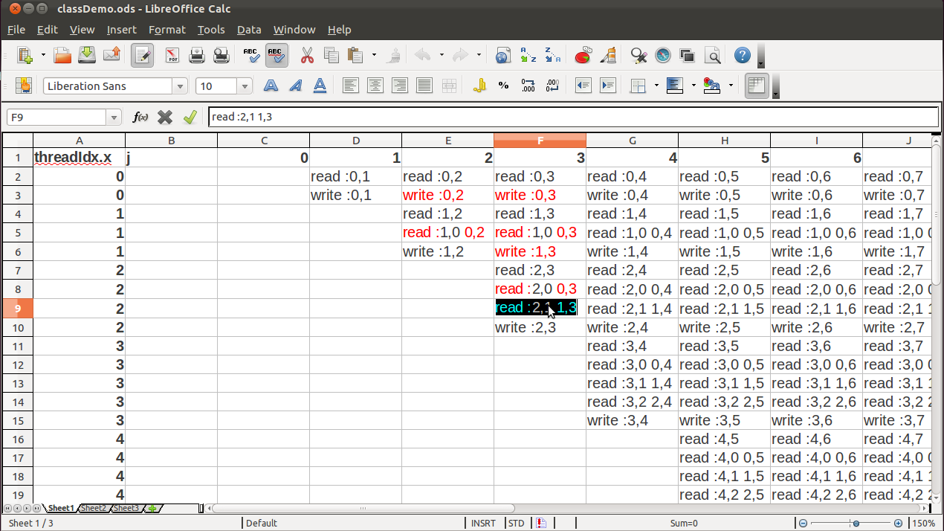
Second Step : Memory Access
Data from previous script is readily visualized using opencalc; the load balancing in this case is fairly poor; on average ~ 50% of threads work, and the amount of work performed increases with threadIdx.x
Potential conflict/race??
wjb19@psu.edu

Slide 39
Second Step : Memory Access
Take j=2 for example; thread 0 writes the location (0,2) thread 1 expects to read
However, within a warp, recall that threads execute SIMD style (single instruction-multiple data); regardless of thread execution order, a memory location is written before it is required by a thread in this example
0 1 2 N-1
Also recall that blocks which are composed of warps are scheduled and executed in any order, we are lucky in this case that the threads working on the same matrix will be a warp or less
0
1
2
.
.
.
N-1
wjb19@psu.edu

Slide 40
Third Step : Second Equations
big = 0.0;
if ((i > j) && (i < matrixSide)) {
sum=inputMatrix[i][j];
for (int k=0;k<j;k++)
sum -= inputMatrix[i][k]*inputMatrix[k][j];
inputMatrix[i][j]=sum;
...
}
Now we work from diagonal down; memory access is similar to before, just 'flipped'
This time increasingly less threads are used; note also we ignore i==j since this just reads and writes, no -= performed
wjb19@psu.edu

Slide 41
Fourth Step : Pivot Search
big=0.0;
if ((i > j) && (i < matrixSide)) {
...
if ((dum=holder[i]*fabs(sum)) >= big) {
big=dum;
imax=i;
}
}
Here we search the valid rows for largest value and corresponding index
We will use shared memory to allow thread cooperation, specifically through parallel reduction
__shared__ float big[matrixSide];
__shared__ int ind[matrixSide];
__shared__ float bigs;
__shared__ int inds;
wjb19@psu.edu

Slide 42
Fourth Step : Pivot Search
big[threadIdx.x]=0.0;
ind[threadIdx.x]=threadIdx.x;
if ((i > j) && (i < matrixSide)) {
...
big[threadIdx.x-j] = scale[i]*fabs(sum);
}//note offset of -j in array and we close this scope, need lowest //thread(s) active for reduction
__syncthreads();
//perform parallel reduction
...
//lowest thread writes out to scalars
if (threadIdx.x==0){
bigs = big[0];
imax = ind[0];
}
__syncthreads();
wjb19@psu.edu

Slide 43
Pivot Search → Parallel Reduction
//consider matrixSide == 16, some phony data
//and recall i==threadIdx.x
if (i<8)
if (big[i+8] > big[i]){
big[i] = big[i+8];
ind[i] = i+8;
}
if (i<4)
if (big[i+4] > big[i]){
big[i] = big[i+4];
ind[i] = i+4;
}
if (i<2)
if (big[i+2] > big[i]){
big[i] = big[i+2];
ind[i] = i+2;
}
if (i<1)
if (big[i+1] > big[i]){
big[i] = big[i+1];
ind[i] = i+1;
}
i = 0 1 2 3 4 5 6 7 8 9 10 11 12 13 14 15
0
3
6
5
7
8
1
2
4
4
7
2
5
9
2
7
4
4
7
5
7
9
2
7
4
4
7
2
5
9
2
7
7
9
7
7
7
9
2
7
4
4
7
2
5
9
2
7
7
9
7
7
7
9
2
7
4
4
7
2
5
9
2
7
Largest value in 0th position of big array
wjb19@psu.edu

Slide 44
Fifth Step : Row Swap
if (j != imax) {
for (int k=0;k<matrixSide;k++) {
dum=inputMatrix[imax][k];
inputMatrix[imax][k]=inputMatrix[j][k];
inputMatrix[j][k]=dum;
}
//should also track permutation of row order
scale[imax]=scale[j];
}
Each thread finds the same conditional result, no warp divergence (a very good thing); if they swap rows, use same index i as before, one element each :
if (j != imax) {
dum=inputMatrix[imax][i];
inputMatrix[imax][i]=inputMatrix[j][i];
inputMatrix[j][i]=dum;
if (threadIdx.x==0) scale[imax]=scale[j];
}
wjb19@psu.edu

Slide 45
Sixth Step : Final Scaling
if (j != matrixSide-1){
dum=1.0/inputMatrix[j*matrixSide+j];
for (int i=j+1;i<matrixSide;i++)
inputMatrix[i*matrixSide+j] *= dum;
}
Use a range of threads again
if (j != matrixSide-1){
dum=1.0/inputMatrix[j*matrixSide+j];
if ((i>=j+1) && (i<matrixSide))
inputMatrix[i*matrixSide+j] *= dum;
}
__syncthreads();
Next steps → compile; get it working/right answer, optimized...
wjb19@psu.edu

Slide 46
Outline
Introduction
Nvidia GPU's
CUDA
  Threads/blocks/grid
  C language extensions
  nvcc/cuda-gdb
  Simple Example
Profiling Code
Parallelization Case Study
  LU decomposition
Optimization/Performance
  Tools
  Tips
wjb19@psu.edu

Slide 47
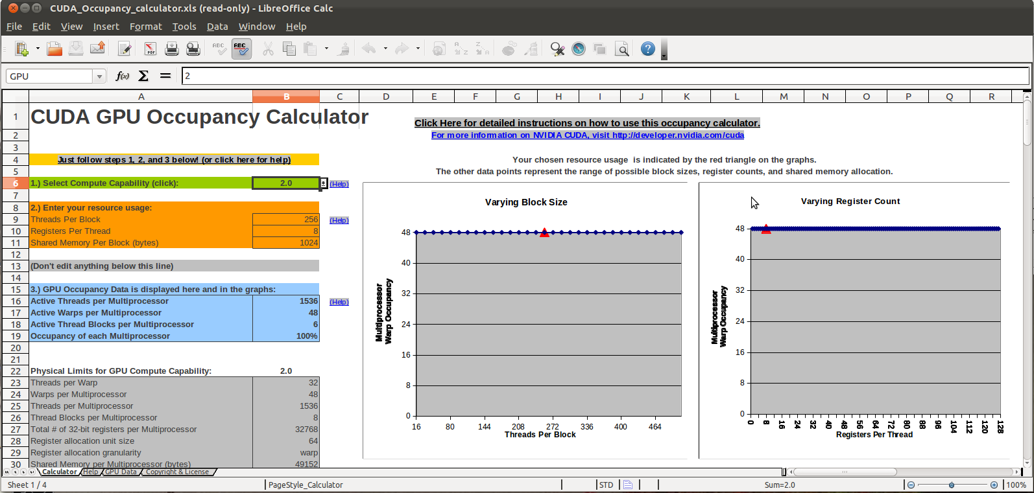
Occupancy Calculator
Once you've compiled and have things working, you can enter threads/block, registers/thread and shared memory from compiler output to the occupancy calculator spreadsheet
Use this tool to increase occupancy which is the ratio of active warps to total available
wjb19@psu.edu

Slide 48
Timing
Time and understand your kernel; consider viewing operations in a spreadsheet as before and load balancing, giving more work to shorter threads eg., by placing extra loop limits in const memory
cudaEvent_t start,stop;
float time;
cudaEventCreate(&start);
cudaEventCreate(&stop);
cudaEventRecord(start,0);
myKernel<<<blocks, threads>>>(...);
cudaEventRecord(stop,0);
cudaEventSynchronize(stop);
cudaEventElapsedTime(&time,start,stop);
cudaEventDestroy(start);
cudaEventDestroy(stop);
printf("%f\n",time);
wjb19@psu.edu

Slide 49
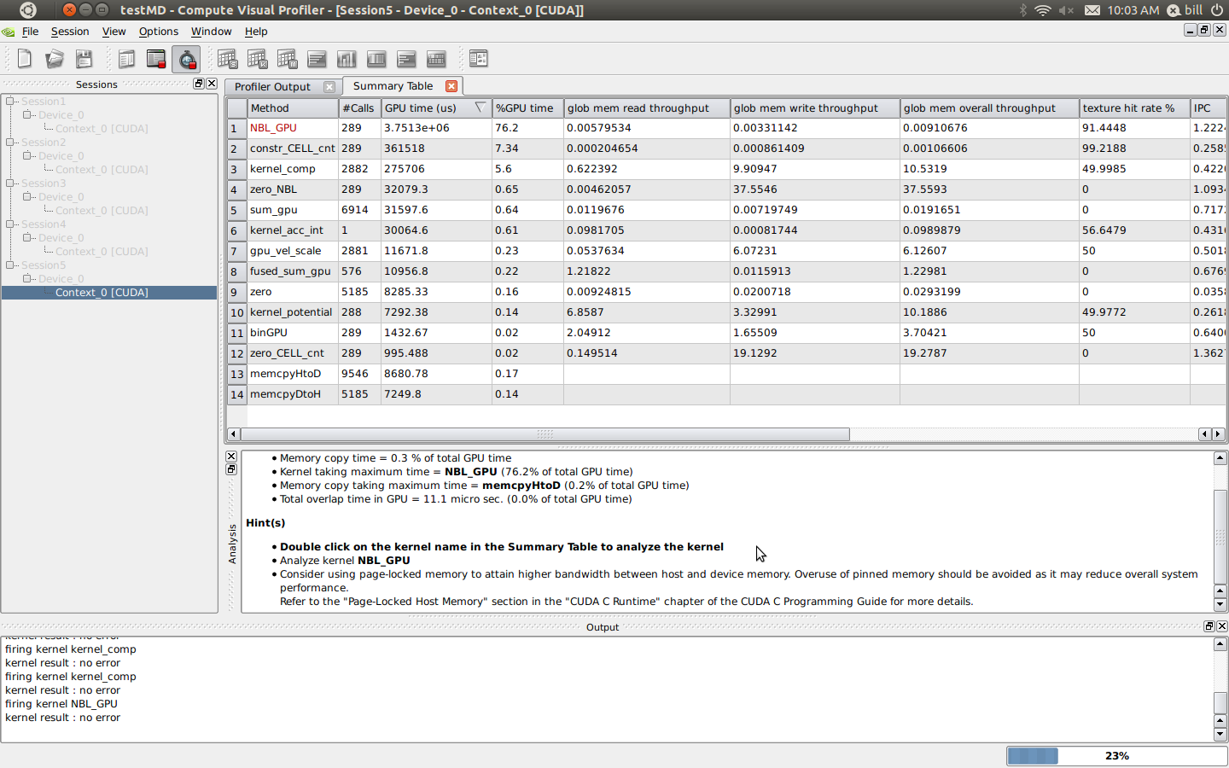
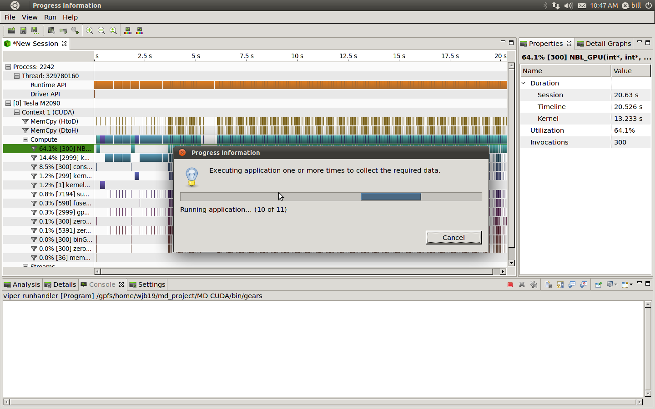
CUDA profilers
Use the profilers to understand your code and improve performance by refactoring, changing memory access and layout, block size etc
nvvp
computeprof
wjb19@psu.edu

Slide 50
Precision
Obvious performance differences btwn single and double precision, much easier to generate floating point exceptions in the former
Solution → mixed precision, algorithms for correction & error checking, removing need for oft-times painful debug
#ifndef _FPE_DEBUG_INFO_
#define _FPE_DEBUG_INFO_ printf("fpe detected in %s around %d, dump follows :\n",__FILE__,__LINE__);
#endif
#define fpe(x) (isnan(x) || isinf(x))
#ifdef _VERBOSE_DEBUG_
if (fpe(FTx)){
_FPE_DEBUG_INFO_
printf("FTx : %f threadIdx %i\n",FTx,threadIdx.x);
asm(“trap;”);
}
#endif
wjb19@psu.edu

Slide 51
Pinned Memory
cudaError_t cudaMallocHost(void ** ptr, size_t size)
Higher bandwidth memory transfers from device to host : from the manual :
Allocates size bytes of host memory that is page-locked and accessible to the device. The driver tracks the virtual memory ranges allocated with this function and automatically accelerates calls to functions such as cudaMemcpy*(). Since the memory can be accessed directly by the device, it can be read or written with much higher bandwidth than pageable memory obtained with functions such as malloc(). Allocating excessive amounts of memory with cudaMallocHost() may degrade system performance, since it reduces the amount of memory available to the system for paging. As a result, this function is best used sparingly to allocate staging areas for data exchange between host and device
wjb19@psu.edu

Slide 52
Driver & Kernel
Driver is (for most of us) a black box, signals can elicit undesirous/non-performant responses :
[wjb19@lionga1 src]$ strace -p 16576
Process 16576 attached - interrupt to quit
wait4(-1, 0x7fff1bfbed6c, 0, NULL) = ? ERESTARTSYS (To be restarted)
--- SIGHUP (Hangup) @ 0 (0) ---
rt_sigaction(SIGHUP, {0x4fac80, [HUP], SA_RESTORER|SA_RESTART, 0x3d4d232980}, {0x4fac80, [HUP], SA_RESTORER|SA_RESTART, 0x3d4d232980}, 8) = 0
Driver/kernel bugs, conflicts; make sure driver, kernel and indeed device are suited:
[wjb19@tesla1 bin]$ more /proc/driver/nvidia/version
NVRM version: NVIDIA UNIX x86_64 Kernel Module 285.05.09 Fri Sep 23 17:31:57 PDT 2011
GCC version: gcc version 4.1.2 20080704 (Red Hat 4.1.2-51)
[wjb19@tesla1 bin]$ uname -r
2.6.18-274.7.1.el5
wjb19@psu.edu

Slide 53
Compiler
Compiler options (indeed compiler choice : --nvvm --open64) can make huge differences :
  Fast math (--use_fast_math)
  Study output of ptx optimizing assembler eg., for register usage, avoid spillage( --ptxas-options=-v)
ptxas info : Compiling entry function '_Z7NBL_GPUPiS_S_S_S_' for 'sm_20'
ptxas info : Function properties for _Z7NBL_GPUPiS_S_S_S_
768 bytes stack frame, 0 bytes spill stores, 0 bytes spill loads
ptxas info : Function properties for _Z9make_int4iiii
40 bytes stack frame, 0 bytes spill stores, 0 bytes spill loads
ptxas info : Function properties for __int_as_float
0 bytes stack frame, 0 bytes spill stores, 0 bytes spill loads
ptxas info : Function properties for fabsf
0 bytes stack frame, 0 bytes spill stores, 0 bytes spill loads
ptxas info : Function properties for sqrtf
0 bytes stack frame, 0 bytes spill stores, 0 bytes spill loads
ptxas info : Used 49 registers, 3072+0 bytes smem, 72 bytes cmem[0], 48 bytes cmem[14]
wjb19@psu.edu

Slide 54
Communication : Inifiniband/MPI
GPUDirect ; Initial results encouraging for performing network transfers on simple payloads between devices:
[wjb19@lionga scratch]$ mpicc -I/usr/global/cuda/4.1/cuda/include -L/usr/global/cuda/4.1/cuda/lib64 mpi_pinned.c -lcudart
[wjb19@lionga scratch]$ qsub test_mpi.sh
2134.lionga.rcc.psu.edu
[wjb19@lionga scratch]$ more test_mpi.sh.o2134
Process 3 is on lionga7.hpc.rcc.psu.edu
Process 0 is on lionga8.hpc.rcc.psu.edu
Process 1 is on lionga8.hpc.rcc.psu.edu
Process 2 is on lionga8.hpc.rcc.psu.edu
Host->device bandwidth for process 3: 2369.949046 MB/sec
Host->device bandwidth for process 1: 1847.745750 MB/sec
Host->device bandwidth for process 2: 1688.932426 MB/sec
Host->device bandwidth for process 0: 1613.475749 MB/sec
MPI send/recv bandwidth: 4866.416857 MB/sec
Single IOH supports 36 PCIe lanes, NVIDIA recommend 16 per device; however IOH doesn't currently support P2P between GPU devices on different chipsets
wjb19@psu.edu

Slide 55
Communication : P2P
For this reason, difficult to achieve peak transfer rates between GPU's separated by QPI eg.,
>cudaMemcpy between GPU0 and GPU1: 316.54 MB/s
>cudaMemcpy between GPU0 and GPU2: 316.55 MB/s
>cudaMemcpy between GPU1 and GPU0: 316.86 MB/s
>cudaMemcpy between GPU2 and GPU0: 316.93 MB/s
>cudaMemcpy between GPU1 and GPU2: 3699.74 MB/s
>cudaMemcpy between GPU2 and GPU1: 3669.23 MB/s
[wjb19@lionga1 ~]$ lspci -tvv
-+-[0000:12]-+-01.0-[1d]--
| +-02.0-[1e]--
| +-03.0-[17-1b]----00.0-[18-1b]--+-04.0-[19]--
| | +-10.0-[1a]--
| | \-14.0-[1b]--+-00.0 nVidia Corporation Device 1091
| | \-00.1 nVidia Corporation GF110 High...
| +-04.0-[1f]--
| +-05.0-[20]--
| +-06.0-[21]--
| +-07.0-[13-16]----00.0-[14-16]--+-04.0-[15]--+-00.0 nVidia Corporation Device 1091
| | | \-00.1 nVidia Corporation GF110 High...
...
...
+-05.0-[05]----00.0 Mellanox Technologies MT26438 [ConnectX VPI PCIe 2.0 5GT/s ...
+-06.0-[0e]--
+-07.0-[06-0a]----00.0-[07-0a]--+-04.0-[08]--+-00.0 nVidia Corporation Device 1091
| | \-00.1 nVidia Corporation GF110 High...
| +-10.0-[09]--
| \-14.0-[0a]--
wjb19@psu.edu

Slide 56
Summary
CUDA and Nvidia GPU's in general provide an exciting and accessible platform for introducing acceleration particularly to scientific applications
Writing effective kernels relies on mapping the problem to the memory and thread hierarchy, ensuring coalesced loads and high occupancy to name a couple of important optimizations
Nvidia refer to the overall porting process as APOD → assess,parallelize,optimize,deploy
To accomplish this cycle, one must balance many factors:
  Profiling & readying serial code for porting
  Optimal tiling &communication
    P2P,Network,Host/device
  Compiler and other optimizations
  Application/kernel/driver interactions
  Precision etc etc
wjb19@psu.edu

Slide 57
References
CUDA C Best Practices Guide January (2012)
NVIDIA’s Next Generation CUDA Compute Architecture: Fermi (2009)
NVIDIA CUDA C Programming Guide 4.0
NVIDIA GPUDirectTM Technology – Accelerating GPU-based Systems (Mellanox)
CUDA Toolkit 4.0 Overview
Numerical Recipes in C
Sreejith Jaya/physics
Pierre-Yves Taunay/aero
Michael Fenn/rcc
Jason Holmes/rcc
Acknowledgements
wjb19@psu.edu

