Slide 1
GPU Fsolve
Algorithm:
  [CPU] parse equations f(y) using Boost::Spirit
  [CPU] differentiate f(y), create analytic J(y)
  [CPU] populate data structures representing f(y), J(y), copy to GPU
  [GPU] Iterate (Newton-Raphson) →
      Numerically evaluate f(y) and J(y)
      Solve for delta in f(y) = -delta . J(y) using GMRES from CUSP
      Update y += delta and repeat until ||f(y)|| < tol

Slide 2
GPU Fsolve
Equations expressed as simple polynomials eg.,
1.0*k(13)*y(74)+1.0*k(18)*y(76)-1.0*k(17)*y(3)*y(35)-1.0*k(14)*y(3)*y(75)
Parser: grammars and descriptors expressed using ~ Extended Backus Naur Form (EBNF) using Boost::Spirit (C++) eg.,
template <typename Iterator>
bool parse_k_vals(Iterator first, Iterator last,std::vector<float>& w)
{
bool r = phrase_parse(first, last,
// grammar for k constants
(
("k(" >> float_[push_back(phoenix::ref(w), _1)] >> ')')
)
,
//skip characters
space | '*' | float_ >> '*' | '-'>>float_ >> '*'| '+' >> float_ >> '*'| "y(" >> float_ >> ')');
return r;
}

Slide 3
GPU Fsolve
For all input equations, parser populates vectors &vectors of maps w/:
    Constant k indices & k values (supplied separate file)
    Other coefficient/sign data
    Variable y indices &powers
Subsequently, CPU calculates analytic Jacobian
  All equations polynomials; differentiation is 'easy'
  Populate map structures
  Ultimately store information in arrays of structs, for tree evaluation on GPU

Slide 4
GPU Fsolve
On GPU, whether Jacobian or function evaluation, one block evaluates one equation or one (i,j) element, respectively:
    Each thread loads and evaluates one eval_node
      This is a sub term in equation or Jacobian element
      Texture memory used for random accesses
      All members multiplied together
    Final tree reduction for complete equation/(i,j)
typedef struct{
float constant; //
int k_index; // for look-up in texture
int y_index_1; // “
float y_exp_1; // the exponent for this term
int y_index_2; // as before
float y_exp_2; // as before
} eval_node;

Slide 5
GPU Fsolve
1.0*k(13)*y(74)+1.0*k(18)*y(76)-1.0*k(17)*y(3)*y(35)-1.0*k(14)*y(3)*y(75)
node evaluation
reduction
0 → 0+2
1 → 1+3
reduction
0 → 0+1
ThreadIdx.x = 0 1 2 3

Slide 6
GPU Fsolve
Function &Jacobian evaluation take place repetitively throughout iterations; THRUST library used for wrapping arrays, for use with CUSP solver(s)
Jacobian matrix represented in COO format, using CUSP:
// create sparse matrix structure (COO format)
cusp::coo_matrix<int, float, cusp::device_memory> J(f_size,f_size,j_size);
//get indices setup
thrust::copy(index_i.begin(),index_i.end(),J.row_indices.begin());
thrust::copy(index_j.begin(), index_j.end(),J.column_indices.begin());
GMRES interface from CUSP used for solve

Slide 7
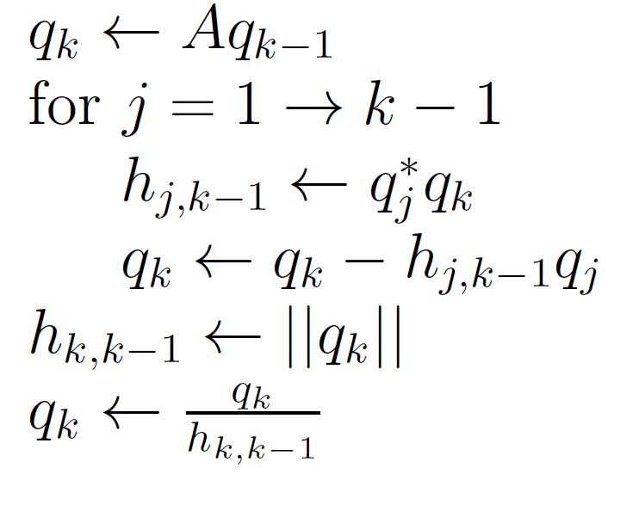
GPU Fsolve
Many matrix-vector operations throughout overall process eg., Arnoldi iterations in GMRES, highly amenable to GPU:
Numerical evaluation of equations, Jacobian very efficient also
Good results overall for several hundred equations, getting tricky for larger sets of equations owing to poor condition number → use preconditioners in CUSP

