Slide 1
Establishing a CUDA Research Center at Penn State: Perspectives on GPU-Enabled Teaching and Research
William J. Brouwer (wjb19@psu.edu)
Pierre-Yves Taunay (py.taunay@psu.edu)
Research Computing and Cyberinfrastructure
The Pennsylvania State University
Nvidia GTC 2014

Slide 2
Outline
Center Overview (RCC @ PSU)
GPU accelerated research
  IceCube
  Metabolic Networks (Fsolve/cuSolve)
  MD + Simulated Annealing
  FQHE (LU Decomposition)
  Smart Proppants (QR Decomposition)
GPU cluster scaling
  Amber
  PetaChem
  Quantum Espresso
    Lanczos Diagonalization
CUDA, needs + wants
Summary
Nvidia GTC 2014

Slide 3
Center Overview
Research Computing and Cyberinfrastructure (RCC) at PSU
provides high performance computing services :
  Hardware, proprietary/open source software
  Consultation (numerical/algorithmic, software development etc)
PhD's, system admins and programmers work together to provide
these services to academics while performing independent
research
Many users are interested in using GPUs for science and engineering research applications, we are a CUDA research center https://research.nvidia.com/content/penn-state-crc-summary
Formerly under ITS, currently incorporating into Office of the Vice President for Research (OVPR)
Nvidia GTC 2014

Slide 4
Center Overview
Hardware is ~ 12K CPU cores, 64 GPUs (Fermi), several Kepler
Red Hat Linux, scheduling via PBS/Moab/Torque
Usual monitoring/management tools eg., Puppet, Jenkins, Nagios, Ganglia, and some custom solution(s) ( eg., CLPR)
Serve ~ 7k users, all campuses in the commonwealth
Use CUDA predominantly, although growing numbers of users trying OpenACC, OpenCL, libraries etc
Environment modules system
Nvidia GTC 2014

Slide 5
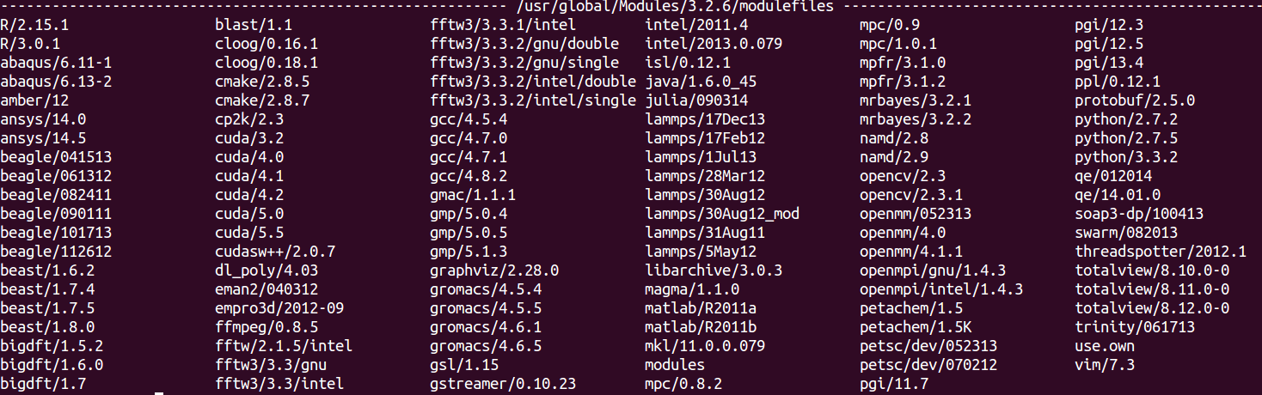
Center Overview
Support many GPU accelerated applications
Nvidia GTC 2014

Slide 6
Outline
Center Overview (RCC @ PSU)
GPU accelerated research
  IceCube
  Metabolic Networks (Fsolve/cuSolve)
  MD + Simulated Annealing
  FQHE (LU Decomposition)
  Smart Proppants (QR Decomposition)
GPU cluster scaling
  Amber
  PetaChem
  Quantum Espresso
    Lanczos Diagonalization
CUDA, needs + wants
Summary
Nvidia GTC 2014

Slide 7
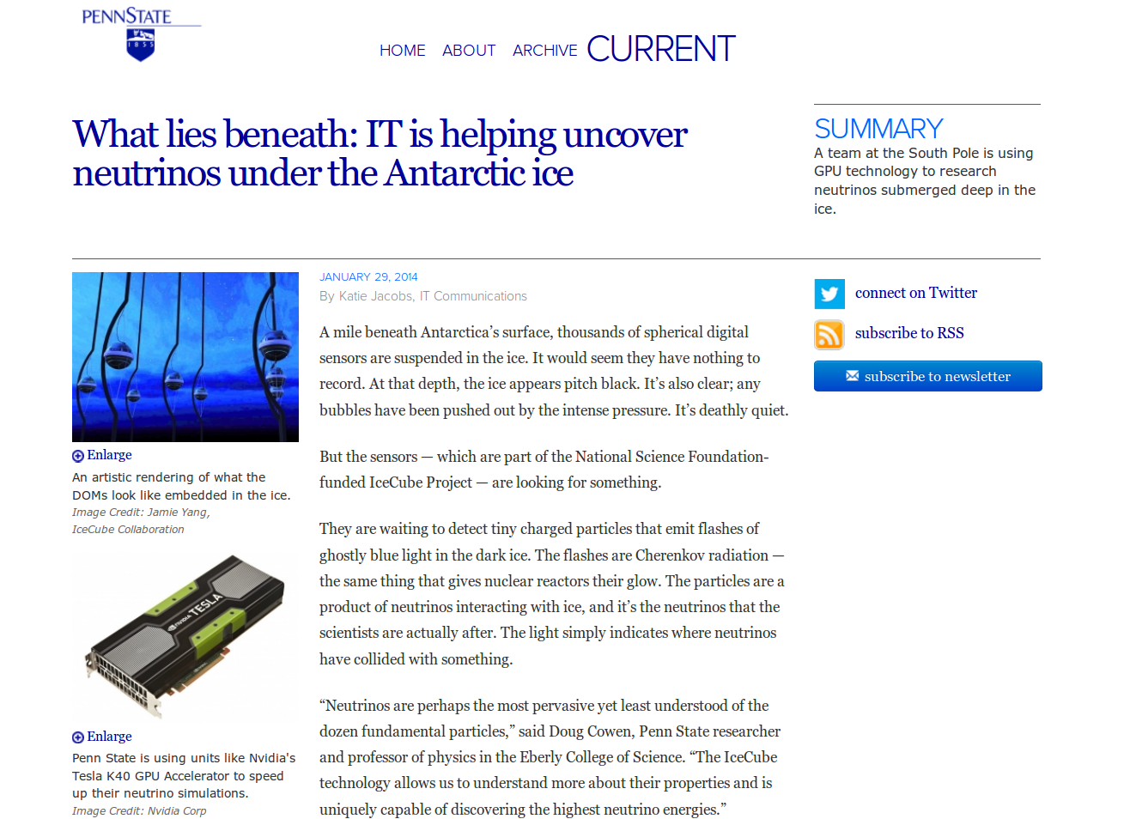
IceCube
Nvidia GTC 2014

Slide 8
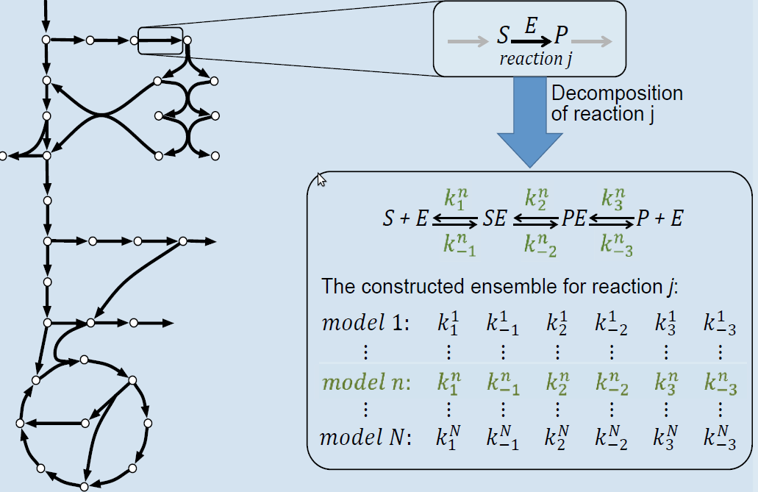
Metabolic Networks
Optimal models for the metabolic networks of microbial organisms important in pharma, energy industries
Ensemble Modeling (EM) is used to construct chemical kinetics of microbial organisms → decompose metabolic reactions into the elementary mechanisms, which are ODE systems f(ki,yj) = dyj/dt
Overall approach maximizes correlation between model predictions and experimental measurements, performed in steady state → solve f(k,y) = 0
Nvidia GTC 2014

Slide 9
Metabolic Networks
  [CPU] parse equations f(k,y)
  [CPU] differentiate f(k,y), create analytic J(k,y)
  [CPU] populate data structures representing f(k,y), J(k,y), copy to GPU
  [GPU] Iterate (Newton-Raphson) →
      Numerically evaluate f(k,y) and J(k,y) by parallel reduction
      Solve for delta in f(k,y) = -delta . J(k,y) using GMRES
      Update y += delta and repeat until ||f(k,y)|| < tol
Nvidia GTC 2014

Slide 10
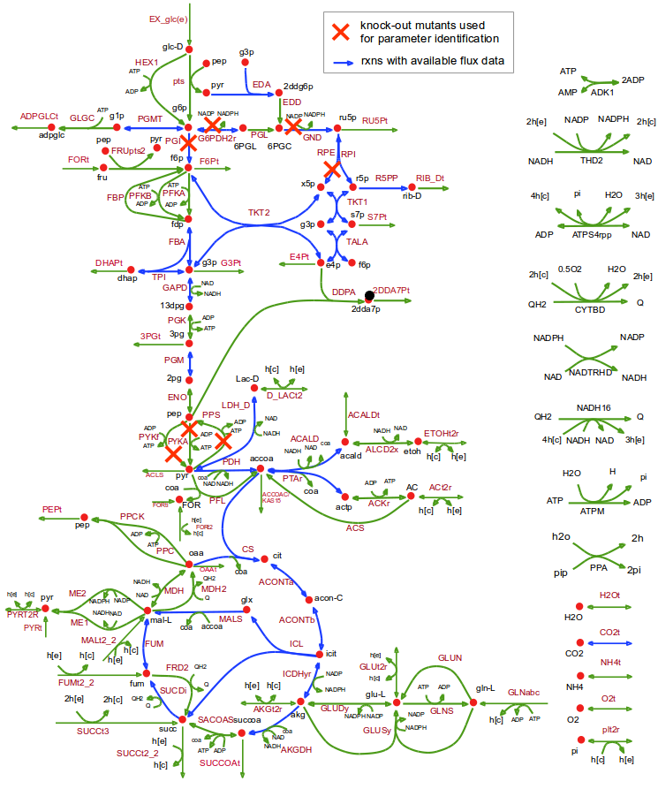
Metabolic Networks
Solution uses various libraries including Boost, Thrust, CUSP and CUDA
Matrices sparse, poorly conditioned, but solution works well for O(10^2) equations
Currently working to scale to larger, more interesting networks and microbial organisms
CuSolve is a work in progress, a GPU-only ODE solve for stiff equations
Nvidia GTC 2014

Slide 11
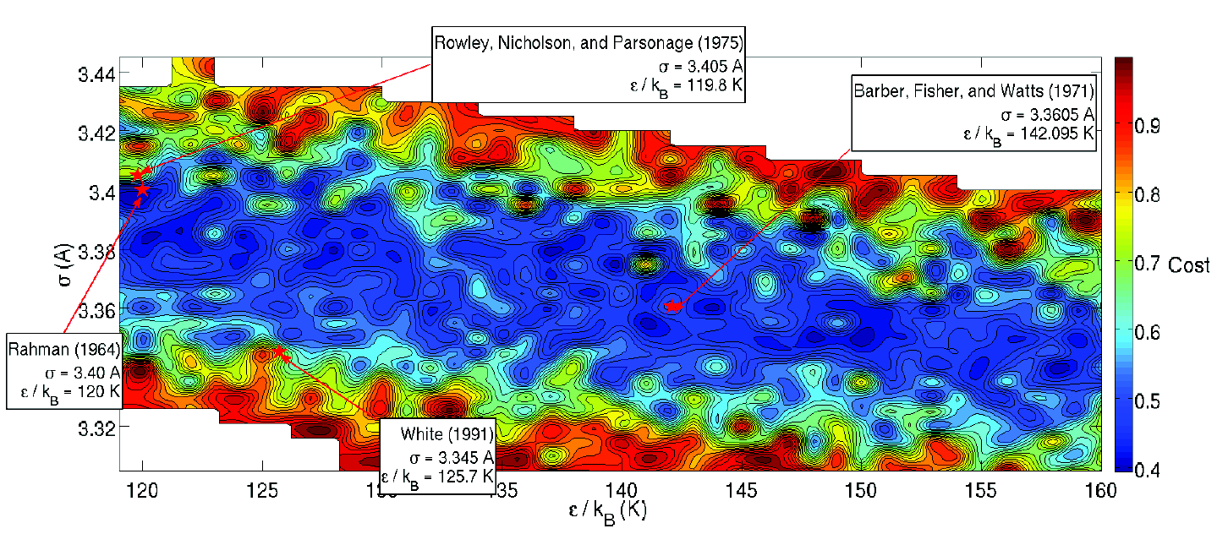
Molecular Dynamics + Sim Anneal
Solve for MD potentials by fitting experimental data for structure factor
Optimization surface (below) is highly non-convex → use simulated annealing, each GPU performs independent MD run
Nvidia GTC 2014

Slide 12
LU Decomposition
Batch LU decomposition developed for fractional quantum Hall effect, fundamental physics that has implications in quantum computation and material science
O(N!) determinants need to be evaluated in constructing wavefunction, process repeated many times in Monte Carlo calculation
Small, dense matrices of side <= 512
Implementation exploits SIMD architecture, parallel reduction
Example; N=11, computation time using 8 GPU devices (w/ MPI), 1024 Monte Carlo iterations is ~ 246 seconds from ~ 31488 single CPU
Nvidia GTC 2014

Slide 13
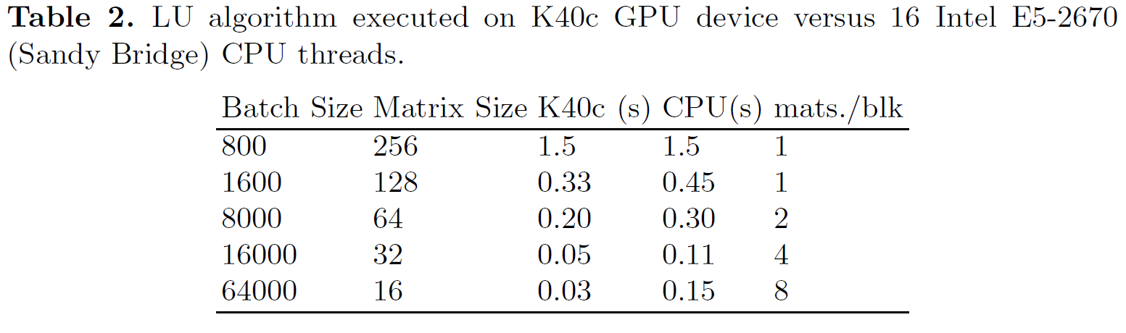
LU Decomposition
Nvidia GTC 2014

Slide 14
QR Decomposition
Proppant materials used to stabilize fissures created during hydraulic fracturing
'Smart proppants' are essentially electrical dipoles which may absorb and re-emit EM energy, irradiated and recorded by downhole instrumentation
This work considers an iteration-free solution to this EM scattering problem, uses linear algebra including LU and SVD decomposition
SVD can be performed using the QR algorithm, in turn a function of QR decomposition
Devised a unique approach for large batches of dense small matrices using Givens rotations; largely independent ops, maps well to GPU
Nvidia GTC 2014

Slide 15
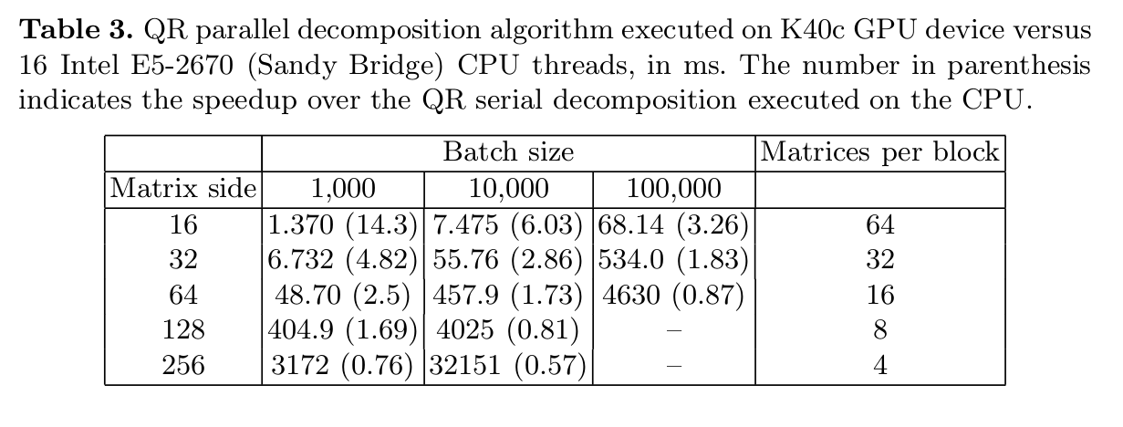
QR Decomposition
Nvidia GTC 2014

Slide 16
Outline
Center Overview (RCC @ PSU)
GPU accelerated research
  IceCube
  Metabolic Networks (Fsolve/cuSolve)
  MD + Simulated Annealing
  FQHE (LU Decomposition)
  Smart Proppants (QR Decomposition)
GPU cluster scaling
  Amber
  PetaChem
  Quantum Espresso
    Lanczos Diagonalization
CUDA, needs + wants
Summary
Nvidia GTC 2014

Slide 17
GPU Cluster Scaling
Several key GPU accelerated software suites were tested using multiple GPUs across two clusters
Cluster | Lion-GA | Stampede
CPU | 12 X5675 @ 3.07 GHz | 16 E5-2680 @ 2.70 GHz
GPU | 8 M2070 or 8 M2090 | 1 K20c
Nodes equipped with GPUs | 8 | 120
Interconnect | 40 Gb/s Mellanox QDR Infiniband | 56 Gb/s Mellanox FDR Infiniband
Nvidia GTC 2014

Slide 18
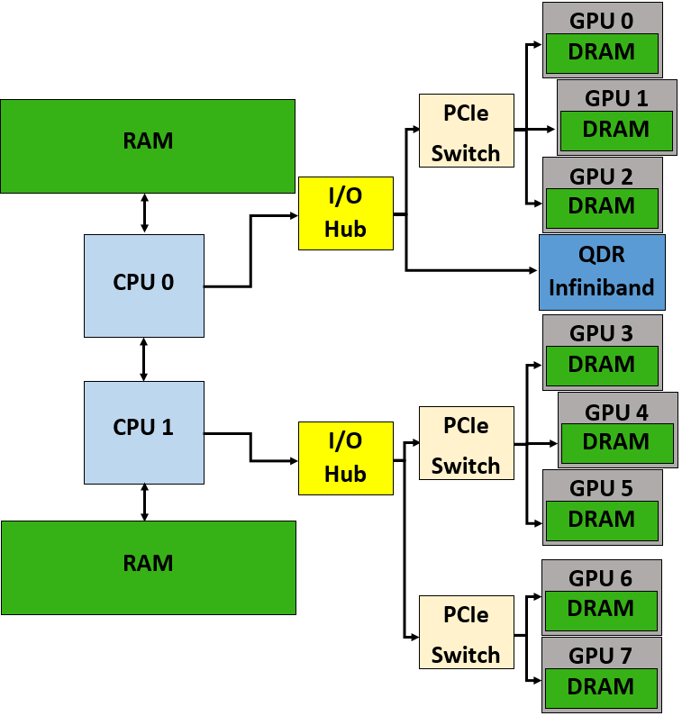
GPU Cluster Scaling
Lion-GA cluster has 3 GPUs per PCIe switch, 3 to 5 GPUs per IOH chip
IOH doesn't support peer to peer transfers between GPU devices on different chipsets
Difficult to achieve peak transfer rates across GPU on different sockets
Nvidia GTC 2014

Slide 19
Amber
Molecular Dynamics is widely used for simulation of solvated proteins or molecules and make use of various force fields (AMBER, ReaxFF, etc.)
AMBER force field is implemented in the eponymous software suite
The software PMEMD in AMBER is used for both explicit solvent Particle Mesh Ewald (PME) and implicit solvent General Borne (GB) simulations
AMBER does not require extensive communication between GPUs or between CPU and GPU, and does not take advantage of the CPU if GPUs are used
GPU acceleration allows for longer simulation times ~ nanosecond or more
Nvidia GTC 2014

Slide 20
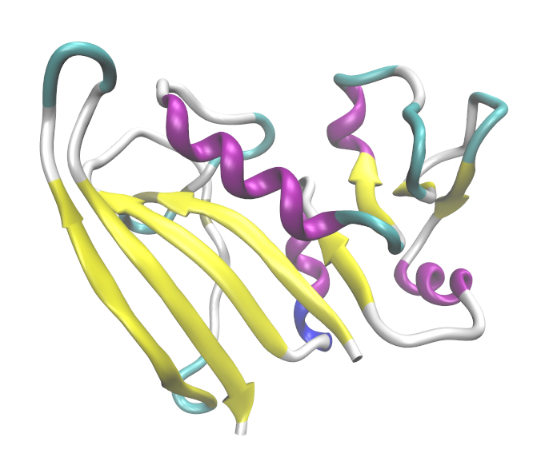
Amber
Nvidia GTC 2014

Slide 21
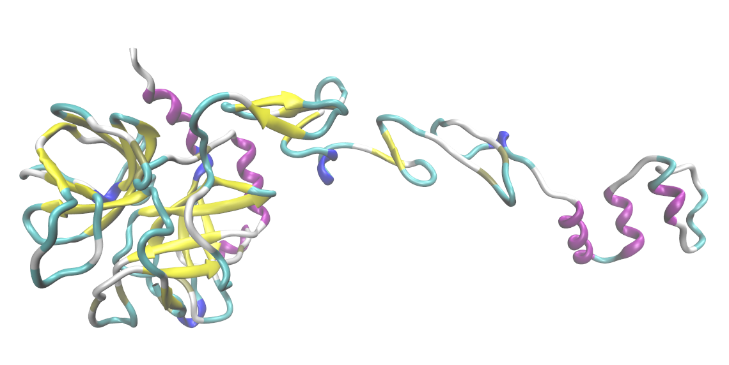
Amber
Nvidia GTC 2014

Slide 22
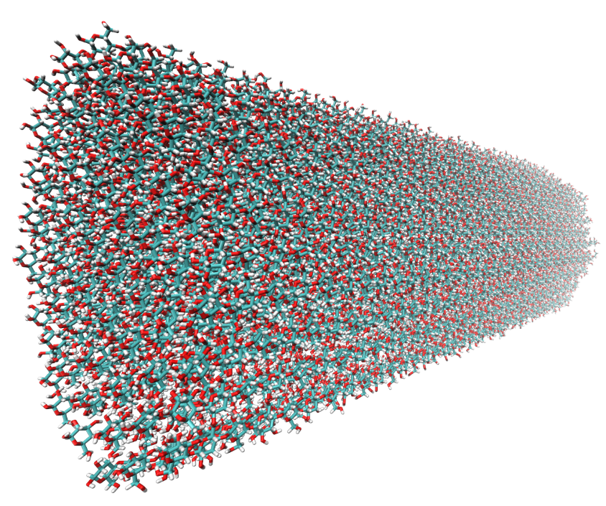
Amber
Nvidia GTC 2014

Slide 23
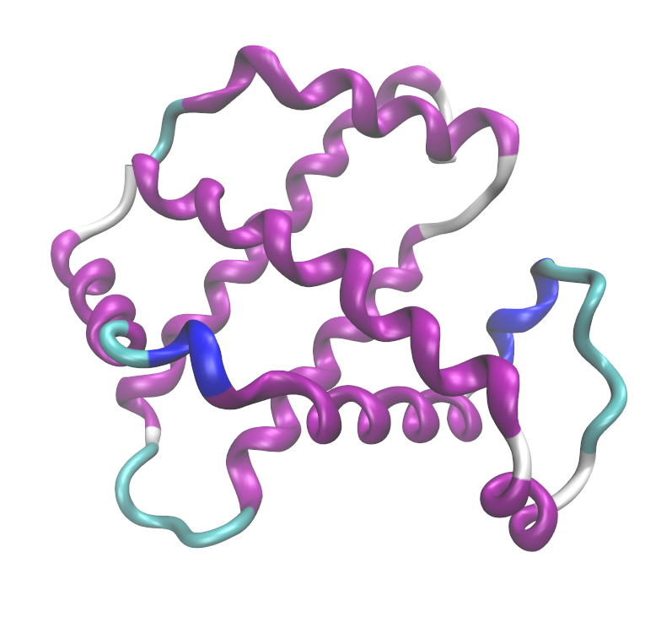
Amber
Nvidia GTC 2014

Slide 24
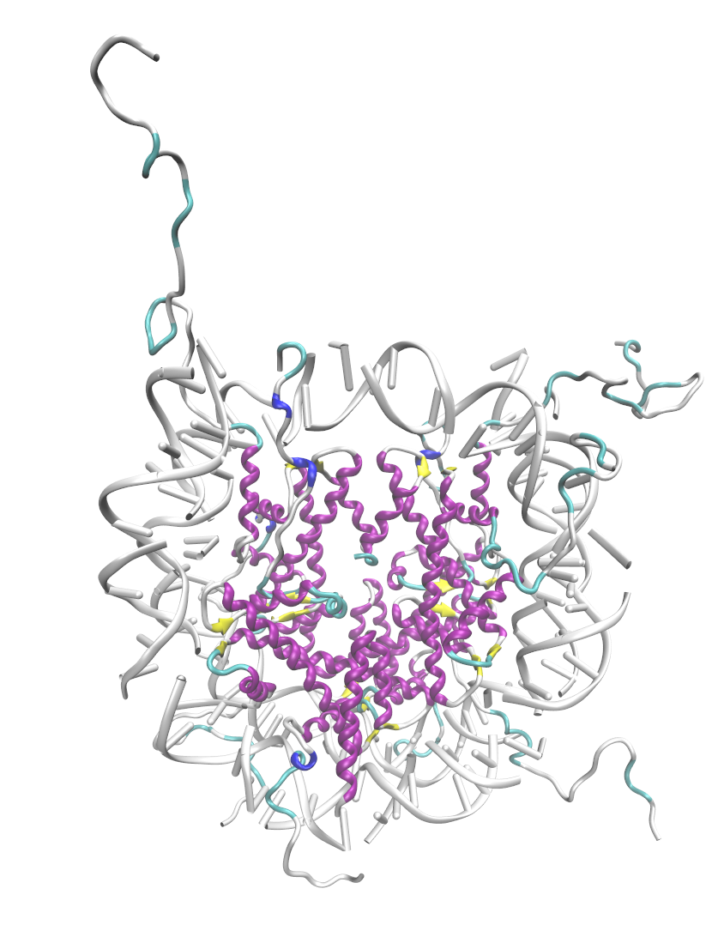
Amber
Nvidia GTC 2014

Slide 25
PetaChem
Quantum Chemistry designed to run on NVIDIA series hardware
Features restricted Hartree-Fock and grid-based Kohn-Sham single point energy and gradient calculations
Various functions supported, geometry optimization, ab-initio molecular dynamics, support for multi-GPU
Benchmark: single point energy, using basis 6-31g for Olestra
Nvidia GTC 2014

Slide 26
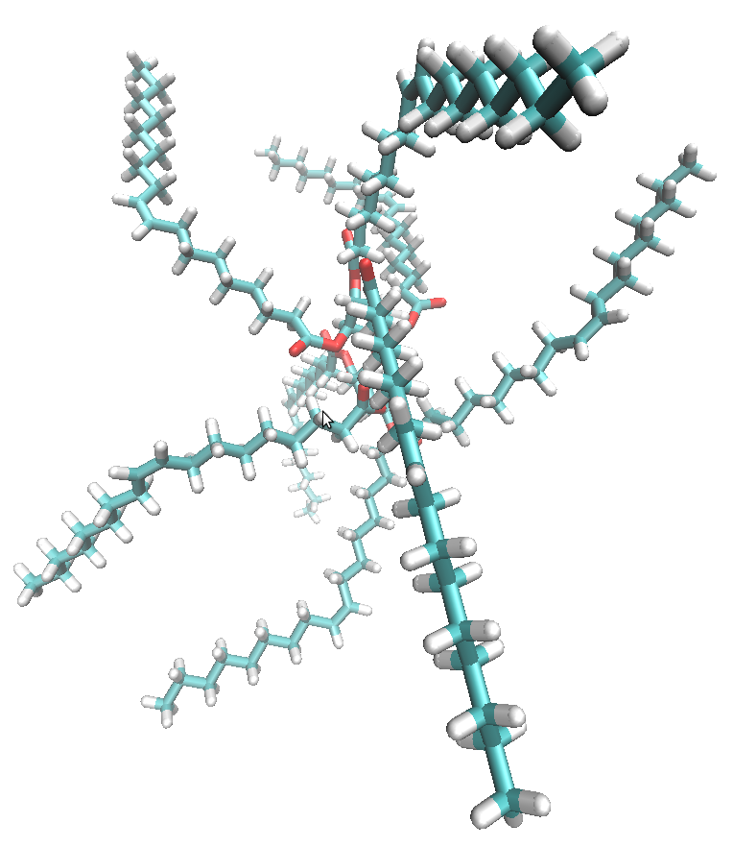
PetaChem
Nvidia GTC 2014

Slide 27
Quantum Espresso
Density Functional Theory (DFT) has enjoyed huge growth in popularity owing to computational and numerical advancements; used widely in material science
Quantum Espresso (QE) is an open source DFT package that has recently added GPU acceleration, largely through BLAS and FFT routines
When building QE with MAGMA (UT/ORNL) or phiGEMM, one introduces heterogeneous CPU/GPU linear algebra routines
Benchmark:
  Self-consistent field calculation, using PBE pseudopotentials,168 atoms (cellulose)
  Periodic boundary conditions, kinetic energy cutoff (Ry) for charge density of 80 Ry, Davidson diagonalization
Nvidia GTC 2014

Slide 28
Quantum Espresso
Nvidia GTC 2014

Slide 29
Lanczos Diagonalization
Key task in many applications, esp quantum chemistry & DFT is diagonalization ie., matrix eigen-decomposition
Lanczos is a power method, produces a tri-diagonal matrix, more readily solvable; consists of many matrix-vector operations, very amenable to GPU, currently using cuBLAS &MKL in a heterogeneous solution.
Originally devised for fundamental physics project at PSU, now intended for incorporation into GPU-Quantum Espresso project being led by Filippo Spiga
Attempting to scale to multiple devices using MPI + GPUdirect, still beset by some numerical/convergence problems with increasing matrix size
Nvidia GTC 2014

Slide 30
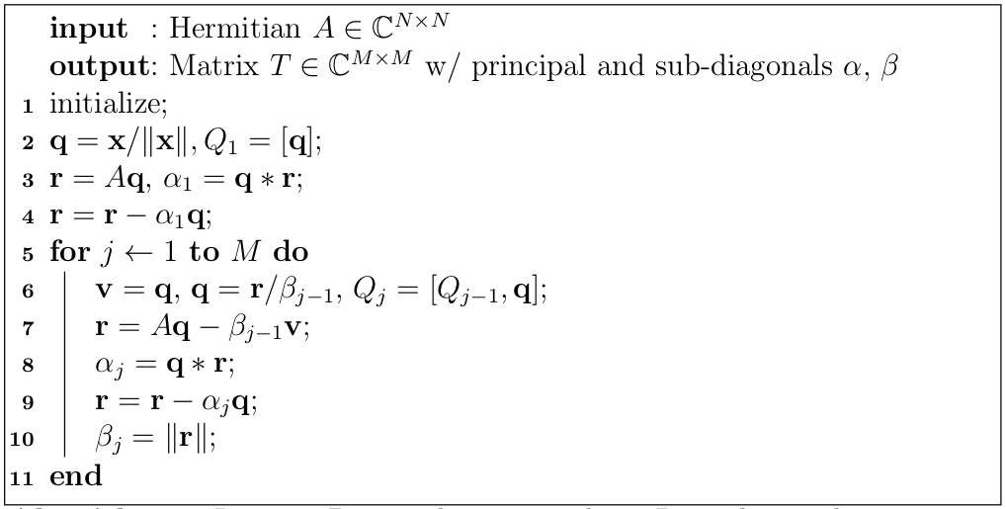
Lanczos Diagonalization
Nvidia GTC 2014

Slide 31
Lanczos Diagonalization
CUDA 5.5/Kepler overall yields pleasing communication results (CUDA-enabled openmpi 1.7.3, MPI send/recv), collectives less impressive
Bandwidths for one-sided comms have some message size dependency &jitter, but effective bandwidth much improved over previous gens.
5
4
3
2
Results of 4 tests
Rhel 6, Intel x86_64, Nvidia driver 331.38
Communication btwn K20 & K40
Bandwidth GB/s
2 4 6 8
1e+07
Increasing msg size in MB, within single application
Nvidia GTC 2014

Slide 32
Outline
Center Overview (RCC @ PSU)
GPU accelerated research
  IceCube
  Metabolic Networks (Fsolve/cuSolve)
  MD + Simulated Annealing
  FQHE (LU Decomposition)
  Smart Proppants (QR Decomposition)
GPU cluster scaling
  Amber
  PetaChem
  Quantum Espresso
    Lanczos Diagonalization
CUDA, needs + wants
Summary
Nvidia GTC 2014

Slide 33
CUDA needs + wants
ODE and Function Solver(s), metabolic networks, chemically reactive flows w/ OpenFOAM
→ support for more C++11 language features?
Lanczos Diagonalization, DFT/quantum chemistry, incorporation into Quantum Espresso
→ further improvements to GPUdirect (or use new multi-GPU interfaces instead)?
Batch LU/QR
→ increased warp size?
Nvidia GTC 2014

Slide 34
Summary
Early adopters astrophysics, quantum chem/condensed matter still active, see most growth in strands of computational biology/life science, 'big data'
Teaching seminars generally well received/attended, but...
Most success from working to identify users/codes that can benefit from GPU by monitoring clusters, and on a related note...
The harvest is plentiful in academia but the workers are few; generally if a code 'works' little pressure to make it better
However changes even in traditional CPU architecture are forcing workers to reevaluate their computational models (thanks Ken Esler for this perspective); we live more and more in a parallel world
Nvidia GTC 2014

Slide 35
Acknowledgements
Mark Berger, Chandra Cheij &Nvidia for generous donations
{Ryan Eagen/Cowen group, Ali Khodayari/Maranas group, Sreejith Jaya Ganesh, Jim Kubicki, Dan Haworth, Adri Van Duin} PSU
{Chuck Gilbert, Jason Holmes} our longsuffering sys admins
HP for donation of 50 M2070
XSEDE/TACC for Stampede cycles
Nvidia GTC 2014

