Slide 1
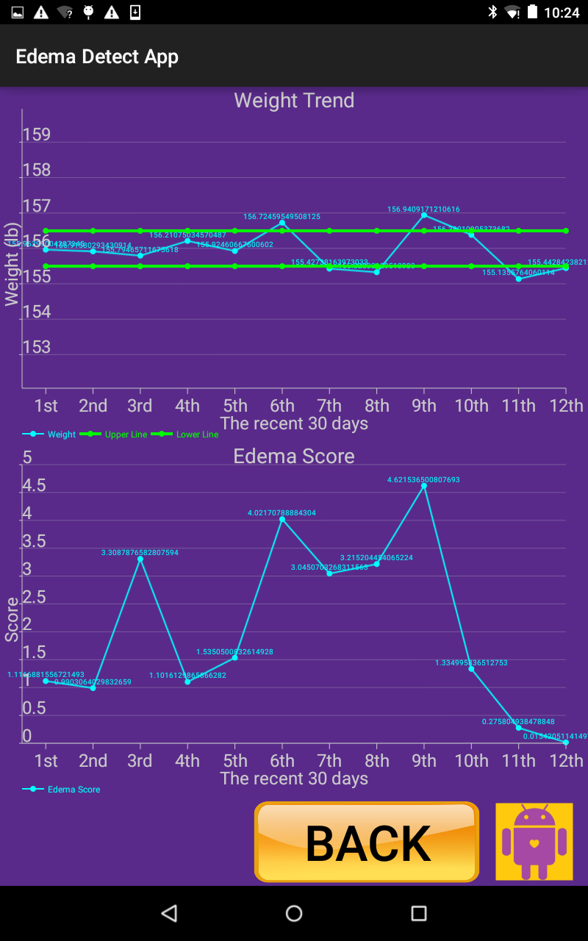
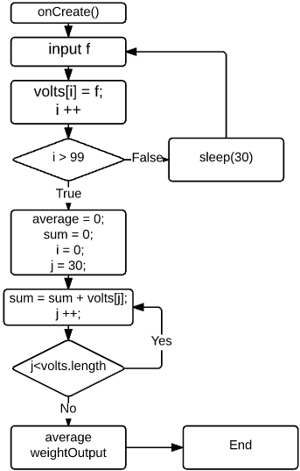
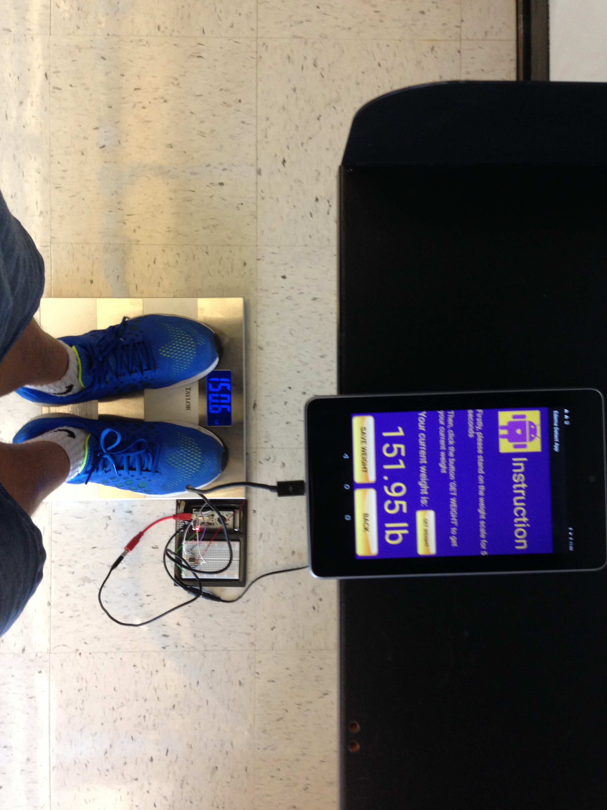
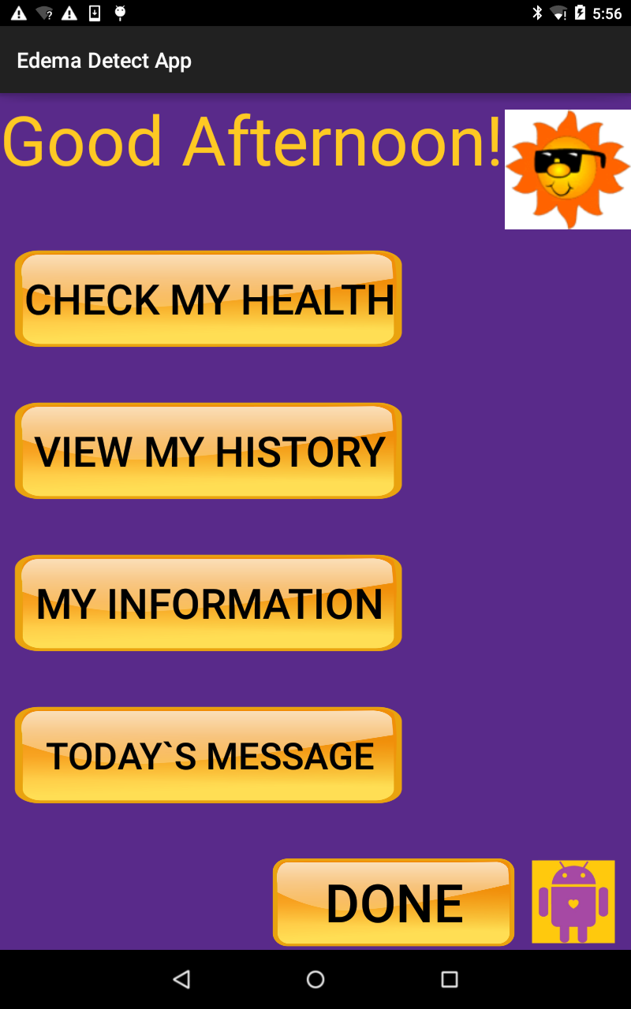
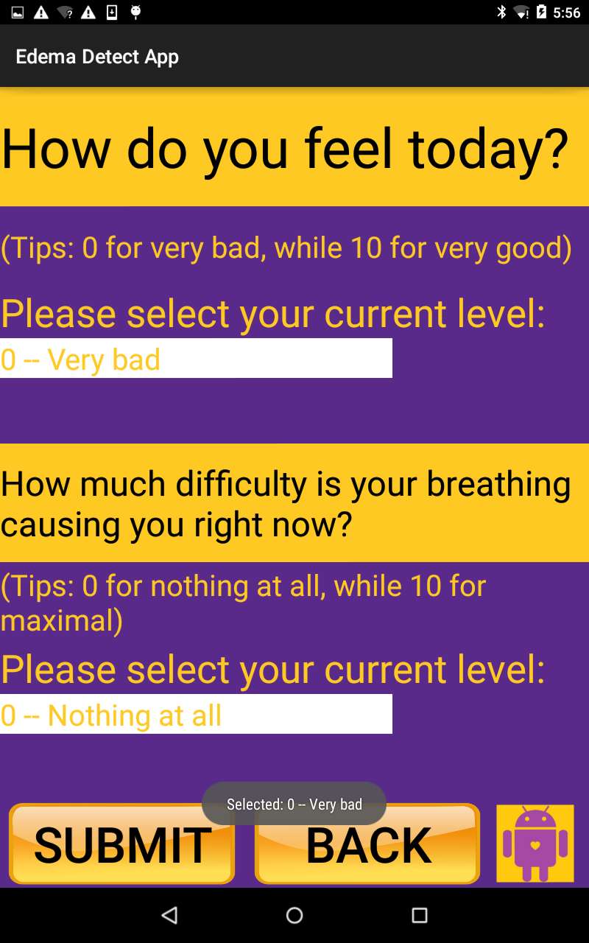
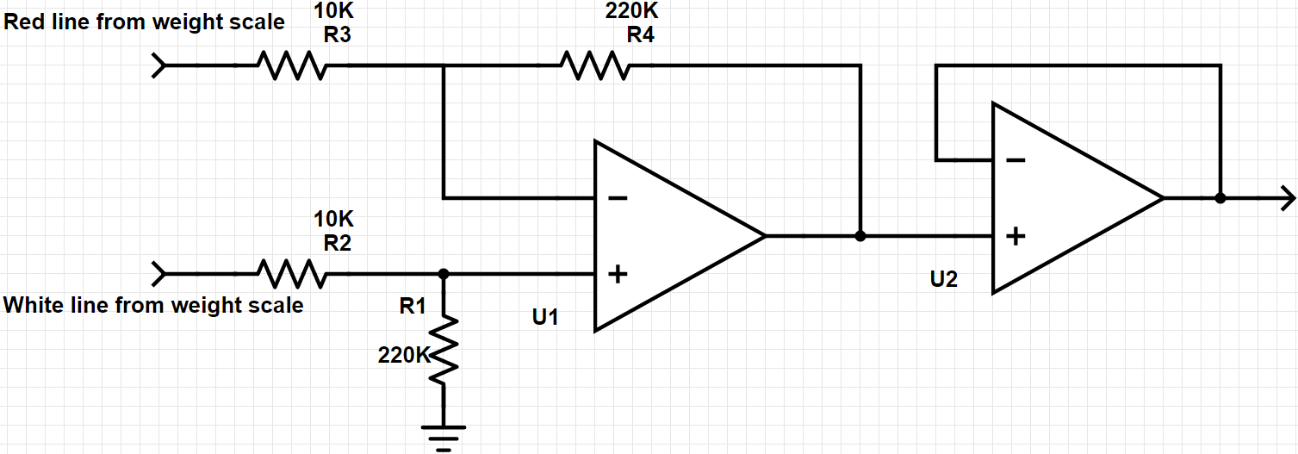
Design and Development of an Android Application for Edema Measurement
Jiabin Wang, Elizabeth M.B Weaver, Brandon D. Langley & Jianchu Yao, Stephanie M. George, Sonya R. Hardin
Abstract
Methods (Continued)
Methods (Continued)
A clinician uses the swelling (edema) of the extremities to assess a patient’s heart condition by pressing his/her thump on the patient’s leg and checking the amount of pitting (indentation) in the skin. Because it is not convenient for heart patients to evaluate their own edema, clinicians may fail to accurately assess based only on weekly or monthly measurement. To solve this significant problem, an Android application for edema measurement is designed and developed. The primary functionality of the application is to, based on signals received from sensors, calculate and show the edema score. The edema score is represented with a number between 1+ and 4+, where 4+ indicates the most severe level. To support the calculation, we designed a hardware device, consisting of a displacement sensor, a force sensor, and an IOIO board, where the IOIO board connects the Android device and all the sensors. The application can also read the patient weight data directly from a weight scale through IOIO board; calculate and display the patient BMI (Body Mass Index); and show the trend of weight and edema score within the most recent 30 days. Additionally, the application gathers patient’s health information by asking their feelings and the level of difficulty experienced in breathing. All the data are stored within a built-in database. To date, all the functions are completed, with the exception of the essential algorithm for edema score calculation, which is still under development. The user friendliness of the application is yet to be tested.
The Edema Android application is designed and developed for continuous monitoring of heart failure (HF) patients. Theoretically, patients` weight changing and Edema score can reflect their health status. In our application, we introduced weight scale, force sensor, and displacement sensor to capture the data from patients.
In general, it`s impossible to get the voltage signal from weight scale directly. To solve the problem and get the exact weight data, we, firstly, conducted the intermedium voltage which reflects measured weight from scale circuit. Then, we deployed two stages of operational amplifiers (with a gain of 22) for enhancing the analog signal to make sure the accuracy of weight displayed on the Android tablet (see figure 1).
From scale bridge
To IOIO AI input
Figure 1: A two-stage operational amplifier with a gain of 22 connects the weight data to the IOIO board.
Sparkfun IOIO board plays a very import role in our application, because all analog signal should be convert into digital flout datatype through the IOIO board for being received by Android tablet. It is controlled by Android application, which means there are some drive code for driving IOIO board within our Android app. The main part is:
class Looper extends BaseIOIOLooper{
….
}
Through methods within this class, the IOIO board can be used with digital input/output,
Analog input, I2C, SPI, PWM (pulse width modulation), and UART control.
Android device which includes tablet, smartphone, TV, and so on is the terminal for patients using via our Android app. In order to support the functionality, the Android app consists of three major part, User Interface (UI), Algorithm, and Database.
Android Studio which is the official tool supported by Google for Android development provides a very powerful UI design approach. For beginner, them can design and develop a simple UI page by dragging in and out. However, to get more structural and consistent UI design, developer should use the text approach coding XML language by themselves. Also, developers can borrow library from open source to implement their own function. For example, within our Android app, we borrowed achartengine from the github to allow patients to see their weight and Edema score`s trend clearly and effectively (see figure 2).
Figure 2: Historical trend display page Figure 3: flow chart of calculating
example: weight and edema score in a the weight.
12-day span.
Within our app, there are two primary algorithms. The first one is to calculate the patient`s real weight from captured voltage data. To improve the accuracy of the measured weight, we designed an array with 100 element capacity for storing data, and used the average number as the parameter to calculate the weight (see figure 3). However, because of lacking the parameters of the weight scale, we have to form the equation for getting the precise weight data. In order to get the equation, we manually selected several samples consisting of voltage and weight data read from the weight scale ranging from 20lb to 400lb, then, used the excel to generate the line chart as well as the equation. The other one is to calculate the Edema score, and the process is similar with the weight calculation. As the equation of measuring weight came from the relationship between the weight displayed on the weight scale and the voltage measured by voltmeter, the equation of elstimating Edema score is from the relationship between the data from force sensor and displacement sensor.
Moreover, to make our app more popular and useful, we introduced the Body Mass Index (BMI) calculation to help patients monitor their body fat based on their height and weight.
The last import part within our app is database which is to store each measurement and provide data for trend chart. The SQL language of Android database named SQLiteDatabase has much in common with traditional SQL language, such as MySQL, but still has some differences. For SQLiteDatabase, the basic methods are execSQL(), insert(),
Update(), and rawQuery(). To realize database-related functions, several methods were implemented. For instance, to build the trend chart, the app retrives weight data and Edema scores from the database by:
public double [] getWeightData(){ public double [] getScoreData(){
…. ….
Cursor rs = db.rawQuery();} Cursor rs = db.rawQuery();}
Through our development, we have already done most part of the app. For example, the patients can use our application to measure their weight easily (see figure 4).
Figure 5: User Interface (UI) within our Android app.
Figure 4: measure weight and read the data
directly from Android tablet, instead of weight scale.
Also, we have the friendly and consistent User Interface (see figure 5). Even though everything looks good, some challenges still exist. For example, the weight data can`t be displayed automatically, instead patients should press the button. The reason about this problem is there are some compatible issues between our app and IOIO board class, and we will figure it out in the future. The second problem is the trend chart. Since we used open source library, it`s not flexible to suit our app. Moreover, we don`t have the algorithm of estimating Edema score, the data which is used to demonstrate the trend chart is generated by random() method. The third one is also the weight measurement. As we mentioned before, we didn`t have the parameters about the scale bridge, as a result, the accuracy of the weight data is still challenged. In the future, the Edema algorithm will be incorporated in the app, in the meantime, the app will be integrated with force sensor and displacement sensor. Moreover, the exactness of the weight data will be improved in some approach. Finally, the app will be tested in the real home environment.
1.
Result and Challenges
Methods
References
Acknowledgements

