Slide 1
PDSM Problems Dataset Analysis

Slide 2
Dataset Summary
1857 observations
111 features
27 / 111 had all NA
40 / 111 were over 30% missing values
11 / 111 had all the same value
After eliminating features with mostly same value and lengthy text based features: 26 usable features
233 observations had no Category associated and so were removed for the purpose of analysis resulting in 1624 usable observations

Slide 3
Missing Data
1324 / 1857 had 0 duration
Taking mean combined with duration data in instances dataset brought this down to 887
Dropping observations with 0 duration and combining with durations from instances dataset left 970 observations with no 0 duration observations
992 / 1857 Problems had no related incident

Slide 4
Missing Data
NA count by feature:
Assignment group = 16
Business service = 131
Category = 233
Company = 923
Opened by = 0
Problem Manager = 27
Type = 99

Slide 5
Meaningful Features
Feature importance was computed using mean impurity decrease during Random Forest as well as CfsSubsetEval in weka which prefers features with high class correlation and low intercorrelation
For Category Prediction:
Business service
Duration Mean
Opened by
Problem Manager
Assignment group
Reassignment Count
Updates

Slide 6
Category Distribution
Application - 1122
Hardware – 345
Other – 233
Network – 59
Inquiry / Help – 39
Infrastructure – 33
Security – 14
Environment 7
Telephony - 5

Slide 7
Datasets
Two datasets created
First dataset created using mostly categorical features, along with features like problem duration
For other features, “other” category created from NA observations
Better to remove NA observations, but already few observations
Created features from difficult to use features such as Created Time of Day from Created Time
Used subsampling and resampling to balance dataset (mostly useful for binary classification task)
Normalized numerical features such as duration mean

Slide 8
Datasets
Second dataset created using problem short descriptions
Bag of Words
Word count / Term Frequency-Inverse Document Frequency vectors
Used to try to classify problem category based on problem descriptions

Slide 9
Visualizations
Relationships between different features
Problem duration
Category
Business service
Problem Manager
Problem updates
Category
Business service
Problem manager

Slide 10
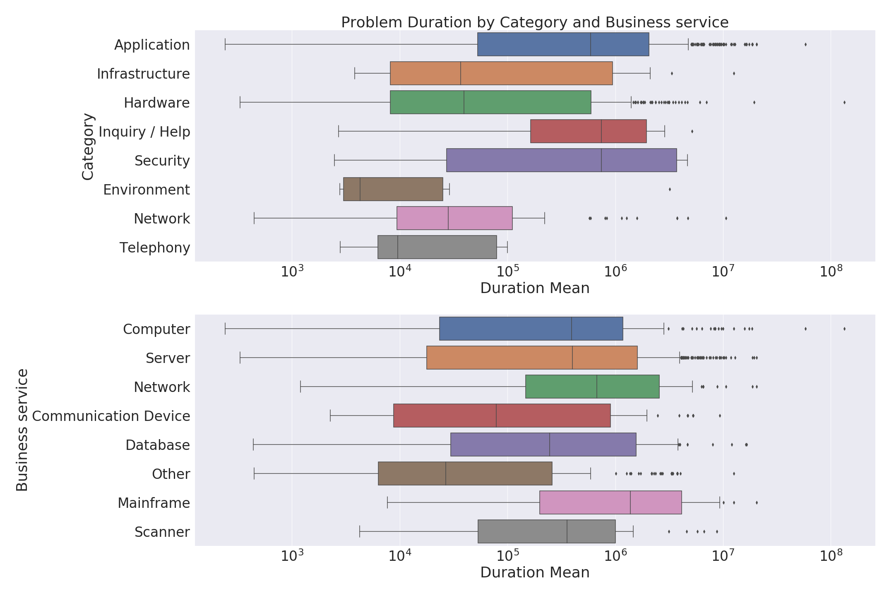

Slide 11
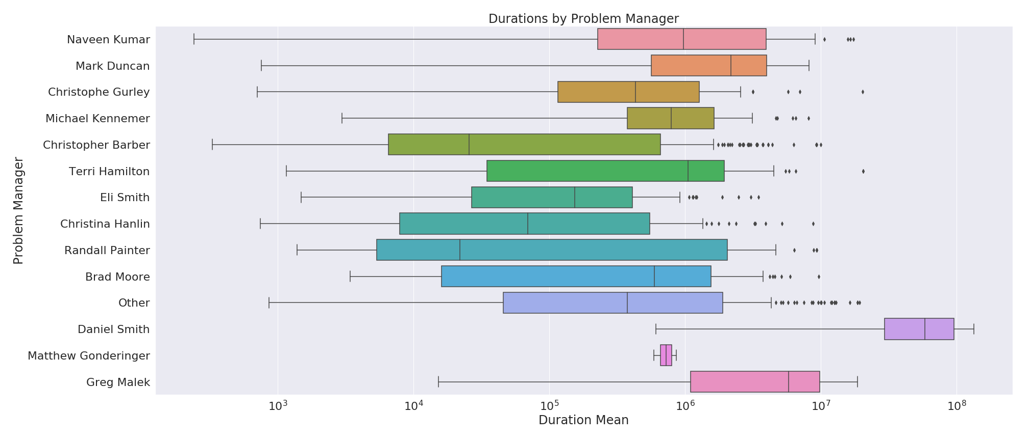

Slide 12
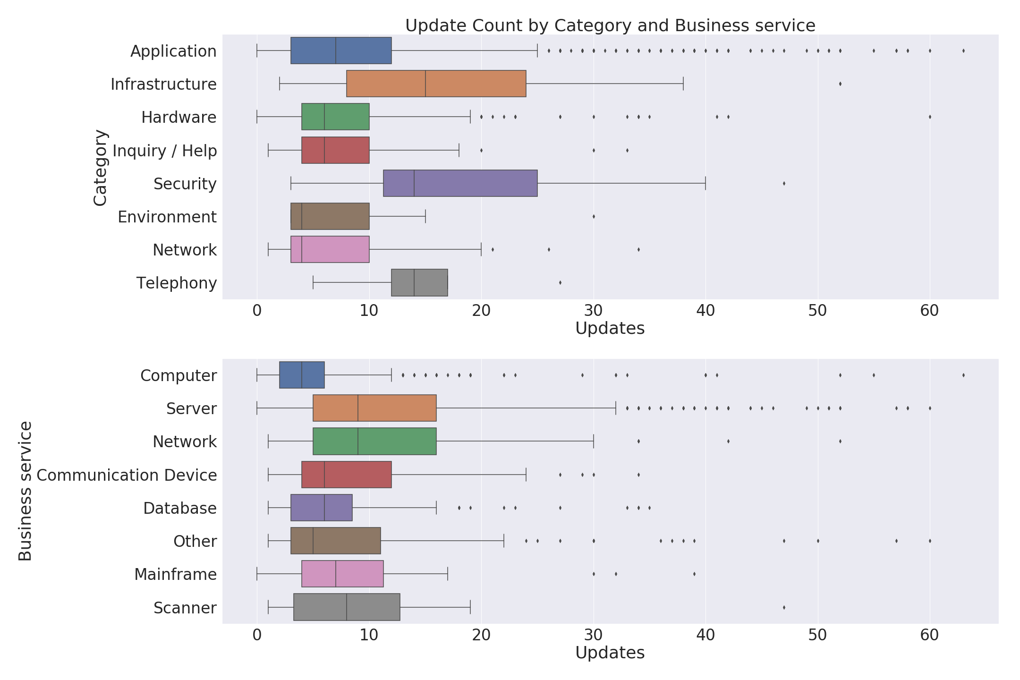

Slide 13
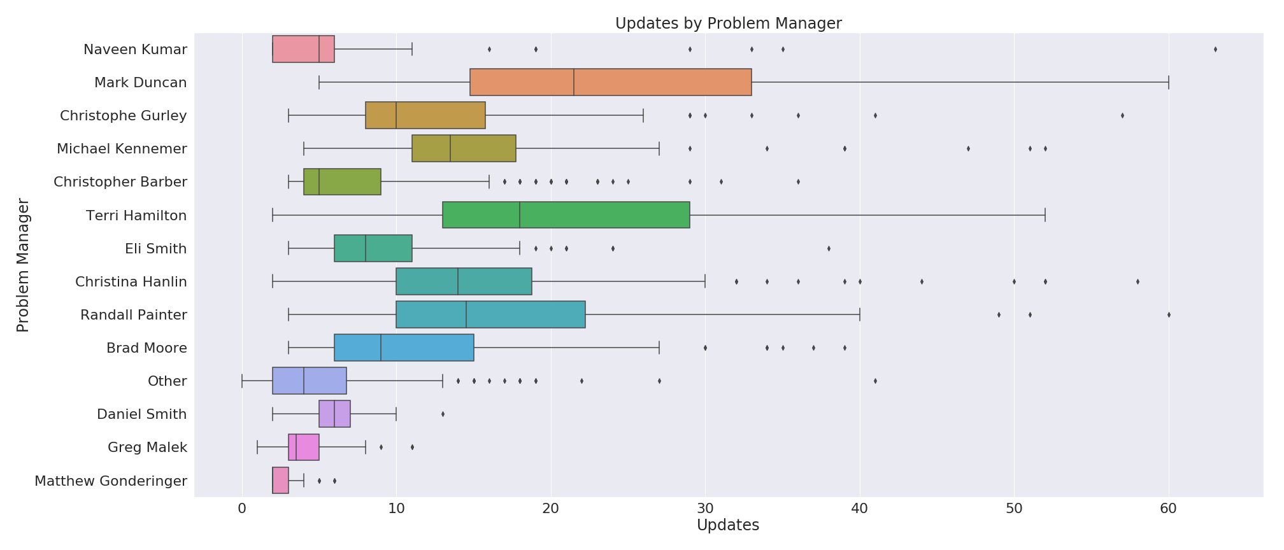

Slide 14
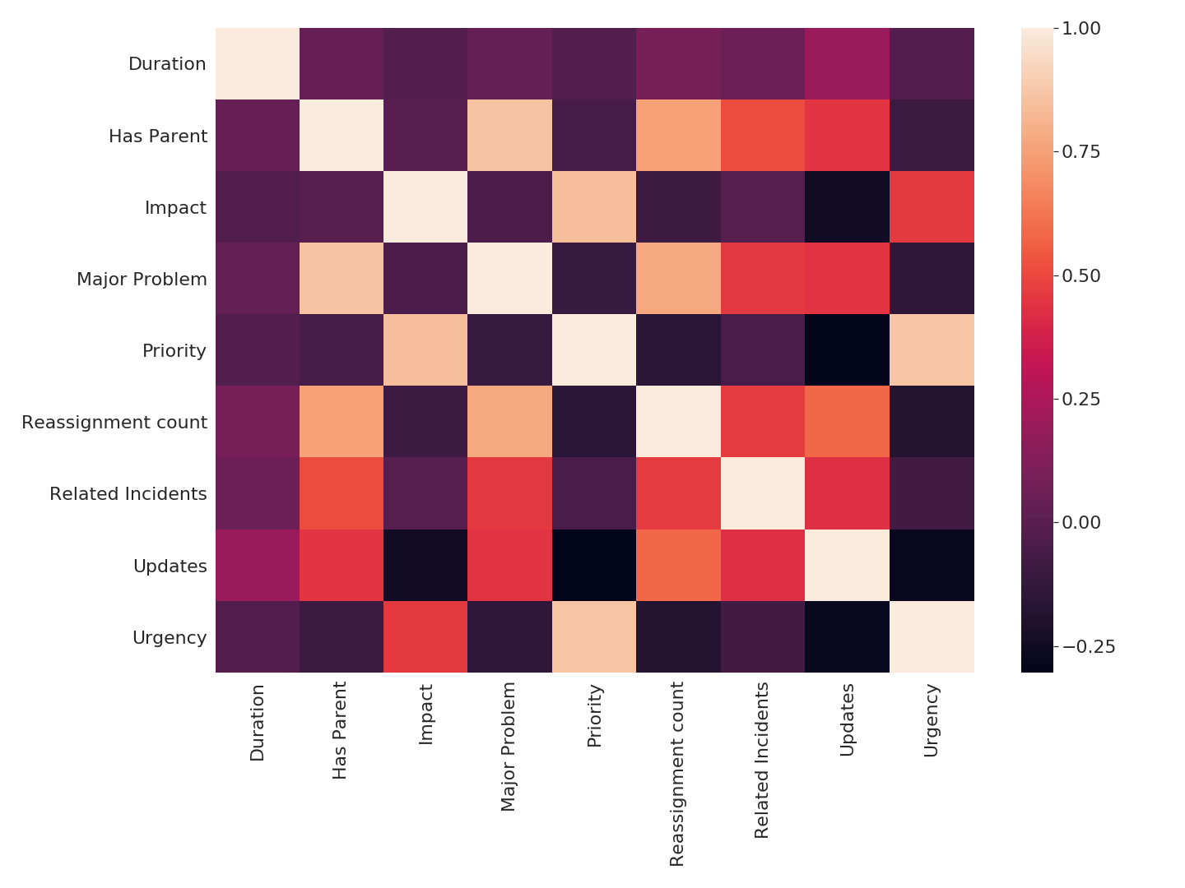

Slide 15
Clustering (At problem creation)
Little success clustering with evaluation on all 8 categories
Mild success clustering with evaluation on Application and Hardware categories
Also performed PCA and clustered the principal components
8 categories
Adjusted Rand Score = 0.08
Silhouette = 0.16
Application vs Hardware
Adjusted Rand Score = 0.06
Silhouette = 0.25

Slide 16
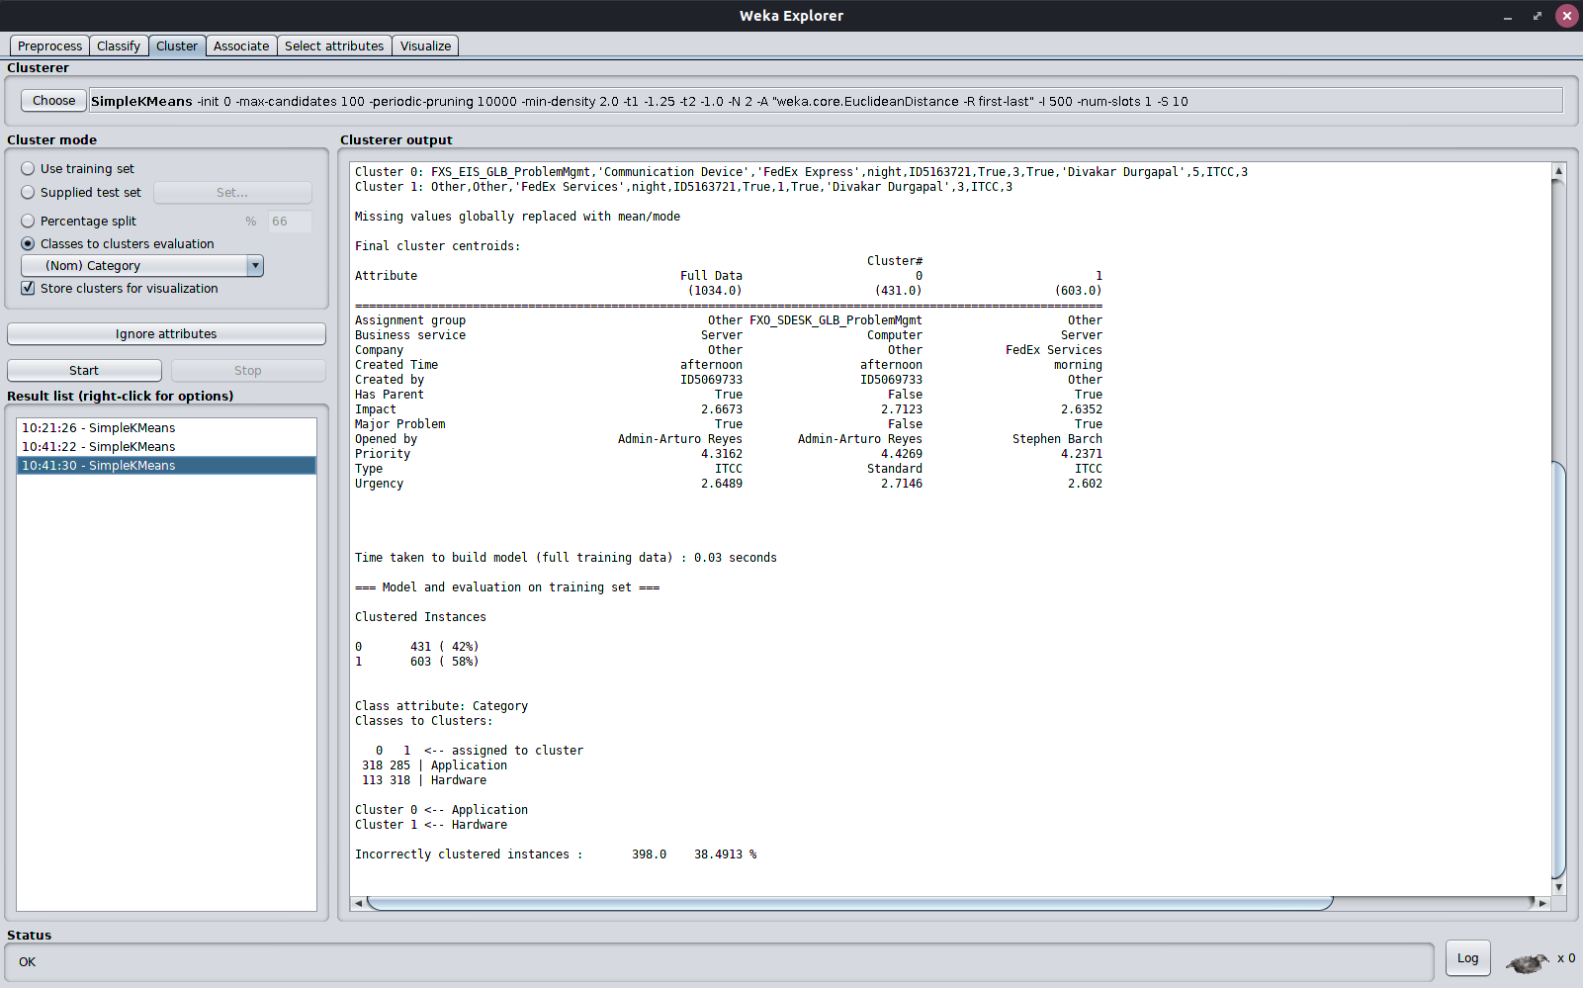
Clustering

Slide 17
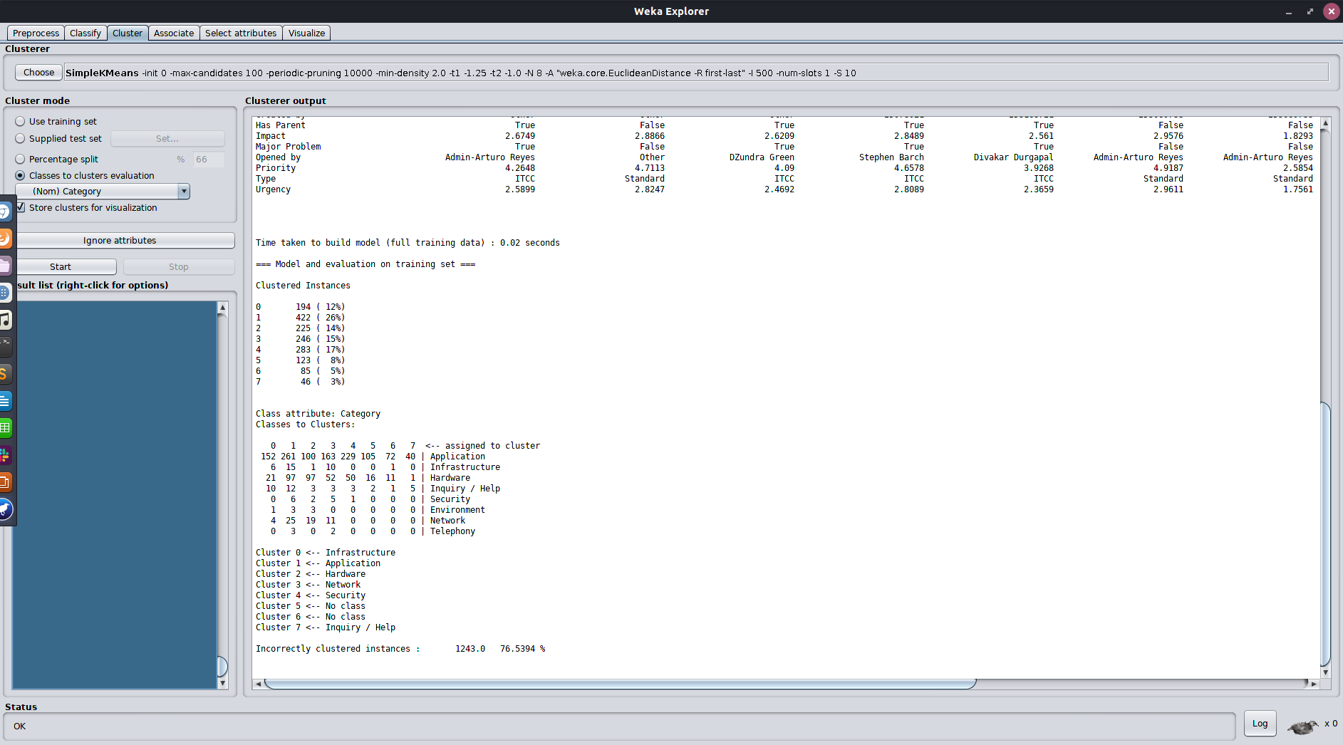

Slide 18
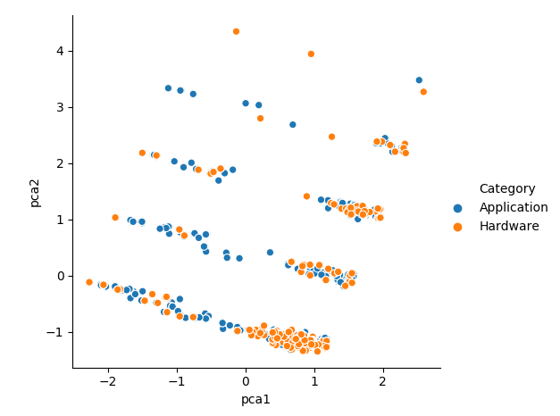

Slide 19
Predicting Category using all features
Important features:
Business service
Duration Mean
Opened by
Business Duration
Created Time
Company
Problem Manager
Created by
Assignment group
Priority

Slide 20
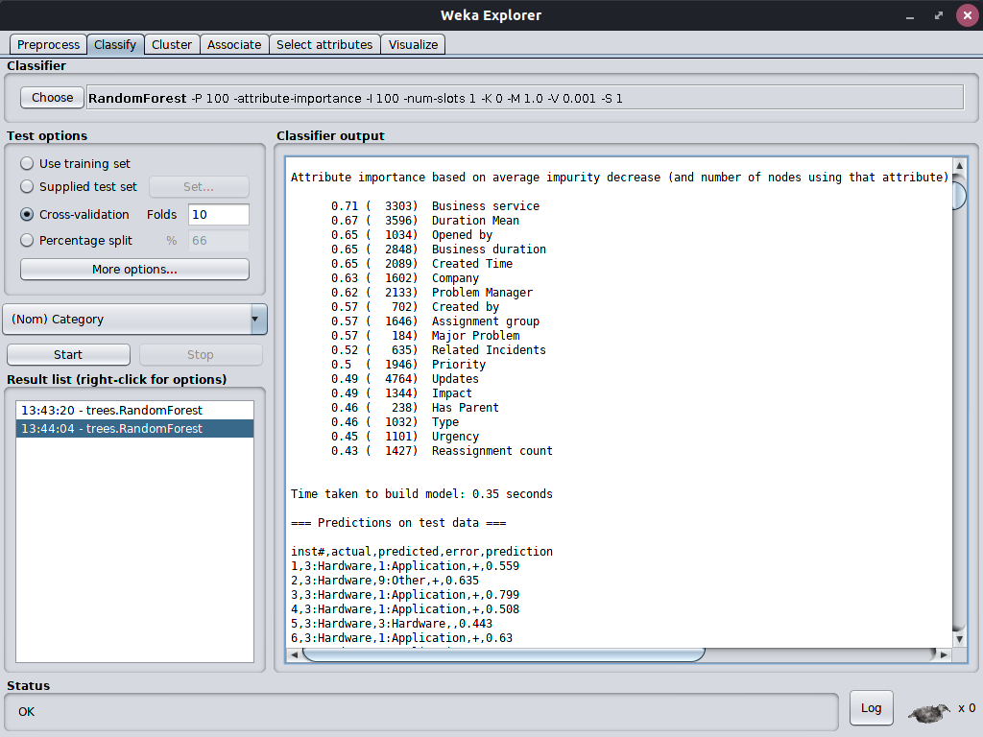

Slide 21
Models
Due to lack of observations for most categories, to make a workable model, classification was turned into binary classification task for category
Application vs Hardware
Due to severely unbalanced class “Application”, dataset was subsampled at a ratio of 1.5:1, leaving only 862 observations for binary classification task
Dataset was also subsampled at a ratio of 2:1 and then resampled using 0.5 bias to uniform resulting in 1034 observations
In order to do full, desired classification, need many more observations for other 6 classes

Slide 22
Models
Category Classification with full dataset
Subsampling 2:1
Resampling 0.5 bias to uniform
1034 observations
 | Random Forest | Naive Bayes | Logistic Regression | Neural Network | SVM (Poly-3)
F-1 score | 0.854 | 0.646 | 0.727 | 0.844 | 0.841
Accuracy | 85.397% | 64.410% | 72.727% | 84.333% | 84.042%

Slide 23
Models
Category Classification with Durations dataset
Resampling 0.5 bias to uniform
842 observations
 | Random Forest | Naive Bayes | Logistic Regression | Neural Network | SVM (Poly-3)
F-1 score | 0.898 | 0.672 | 0.725 | 0.886 | 0.862
Accuracy | 89.786% | 66.746% | 72.922% | 88.599% | 86.105%

Slide 24
Models
Category Classification with Tf-idf Word Vectors
Subsampling 1.5:1
 | Random Forest | Naive Bayes | Logistic Regression | SVM (Poly-2)
F-1 score | 0.696 | 0.673 | 0.609 | 0.694
Accuracy | 71.926% | 66.937% | 61.485% | 71.230%

Slide 25
Models
Category Classification with Tf-idf Word Vectors
Subsampling 2:1
Resampling 0.5 bias to uniform
 | Random Forest | Naive Bayes | Logistic Regression | SVM (Poly-2)
F-1 score | 0.889 | 0.723 | 0.842 | 0.886
Accuracy | 89.072% | 72.147% | 84.236% | 88.781%

Slide 26
Predicting Category at Problem Creation
Important features (in order of importance):
Business service
Opened by
Company
Created Time
Created by
Assignment group
Type
Priority
Only 13 total features available for category prediction at problem creation

Slide 27
Predicting Category at Problem Creation
Features dropped:
Problem Manager
Reassignment count
Related Incidents
Updates
Duration Mean

Slide 28
Predicting Category at Problem Creation
Category Classification with full dataset
Subsampling 2:1
Resampling 0.5 bias to uniform
1034 observations
 | Random Forest | Naive Bayes | Logistic Regression | Neural Network | SVM (Poly-3)
F-1 score | 0.794 | 0.631 | 0.678 | 0.774 | 0.779
Accuracy | 79.497% | 62.959% | 68.472% | 77.369% | 77.950%

Slide 29
Predicting Duration at Problem Creation
Not feasible at the moment to predict problem duration with current data
Given a more complete and larger dataset, would like to look at this again
All models had correlation coefficient < 0.2 and error measures > 90%

Slide 30
Visualizing important features with J48 Tree
For distinguishing between two categories (App vs Hardware), Major Problem and then Business service / Assignment group were the best ways to split the data
For distinguishing between all 8 categories, Assignment group was the best way to split the data
Note: Model to classify 8 categories is likely not reliable due to unbalanced data. Heavily subsampled in order to build tree

Slide 31
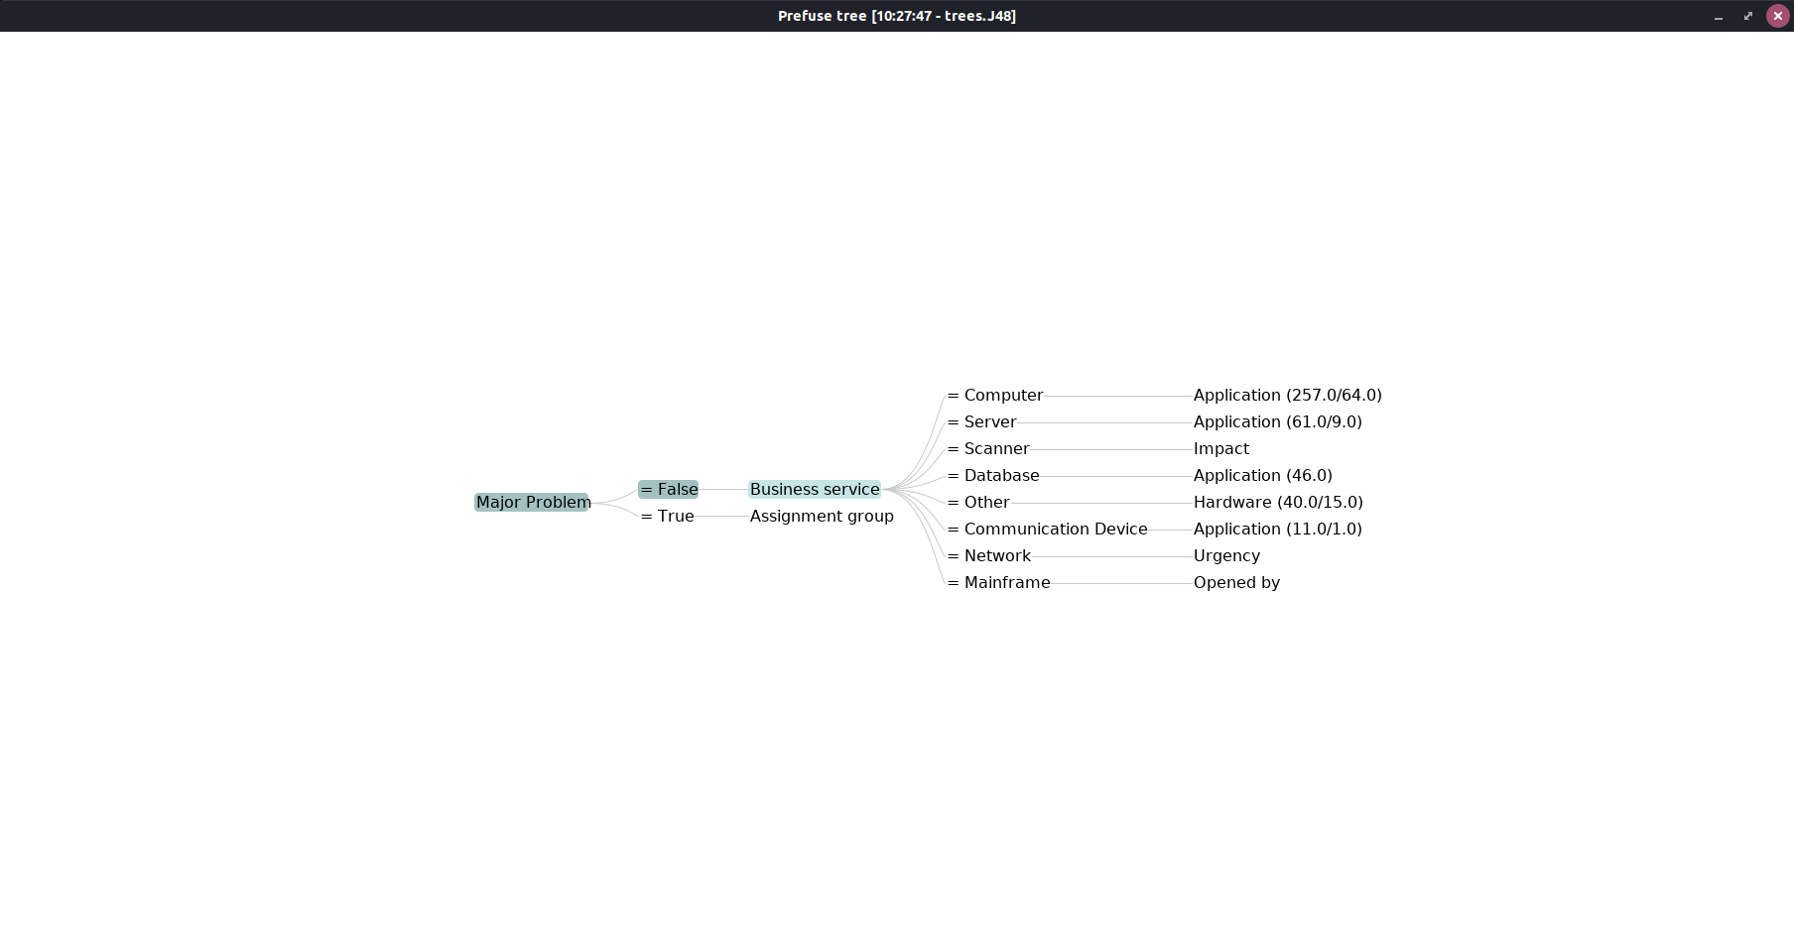

Slide 32
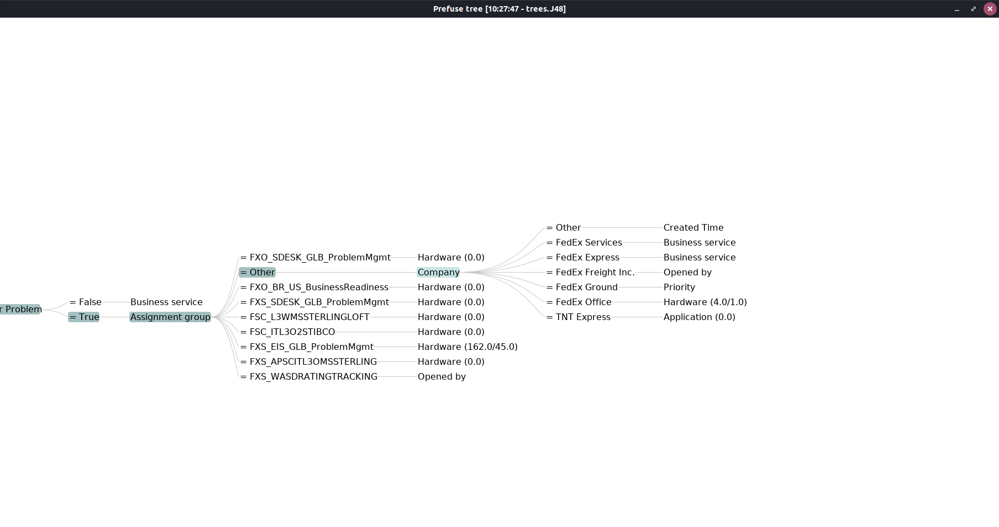

Slide 33
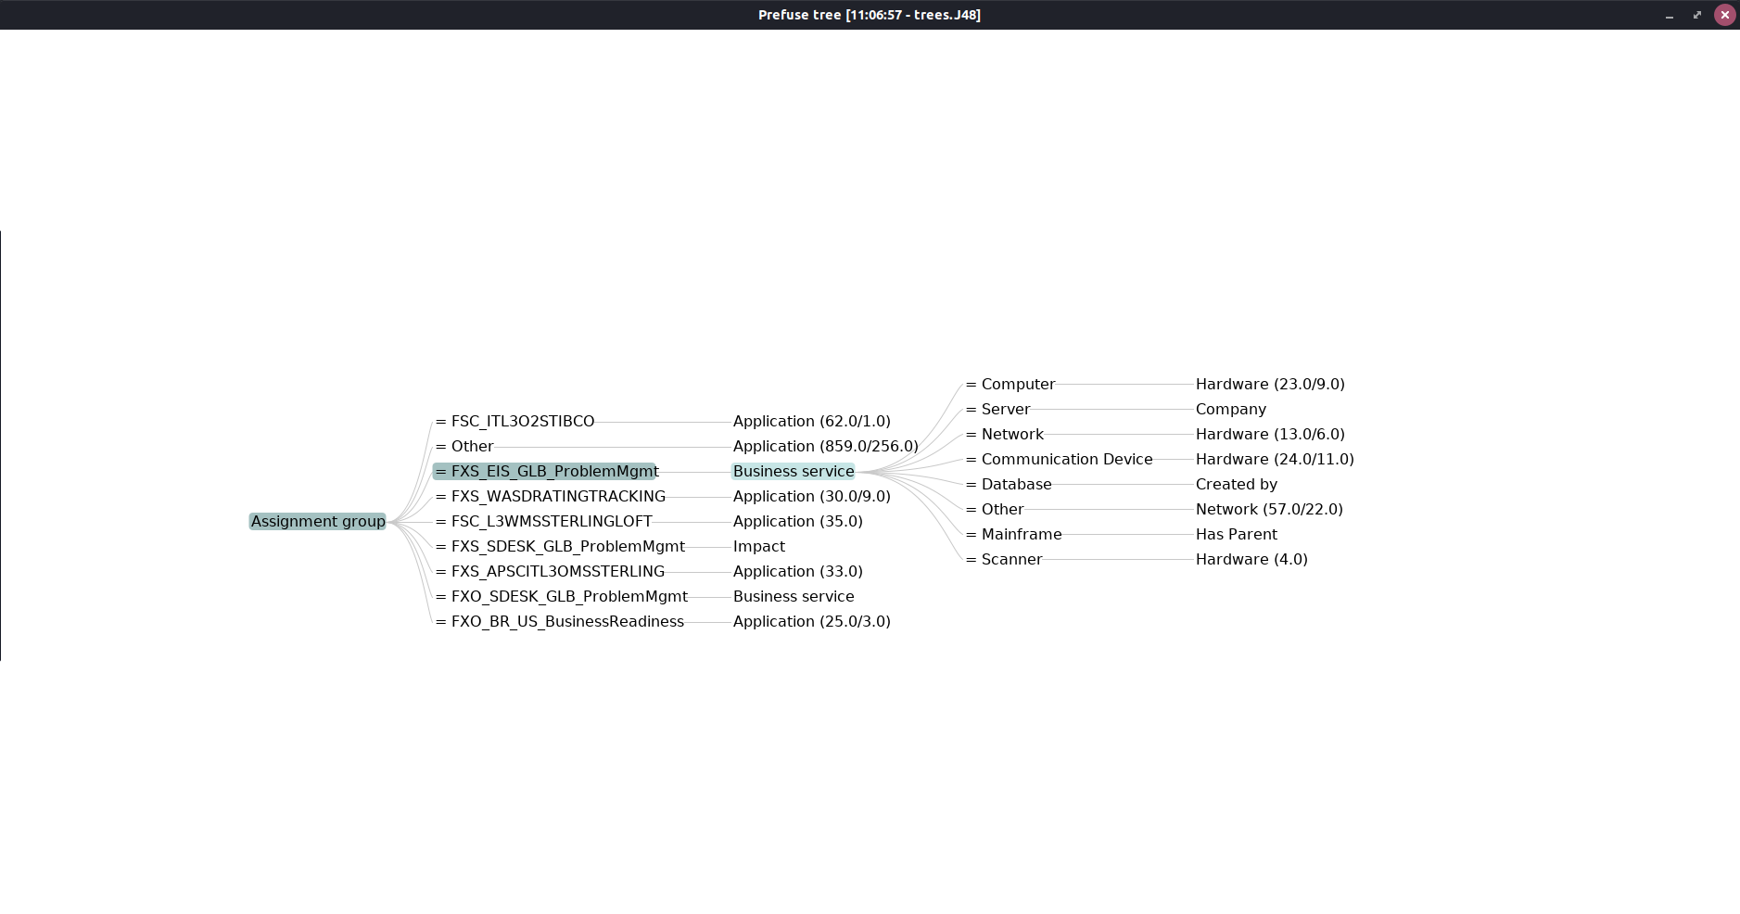

Slide 34
Summary
Many NAs
Need many more observations to build reliable models, especially of infrequent categories
Business service, Assignment group, and who the problem was opened by are probably the best features for category prediction when a problem is created
Tfidf / word count vectorization of short descriptions suggested problem short descriptions are also useful in determining category
Best model may be an ensemble model factoring in categorical variables along with tfidf / word count vectors taken from short descriptions

