Slide 2
Dataset Summary
1857 observations
111 features
27 / 111 had all NA
40 / 111 were over 30% missing values
11 / 111 had all the same value
After eliminating features with mostly same value and lengthy text based features: 26 usable features
233 observations had no Category associated and so were removed for the purpose of analysis resulting in 1624 usable observations

Slide 3
Missing Data
1324 / 1857 had 0 duration
Taking mean combined with duration data in instances dataset brought this down to 887
Dropping observations with 0 duration and combining with durations from instances dataset left 970 observations with no 0 duration observations
992 / 1857 Problems had no related incident

Slide 4
Missing Data
NA count by feature:
Assignment group = 16
Business service = 131
Category = 233
Company = 923
Opened by = 0
Problem Manager = 27
Type = 99

Slide 5
Meaningful Features
For Category Prediction:
Business service
Duration Mean
Opened by
Problem Manager
Reassignment Count
Updates

Slide 6
Category Distribution
Application - 1122
Hardware – 345
Other – 233
Network – 59
Inquiry / Help – 39
Infrastructure – 33
Security – 14
Environment 7
Telephony - 5

Slide 7
Datasets
Two datasets created
First dataset created using mostly categorical features, along with features like problem duration
For other features, “other” category created from NA observations
Better to remove NA observations, but already few observations
Created features from difficult to use features such as Created Time of Day from Created Time
Second dataset created using problem short descriptions
Bag of Words
Term Frequency-Inverse Document Frequency word vectors
Used to try to classify problem category based on problem descriptions

Slide 8
Visualizations
Relationships between different features
Problem duration
Category
Business service
Problem Manager
Problem updates
Category
Business service
Problem manager

Slide 9
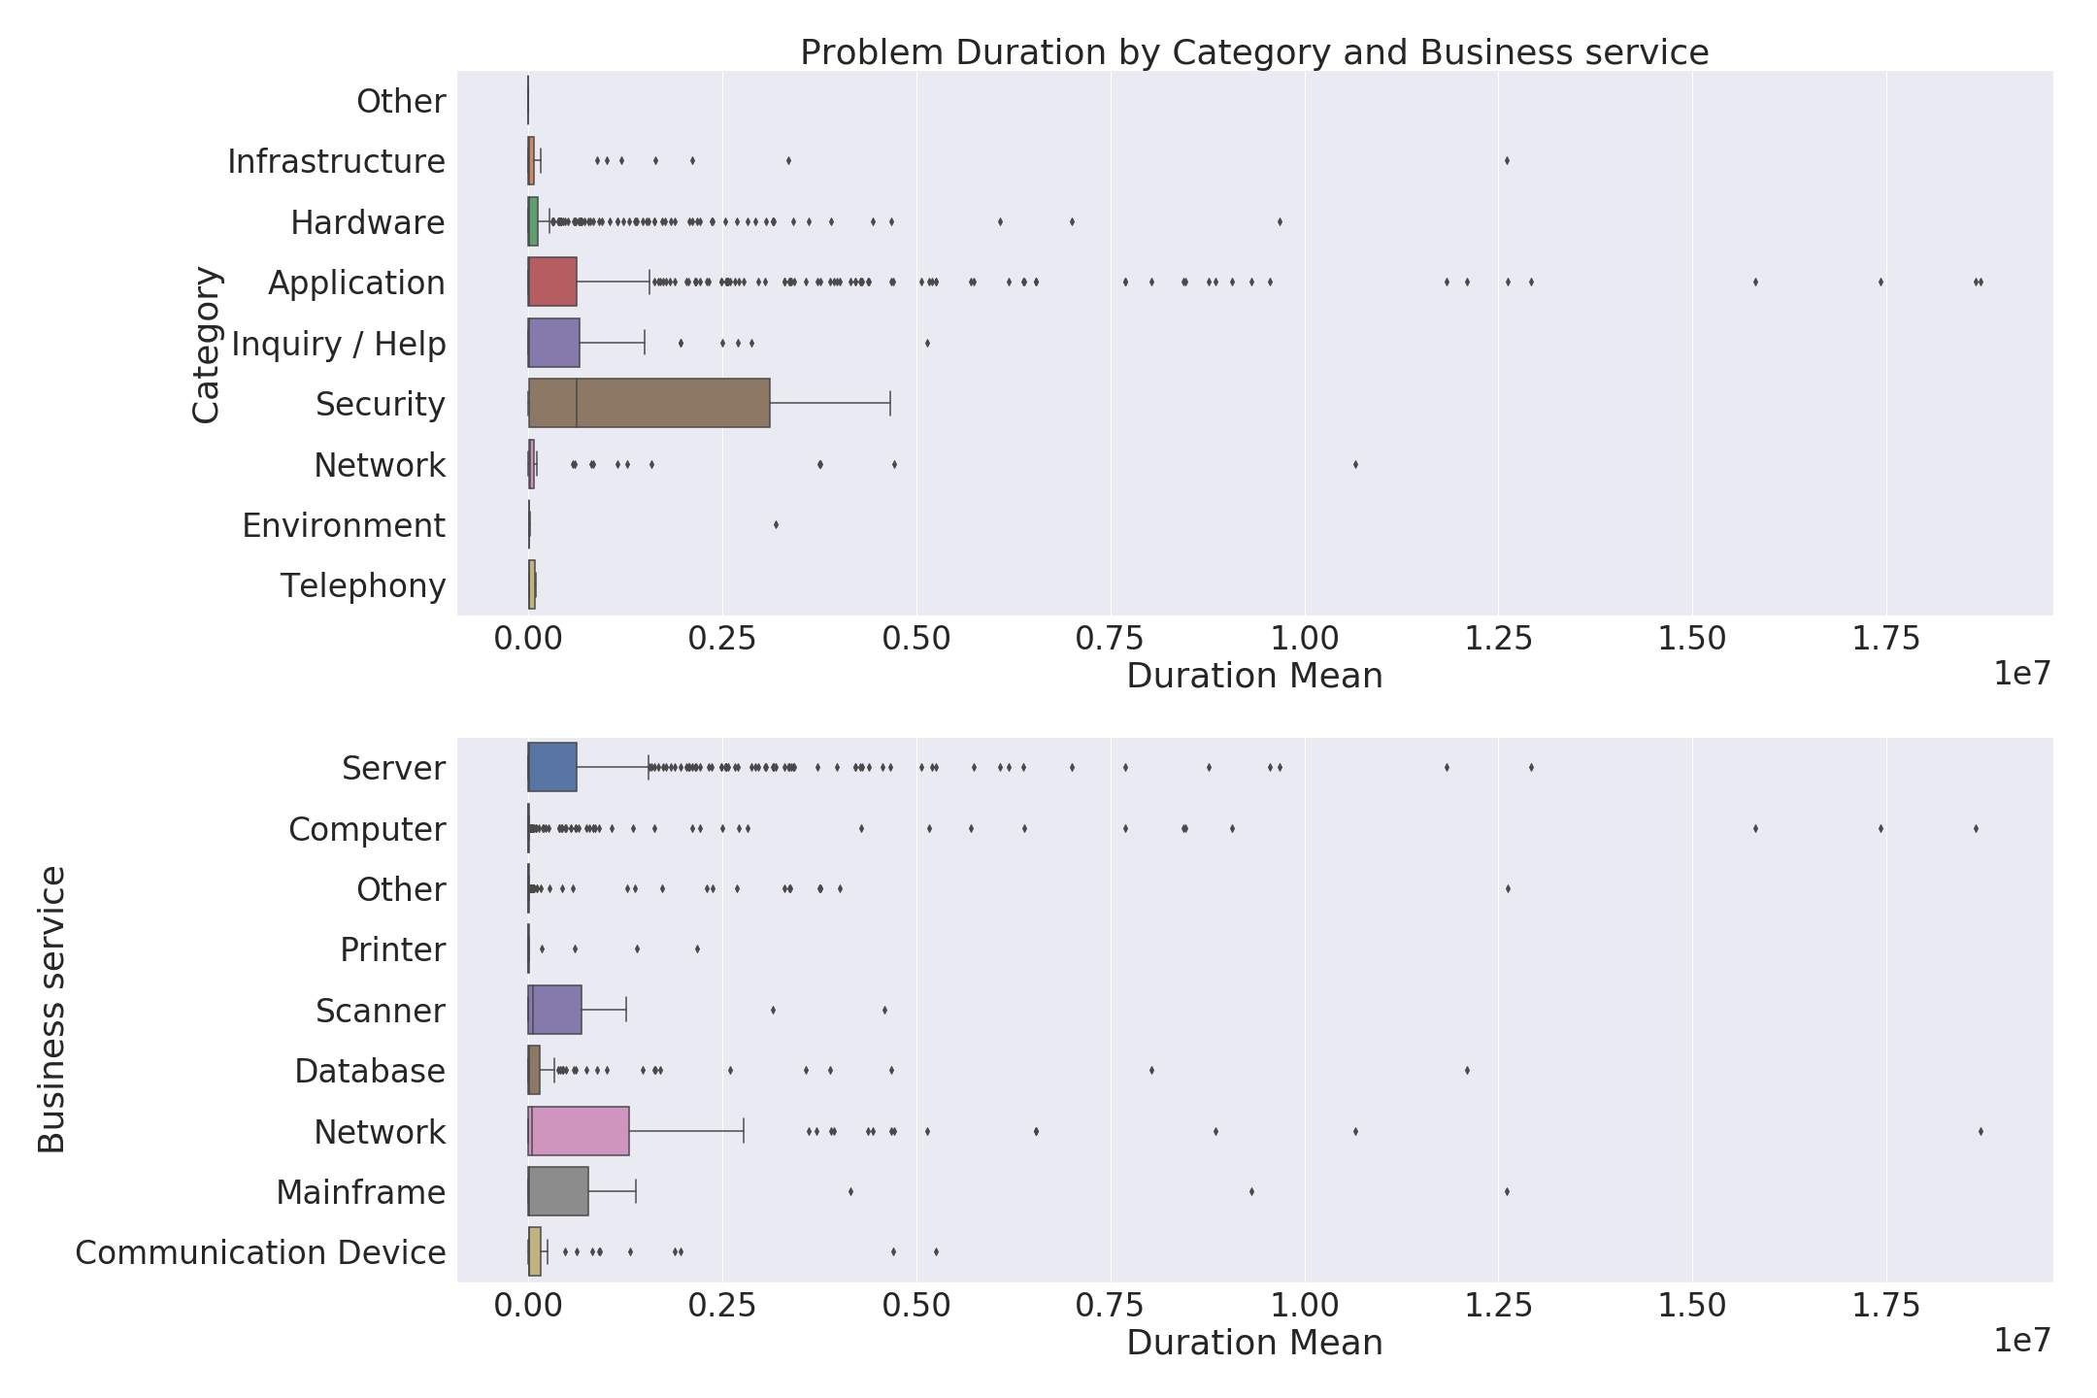

Slide 10
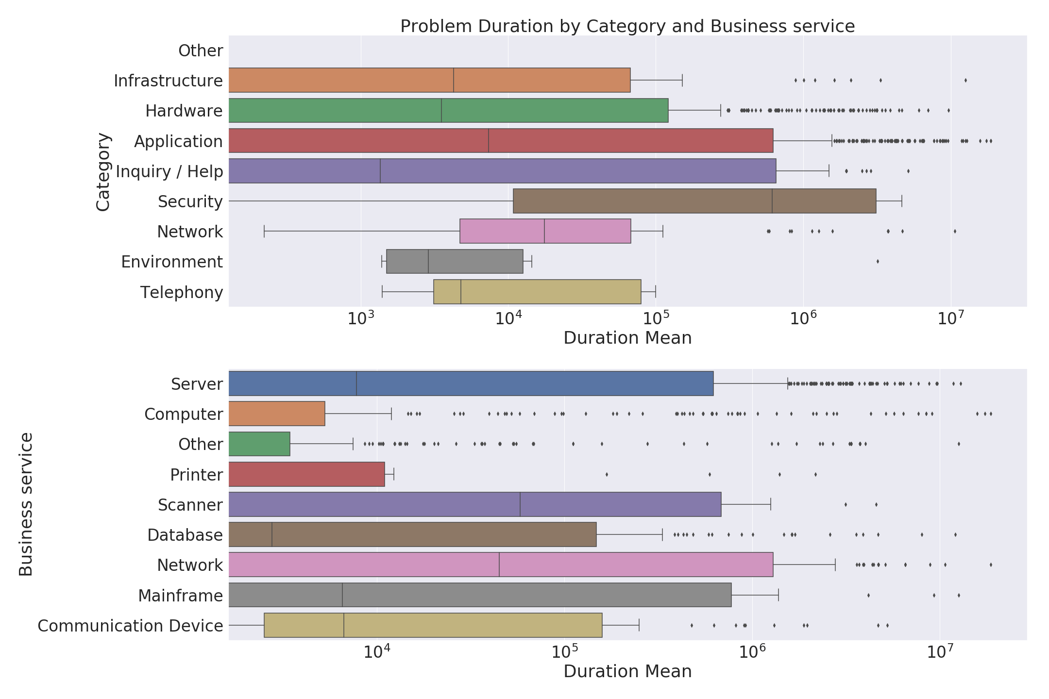

Slide 11
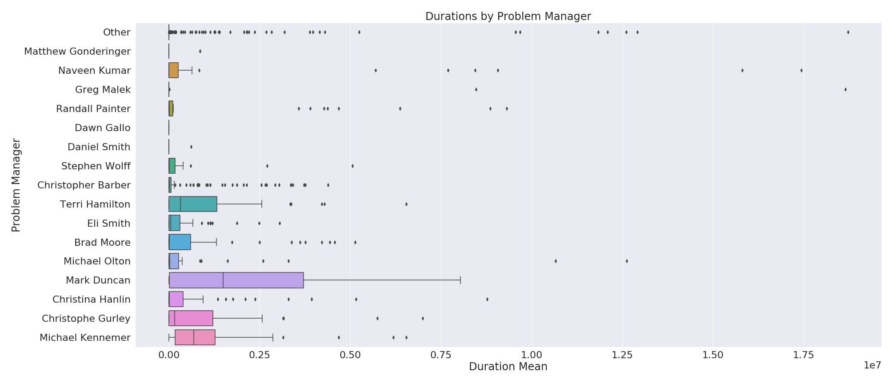

Slide 12
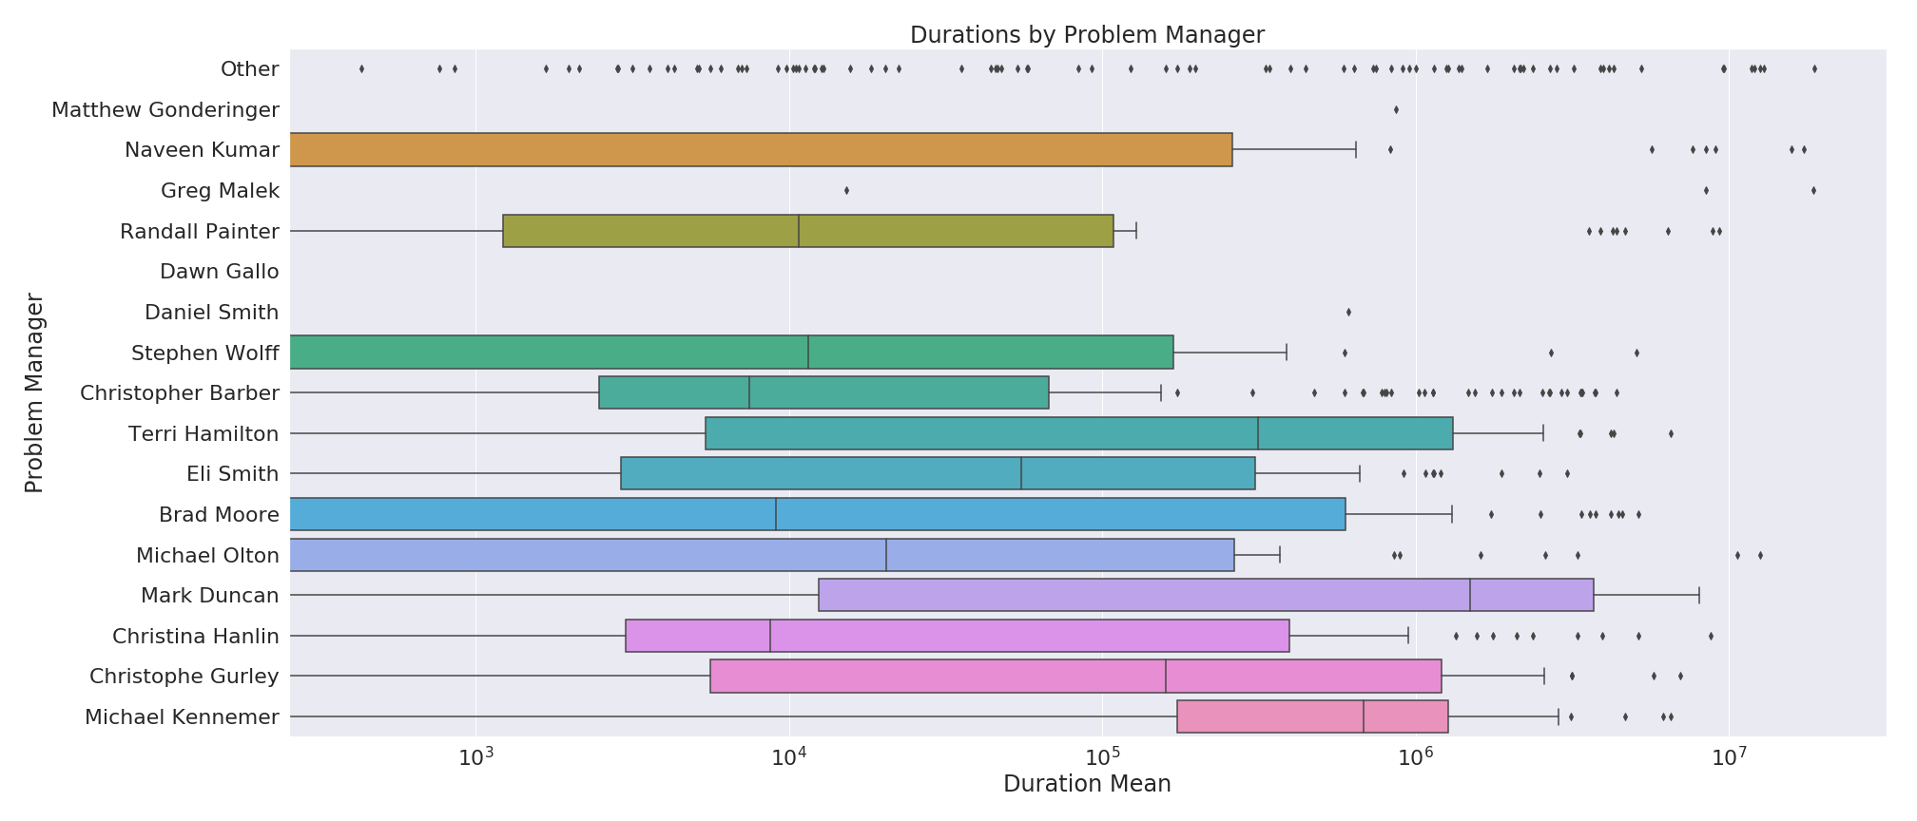

Slide 13
Clustering
Important features:
Busines

Slide 14
Predicting Category using all features
Important features:
Business service
Duration Mean
Opened by
Business Duration
Created Time
Company
Problem Manager
Created by
Assignment group
Priority

Slide 15
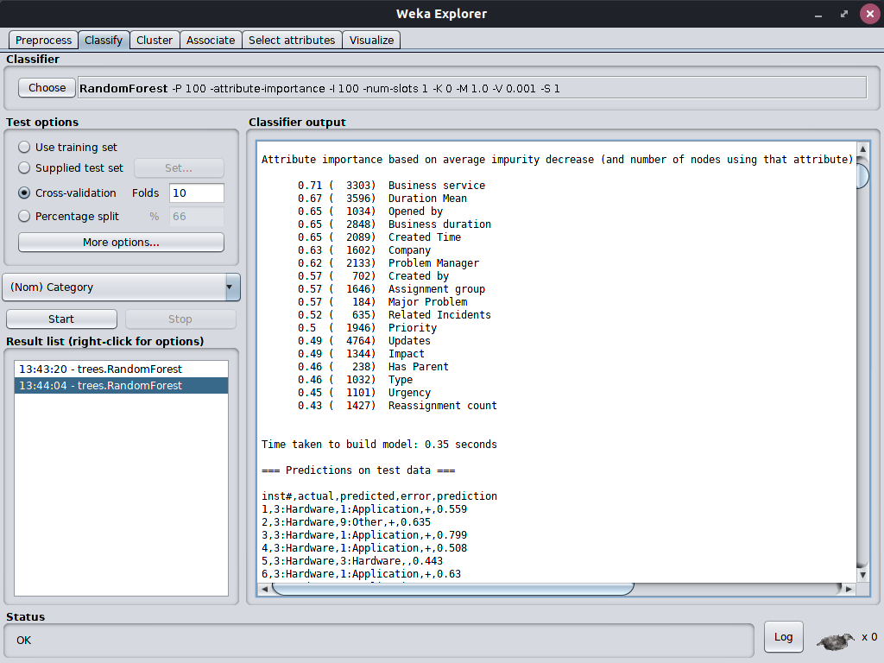

Slide 16
Models
Very few observations for most category classes
To make a workable model, classification turned into binary classification task for category
Application vs Hardware
Due to severely unbalanced class “Application”, dataset was subsampled at a ratio of 1.5:1, leaving only 862 observations for binary classification task
Dataset was also subsampled at a ratio of 2:1 and then resampled using 0.5 bias to uniform resulting in 1034 observations
In order to do full, desired classification, need many more observations for other 6 classes

Slide 17
Models
Category Classification with full dataset
Subsampling 2:1
Resampling 0.5 bias to uniform
1034 observations
 | Random Forest | Naive Bayes | Logistic Regression | Neural Network | SVM (Poly-3)
F-1 score | 0.854 | 0.646 | 0.727 | 0.844 | 0.841
Accuracy | 85.397% | 64.410% | 72.727% | 84.333% | 84.042%

Slide 18
Models
Category Classification with Durations dataset
Resampling 0.5 bias to uniform
842 observations
 | Random Forest | Naive Bayes | Logistic Regression | Neural Network | SVM (Poly-3)
F-1 score | 0.898 | 0.672 | 0.725 | 0.886 | 0.862
Accuracy | 89.786% | 66.746% | 72.922% | 88.599% | 86.105%

Slide 19
Models
Category Classification with Tf-idf Word Vectors
Subsampling 1.5:1
 | Random Forest | Naive Bayes | Logistic Regression | Neural Network | SVM (Poly-2)
F-1 score | 0.696 | 0.673 | 0.609 |  | 0.694
Accuracy | 71.926% | 66.937% | 61.485% |  | 71.230%

Slide 20
Models
Category Classification with Tf-idf Word Vectors
Subsampling 2:1
Resampling 0.5 bias to uniform
 | Random Forest | Naive Bayes | Logistic Regression | Neural Network | SVM (Poly-2)
F-1 score | 0.889 | 0.723 | 0.842 |  | 0.886
Accuracy | 89.072% | 72.147% | 84.236% |  | 88.781%

Slide 21
Predicting Category at Problem Creation
Important features (in order of importance):
Business service
Opened by
Company
Created Time
Created by
Assignment group
Type
Priority

Slide 22
Predicting Category at Problem Creation
Features dropped:
Problem Manager
Reassignment count
Related Incidents
Updates
Duration Mean

Slide 23
Predicting Category at Problem Creation
Category Classification with full dataset
Subsampling 2:1
Resampling 0.5 bias to uniform
1034 observations
 | Random Forest | Naive Bayes | Logistic Regression | Neural Network | SVM (Poly-3)
F-1 score | 0.794 | 0.631 | 0.678 | 0.774 | 0.779
Accuracy | 79.497% | 62.959% | 68.472% | 77.369% | 77.950%

Slide 24
Predicting Duration at Problem Creation
Not really possible
All models had correlation coefficient of < 0.2 and error measures > 90%

Slide 25
Summary
Many NAs
All models had correlation coefficient of < 0.2 and error measures > 90%

