Slide 2
Dataset Summary
1857 observations
111 features
27 / 111 had all NA
40 / 111 were over 30% missing values
11 / 111 had all the same value
After eliminating features with mostly same value and lengthy text based features: 26 usable features

Slide 3
Missing Data
1324 / 1857 had 0 duration
Taking mean combined with duration data in instances dataset brought this down to 887
992 / 1857 Problems had no related incident

Slide 4
Missing Data
NA count by feature:
Assignment group = 16
Business service = 131
Category = 233
Company = 923
Opened by = 0
Problem Manager = 27
Type = 99

Slide 5
Meaningful Features
For Category Prediction:
Business service
Duration Mean
Opened by
Problem Manager
Reassignment Count
Updates

Slide 6
Category Distribution
Application - 1122
Hardware – 345
Other – 233
Network – 59
Inquiry / Help – 39
Infrastructure – 33
Security – 14
Environment 7
Telephony - 5

Slide 7
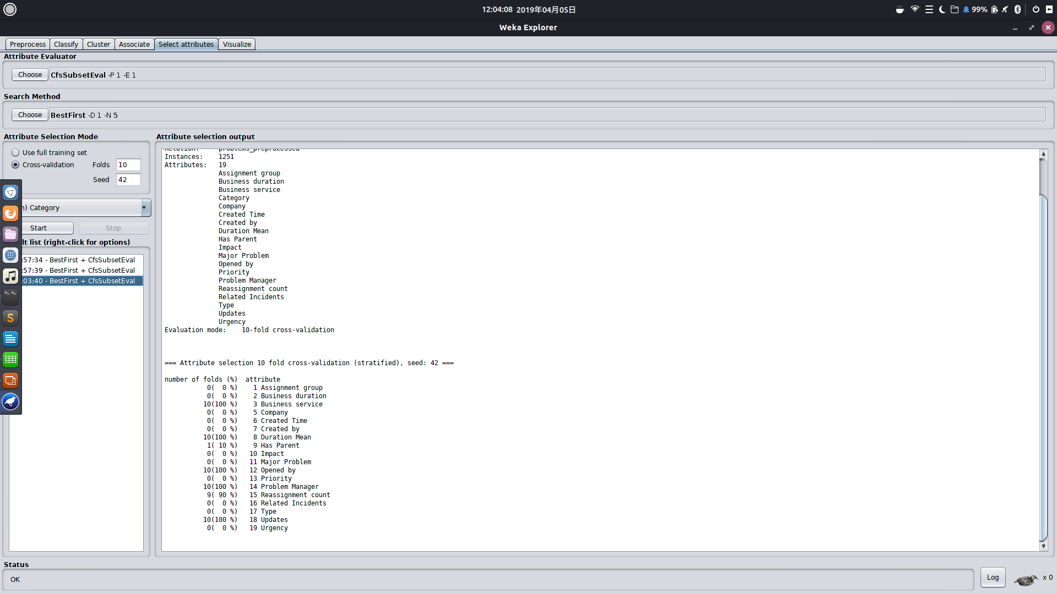

Slide 8
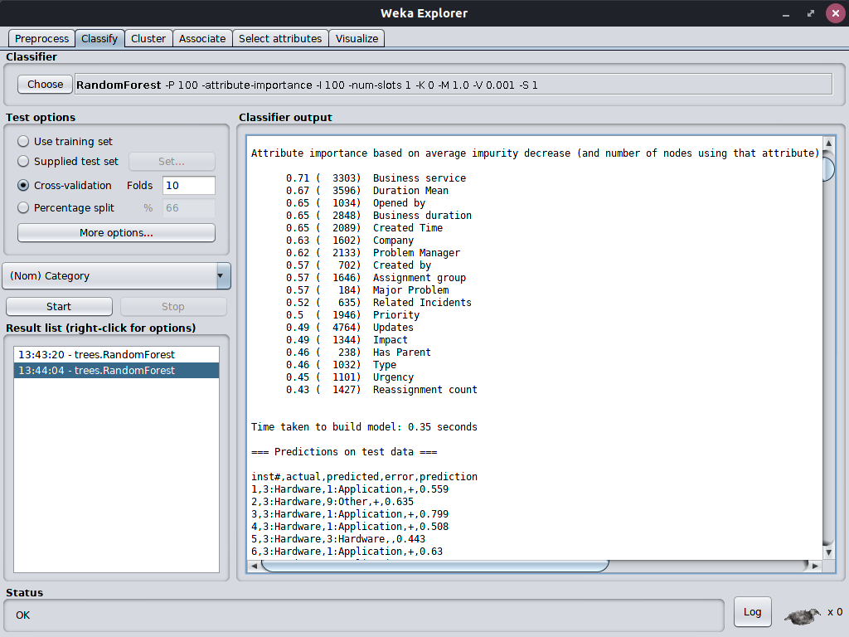

Slide 9
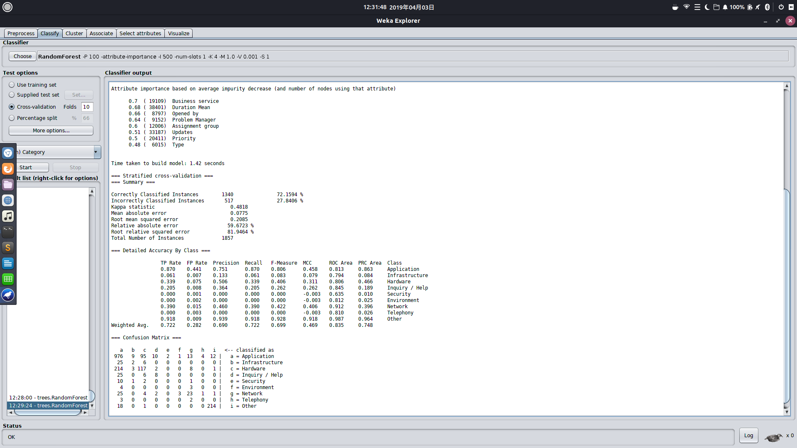

Slide 10
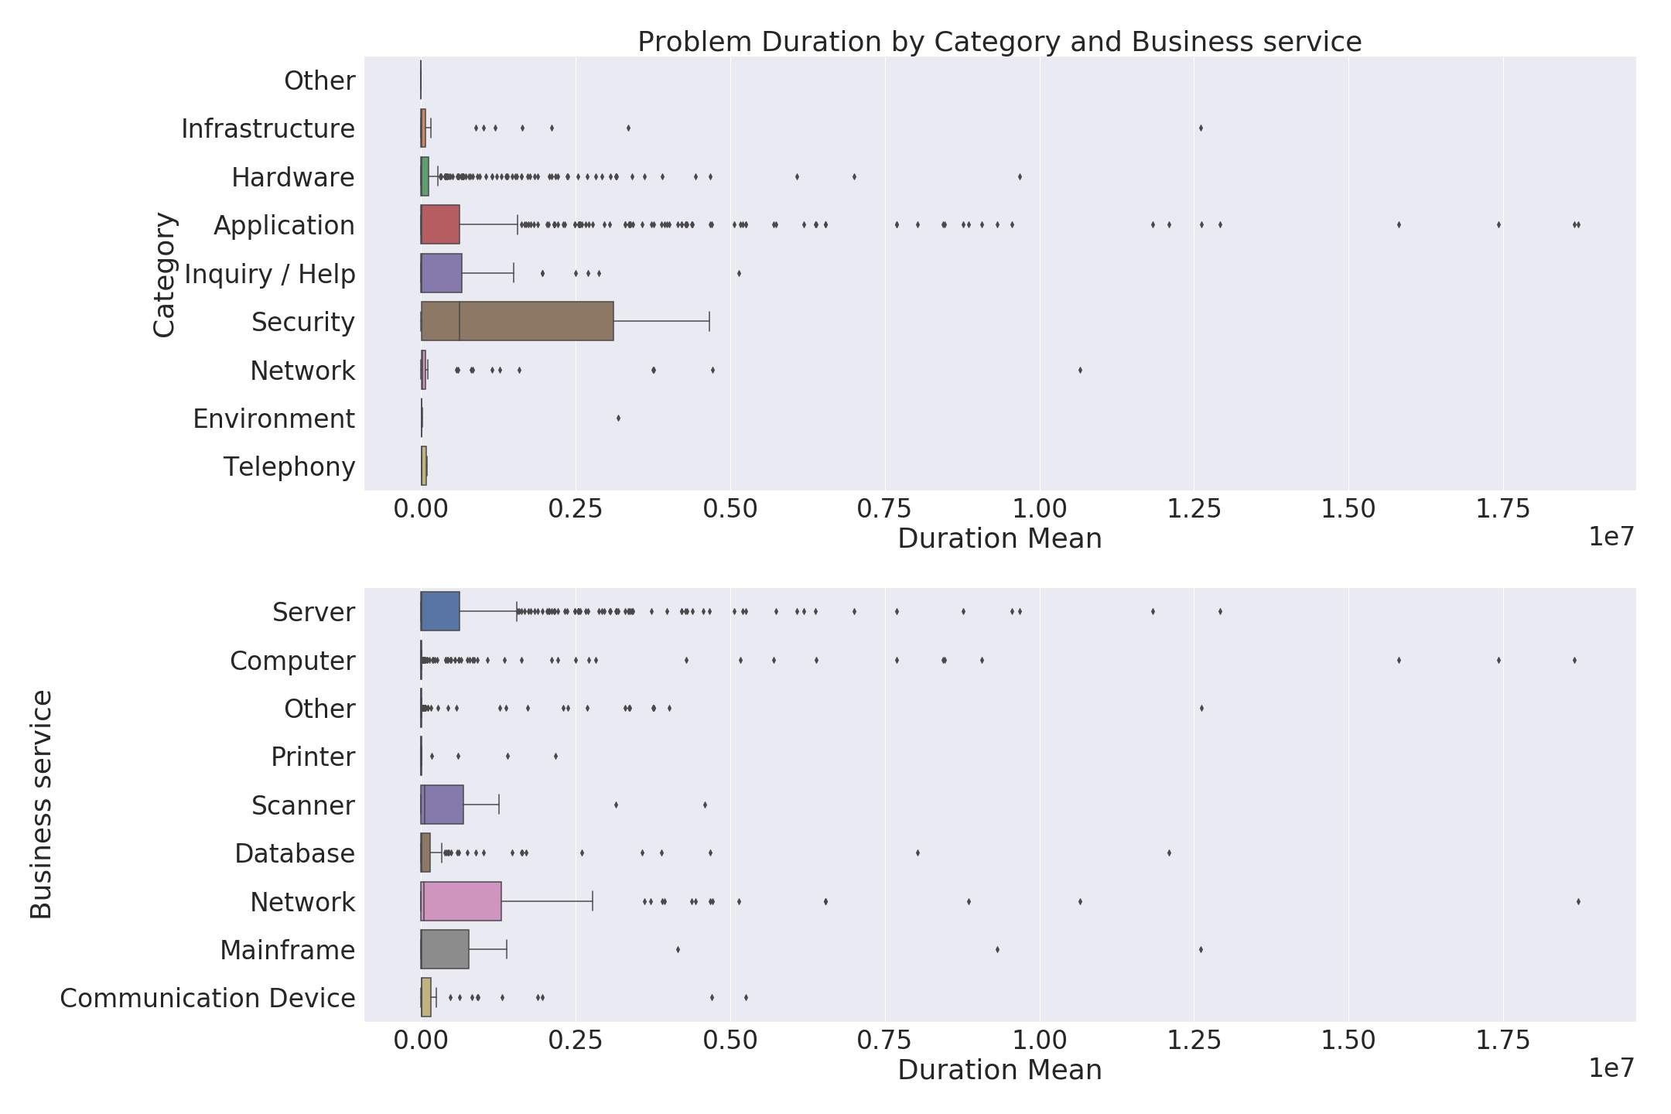

Slide 11
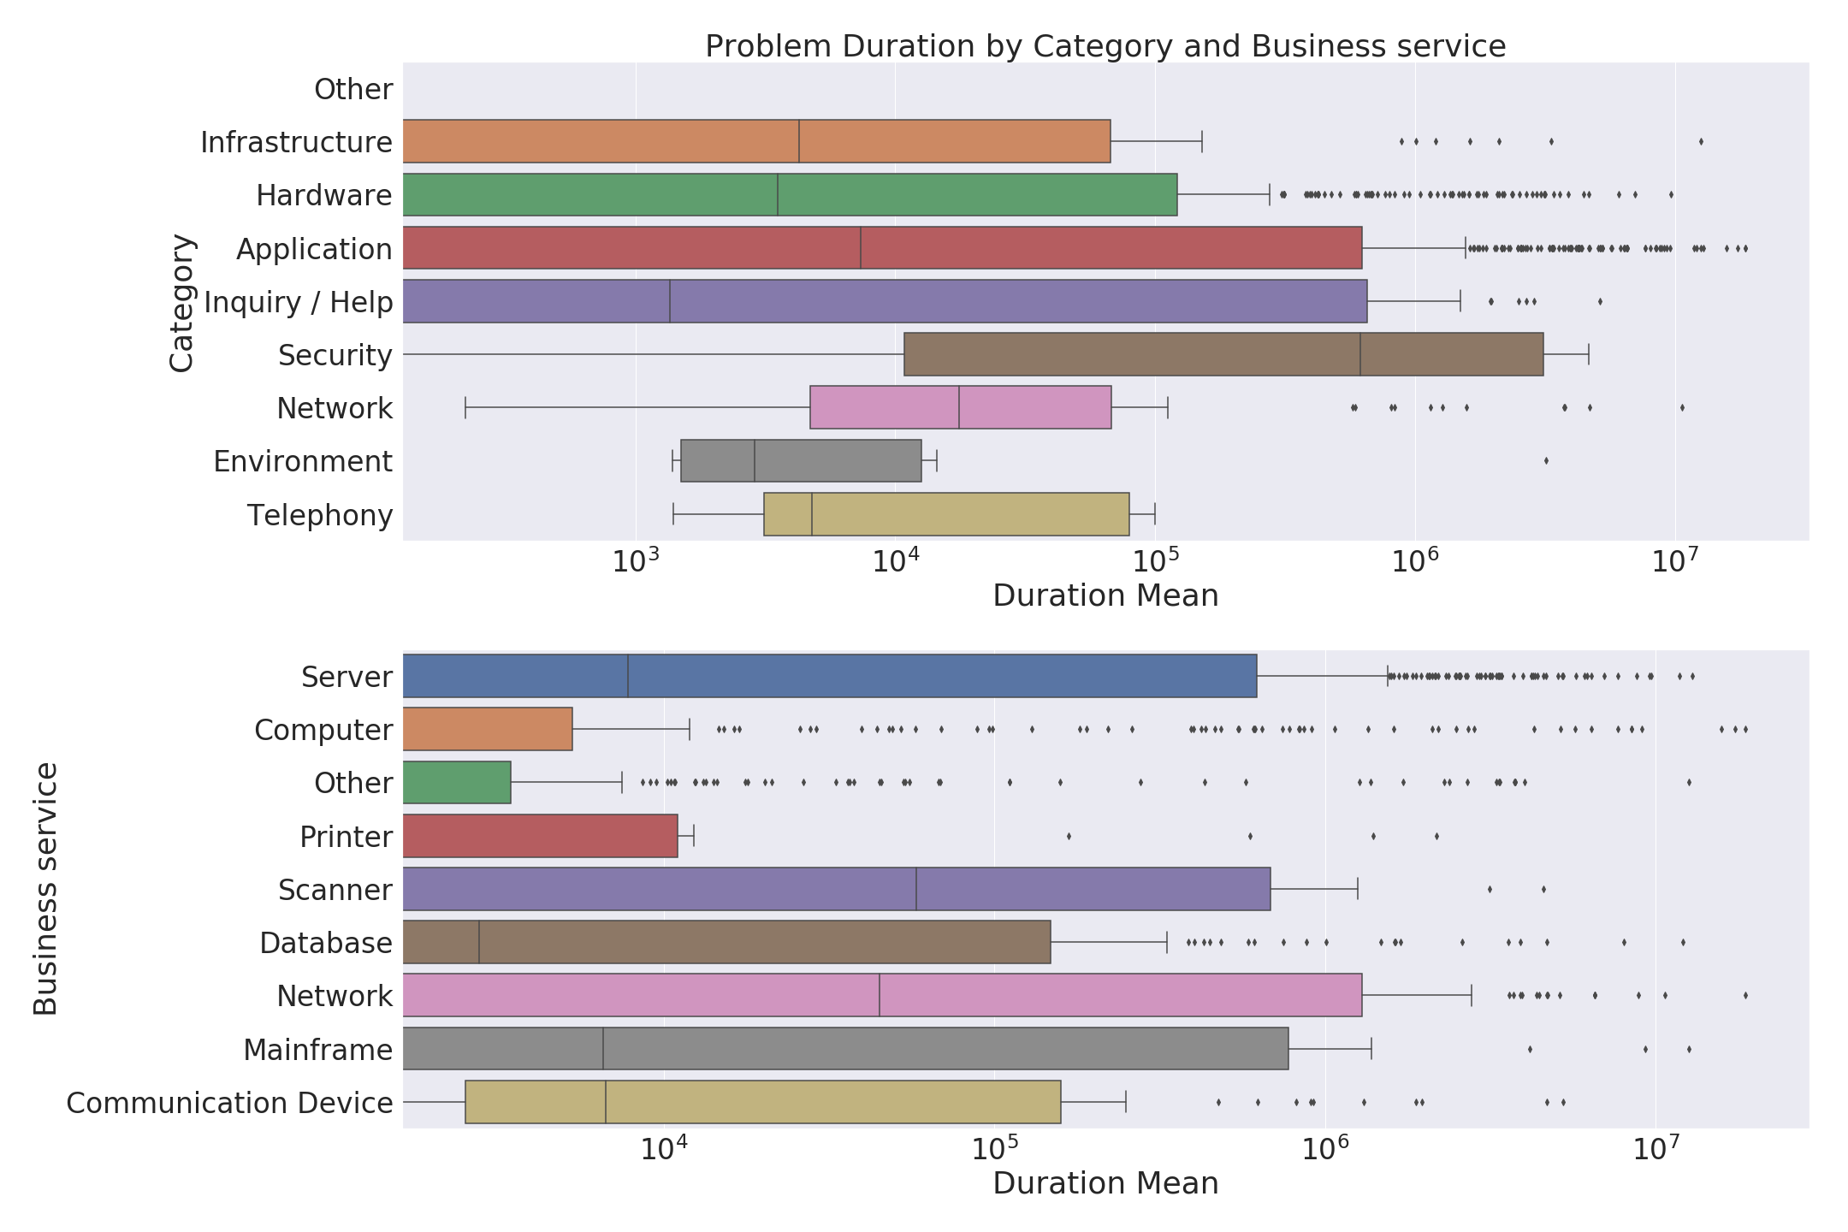

Slide 12
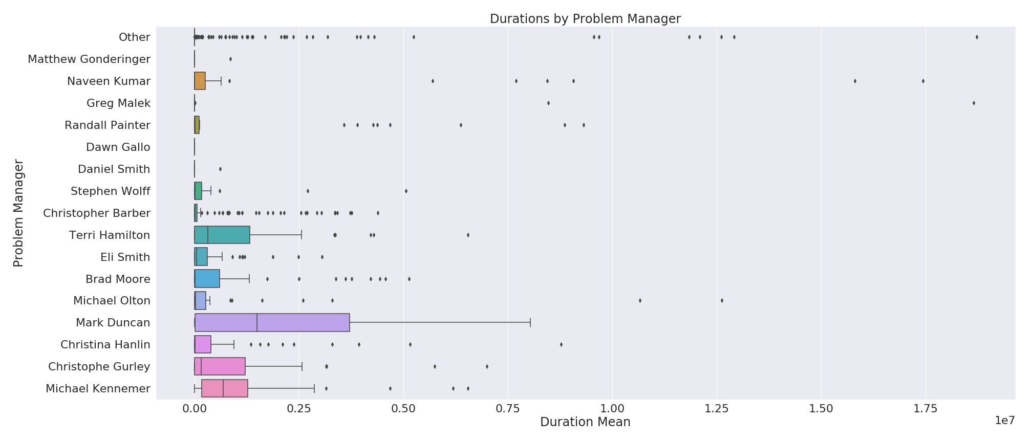

Slide 13
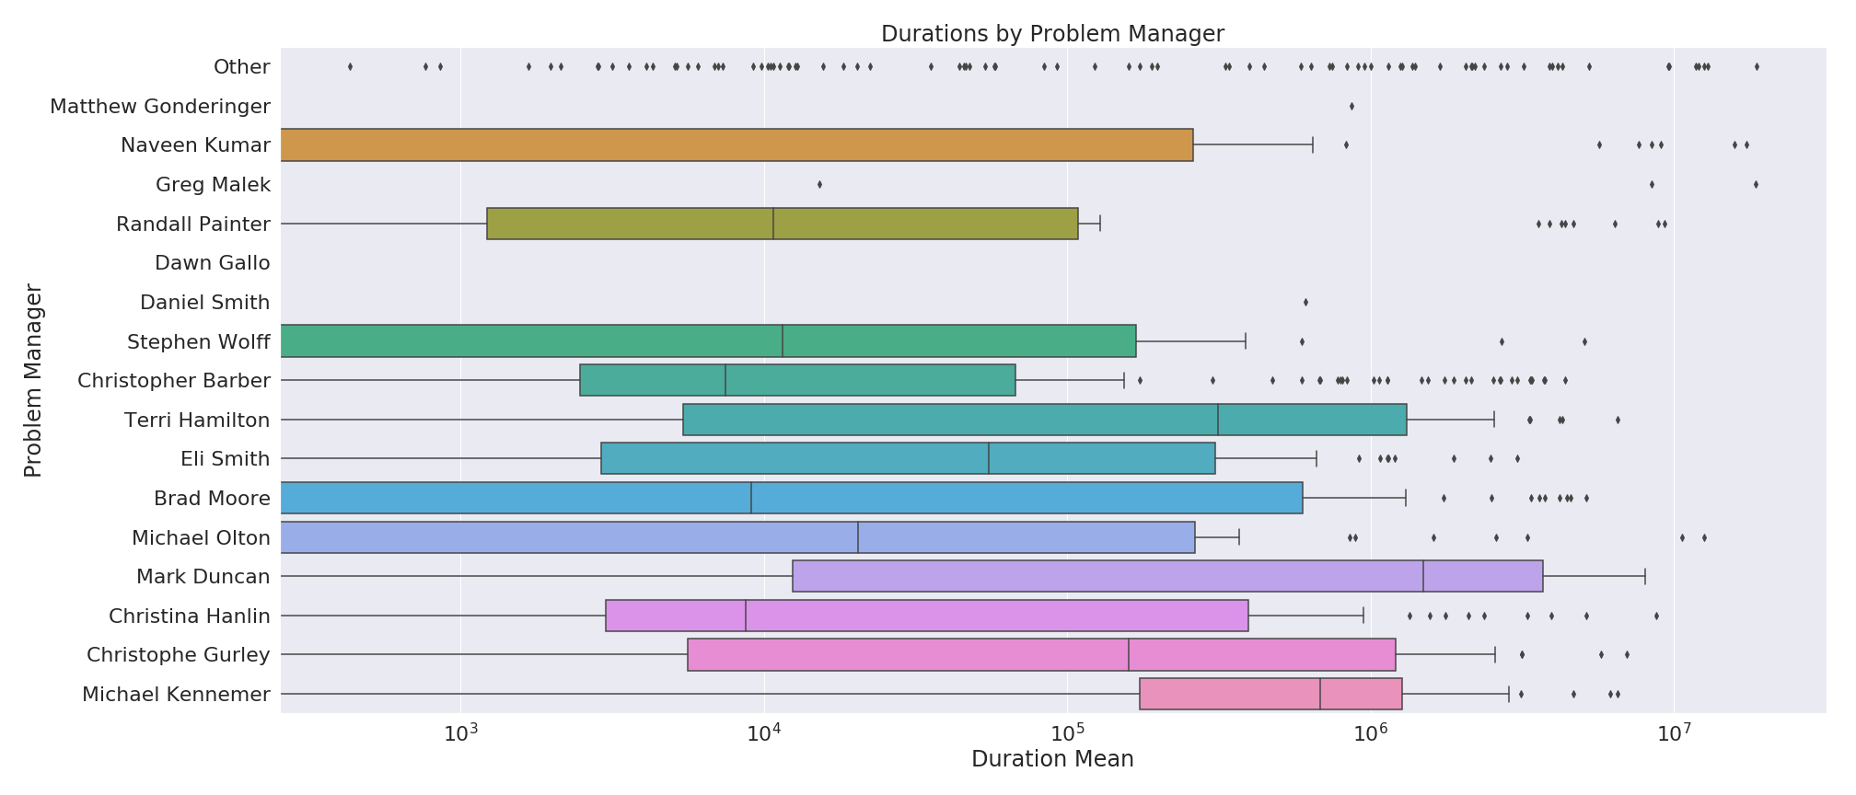

Slide 14
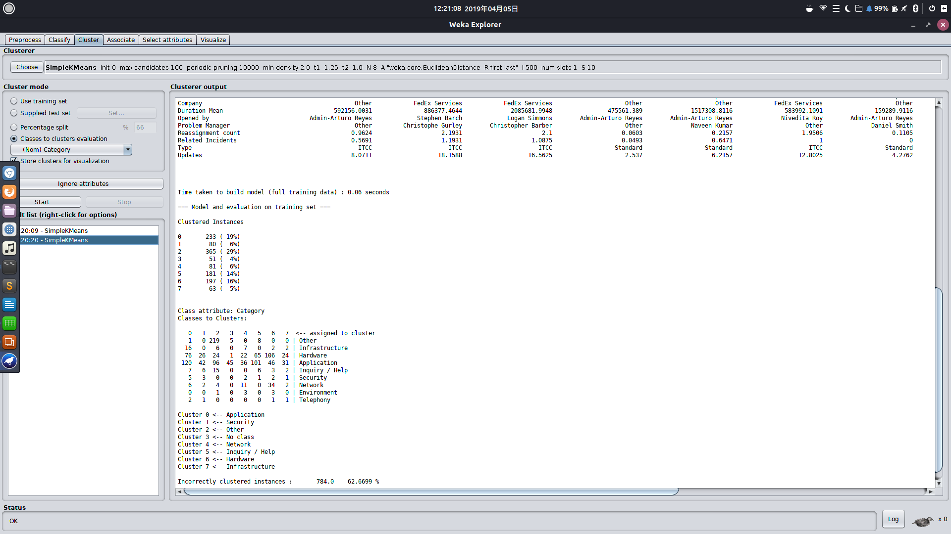

Slide 15
Models

Slide 16
Predicting Category at Problem Creation
Important features (in order of importance):
Business service
Opened by
Company
Created Time
Created by
Assignment group
Type
Priority

Slide 18
Predicting Duration at Problem Creation
Not really possible
All models had correlation coefficient of < 0.2 and error measures > 90%

