Slide 1
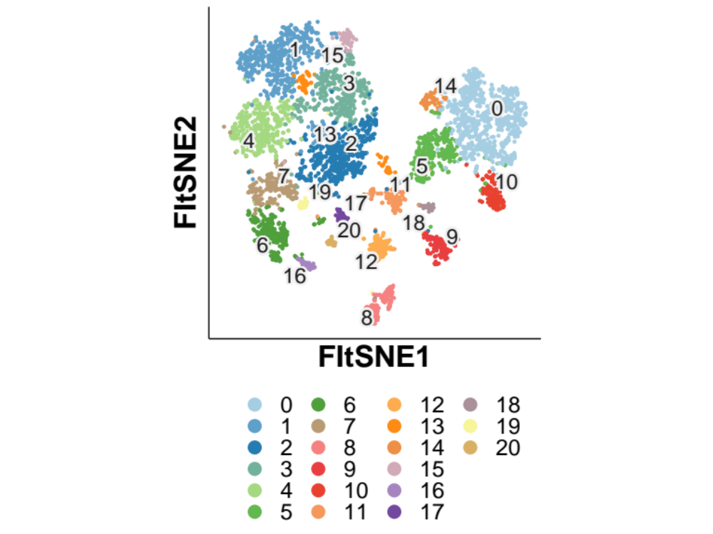
0: Capillary ECs
1: Monocytes
2: Lars2+ MΦ
3: Trem2+ MΦ
4: H2-Ab1+ MΦ
5: Sprouting ECs
6: mDCs
7: Cd14+ MΦ
8: Fibroblasts
9: Mural Cells
10: Lymphatic ECs
11: Red Blood Cells
12: MuSCs
13: Erythrophagocytes
14: Large Vessel ECs
15: Ly6c2+ MΦ
16: Regulatory T Cells
17: NK Cells
18: Schwann Cells
19: NKT Cells
20: pDCs
Inflammatory pop.
Endothelial pop.
FltSNE2
MuSCs
Fibroblasts
FltSNE1

Slide 2
0: Capillary ECs
1: Monocytes
2: Lars2+ MΦ
3: Trem2+ MΦ
4: H2-Ab1+ MΦ
5: Sprouting ECs
6: mDCs
7: Cd14+ MΦ
8: Fibroblasts
9: Mural Cells
10: Lymphatic ECs
11: Red Blood Cells
12: MuSCs
13: Erythrophagocytes
14: Large Vessel ECs
15: Ccl24+ MΦ
16: Regulatory T Cells
17: NK Cells
18: Schwann Cells
19: NKT Cells
20: pDCs
FltSNE2
FltSNE1

Slide 3
Folr2+ Monocytes
Ccl24+ MΦ
Large Vessel ECs
Trem2+ MΦ
H2-Ab1+ MΦ
Erythrophagocytes
FltSNE2
Lars2+ MΦ
Capillary ECs
Sprouting ECs
Cd14+ MΦ
Red Blood Cells
NKT Cells
NK Cells
Lymphatic ECs
mDCs
Schwann Cells
MuSCs
pDCs
Mural Cells
Regulatory T Cells
Fibroblasts
FltSNE1

Slide 4
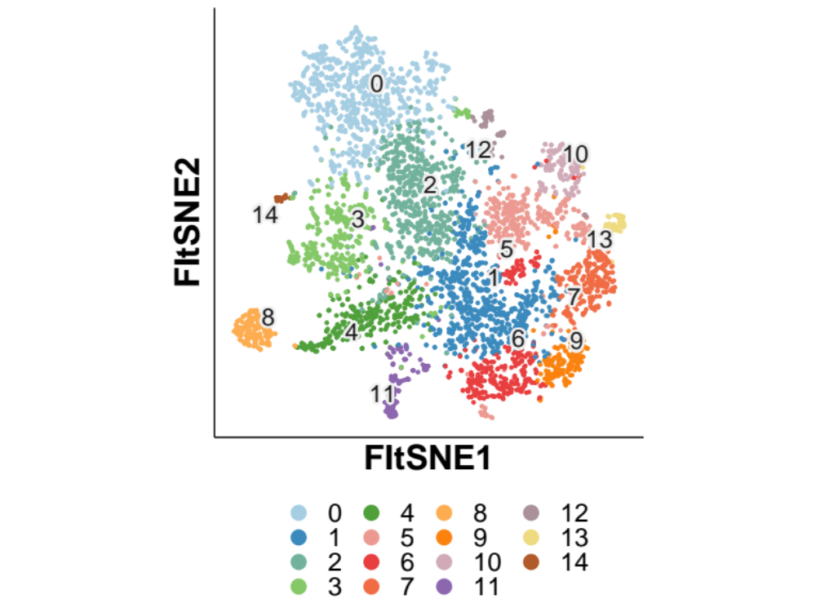
Schwann Cells
0: Fibroblasts
1: Mono/MΦ
2: Sparc+ MΦ
3: MuSCs
4: Sprouting ECs
5: Lars2+ MΦ
6: Trem2+ MΦ
7: H2-Ab1+ MΦ
8: Capillary ECs
9: Folr2+ Monocytes
10: Cd14+ MΦ
11: Mural Cells
12: Cytotoxic T cells
13: mDCs
14: Schwann Cells
FltSNE2
FltSNE1

Slide 5
Fibroblasts
0: Fibroblasts
1: IntMonoMΦ
2: Sparc+ MΦ
3: MuSCs
4: Sprouting ECs
5: Lars2+ MΦ
6: Trem2+ MΦ
7: H2-Ab1+ MΦ
8: Capillary ECs
9: Monocytes
10: Cd14+ MΦ
11: Mural Cells
12: Cytotoxic T cells
13: mDCs
14: Schwann Cells
Inflammatory pop.
FltSNE2
MuSCs
Endothelial pop.
FltSNE1

Slide 6
Fibroblasts
Cytotoxic T cells
FltSNE2
Schwann Cells
Cd14+ MΦ
Sparc+ MΦ
mDCs
Lars2+ MΦ
MuSCs
H2-Ab1+ MΦ
Capillary ECs
Sprouting ECs
Mono/MΦ
Trem2+ MΦ
Folr2+ Monocytes
Mural Cells
FltSNE1

