Slide 1
Language Metaprogramming
CS 1501 Metaprogramming
Maxwell Patek
(mtp4be)

Slide 2
Language Metaprogramming
Machine Language
Homoiconicity
Abstraction
Compiler
Interpreter
Bootstrapping
Self-Hosting
Subset Compilers
Specializers
Partial Evaluation
Futamura Projections
Compiler Compilers

Slide 3
In the beginning…
there was only a processor,
which could be pointed at some 1s and 0s
and told to execute.

Slide 4
Machine Code
At first:
We were directly programming hardware
No languages
Programs were in binary
Agreement between
processor designer
operating system designer
programmers
on a binary interface
example: 0001 might mean MOVE
example: 0010 might mean ADD
etc.

Slide 5
Homoiconicity
A property of languages
Definition:
When programs are represented in the same format as a primitive data structure in the language.
Which of these languages are homoiconistic?
Python?
no
Java?
no
C/C++?
no
Machine Code
YES
IBCM
YES
Check out Lisp!

Slide 6
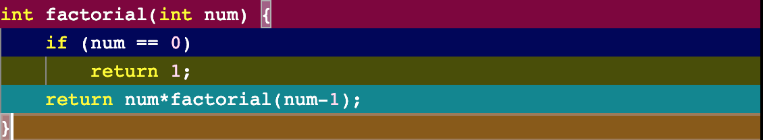
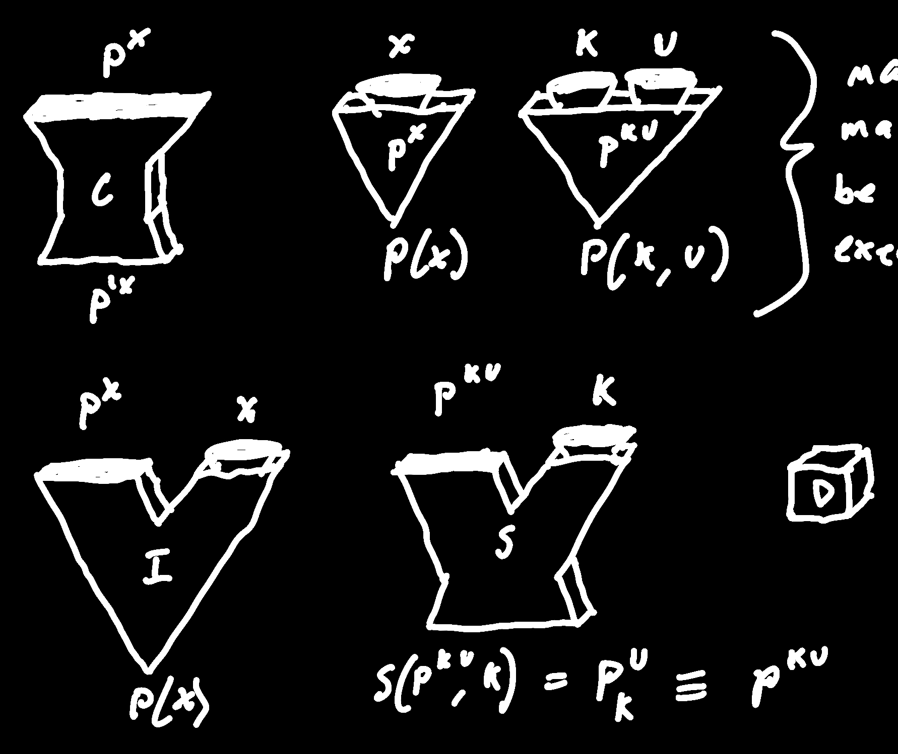
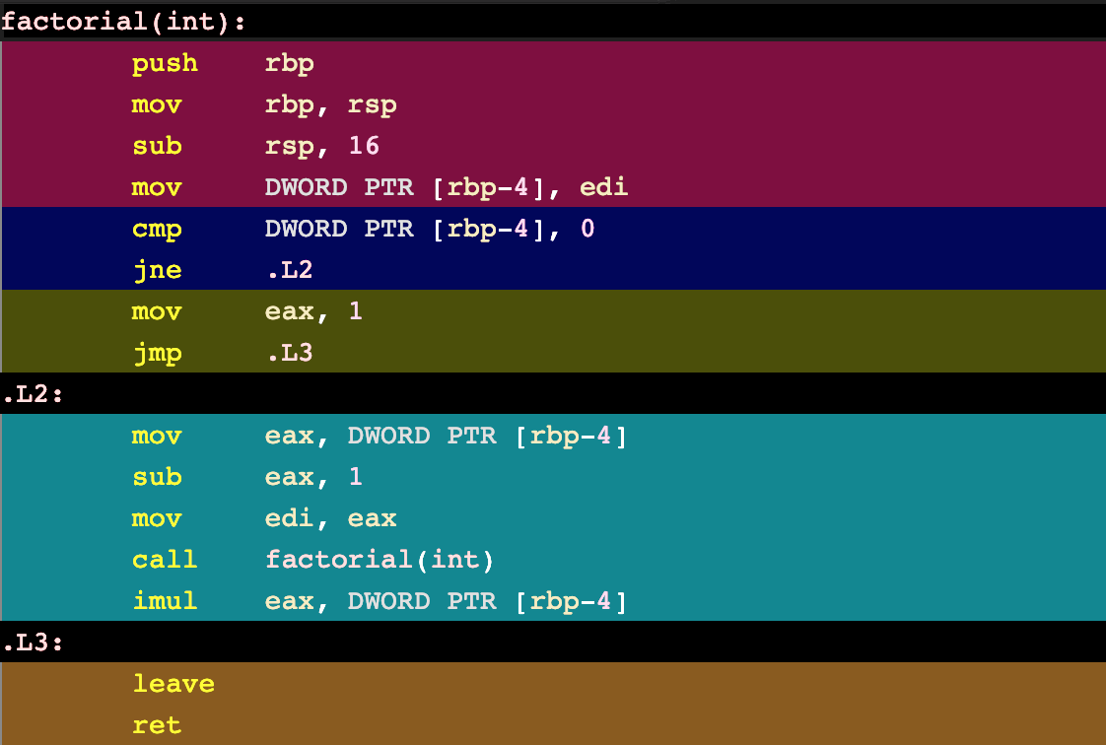
Compilers
Check out:
https://godbolt.org

Slide 7
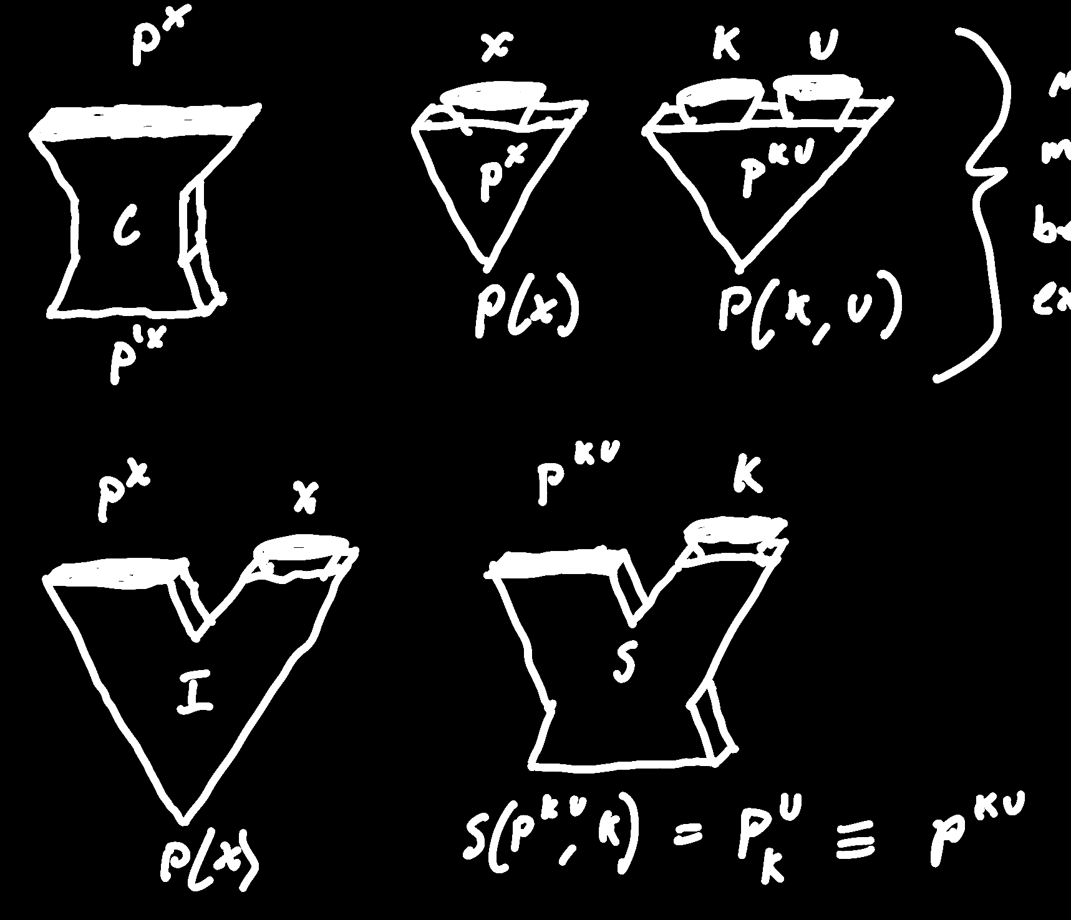
Interpreters
Machine that execute the program directly
Analyzes the program
does not translate
executes on programs behalf
Interpreter takes in x
may seem to only take in program
python3 file.py
^^ ^^
interpreter, program
but will gather other resources
if program requests them
so interpreter is function of P and x.
Note:
Interpreters are easier to write!

Slide 8

Some Notation
Functions
P is for Program
May or may not be executable
C is for Compiler
I is for Interpreter
Superscript denotes the inputs of a function
So an interpreter could be written:
I^{Px}
And if we called the interpreter
I^{Px}(P, x)
Which would output
P^{x}(x)
Inputs
Boxy for program input
Funnel for data input
Outputs
Boxy for program output
Pointy for data output

Slide 9
Compiler Interpreter Relationship
P(D)
P(D)
C(P)
(D)
= I(P, D)

Slide 10

Bootstrapping
Our Language
Assembly
Some other language
Self Hosting
Advantages
Can help develop language without learning other language
improvements to compiler improve programs and the compiler itself
Chicken or Egg?
Somehow we need an executable compiler
Bootstrap Compilers
Subset Compilers
1
0
Bootstrap Compilers
2
Simple Compiler
3
Advanced Compiler
Self-hosted Compiler
4
5

Slide 11
Note
Compilers are Programs
Interpreters are Programs
Programs are Data
Since programs are data
Homoiconicity makes all of these much easier to implement

Slide 12
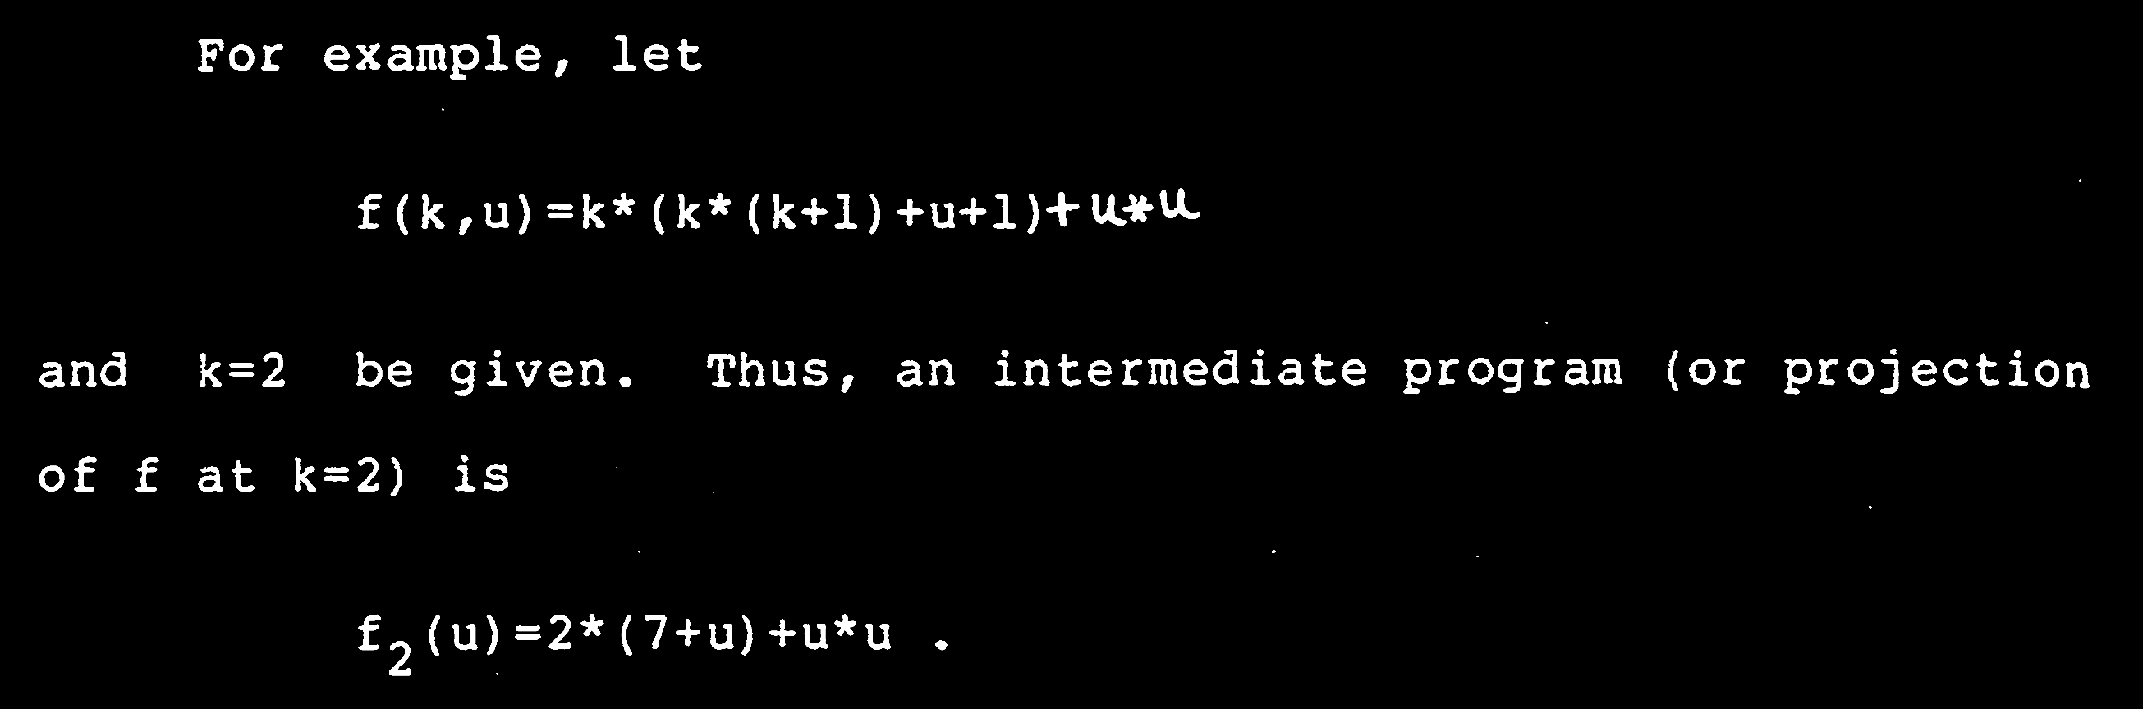
Partial Computation
def partial(func, *args, **keywords):
def newfunc(*fargs, **fkeywords):
newkeywords = keywords.copy()
newkeywords.update(fkeywords)
return func(*args, *fargs, **newkeywords)
return newfunc
or specialization
[Like calling partial(f, k=2), but smarter]

Slide 13
Specializer
Let’s say we have a machine
similar to the partial function
that converts f(k, u) into f_{k}(u)
Let’s call this machine a Specializer (S)
Some more notation:
subscript denotes specialization
= means “the same as”
≡ means “does the same thing as”
P_{k}^{u} ≡ P^{ku}

Slide 14
Specializer Example

Slide 15

Futamura Projections
S(P^{ku}, k) ≡ P^{ku}
x
x
x
→
≡
Function of x
does the same thing as a compiled P
Specialized version of interpreter that runs P
S(I, P) ≡ C(P)

Slide 16
Futamura Projections
S(P^{ku}, k) ≡ P(k, u)
S(I, P) ≡ C(P)
x
x
x
→
→
Function of x
does the same thing as a compiled P
Specialized version of a specializer that specializes I on P
S(S, I)(P) ≡ C(P)

Slide 17
Futamura Projections
S(P^{ku}, k) ≡ P(k, u)
P
S(I, P) ≡ C(P)
P
P
→
≡
Function of P
equivalent to compiler
Specialized version of a specializer that specializes I on P
S(S, I) ≡ C

Slide 18
Futamura Projections
S(P^{ku}, k) ≡ P(k, u)
P
S(I, P) ≡ C(P)
P
S(S, I) ≡ C
→
→
Function of P
equivalent to compiler
Specialized version of a specializer that specializes a
specializer on I
S(S, S)(I) ≡ C

Slide 19
Futamura Projections
S(P^{ku}, k) ≡ P(k, u)
I
S(I, P) ≡ C(P)
S(S, I) ≡ C
I
Some Machine that Outputs a Compiler from an Interpreter
→
≡
Function of I
Specialized version of a specializer that specializes a
specializer on I
equivalent to a compiler-compiler
S(S, S) ≡ CC

Slide 20
Compiler Compilers
We’ve just constructed a machine
that takes in interpreters
and compiles a compiler
thus, a compiler compiler
There are other compiler compilers
hand-written
take in a grammar
output a parser for that grammer
with hooks into some back-end
Domain Specific Languages
programming paradigm, like OOP and Functional
develop language for the problem space
solve problem in that language

Slide 21
Extra-Credit Write-Up Homeworks
Why is Lisp Homoiconic?
What are three good, efficient applications of a partial-evaluation specializer?
Why are they good applications?
What is Jones Optimality?
Have we achieved it?

