Slide 1
Metaprogramming
CS 1501 Metaprogramming
Maxwell Patek
(mtp4be)

Slide 2
Making Our Own Objects
class keyword
class name
methods are just functions inside the class
>>> class foo:
... def hi(self):
... print(self)
...
>>> f = foo()
>>> f.hi()
<__main__.foo object at 0x103729cf8>
>>> f
<__main__.foo object at 0x103729cf8>
self is first parameter by convention
self == this from Java
blank line to end block in shell
don’t need new from java
same exact thing

Slide 3
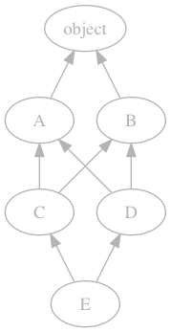
C3 Linearization
We need to compute the MRO (Linearization L) of a class
let the head of a list be the first element ([0])
let the tail of a list be everything after the first element ([1:])
let $merge(list1, list2, …, listn)$ be:
find the first head that is not in the tail of any other list
append it to the output list
remove it from input lists
repeat until all input lists are empty
$L(X) = [X] + merge( L(Y_{1}), L(Y_{2}), …, L(Yn), \left[Y_{1},Y_{2}, …, Yn\right] )$
where X.__bases__ = (Y₁, Y₂, …, Y_{n})
What’s $L(E)$?
$\left[E\right]+merge(L\left(C\right), L\left(D\right), [C, D])$
$\left[E\right]+merge([C,A,B, object], [D,B,A, object] [C, D])$
$\left[E, C, D, !!!\right]$
Does Not Exist!

Slide 4
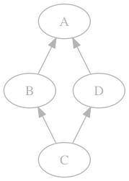
But What About super()?
>>> class A:
... def foo(self):
... print('A')
>>> class B(A):
... def foo(self):
... super().foo()
>>> class D(A):
... def foo(self):
... print('D')
>>> class C(B, D):
... pass
>>> B().foo()
A
>>> C().foo()
D
It cant just mean “acces the superclass”
Which one?
We should use the MRO
It actually means “next in the MRO”
But which MRO?
We can’t know
Who’s B’s super()?
A?
Keep this in mind
for the homework

Slide 5
Functions are objects
You can
assign them to variables
call methods on them
You can
pass them in to functions
return them from functions
>>> from statistics import mean
>>> func = mean
>>> func([1,2,3])
2
>>> func = sum
>>> func([1,2,3])
6
>>> func.__eq__(sum)
True
>>> func.__str__()
'<built-in function sum>'
>>> print(func)
<built-in function sum>
>>> def mean_or_sum(num):
... if num == 0:
... return mean
... return sum
...
>>> mean_or_sum(0)([1,2,3])
2
>>> mean_or_sum(1)([1,2,3])
6

Slide 6
A Closure:
>>> x = 1
>>> def make_closure():
... x = 2
... def close():
... print(x)
... return close
...
>>> c = make_closure()
>>> c()
2
>>> print(x)
1
>>> c.__code__.co_freevars
('x',)
>>> c.__code__.co_cellvars
()
>>> make_closure.__code__.co_freevars
()
>>> make_closure.__code__.co_cellvars
('x',)
>>> c.__closure__
(<cell at 0x103911af8: int object at 0x1009e0ca0>,)
“Closes”

Slide 7
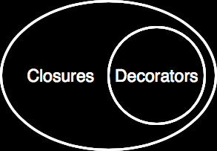
Decorators ⊂ Closures
def decorator(func):
...
def wrapper(*args, **kwargs):
...
return func(params)
...
return wrapper
1) Take in a function
2) Wrap that function
wrapper should match func’s signature
(*args, **kwargs)
3) return the wrapper

Slide 8
Some Syntactic Sugar
>>> @decorator
... def bar(a):
... print(a)
...
decorating bar
>>> bar(10)
10
Notice how we actually applied the decorator:
foo = decorator(foo)
Python provides some special syntax for this
We can decorate at definition time

Slide 9
>>> type(42)
<class ‘int’>
>>> type(int)
<class ‘type’>
>>> type(type)
<class ‘type’>
>>> type(type(type(type(type(type(type(
<class ‘type’>
>>> isinstance(type, type)
True
I’ve been lying…
type() is not a function.
It is a class.
Another Fixed Point

Slide 10
exec and eval globals and locals
>>> eval('a+b')
Traceback (most recent call last):
File "<stdin>", line 1, in <module>
File "<string>", line 1, in <module>
NameError: name ‘a' is not defined
>>> eval('a+b', {'a':1}, {'b':2})
3
>>> g = {'__builtins__': None}
>>> g
{'__builtins__': None}
>>> exec('a=5', g)
>>> g
{'__builtins__': None, 'a': 5}
Both functions may take in optional args:
globals
locals
which determine
the context of evaluation
and destination of execution
IMPORTANT NOTE:
dynamically modifying locals:
is not supported
and often will not work
more on next slide

Slide 11
Cofoja
@Requires({
"currentBuffer != null",
"tokenizer != null",
"token != null"
})
private void transformCommon(StringBuilder currentBuffer,
BalancedTokenizer tokenizer, Token token) {
switch (token.kind) {
case COMMENT:
int length = token.text.length();
for (int i = 0; i < length; ++i)
currentBuffer.append(" ");
break;
default:
currentBuffer.append(token.text); } }

Slide 12
Templates
unsigned int factorial(unsigned int n) {
return n == 0 ? 1 : n * factorial(n - 1);
}
template <unsigned int n> // n must be constexpr
struct factorial {
enum { value = n * factorial<n - 1>::value };
}; // ^^^ must be constexpr ^^^
template <>
struct factorial<0> { // base case specialization
enum { value = 1 };
};
// ^^ structs themselves are const

Slide 13
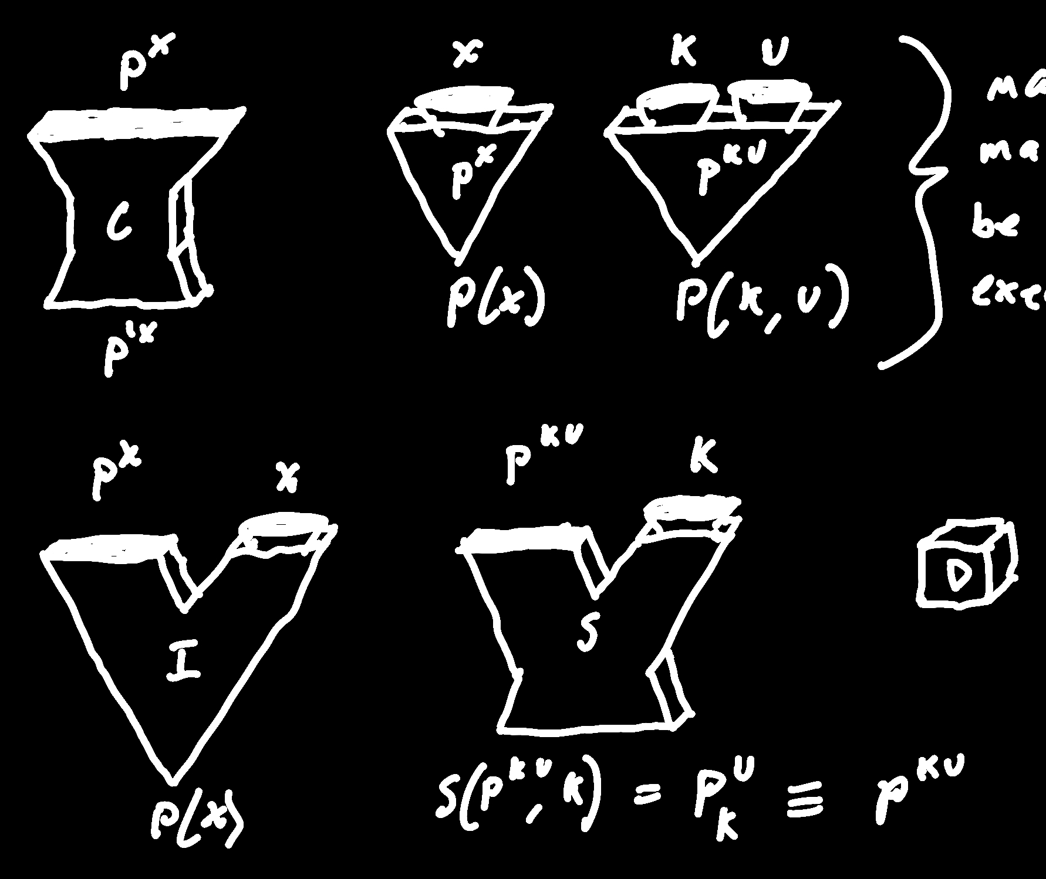

Bootstrapping
Our Language
Assembly
Some other language
Self Hosting
Advantages
Can help develop language without learning other language
improvements to compiler improve programs and the compiler itself
Chicken or Egg?
Somehow we need an executable compiler
Bootstrap Compilers
Subset Compilers
1
0
Bootstrap Compilers
2
Simple Compiler
3
Advanced Compiler
Self-hosted Compiler
4
5

Slide 14
Futamura Projections
S(P^{ku}, k) ≡ P(k, u)
I
S(I, P) ≡ C(P)
S(S, I) ≡ C
I
Some Machine that Outputs a Compiler from an Interpreter
→
≡
Function of I
Specialized version of a specializer that specializes a
specializer on I
equivalent to a compiler-compiler
S(S, S) ≡ CC

Slide 15
Extra-Credit Write-Up Homeworks
Why is Lisp Homoiconic?
What are three good, efficient applications of a partial-evaluation specializer?
Why are they good applications?
What is Jones Optimality?
Have we achieved it?

Slide 16
Final Exam
glfh

