Slide 1


P53 and DNA Damage
William Cesaretti
Computer Science
E340/E542—Introduction to Computational Bioengineering

Slide 2

Overview
Biological Background
Motivation and Goals
Mathematical Background
Key Results
Issues Faced in Reproduction
Future Work
https://colab.research.google.com/drive/1xNMxBov0yLKOwlS6RKQIRZV6kpGC7VIq?usp=sharing
Key References:
***Tongli Zhang, Paul Brazhnik & John J. Tyson (2007) Exploring Mechanisms of the DNA-Damage Response: p53 Pulses and their Possible Relevance to Apoptosis, Cell Cycle, 6:1, 85-94, DOI: 10.4161/cc.6.1.3705 https://pubmed.ncbi.nlm.nih.gov/17245126/
Tyson, J. Monitoring p53's pulse. Nat Genet 36, 113–114 (2004). https://doi.org/10.1038/ng0204-113
Vogelstein B, Lane D, Levine AJ. Surfing the p53 network. Nature 2000; 408:307-10. https://pubmed.ncbi.nlm.nih.gov/11099028/

Slide 3
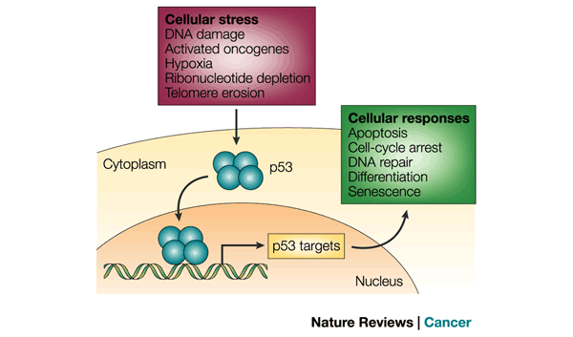
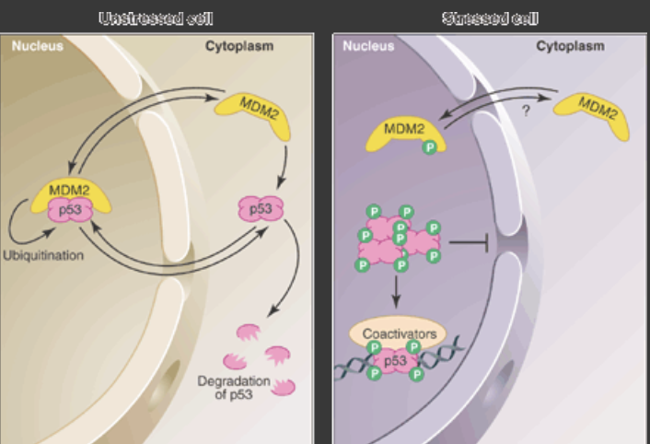
Biological Background
DNA is under constant stress
The p53 and Mdm2 feedback loop
Researchers have found levels of p53 and MDM2 rise and fall in pulses post DNA damage
We will investigate the pulses and relationships

Slide 4
Motivation and Goals
P53 system is important as the protein stops tumors
Create an interactive, educational walkthrough of the system
Show DNA damage’s affect on pulses

Slide 5
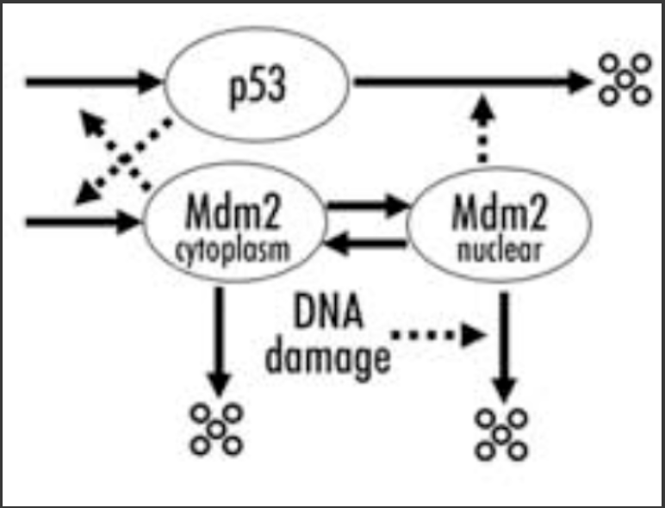
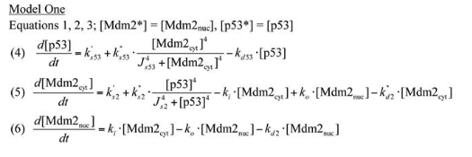
Mathematical Background
Ordinary Differential Equations

Slide 6
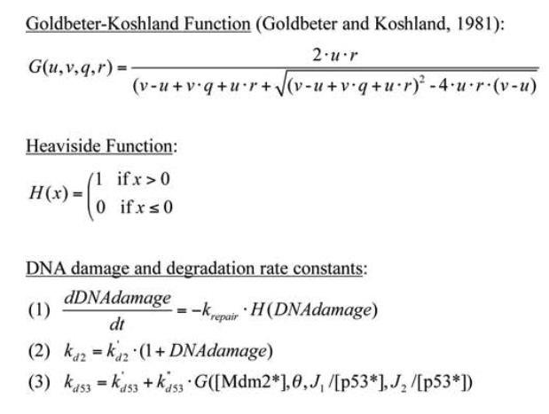
Mathematical Background cont.
DNA Damage

Slide 7
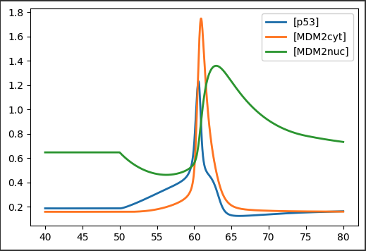
Goal
Pulses occur but under what conditions?

Slide 8
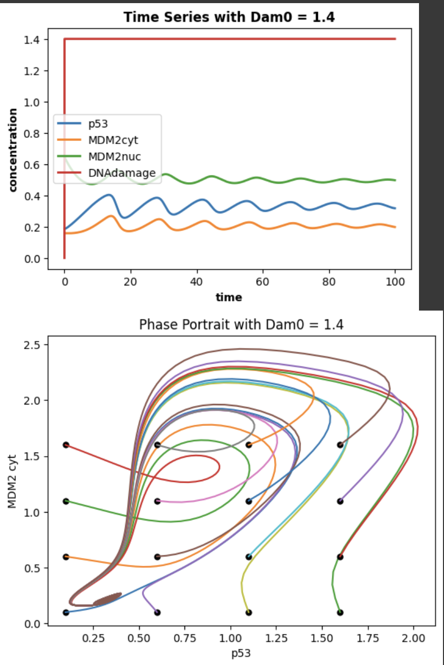
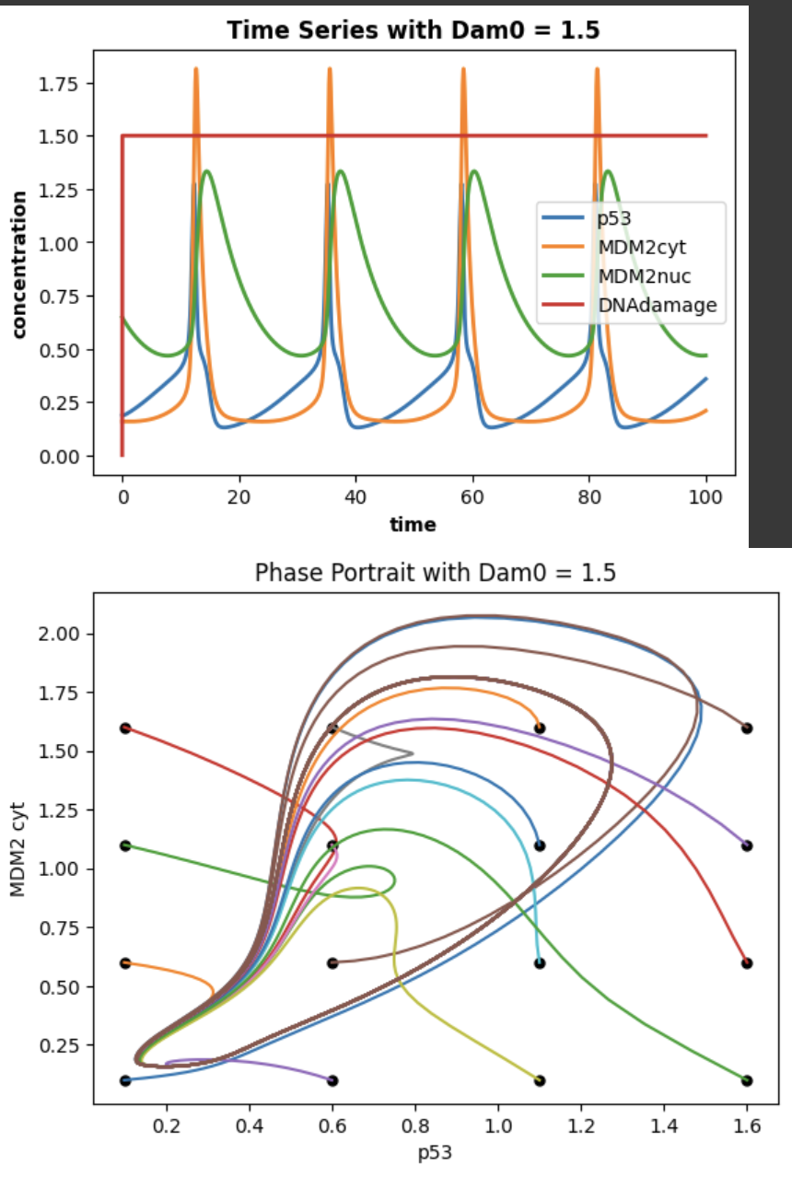
Key Results

Slide 9
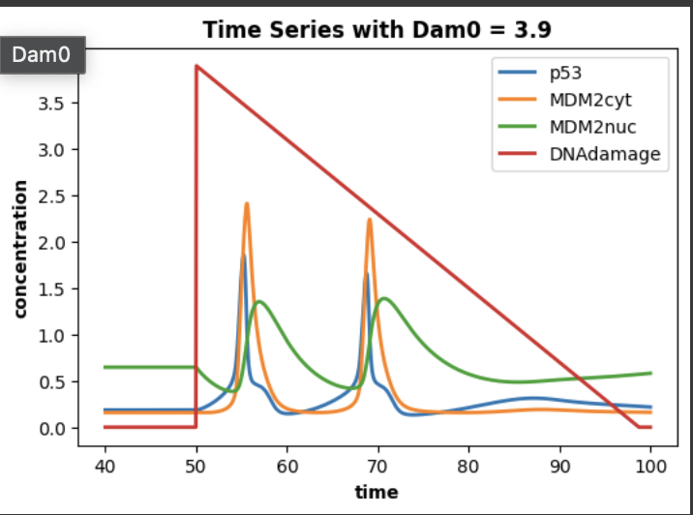
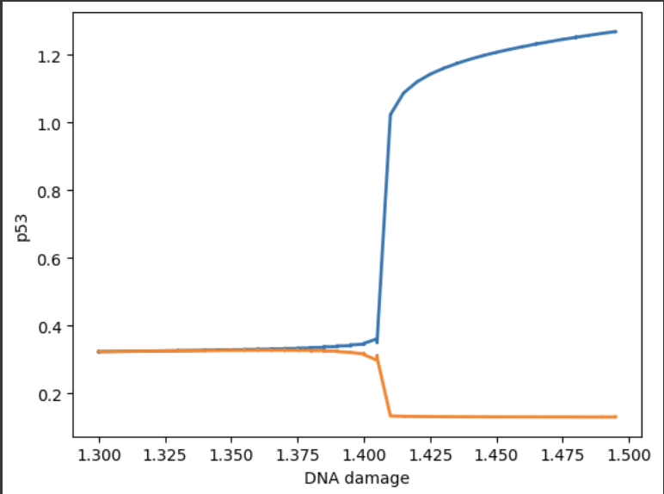
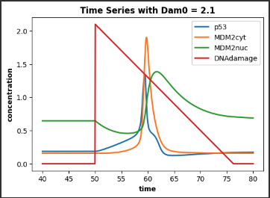
Key Results

Slide 10
Issues Faced in Reproducing the Source Materials
Computational:
Changing parameters
Bifurcation diagram
Scientific:
Understanding the mathematical model

Slide 11
Conclusion
Pulses are related to DNA damage level
Understand the p53, Mdm2, DNA damage interaction through a Colab notebook
https://colab.research.google.com/drive/1xNMxBov0yLKOwlS6RKQIRZV6kpGC7VIq?usp=sharing
Key References:
***Tongli Zhang, Paul Brazhnik & John J. Tyson (2007) Exploring Mechanisms of the DNA-Damage Response: p53 Pulses and their Possible Relevance to Apoptosis, Cell Cycle, 6:1, 85-94, DOI: 10.4161/cc.6.1.3705 https://pubmed.ncbi.nlm.nih.gov/17245126/
Tyson, J. Monitoring p53's pulse. Nat Genet 36, 113–114 (2004). https://doi.org/10.1038/ng0204-113
Vogelstein B, Lane D, Levine AJ. Surfing the p53 network. Nature 2000; 408:307-10. https://pubmed.ncbi.nlm.nih.gov/11099028/

Slide 12
Future Work
Publish with DOI
Examine the other models in paper
Change the mathematics of the model??

