Slide 1
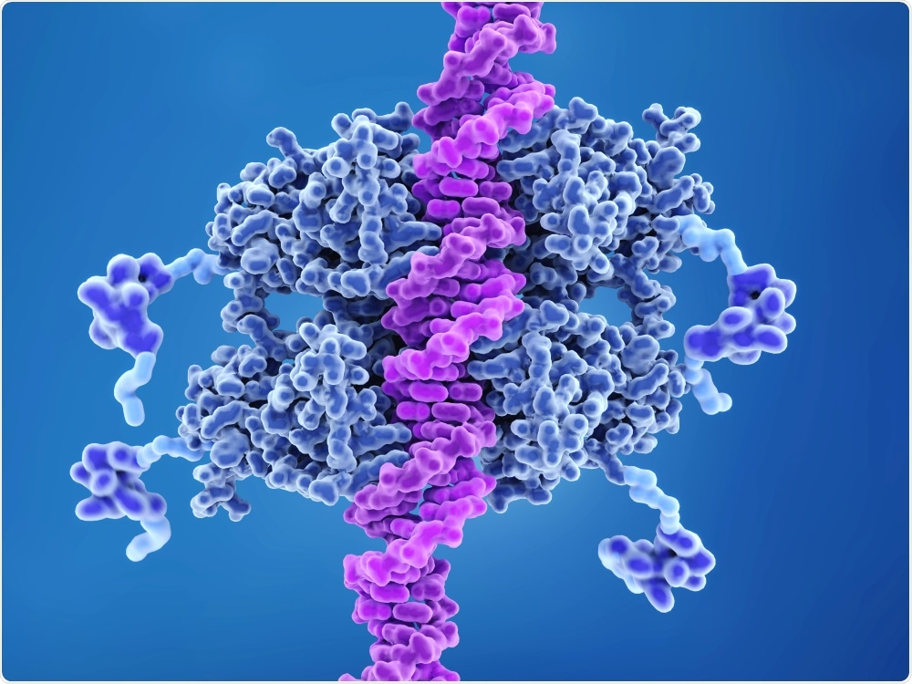
p53 and DNA damage
William Cesaretti

Slide 2
Summary
https://colab.research.google.com/drive/1xNMxBov0yLKOwlS6RKQIRZV6kpGC7VIq?usp=sharing

Slide 3
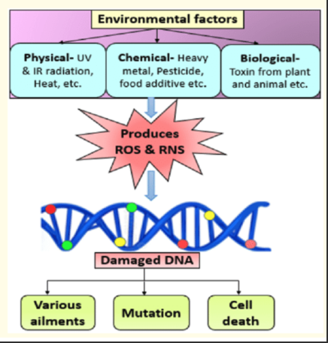
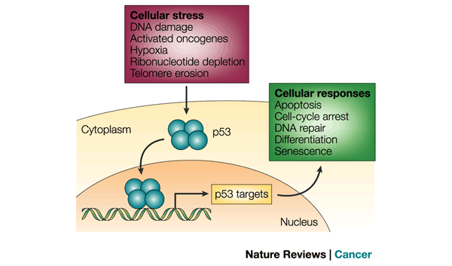
Biological
Background
DNA is under constant stress
Cells have complex mechanisms to combat said stress
The p53 protein is one of the mechanisms to help repair DNA damage

Slide 4
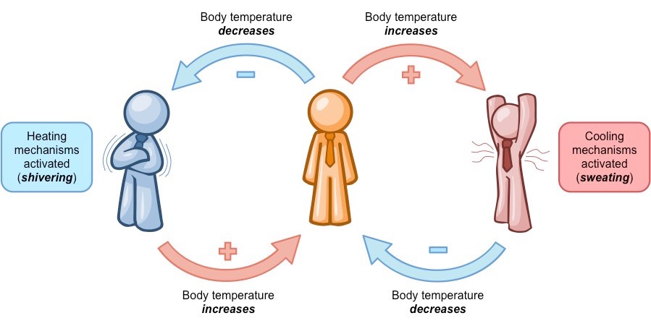
Biological
Background cont.
MDM2 is a protein that suppresses p53
Increase in p53 causes MDM2 production, thereby decreasing the level of p53
Autoregulatory feedback loop

Slide 5
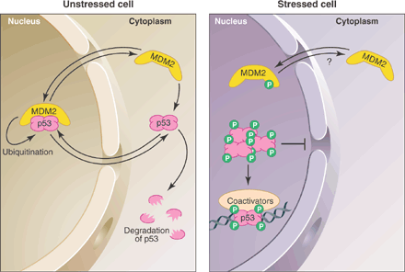
Biological
Background cont.
DNA damage -> p53 accumulates to help repair the damage/apoptosis/senescence/arrest
Researchers have found levels of p53 and MDM2 rise and fall in pulses post DNA damage
They investigated the function of pulses

Slide 6
Motivation and Goals
P53 system is important as the protein stops tumors
Create an interactive, educational walkthrough of the system
Highlight the amount of DNA damage impact on p53

Slide 7
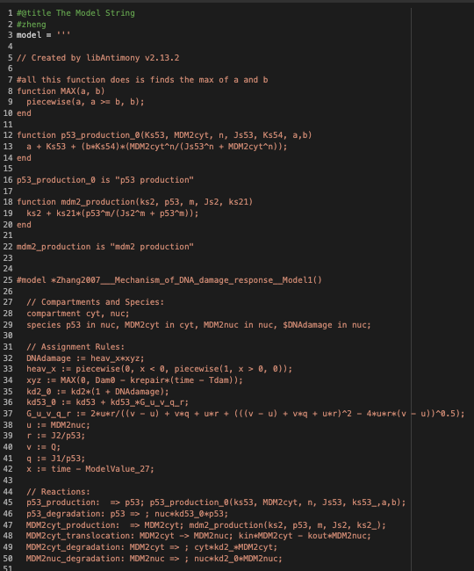
The model
Model already exists (used
SBML -> Antimony translator online)
Protein signaling network
Review the ODE’s of p53 and MDM2
And go over the how DNA damage is simulated

Slide 8
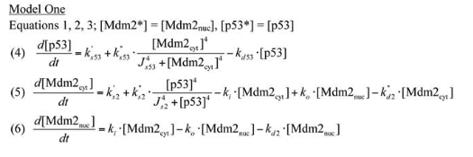
ODE’s

Slide 9
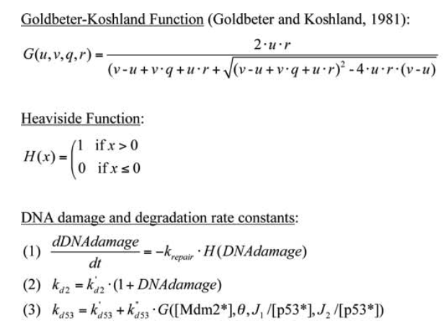
DNA Damage
GK function (feedback loops lead to nonlinearity)
H() to represent binary conditions
Kd2 is degradation rate constant of MDM2 nuc
Kd53 is degradation rate constant of p53

Slide 10
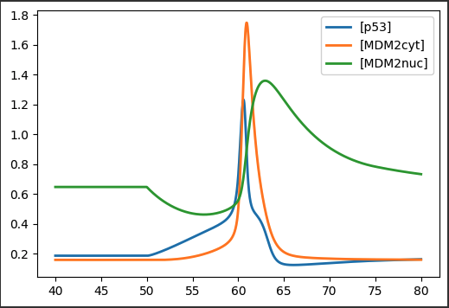
Original Parameters
Concentrations initialized to ss values
DNA damage at time=50
MDM2 decreases due to DNA damage
Lack of inhibitor results in p53 growth
P53 activates MDM2 cyt

Slide 11
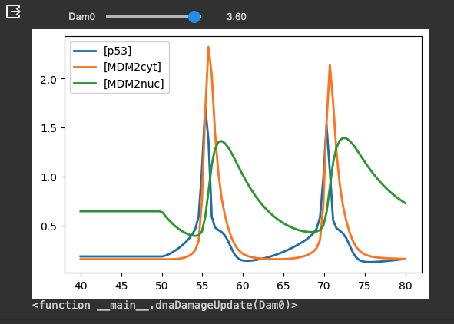
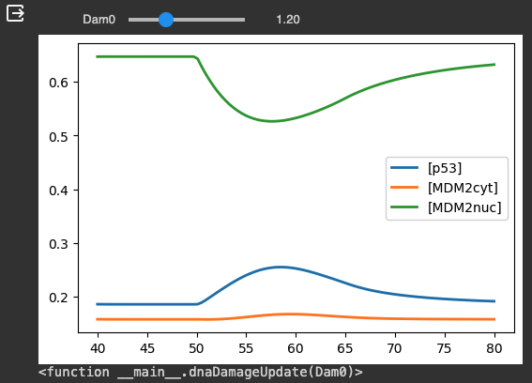
Explore
DNA Damage
Concentrations initialized to ss values
Slider to adjust ‘Dam0’ parameter in model
Linear impact on amount of DNA Damage
High damage = pulses
Low damage = flatter curves

Slide 12
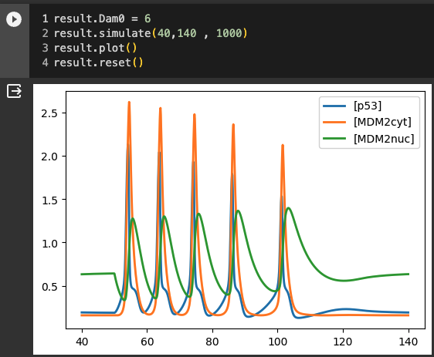
Further Examine Pulses
Concentrations initialized to ss values
Slider to adjust ‘Dam0’ parameter in model
Linear impact on amount of DNA Damage
High damage = pulses
Low damage = flatter curves

Slide 13
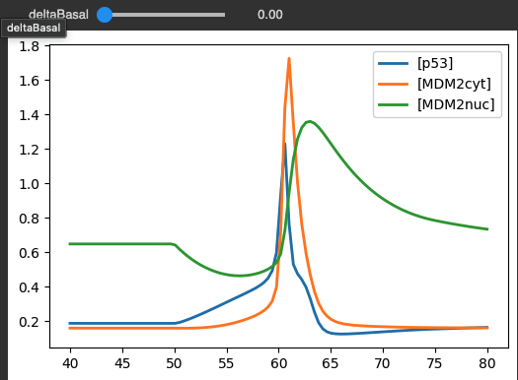
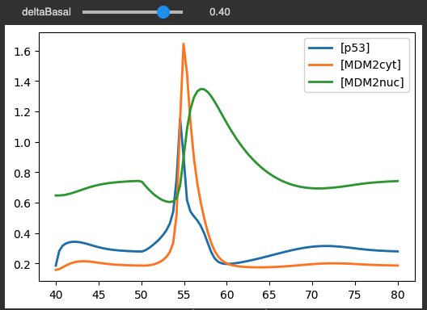

Explore p53 Production
Alter the basal rate of transcription of p53: k’s53
What do we expect?
When increasing the basal rate, the process speeds up

Slide 14
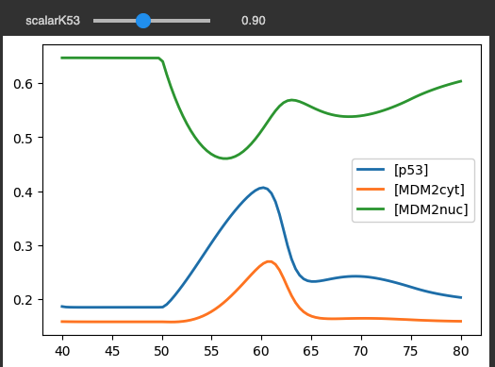
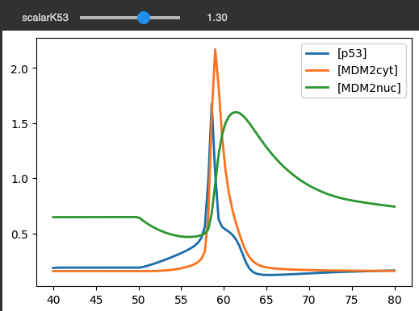
Explore p53 Production cont.
Alter the ks53 by multiplying it by a scalar value
Decrease size of ks53, the lines do not overlap

Slide 15
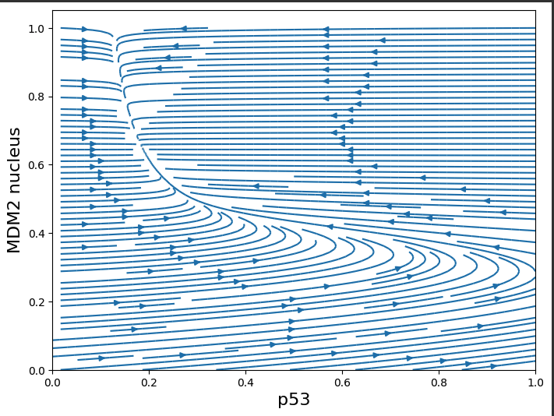
Phase Plots
Plot the 3 variables in 3 different plots
Better visualize the steady state and how the model converges
Instruct users to trace the plots by starting at any random point
MDM2 nucleus vs p53
Lines are more horizontal…

Slide 16
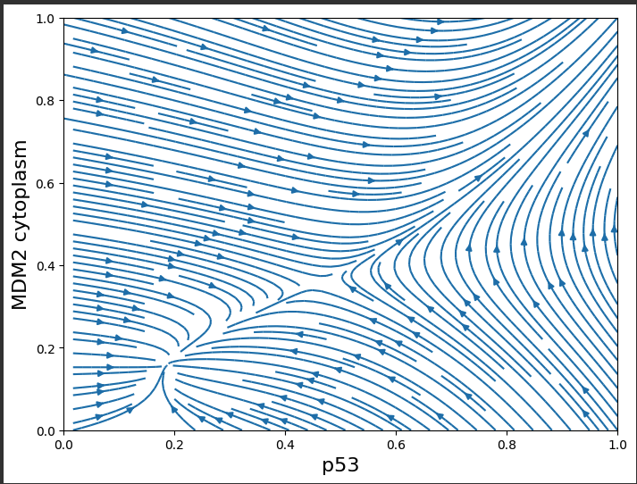
Phase Plots cont.
MDM2 cytoplasm vs p53
Not all states converge to the steady states
Why is this?

Slide 17
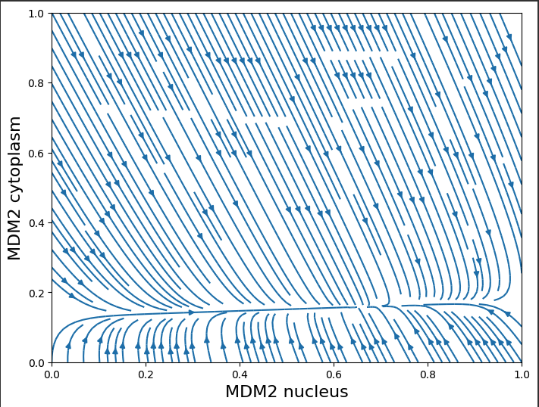
Phase Plots cont.
MDM2 cytoplasm vs MDM2 nucleus
Always converge
Lines are more vertical than horizontal…

Slide 18
Thank you
I’d appreciate any critiques, questions, or thoughts.

Slide 19
References
[1] Tongli Zhang, Paul Brazhnik & John J. Tyson (2007) Exploring Mechanisms of the DNA-Damage Response: p53 Pulses and their Possible Relevance to Apoptosis, Cell Cycle, 6:1, 85-94, DOI: 10.4161/cc.6.1.3705
[2] Clancy S. DNA damage & repair: mechanisms for maintaining DNA integrity. Nature Education. 2008;1(1):103. Available from: https://www.nature.com/scitable/topicpage/dna-damage-repair-mechanisms-for-maintaining-dna-344/#
[3] Sauro HM. Systems Biology: Introduction to Pathway Modeling. Ambrosius Publishing; 2020. p. 292.
[4] Tyson, J. Monitoring p53's pulse. Nat Genet 36, 113–114 (2004). https://doi.org/10.1038/ng0204-113
[5] Vogelstein B, Lane D, Levine AJ. Surfing the p53 network. Nature 2000; 408:307-10.
[6] Chène, P. Inhibiting the p53–MDM2 interaction: an important target for cancer therapy. Nat Rev Cancer 3, 102–109 (2003). https://doi.org/10.1038/nrc991
[7] Singh, Nitika & Sharma, Bechan. (2019). EC PHARMACOLOGY AND TOXICOLOGY Review Article Role of Toxicants in Oxidative Stress Mediated DNA Damage and Protection by Phytochemicals. 7. 325-330.
[8] Mijit, M., Caracciolo, V., Melillo, A., Amicarelli, F., & Giordano, A. (2020). Role of p53 in the Regulation of Cellular Senescence. Biomolecules, 10(3). https://doi.org/10.3390/biom10030420

