Slide 1

Data Analysis Programming: Project
Steam Store Game Analysis
컴퓨터공학
201714220 정든솔
2021.12.17
Copyrightⓒ. Saebyeol Yu. All Rights Reserved.

Slide 2

CONTENTS
001
Data Set
Data
Preprocessing
002
Time-Series & Regression
Time-Series & Correlation
Linear Regression
003
Clustering
Handling Outlier & Scaling(Normalization)
K-Means & Agglomerative Clustering
004
Multi-label Classification
Classification without Balancing Data
Classification with Over-sampling Data
005
Difficulty & Further Investigation
Copyrightⓒ. Saebyeol Yu. All Rights Reserved.

Slide 3
Part 1.
Data Set
Data Set
Copyrightⓒ. Saebyeol Yu. All Rights Reserved.

Slide 4
Data Analysis Programming
1.1 Data
Data
Steam Store Games (Clean dataset)
Games data scraped from Steam Store and SteamSpy APIs
Data Collected: May, 2019
Data Size: 27,075 Instances
Source: https://www.kaggle.com/nikdavis/steam-store-games
Data type: object(9), int64(8), float64(1)
Picture 1. Origin Data Set

Slide 5
Data Analysis Programming
1.2 Preprocessing
Proprocessing
release_date
pd.to_datetime으로 Timestamp로 변경
Rating
rating = positive_ratings / (positive_ratings + negative_ratings)
total_ratings = positive_ratings + negative_ratings
Owners
owner_level ≒ [ log(owners) ]
owners = (owners.MAX + owners.MIN) / 2
Genres
One-hot Encoding + Drop unnecessary genres
Picture 2. Preprocessed Data Set

Slide 6
Part 2.
Time-Series & Regression
Time-Series & Regression
Copyrightⓒ. Saebyeol Yu. All Rights Reserved.

Slide 7
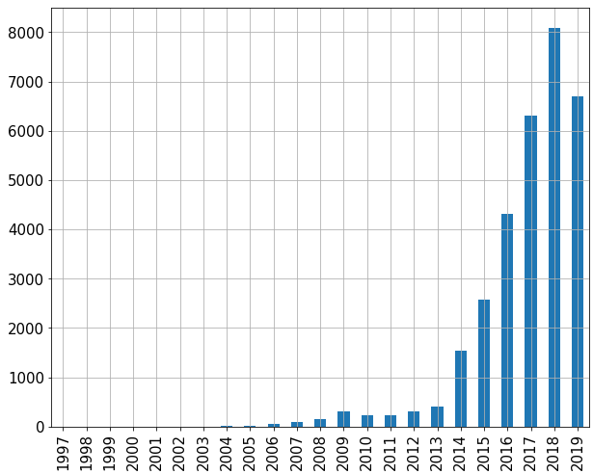
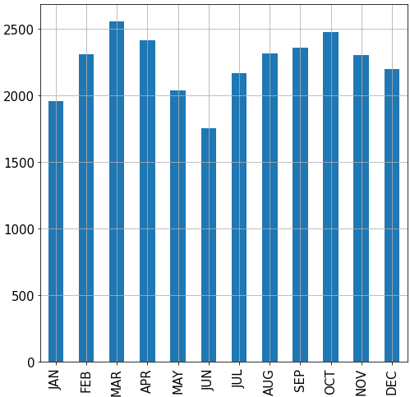
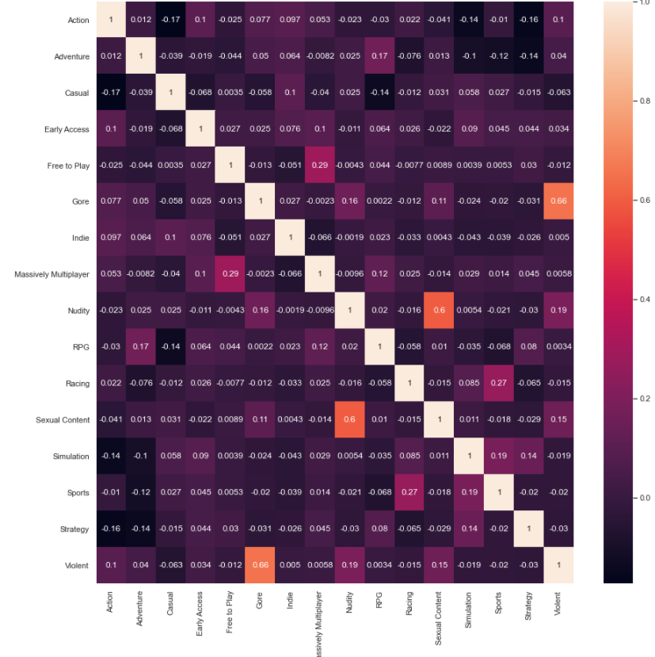
Data Analysis Programming
2.1 Time-Series & Correlation
Time-Series
Trend: Incresed (Decreased in 2019)
Seasonality: Non-vacation season
Correlation
Low correlation between Genres
Picture 3. Trend of Data
Picture 4. Seasonality of Data
Picture 5. Correlation between Genres

Slide 8
Data Analysis Programming
2.2 Linear Regression
Linear Regression
Features
average_playtime / price / owner_level
Target
rating
Evaluation
Coefficient: 4.30933148 e-07 / 2.37918180 e-03 / 1.04271649 e-02
Constant: 0.6922360802261261MAE: 0.182503
Evaluation
MAE: 0.182503
MSE: 0.053695
RMSE: 0.231722
R2: 0.011840

Slide 9
Part 3.
Clustering
Clustering
Copyrightⓒ. Saebyeol Yu. All Rights Reserved.

Slide 10
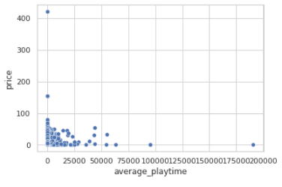
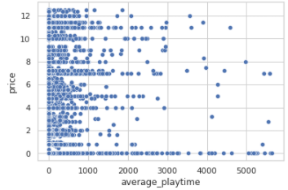
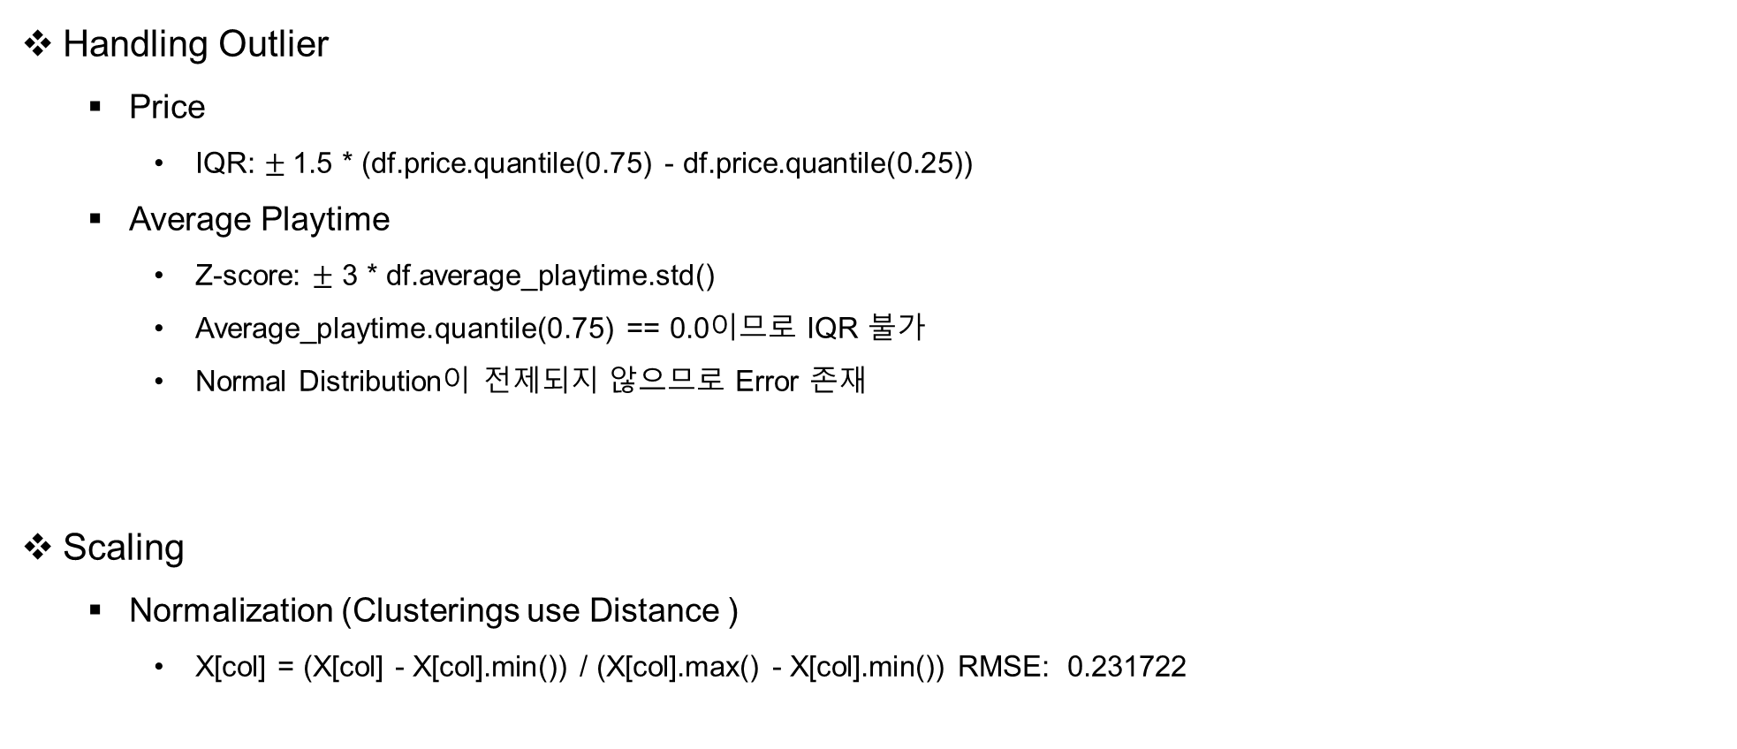
Data Analysis Programming
3.1 Handling Outlier & Scaling(Normalization)
Handling Outlier
Price
IQR: $±$1.5 * (df.price.quantile(0.75) - df.price.quantile(0.25))
Average Playtime
Z-score: $±$ 3 * df.average_playtime.std()
Average_playtime.quantile(0.75) == 0.0이므로 IQR 불가
Normal Distribution이 전제되지 않으므로 Error 존재
Scaling
Normalization (Clusterings use Distance )
X[col] = (X[col] - X[col].min()) / (X[col].max() - X[col].min()) RMSE: 0.231722
Picture 6. Data with Outlier
Picture 7. Data without Outlier

Slide 11
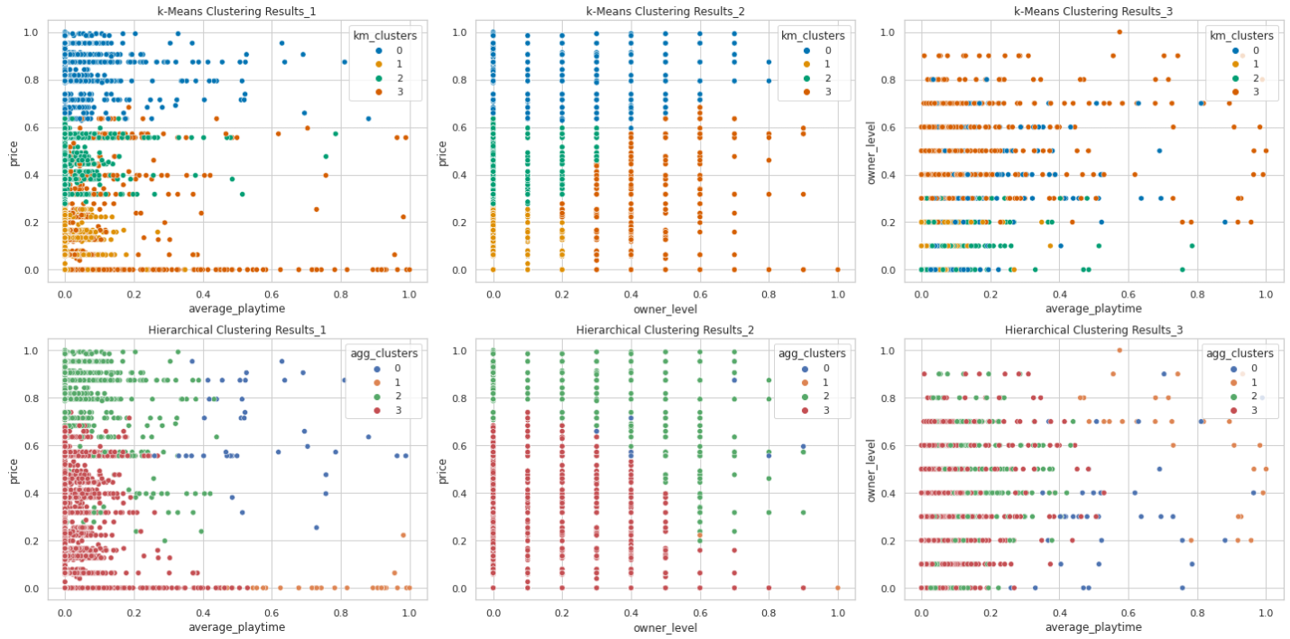
Data Analysis Programming
3.2 Clustering

Slide 12
Part 4.
Multi-label Classification
Multi-label Classification
Copyrightⓒ. Saebyeol Yu. All Rights Reserved.

Slide 13
Data Analysis Programming
4.1 Classification without Balancing Data
Classification
Logistic Regression
K-Nearest Neighbors
Gaussian Naïve Bayes
Decision Tree Classification
Feature Importances: TOP 20
Random Forest Classification
Feature Importances: TOP 20
Support Vector Machine
Data Split & Feature
Train set : Test set == 80 : 20
Feature: Clustering에 사용된 Feature 제외

Slide 14
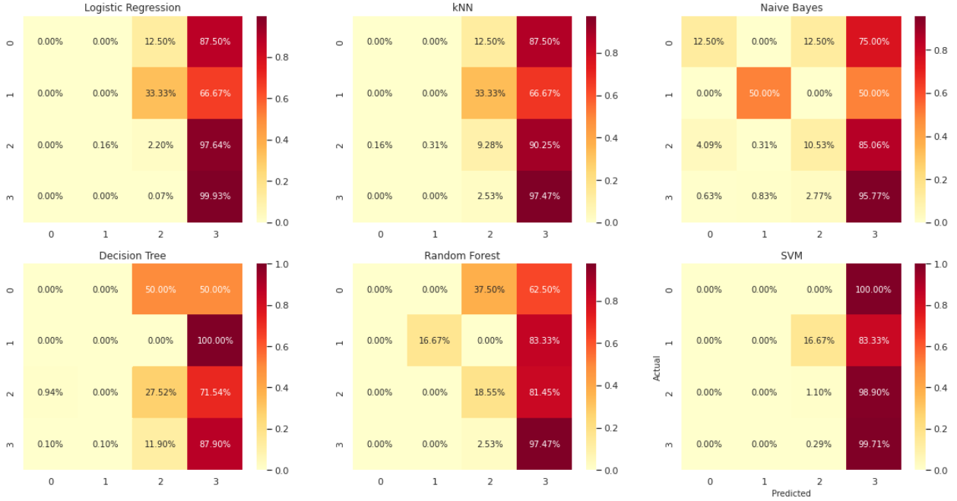
Data Analysis Programming
4.1 Classification without Balancing Data
Average Accuracy: 0.847881

Slide 15
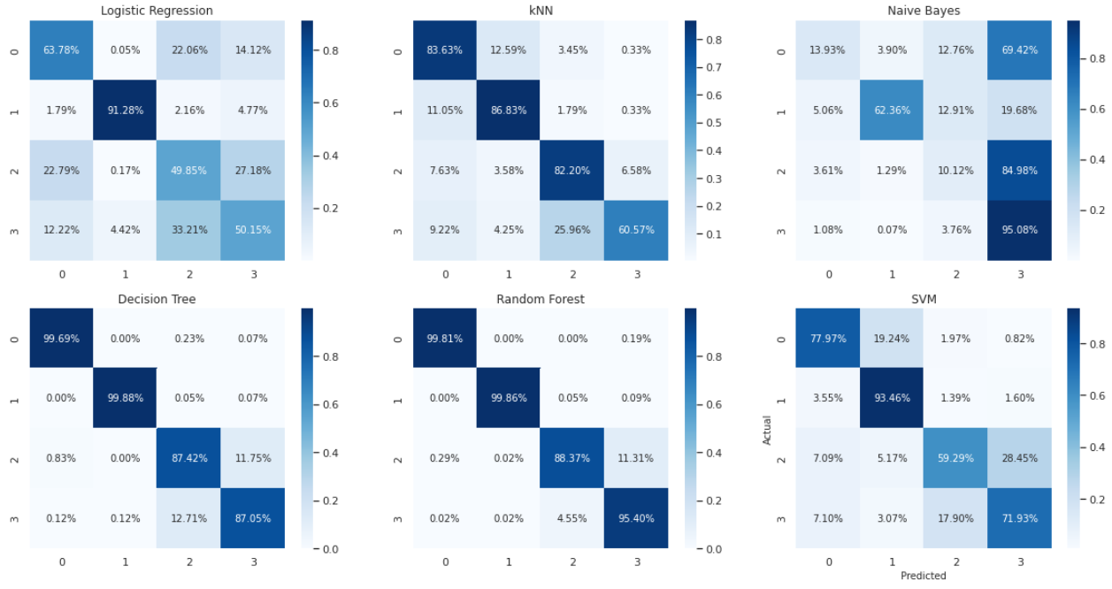
Data Analysis Programming
4.2 Classification with Over-sampling Data
Average Accuracy: 0.755116

Slide 16
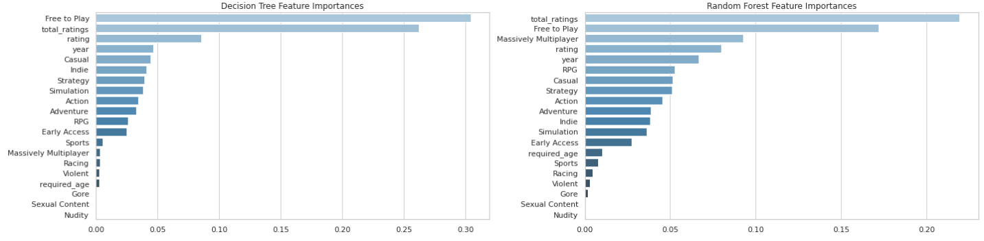
Data Analysis Programming
4.2 Classification with Over-sampling Data
Feature Importances

Slide 17
Part 5.
Difficulty & Future Task
Difficulty & Future Task
Copyrightⓒ. Saebyeol Yu. All Rights Reserved.

Slide 18
Data Analysis Programming
5.1 Difficulty & Future Task
Difficulty
Data set
Multi-valued Attributes: Genres, steamspy_tags
Overly Categorical Data: Owners
Worthless Data: average_playtime, median_playtime
Feature & Target
Genres: Multi-label
Game Type: Multi-class
Future Task
Need more valuable data and preprocessing to make worth analysis

Slide 19
Thank You
201714220 정든솔
Copyrightⓒ. Saebyeol Yu. All Rights Reserved.

