Slide 1

Olist Customer Segmentation
EDHEC Business School
MSc in Data Analytics & Artificial Intelligence
Data Science Track - Advanced Data Sciences
Group Members
57488 Charles LIETAR
61781 Hojun JUNG
74098 Omar EL-HAJJAR

Slide 2
SUMMARY
I
II
III
CONTEXT DEFINITION
OUR STRATEGY
OUR SOLUTION
Understanding OLIST’s segmentation needs
Adopting an unsupervised Machine Learning approach to meet OLIST’s needs
Serving our OLIST’s needs with customer clusters

Slide 3
I.CONTEXT DEFINITION
Our client
Client’s goal
OLIST, an online e-commerce site for sellers that connects merchants and their products to the main marketplaces of Brazil.
OLIST marketing teams are looking to segment their customers for efficient and routine targeting when leading a communication campaign.
Issue
Value we can bring
How can OLIST adapts its communication strategies to different customers’ audiences ?
Based on OLIST’s business databases, we will segment its customers by creating relevant clusters that will drive efficient communication targeting.

Slide 4
II. OUR STRATEGY
The Data Science workflow
01
02
03
04
Data Exploration
Data Preparation
Clustering
Selecting best model
Understanding OLIST’s business data and significant patterns
Preparing our segmentation dataset and selecting relevant variables to supervise the clusters
Testing 2 different algorithms to build our clustering model
Selecting the most relevant clustering model to meet OLIST’s needs

Slide 5
II. OUR STRATEGY
Feature Selection
Note : Frequency variable was not selected as 97% of the customers appeared to be one-time buyers.
From ‘Order’ & ‘RFM’
Table
Recency
When was the last order of customers made from the end date (‘2018-09-04')?
Ex. Customer X purchased 700 days ago. We will only keep Customers with records within 210 days.
How much did customers spend per purchase?
Ex. This varies from 9.5 to 7274 with mean of 168.2 R$. For better accuracy of model, we will only keep customers whose monetary values are less than 475 R$.
Monetary
What’s the customers satisfaction regarding the business operations?
Ex. A review score is aggregated in average. Hence, customer Y shows 5.0 average review score
Review score

Slide 6
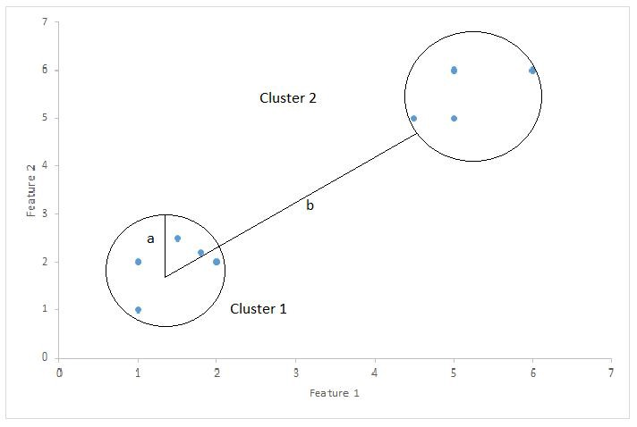
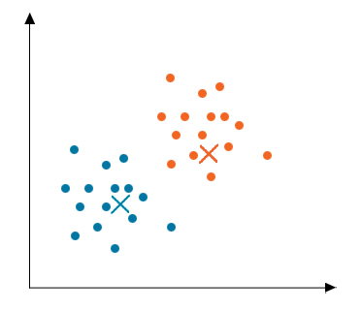
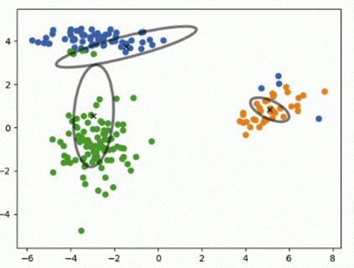
II. OUR STRATEGY
Applying Clustering Methods
Normalization
Scaling | Before | After
Monetary | 474.99 | 3.84
Avg_review _score | 1.0 | -2.31
In order to apply clustering algorithms, we need to rescale our data to avoid feature domination in the distance formula.
Z-score is used for normalization technique.
(max denoted 3.84 and min -2.30 in our case)
Silhouette Score
A measure of how similar an object is to its own cluster compared to other clusters.
The greater it is, the better it is (max denoted 1)
The algorithms
We will choose to test two different techniques:
K-means Clustering : it clusters data by trying to separate samples in K groups of equal variance, using the euclidean distance.
Gaussian Mixture models : a probabilistic algorithm that will use K independent Gaussian distributions to model K separated clusters, using the expectation-maximization algorithm to do so

Slide 7
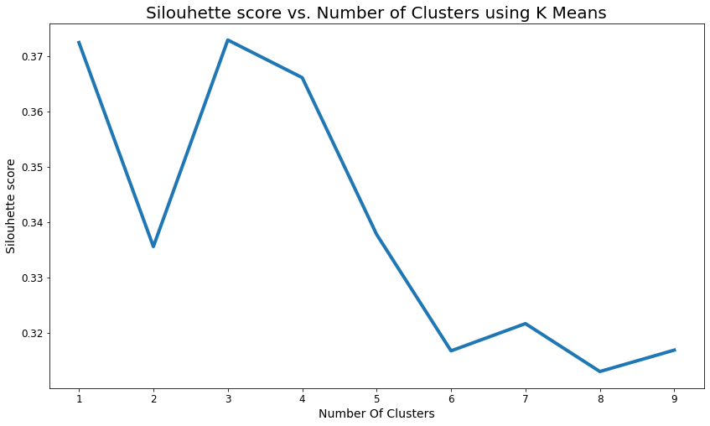
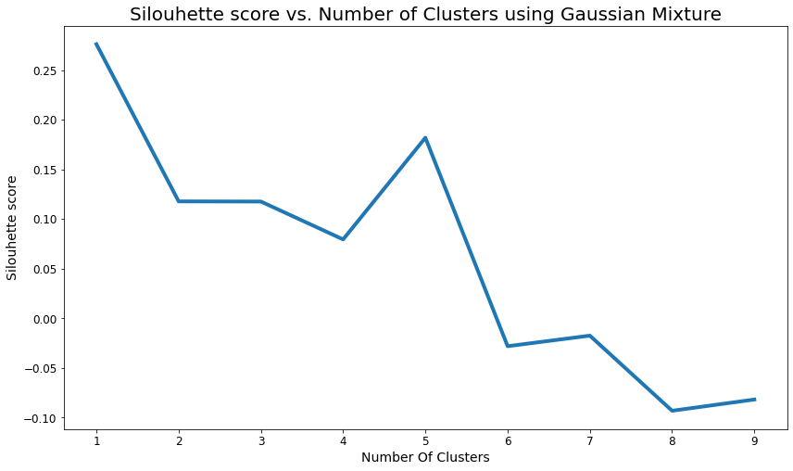
II. OUR STRATEGY
Selecting the Best Method
K-means Clustering
Gaussian Mixture Clustering
k=3
k=5
The optimal number of clusters maximizing the silhouette score is reached when there are 3 clusters (segmentations).
The greater the number of clusters while fitting Gaussian Mixture models, the lower the silhouette score tends to be.
We thus opt for K-means clustering, as we prefer to keep simple model delivering the highest silouhette score.

Slide 8
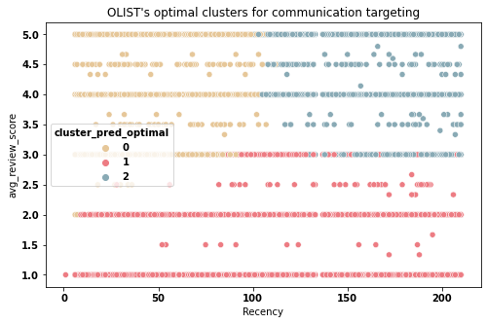
II. OUR SOLUTION
3 clusters to meet OLIST’s communication targeting needs
0
1
2
Cluster 1 : Recent customers satisfied by their products
They are OLIST’s current promoters
We recommend maintaining their fidelity with recurrent targeting.
Cluster 2: Former and recent customers unsatisfied by their products
They might be OLIST’s detractors.
We recommend understanding their dissatisfaction before targeting them.
Cluster 0 : Former customers satisfied by their products
They must be OLIST’s ex-promoters.
We recommend targeting them in priority to retrieve their trust.
Earth is the third planet from the Sun
Please, see our detailed notebook for the complete data analysis.

Slide 9
Thank you !

