Slide 1
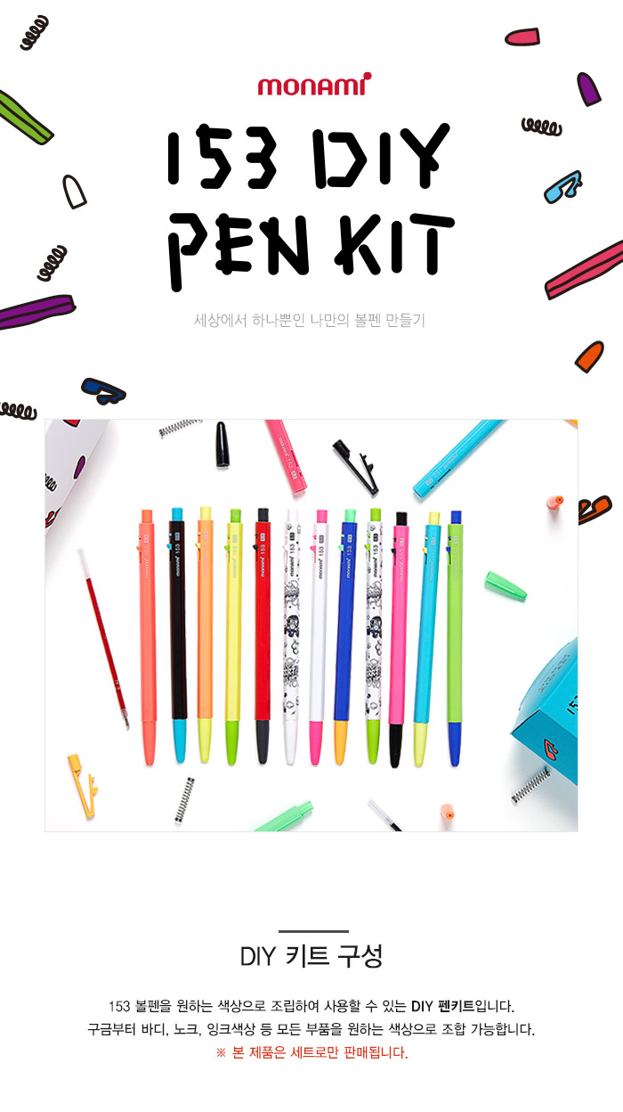
Korean Sign Language
Learning Site
Team. 아지들
2020 Database System
Professor. Aziz
Notes:
Hello everyone.
I'm Jung Hae-kyung, a member of the team 아지들, and I'm in charge of the presentation today . I’d like to tell you about our team project called Korean sign Language learning site.

Slide 2
CONTENTS
01
02
03
04
05
Team & Roles
Project Idea
Methods
Progress
Schedule
Notes:
Let us first take a look at the contents of the presentation.
There are five main things dealt in my presentation.

Slide 3

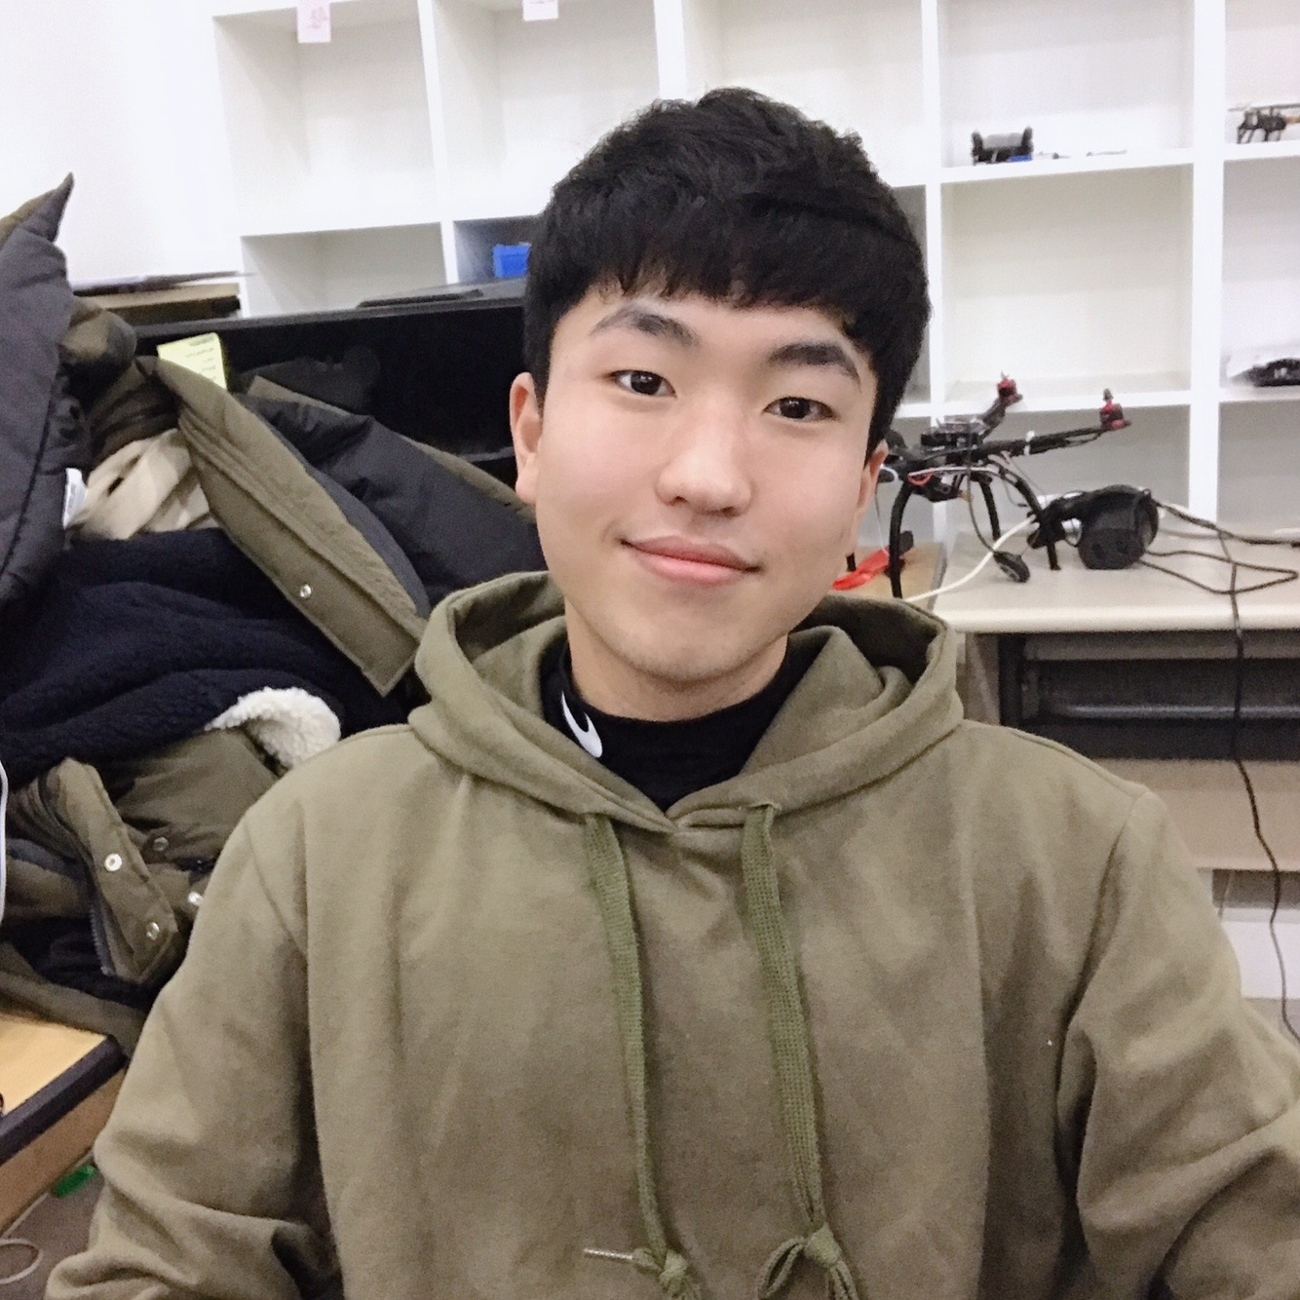
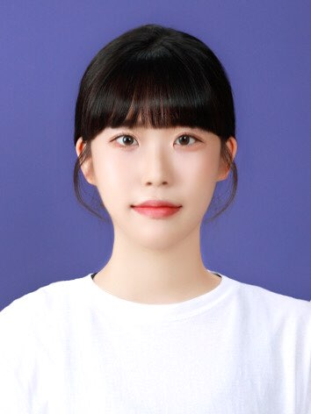

01
Team & Roles
2017038062 정해경
2016039006 문재식
2017038049 차송희
01
DB Design (ERD)
Requirements Analysis
DB Management
Search Page
DB Implementation
Schema Desgin
Wordbook Page
Login & Signup Page
Main Page
Notes:
Let me start off by introducing my team members and each role.
There are three members in our team. We have a horizontal structure without a team leader. The first member is me. I mainly design the database and take charge of developing search pages and wordbook pages. The second member 문재식. He analyzes the user's requirements, implements the database, and develops login and signup pages. The last member is 차송희. She is in charge of database management and designs schemas. She also develop the main page.

Slide 4
02
Project Idea
‘Communication Method of the hearing impaired’
Other (1.3%)
Simple Gesture (9.3%)
Writing ( 10.7%)
Korean Sign Language (78.7%)
출처 : 청각 장애인의 언어 사용 실태 여부, 한국 농아인 협회
Notes:
The next part is the project idea.
Let's look at the following picture and see how the hearing impaired communicate.
As you can see, compared to other methods, Korean sign language is used the most at about 80 percents.

Slide 5
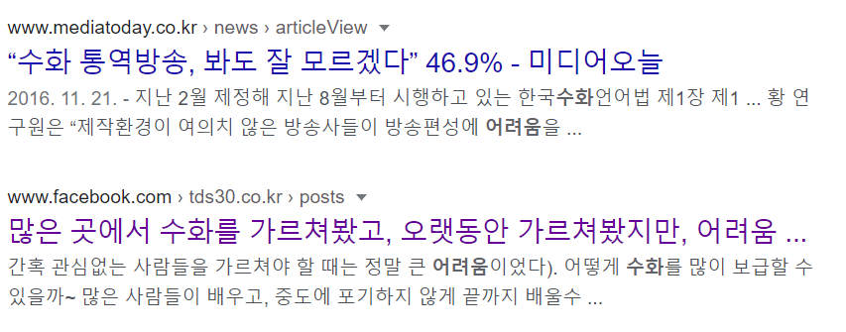
02
Project Idea
‘Difficulty in Sign Language learning, poor accessibility’
Notes:
However, due to the low accessibility of sign language, people have the following difficulties.

Slide 6



02
Project Idea
Increase the Accessibility.
Korean Sign Language Site
Make your own Wordbook.
Easy Learn Sign Language Anyone!
Notes:
So we wanted to make it easier for people to access and learn about Korean sign language. Also, we wanted to make it more memorable through the function of wordbook.

Slide 7


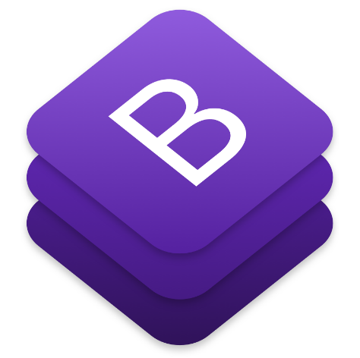
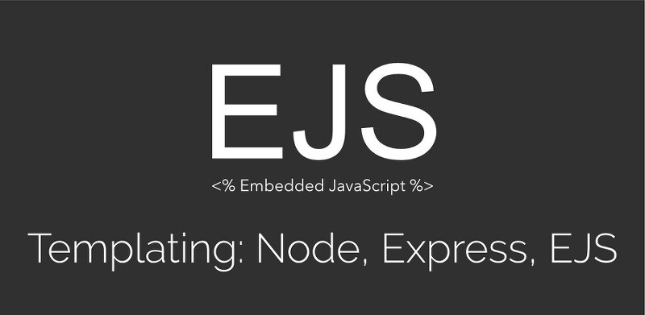

03
Method
OpenSource
Notes:
In the next session, let’s take a look at the method. We used the following open source.
We used bootstrap to organize the screen and jquery to simplify the client-side script language in HTML. Also we used node.js and EJS that can use variables sent by servers to create dynamic webpages. Data from Node.js server can be used immediately using EJS to generate html. MYSQL was used to store and manage data.
사용하는 오픈소스들 /
ejs(embedded javascript) templete-> 동적 웹페이지(dynamic webpage)를 만들기 위한것, 서버에서 보낸 변수를 사용할 수 있다, EJS를 이용해서 Node.js 서버로부터 가져온 데이터를 html을 생성할 때 바로 사용할 수 있다.

Slide 8

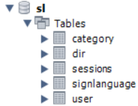
03
Method
Database
design
category(category_id, category_name, sub_category)
Signlanguage
(sl_id, sub_category, title, des, videourl, imgurl,pos)
dir(user_id, sl_id)
user(user_num, pw, name)
sessions(session_id, expires, data)
Notes:
From now on, I will explain how we designed the database. Our database consists of 5 tables. Category table is used to the situations in which sign language is used. The DIR table is a table created for a wordbook. user table is used for the user's login and the session table is used for matching.

Slide 9
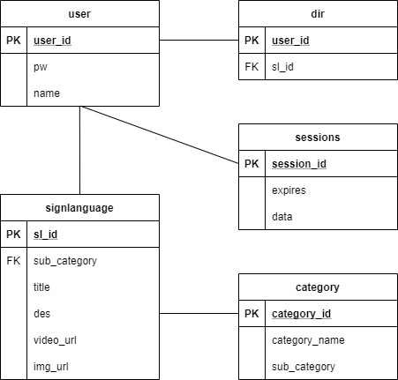

03
Method
Database
design
Gets sl table data through sl_id,
which corresponds to the same as dir_id of user
and dir_id of dir table.
Notes:
The next screen shows better relationships between database tables. The signlanguage table and category table are the most important because they store information about Korean sign language. It can be seen that the signlanguage table's foreign key is a sub_category, which is related to the category table’s attribute.

Slide 10
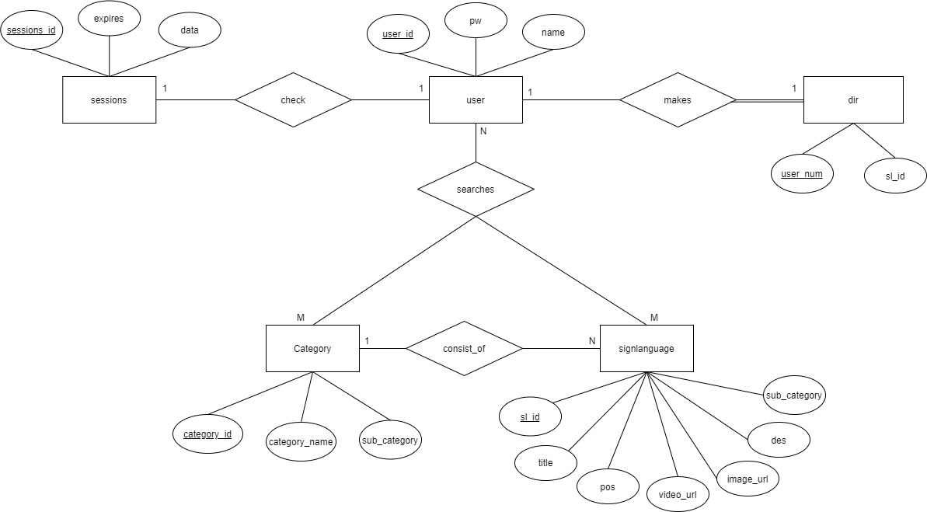
03
Method
03
E-R
Diagram
Notes:
The following is an E-R diagram, which gives a brief overview of our team's database relationships and information. The relationship, cardinality, and participation for each table are shown. Specifically, you can look at the user table and the dir table for participation. Because creating a wordbook is a user's choice, it is shown as follows.

Slide 11
04
Progress
80%
90%
60%
Web page composition
Database design
implementation
Notes:
Next is the progress. We have almost completed the composition and database design of the web page. But implementation is still under development.

Slide 12
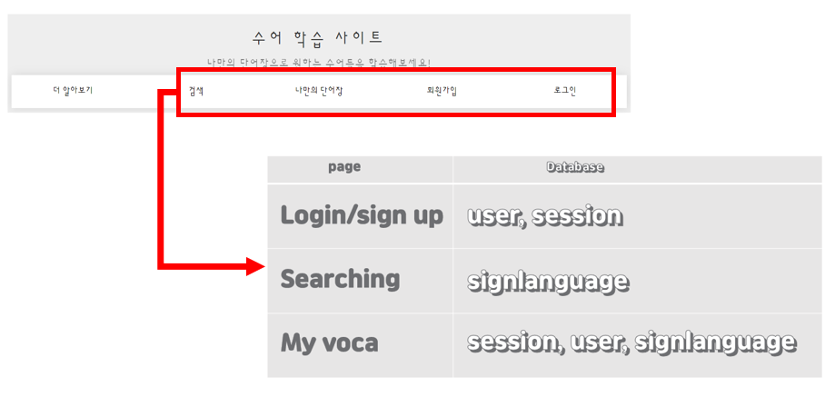
04
Progress
Web page
composition
, category
Notes:
When I show you the main screen composition, the sessions are divided as follows and the following database tables are used.

Slide 13
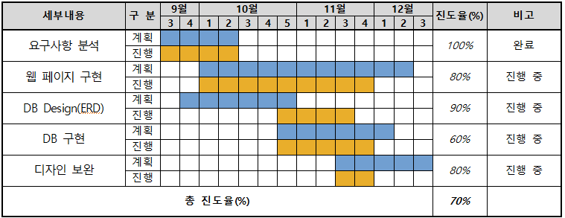
05
Schedule
Notes:
The last part is the schedule. As I mentioned earlier, the screen composition and database design are almost complete according to the plan. However, because the database is likely to be modified and the design of the screen can be modified, we planned as follows.

Slide 14
Thank you!

