Slide 1


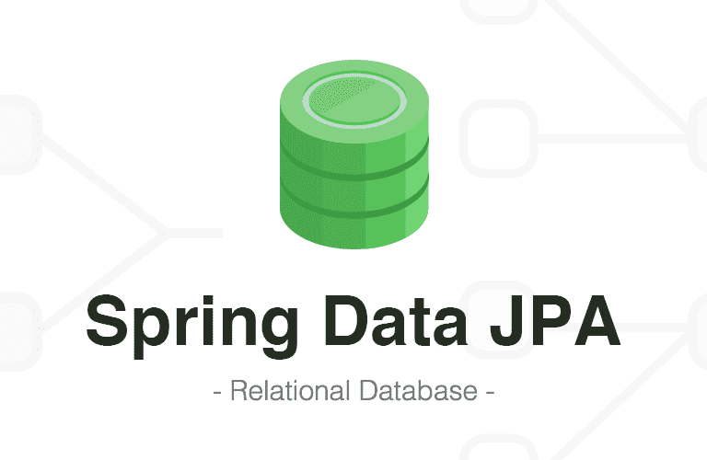





TradePro
Container 1
Container 4
DBApp (시뮬레이션)
Message Hub
Container 2
Container 3
Monitor
Web
시뮬레이션 App
거래 App
Container 5
DBApp(거래)
OpenAPI Module

