Slide 1



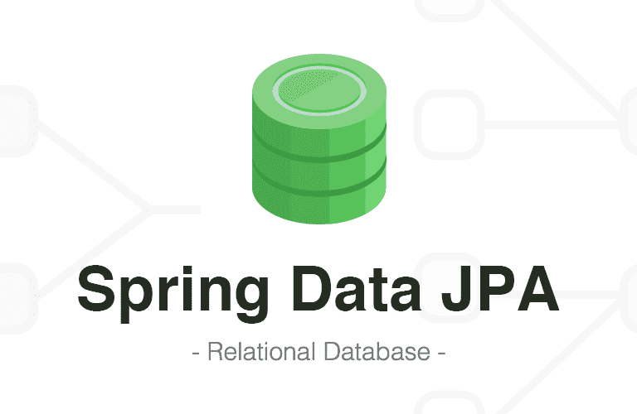



TradePro
Container 2
Container 4
시뮬레이션 App
DBApp (시뮬레이션)
Monitor
Web
Container 3
거래 App
Container 5
DBApp(거래)
OpenAPI Module

