Slide 1

An Introduction to Vue
Wes Dingman
Notes:
ercent of the developers surveyed that use the specific language regularly
Obviously web based development is not going anywhere so its good you are in this class

Slide 2

Who am I ?
Towson University Class of 2019 – BS Computer Science
Johns Hopkins University Class of 2022 – MS Computer Science
Full stack software engineer at Next Century Corporation working on the DARPA (Defense Advanced Research Projects Agency) Medifor Platform
Prior students of Jay’s for his undergraduate web development course
Notes:
Initially went to UMD then ended up at Towson
Loved it here, published some papers and worked pretty closely with a lot of the professors
Talk about Medifor and Deepfake detection a little bit, can touch on working in the defense industry
Give credit to Jays class, very relevant in the working world

Slide 3
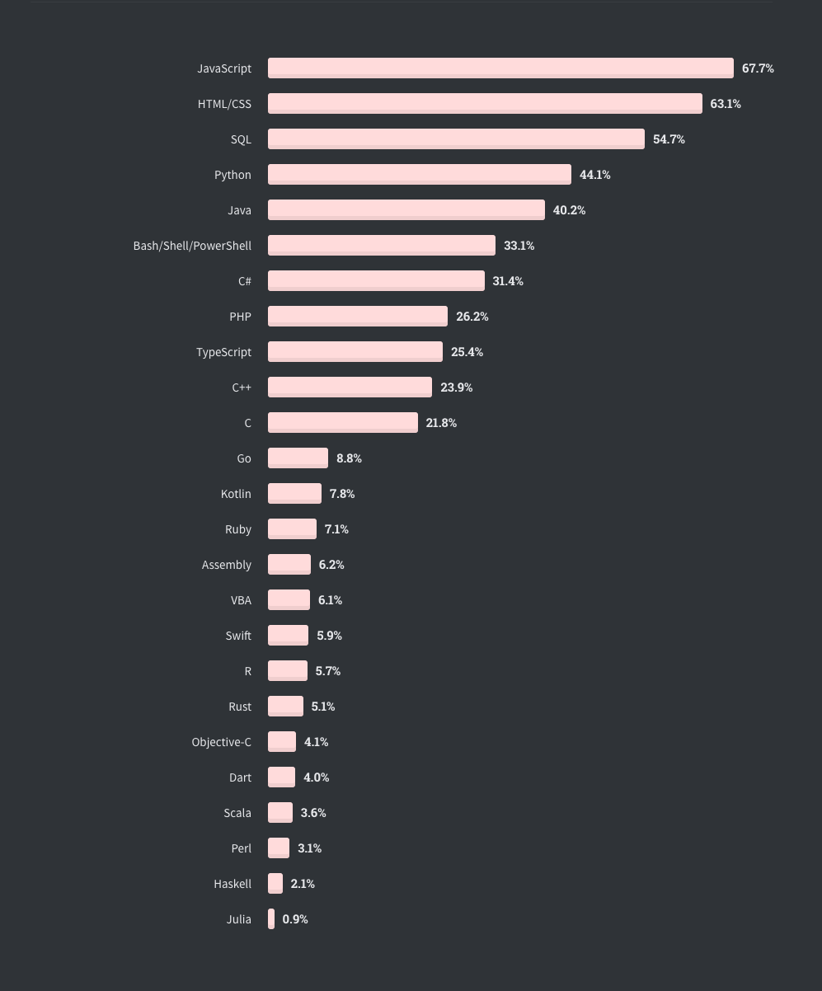
“Any application that can be written in JavaScript, will eventually be written in JavaScript” - Atwoods Law 2007
Stack Overflow 2020 Survey - Most Used Languages
Notes:
Javascript is not going anywhere, its very important that you are in this class
Whether its front end, backend or just general scripting javascript is never going away
Atwood cofounded stack overflow
Talk about whitebox and how they used nodejs to control pis which handled all their shipping and label printing etc

Slide 4







Technologies that I work with
Notes:
These are the technologies I work with on a daily basis, full stack all day
Mention a little bit how important docker is for modern development

Slide 5
Talk Structure
What is a web framework?
How Vue came to be
Why Vue is popular
What makes a Vue component
Examples
Props
State
Directives
Component Lifecycle
REST Calls
Notes:
Going to be going through all of this then give a live demo

Slide 6


Web Frameworks
“A web framework is a code library that makes web development quicker and easier by giving basic patterns for building reliable, scalable and maintainable web applications”
Prebuilt functions
No more writing raw html
Huge component libraries
Community driven support
Single page applications
Notes:
Other popular frameworks: Svelte, Ember Meteor but the three on the screen are kind
React – Facebook, Angular – Google, Vue is grassroots open source

Slide 7

What is a Single Page Application?
.vue
index.html
A web application that interacts with the user by dynamically rewriting the current web page instead of fetching new html files from the server…the goal of this it to have faster transitions which provide a better user experience.
Only one html file!
Notes:
Vue has a built in compiler which precompiles all of your vue files to HTML files and javascript files which are then embedded as <script> tags into your index.html
Also embeds <style> tags
Manipulates the virtual DOM

Slide 8

Notes:
https://github.com/vuejs/awesome-vue

Slide 9
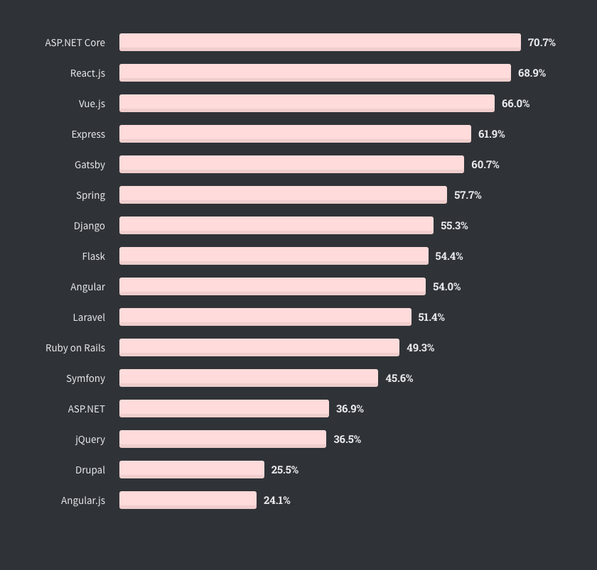
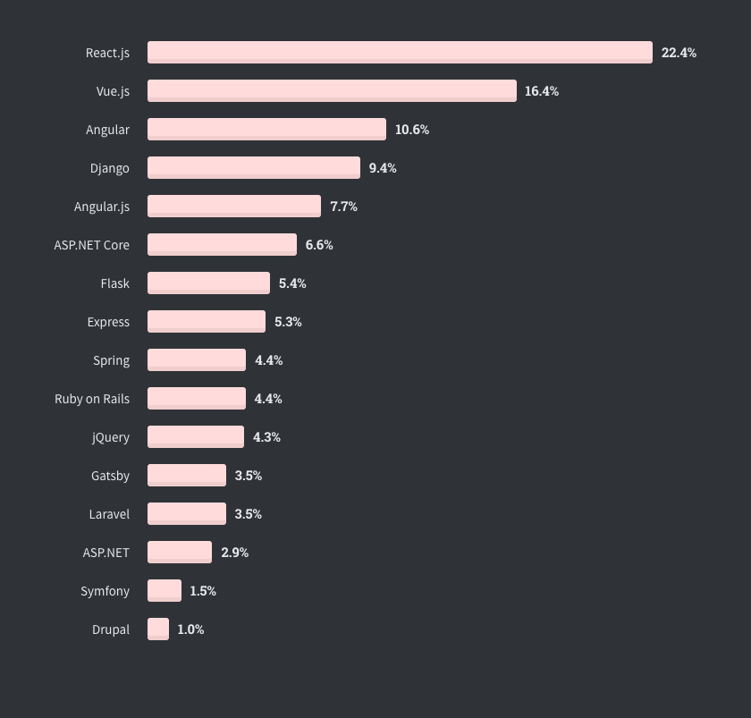
Stack Overflow 2020 Survey – Most Loved Frameworks
Stack Overflow 2020 Survey – Most Wanted Frameworks
Notes:
Percentage of developers currently working with framework you want to continue working with it
Percentage of developers who aren’t working with the framework but expressed interesting in developing with it

Slide 10
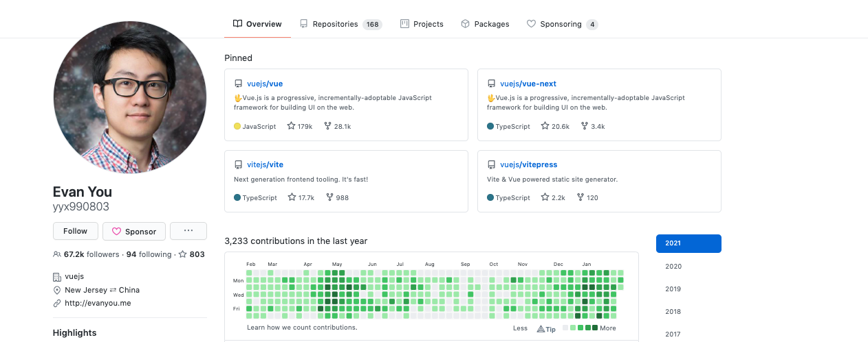
Vue Origin Story
Created in 2014 by Evan You
Completely grassroots open-source project
Currently maintained by Evan and a team of 24 developers financed via crowdfunding
Excellent Documentary on YouTube
Notes:
Evan was an ex google employee working on their experimental team
Decided to make vue because he was unsatisfied with current features of react, angular and svelte and wanted to take the best aspects of each
Vue is not owned by facebook or google so it is totally community driven development. Many of the framework decisions and plans are decided by the community

Slide 11

Notes:
Maybe show a minute or two of the documentary?

Slide 12

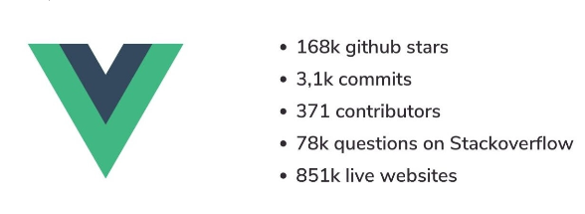


Notes:
Vue is a little more opinionated than react but it has excellent documentation which is translated to dozens of languages

Slide 13
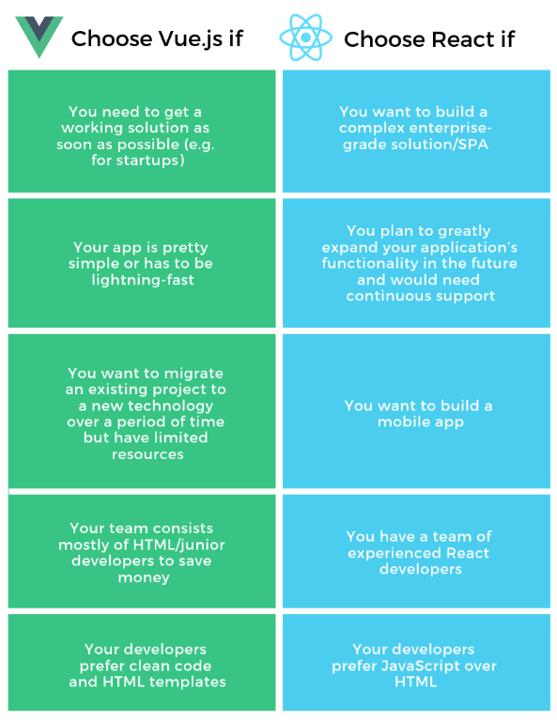
Notes:
I’ve worked with both but I think Vue is much easier to scaffold a project and the Vue CLI is awesome
I also like Vuex a lot more than Redux
Syntax is my opinion is much cleaner and easier to read

Slide 14
So why is Vue so popular?
Single File Components.
No more JSX
No more render functions
Easy to read template syntax
HTML, CSS & JS in one file
Notes:
There are tons of ways you can define components in Vue – Strings, Template Literals, X templates, inline templates, Render functions, JSX

Slide 15
What actually is a component?
“Web components are a suite of different technologies allowing to create reusable custom elements – with their functionality encapsulated away from the rest of your code – and utilize them in your web APP”
- Mozilla Developer Network Web Docs
You can somewhat liken them to classes in Java.
They are meant to be modular and reusable through your web application.
Typically have some ‘state’ which can be updated or modified which will ultimately determine what the user sees.
Notes:
This is a question that gets asked a lot and can be pretty confusing to understand at first, but components are an integral part of building an web application or site
The mozilla definition is the big boy definition

Slide 16
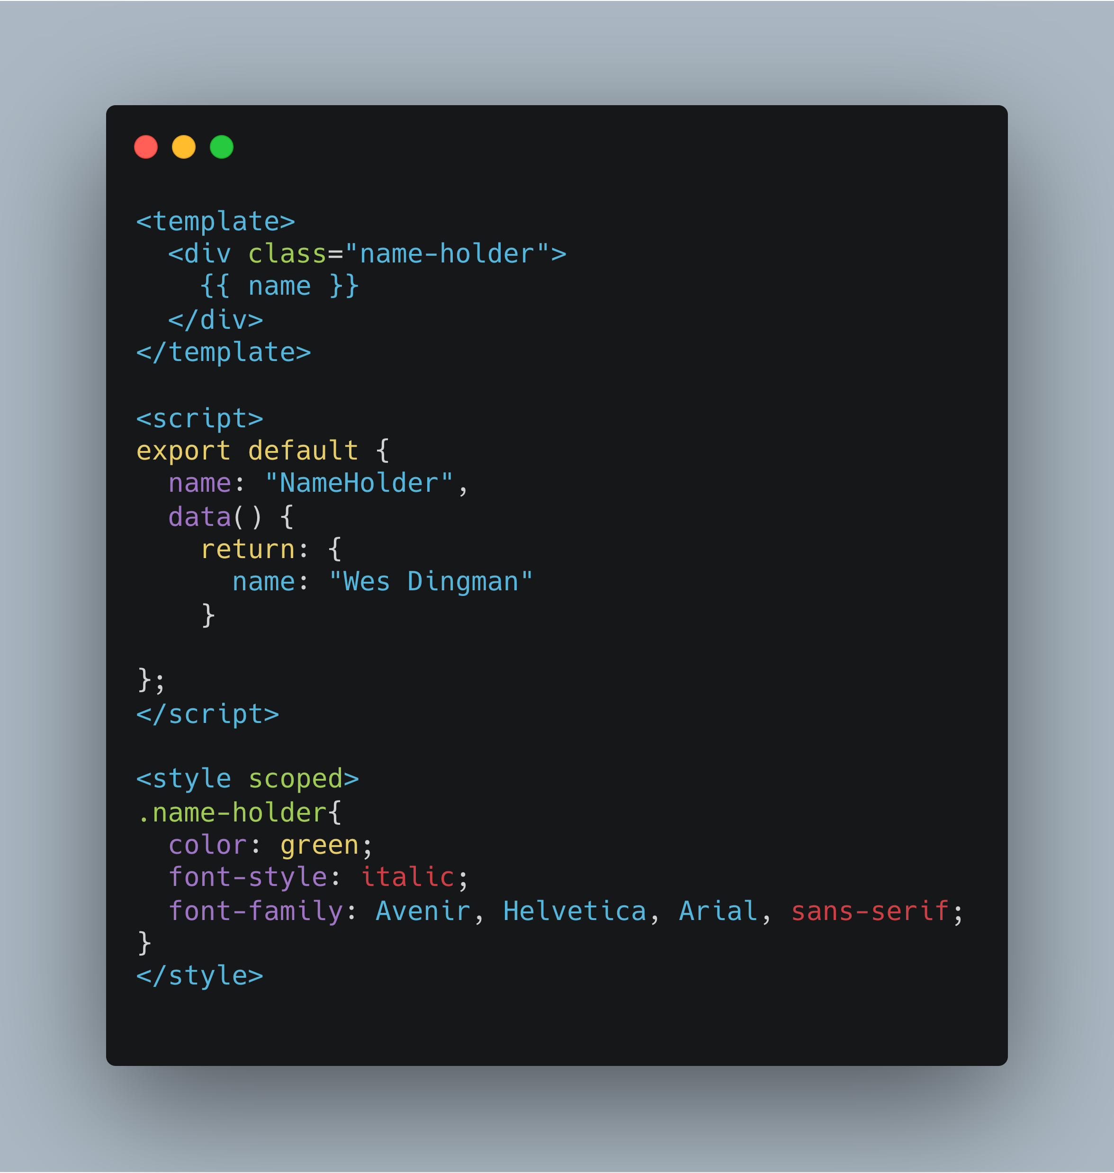
Wes Dingman
NameHolder.vue
Notes:
A very simple component that just displays a name, making it green and italics
We are going to give examples then work backwards

Slide 17
Three Essentials of Vue Component
<template> - HTML
<script> - Javascript
<style> - CSS
NameHolder.vue
Notes:
Template will house all of your HTML for the component….to access data in the component use double curly braces {{}}
Script houses all of your javascript, theres a lot more to unpack here
Style houses all of your css, scoped will make it bind to only this component. You can omit style tag if you want to use global css. Be conscious of ‘scoped’, this limits the scope of the css to the current component

Slide 18
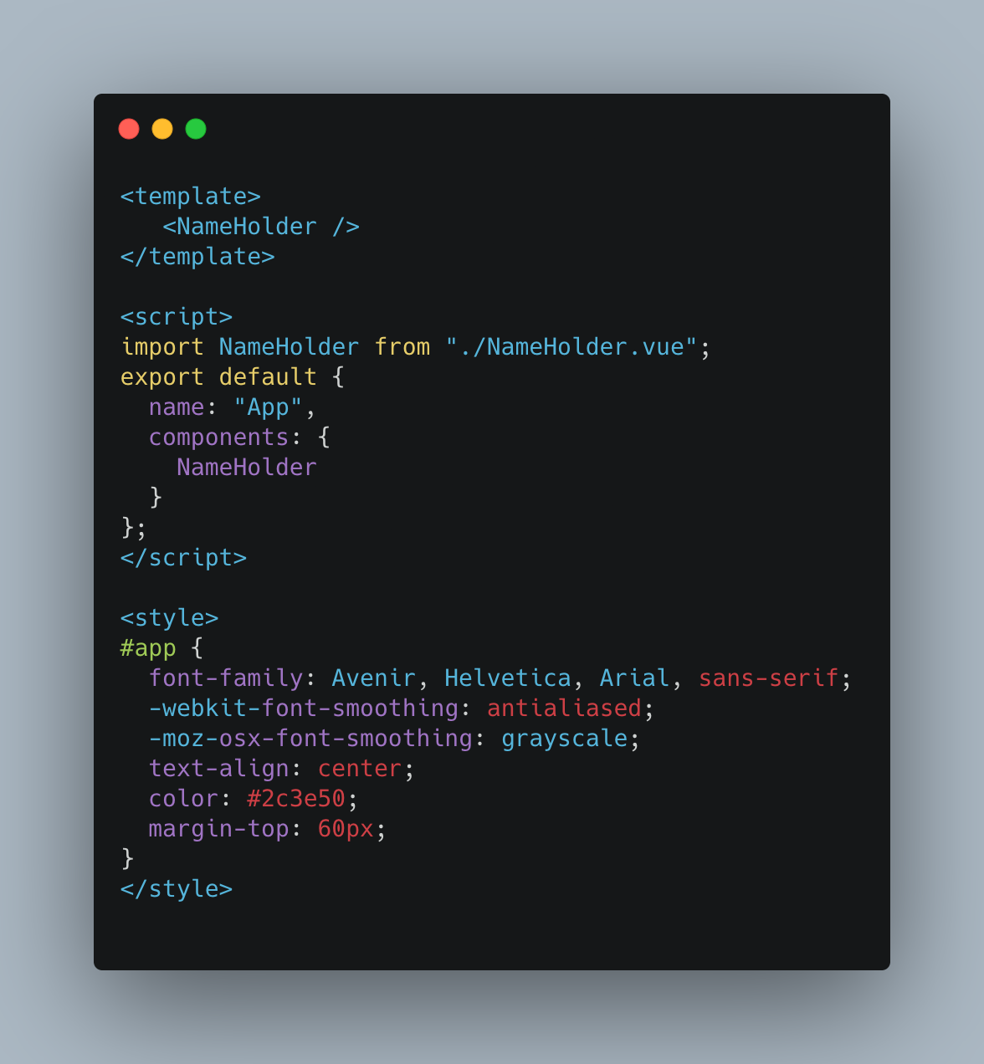
App.vue
NameHolder.vue
Notes:
Typically all vue applications start with a top level component called App.vue, it will be the parents component in your whole applications components tree
Its very common to have the Header/Navbar/Body/Footer layout and you will build from there
This is obviously a very contrived example where App only has a single child component – NameHolder
Notice that in the script section we don’t have the data() function because App.vue has no state, we do though have the components section which denotes that we are using some child components which must be registered

Slide 19
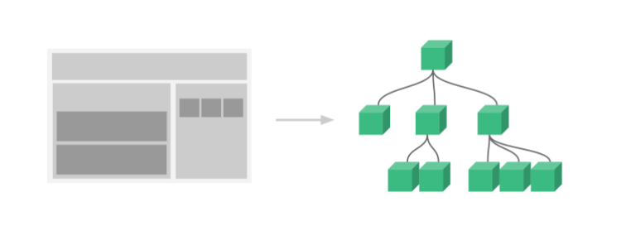
Notes:
Simple example of a component tree with a top level navbar, a body and an aside

Slide 20

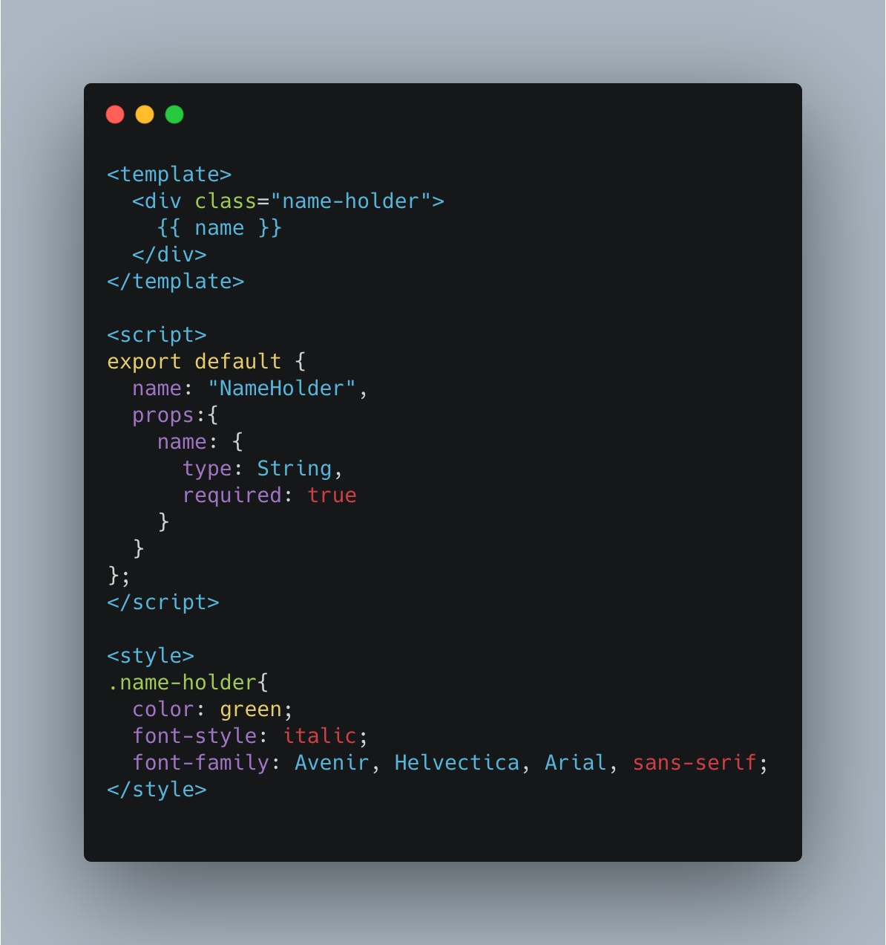
Passing data with props
Walter White
App.vue
NameHolder.vue
Notes:
Props (properties) are custom attributes you can register on a component
When a value is passed to a prop attribute it becomes a property on that component instance
Props can update dynamically as your application is running so new views can be rendered to the user
Props only flow down from a parent component to a child, events flow up ( probably wont touch on that )

Slide 21
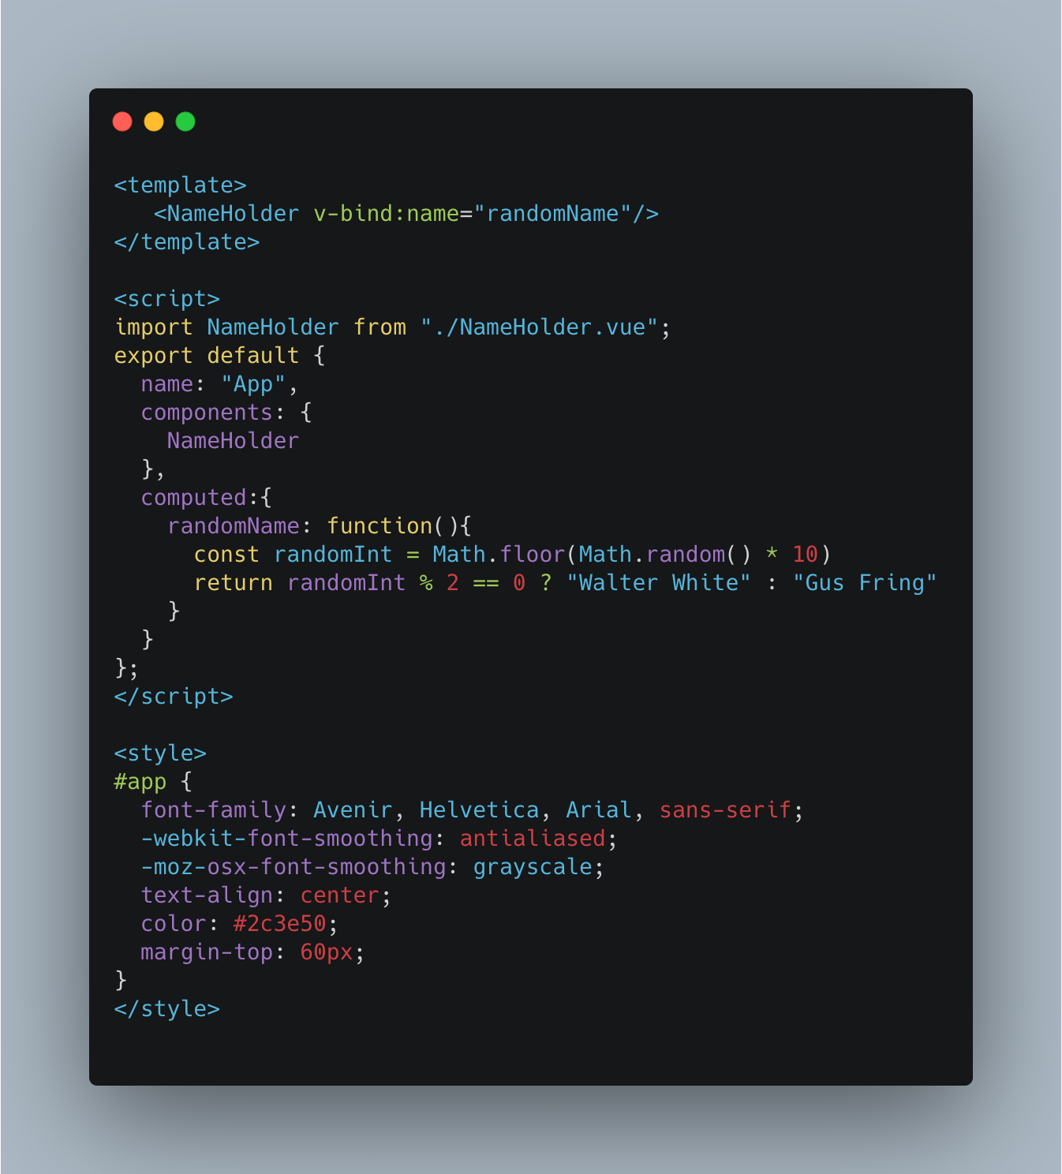
Passing data with dynamic props
v-bind: allows you to bind the property ‘name’ to the computed value of ‘randomName’
v-bind: is a type of directive
directives are special tokens in the <template> that tells the Vue library to do something to the DOM element
Shorthand for v-bind:name=“RandomName” :name=“randomName
computed is a field of the component which defines various functions which ‘compute’ values…always have a return value
App.vue
NameHolder.vue
Notes:
Here we are binding the prop ‘name’ to the computed value “randomName”
Random name is returning either Walter White or Gus Fring
Computed is an instance field of the script

Slide 22
Passing data with dynamic props
v-bind: allows you to bind the property ‘name’ to the computed value of ‘randomName’
v-bind: is a type of directive
directives are special tokens in the <template> that tells the Vue library to do something to the DOM element
Shorthand for v-bind:name=“RandomName” :name=“randomName
computed is a field of the component which defines various functions which ‘compute’ values…always have a return value
App.vue
NameHolder.vue
Notes:
Here we are binding the prop ‘name’ to the computed value “randomName”
Random name is returning either Walter White or Gus Fring
Computed is an instance field of the script

Slide 23
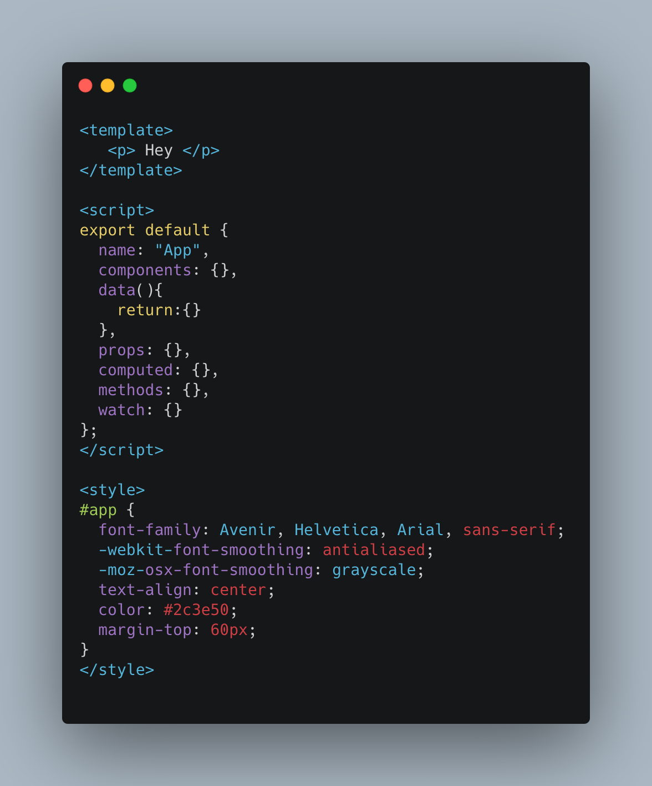
Component Attributes
name – name of the component
components – where child components are registered
data – where the state of the component lives
props – the props that the component consumes from a parent component
computed – collection of functions that ‘compute’ a return value
methods – collection of functions that ‘do something’ i.e. trigger an event, log to the console, mutate the state
watch – allows you to watch fields for changes…you could watch a state value and every time it changes then you would do something
There are also lifecycle methods that you can kick off depending on where the component is in its ‘lifecycle’
App.vue

Slide 24
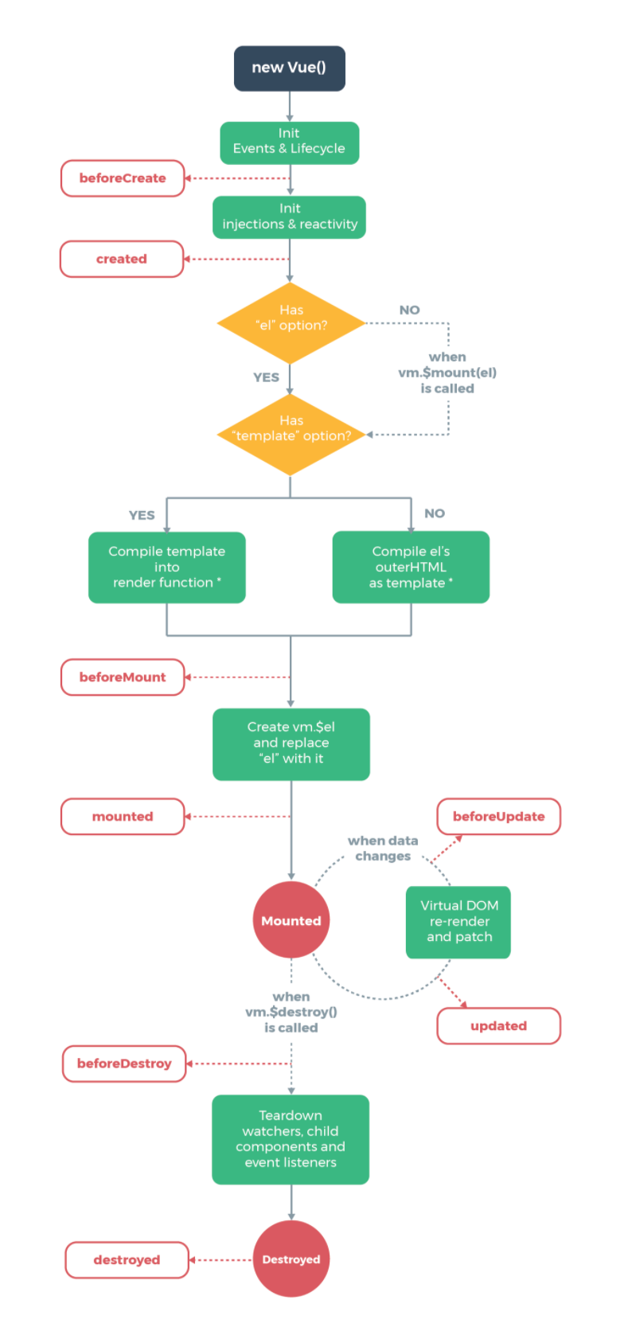
Component Lifecyle

