Slide 1


Slide 2


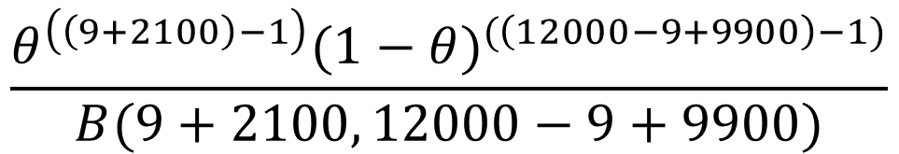

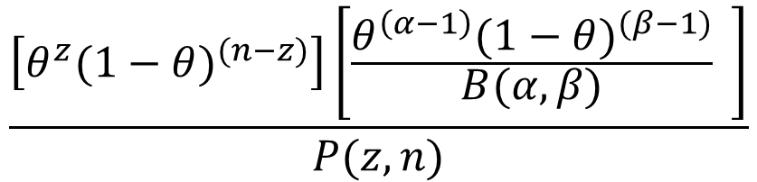
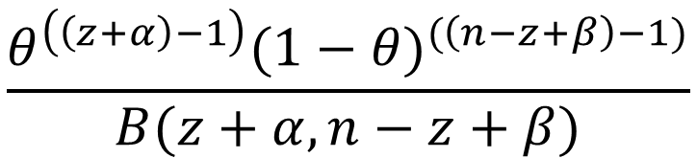
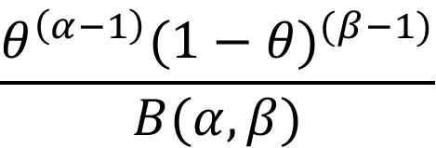
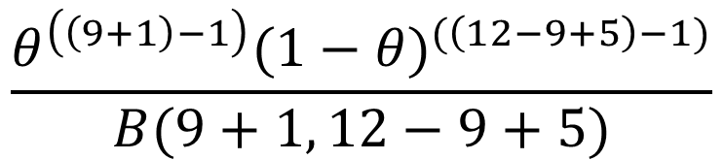

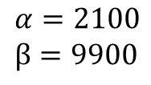
$$n=12 \\ z=9$$
$$α=2100 \\ β=9900$$
$$\frac{θ^{\left(\left(z+α\right)−1\right)}{(1−θ)}^{(\left(n−z+β\right)−1)}}{B(z+α, n−z+β)}$$
$$θ^{z}{(1−θ)}^{(n−z)}$$
$$P(θ|D)$$
$$\left(θ\right)\left(1−θ\right)\left(θ\right)\left(θ\right)…$$
$$\frac{θ^{\left(α−1\right)}{(1−θ)}^{(β−1)}}{B(α,β)}$$
$$\frac{\left[θ^{z}{(1−θ)}^{(n−z)}\right]\left[\frac{θ^{\left(α−1\right)}{(1−θ)}^{(β−1)}}{B(α,β)} \right]}{P(z, n)}$$
$$\frac{θ^{\left(\left(9+1\right)−1\right)}{(1−θ)}^{(\left(12−9+5\right)−1)}}{B(9+1, 12−9+5)}$$
$$\frac{θ^{\left(\left(9+2100\right)−1\right)}{(1−θ)}^{(\left(12000−9+9900\right)−1)}}{B(9+2100, 12000−9+9900)}$$

Slide 3
Statistics
Frequentist
Bayesian

