Slide 1
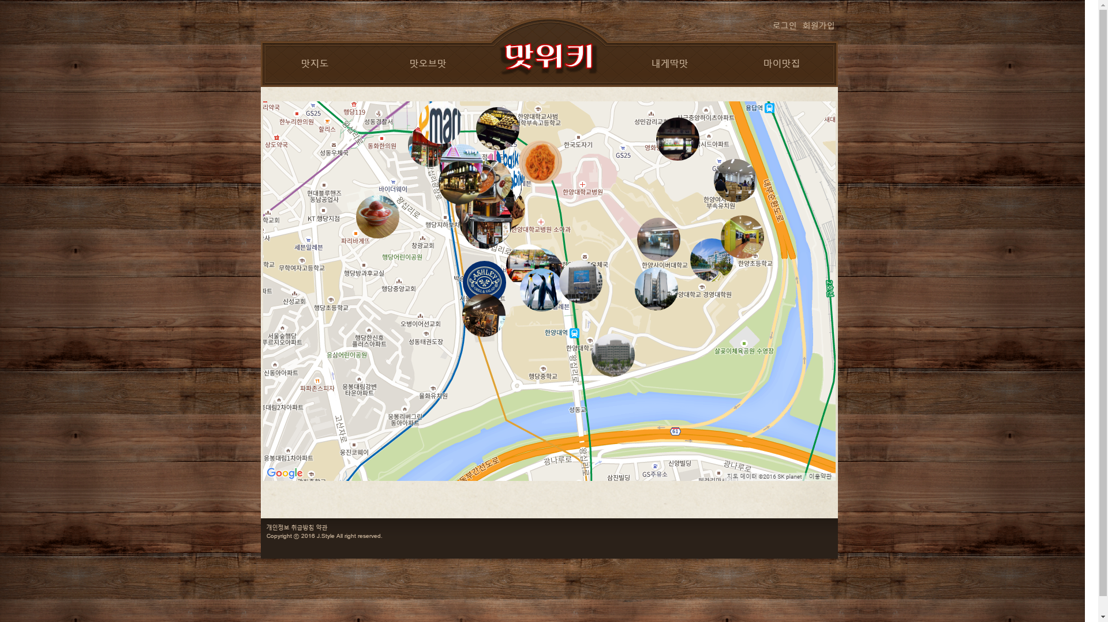

왕십리 맛집의 모든 것
맛위키
2016.05.09.
정승철 / 컴퓨터전공 4학년

Slide 2

목차
Feedback Detection
Collaborative Filtering
계획사항

Slide 3
Feedback Detection
01

Slide 4

Feedback Detection
Explicit Method
Implicit Method
1. Feedback Detection

Slide 5

Explicit method
Rating
Ask
1. Feedback Detection

Slide 6

Implicit method
Wishlist
Time
write, link, and so on.
1. Feedback Detection

Slide 7
Collaborative Filtering
02

Slide 8
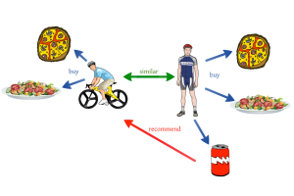
Collaborative Filtering
2. Collaborative Filtering

Slide 9
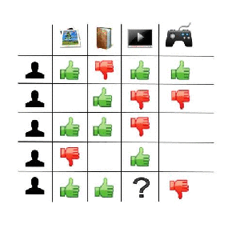
Collaborative Filtering
2. Collaborative Filtering

Slide 10
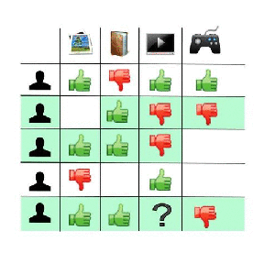
Collaborative Filtering
2. Collaborative Filtering

Slide 11
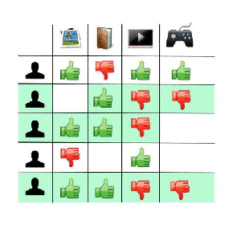
Collaborative Filtering
2. Collaborative Filtering

Slide 12

Collaborative Filtering
Correlation
Coefficient
Significance
Weighting
Neighbor
Selection
Rating
(Ranking)
Prediction
2. Collaborative Filtering

Slide 13



Correlation Coefficient
2. Collaborative Filtering

Slide 14
Correlation Coefficient
(1, 4, 5) / (2, 5, 4)
covar ≒ 1.78
corr ≒ 0.84
(1, 4, 5) / (4, 2, 1)
covar ≒ -2.11
corr ≒ -0.96
2. Collaborative Filtering

Slide 15
Correlation Coefficient
covar > 0인 것만 선택한다!
(1, 4, 5) / (2, 5, 4)
covar ≒ 1.78
corr ≒ 0.84
(1, 4, 5) / (4, 2, 1)
covar ≒ -2.11
corr ≒ -0.96
2. Collaborative Filtering

Slide 16

Significance Weighting
2. Collaborative Filtering

Slide 17
Significance Weighting
(1, 5) / (2, 5)
corr = 1
weighted corr = 0.2
(1, 5, 4, 5, 5) / (2, 5, 4, 5, 4)
corr ≒ 0.94
Weighted corr ≒ 0.94
2. Collaborative Filtering

Slide 18
Neighbor Selection
Prediction의 Source로 사용할 user 선택
에 따라, most similar한 5 user 선택
2. Collaborative Filtering

Slide 19

Rating Prediction
2. Collaborative Filtering

Slide 20


Ranking Prediction
2. Collaborative Filtering

Slide 21

Ranking Prediction
가 되는 i를 구하는 문제!
2. Collaborative Filtering

Slide 22
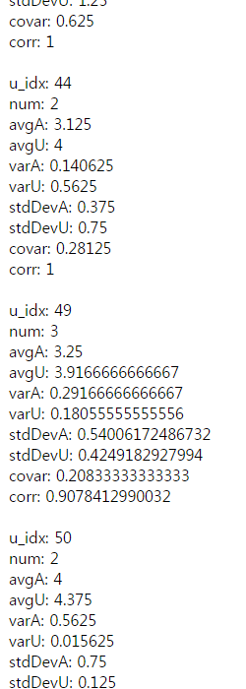
2. Collaborative Filtering

Slide 23
2. Collaborative Filtering

Slide 24
2. Collaborative Filtering

Slide 25
2. Collaborative Filtering

Slide 26
2. Collaborative Filtering

Slide 27
2. Collaborative Filtering

Slide 28
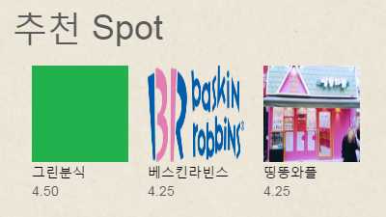
2. Collaborative Filtering

Slide 29
계획사항
03

Slide 30
계획사항
Wishlist - Implicit Feedback
Cold Start 보완대책
3. 계획사항

Slide 31

Q&A

Slide 32
http://www.tastewiki.xyz

