Slide 1
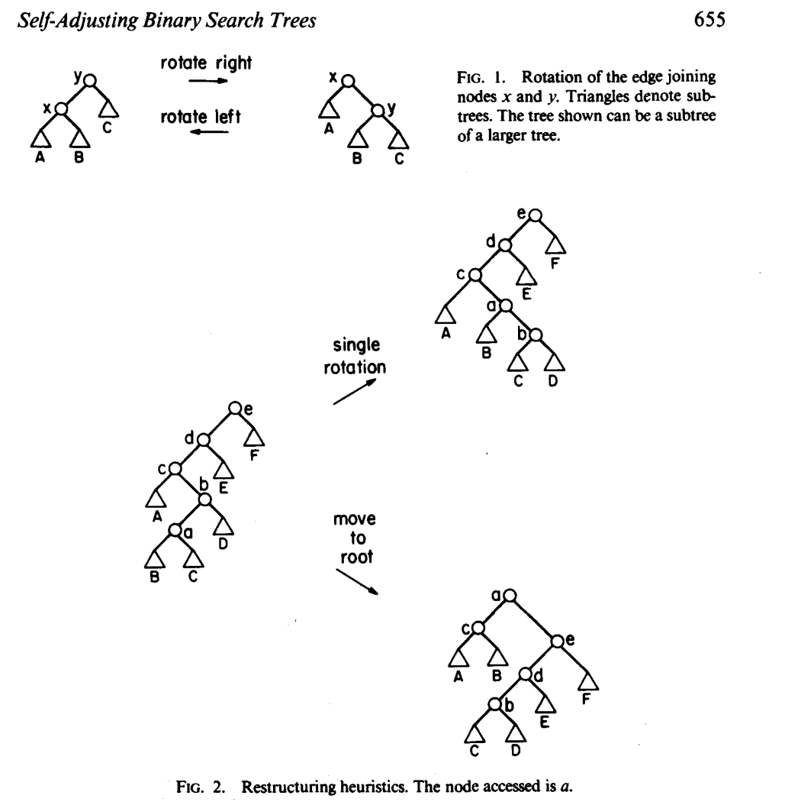
Splay Tree
DANIEL DOMINIC SLEATOR AND ROBERT ENDRE TARJAN

Slide 2
Operations
B-Tree of order 4
  Each node has at most 4 pointers and 3 keys, and at least 2 pointers and 1 key.
Insert: 5, 3, 21, 9, 1, 13, 2, 7, 10, 12, 4, 8
Delete: 2, 21, 10, 3, 4

Slide 3
5, 3, 21, 9, 1, 13, 2, 7, 10, 12, 4, 8
* 5 *
a
* 3 * 5 *
a
* 3 * 5 * 21 *
a

Slide 4
5, 3, 21, 9, 1, 13, 2, 7, 10, 12, 4, 8
* 9 *
a
b
c
* 3 * 5 *
* 21 *
Node a splits creating 2 children: b and c

Slide 5
5, 3, 21, 9, 1, 13, 2, 7, 10, 12, 4, 8
* 9 *
a
b
c
* 1 * 3 * 5 *
* 13 * 21 *
Nodes b and c have room to insert more elements

Slide 6
5, 3, 21, 9, 1, 13, 2, 7, 10, 12, 4, 8
* 3 * 9 *
a
b
d
c
* 1 * 2 *
* 5 *
* 13 * 21 *
Node b has no more room, so it splits creating node d.

Slide 7
5, 3, 21, 9, 1, 13, 2, 7, 10, 12, 4, 8
* 3 * 9 *
a
b
d
c
* 1 * 2 *
* 5 * 7 *
* 10 * 13 * 21 *
Nodes d and c have room to add more elements

Slide 8
5, 3, 21, 9, 1, 13, 2, 7, 10, 12, 4, 8
* 3 * 9 * 13 *
a
b
d
c
e
* 1 * 2 *
* 5 * 7 *
* 10 * 12 *
* 21 *
Nodes c must split into nodes c and e

Slide 9
5, 3, 21, 9, 1, 13, 2, 7, 10, 12, 4, 8
a
* 3 * 9 * 13 *
b
d
c
e
* 1 * 2 *
* 4 * 5 * 7 *
* 10 * 12 *
* 21 *
Node d has room for another element

Slide 10
5, 3, 21, 9, 1, 13, 2, 7, 10, 12, 4, 8
a
* 9 *
f
g
* 3 * 7 *
* 13 *
b
d
h
c
e
* 1 * 2 *
* 4 * 5 *
* 8 *
* 10 * 12 *
* 21 *
Node d must split into 2 nodes. This causes node a to split into 2 nodes and the tree grows a level.

Slide 11
Delete 2
* 9 *
a
f
g
* 3 * 7 *
* 13 *
b
d
h
c
e
* 1 *
* 4 * 5 *
* 8 *
* 10 * 12 *
* 21 *
Node b can loose an element without underflow.

Slide 12
Delete 21
* 9 *
a
f
g
* 3 * 7 *
* 12 *
b
d
h
c
e
* 1 *
* 4 * 5 *
* 8 *
* 10 *
* 13 *
Deleting 21 causes node e to underflow, so elements are redistributed between nodes c, g, and e

Slide 13
Delete 10
* 3 * 7 * 9 *
a
b
d
h
e
* 1 *
* 4 * 5 *
* 8 *
* 12 * 13 *
Deleting 10 causes node c to underflow. This causes the parent, node g to recombine with nodes f and a. This causes the tree to shrink one level.

Slide 14
Delete 3
* 4 * 7 * 9 *
a
b
d
h
e
* 1 *
* 5 *
* 8 *
* 12 * 13 *
Because 3 is a pointer to nodes below it, deleting 3 requires keys to be redistributed between nodes a and d.

Slide 15
Delete 4
* 7 * 9 *
a
b
h
e
* 1 * 5 *
* 8 *
* 12 * 13 *
Deleting 4 requires a redistribution of the keys in the subtrees of 4; however, nodes b and d do not have enough keys to redistribute without causing an underflow. Thus, nodes b and d must be combined.

