Slide 1

Digital Integrated Circuits
A Design Perspective
Jan M. Rabaey
Anantha Chandrakasan
Borivoje Nikolić
Timing Issues
January 2003

Slide 2
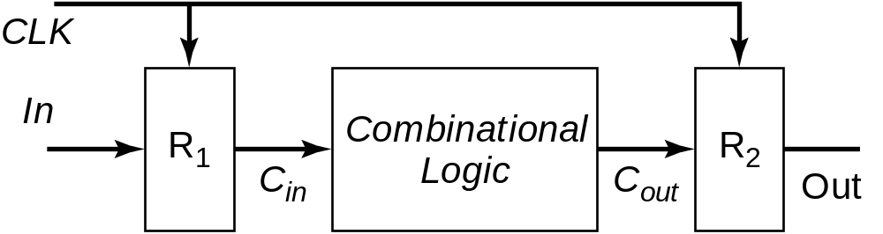
Synchronous Timing

Slide 3
Timing Definitions

Slide 4
Latch Parameters
D
Q
Clk
T
Clk
PW_{m}
t_{su}
D
t_{hold}
t_{c-q}
t_{d-q}
Q
Delays can be different for rising and falling data transitions

Slide 5
Register Parameters
D
Q
Clk
T
Clk
D
t_{hold}
t_{su}
t_{c-q}
Q
Delays can be different for rising and falling data transitions

Slide 6
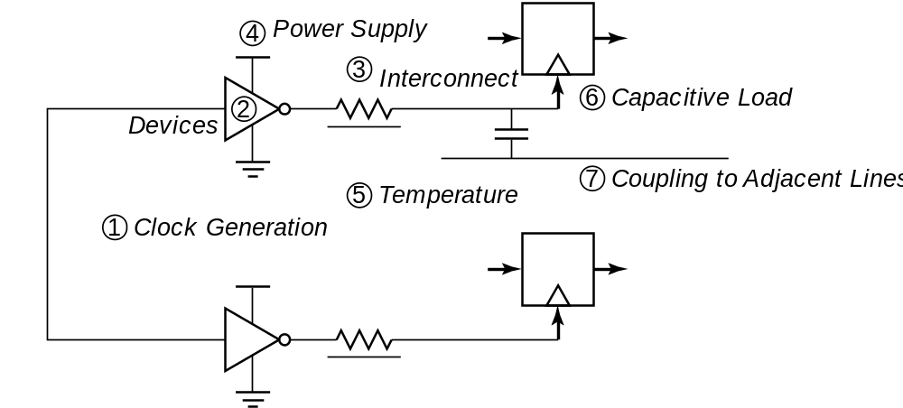
Clock Uncertainties
Sources of clock uncertainty

Slide 7
Clock Nonidealities
Clock skew
  Spatial variation in temporally equivalent clock edges; deterministic + random, t_{SK}
Clock jitter
  Temporal variations in consecutive edges of the clock signal; modulation + random noise
  Cycle-to-cycle (short-term) t_{JS}
  Long term t_{JL}
Variation of the pulse width
  Important for level sensitive clocking

Slide 8
Clock Skew and Jitter
Clk
t_{SK}
Clk
t_{JS}
Both skew and jitter affect the effective cycle time
Only skew affects the race margin

Slide 9
Clock Skew
# of registers
Earliest occurrence
of Clk edge
Nominal – δ/2
Latest occurrence
of Clk edge
Nominal + δ /2
Insertion delay
Clk delay
Max Clk skew
δ

Slide 10
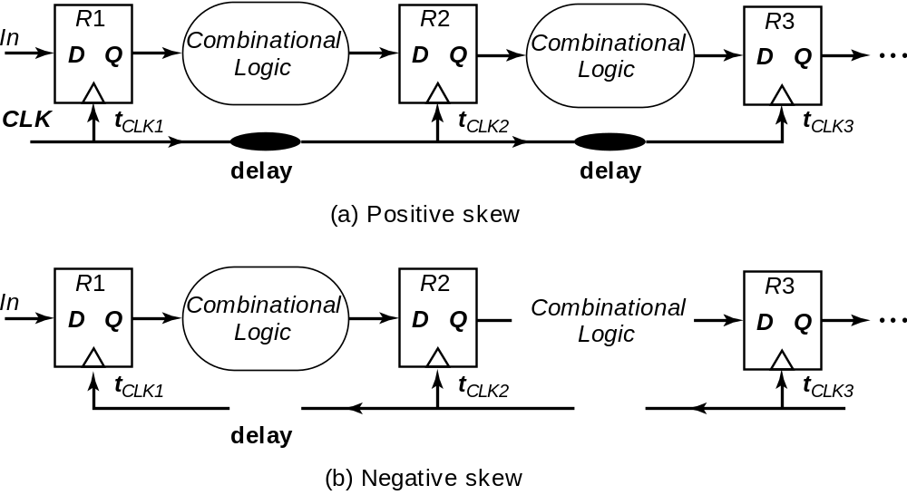
Positive and Negative Skew

Slide 11
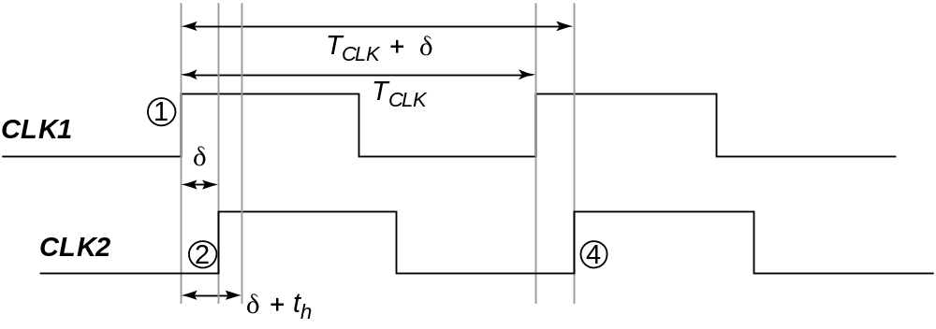
Positive Skew
Launching edge arrives before the receiving edge

Slide 12
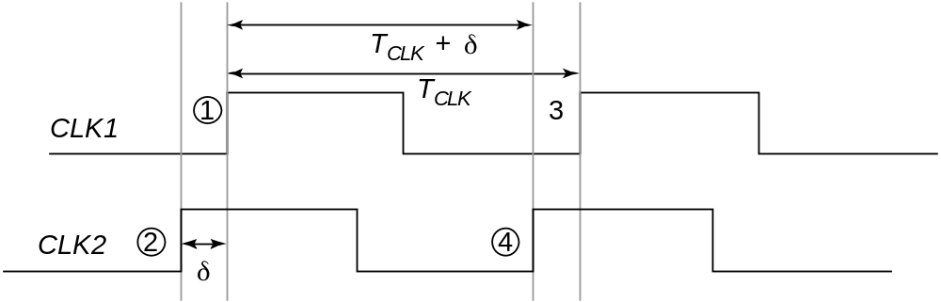
Negative Skew
Receiving edge arrives before the launching edge

Slide 13
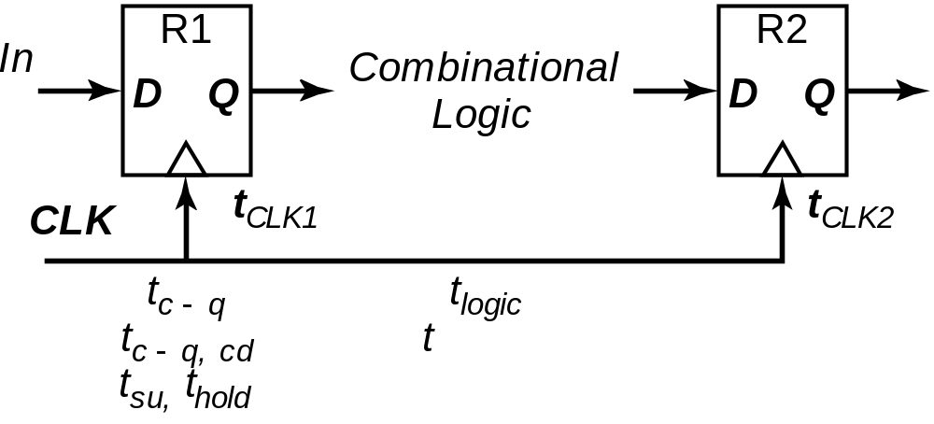
Timing Constraints
Minimum cycle time:
T - δ = t_{c-q} + t_{su} + t_{logic}
Worst case is when receiving edge arrives early (positive δ)

Slide 14
Timing Constraints
Hold time constraint:
t_{(c-q, cd)} + t_{(logic, cd)} > t_{hold} + δ
Worst case is when receiving edge arrives late
Race between data and clock

Slide 15
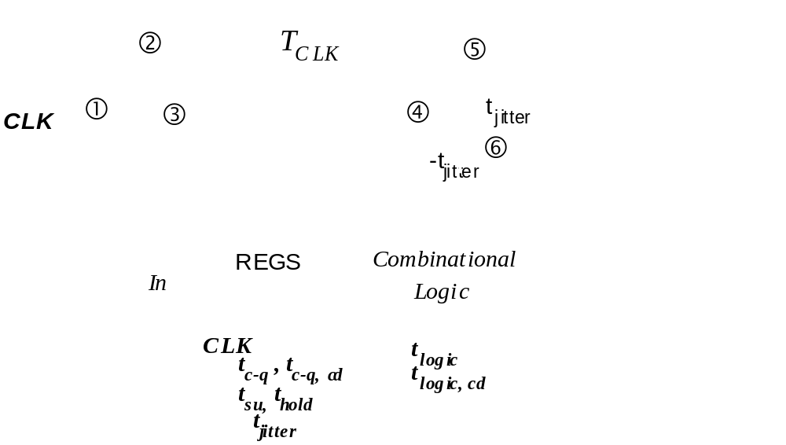
Impact of Jitter

Slide 16
Longest Logic Path in
Edge-Triggered Systems
T_{JI} + δ
T_{SU}
Clk
T_{Clk-Q}
T_{LM}
T
Latest point
of launching
Earliest arrival
of next cycle

Slide 17
Clock Constraints in
Edge-Triggered Systems
If launching edge is late and receiving edge is early, the data will not be too late if:
T_{c-q} + T_{LM} + T_{SU} < T – T_{JI,1} – T_{JI,2} - δ
Minimum cycle time is determined by the maximum delays through the logic
T_{c-q} + T_{LM} + T_{SU} + δ + 2 T_{JI} < T
Skew can be either positive or negative

Slide 18
Shortest Path
Earliest point
of launching
Clk
T_{Clk-Q}
T_{Lm}
Clk
T_{H}
Data must not arrive
before this time
Nominal
clock edge

Slide 19
Clock Constraints in Edge-Triggered Systems
If launching edge is early and receiving edge is late:
T_{c-q} + T_{LM} – T_{JI,1} < T_{H} + T_{JI,2} + δ
Minimum logic delay
T_{c-q} + T_{LM} < T_{H} + 2T_{JI}+ δ

Slide 20
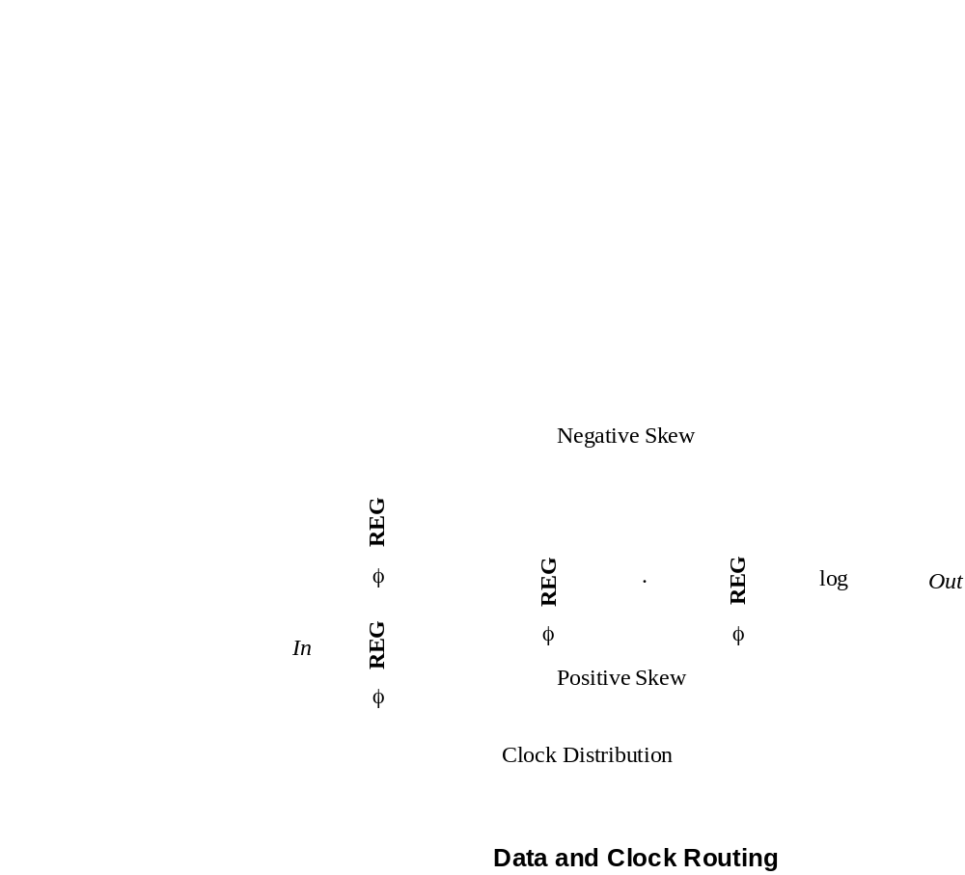
How to counter Clock Skew?

Slide 21
Flip-Flop – Based Timing
Skew
Flip-flop
delay
Logic delay
φ
T_{SU}
T_{Clk-Q}
Flip
-flop
φ = 1
φ = 0
Logic
Representation after
M. Horowitz, VLSI Circuits 1996.

Slide 22
Flip-Flops and Dynamic Logic
Logic delay
T_{SU}
T_{SU}
T_{Clk-Q}
T_{Clk-Q}
φ = 1
φ = 1
φ = 0
φ = 0
Logic delay
Precharge
Evaluate
Precharge
Evaluate
Flip-flops are used only with static logic

Slide 23
Latch timing
t_{D-Q}
When data arrives
to transparent latch
Latch is a ‘soft’ barrier
D
Q
Clk
t_{Clk-Q}
When data arrives
to closed latch
Data has to be ‘re-launched’

Slide 24
Single-Phase Clock with Latches
φ
Latch
Logic
T_{skl}
T_{skl}
T_{skt}
T_{skt}
Clk
PW
P

Slide 25
Latch-Based Design
  L1 latch is transparent
  when φ = 0
L2 latch is transparent
when φ = 1
φ
L1
L2
Logic
Latch
Latch
Logic

Slide 26
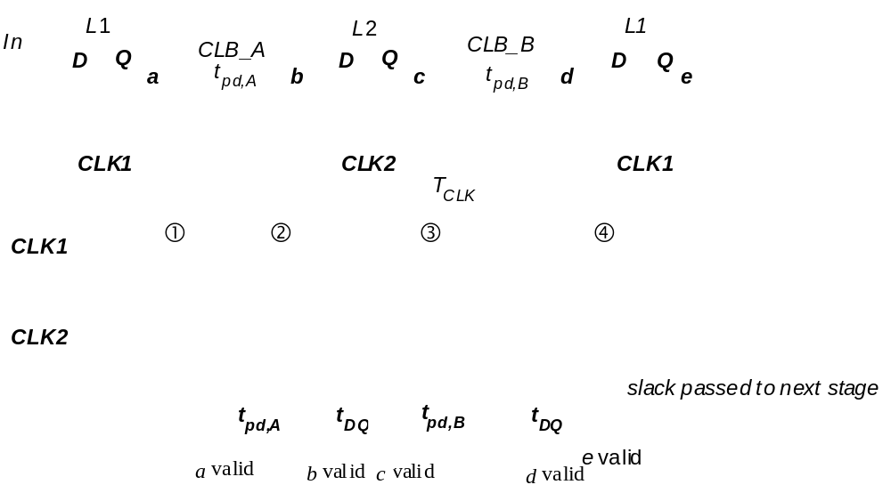
Slack-borrowing

Slide 27
Latch-Based Timing
Skew
Static logic
φ
φ = 1
L2 latch
L1
Logic
L2
Latch
Latch
L1 latch
Logic
Long
path
φ = 0
Can tolerate skew!
Short
path

Slide 28
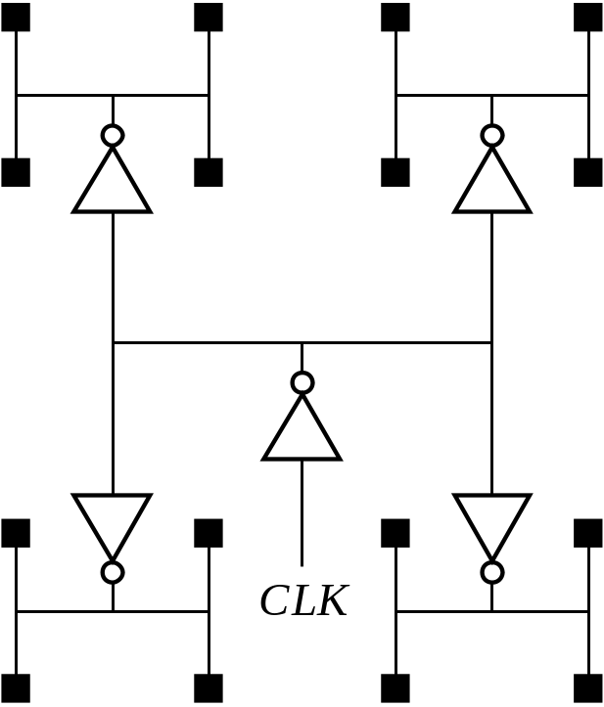
Clock Distribution
H-tree
Clock is distributed in a tree-like fashion

Slide 29
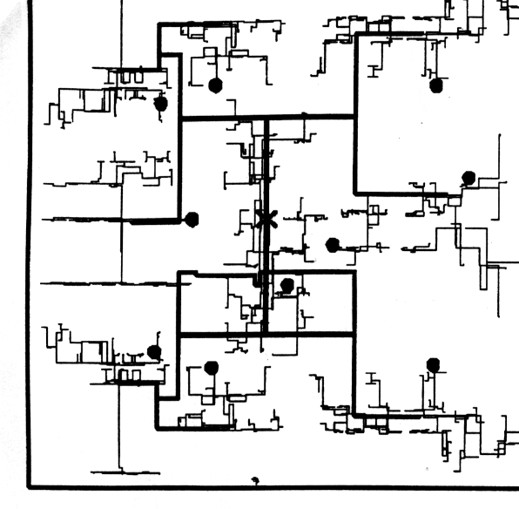
More realistic H-tree
[Restle98]

Slide 30
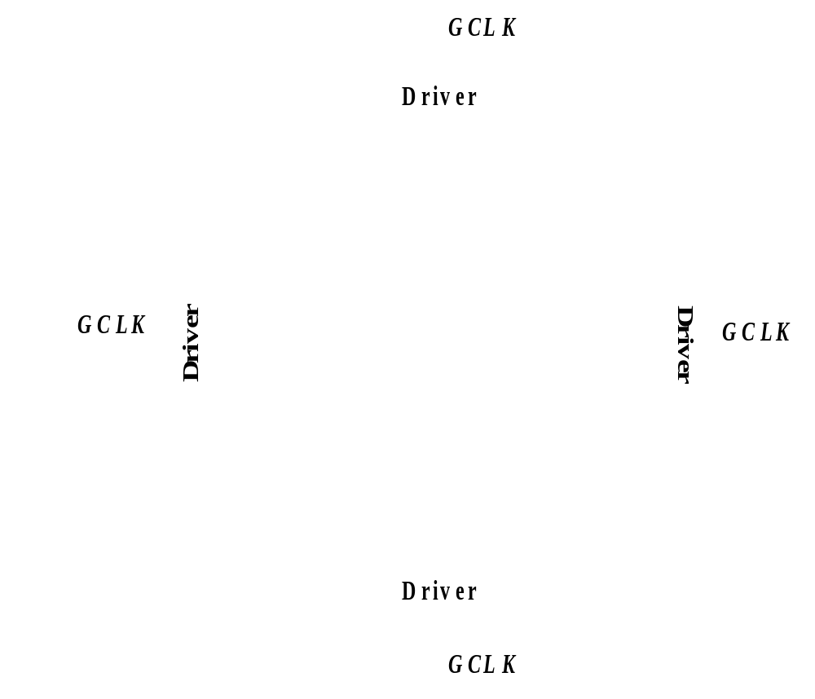
The Grid System
No rc-matching
Large power

Slide 31
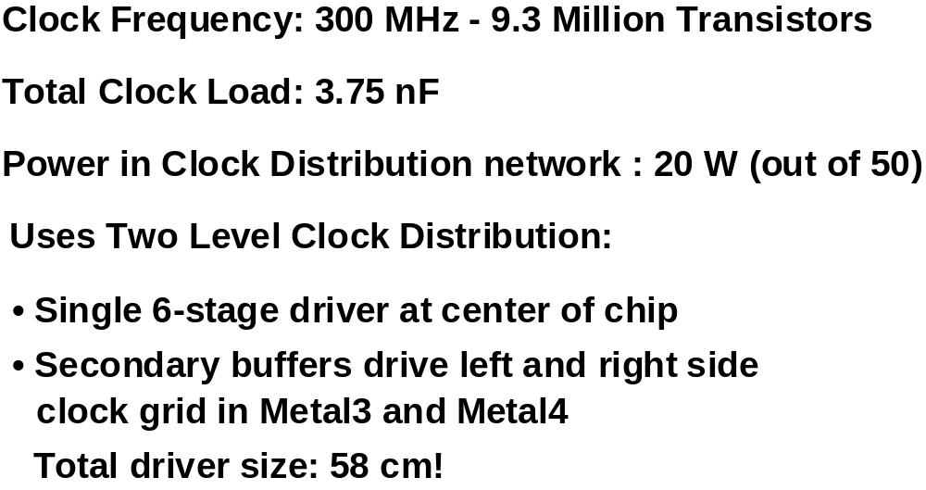
Example: DEC Alpha 21164

Slide 32
21164 Clocking
t_{cycle}= 3.3ns
2 phase single wire clock, distributed globally
2 distributed driver channels
  Reduced RC delay/skew
  Improved thermal distribution
  3.75nF clock load
  58 cm final driver width
Local inverters for latching
Conditional clocks in caches to reduce power
More complex race checking
Device variation
t_{rise} = 0.35ns
t_{skew} = 150ps
Clock waveform
final drivers
pre-driver
Location of clock
driver on die

Slide 33
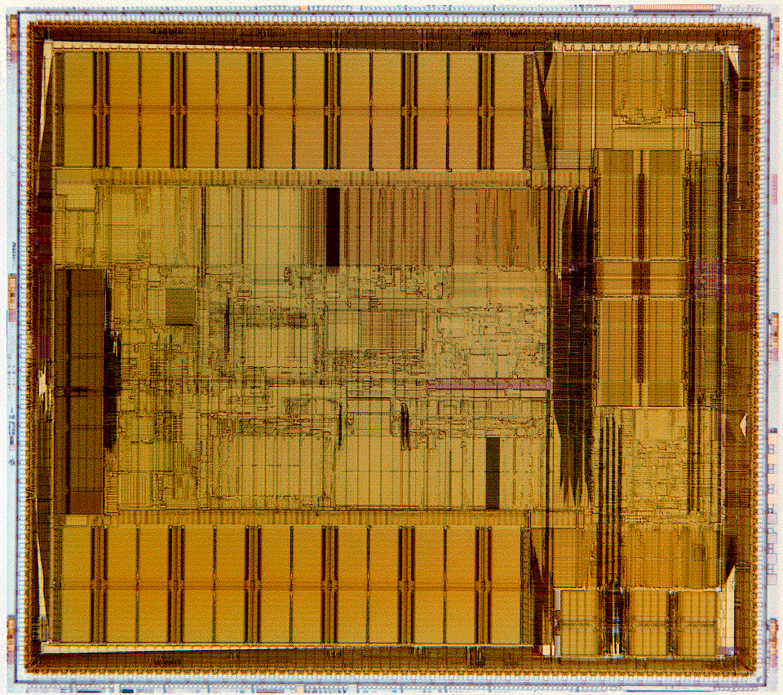

Slide 34
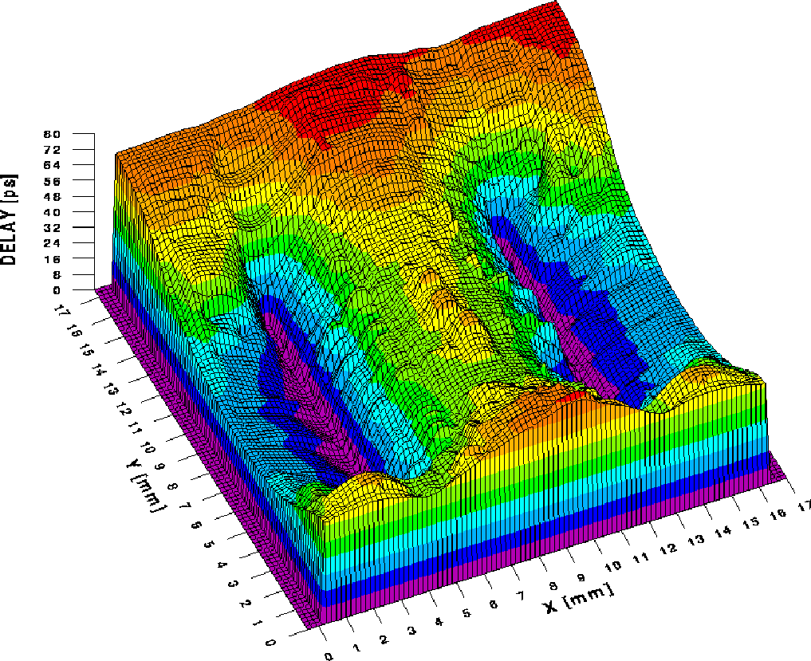
Clock Skew in Alpha Processor

Slide 35
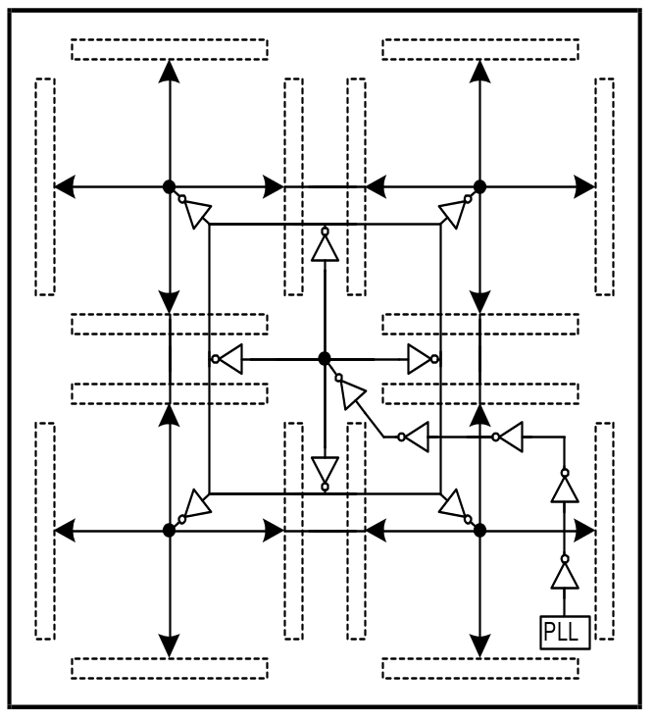
EV6 (Alpha 21264) Clocking
600 MHz – 0.35 micron CMOS
t_{cycle}= 1.67ns
t_{rise} = 0.35ns
t_{skew} = 50ps
Global clock waveform
2 Phase, with multiple conditional buffered clocks
  2.8 nF clock load
  40 cm final driver width
Local clocks can be gated “off” to save power
Reduced load/skew
Reduced thermal issues
Multiple clocks complicate race checking

Slide 36
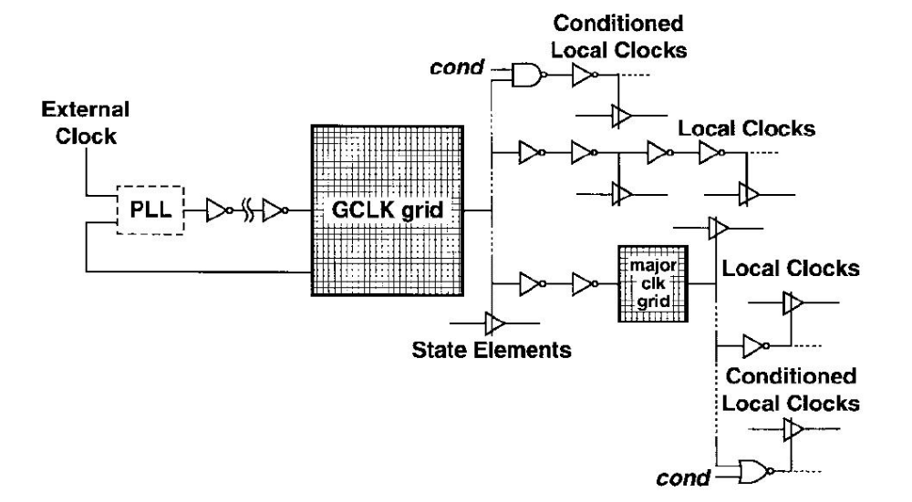
21264 Clocking

Slide 37
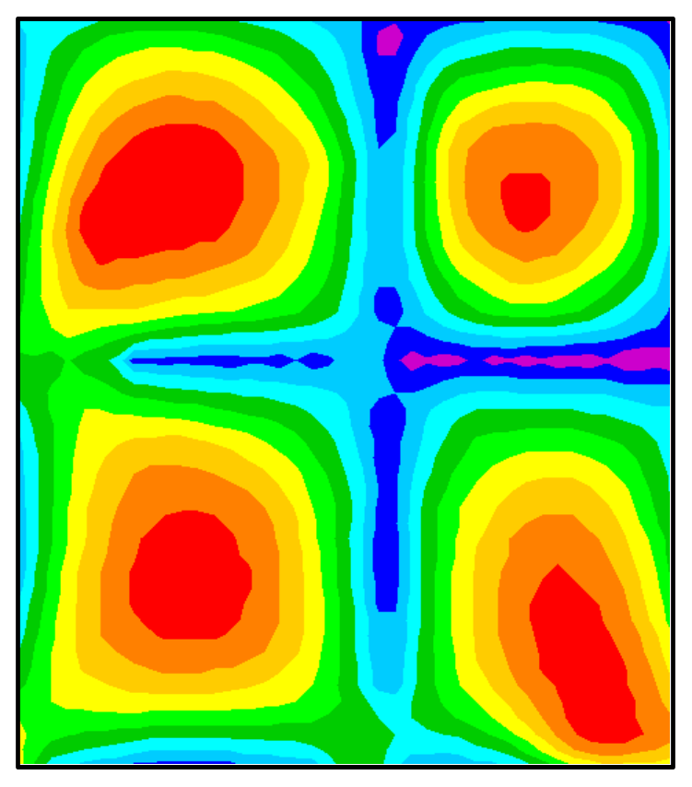
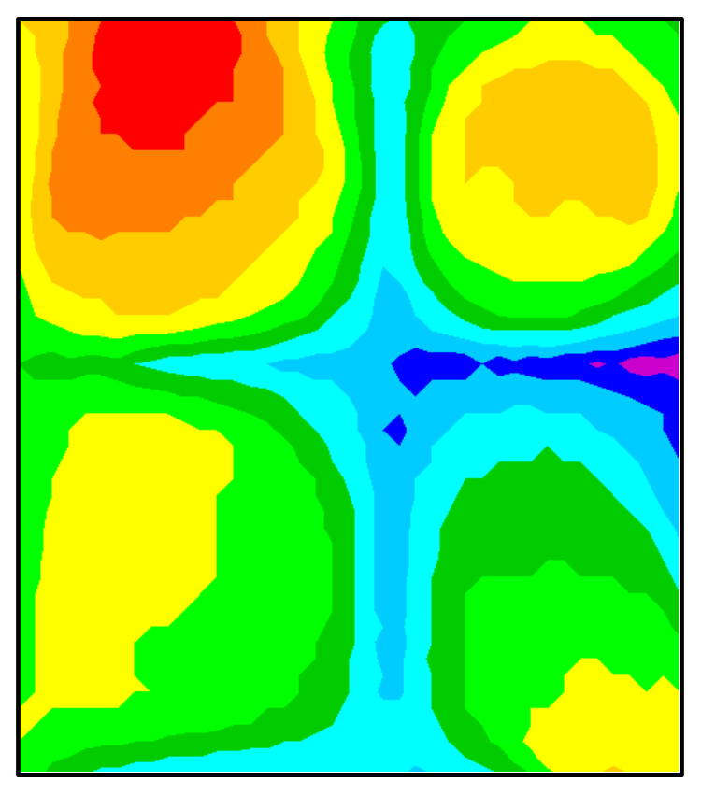


EV6 Clock Results
ps
5
10
15
20
25
30
35
40
45
50
ps
300
305
310
315
320
325
330
335
340
345
GCLK Skew
(at Vdd/2 Crossings)
GCLK Rise Times
(20% to 80% Extrapolated to 0% to 100%)

Slide 38
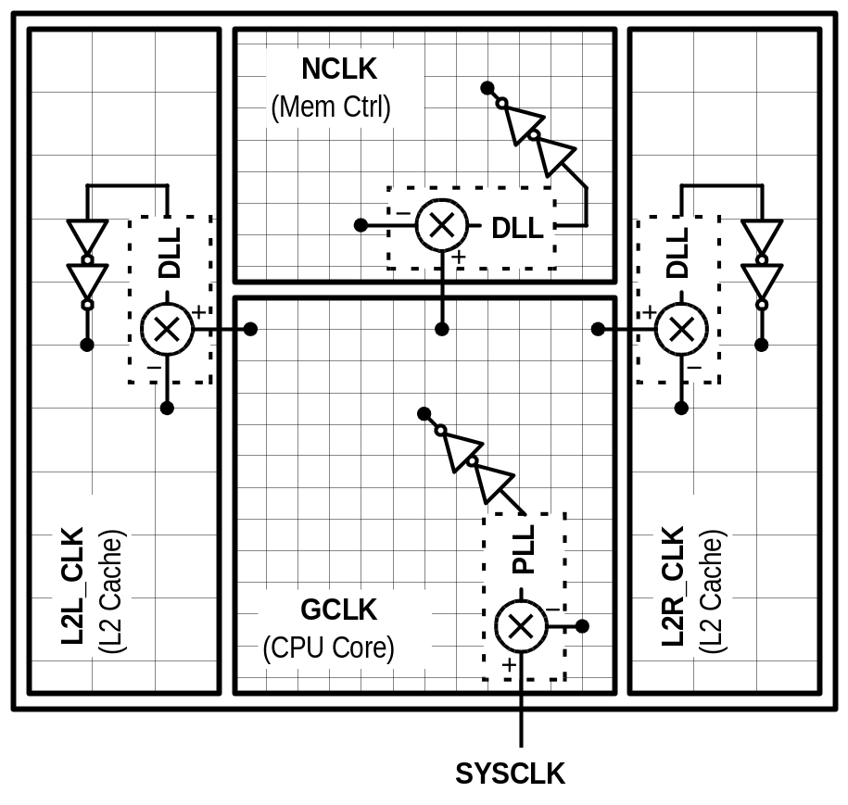
EV7 Clock Hierarchy
Active Skew Management and Multiple Clock Domains
+ widely dispersed drivers
+ DLLs compensate static and low-frequency variation
+ divides design and verification effort
- DLL design and verification is added work
+ tailored clocks

Slide 39
Self-timed and Asynchronous Design
Functions of clock in synchronous design
1) Acts as completion signal
2) Ensures the correct ordering of events
Truly asynchronous design
1) Completion is ensured by careful timing analysis
2) Ordering of events is implicit in logic
Self-timed design
1) Completion ensured by completion signal
2) Ordering imposed by handshaking protocol

Slide 40
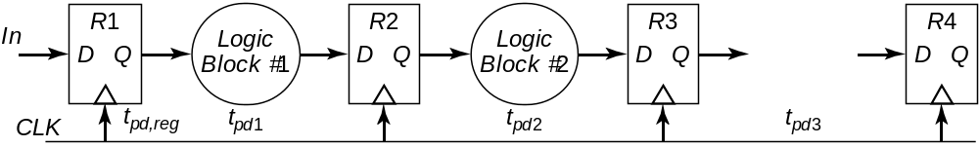
Synchronous Pipelined Datapath

Slide 41
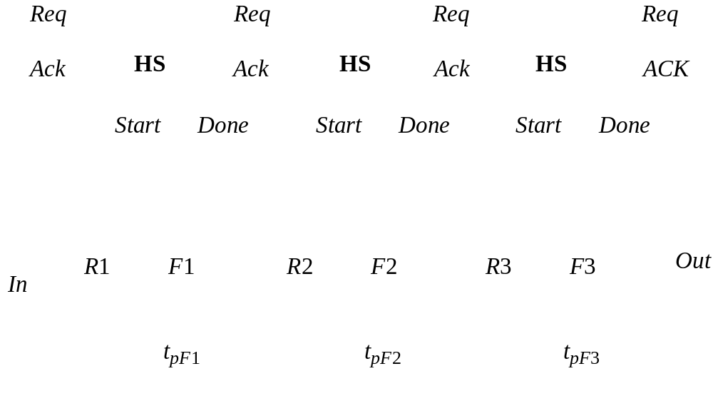
Self-Timed Pipelined Datapath

Slide 42
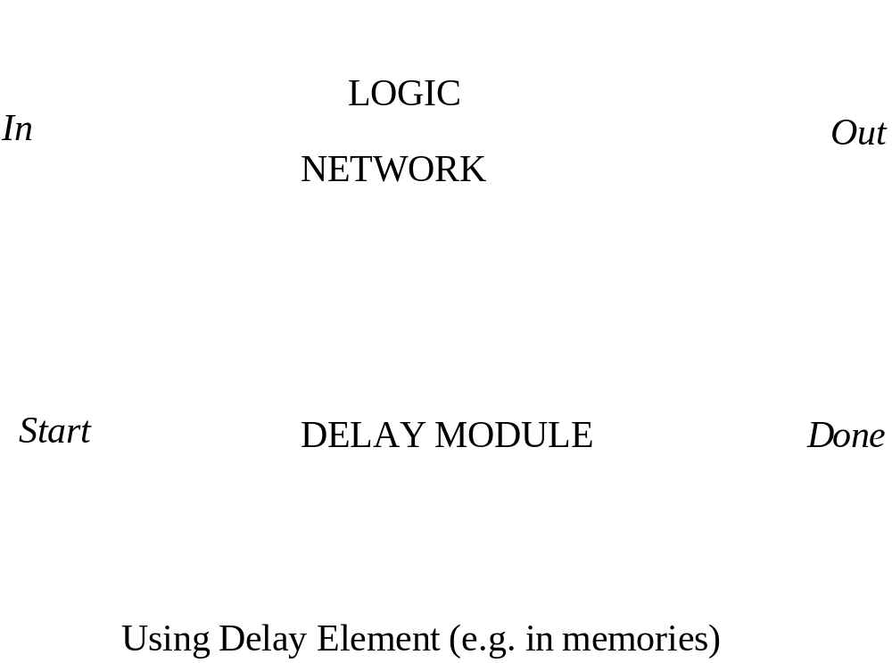
Completion Signal Generation

Slide 43
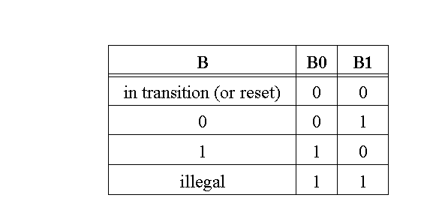
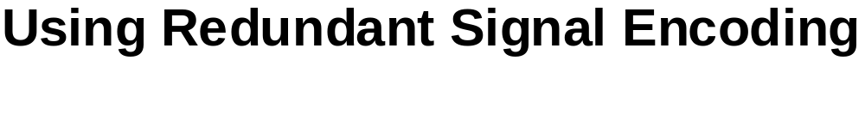
Completion Signal Generation

Slide 44
Completion Signal in DCVSL
V
DD
V
DD
Start
B
0
Done
B
1
B
0
B
1
In
1
In
1
PDN
PDN
In
2
In
2
Start

Slide 45
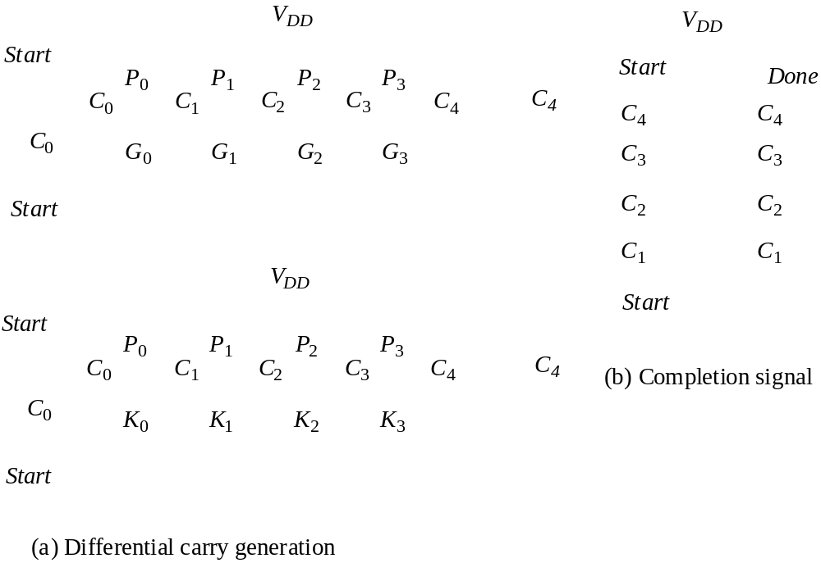
Self-Timed Adder

Slide 46
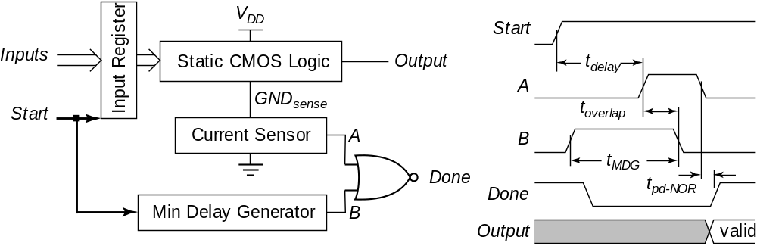
Completion Signal Using Current Sensing

Slide 47
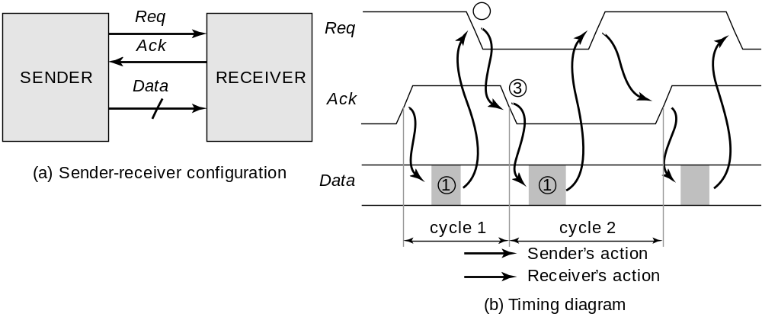
Hand-Shaking Protocol
Two Phase Handshake

Slide 48
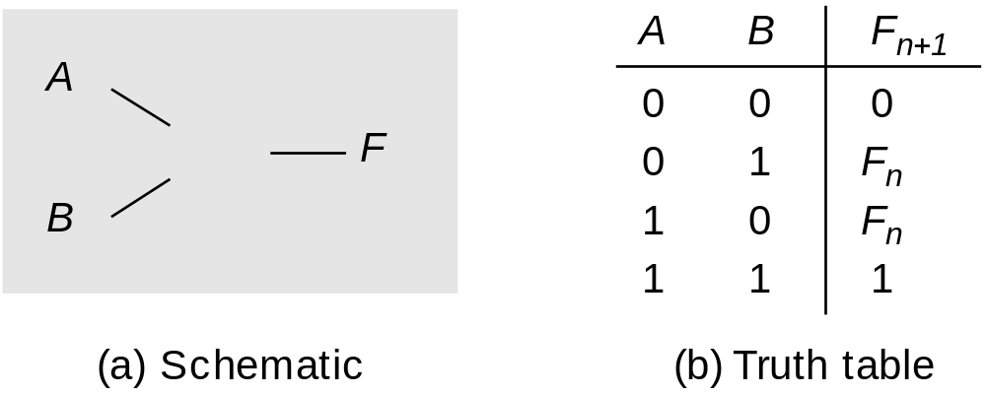
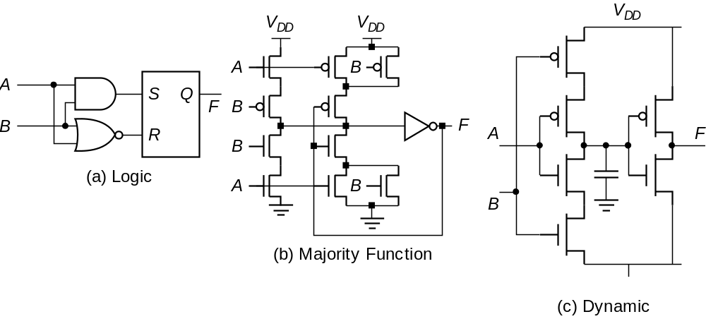
Event Logic – The Muller-C Element

Slide 49
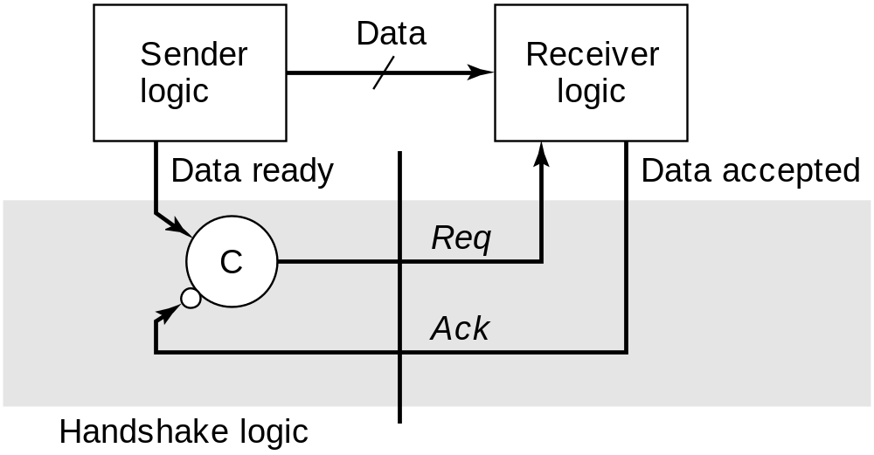
2-Phase Handshake Protocol
Advantage : FAST - minimal # of signaling events (important for global interconnect)
Disadvantage : edge - sensitive, has state

Slide 50
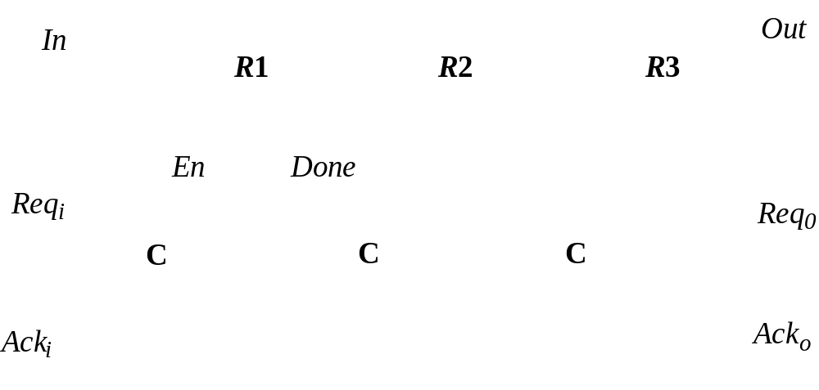
Example: Self-timed FIFO
All 1s or 0s -> pipeline empty
Alternating 1s and 0s -> pipeline full

Slide 51
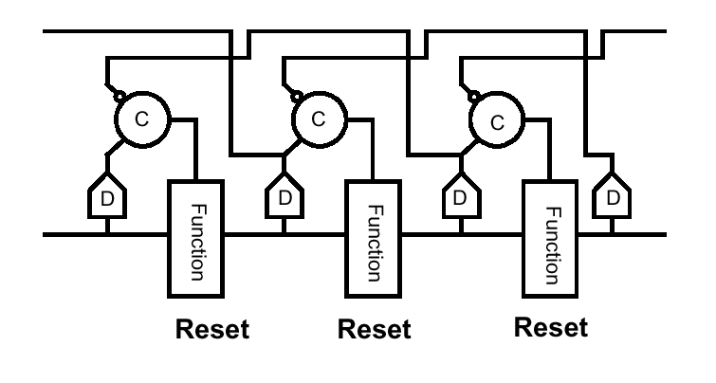
2-Phase Protocol

Slide 52
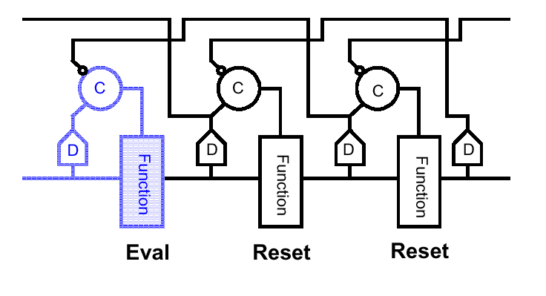
Example
From [Horowitz]

Slide 53
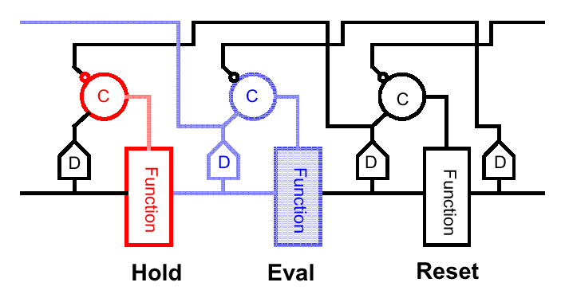
Example

Slide 54
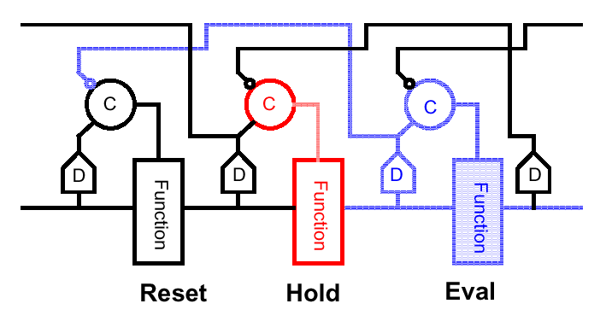
Example

Slide 55
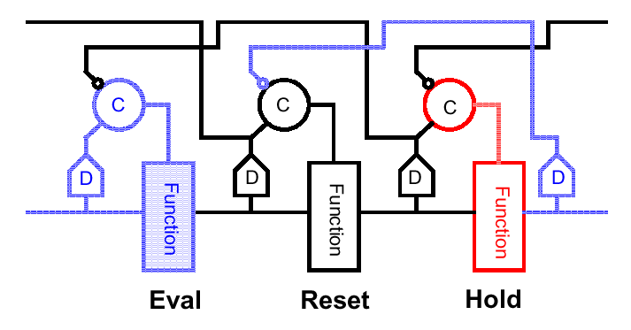
Example

Slide 56
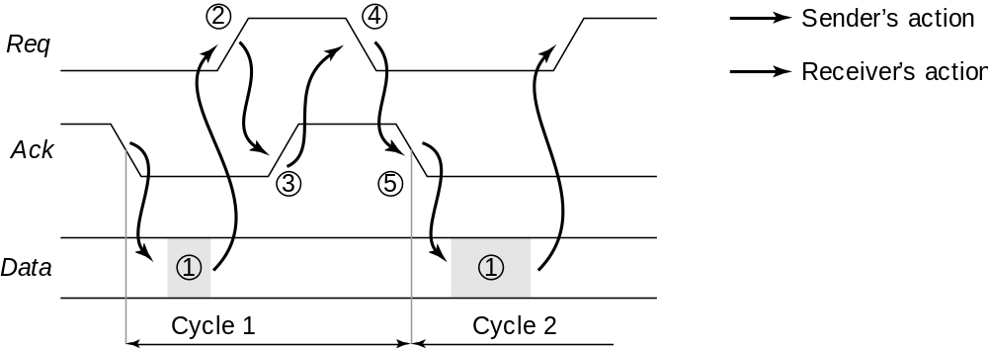
4-Phase Handshake Protocol
Also known as RTZ
Slower, but unambiguous

Slide 57
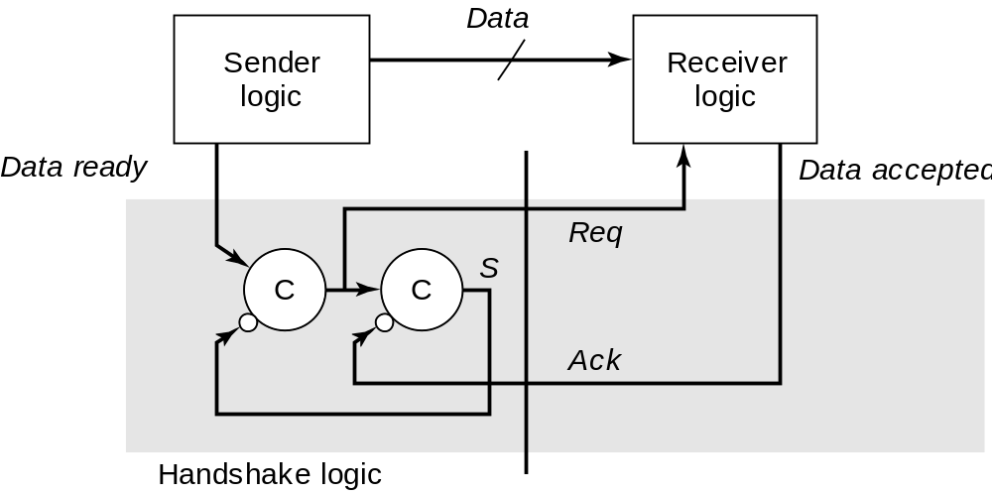
4-Phase Handshake Protocol
Implementation using Muller-C elements

Slide 58
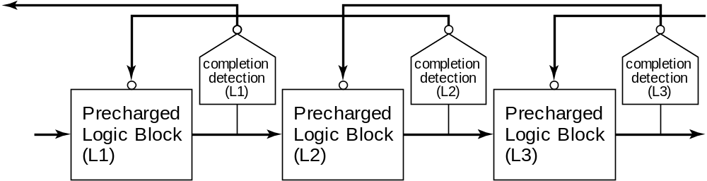
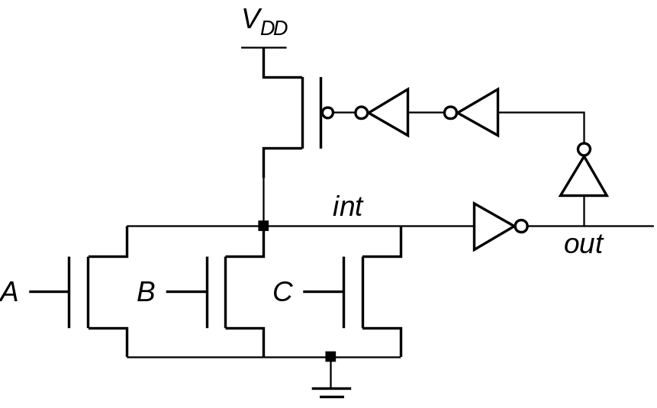
Self-Resetting Logic
Post-charge
logic

Slide 59
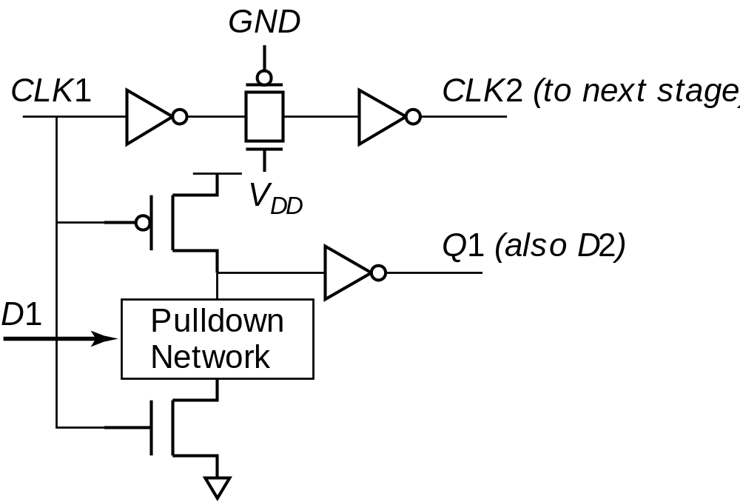
Clock-Delayed Domino

Slide 60
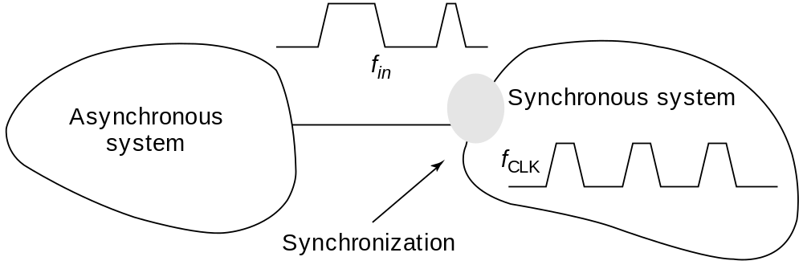
Asynchronous-Synchronous Interface

Slide 61
Synchronizers and Arbiters
Arbiter: Circuit to decide which of 2 events occurred first
Synchronizer: Arbiter with clock φ as one of the inputs
Problem: Circuit HAS to make a decision in limited time - which decision is not important
Caveat: It is impossible to ensure correct operation
But, we can decrease the error probability at the expense of delay

Slide 62
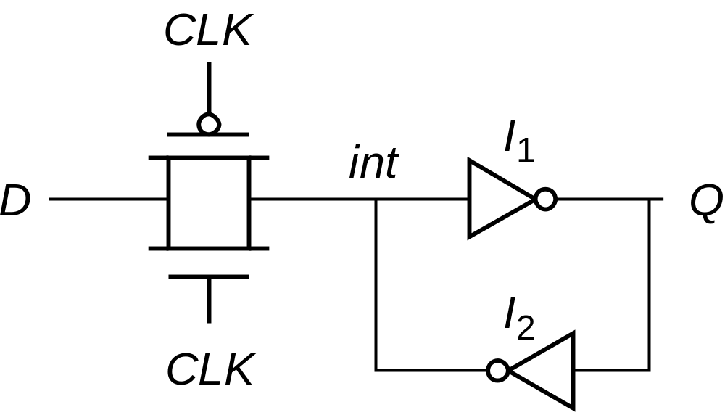
A Simple Synchronizer
• Data sampled on rising edge of the clock
• Latch will eventually resolve the signal value,
but ... this might take infinite time!

Slide 63
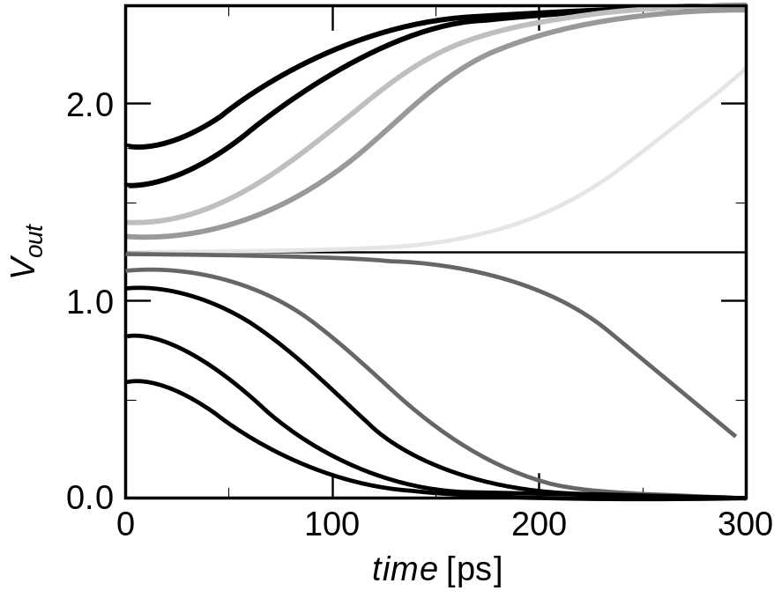
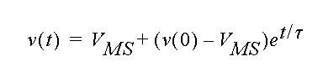
Synchronizer: Output Trajectories
Single-pole model for a flip-flop

Slide 64
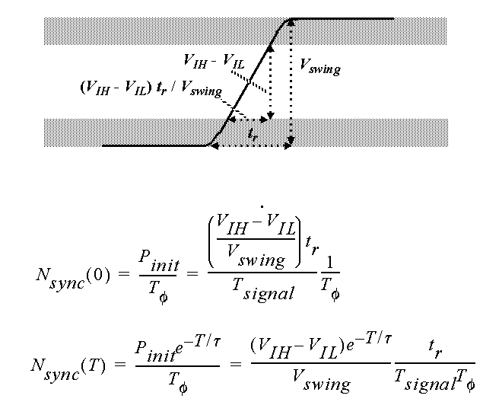
Mean Time to Failure

Slide 65
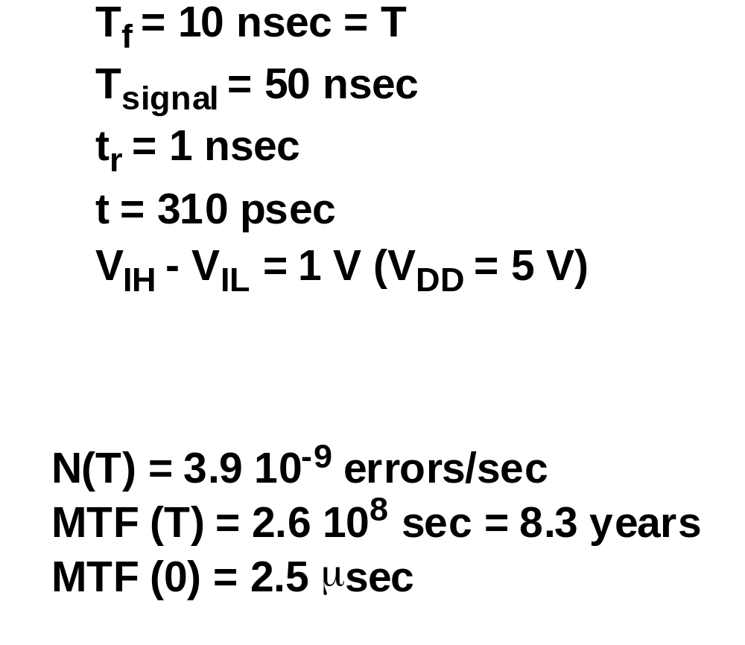
Example

Slide 66
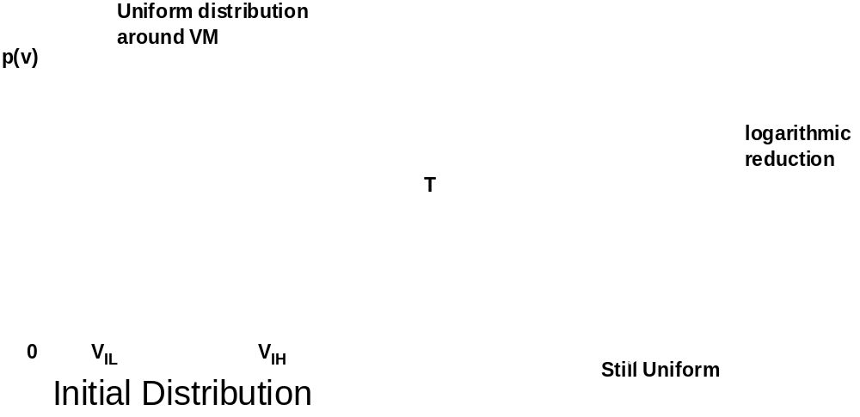
Influence of Noise
Low amplitude noise does not influence synchronization behavior

Slide 67
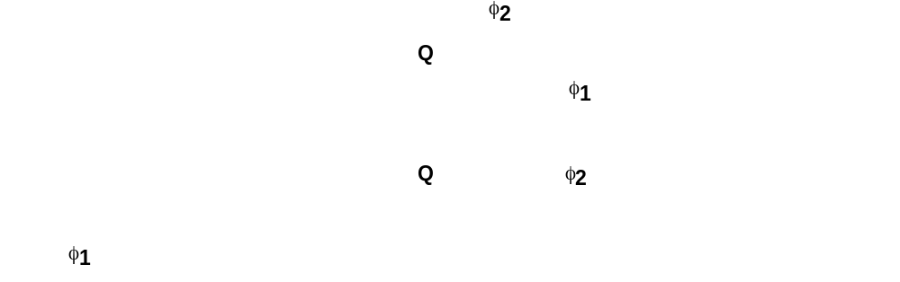
Typical Synchronizers
2 phase clocking circuit
Using delay line

Slide 68

Cascaded Synchronizers Reduce MTF

Slide 69

Arbiters

Slide 70

PLL-Based Synchronization

Slide 71

PLL Block Diagram

Slide 72

Phase Detector
Output before filtering
Transfer
characteristic

Slide 73

Phase-Frequency Detector

Slide 74

PFD Response to Frequency

Slide 75

PFD Phase Transfer Characteristic

Slide 76

Charge Pump

Slide 77

PLL Simulation

Slide 78
Clock Generation using DLLs
Delay-Locked Loop (Delay Line Based)
f_{REF}
U
Phase
Det
Charge
Pump
D
DL
Filter
f_{O}
Phase-Locked Loop (VCO-Based)
f_{REF}
U
PD
D
CP
VCO
÷N
Filter
f_{O}

Slide 79

Delay Locked Loop

Slide 80

DLL-Based Clock Distribution

