Slide 1

Digital Integrated Circuits
A Design Perspective
Jan M. Rabaey
Anantha Chandrakasan
Borivoje Nikolic
The Wire
July 30, 2002

Slide 2


The Wire
schematics
physical

Slide 3
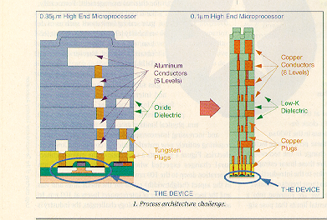
Interconnect Impact on Chip

Slide 4
Wire Models
All-inclusive model
Capacitance-only

Slide 5
Impact of Interconnect Parasitics
Interconnect parasitics
  reduce reliability
  affect performance and power consumption
Classes of parasitics
  Capacitive
  Resistive
  Inductive

Slide 6
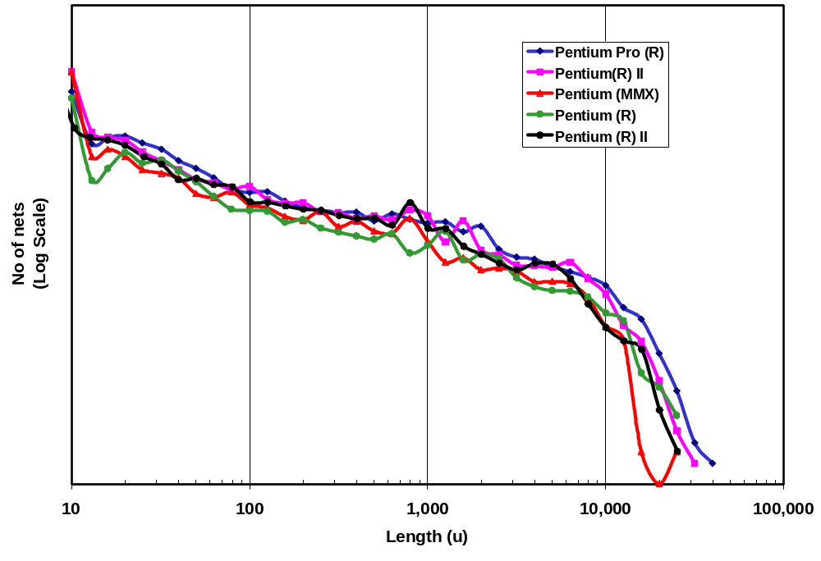

Nature of Interconnect
Global Interconnect
S
Global
= S
Die
S
Local
= S
Technology
Source: Intel

Slide 7
INTERCONNECT
Capacitance

Slide 8
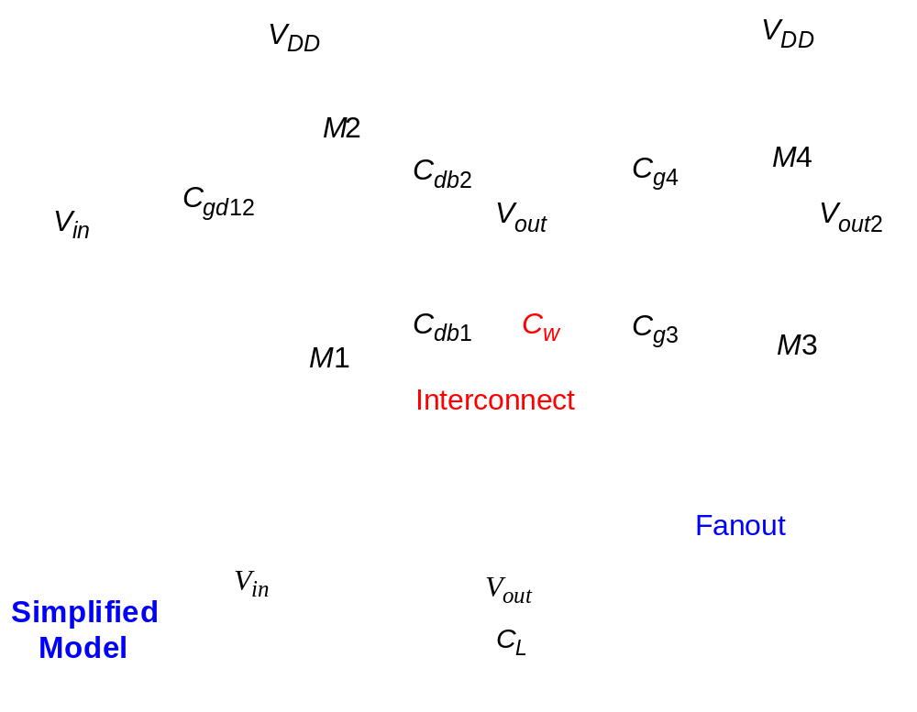
Capacitance of Wire Interconnect

Slide 9
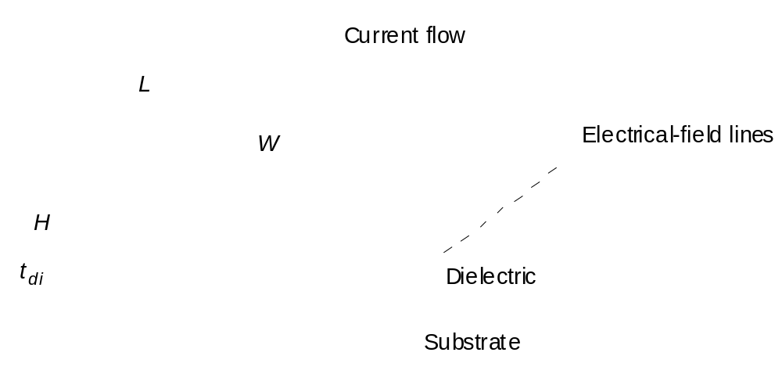
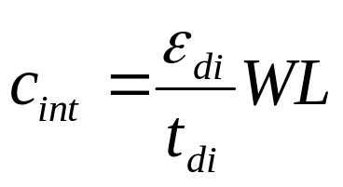
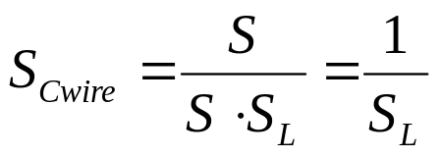
Capacitance: The Parallel Plate Model

Slide 10
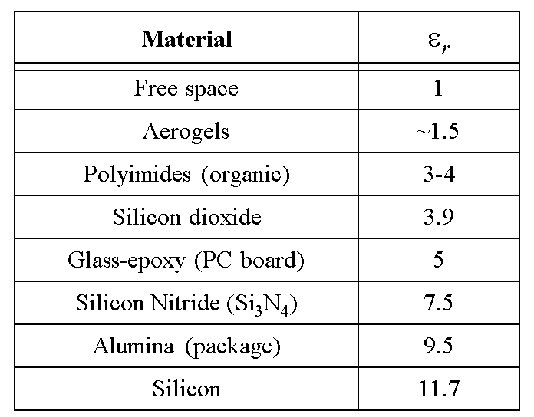
Permittivity

Slide 11
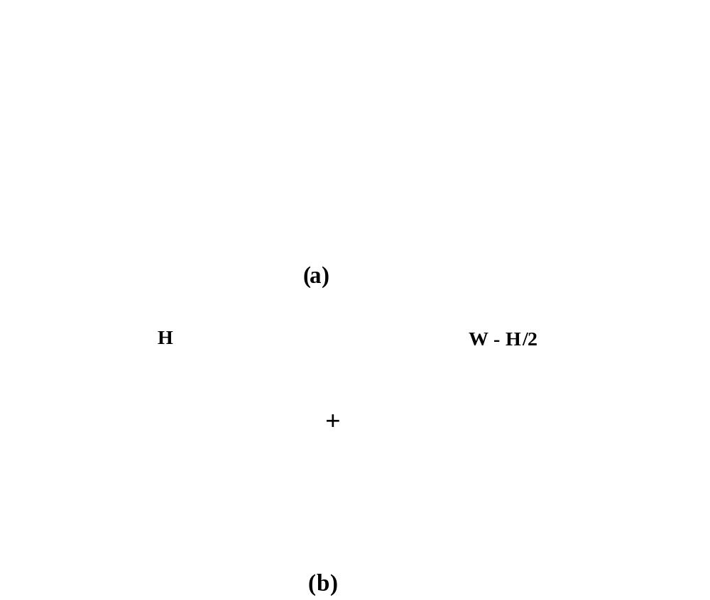
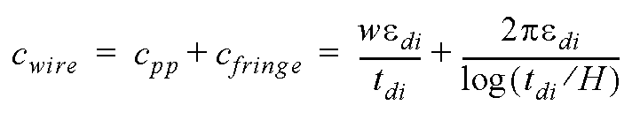
Fringing Capacitance

Slide 12
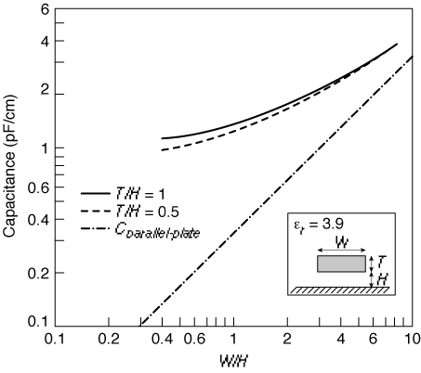

Fringing versus Parallel Plate

Slide 13
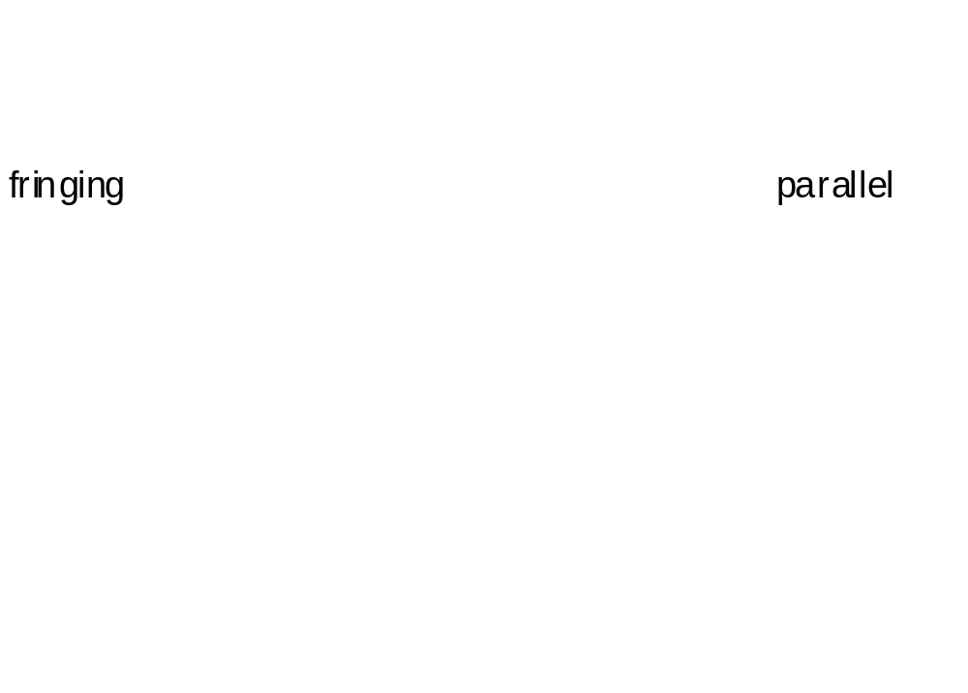
Interwire Capacitance

Slide 14
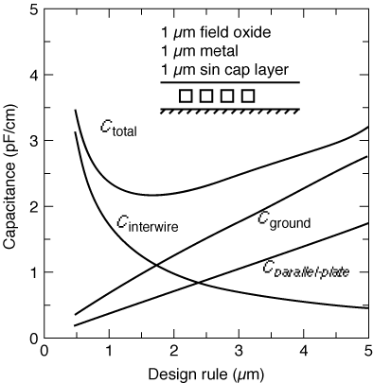
Impact of Interwire Capacitance

Slide 15
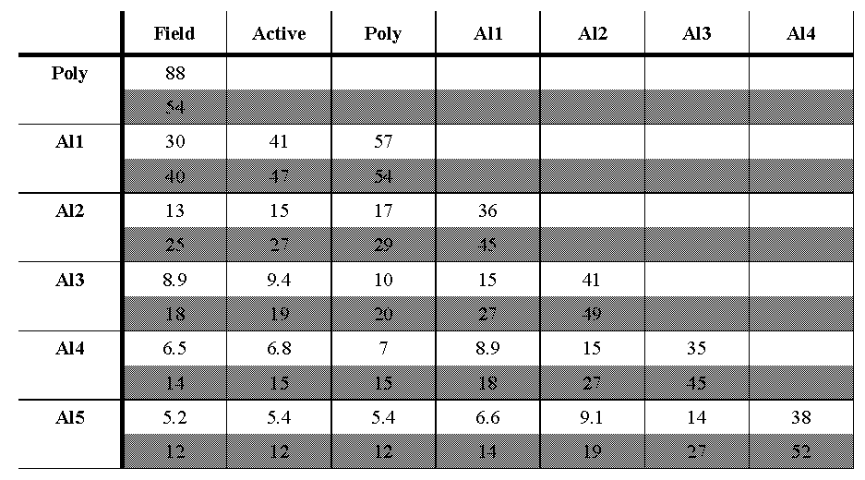
Wiring Capacitances (0.25 μm CMOS)

Slide 16
INTERCONNECT
Resistance

Slide 17
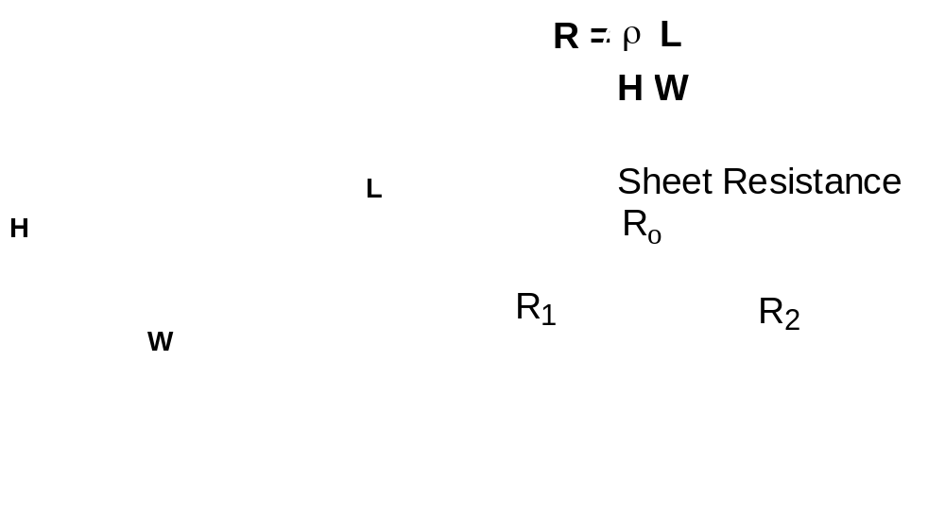
Wire Resistance

Slide 18
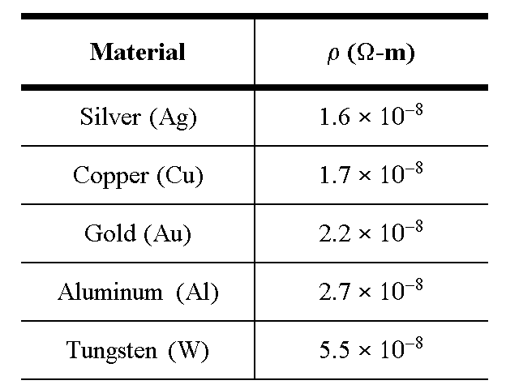
Interconnect Resistance

Slide 19
Dealing with Resistance
Selective Technology Scaling
Use Better Interconnect Materials
  reduce average wire-length
  e.g. copper, silicides
More Interconnect Layers
  reduce average wire-length

Slide 20
Polycide Gate MOSFET
Silicide
PolySilicon
SiO
2
n
+
n
+
p
Silicides: WSi
2,
TiSi
2
, PtSi
2
and TaSi
Conductivity: 8-10 times better than Poly

Slide 21
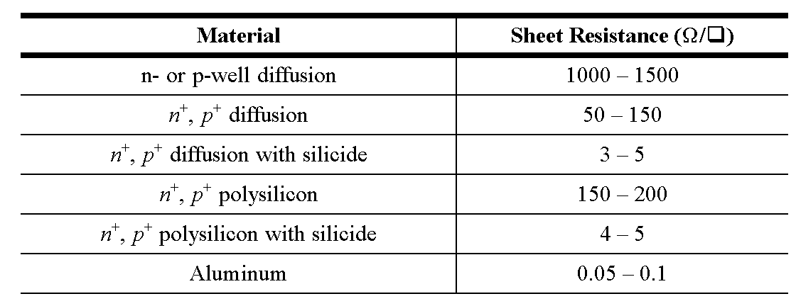
Sheet Resistance

Slide 22
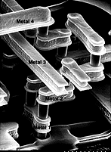
Modern Interconnect

Slide 23
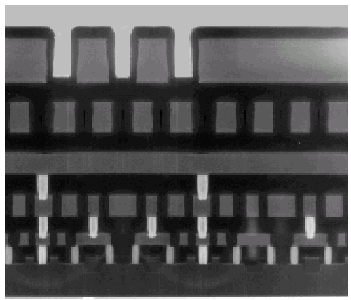
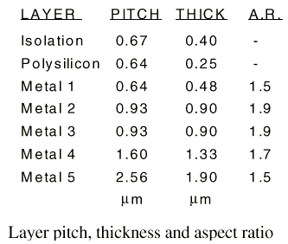
Example: Intel 0.25 micron Process
5 metal layers
Ti/Al - Cu/Ti/TiN
Polysilicon dielectric

Slide 24
INTERCONNECT
Inductance

Slide 25
Interconnect
Modeling

Slide 26
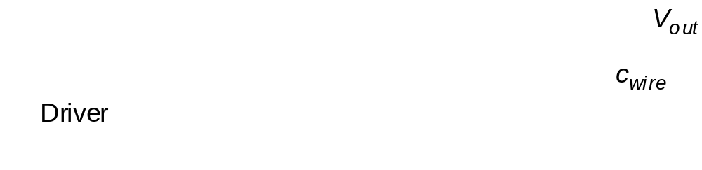
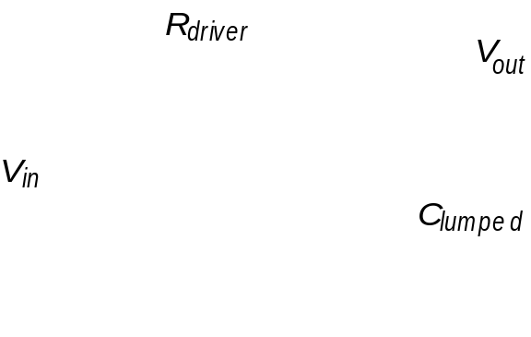
The Lumped Model

Slide 27
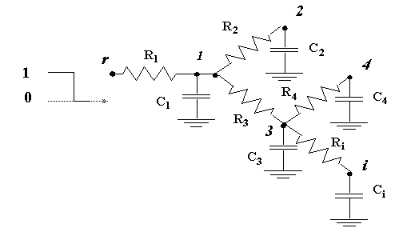
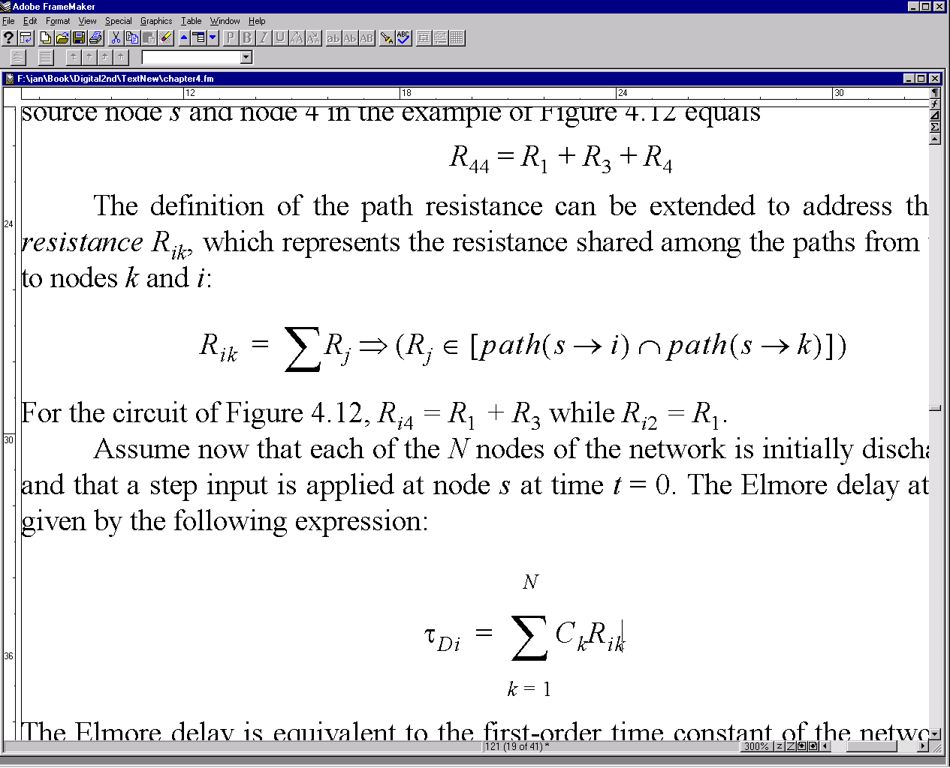
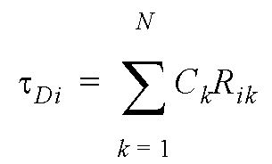
The Lumped RC-Model
The Elmore Delay

Slide 28
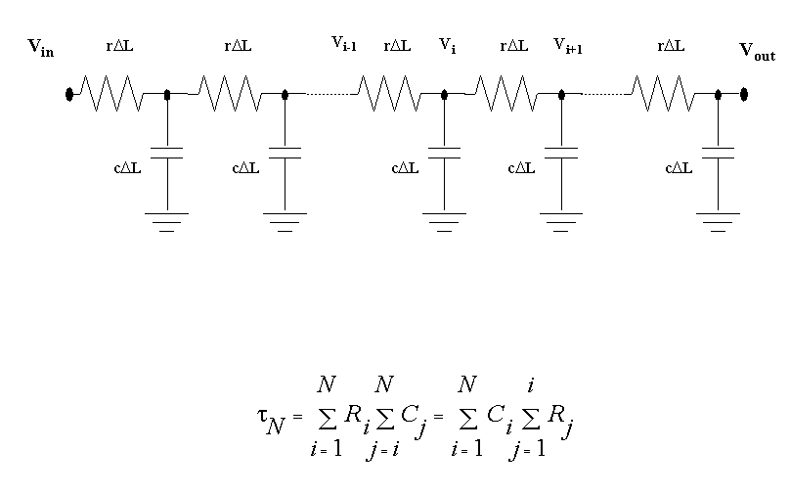
The Ellmore Delay
RC Chain

Slide 29
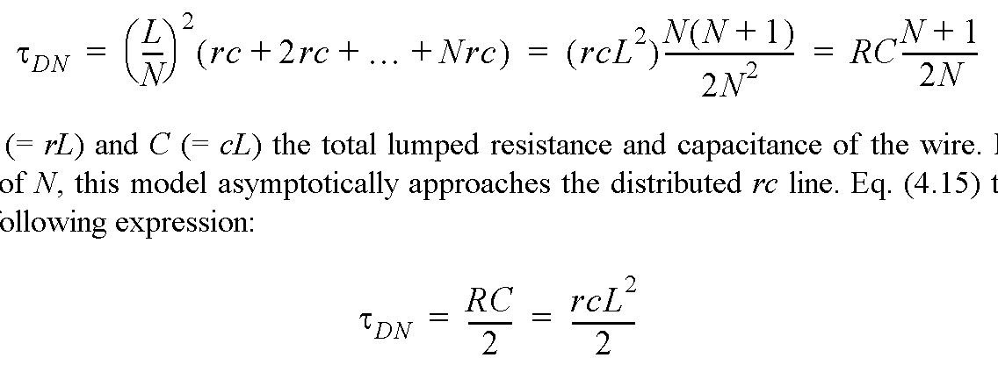
Wire Model
Assume: Wire modeled by N equal-length segments
For large values of N:

Slide 30
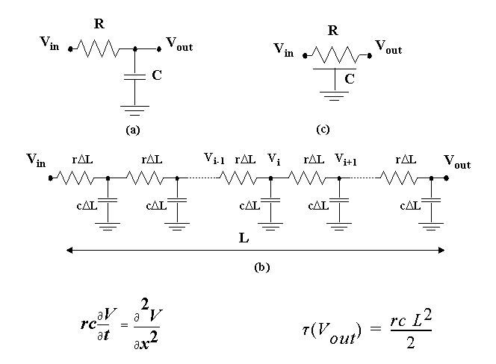
The Distributed RC-line
The diffusion equation

Slide 31
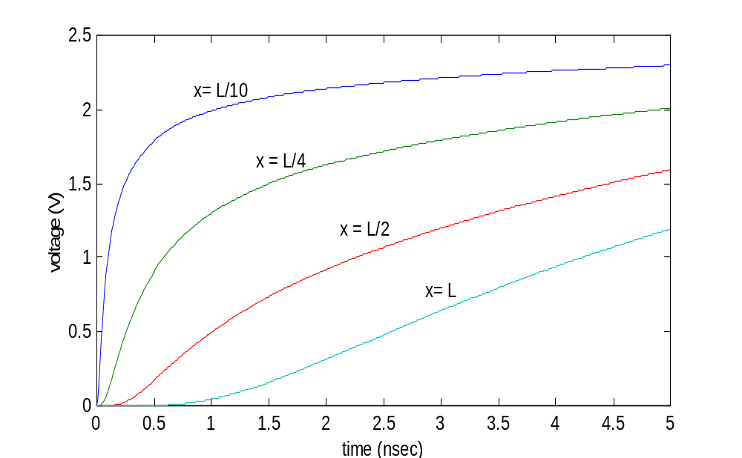
Step-response of RC wire as a function of time and space

Slide 32
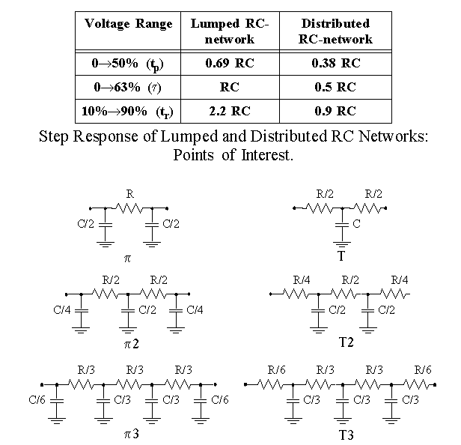
RC-Models

Slide 33
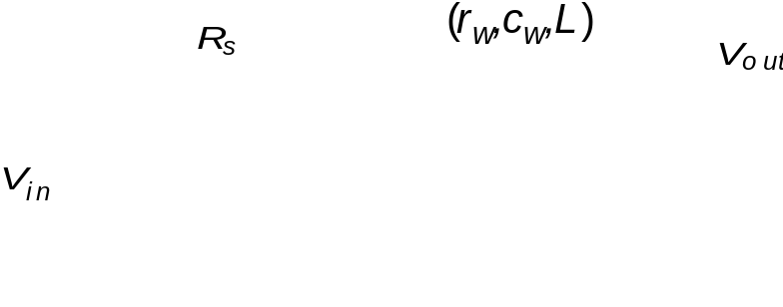
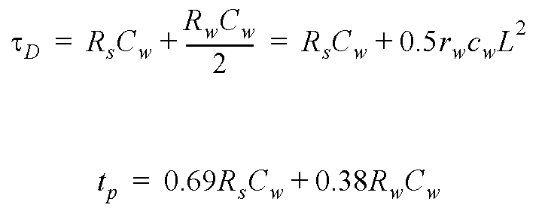
Driving an RC-line

Slide 34
Design Rules of Thumb
rc delays should only be considered when t_{pRC} >> t_{pgate} of the driving gate
  Lcrit >> √ t_{pgate}/0.38rc
rc delays should only be considered when the rise (fall) time at the line input is smaller than RC, the rise (fall) time of the line
  t_{rise} < RC
  when not met, the change in the signal is slower than the propagation delay of the wire
© MJIrwin, PSU, 2000

