Slide 1

Digital Integrated Circuits
A Design Perspective
Jan M. Rabaey
Anantha Chandrakasan
Borivoje Nikolic
Designing Sequential
Logic Circuits
November 2002

Slide 2
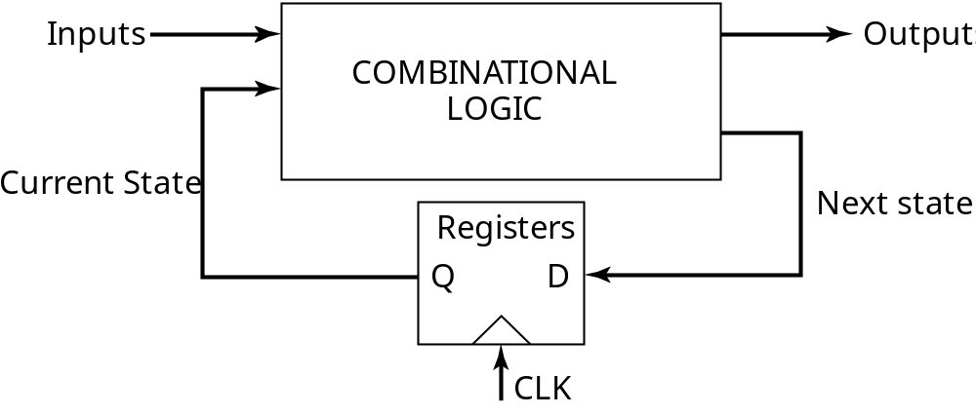
Sequential Logic
2 storage mechanisms
• positive feedback
• charge-based

Slide 3
Naming Conventions
In our text:
  a latch is level sensitive
  a register is edge-triggered
There are many different naming conventions
  For instance, many books call edge-triggered elements flip-flops
  This leads to confusion however

Slide 4
Latch versus Register
Latch
stores data when
clock is low
Register
stores data when
clock rises
D
Q
D
Q
Clk
Clk
Clk
Clk
D
D
Q
Q

Slide 5
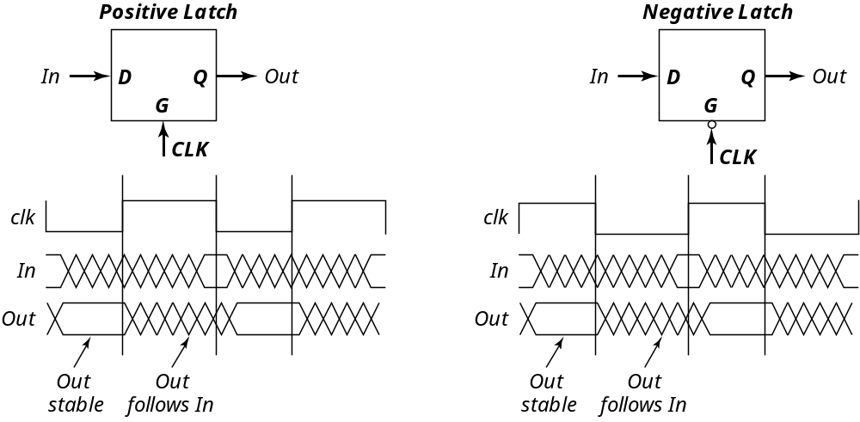
Latches

Slide 6
Latch-Based Design
N latch is transparent
when φ = 0
P latch is transparent
when φ = 1
φ
N
P
Logic
Latch
Latch
Logic

Slide 7
Timing Definitions
CLK
t
Register
t
su
t
hold
D
Q
D
DATA
CLK
STABLE
t
t
c
2
q
Q
DATA
STABLE
t

Slide 8
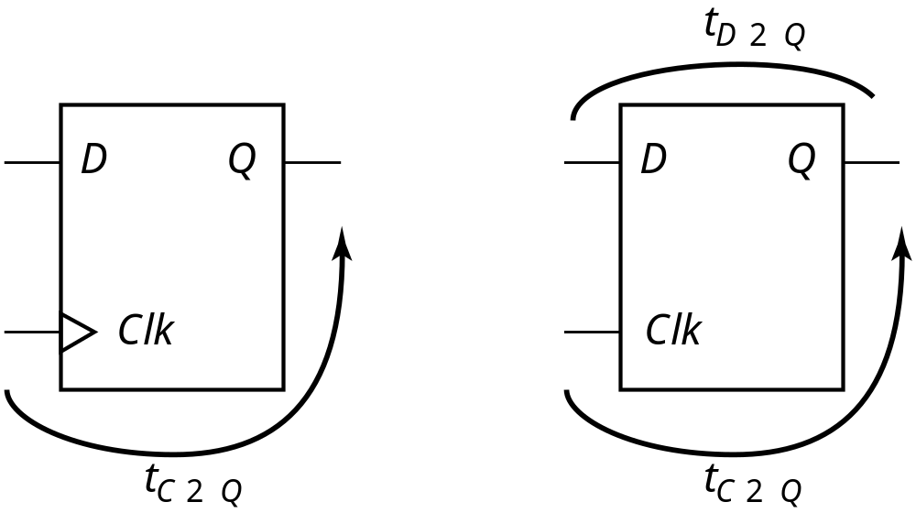
Characterizing Timing
Register
Latch

Slide 9
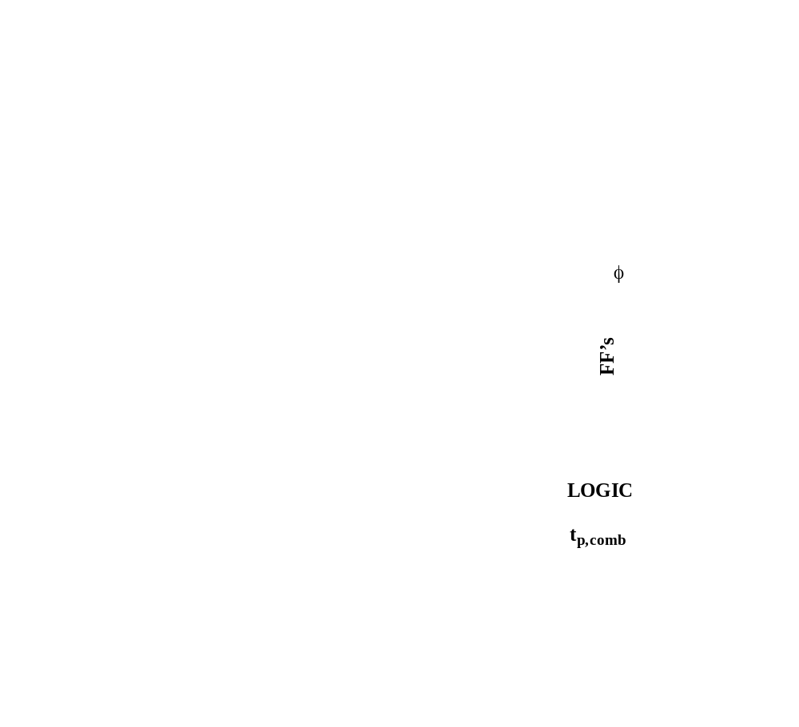
Maximum Clock Frequency
Also:
t_{cdreg} + t_{cdlogic} > t_{hold}
t_{cd}: contamination delay = minimum delay
t_{clk-Q} + t_{p,comb} + t_{setup} = T

Slide 10
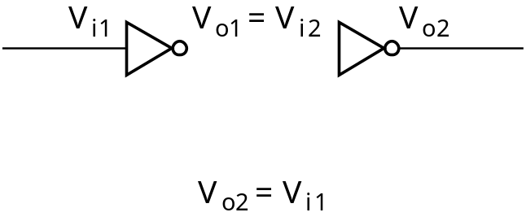
Positive Feedback: Bi-Stability
V
1
V_{i2}
1
o1
o
o
V
V
5
2
i
V
V
i
1
V
o
2
A
V
=
V
1
i
2
o
o
V
1
5
2
C
i
V
B
V
i
1
=
V
o
2

Slide 11
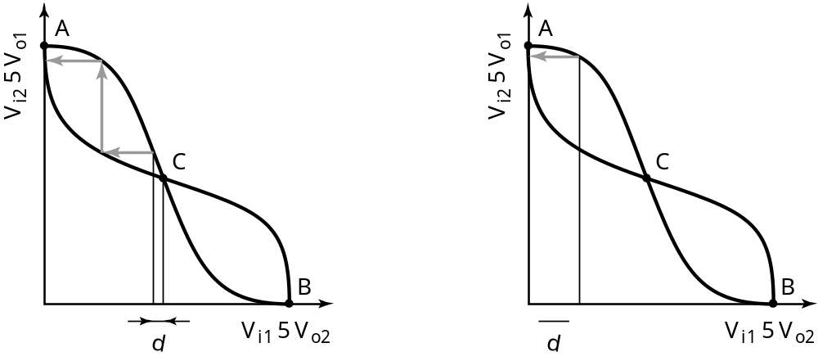
Meta-Stability
Gain should be larger than 1 in the transition region

Slide 12
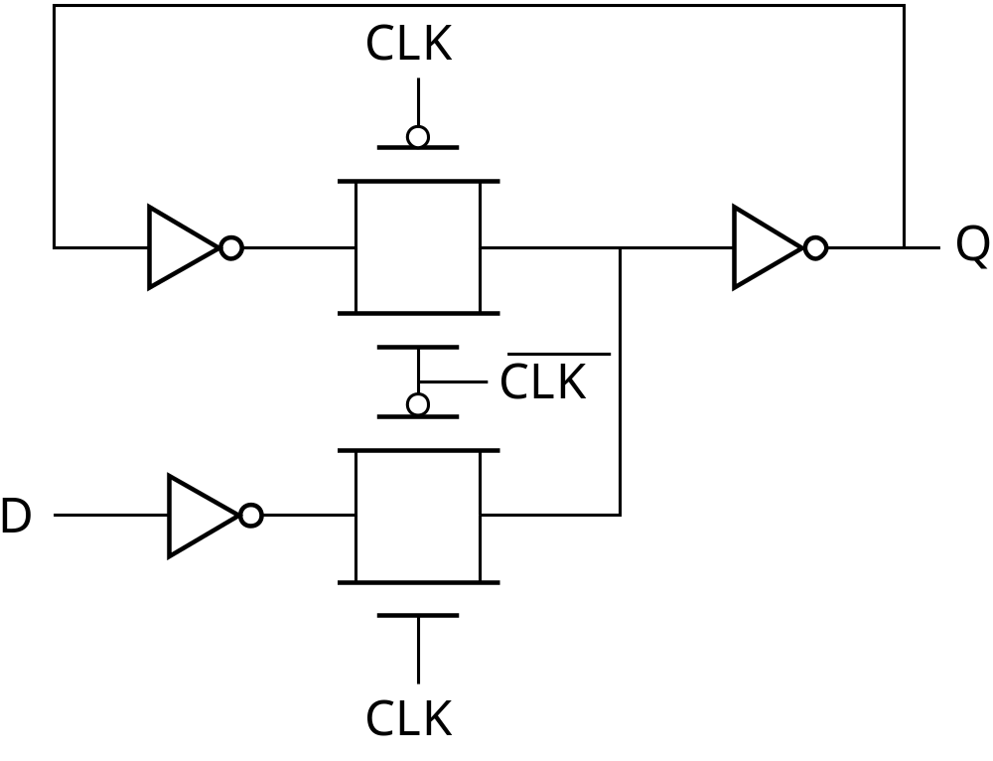
Writing into a Static Latch
Use the clock as a decoupling signal,
that distinguishes between the transparent and opaque states
CLK
D
D
CLK
Forcing the state
(can implement as NMOS-only)
Converting into a MUX

Slide 13


Mux-Based Latches
Negative latch
(transparent when CLK= 0)
Positive latch
(transparent when CLK= 1)
1
Q
0
Q
D
0
D
1
CLK
CLK

Slide 14
Mux-Based Latch

Slide 15
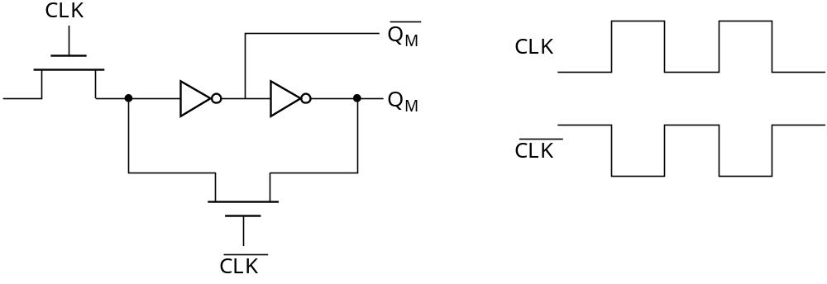
Mux-Based Latch
NMOS only
Non-overlapping clocks

Slide 16
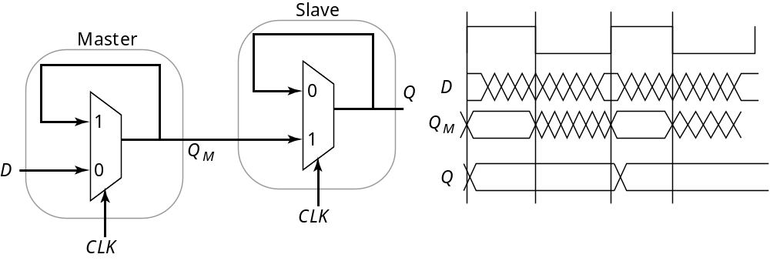
Master-Slave (Edge-Triggered) Register
Two opposite latches trigger on edge
Also called master-slave latch pair

Slide 17
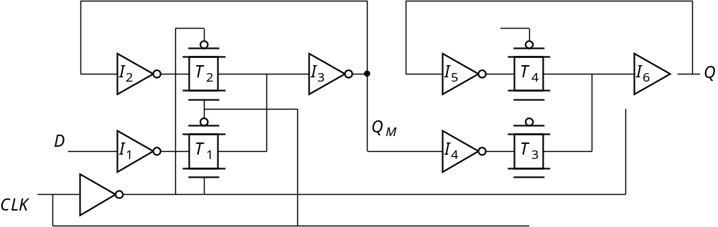
Master-Slave Register
Multiplexer-based latch pair

Slide 18
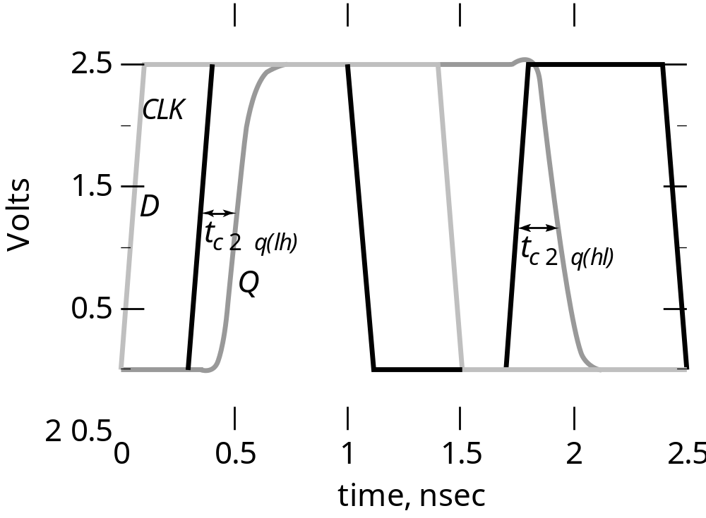
Clk-Q Delay

Slide 19
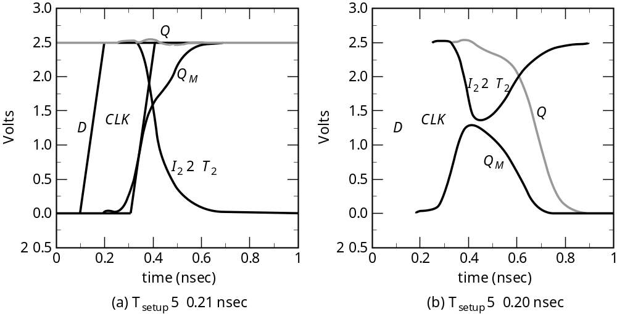
Setup Time

Slide 20
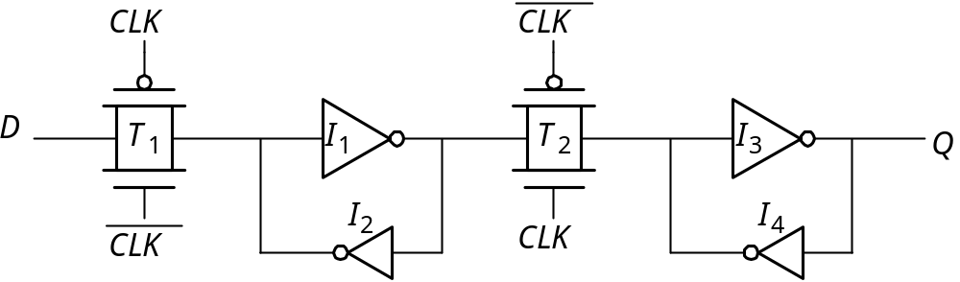
Reduced Clock Load
Master-Slave Register

Slide 21
Avoiding Clock Overlap
CLK
X
CLK
Q
D
A
B
CLK
CLK
(a) Schematic diagram
CLK
CLK
(b) Overlapping clock pairs

Slide 22
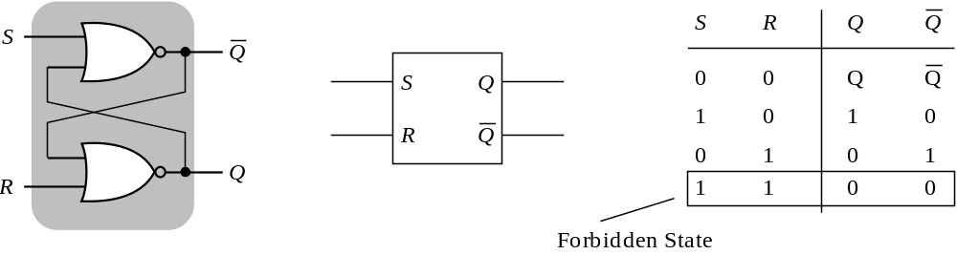
Overpowering the Feedback Loop ─
Cross-Coupled Pairs
NOR-based set-reset

Slide 23
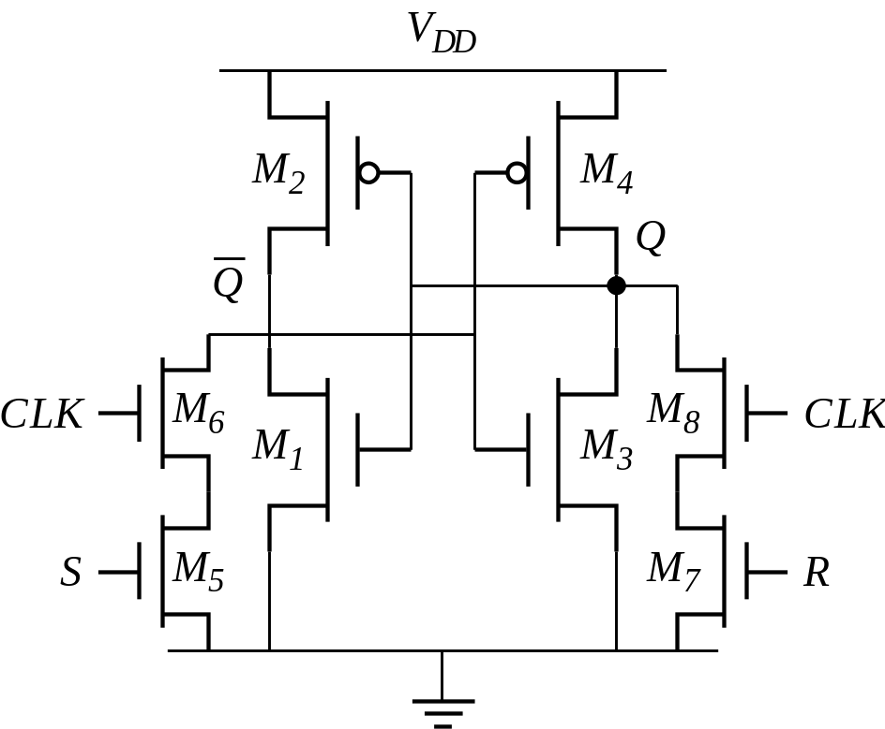
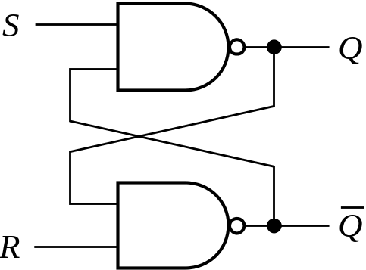
Cross-Coupled NAND
Added clock
Cross-coupled NANDs
This is not used in datapaths any more,
but is a basic building memory cell

Slide 24
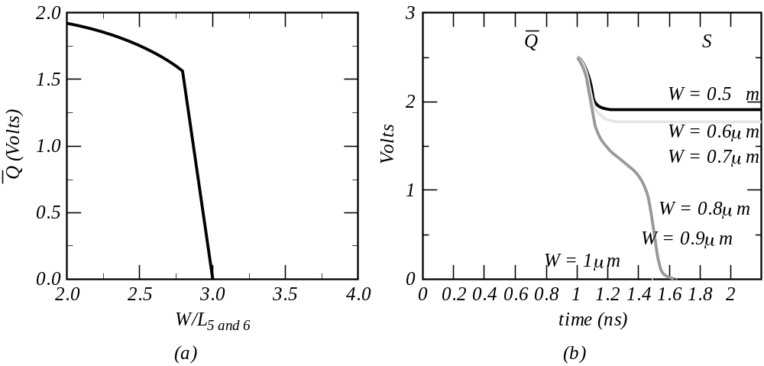
Sizing Issues
Output voltage dependence
on transistor width
Transient response

Slide 25
Storage Mechanisms
Static
Dynamic (charge-based)
CLK
D
Q
CLK

Slide 26
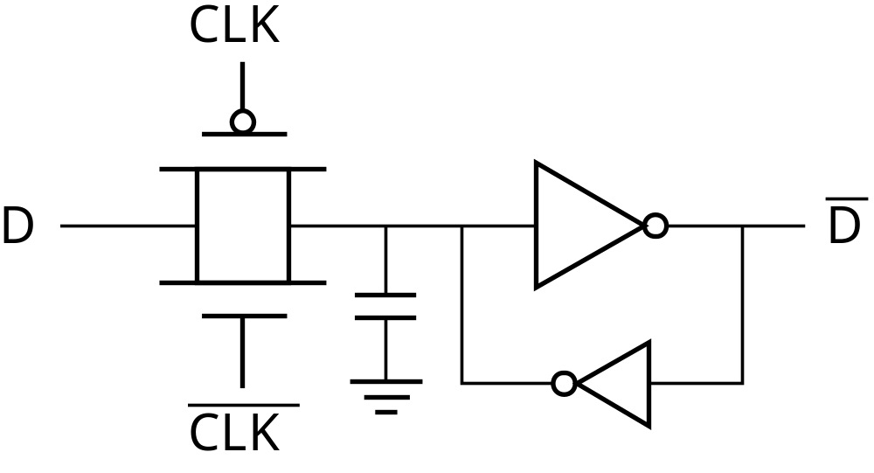
Making a Dynamic Latch Pseudo-Static

Slide 27
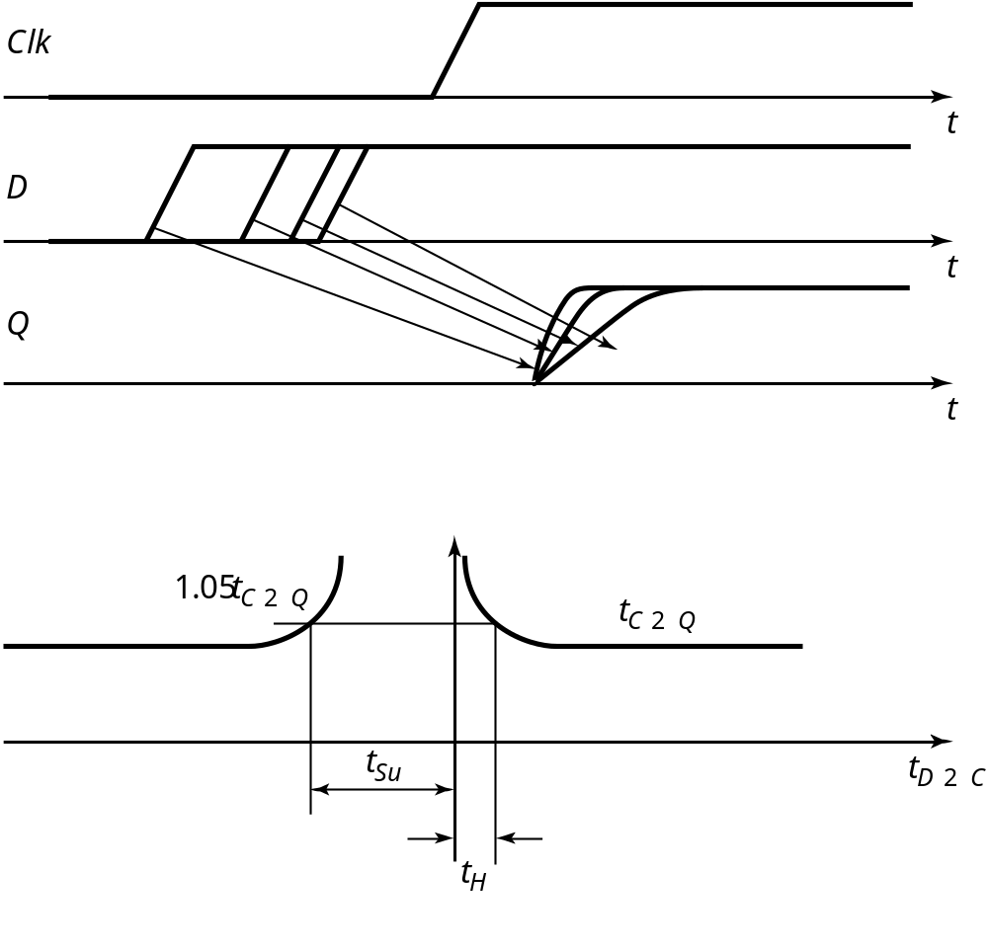
More Precise Setup Time

Slide 28
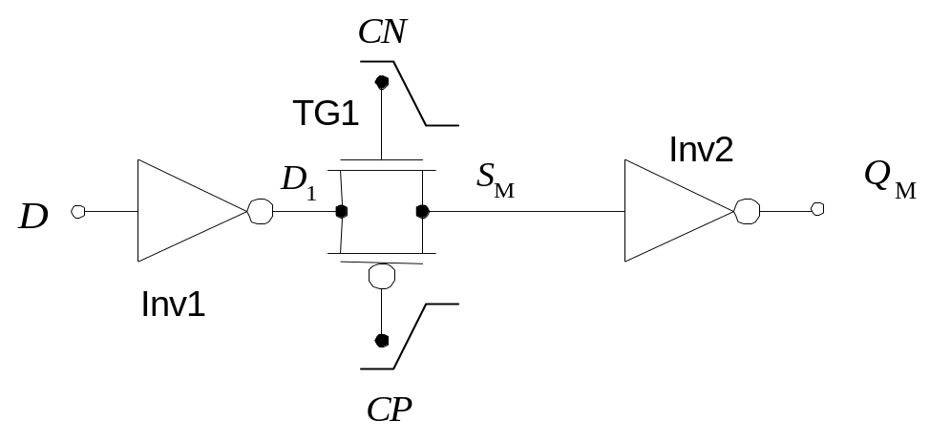
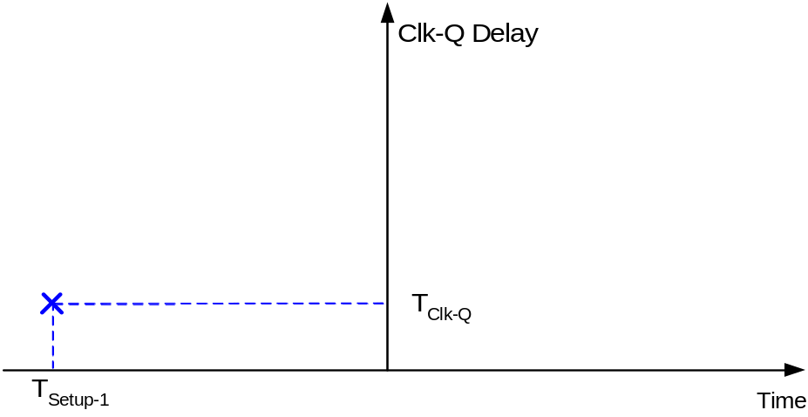
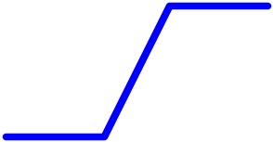
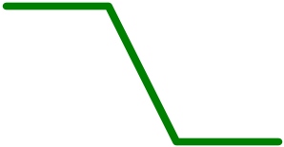
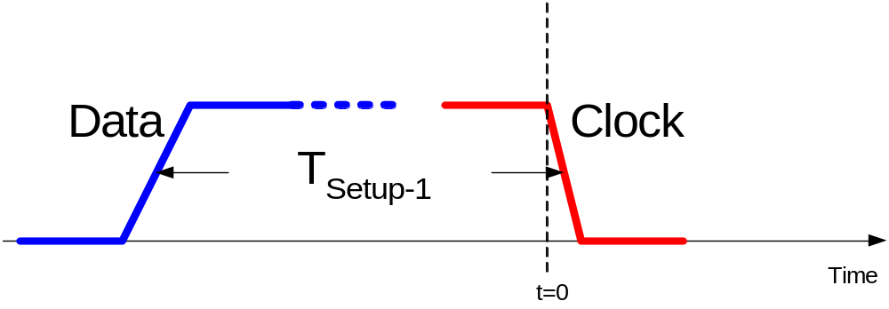
Setup/Hold Time Illustrations
Circuit before clock arrival (Setup-1 case)

Slide 29
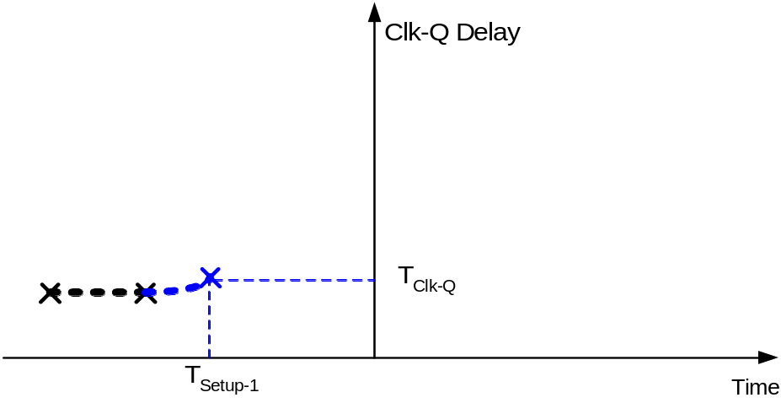
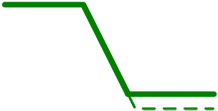
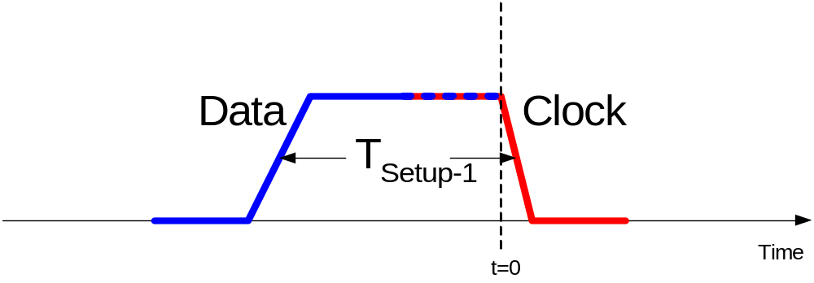
Setup/Hold Time Illustrations
Circuit before clock arrival (Setup-1 case)

Slide 30
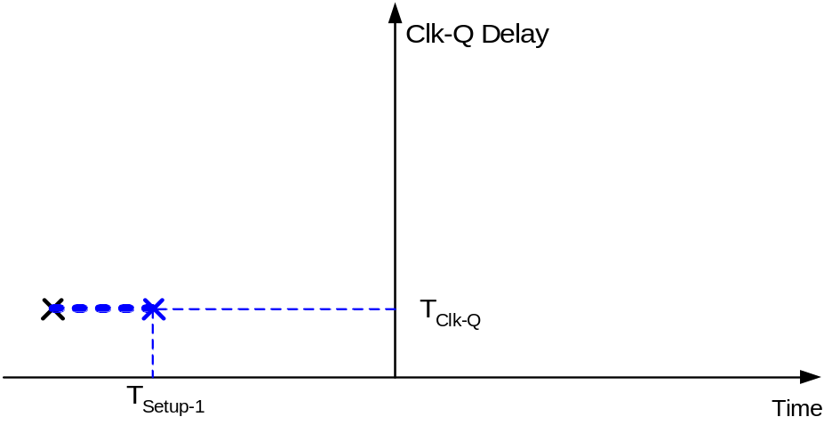
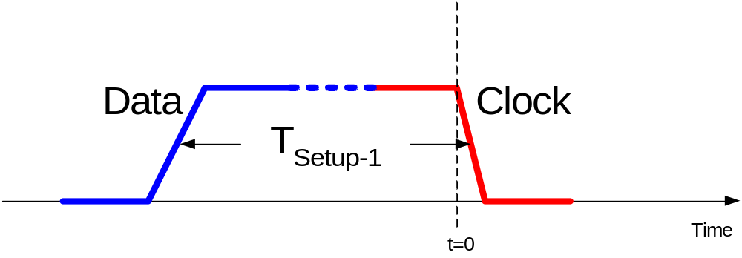
Setup/Hold Time Illustrations
Circuit before clock arrival (Setup-1 case)

Slide 31
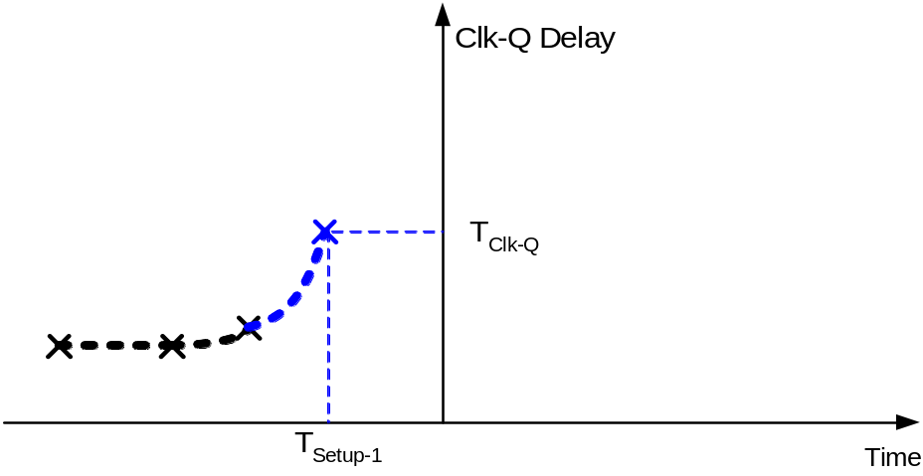
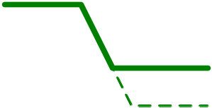
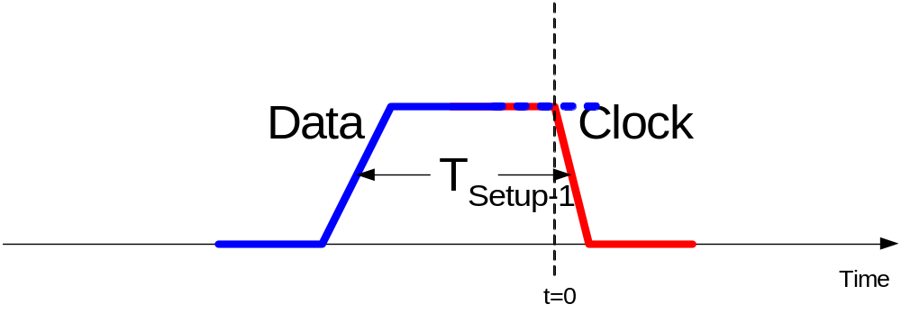
Setup/Hold Time Illustrations
Circuit before clock arrival (Setup-1 case)

Slide 32
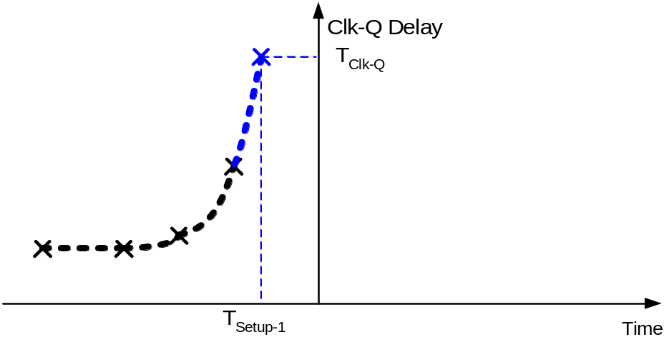
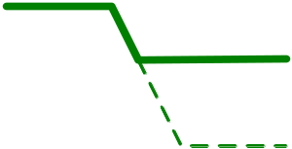
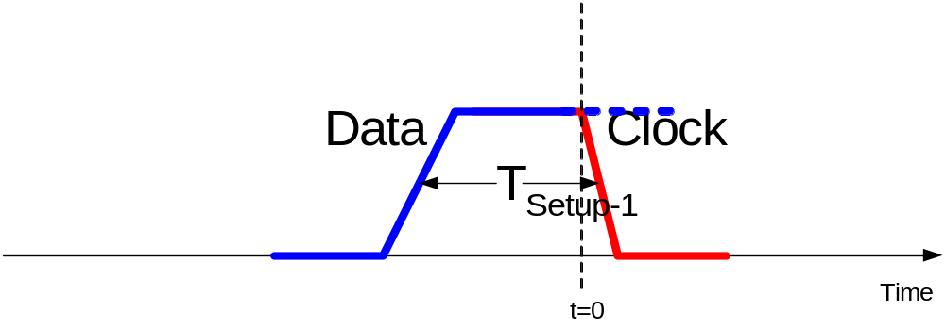
Setup/Hold Time Illustrations
Circuit before clock arrival (Setup-1 case)

Slide 33
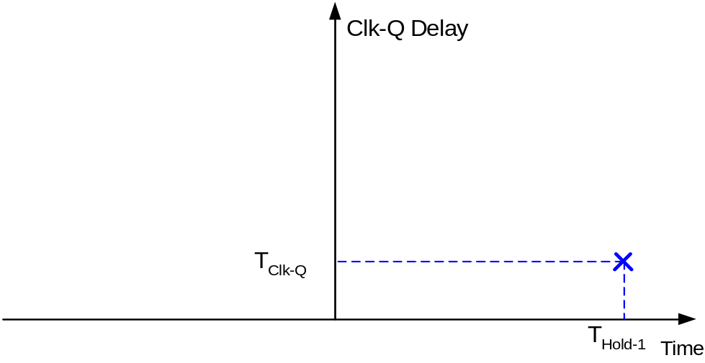
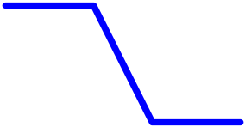
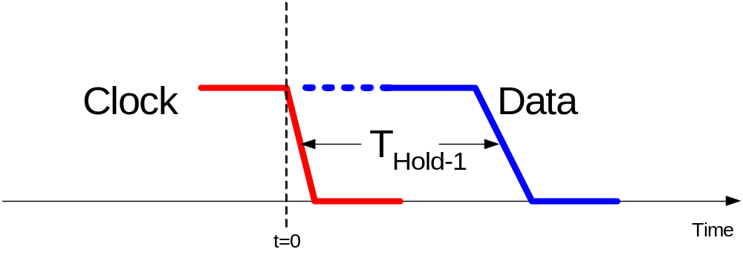
Setup/Hold Time Illustrations
Hold-1 case
0

Slide 34
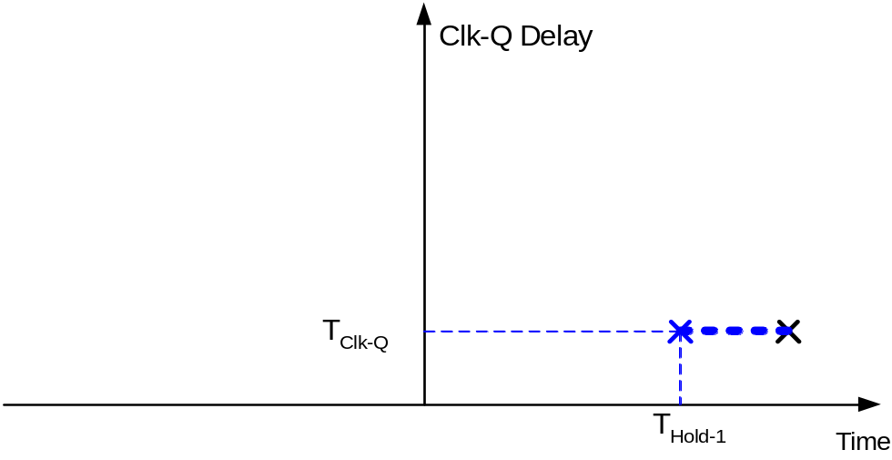
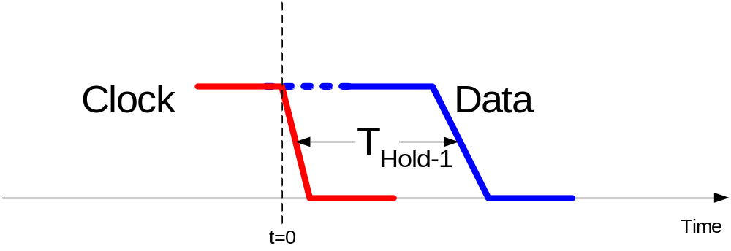
Setup/Hold Time Illustrations
Hold-1 case
0

Slide 35
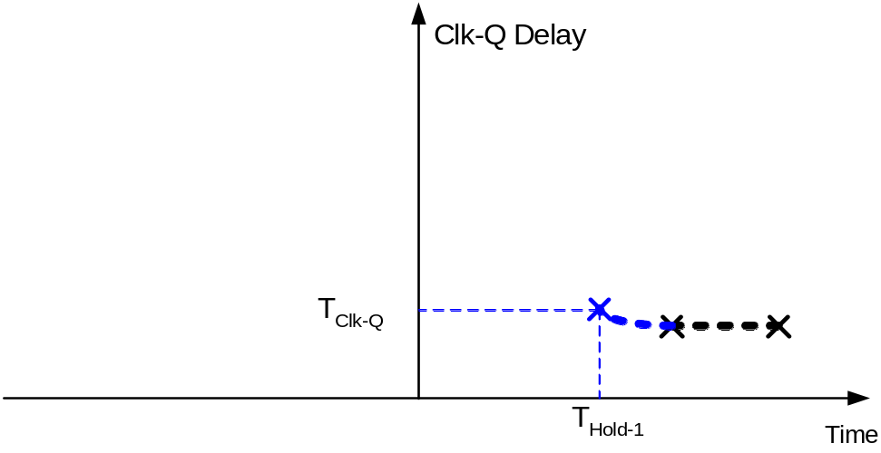
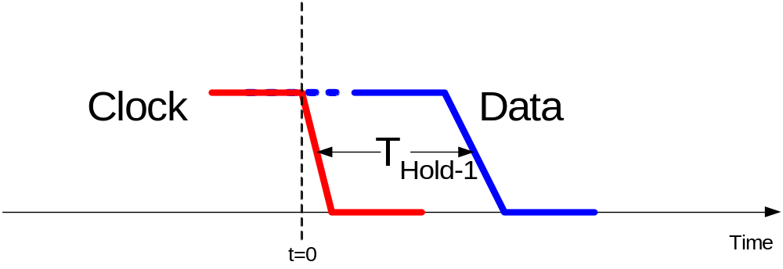
Setup/Hold Time Illustrations
Hold-1 case
0

Slide 36
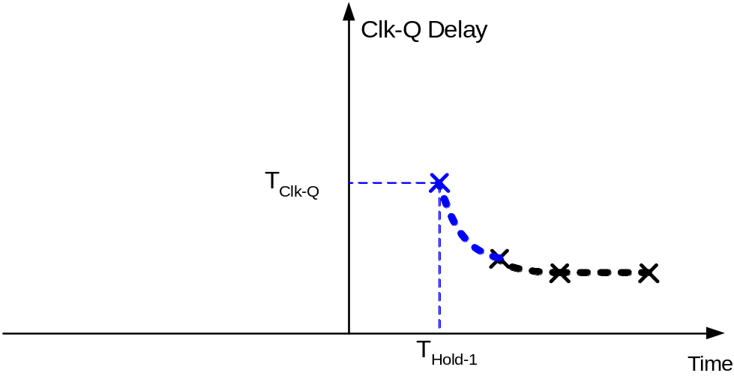

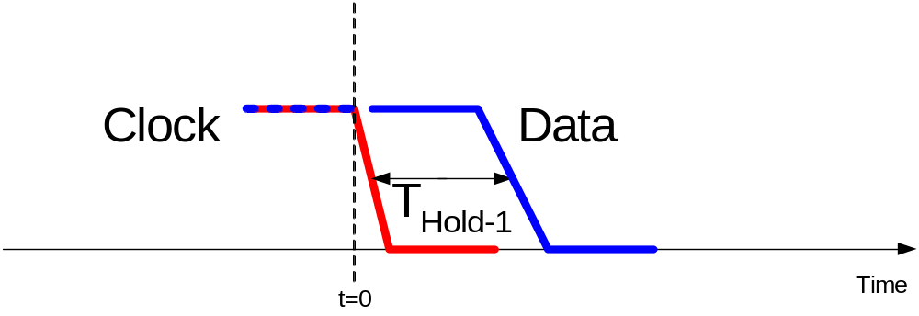
Setup/Hold Time Illustrations
Hold-1 case
0

Slide 37
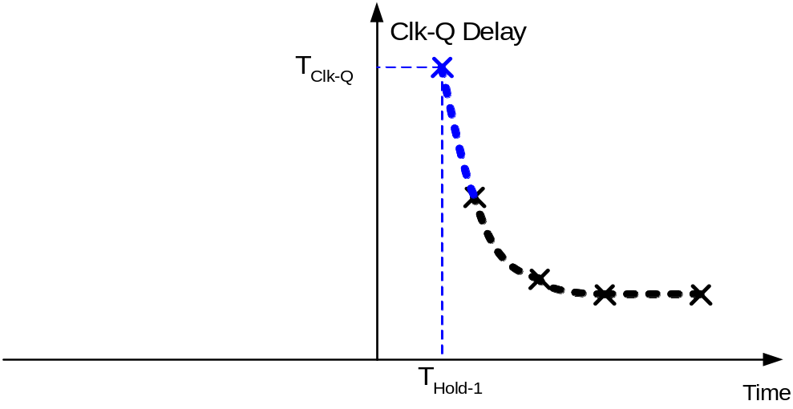

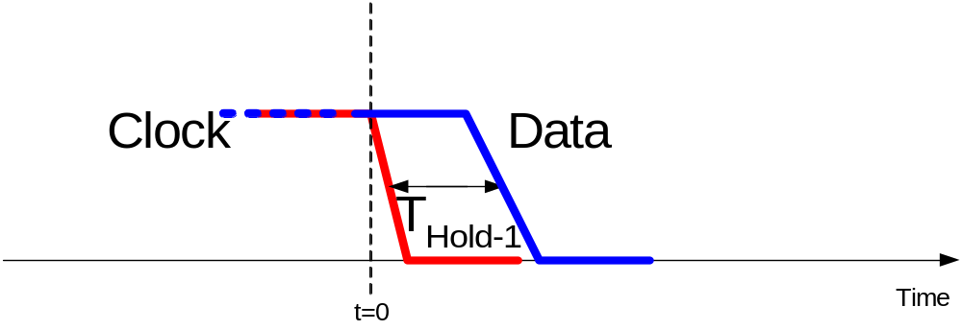

Setup/Hold Time Illustrations
Hold-1 case
0

Slide 38
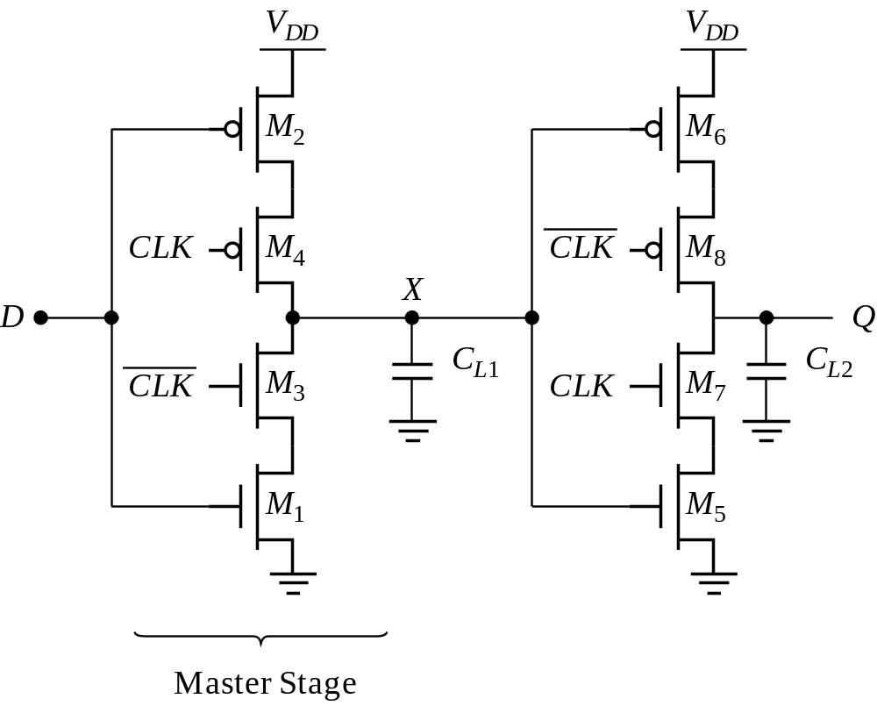
Other Latches/Registers: C²MOS
“Keepers” can be added to make circuit pseudo-static

Slide 39
Insensitive to Clock-Overlap
V
DD
V
DD
V
DD
V
DD
M
2
M
6
M
2
M
6
0
M
4
0
M
8
X
X
D
Q
D
Q
1
M
3
1
M
7
M
1
M
5
M
1
M
5
(a) (0-0) overlap
(b) (1-1) overlap

Slide 40
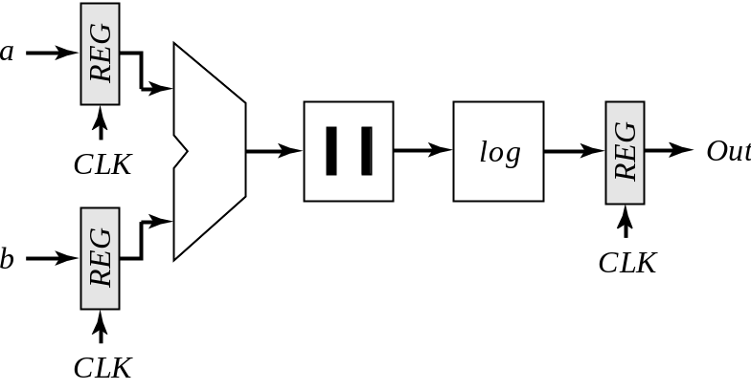
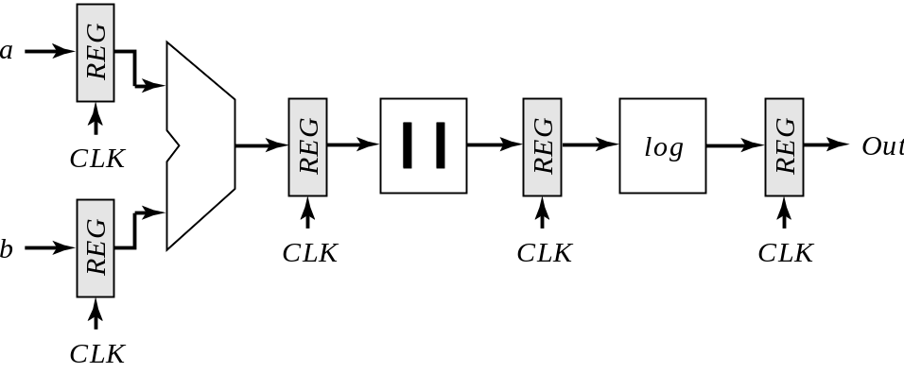
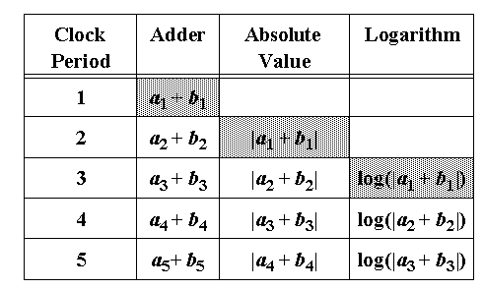
Pipelining
Reference
Pipelined

Slide 41

Other Latches/Registers: TSPC
Positive latch
(transparent when CLK= 1)
Negative latch
(transparent when CLK= 0)

Slide 42

Including Logic in TSPC
Example: logic inside the latch
AND latch

Slide 43

TSPC Register

Slide 44
Pulse-Triggered Latches
An Alternative Approach
Ways to design an edge-triggered sequential cell:
Master-Slave Latches
Pulse-Triggered Latch
L1
L2
L
Data
Data
D
Q
D
Q
D
Q
Clk
Clk
Clk
Clk
Clk

Slide 45

Pulsed Latches

Slide 46

Pulsed Latches
Hybrid Latch – Flip-flop (HLFF), AMD K-6 and K-7 :

Slide 47

Hybrid Latch-FF Timing

Slide 48

Latch-Based Pipeline

Slide 49


Non-Bistable Sequential Circuits─
Schmitt Trigger
VTC with hysteresis
Restores signal slopes

Slide 50

Noise Suppression using Schmitt Trigger

Slide 51

CMOS Schmitt Trigger
Moves switching threshold
of the first inverter

Slide 52
Schmitt Trigger Simulated VTC
2.5
2.5
2.0
2.0
1.5
V
M
1
1.5
(V)
(V)
X
1.0
V
x
1.0
V
M
2
V
k
= 1
k
= 3
0.5
0.5
k
= 2
k
= 4
0.0
0.0
0.5
1.0
1.5
2.0
2.5
0.0
0.0
0.5
1.0
1.5
2.0
2.5
V
in
(V)
V
in
(V)
Voltage-transfer characteristics with hysteresis.
The effect of varying the ratio of the
PMOS device
M
. The width is
k
* 0.5 m.
4
m

Slide 53

CMOS Schmitt Trigger (2)

Slide 54

Multivibrator Circuits

Slide 55

Transition-Triggered Monostable

Slide 56

Monostable Trigger (RC-based)

Slide 57

Astable Multivibrators (Oscillators)
0
1
2
N-1
Ring Oscillator
simulated response of 5-stage oscillator

Slide 58

Relaxation Oscillator

Slide 59

Voltage Controller Oscillator (VCO)

Slide 60
Differential Delay Element and VCO
V
o
2
V
o
1
v
3
in
v
1
1
in
2
v
2
v
4
V
ctrl
delay cell
two stage VCO
3.0
2.5
V
1
V
2
V
3
V
4
2.0
1.5
1.0
0.5
0.0
2
0.5
0.5
1.5
2.5
3.5
time (ns)
simulated waveforms of 2-stage VCO

