Slide 1
VLSI TERM PROJECT
Professor: Jin Sang Kim
Pham Thi Nhan 2017315465
Nguyen Cong Luong 2017315445
Duong Duc Nha 2017315446

Slide 2
Out Line
Introduction
Front-End design
Top Level design
Logic Synthesis
Synthesize simulation
Back-End design
Design and Timing Setup
Floor planning
Placement
Clock Tree Synthesis
Routing
Design for Manufacturing

Slide 3
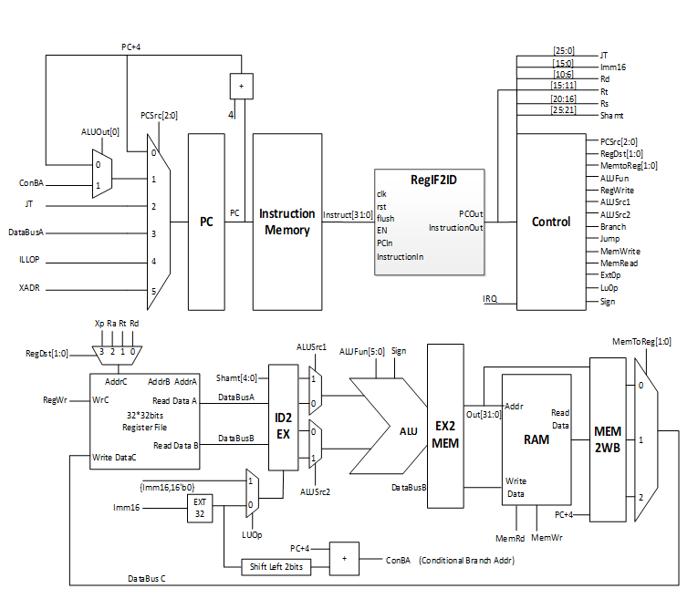
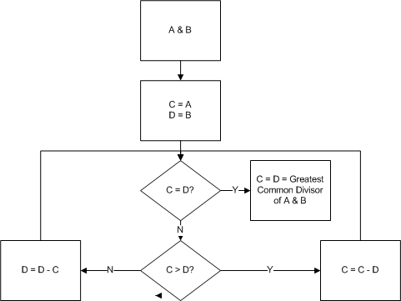
Introduction

Slide 4
Front-End Design
Top Level design
Logic Synthesis
Synthesize simulation

Slide 5
Top Level Design
Block | Function
IF | Implement jump/branch command
InstructionMem | Contain rom code and extract rom data based on PC address
IF2ID | Convert instruction in to instruction out
Control | Obtain code and send commands to other block
Hazard | Process hazard condition/opcode
ID2EX | Convert from instruction command to opcode, address, function
ALU | Implement algorithms like add, subtract, or, xor…
EX2MEM | Convert write/read command to register
datamem | Control obtain and send data through UART interface
digitube | Send data to digi output port
Forward | Forward address for register
Register | RAM, used to save data
Mem2WB | Convert data to write to output port

Slide 6
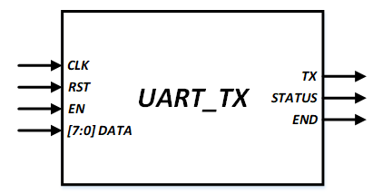
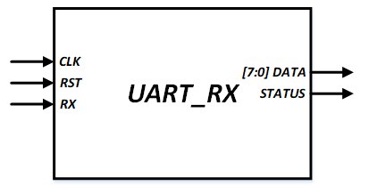
Function Verification: RTL Code
This design is receive and transfer data by UART standard. We need 2 block UART_TX and UART_RX.

Slide 7
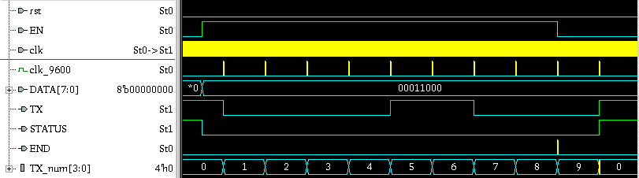
Function Verification: RTL Code
UART_TX
LSB
MSB
0
0
0
0
1
1
0
0
0
1
Pre-amble

Slide 8
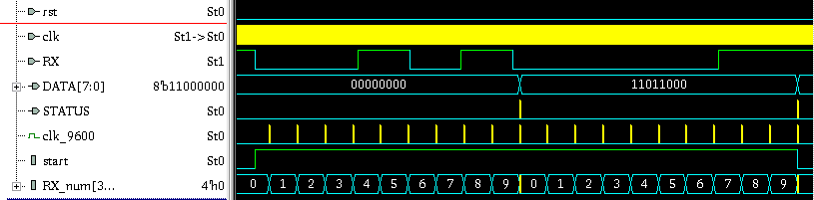
Function Verification: RTL Code
UART_RX
Pre-amble
0
0
0
0
1
1
0
1
1
LSB
MSB

Slide 9
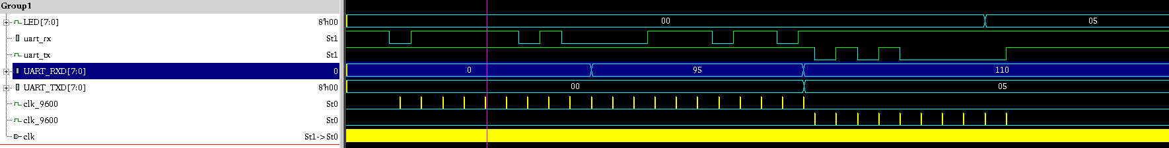
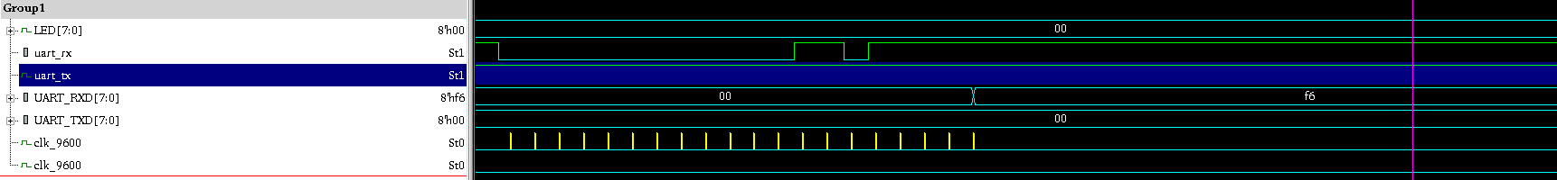
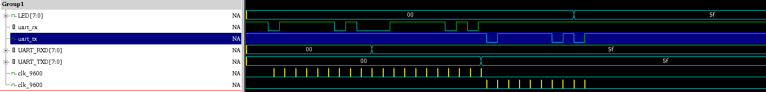
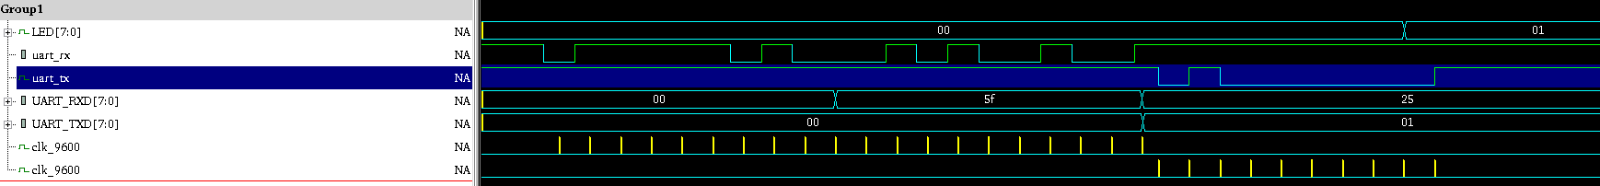
Function Verification: RTL Code
8’h05
Vector 1:
Data1=8’hcd
Data2=8’hff.
Expect 8’h05
8’h00
Vector 2:
Data1=8’0
Data2=8’hf6.
Expect 8’b00
8’h5f
Vector 3:
Data1=8’h5f
Data2=8’h5f.
Expect 8’h5f
8’h01
Vector 4:
Data1=8’h5f
Data2=8’h25.
Expect 8’h01

Slide 10
Logic Synthesis
Adding I/O Pads: The samsung pdk package has 208 pins, all pins should be assigned with pads.
Kinds of Pad:
Input pad: (phic)
Output pad: (phob12)
Power pad (IO-pad vs. core): (vdd33oph , vdd12ih)
Ground pad (IO-pad vs. core): (vssoh, vssiph)

Slide 11
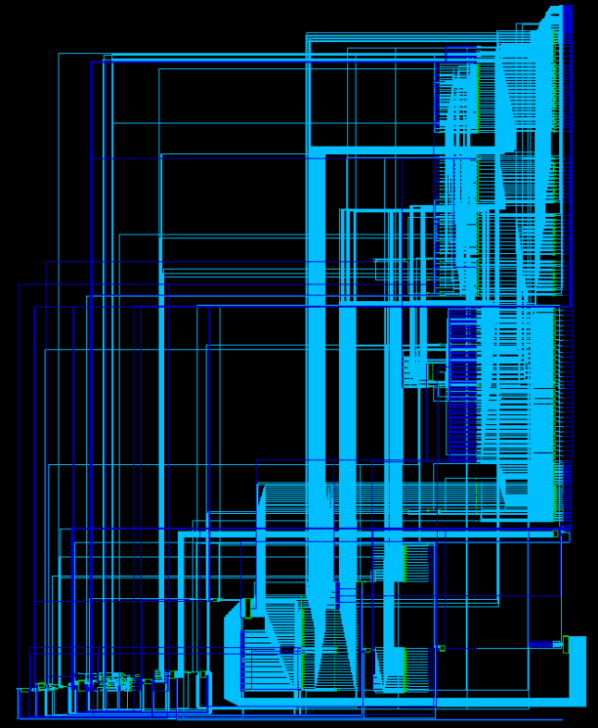
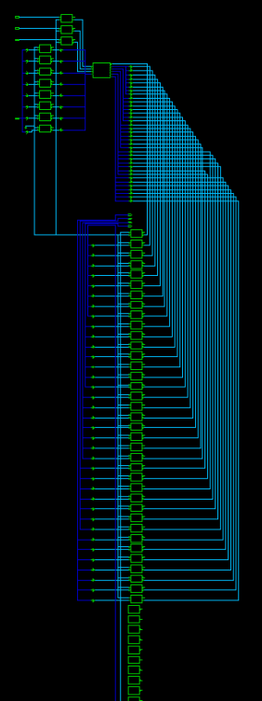
Logic Synthesis
Synthesis CPU
Synthesis CPU with PAD

Slide 12
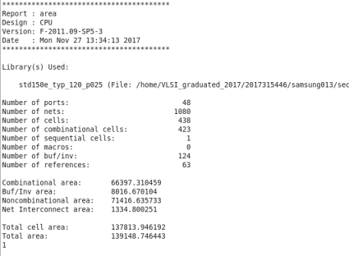
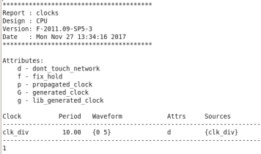
Logic synthesis: Area and Clock report
Total cell area: 137813.946192
Area of our design: (NAND gate) = 1.5
The amount of gates about 91876

Slide 13
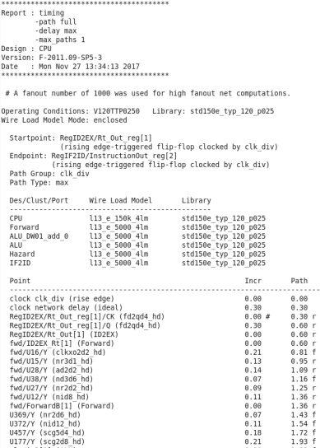
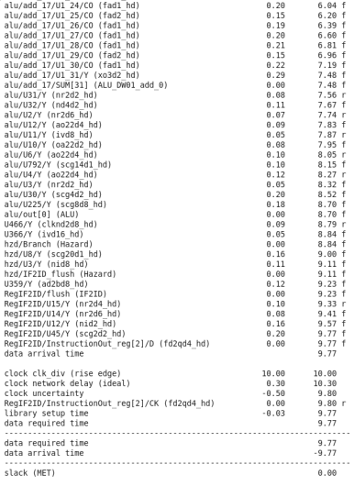
Logic Synthesis: Max delay report

Slide 14
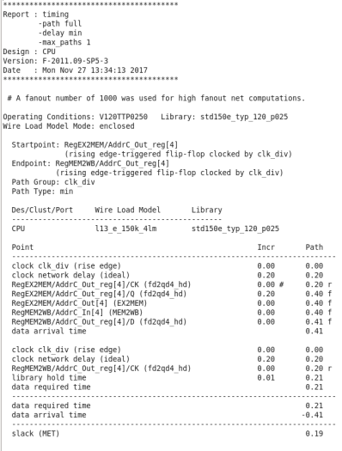
Logic Synthesis: Min delay report

Slide 15
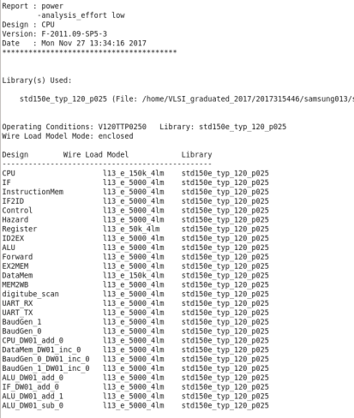
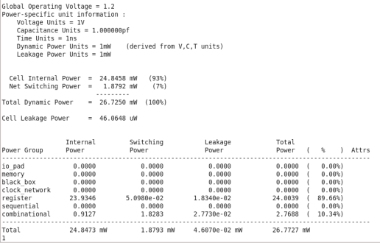
Logic Synthesis: Power report

Slide 16
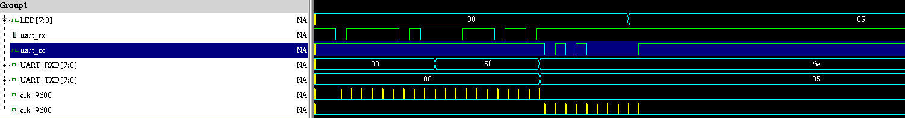
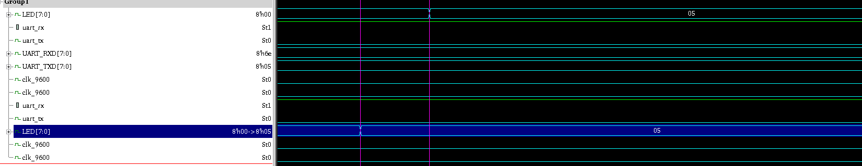
Function Verification
Vector 1: Data 1 < Data 2 (Data 1 = 8’h5f, Data 2 = 8’h6e)
8’h05
Expected data is 8’h05
SYN
RTL

Slide 17
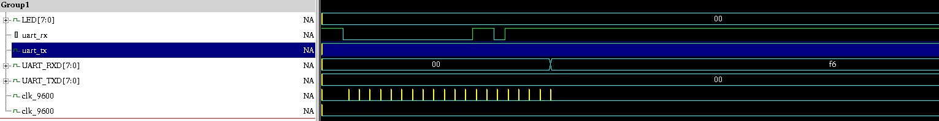
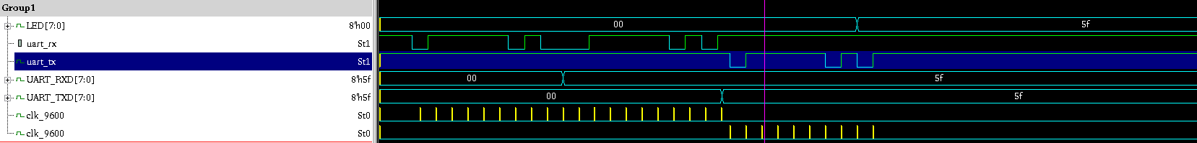
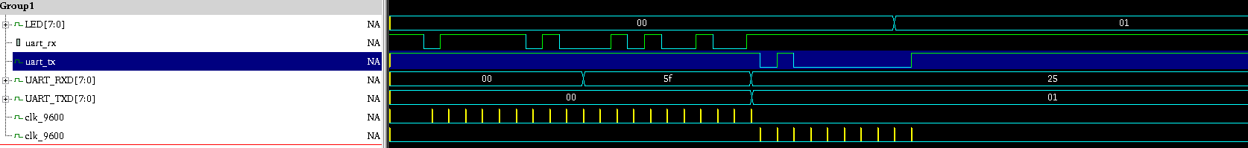
Function Verification
8’h00
Vector 2:
Data1=8’0
Data2=8’hf6.
Expect 8’b00
8’h5f
Vector 3:
Data1=8’h5f
Data2=8’h5f.
Expect 8’h5f
8’h01
Vector 4:
Data1=8’h5f
Data2=8’h25.
Expect 8’h01

Slide 18
Back-End Design
Design and Timing Setup
Floor planning
Placement
Clock Tree Synthesis
Routing
Design for Manufacturing

Slide 19
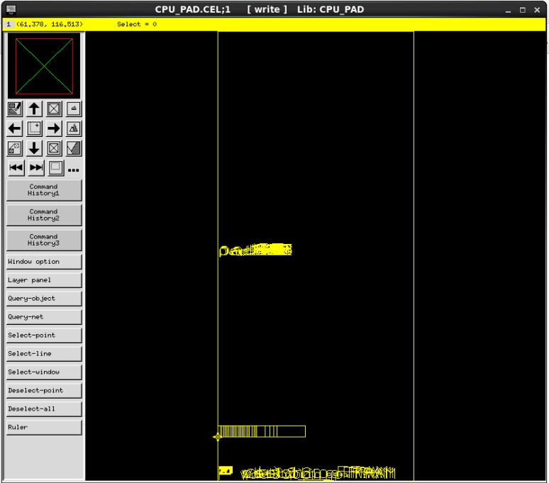
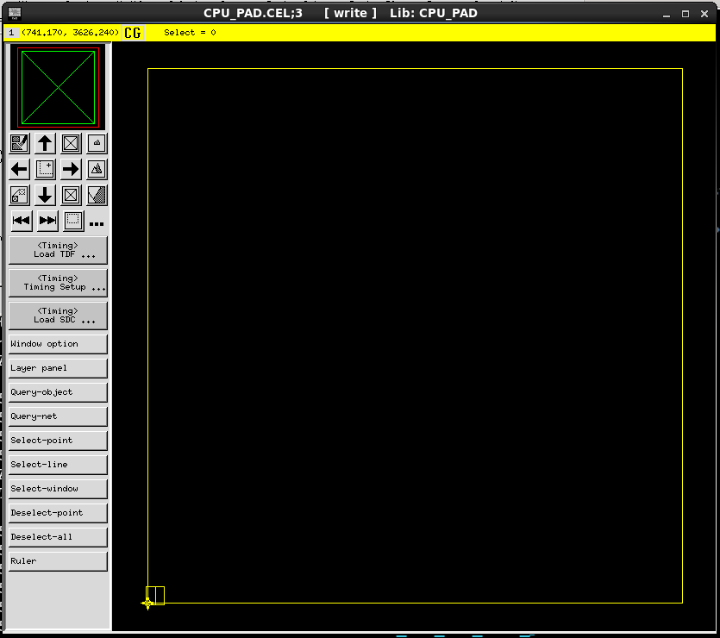

Design and Timing Setup
Load synthesis result
Library setting
Global net setting
Load design, SDC and TDF.
PADs
Cells

Slide 20
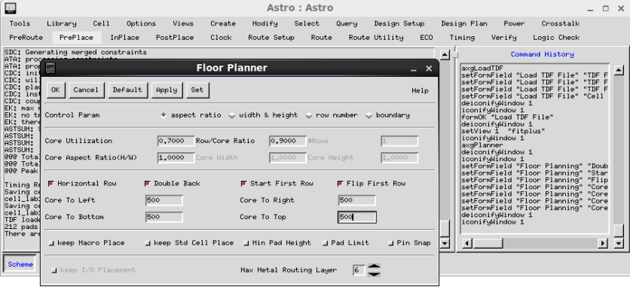
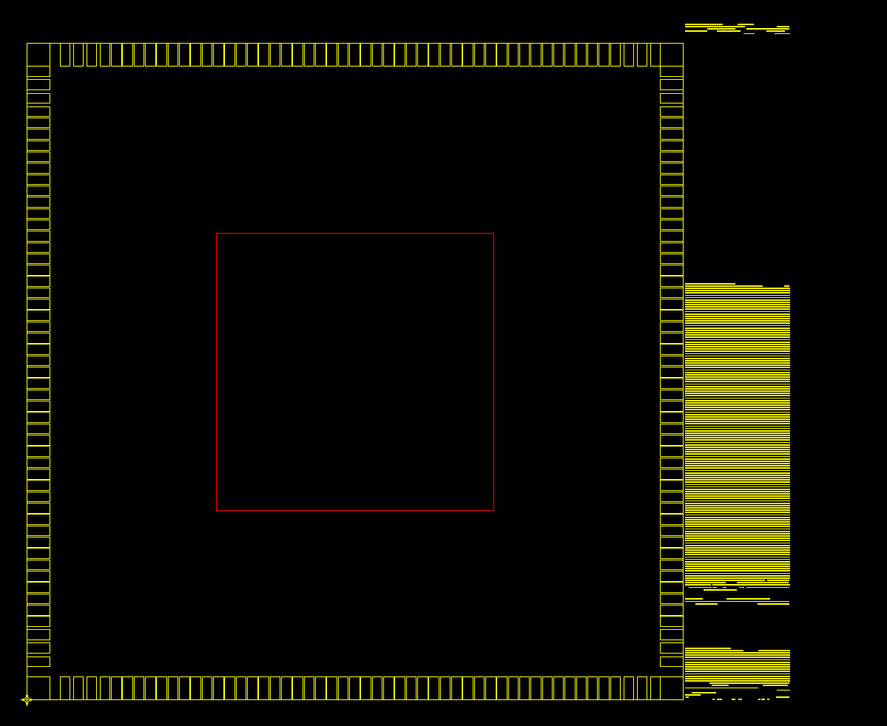
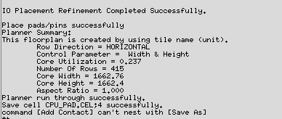
Floor planning: Setup Floorplannig

Slide 21
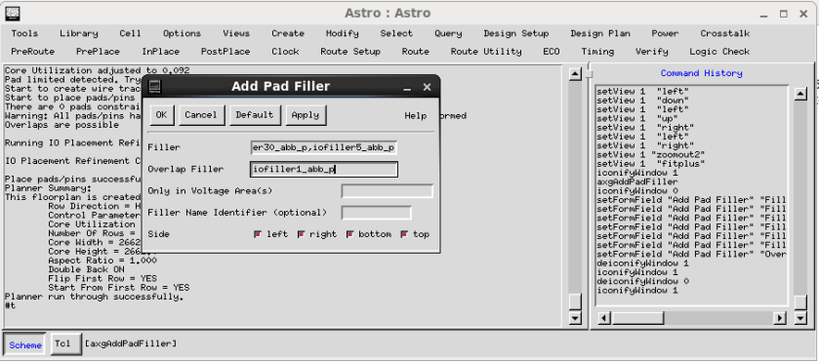
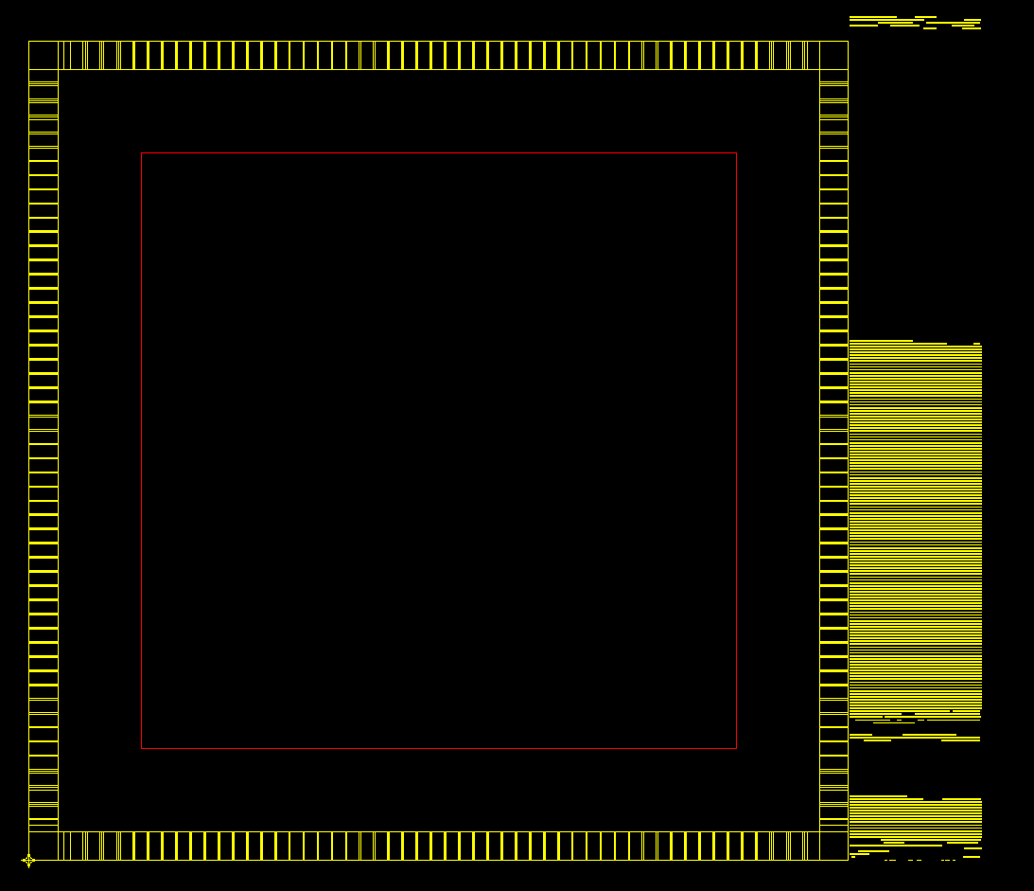

Floor planning: Insert Pad filler

Slide 22
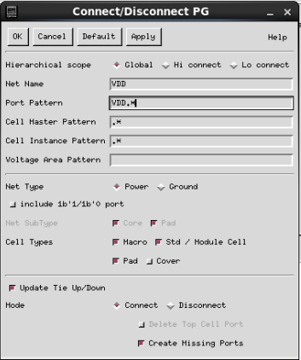
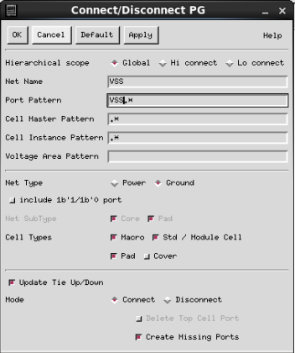


Floor Planning: Connect Ports to PWR/GND

Slide 23
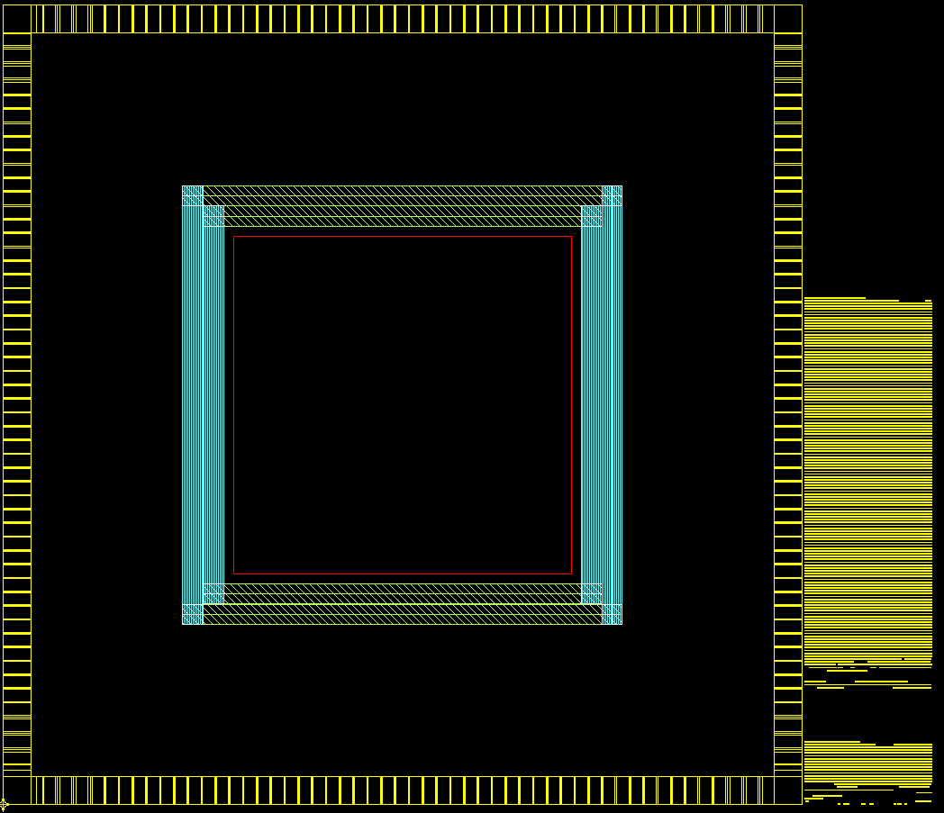
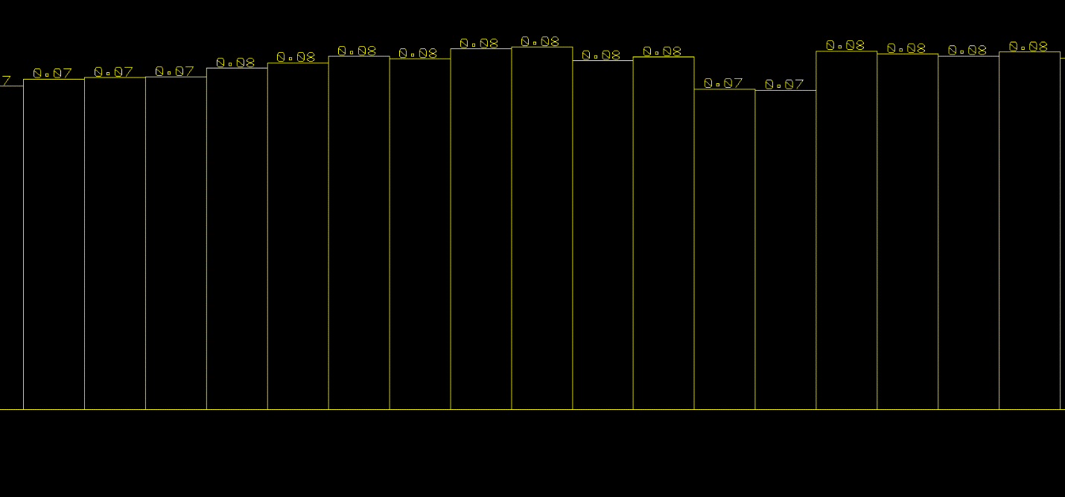
Floor Planning: Create Rectangular Rings

Slide 24
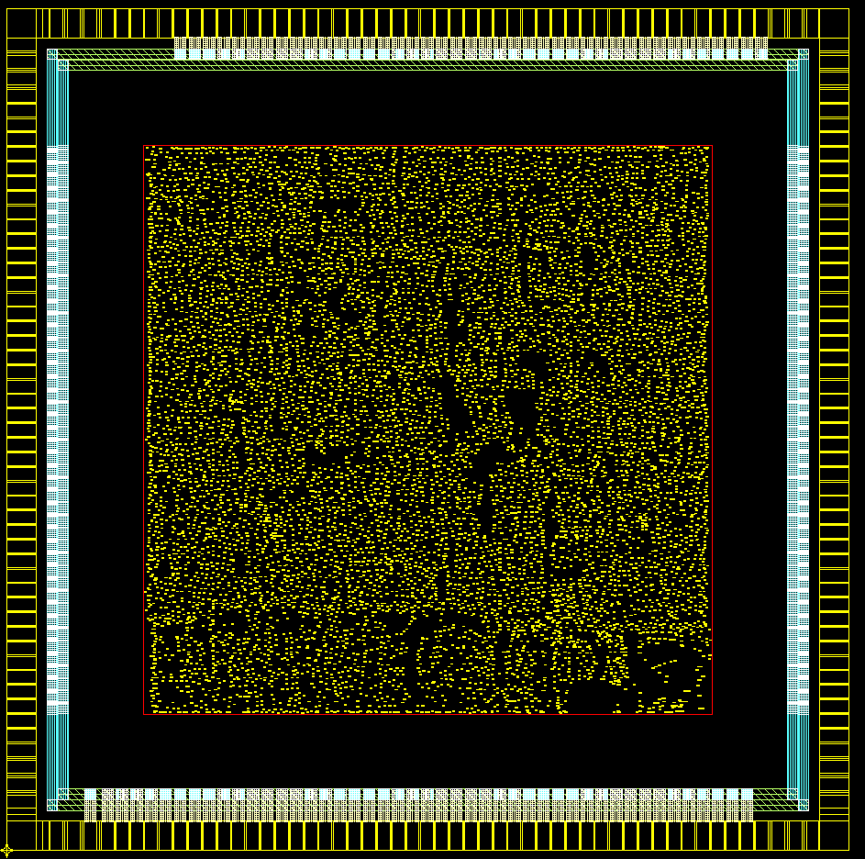
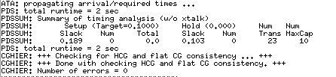
Placement: Place the standard cells

Slide 25
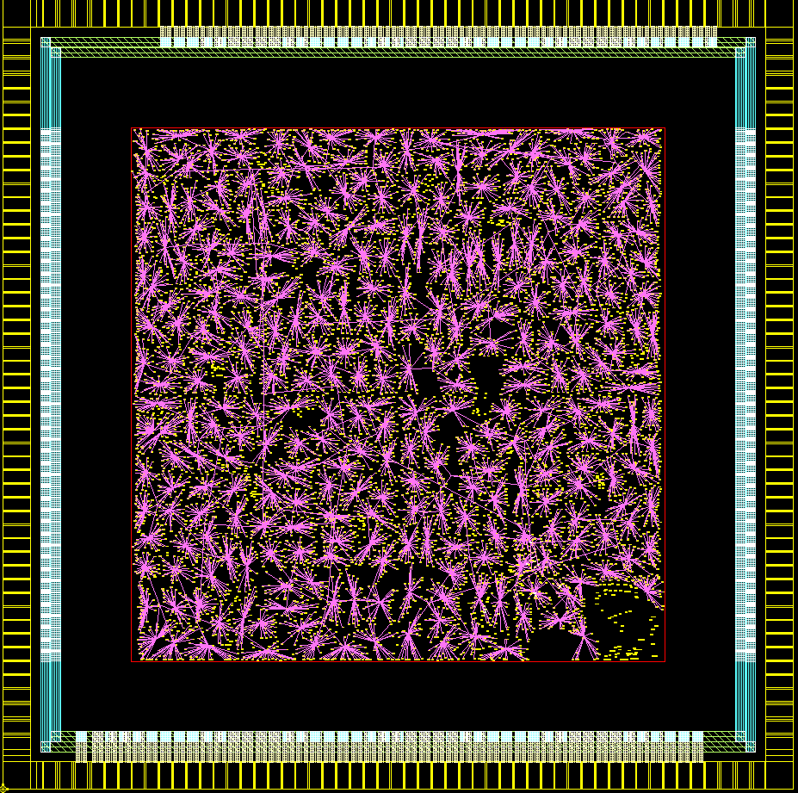

Clock Tress Synthesis

Slide 26
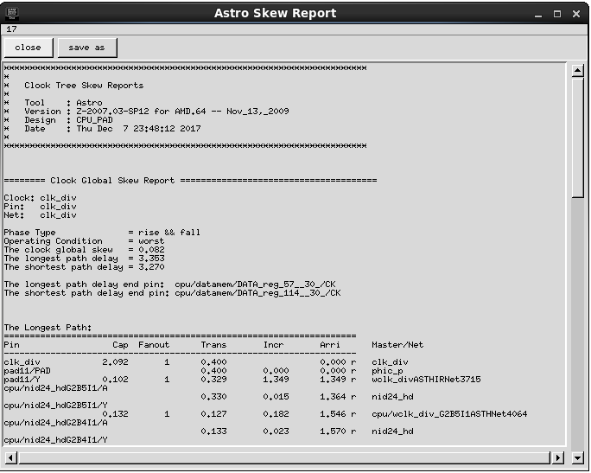
Clock Tree Synthesis: Skew Analysis

Slide 27
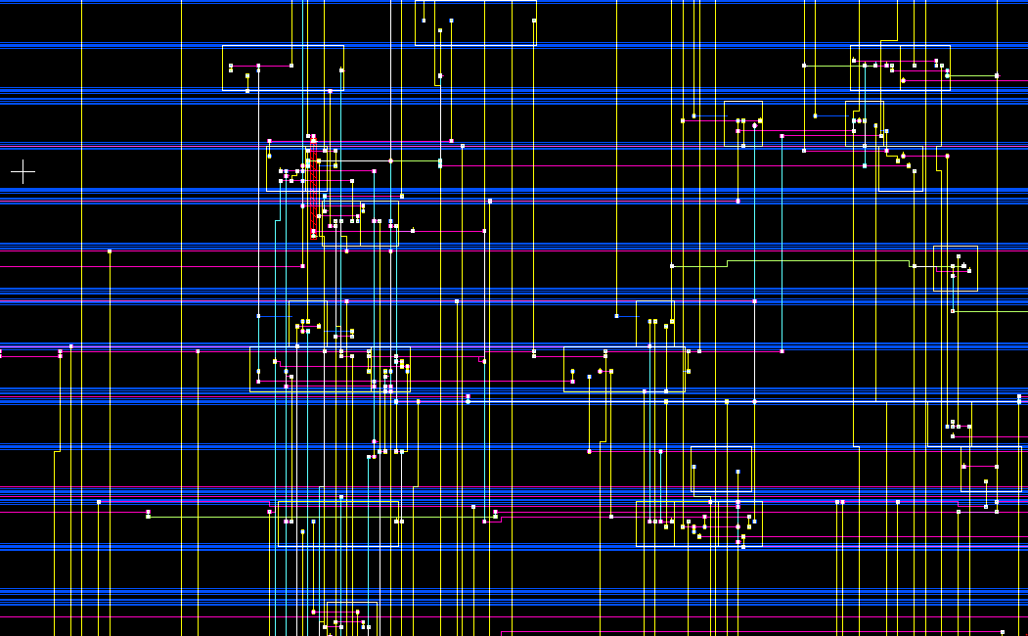

Routing: Detail Route

Slide 28
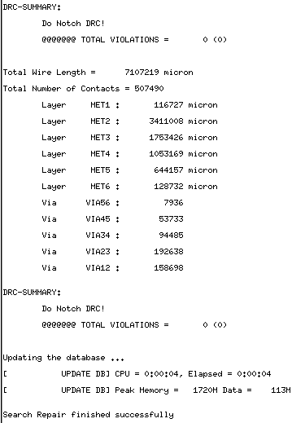
Routing: Search and Repair

Slide 29
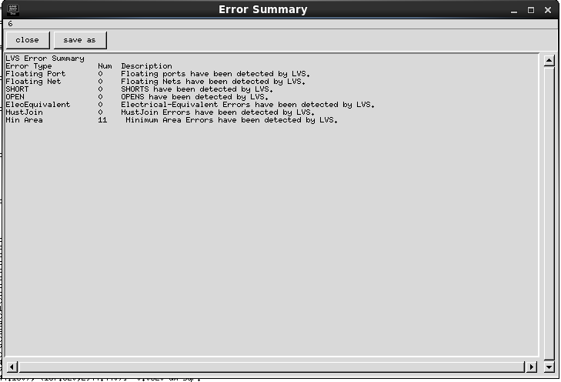
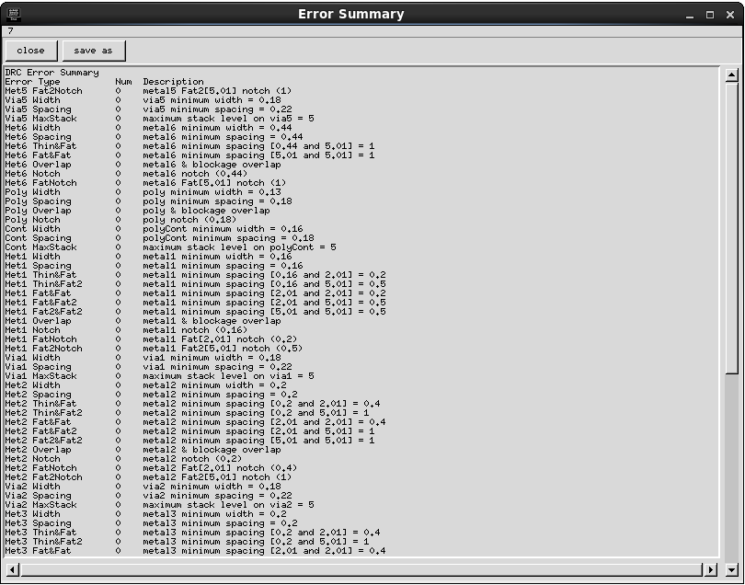
Routing: LVS and DRC Check

Slide 30
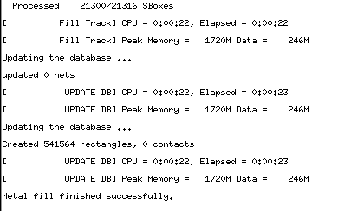
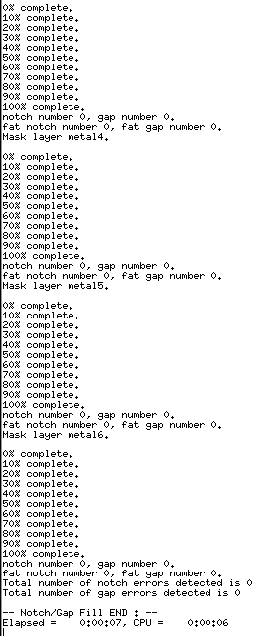
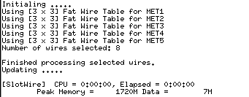

Design for Manufacturing
Slot wire fix
Metal fill result
Notch/Gap Fill results
Adding Wellfiller result

Slide 31
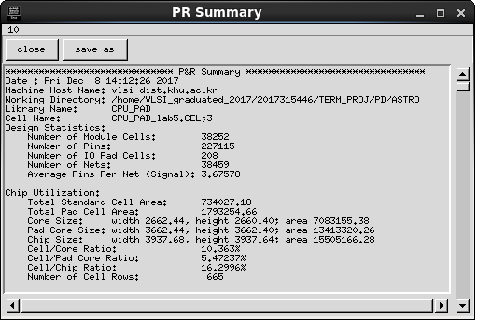
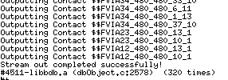
How to get output files
PR Summary
Save the LVS &DRC error report
Delay information extraction (SDF file)
Parasitic Output Extraction (.DSPF)
Netlist file extraction (.v) -> 2 things
GDS file extraction
Stream out success

Slide 32
Datasheet
Update the last page in Report.

Slide 33
Thank You

