Slide 1
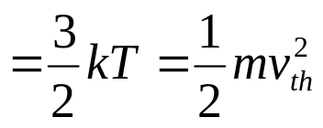
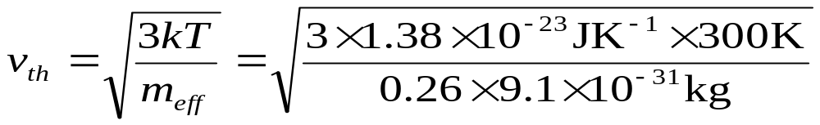

Chapter 2 Motion and Recombination
of Electrons and Holes
2.1 Thermal Motion
Average electron or hole kinetic energy
Modern Semiconductor Devices for Integrated Circuits (C. Hu)
Slide 2-<number>

Slide 2
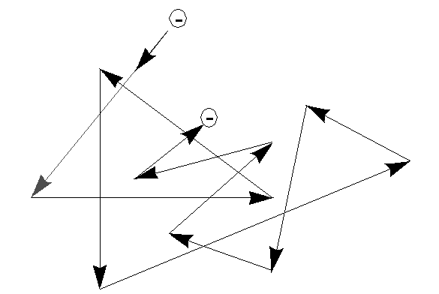
2.1 Thermal Motion
Zig-zag motion is due to collisions or scattering
with imperfections in the crystal.
Net thermal velocity is zero.
Mean time between collisions is τ_{m} ~ 0.1ps
Modern Semiconductor Devices for Integrated Circuits (C. Hu)
Slide 2-<number>

Slide 3
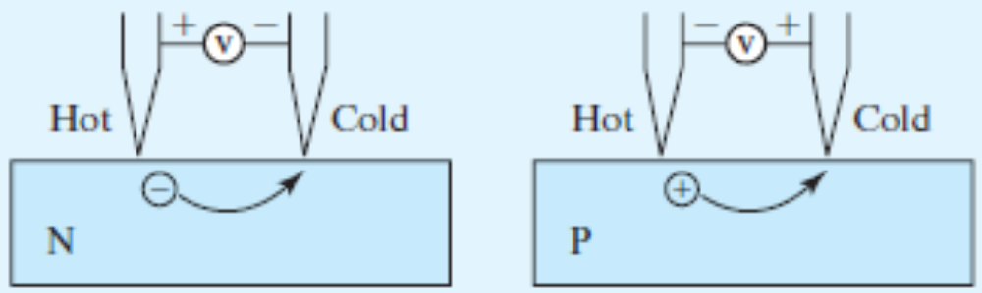
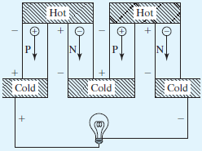
Hot-point Probe can determine sample doing type
Hot-point Probe distinguishes N and P type semiconductors.
Thermoelectric Generator (from heat to electricity ) and Cooler (from electricity to refrigeration)
Modern Semiconductor Devices for Integrated Circuits (C. Hu)
Slide 2-<number>

Slide 4
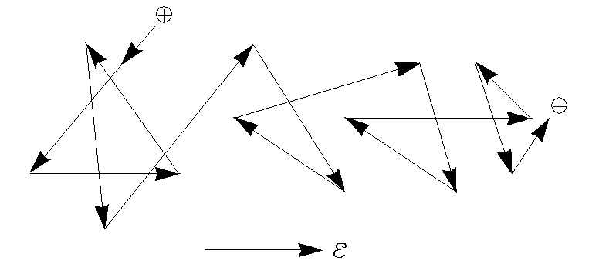
2.2 Drift
2.2.1 Electron and Hole Mobilities
Drift is the motion caused by an electric field.
Modern Semiconductor Devices for Integrated Circuits (C. Hu)
Slide 2-<number>

Slide 5
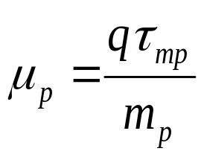
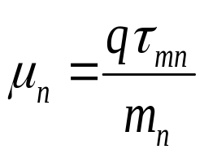
2.2.1 Electron and Hole Mobilities
m
v
=
q
E
τ
p
mp
q
E
τ
v
=
mp
m
p
v
=
μ
E
v
=
−
μ
E
p
n
μ_{p} is the hole mobility and μ_{n} is the electron mobility
Modern Semiconductor Devices for Integrated Circuits (C. Hu)
Slide 2-<number>

Slide 6
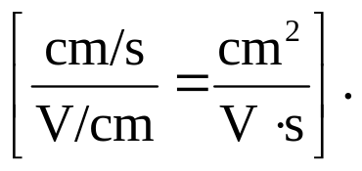
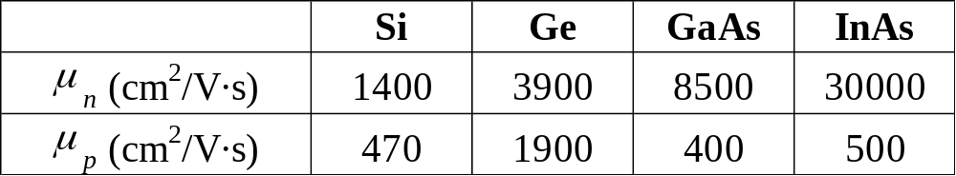
2.2.1 Electron and Hole Mobilities
v =μ E ; μ has the dimensions of v/E
Electron and hole mobilities of selected semiconductors
Based on the above table alone, which semiconductor and which carriers (electrons or holes) are attractive for applications in high-speed devices?
Modern Semiconductor Devices for Integrated Circuits (C. Hu)
Slide 2-<number>

Slide 7
Drift Velocity, Mean Free Time, Mean Free Path
EXAMPLE: Given μ_{p} = 470 cm²/V·s, what is the hole drift velocity at E = 10³ V/cm? What is τ_{mp} and what is the distance traveled between collisions (called the mean free path)? Hint: When in doubt, use the MKS system of units.
Solution: ν = μ_{p}E = 470 cm²/V·s × 10³ V/cm = 4.7× 10⁵ cm/s
τ_{mp} = μ_{p}m_{p}/q =470 cm²/V ·s × 0.39 × 9.1×10⁻³¹ kg/1.6×10⁻¹⁹ C
= 0.047 m²/V ·s × 2.2×10⁻¹² kg/C = 1×10⁻¹³s = 0.1 ps
mean free path = τ_{mh}ν_{th} ~ 1× 10⁻¹³ s × 2.2×10⁷ cm/s
= 2.2×10⁻⁶ cm = 220 Å = 22 nm
This is smaller than the typical dimensions of devices, but getting close.
Modern Semiconductor Devices for Integrated Circuits (C. Hu)
Slide 2-<number>

Slide 8
2.2.2 Mechanisms of Carrier Scattering
There are two main causes of carrier scattering:
  1. Phonon Scattering
  2. Ionized-Impurity (Coulombic) Scattering
Phonon scattering mobility decreases when temperature rises:
μ = qτ/m
∝ T
v_{th} ∝ T^{1/2}
Modern Semiconductor Devices for Integrated Circuits (C. Hu)
Slide 2-<number>

Slide 9
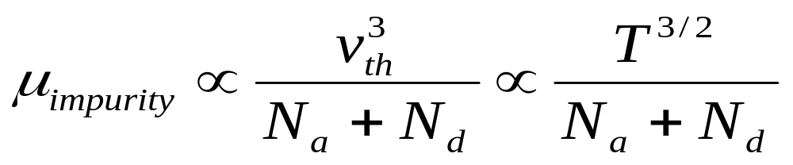
Impurity (Dopant)-Ion Scattering or Coulombic Scattering
Boron Ion
Electron
_
-
-
Electron
+
Arsenic
Ion
There is less change in the direction of travel if the electron zips by
the ion at a higher speed.
Modern Semiconductor Devices for Integrated Circuits (C. Hu)
Slide 2-<number>

Slide 10
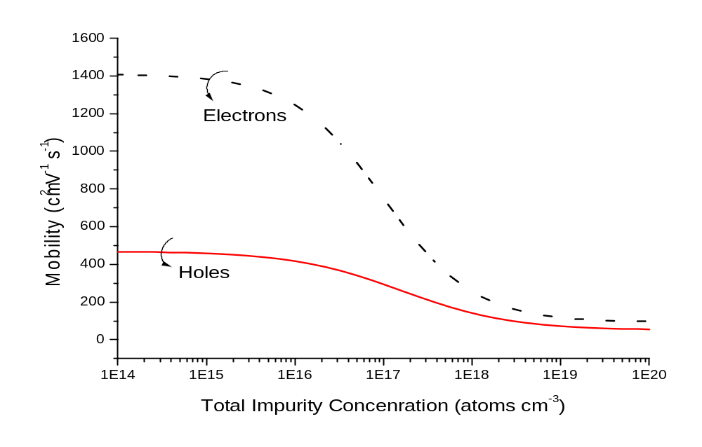
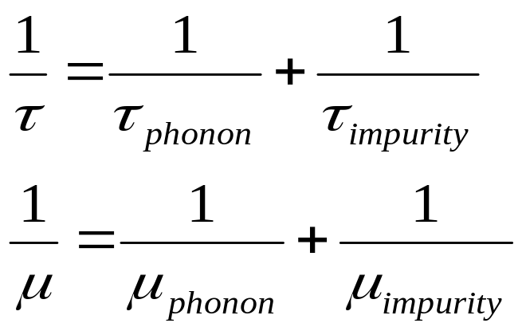
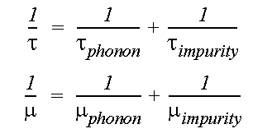
Total Mobility
N_{a} + N_{d} (cm⁻³)
Modern Semiconductor Devices for Integrated Circuits (C. Hu)
Slide 2-<number>

Slide 11
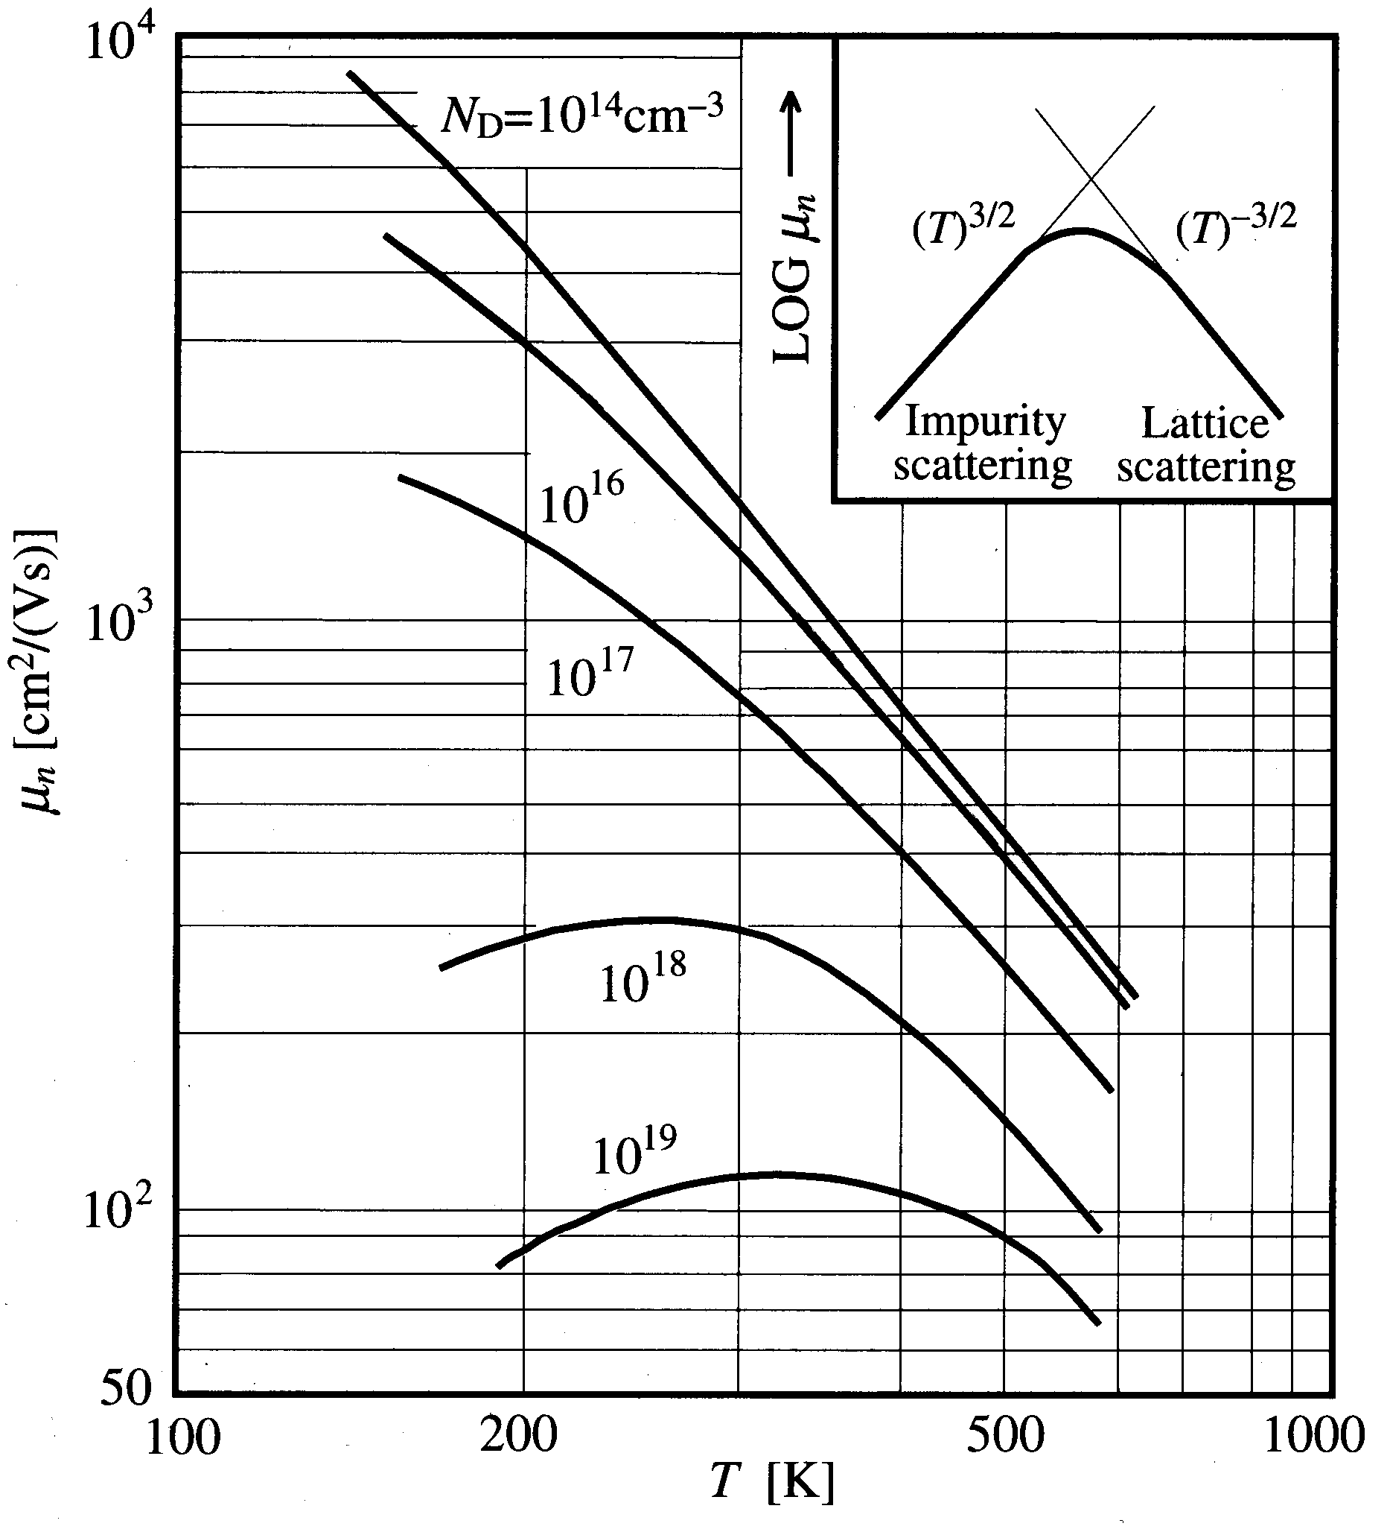


Temperature Effect on Mobility
Question:
What N_{d} will make dμ_{n}/dT = 0 at room temperature?
Modern Semiconductor Devices for Integrated Circuits (C. Hu)
Slide 2-<number>

Slide 12
Velocity Saturation
When the kinetic energy of a carrier exceeds a critical value, it generates an optical phonon and loses the kinetic energy.
Therefore, the kinetic energy is capped at large E, and the velocity does not rise above a saturation velocity, v_{sat} .
Velocity saturation has a deleterious effect on device speed as shown in Ch. 6.
Modern Semiconductor Devices for Integrated Circuits (C. Hu)
Slide 2-<number>

Slide 13

2.2.3 Drift Current and Conductivity
E
J
p
unit
+
area
+
ν
Hole current density
J_{p} = qpv A/cm² or C/cm²·sec
If p = 10¹⁵cm⁻³ and v = 10⁴ cm/s, then
J_{p}= 1.6×10⁻¹⁹C × 10¹⁵cm⁻³ × 10⁴cm/s
=
EXAMPLE:
Modern Semiconductor Devices for Integrated Circuits (C. Hu)
Slide 2-<number>

Slide 14

2.2.3 Drift Current and Conductivity
J_{p,drift} = qpv = qpμ_{p}E
J_{n,drift} = –qnv = qnμ_{n}E
J_{drift} = J_{n,drift} + J_{p,drift} = σ E =(qnμ_{n}+qpμ_{p})E
conductivity (1/ohm-cm) of a semiconductor is σ = qnμ_{n} + qpμ_{p}
1/σ = is resistivity (ohm-cm)
Modern Semiconductor Devices for Integrated Circuits (C. Hu)
Slide 2-<number>

Slide 15
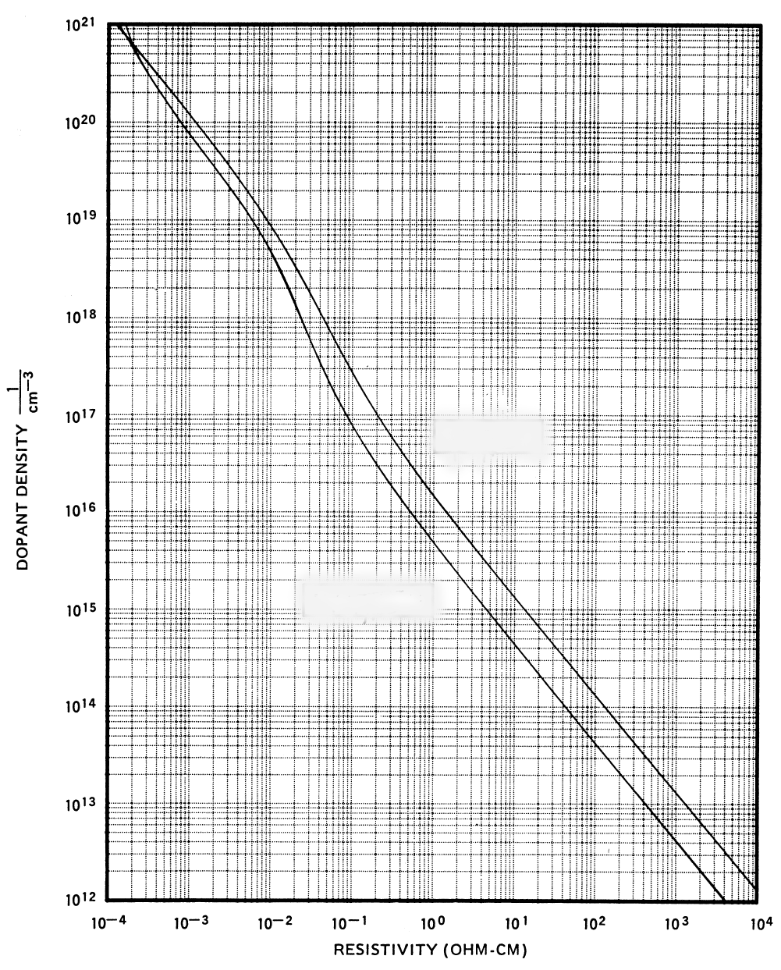
Relationship between Resistivity and Dopant Density
DOPANT DENSITY cm⁻³
P-type
N-type
RESISTIVITY (Ω⋅cm)
ρ = 1/σ
Modern Semiconductor Devices for Integrated Circuits (C. Hu)
Slide 2-<number>

Slide 16
EXAMPLE: Temperature Dependence of Resistance
(a) What is the resistivity (ρ) of silicon doped with 10¹⁷cm⁻³ of arsenic?
(b) What is the resistance (R) of a piece of this silicon material 1μm long and 0.1 μm² in cross-sectional area?
Solution:
(a) Using the N-type curve in the previous figure, we find that ρ = 0.084 Ω-cm.
(b) R = ρL/A = 0.084 Ω-cm × 1 μm / 0.1 μm²
= 0.084 Ω-cm × 10⁻⁴ cm/ 10⁻¹⁰ cm²
= 8.4 × 10⁻⁴ Ω
Modern Semiconductor Devices for Integrated Circuits (C. Hu)
Slide 2-<number>

Slide 17
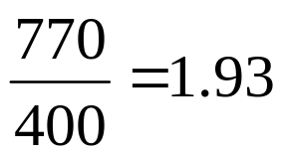
EXAMPLE: Temperature Dependence of Resistance
By what factor will R increase or decrease from T=300 K to T=400 K?
Solution: The temperature dependent factor in σ (and therefore ρ) is μ_{n}. From the mobility vs. temperature curve for 10¹⁷cm⁻³, we find that μ_{n} decreases from 770 at 300K to 400 at 400K. As a result, R increases by
Modern Semiconductor Devices for Integrated Circuits (C. Hu)
Slide 2-<number>

Slide 18
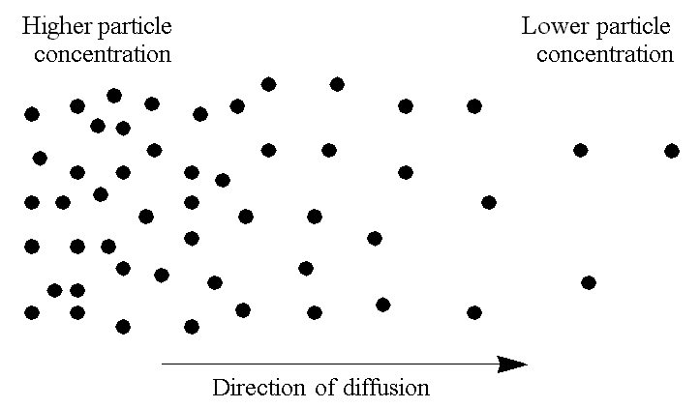
2.3 Diffusion Current
Particles diffuse from a higher-concentration location to a lower-concentration location.
Modern Semiconductor Devices for Integrated Circuits (C. Hu)
Slide 2-<number>

Slide 19
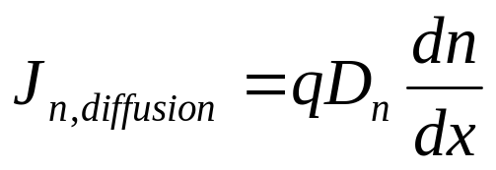
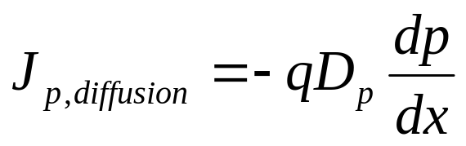
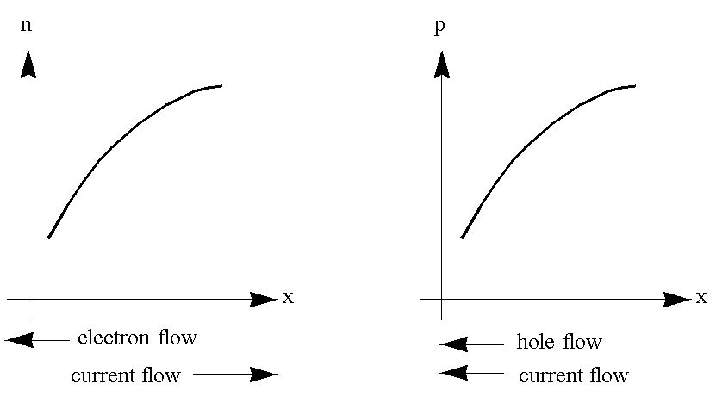
2.3 Diffusion Current
D is called the diffusion constant. Signs explained:
n
p
x
x
Modern Semiconductor Devices for Integrated Circuits (C. Hu)
Slide 2-<number>

Slide 20
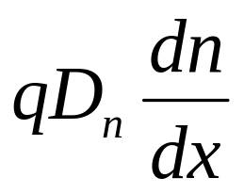
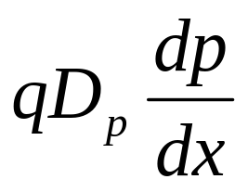
Total Current – Review of Four Current Components
J_{TOTAL} = J_{n} + J_{p}
J_{n} = J_{n,drift} + J_{n,diffusion} = qnμ_{n}E +
J_{p} = J_{p,drift} + J_{p,diffusion} = qpμ_{p}E –
Modern Semiconductor Devices for Integrated Circuits (C. Hu)
Slide 2-<number>

Slide 21
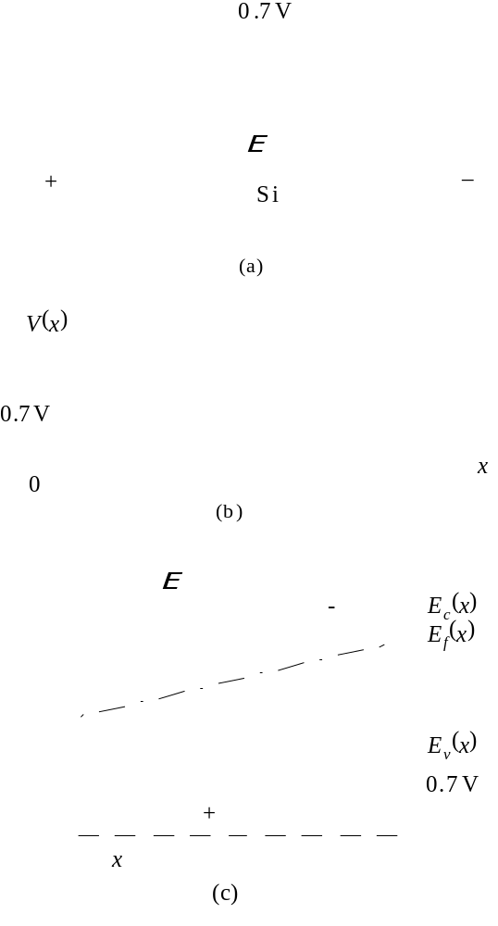
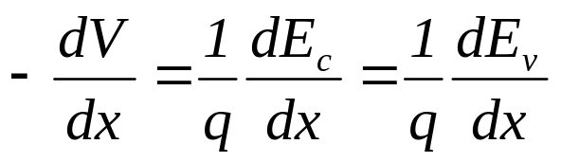
2.4 Relation Between the Energy Diagram and V, E
0.7eV
+
N type Si
–
N-
E_{c} and E_{v} vary in the opposite
direction from the voltage. That
is, E_{c} and E_{v} are higher where the voltage is lower.
E
E
c
(x)
-
E
f
(x)
E
v
(x)
E(x)=
0.7V
+
x
Modern Semiconductor Devices for Integrated Circuits (C. Hu)
Slide 2-<number>

Slide 22
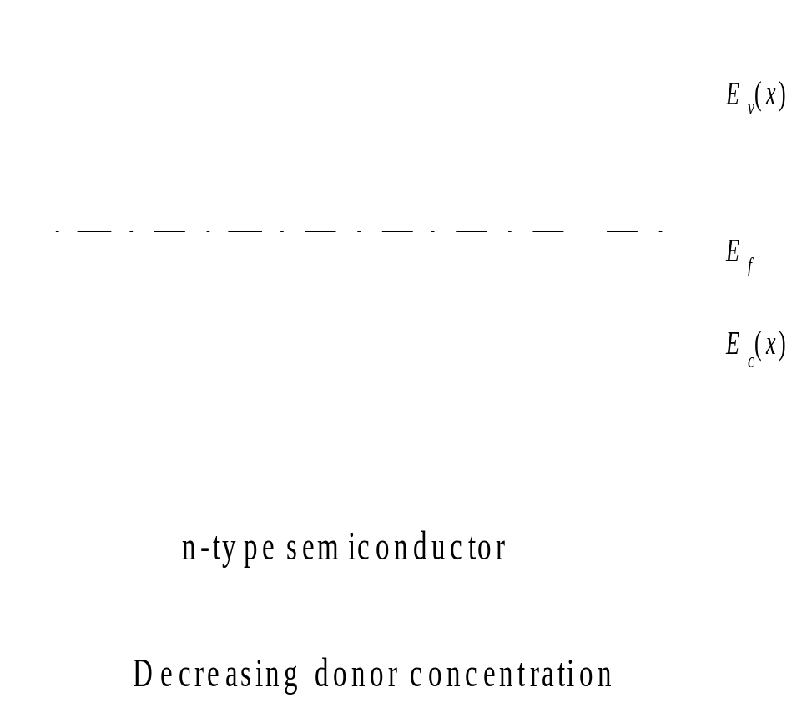
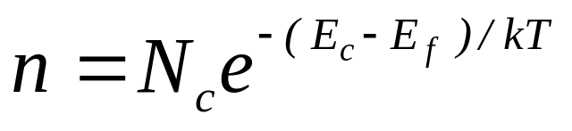

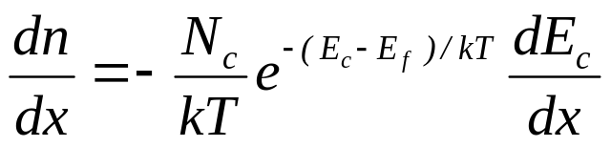
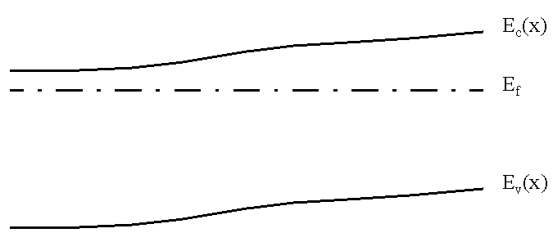
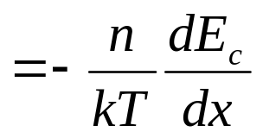
2.5 Einstein Relationship between D and μ
Consider a piece of non-uniformly doped semiconductor.
E_{c}(x)
E_{f}
n
=
−
q
E
E_{v}(x)
kT
Modern Semiconductor Devices for Integrated Circuits (C. Hu)
Slide 2-<number>

Slide 23
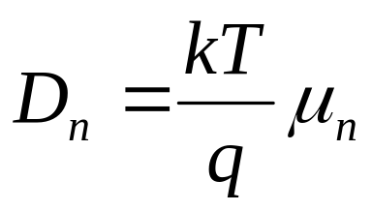
2.5 Einstein Relationship between D and μ
dn
n
=
−
q
E
dx
kT
dn
at equilibrium.
J
=
qn
μ
E
+
qD
=
0
n
n
n
dx
qD
0
=
qn
μ
E
−
qn
n
E
n
kT
kT
Similarly,
D
=
μ
p
q
p
These are known as the Einstein relationship.
Modern Semiconductor Devices for Integrated Circuits (C. Hu)
Slide 2-<number>

Slide 24
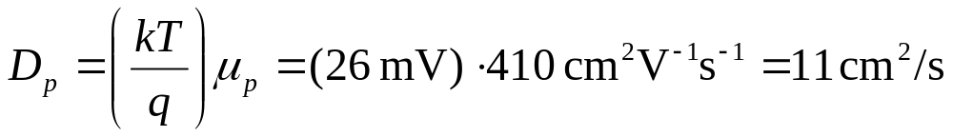
EXAMPLE: Diffusion Constant
What is the hole diffusion constant in a piece of silicon with μ_{p} = 410 cm² V⁻¹s⁻¹ ?
Solution:
Remember: kT/q = 26 mV at room temperature.
Modern Semiconductor Devices for Integrated Circuits (C. Hu)
Slide 2-<number>

Slide 25
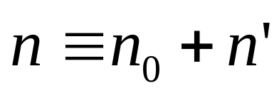
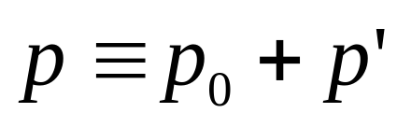
2.6 Electron-Hole Recombination
The equilibrium carrier concentrations are denoted with n₀ and p₀.
The total electron and hole concentrations can be different from n₀ and p₀ .
The differences are called the excess carrier concentrations n’ and p’.
Modern Semiconductor Devices for Integrated Circuits (C. Hu)
Slide 2-<number>

Slide 26
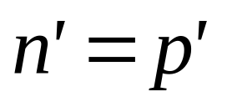
Charge Neutrality
Charge neutrality is satisfied at equilibrium (n’= p’= 0).
When a non-zero n’ is present, an equal p’ may be assumed to be present to maintain charge equality and vice-versa.
If charge neutrality is not satisfied, the net charge will attract or repel the (majority) carriers through the drift current until neutrality is restored.
Modern Semiconductor Devices for Integrated Circuits (C. Hu)
Slide 2-<number>

Slide 27
Recombination Lifetime
Assume light generates n’ and p’. If the light is suddenly turned off, n’ and p’ decay with time until they become zero.
The process of decay is called recombination.
The time constant of decay is the recombination time or carrier lifetime, τ .
Recombination is nature’s way of restoring equilibrium (n’= p’= 0).
Modern Semiconductor Devices for Integrated Circuits (C. Hu)
Slide 2-<number>

Slide 28
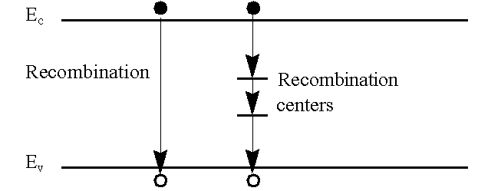
Recombination Lifetime
τ ranges from 1ns to 1ms in Si and depends on the density of metal impurities (contaminants) such as Au and Pt.
These deep traps capture electrons and holes to facilitate recombination and are called recombination centers.
E_{c}
Direct Recombination
is unfavorable in silicon
Recombination
centers
E_{v}
Modern Semiconductor Devices for Integrated Circuits (C. Hu)
Slide 2-<number>

Slide 29
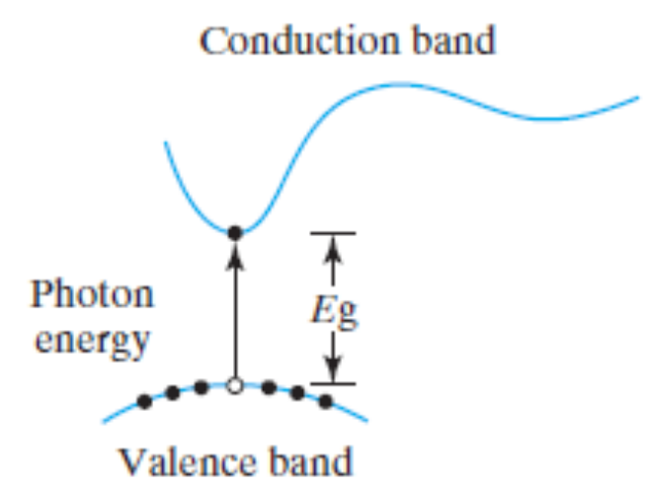
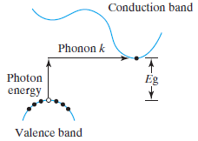
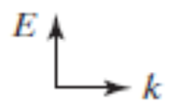
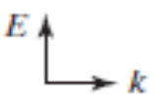
Direct and Indirect Band Gap
Trap
Direct band gap
Example: GaAs
Direct recombination is efficient as k conservation is satisfied.
Indirect band gap
Example: Si
Direct recombination is rare as k conservation is not satisfied
Modern Semiconductor Devices for Integrated Circuits (C. Hu)

Slide 30
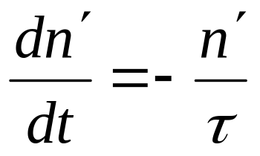
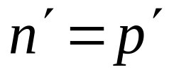
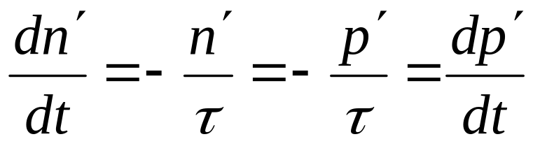
Rate of recombination (s⁻¹cm⁻³)
Modern Semiconductor Devices for Integrated Circuits (C. Hu)
Slide 2-<number>

Slide 31
EXAMPLE: Photoconductors
A bar of Si is doped with boron at 10¹⁵cm⁻³. It is exposed to light such that electron-hole pairs are generated throughout the volume of the bar at the rate of 10²⁰/s·cm³. The recombination lifetime is 10μs. What are (a) p₀ , (b) n₀ , (c) p’, (d) n’, (e) p , (f) n, and (g) the np product?
Modern Semiconductor Devices for Integrated Circuits (C. Hu)
Slide 2-<number>

Slide 32
EXAMPLE: Photoconductors
Solution:
(a) What is p₀?
p₀ = N_{a} = 10¹⁵ cm⁻³
(b) What is n₀ ?
n₀ = n_{i}²/p₀ = 10⁵ cm⁻³
(c) What is p’?
In steady-state, the rate of generation is equal to the rate of recombination.
10²⁰/s-cm³ = p’/τ
∴ p’= 10²⁰/s-cm³ · 10⁻⁵s = 10¹⁵ cm⁻³
Modern Semiconductor Devices for Integrated Circuits (C. Hu)
Slide 2-<number>

Slide 33
EXAMPLE: Photoconductors
(d) What is n’?
n’= p’= 10¹⁵ cm⁻³
(e) What is p?
p = p₀ + p’= 10¹⁵cm⁻³ + 10¹⁵cm⁻³ = 2×10¹⁵cm⁻³
(f) What is n?
n = n₀ + n’= 10⁵cm⁻³ + 10¹⁵cm⁻³ ~ 10¹⁵cm⁻³ since n₀ << n’
(g) What is np?
np ~ 2×10¹⁵cm⁻³ ·10¹⁵cm⁻³ = 2×10³⁰ cm⁻⁶ >> n_{i}² = 10²⁰ cm⁻⁶. The np product can be very different from n_{i}².
Modern Semiconductor Devices for Integrated Circuits (C. Hu)
Slide 2-<number>

Slide 34
2.7 Thermal Generation
If n’ is negative, there are fewer electrons than the equilibrium value.
As a result, there is a net rate of thermal generation at the rate of |n′|/τ .
Modern Semiconductor Devices for Integrated Circuits (C. Hu)
Slide 2-<number>

Slide 35
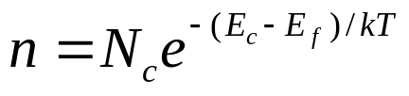
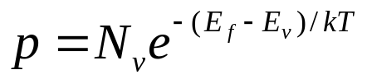
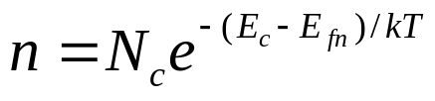
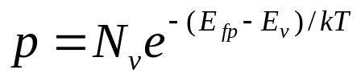
2.8 Quasi-equilibrium and Quasi-Fermi Levels
Whenever n’ = p’ ≠ 0, np ≠ n_{i}². We would like to preserve and use the simple relations:
But these equations lead to np = n_{i}². The solution is to introduce two quasi-Fermi levels E_{fn} and E_{fp} such that
Even when electrons and holes are not at equilibrium, within each group the carriers can be at equilibrium. Electrons are closely linked to other electrons but only loosely to holes.
Modern Semiconductor Devices for Integrated Circuits (C. Hu)
Slide 2-<number>

Slide 36
EXAMPLE: Quasi-Fermi Levels and Low-Level Injection
Consider a Si sample with N_{d}=10¹⁷cm⁻³ and n’=p’=10¹⁵cm⁻³.
(a) Find E_{f} .
n = N_{d} = 10¹⁷ cm⁻³ = N_{c}exp[–(E_{c}– E_{f})/kT]
∴ E_{c}– E_{f} = 0.15 eV. (E_{f} is below E_{c} by 0.15 eV.)
Note: n’ and p’ are much less than the majority carrier
concentration. This condition is called low-level
injection.
Modern Semiconductor Devices for Integrated Circuits (C. Hu)
Slide 2-<number>

Slide 37
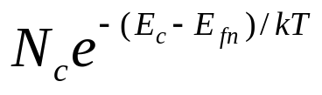
EXAMPLE: Quasi-Fermi Levels and Low-Level Injection
Now assume n′ = p′ = 10¹⁵ cm⁻³.
(b) Find E_{fn} and E_{fp} .
n = 1.01×10¹⁷cm⁻³ =
∴ E_{c}–E_{fn} = kT × ln(N_{c}/1.01×10¹⁷cm⁻³)
= 26 meV × ln(2.8×10¹⁹cm⁻³/1.01×10¹⁷cm⁻³)
= 0.15 eV
E_{fn} is nearly identical to E_{f} because n ≈ n₀ .
Modern Semiconductor Devices for Integrated Circuits (C. Hu)
Slide 2-<number>

Slide 38
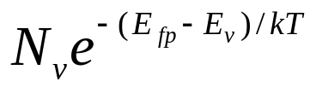
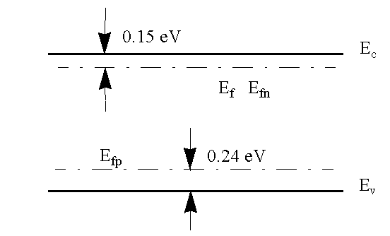
EXAMPLE: Quasi-Fermi Levels
p = 10¹⁵ cm⁻³ =
∴ E_{fp}–E_{v} = kT × ln(N_{v}/10¹⁵cm⁻³)
= 26 meV × ln(1.04×10¹⁹cm⁻³/10¹⁵cm⁻³)
= 0.24 eV
E_{c}
E_{f}
E_{fn}
E_{fp}
E_{v}
Modern Semiconductor Devices for Integrated Circuits (C. Hu)
Slide 2-<number>

Slide 39

2.9 Chapter Summary
v
=
μ
E
p
p
v
=
-
μ
E
n
n
J
=
qp
μ
E
p
,
drift
p
J
=
qn
μ
E
n
,
drift
n
Modern Semiconductor Devices for Integrated Circuits (C. Hu)
Slide 2-<number>

Slide 40


2.9 Chapter Summary
τ is the recombination lifetime.
n’ and p’ are the excess carrier concentrations.
n = n₀+ n’
p = p₀+ p’
Charge neutrality requires n’= p’.
rate of recombination = n’/τ = p’/τ
E_{fn} and E_{fp} are the quasi-Fermi levels of electrons and holes.
Modern Semiconductor Devices for Integrated Circuits (C. Hu)
Slide 2-<number>

