Slide 1
Chapter 3
Device Fabrication Technology
About 10²⁰ transistors (or 10 billion for every person in the world) are manufactured every year.
VLSI (Very Large Scale Integration)
ULSI (Ultra Large Scale Integration)
GSI (Giga-Scale Integration)
Variations of this versatile technology are used for flat-panel displays, micro-electro-mechanical systems (MEMS), and chips for DNA screening...
Modern Semiconductor Devices for Integrated Circuits (C. Hu)
Slide 3-<number>

Slide 2

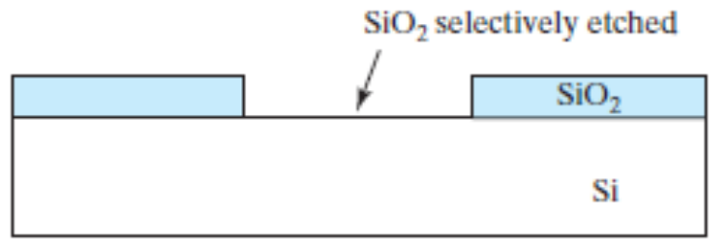
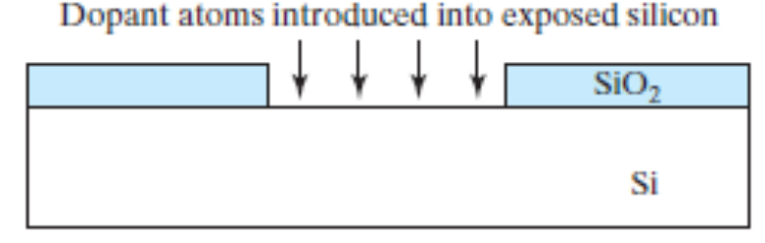

3.1 Introduction to Device Fabrication
Oxidation
Lithography &
Etching
Ion Implantation
Annealing &
Diffusion
Modern Semiconductor Devices for Integrated Circuits (C. Hu)
Slide 3-<number>

Slide 3
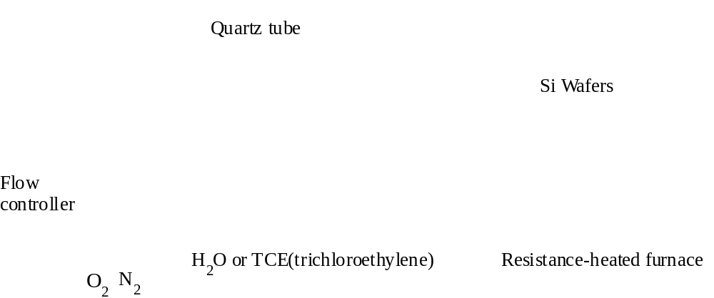
3.2 Oxidation of Silicon
Modern Semiconductor Devices for Integrated Circuits (C. Hu)
Slide 3-<number>

Slide 4
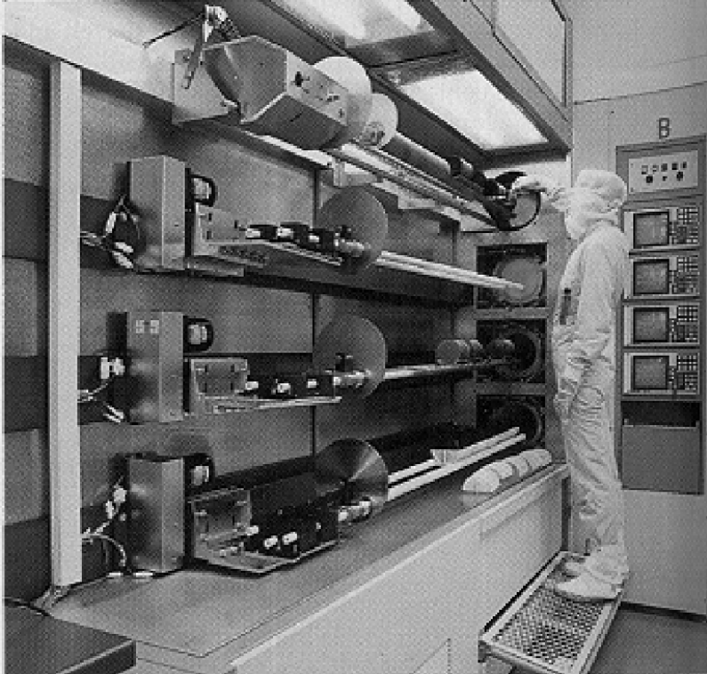
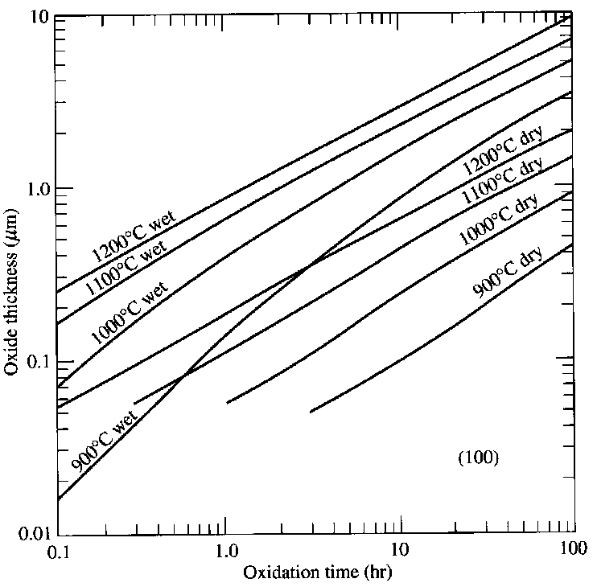
3.2 Oxidation of Silicon
Dry Oxidation :
Si + O₂ → SiO₂
Si +2H₂O → SiO₂ + 2H₂
Wet Oxidation :
Modern Semiconductor Devices for Integrated Circuits (C. Hu)
Slide 3-<number>

Slide 5
3.2 Oxidation of Silicon
EXAMPLE : Two-step Oxidation
(a) How long does it take to grow 0.1μm of dry oxide at 1000 ºC ?
(b) After step (a), how long will it take to grow an additional 0.2μm of oxide at 900 ºC in a wet ambient ?
Solution:
(a) From the “1000ºC dry” curve in Slide 3-3, it takes 2.5 hr to grow 0.1μm of oxide.
(b) Use the “900ºC wet” curve only. It would have taken 0.7hr to grow the 0.1 μm oxide and 2.4hr to grow 0.3 μm oxide from bare silicon. The answer is 2.4hr–0.7hr = 1.7hr.
Modern Semiconductor Devices for Integrated Circuits (C. Hu)
Slide 3-<number>

Slide 6
3.3 Lithography
Resist Coating
(c)
Development
(a)
Positive resist
Negative resist
Photoresist
Si
Oxide
(b)
Exposure
Si
Si
(d)
Etching and Resist Strip
Deep Ultraviolet Light
Optical
Lens system
Photomask with
opaque and
clear patterns
Si
Si
Modern Semiconductor Devices for Integrated Circuits (C. Hu)
Slide 3-<number>

Slide 7
3.3 Lithography
Photolithography Resolution Limit, R
R ≥ kλ due to optical diffraction
Wavelength λ needs to be minimized. (248 nm, 193 nm, 157 nm?)
k (<1) can be reduced will
Large aperture, high quality lens
Small exposure field, step-and-repeat using “stepper”
Optical proximity correction
Phase-shift mask, etc.
Lithography is difficult and expensive. There can be 40 lithography steps in an IC process.
Modern Semiconductor Devices for Integrated Circuits (C. Hu)
Slide 3-<number>

Slide 8
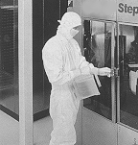
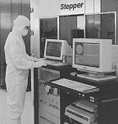
3.3 Lithography
Wafers are being loaded into a stepper in a clean room.
Modern Semiconductor Devices for Integrated Circuits (C. Hu)
Slide 3-<number>

Slide 9
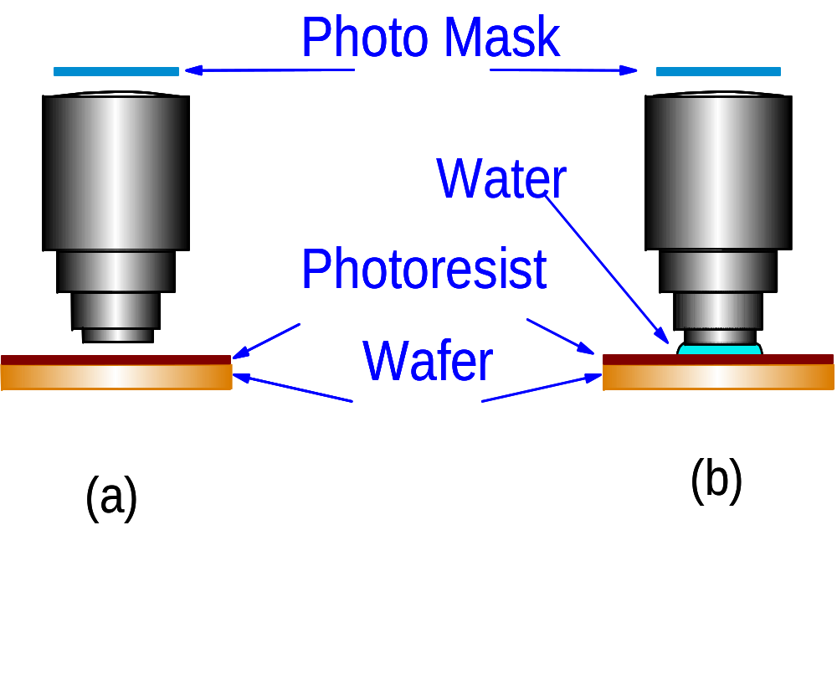
3.3.1 Wet Lithography
conventional dry lithography
wet or immersion lithography
Modern Semiconductor Devices for Integrated Circuits (C. Hu)
Slide 3-<number>

Slide 10
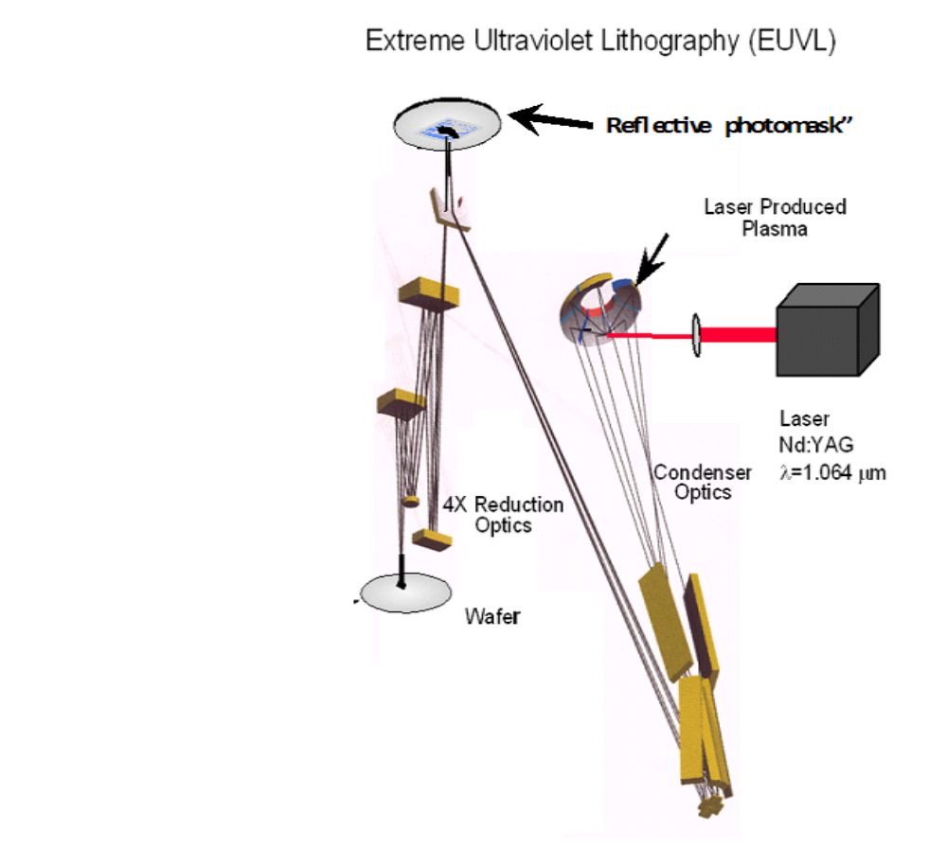
Extreme UV Lithography (13nm wavelength)
Reflective “photomask”
Laser produced plasma emitting EUV
No suitable lens material at this wavelength. Optics is based on mirrors with nm flatness.
Modern Semiconductor Devices for Integrated Circuits (C. Hu)
Slide 3-<number>

Slide 11
Beyond Optical Lithography
Electron Beam Writing : Electron beam(s) scans and exposed electron resist on wafer. Ready technology with relatively low throughput.
Electron Projection Lithography : Exposes a complex
pattern using mask and electron lens similar to
optical lithography.
Nano-imprint : Patterns are etched into a durable material to make a “stamp.” This stamp is pressed into a liquid film over the wafer surface. Liquid is hardened with UV to create an imprint of the fine patterns.
Modern Semiconductor Devices for Integrated Circuits (C. Hu)
Slide 3-<number>

Slide 12
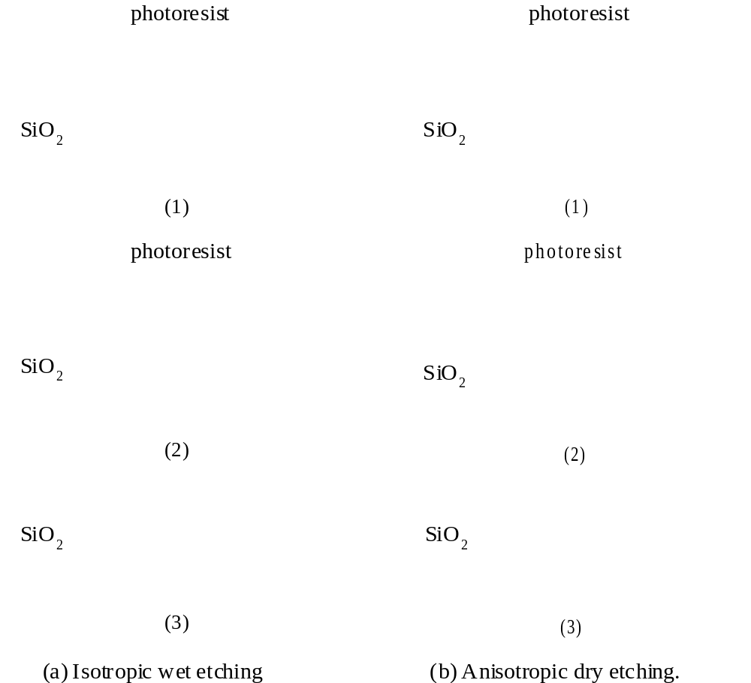
3.4 Pattern Transfer–Etching
Isotropic etching
Anisotropic etching
Modern Semiconductor Devices for Integrated Circuits (C. Hu)
Slide 3-<number>

Slide 13
3.4 Pattern Transfer–Etching
Reactive-Ion Etching Systems
Gas Baffle
Gas Inlet
Wafers
RF
RF
Vacuum
Cross-section View
Top View
Modern Semiconductor Devices for Integrated Circuits (C. Hu)
Slide 3-<number>

Slide 14
3.4 Pattern Transfer–Etching
Dry Etching (also known as Plasma Etching, or
Reactive-Ion Etching) is anisotropic.
Silicon and its compounds can be etched by plasmas
containing F.
Aluminum can be etched by Cl.
Some concerns :
- Selectivity and End-Point Detection
- Plasma Process-Induced Damage or Wafer Charging
Damage and Antenna Effect
Modern Semiconductor Devices for Integrated Circuits (C. Hu)
Slide 3-<number>

Slide 15
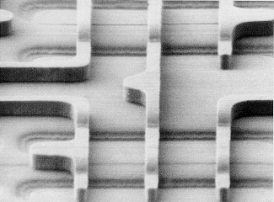
Scanning electron microscope view of a plasma-etched 0.16 μm pattern in polycrystalline silicon film.
Modern Semiconductor Devices for Integrated Circuits (C. Hu)
Slide 3-<number>

Slide 16
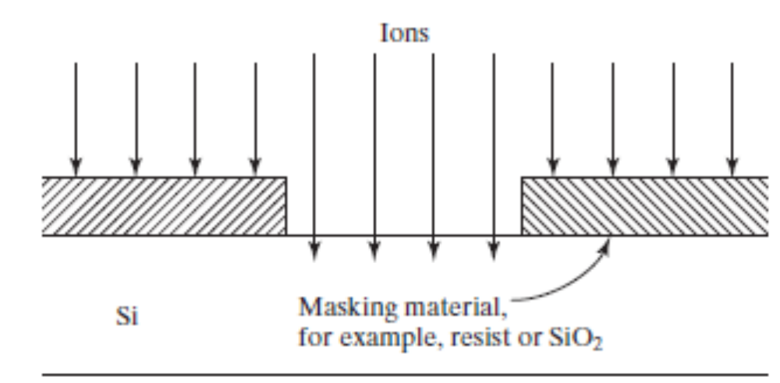
3.5 Doping
3.5.1 Ion Implantation
Dopant ions
The dominant doping method
Excellent control of dose (cm⁻²)
Good control of implant depth with energy (KeV to MeV)
Repairing crystal damage and dopant activation requires annealing, which can cause dopant diffusion and loss of depth control.
Modern Semiconductor Devices for Integrated Circuits (C. Hu)
Slide 3-<number>

Slide 17
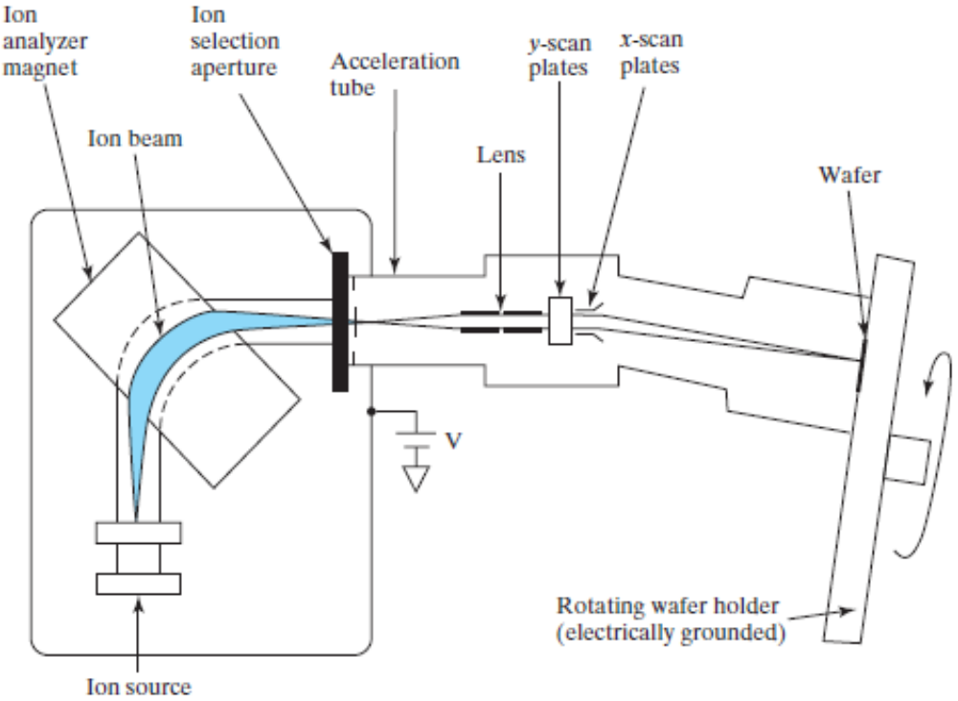
3.5.1 Ion Implantation
Schematic of an Ion Implanter
Modern Semiconductor Devices for Integrated Circuits (C. Hu)
Slide 3-<number>

Slide 18
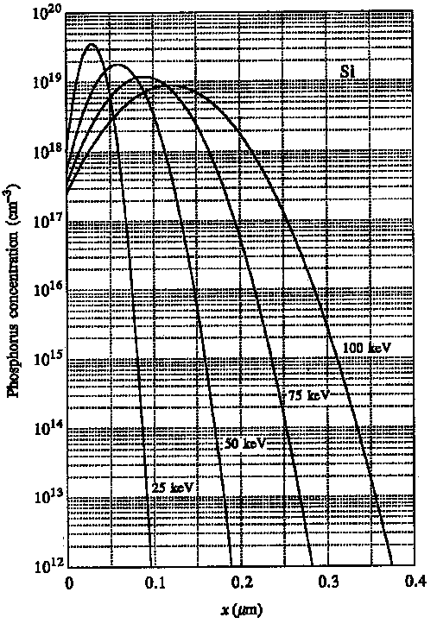
3.5.1 Ion implantation
Phosphorous density
profile after
implantation
Modern Semiconductor Devices for Integrated Circuits (C. Hu)
Slide 3-<number>

Slide 19
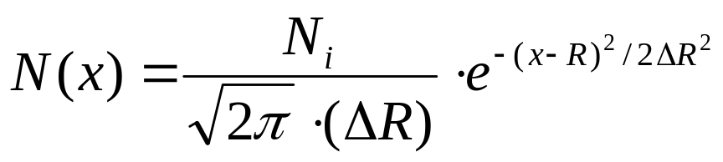
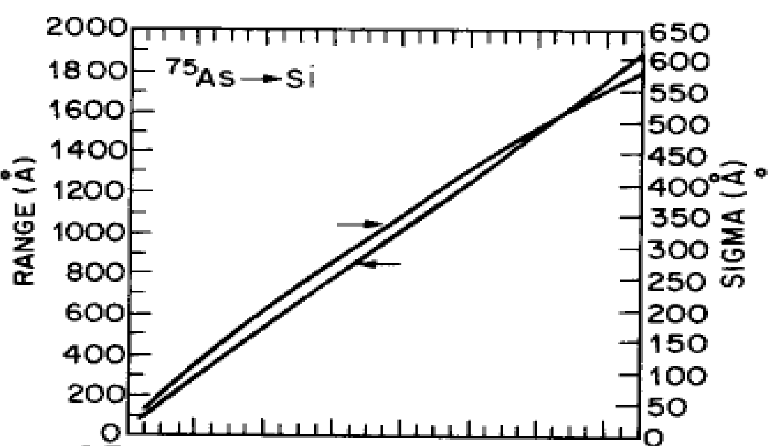

3.5.1 Ion Implantation
Model of Implantation Doping Profile (Gaussian)
N_{i} : dose (cm⁻²)
R : range or depth
ΔR : spread or sigma
Modern Semiconductor Devices for Integrated Circuits (C. Hu)
Slide 3-<number>

Slide 20
Other Doping Methods
Gas-Source Doping : For example, dope Si with P using POCl₃.
Solid-Source Doping : Dopant diffuses from a doped
solid film (SiGe or oxide) into Si.
In-Situ Doping : Dopant is introduced while a Si film is being deposited.
Modern Semiconductor Devices for Integrated Circuits (C. Hu)
Slide 3-<number>

Slide 21
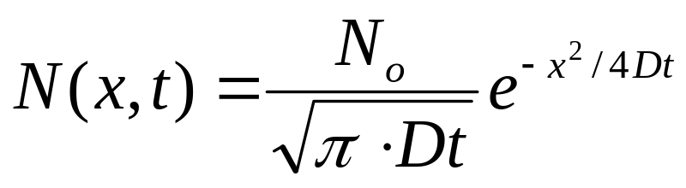

3.6 Dopant Diffusion
Junction depth
SiO
2
n-type
diffusion layer
p-type Si
N : N_{d} or N_{a} (cm⁻³)
N_{o} : dopant atoms per cm²
t : diffusion time
D : diffusivity, is the approximate distance of dopant diffusion
Modern Semiconductor Devices for Integrated Circuits (C. Hu)
Slide 3-<number>

Slide 22
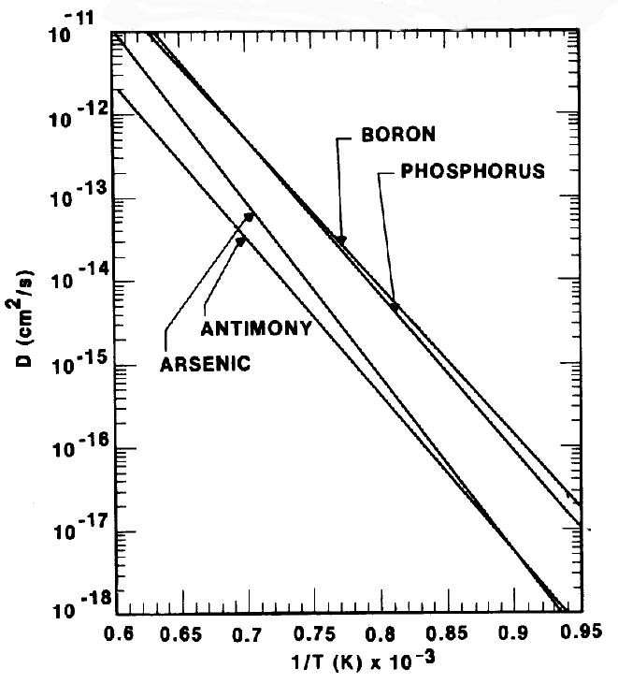
3.6 Dopant Diffusion
D increases with increasing temperature.
Some applications need very deep junctions (high T, long t). Others need very shallow junctions (low T, short t).
Modern Semiconductor Devices for Integrated Circuits (C. Hu)
Slide 3-<number>

Slide 23
3.6 Dopant Diffusion
Shallow Junction and Rapid Thermal Annealing
After ion implantation, thermal annealing is required. Furnace annealing takes minutes and causes too much diffusion of dopants for some applications.
In rapid thermal annealing (RTA), the wafer is heated to high temperature in seconds by a bank of heat lamps.
In flash annealing (100mS) and laser annealing (<1uS), dopant ddiffusion is practically eliminated.
Modern Semiconductor Devices for Integrated Circuits (C. Hu)
Slide 3-<number>

Slide 24
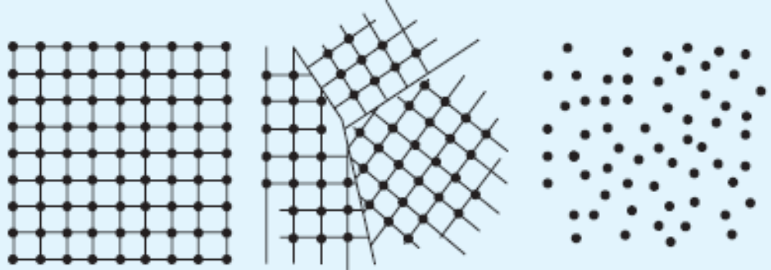
3.7 Thin-Film Deposition
Three Kinds of Solid
Crystalline
Polycrystalline
Amorphous
Example:
Silicon wafer
Thin film of SiO₂ or Si₃N₄.
Thin film of Si or metal.
Modern Semiconductor Devices for Integrated Circuits (C. Hu)
Slide 3-<number>

Slide 25
3.7 Thin-Film Deposition
Examples of thin films in integrated circuits
Advanced MOSFET gate dielectric
Poly-Si film for transistor gates
Metal layers for interconnects
Dielectric between metal layers
Encapsulation of IC
Modern Semiconductor Devices for Integrated Circuits (C. Hu)
Slide 3-<number>

Slide 26
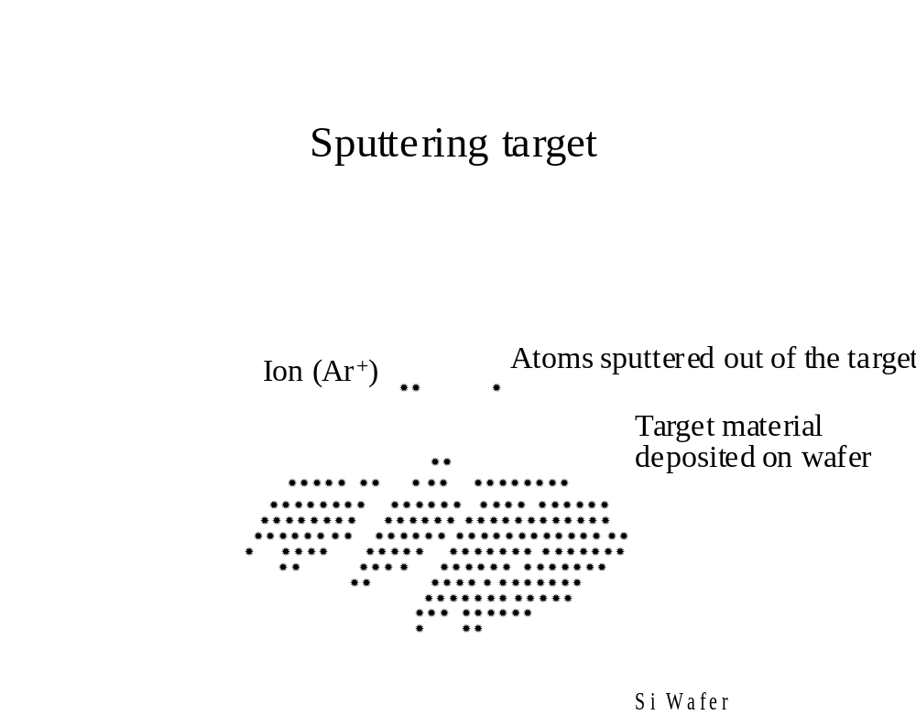
3.7.1 Sputtering
Schematic Illustration of Sputtering Process
Modern Semiconductor Devices for Integrated Circuits (C. Hu)
Slide 3-<number>

Slide 27
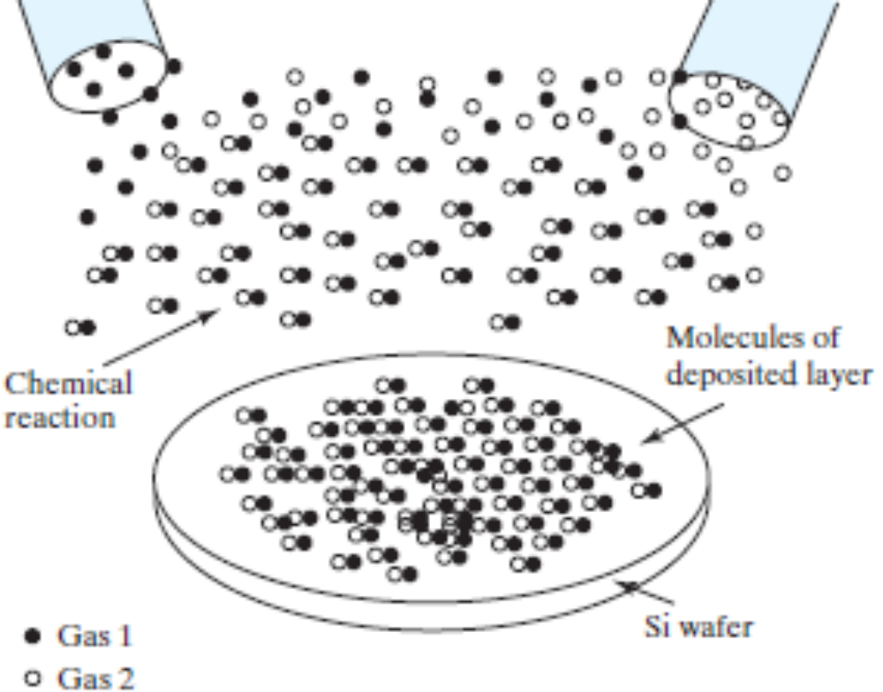
3.7.2 Chemical Vapor Deposition (CVD)
Thin film is formed from gas phase components.
Modern Semiconductor Devices for Integrated Circuits (C. Hu)
Slide 3-<number>

Slide 28
Some Chemical Reactions of CVD
Poly-Si : SiH₄ (g) Si (s) + 2H₂ (g)
Si3N4 : 3SiH₂Cl₂ (g)+4NH₃ (g) Si₃N₄ (s)+6HCl(g)+6H₂ (g)
SiO2 : SiH₄ (g) + O₂ (g) SiO₂ (s) + 2H₂ (g)
or
SiH₂Cl₂ (g)+2N₂O (g) SiO₂ (s)+2HCl (g)+2N₂ (g)
Modern Semiconductor Devices for Integrated Circuits (C. Hu)
Slide 3-<number>

Slide 29
3.7.2 Chemical Vapor Deposition (CVD)
Two types of CVD equipment:
LPCVD (Low Pressure CVD) : Good uniformity.
Used for poly-Si, oxide, nitride.
PECVD (Plasma Enhanced CVD) : Low temperature
process and high deposition rate. Used for oxide,
nitride, etc.
Modern Semiconductor Devices for Integrated Circuits (C. Hu)
Slide 3-<number>

Slide 30
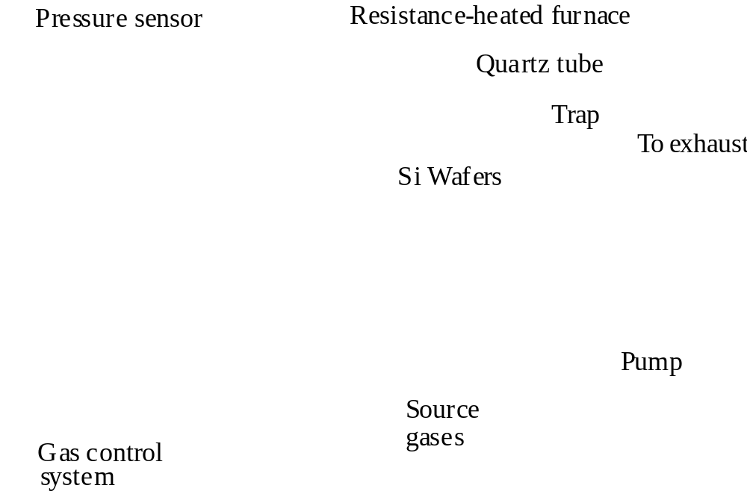
3.7.2 Chemical Vapor Deposition (CVD)
LPCVD Systems
Modern Semiconductor Devices for Integrated Circuits (C. Hu)
Slide 3-<number>

Slide 31
3.7.2 Chemical Vapor Deposition (CVD)
Cold Wall Parallel Plate
Gas Injection
Ring
Wafers
Pump
Heater Coil
Wafers
Gas
Inlet
Pump
Hot Wall Parallel Plate
Power leads
Plasma Electrodes
PECVD Systems
Modern Semiconductor Devices for Integrated Circuits (C. Hu)
Slide 3-<number>

Slide 32
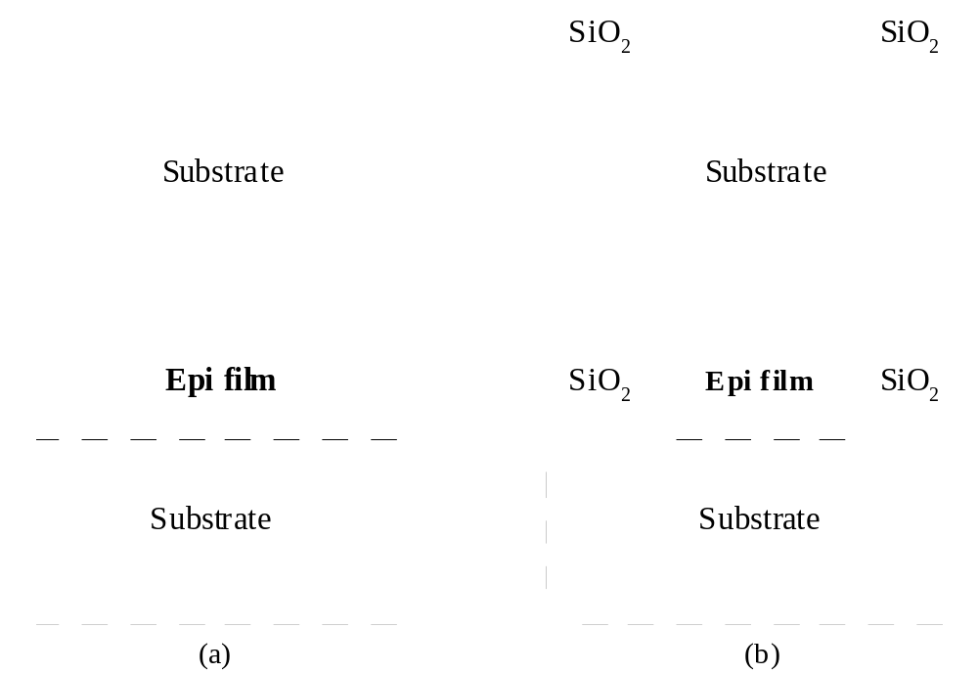
3.7.3 Epitaxy (Deposition of Single-Crystalline Film)
Epitaxy
Selective Epitaxy
Si
Si
Si
Si
Modern Semiconductor Devices for Integrated Circuits (C. Hu)
Slide 3-<number>

Slide 33
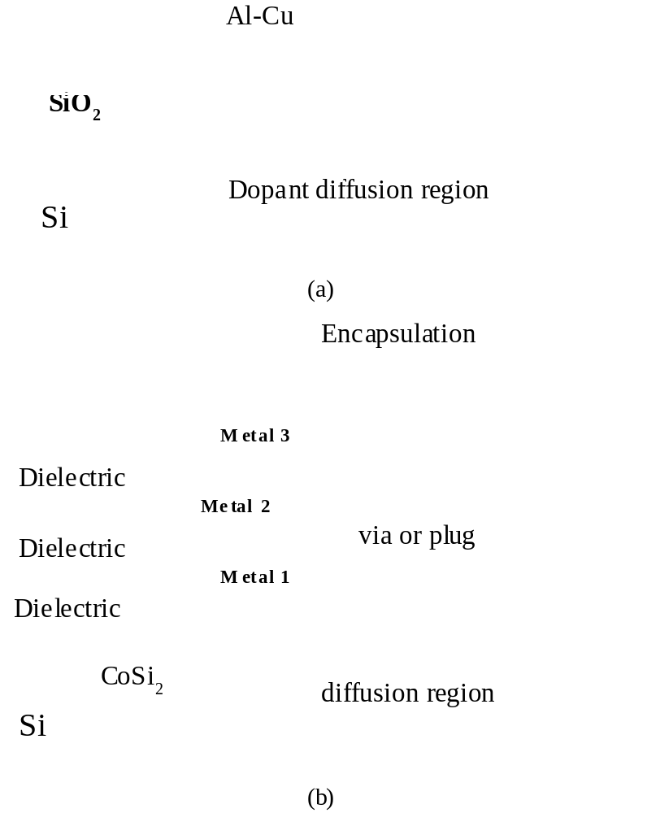
3.8 Interconnect – The Back-end Process
Al or Cu
silicide
Modern Semiconductor Devices for Integrated Circuits (C. Hu)
Slide 3-<number>

Slide 34
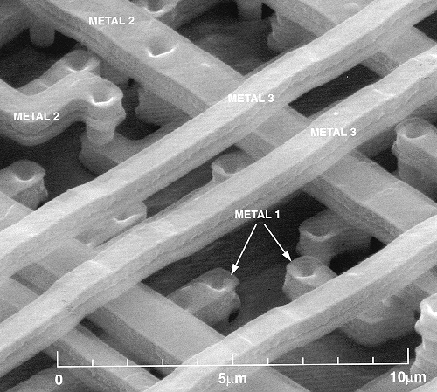
3.8 Interconnect – The Back-end Process
SEM: Multi-Level Interconnect (after removing the dielectric)
Modern Semiconductor Devices for Integrated Circuits (C. Hu)
Slide 3-<number>

Slide 35
3.8 Interconnect – The Back-end Process
Copper Interconnect
Al interconnect is prone to voids formation by electromigration.
Cu has excellent electromigration reliability
and 40% lower resistance than Al.
Because dry etching of copper is difficult (copper etching products tend to be non-volatile), copper patterns are defined by a damascene process.
Modern Semiconductor Devices for Integrated Circuits (C. Hu)
Slide 3-<number>

Slide 36
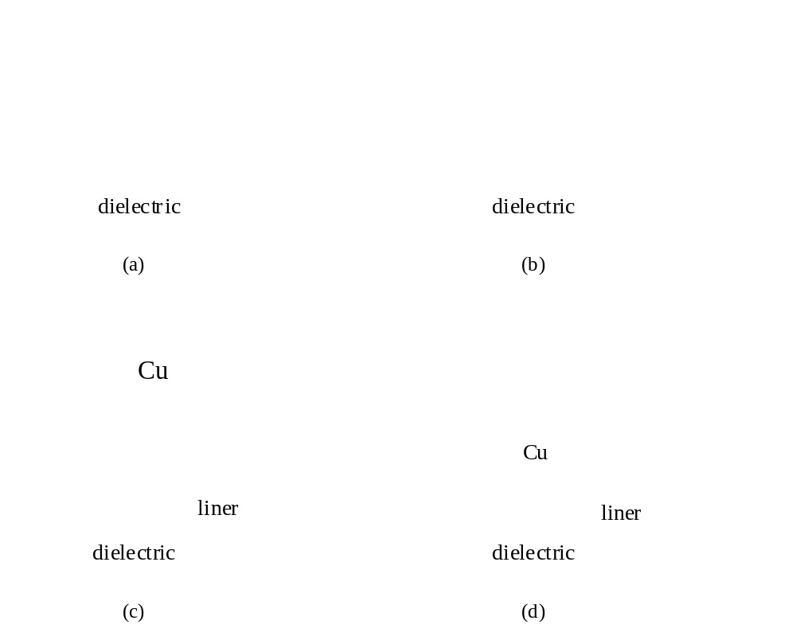
3.8 Interconnect – The Back-end Process
Copper Damascene Process
Chemical-Mechanical
Polishing (CMP)
removes unwanted
materials.
Barrier liner prevents
Cu diffusion.
Modern Semiconductor Devices for Integrated Circuits (C. Hu)
Slide 3-<number>

Slide 37
3.8 Interconnect – The Back-end Process
Planarization
A flat surface is highly desirable for subsequent
lithography and etching.
CMP (Chemical-Mechanical Polishing) is used
to planarize each layer of dielectric in the interconnect system. Also used in the front-end process.
Modern Semiconductor Devices for Integrated Circuits (C. Hu)
Slide 3-<number>

Slide 38
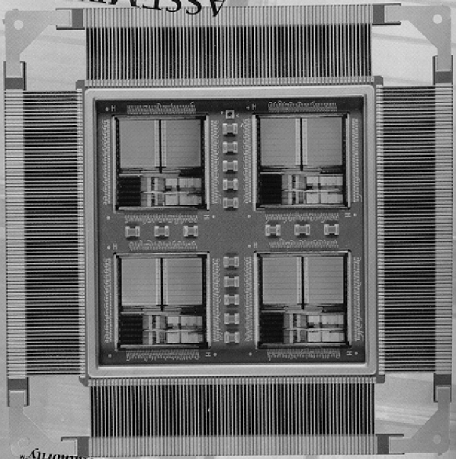
3.9 Testing, Assembly, and Qualification
Wafer acceptance test
Die sorting
Wafer sawing or laser cutting
Packaging
Flip-chip solder bump technology
Multi-chip modules
Burn-in
Final test
Qualification
Modern Semiconductor Devices for Integrated Circuits (C. Hu)
Slide 3-<number>

Slide 39
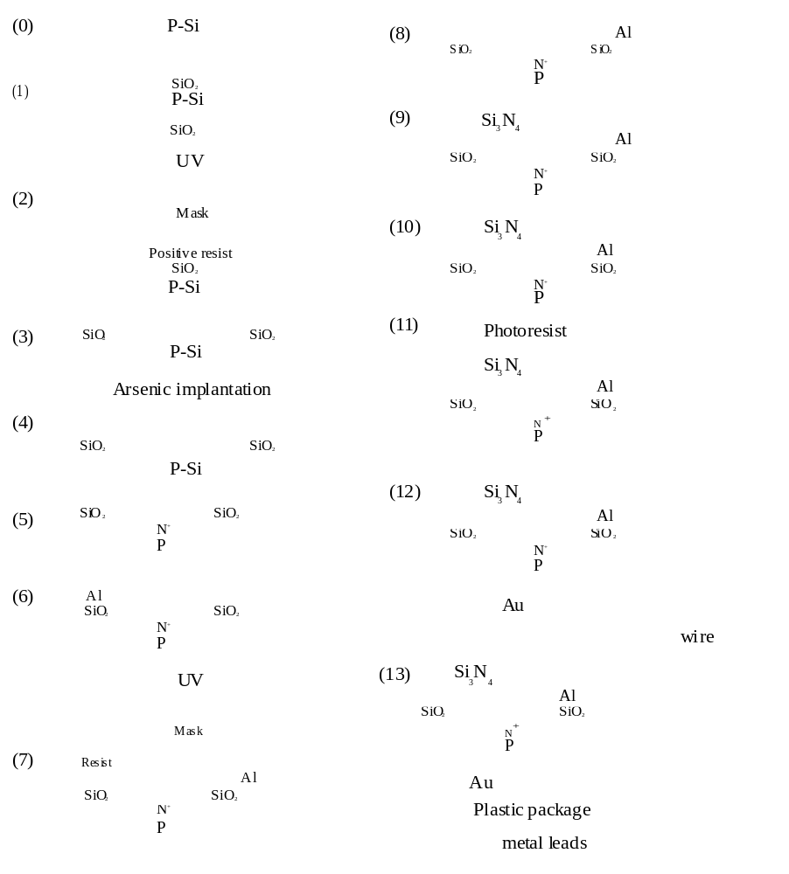
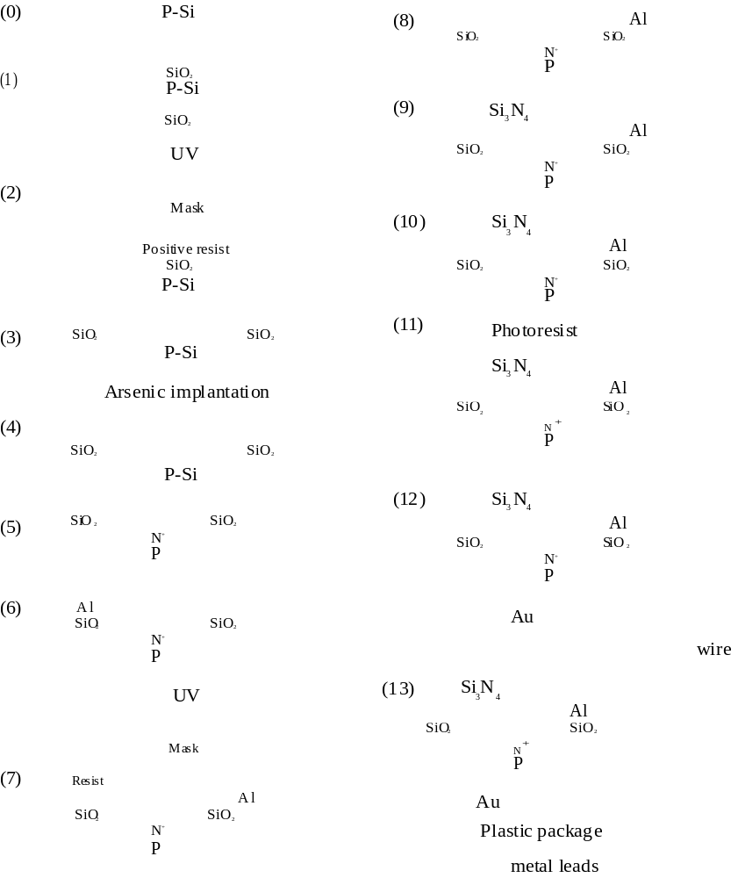
3.10 Chapter Summary–A Device Fabrication Example
Ion Implantation
Wafer
Oxidation
Annealing &
Diffusion
UV
Al
Sputtering
Lithography
UV
Etching
Lithography
Modern Semiconductor Devices for Integrated Circuits (C. Hu)
Slide 3-<number>

Slide 40
3.10 Chapter Summary–A Device Fabrication Example
Metal
etching
Back side metallization
CVD
nitride
deposition
Lithography
and etching
Back Side
milling
Dicing, wire bonding,
and packaging
Modern Semiconductor Devices for Integrated Circuits (C. Hu)
Slide 3-<number>

