Slide 1
Chapter 4 PN and Metal-Semiconductor Junctions
4.1 Building Blocks of the PN Junction Theory
– +
V
Donor ions
I
N
P
N-type
P-type
I
diode
symbol
V
Reverse bias
Forward bias
PN junction is present in perhaps every semiconductor device.
Modern Semiconductor Devices for Integrated Circuits (C. Hu)
Slide 4-<number>

Slide 2
4.1.1 Energy Band Diagram of a PN Junction
N-region
P-region
E_{f} is constant at equilibrium
(a)
E_{f}
E_{c}
E_{c} and E_{v} are known relative to E_{f}
E_{c}
E_{f}
(b)
E_{v}
E_{v}
E_{c}
E_{c} and E_{v} are smooth, the exact shape to be determined.
E_{f}
(c)
E_{v}
Neutral
Depletion
Neutral
A depletion layer exists at the PN junction where n ≈ 0 and p ≈ 0.
N-region
layer
P-region
E_{c}
(d)
E_{f}
E_{v}
Modern Semiconductor Devices for Integrated Circuits (C. Hu)
Slide 4-<number>

Slide 3
4.1.2 Built-in Potential
N-type
P-type
(a)
N_{d}
N_{a}
N
d
N
a
E_{c}
q
φ_{bi}
(b)
E_{f}
E_{v}
V
φ_{bi}
(c)
x_{N}
0
x_{P}
x
Can the built-in potential be measured with a voltmeter?
Modern Semiconductor Devices for Integrated Circuits (C. Hu)
Slide 4-<number>

Slide 4
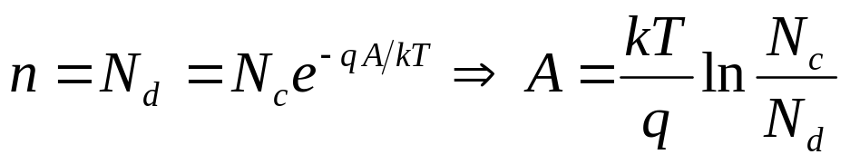
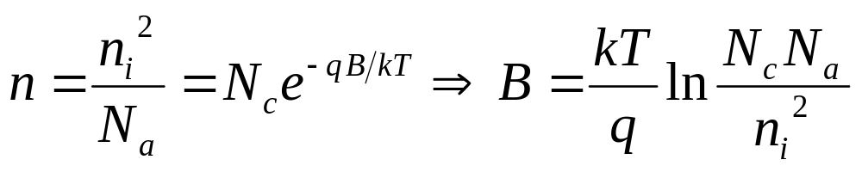
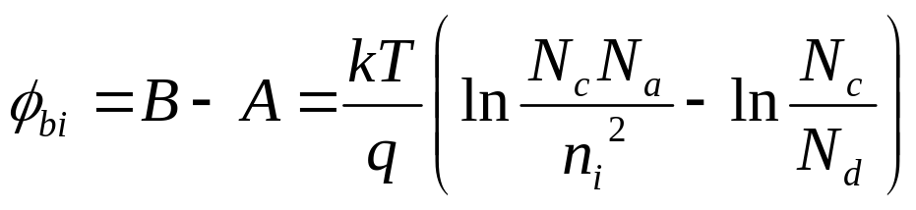
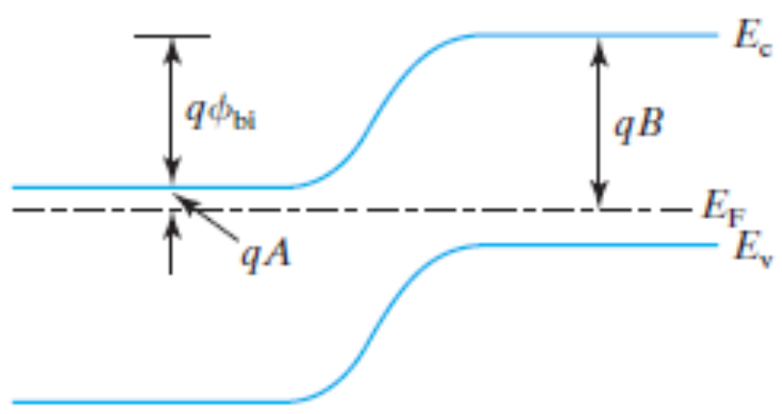
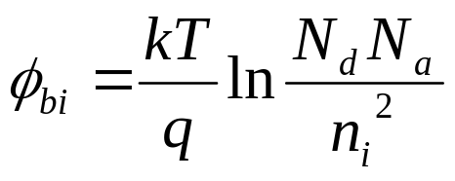
4.1.2 Built-in Potential
N-region
P-region
Modern Semiconductor Devices for Integrated Circuits (C. Hu)
Slide 4-<number>

Slide 5




4.1.3 Poisson’s Equation
Gauss’s Law:
e
a
A
a
r
ε_{s}: permittivity (~12ε_{o} for Si)
ρ: charge density (C/cm³)
E
(
x
)
ρ
E
(
x
+
Δ
x
)
Δ
x
x
Poisson’s equation
Modern Semiconductor Devices for Integrated Circuits (C. Hu)
Slide 4-<number>

Slide 6
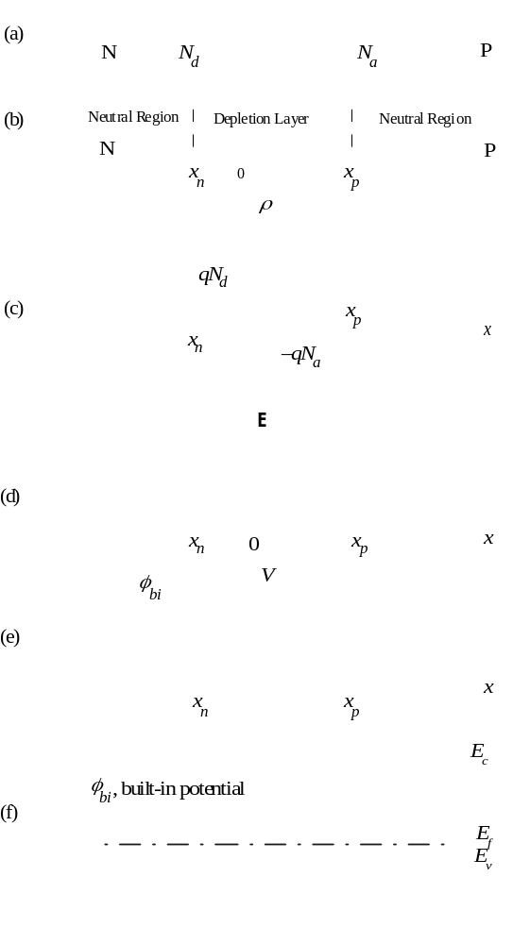
4.2.1 Field and Potential in the Depletion Layer
4.2 Depletion-Layer Model
On the P-side of the depletion layer, ρ = –qN_{a}
N
P
d
E
=
−
qN
a
dx
ε
s
P
=
−
qN
+
=
qN
−
E
(
x
)
a
x
C
a
(
x
x
)
N
ε
1
ε
P
s
s
On the N-side, ρ = qN_{d}
=
qN
-
E
(
x
)
d
(
x
x
)
ε
N
N
P
s
Modern Semiconductor Devices for Integrated Circuits (C. Hu)
Slide 4-<number>

Slide 7
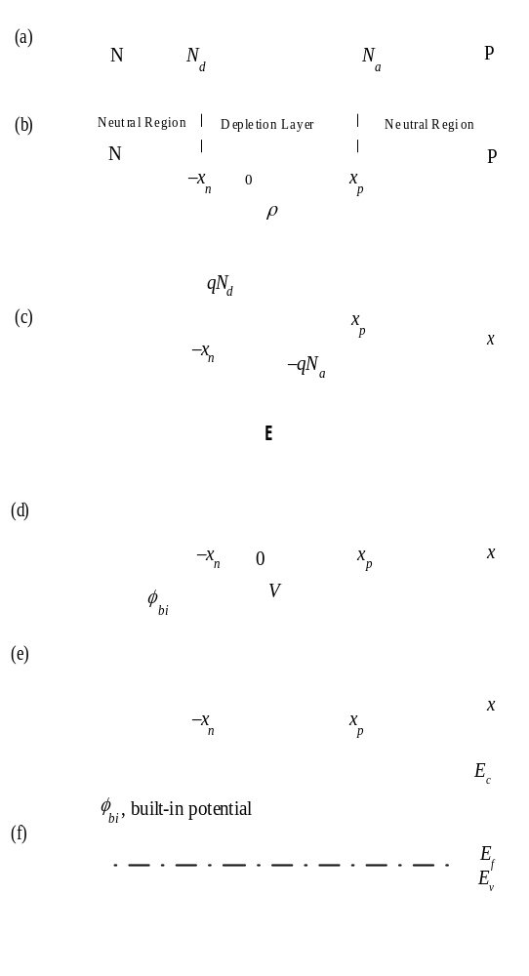
4.2.1 Field and Potential in the Depletion Layer
N
P
The electric field is continuous at x = 0.
N_{a} |x_{P}| = N_{d}|x_{P}|
Which side of the junction is depleted more?
A one-sided junction is called a N⁺P junction or P⁺N junction
Modern Semiconductor Devices for Integrated Circuits (C. Hu)
Slide 4-<number>

Slide 8

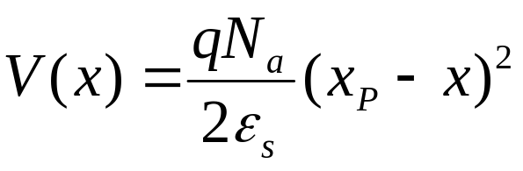
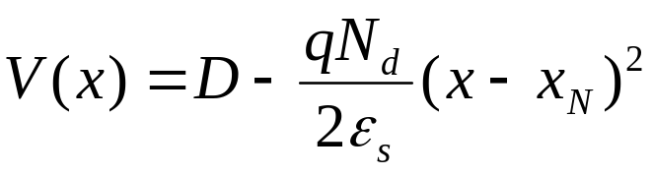
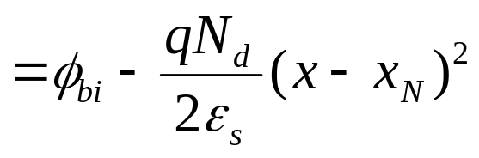
4.2.1 Field and Potential in the Depletion Layer
On the P-side,
N
P
Arbitrarily choose the voltage at x = x_{P} as V = 0.
N
P
On the N-side,
Modern Semiconductor Devices for Integrated Circuits (C. Hu)
Slide 4-<number>

Slide 9
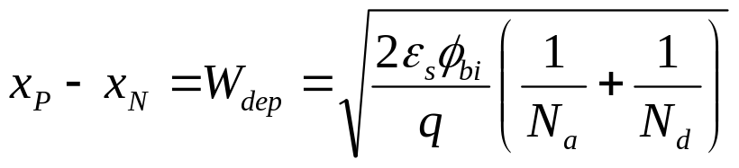
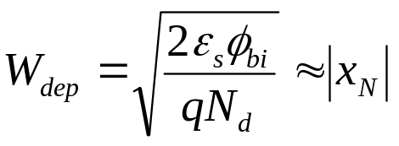
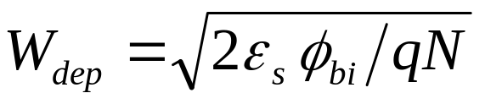
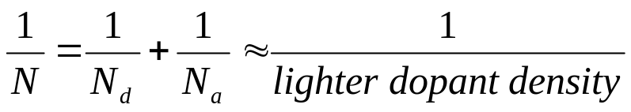
4.2.2 Depletion-Layer Width
N
P
V is continuous at x = 0
If N_{a} >> N_{d} , as in a P⁺N junction,
|
|
|
|
x
=
x
N
N
≅
0
P
N
d
a
What about a N⁺P junction?
where
Modern Semiconductor Devices for Integrated Circuits (C. Hu)
Slide 4-<number>

Slide 10
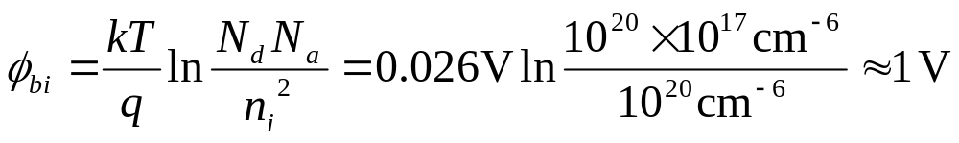
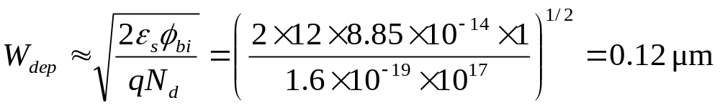
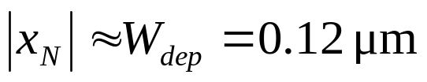
EXAMPLE: A P⁺N junction has N_{a}=10²⁰ cm⁻³ and N_{d} =10¹⁷cm⁻³. What is a) its built in potential, b)W_{dep} , c)x_{N} , and d) x_{P} ?
Solution:
a)
b)
c)
d)
Modern Semiconductor Devices for Integrated Circuits (C. Hu)
Slide 4-<number>

Slide 11
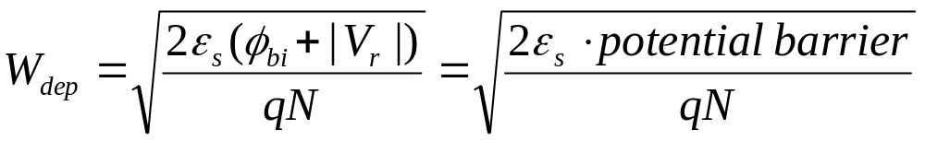
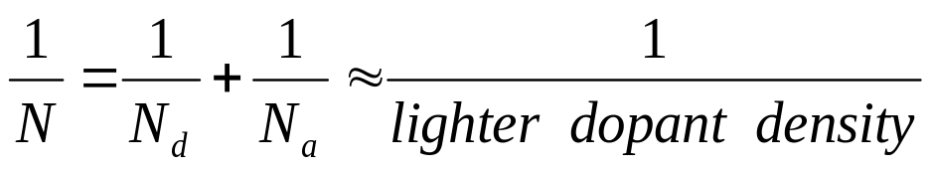
4.3 Reverse-Biased PN Junction
V
+
–
N
P
E_{c}
qφ_{bi}
E_{c}
E_{f}
E_{f}
E_{v}
E_{v}
(a) V = 0
E_{c}
qφ_{bi} + qV
E_{fp}
Does the depletion layer
widen or shrink with
increasing reverse bias?
E_{c}
qV
E_{v}
E_{fn}
E_{v}
(b) reverse-biased
Modern Semiconductor Devices for Integrated Circuits (C. Hu)
Slide 4-<number>

Slide 12
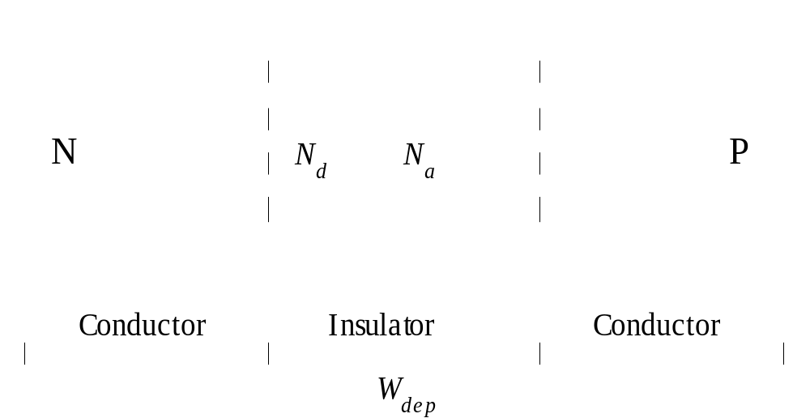
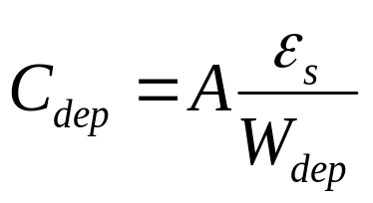
4.4 Capacitance-Voltage Characteristics
Reverse biased PN junction is a capacitor.
Is C_{dep} a good thing?
How to minimize junction capacitance?
Modern Semiconductor Devices for Integrated Circuits (C. Hu)
Slide 4-<number>

Slide 13
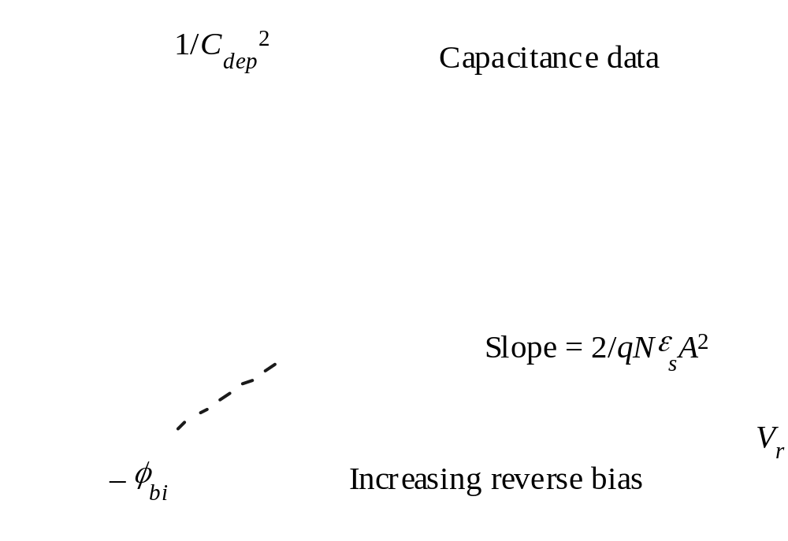
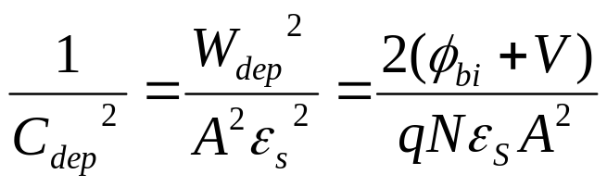
4.4 Capacitance-Voltage Characteristics
From this C-V data can N_{a} and N_{d} be determined?
Modern Semiconductor Devices for Integrated Circuits (C. Hu)
Slide 4-<number>

Slide 14
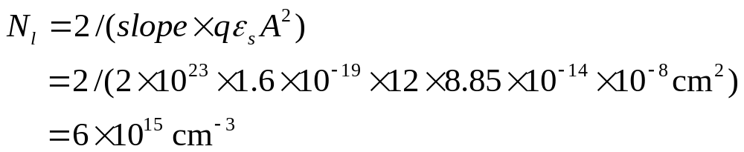
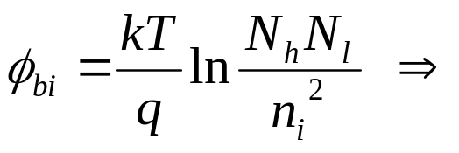
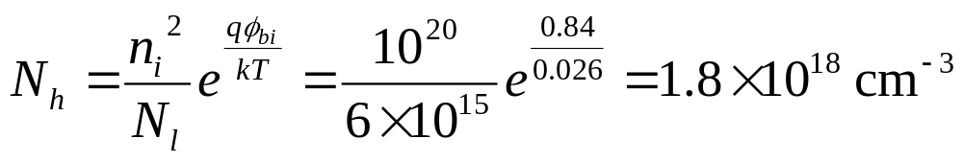
EXAMPLE: If the slope of the line in the previous slide is 2x10²³ F⁻² V⁻¹, the intercept is 0.84V, and A is 1 μm², find the lighter and heavier doping concentrations N_{l} and N_{h} .
Solution:
Is this an accurate way to determine N_{l} ? N_{h} ?
Modern Semiconductor Devices for Integrated Circuits (C. Hu)
Slide 4-<number>

Slide 15
4.5 Junction Breakdown
I
Forward Current
V
B
, breakdown
voltage
V
R
Small leakage
Current
A
P
N
R
C
A
3.7 V
IC
Zener diode
B
D
A Zener diode is designed to operate in the breakdown mode.
Modern Semiconductor Devices for Integrated Circuits (C. Hu)
Slide 4-<number>

Slide 16
4.5.1 Peak Electric Field
Neutral Region
increasing
+
reverse bias
N
N
a
P
0
x
p
⎡
2
qN
⎤
1
/
2
(a)
E
=
E
(
0
)
=
⎢
(
φ
+
|
V
|)
⎥
E
p
ε
bi
r
⎣
⎦
E
p
s
increasing reverse bias
ε
E
2
V
=
s
crit
−
φ
x
B
2
qN
bi
x
p
(b)
Modern Semiconductor Devices for Integrated Circuits (C. Hu)
Slide 4-<number>

Slide 17
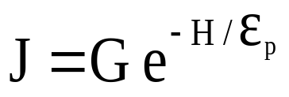
4.5.2 Tunneling Breakdown
Dominant if both sides of a junction are very heavily doped.
Filled States
-
Empty States
E_{c}
E_{v}
I
E
=
E
≈
10
6
V/cm
V
p
crit
Breakdown
Modern Semiconductor Devices for Integrated Circuits (C. Hu)
Slide 4-<number>

Slide 18
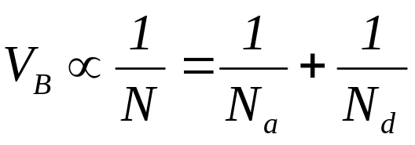
4.5.3 Avalanche Breakdown
impact ionization: an energetic electron generating electron and hole, which can also cause impact ionization.
E
c
original
electron
E
E
fp
v
Impact ionization + positive feedback→avalanche breakdown
ε
E
2
electron-hole
V
=
s
crit
pair generation
B
2
qN
E
c
E
fn
Modern Semiconductor Devices for Integrated Circuits (C. Hu)
Slide 4-<number>

Slide 19
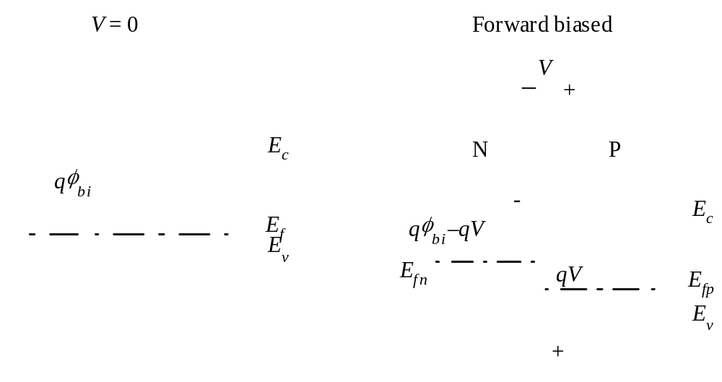

4.6 Forward Bias – Carrier Injection
V=0
I=0
Forward biased
Drift and diffusion cancel out
Minority carrier injection
Modern Semiconductor Devices for Integrated Circuits (C. Hu)
Slide 4-<number>

Slide 20
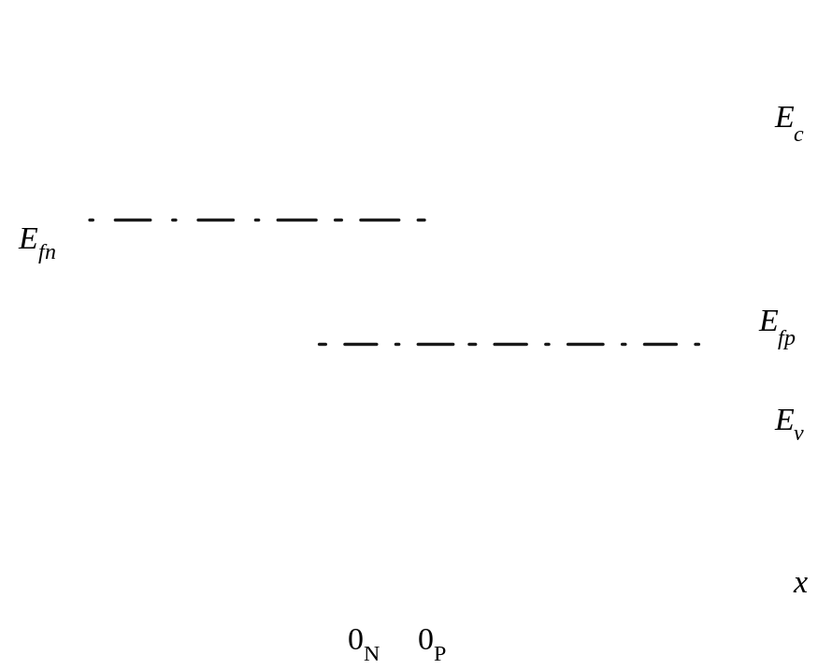
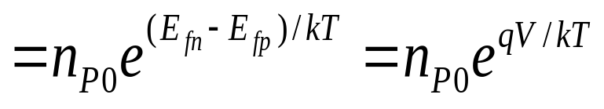
4.6 Forward Bias –
Quasi-equilibrium Boundary Condition
E_{c}
E_{fn}
The minority carrier
densities are raised
by e^{qV/kT}
Which side gets more
carrier injection?
E_{fn}
E_{fp}
E_{v}
x
x_{N}
x_{P}
Modern Semiconductor Devices for Integrated Circuits (C. Hu)
Slide 4-<number>

Slide 21
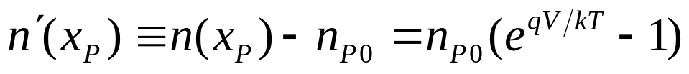
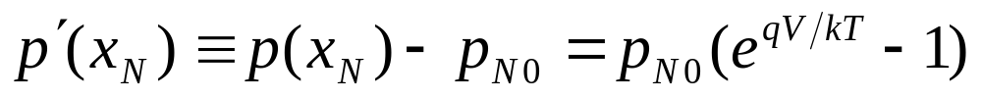
4.6 Carrier Injection Under Forward Bias–
Quasi-equilibrium Boundary Condition
n
2
n
(
x_{P}
)
=
n
e
q
V
kT
=
i
e
q
V
kT
P
0
N
a
n
2
p
(
x_{P}
)
=
p
e
q
V
kT
=
i
e
q
V
kT
N
0
N
d
Modern Semiconductor Devices for Integrated Circuits (C. Hu)
Slide 4-<number>

Slide 22
EXAMPLE: Carrier Injection
A PN junction has N_{a}=10¹⁹cm⁻³ and N_{d}=10¹⁶cm⁻³. The applied voltage is 0.6 V.
Question: What are the minority carrier concentrations at the depletion-region edges?
Solution:
Question: What are the excess minority carrier concentrations?
Solution:
Modern Semiconductor Devices for Integrated Circuits (C. Hu)
Slide 4-<number>

Slide 23
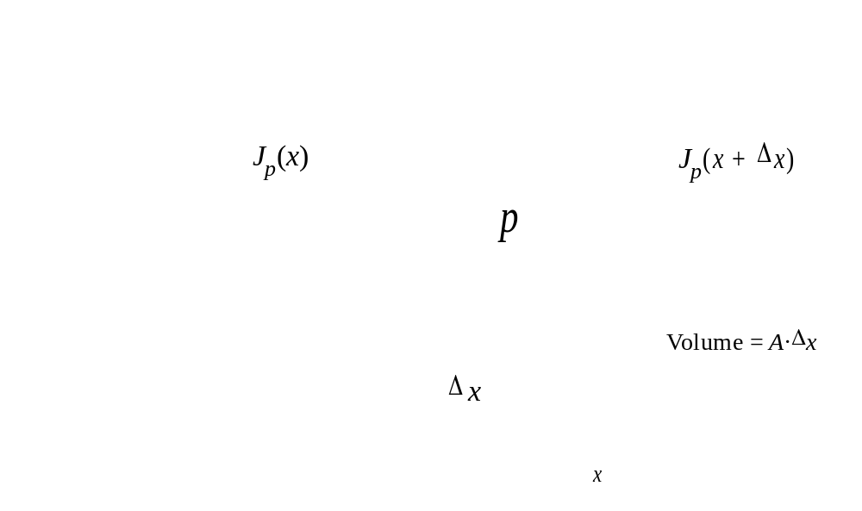
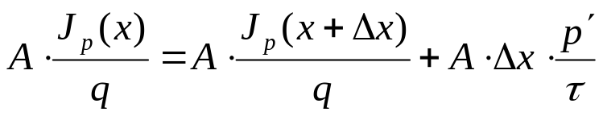
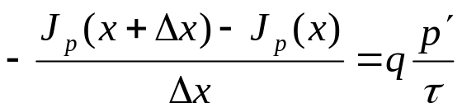
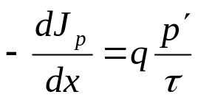
4.7 Current Continuity Equation
Modern Semiconductor Devices for Integrated Circuits (C. Hu)
Slide 4-<number>

Slide 24


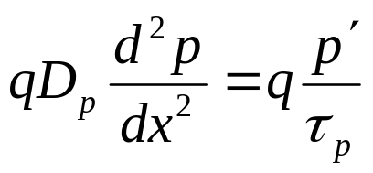
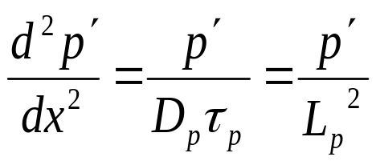
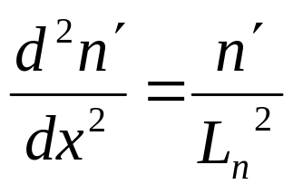
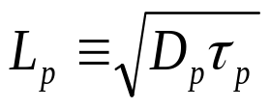
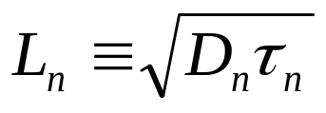
4.7 Current Continuity Equation
Minority drift current is negligible;
J_{p}= –qD_{p}dp/dx
L_{p} and L_{n} are the diffusion lengths
Modern Semiconductor Devices for Integrated Circuits (C. Hu)
Slide 4-<number>

Slide 25
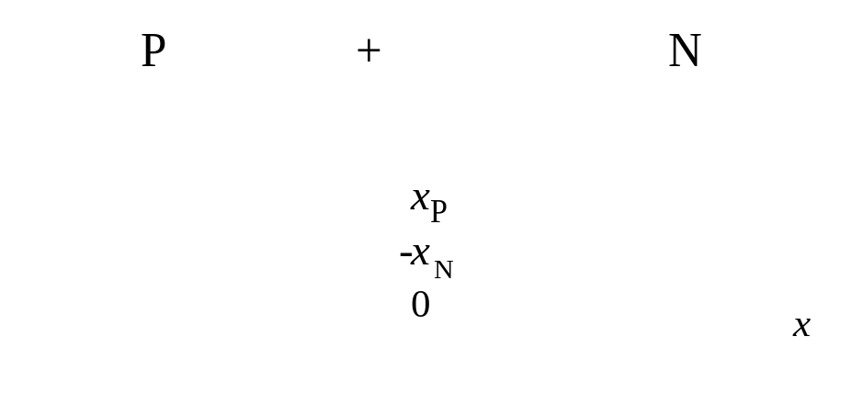
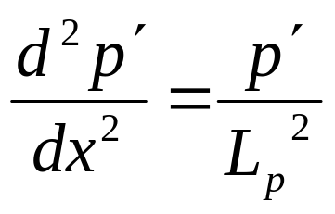

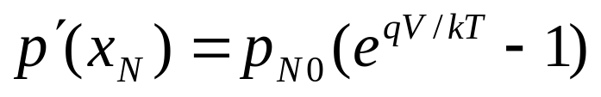
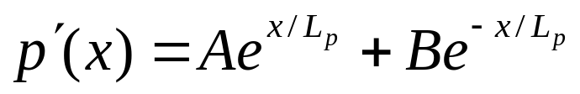
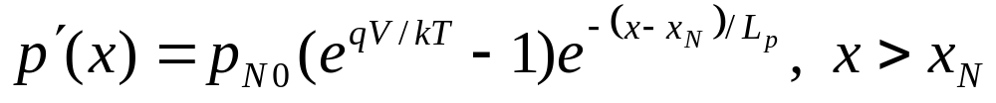
4.8 Forward Biased Junction-- Excess Carriers
Modern Semiconductor Devices for Integrated Circuits (C. Hu)
Slide 4-<number>

Slide 26
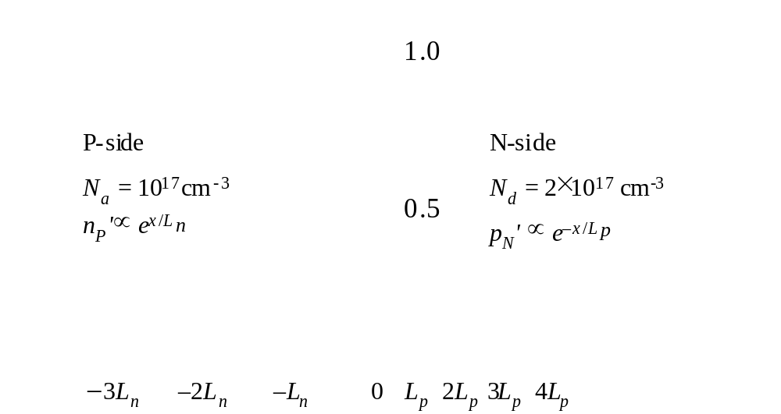
4.8 Excess Carrier Distributions
Modern Semiconductor Devices for Integrated Circuits (C. Hu)
Slide 4-<number>

Slide 27
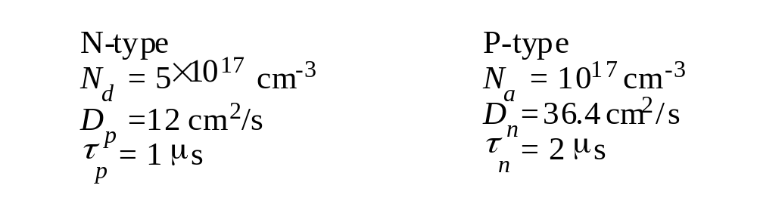
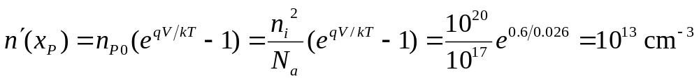
EXAMPLE: Carrier Distribution in Forward-biased PN Diode
Sketch n'(x) on the P-side.
10
13
cm
-3
N-side
P-side
n’ ( = p’ )
p´ ( = n’ )
2
×10
12
x
Modern Semiconductor Devices for Integrated Circuits (C. Hu)
Slide 4-<number>

Slide 28

EXAMPLE: Carrier Distribution in Forward-biased PN Diode
How does L_{n} compare with a typical device size?
What is p'(x) on the P- side?
Modern Semiconductor Devices for Integrated Circuits (C. Hu)
Slide 4-<number>

Slide 29



4.9 PN Diode I-V Characteristics
J
total
J_{total}
J_{n} = J_{total} – J_{p}
J_{p} = J_{total} – J_{n}
J_{nP}
J_{nP}
J_{pN}
J_{pN}
x
P-side
0
N-side
P-side
0
N-side
Modern Semiconductor Devices for Integrated Circuits (C. Hu)
Slide 4-<number>

Slide 30



The PN Junction as a Temperature Sensor
What causes the IV curves to shift to lower V at higher T ?
Modern Semiconductor Devices for Integrated Circuits (C. Hu)
Slide 4-<number>

Slide 31





4.9.1 Contributions from the Depletion Region
Space-Charge Region (SCR) current
Under forward bias, SCR current is an extra current with a slope 120mV/decade
Modern Semiconductor Devices for Integrated Circuits (C. Hu)
Slide 4-<number>

Slide 32




4.10 Charge Storage
What is the relationship between τ_{s} (charge-storage time) and τ (carrier lifetime)?
Modern Semiconductor Devices for Integrated Circuits (C. Hu)
Slide 4-<number>

Slide 33


4.11 Small-signal Model of the Diode
I
V
R
C
=
q
=
kT
I
(
e
qV
/
kT
)
I
/
kT
0
DC
q
What is G at 300K and I_{DC} = 1 mA?
Diffusion Capacitance:
Which is larger, diffusion or depletion capacitance?
Modern Semiconductor Devices for Integrated Circuits (C. Hu)
Slide 4-<number>

Slide 34

Part II: Application to Optoelectronic Devices
4.12 Solar Cells
Solar Cells is also known as photovoltaic cells.
Converts sunlight to electricity with 10-30% conversion efficiency.
1 m² solar cell generate about 150 W peak or 25 W continuous power.
Low cost and high efficiency are needed for wide deployment.
Modern Semiconductor Devices for Integrated Circuits (C. Hu)
Slide 4-<number>

Slide 35


4.12.1 Solar Cell Basics
I
Short Circuit
Dark IV
light
Eq.(4.9.4)
N
P
I
sc
0.7 V
-
0
V
E
Solar Cell
c
IV
Eq.(4.12.1)
E
–
I
Maximum
v
+
sc
(a)
power-output
Modern Semiconductor Devices for Integrated Circuits (C. Hu)
Slide 4-<number>

Slide 36



Direct-Gap and Indirect-Gap Semiconductors
Electrons have both particle and wave properties.
An electron has energy E and wave vector k.
direct-gap semiconductor
indirect-gap semiconductor
Modern Semiconductor Devices for Integrated Circuits (C. Hu)
Slide 4-<number>

Slide 37




4.12.2 Light Absorption
α(1/cm): absorption coefficient
1/α : light penetration depth
A thinner layer of direct-gap semiconductor can absorb most of solar radiation than indirect-gap semiconductor. But Si…
Modern Semiconductor Devices for Integrated Circuits (C. Hu)
Slide 4-<number>

Slide 38


4.12.3 Short-Circuit Current and Open-Circuit Voltage
If light shines on the N-type semiconductor and generates holes (and electrons) at the rate of G s⁻¹cm⁻³ ,
If the sample is uniform (no PN junction), d²p’/dx² = 0 → p’ = GL_{p}²/D_{p}= Gτ_{p}
Modern Semiconductor Devices for Integrated Circuits (C. Hu)
Slide 4-<number>

Slide 39






Solar Cell Short-Circuit Current, I_{sc}
Assume very thin P+ layer and carrier generation in N region only.
I_{sc}
P⁺
N
0
x
P'
0
L_{p}
x
G is really not uniform. L_{p} needs be larger than the light penetration depth to collect most of the generated carriers.
Modern Semiconductor Devices for Integrated Circuits (C. Hu)
Slide 4-<number>

Slide 40




Open-Circuit Voltage
Total current is I_{SC} plus the PV diode (dark) current:
Solve for the open-circuit voltage (V_{oc}) by setting I=0
How to raise V_{oc} ?
Modern Semiconductor Devices for Integrated Circuits (C. Hu)
Slide 4-<number>

Slide 41



4.12.4 Output Power
A particular operating point on the solar cell I-V curve maximizes the output power (I V).
Si solar cell with 15-20% efficiency dominates the market now
Theoretically, the highest efficiency (~24%) can be obtained with 1.9eV >Eg>1.2eV. Larger Eg lead to too low Isc (low light absorption); smaller Eg leads to too low Voc.
Tandem solar cells gets 35% efficiency using large and small Eg materials tailored to the short and long wavelength solar light.
Modern Semiconductor Devices for Integrated Circuits (C. Hu)
Slide 4-<number>

Slide 42
4.13 Light Emitting Diodes and Solid-State Lighting
Light emitting diodes (LEDs)
LEDs are made of compound semiconductors such as InP and GaN.
Light is emitted when electron and hole undergo radiative recombination.
E_{c}
Radiative recombination
Non-radiative recombination through traps
E_{v}
Modern Semiconductor Devices for Integrated Circuits (C. Hu)
Slide 4-<number>

Slide 43




Direct and Indirect Band Gap
Trap
Direct band gap
Example: GaAs
Direct recombination is efficient as k conservation is satisfied.
Indirect band gap
Example: Si
Direct recombination is rare as k conservation is not satisfied
Modern Semiconductor Devices for Integrated Circuits (C. Hu)

Slide 44



4.13.1 LED Materials and Structure
Modern Semiconductor Devices for Integrated Circuits (C. Hu)
Slide 4-<number>

Slide 45

4.13.1 LED Materials and Structure
compound semiconductors
binary semiconductors:
- Ex: GaAs, efficient emitter
ternary semiconductor :
- Ex: GaAs_{1-x}P_{x} , tunable E_{g} (to vary the color)
quaternary semiconductors:
- Ex: AlInGaP , tunable E_{g} and lattice constant (for growing high quality epitaxial films on inexpensive substrates)
 |  | Wavelength (μm) | Color | Lattice constant (Å)
InAs | 0.36 | 3.44 |  | 6.05
InN | 0.65 | 1.91 | infrared | 3.45
InP | 1.36 | 0.92 | violet | 5.87
GaAs | 1.42 | 0.87 |  | 5.66
GaP | 2.26 | 0.55 |  | 5.46
AlP | 3.39 | 0.51 |  | 5.45
GaN | 2.45 | 0.37 |  | 3.19
AlN | 6.20 | 0.20 | UV | 3.11
E_{g}(eV)
red
yellow
blue
Red
Yellow
Green
Blue
Light-emitting diode materials
Modern Semiconductor Devices for Integrated Circuits (C. Hu)
Slide 4-<number>

Slide 46


Common LEDs
Spectral range | Material System | Substrate | Example Applications
Infrared | InGaAsP | InP | Optical communication
Infrared-Red | GaAsP | GaAs | Indicator lamps. Remote control
Red-Yellow | AlInGaP | GaA or GaP | Optical communication. High-brightness traffic signal lights
Green-Blue | InGaN | GaN or sapphire | High brightness signal lights. Video billboards
Blue-UV | AlInGaN | GaN or sapphire | Solid-state lighting
Red-Blue | Organic semicon-ductors | glass | Displays
AlInGaP Quantun Well
Modern Semiconductor Devices for Integrated Circuits (C. Hu)
Slide 4-<number>

Slide 47
4.13.2 Solid-State Lighting
luminosity (lumen, lm): a measure of visible light energy
normalized to the sensitivity of the human eye at different wavelengths
Incandescent lamp | Compact fluorescent lamp | Tube fluorescent lamp | White LED | Theoretical limit at peak of eye sensitivity ( λ=555nm) | Theoretical limit (white light)
17 | 60 | 50-100 | 90-? | 683 | ~340
Luminous efficacy of lamps in lumen/watt
Organic Light Emitting Diodes (OLED) :
has lower efficacy than nitride or aluminide based compound semiconductor LEDs.
Terms: luminosity measured in lumens. luminous efficacy,
Modern Semiconductor Devices for Integrated Circuits (C. Hu)
Slide 4-<number>

Slide 48



4.14 Diode Lasers
4.14.1 Light Amplification
(a) Absorption
(d) Net Light Absorption
(b) Spontaneous Emission
(e) Net Light Amplification
Light amplification requires population inversion: electron occupation probability is larger for higher E states than lower E states.
(c) Stimulated Emission
Stimulated emission: emitted photon has identical frequency and directionality as the stimulating photon; light wave is amplified.
Modern Semiconductor Devices for Integrated Circuits (C. Hu)
Slide 4-<number>

Slide 49








4.14.1 Light Amplification in PN Diode
Population inversion is achieved when
Equilibrium, V=0
Population inversion, qV > Eg
Modern Semiconductor Devices for Integrated Circuits (C. Hu)
Slide 4-<number>

Slide 50


4.14.2 Optical Feedback and Laser
Laser threshold is reached (light intensity grows by feedback) when
P
+
light
out
N
+
Cleaved
R1, R2: reflectivities of the two ends
G : light amplification factor (gain) for a round-trip travel of the light through the diode
crystal
plane
Light intensity grows until , when the light intensity is just large enough to stimulate carrier recombinations at the same rate the carriers are injected by the diode current.
Modern Semiconductor Devices for Integrated Circuits (C. Hu)
Slide 4-<number>

Slide 51

4.14.2 Optical Feedback and Laser Diode
Distributed Bragg reflector (DBR) reflects light with multi-layers of semiconductors.
Vertical-cavity surface-emitting laser (VCSEL) is shown on the left.
Quantum-well laser has smaller threshold current because fewer carriers are needed to achieve population inversion in the small volume of the thin small-Eg well.
Modern Semiconductor Devices for Integrated Circuits (C. Hu)
Slide 4-<number>

Slide 52
4.14.3 Laser Applications
Red diode lasers: CD, DVD reader/writer
Blue diode lasers: Blu-ray DVD (higher storage density)
1.55 μm infrared diode lasers: Fiber-optic communication
4.15 Photodiodes
Photodiodes: Reverse biased PN diode. Detects photo-generated current (similar to Isc of solar cell) for optical communication, DVD reader, etc. Avalanche photodiodes: Photodiodes operating near avalanche breakdown amplifies photocurrent by impact ionization.
Modern Semiconductor Devices for Integrated Circuits (C. Hu)
Slide 4-<number>

Slide 53
Part III: Metal-Semiconductor Junction
Two kinds of metal-semiconductor contacts:
Rectifying Schottky diodes: metal on lightly doped silicon
Low-resistance ohmic contacts: metal on heavily doped silicon
Modern Semiconductor Devices for Integrated Circuits (C. Hu)
Slide 4-<number>

Slide 54
φ_{Bn} Increases with Increasing Metal Work Function
Vacuum level,
E
0
χ
= 4.05 eV
ψ
: Work Function of metal
Si
M
q
ψ
M
χ
: Electron Affinity of Si
q
φ
E
Si
Bn
c
E
f
Theoretically,
φ_{Bn}= ψ_{M} – χ_{Si}
E
v
Semiconductor Devices for Integrated Circuits (C. Hu)
Slide 4-<number>

Slide 55
4.16 Schottky Barriers
Energy Band Diagram of Schottky Contact
Metal
Depletion
Neutral region
layer
qφ_{Bn}
E_{c}
E_{f}
N-Si
Schottky barrier height, φ_{B} , is a function of the metal material.
φ_{B} is the most important parameter. The sum of qφ_{Bn} and qφ_{Bp} is equal to E_{g} .
E_{v}
E_{c}
P-Si
E_{f}
qφ_{Bp}
E_{v}
Modern Semiconductor Devices for Integrated Circuits (C. Hu)
Slide 4-<number>

Slide 56

Schottky barrier heights for electrons and holes
φ_{Bn} + φ_{Bp} ≈ E_{g}
φ_{Bn} increases with increasing metal work function
Modern Semiconductor Devices for Integrated Circuits (C. Hu)
Slide 4-<number>

Slide 57
Fermi Level Pinning
A high density of energy states in the bandgap at the metal-semiconductor interface pins E_{f} to a narrow range and φ_{Bn} is typically 0.4 to 0.9 V
Question: What is the typical range of φ_{Bp}?
Vacuum level,
E
0
χ
Si
= 4.05 eV
q
ψ
M
q
φ
Bn
E
c
+
−
E
f
E
v
Modern Semiconductor Devices for Integrated Circuits (C. Hu)
Slide 4-<number>

Slide 58

Schottky Contacts of Metal Silicide on Si
Silicide: A silicon and metal compound. It is conductive similar to a metal.
Silicide-Si interfaces are more stable than metal-silicon interfaces. After metal is deposited on Si, an annealing step is applied to form a silicide-Si contact. The term metal-silicon contact includes and almost always means silicide-Si contacts.
φ_{Bn}
φ_{Bp}
Modern Semiconductor Devices for Integrated Circuits (C. Hu)
Slide 4-<number>

Slide 59

Using C-V Data to Determine φ_{B}
qφ_{Bn}
qφ_{bi}
E_{c}
E_{f}
E_{v}
qφ_{Bn}
q(φ_{bi} + V)
qV
E_{c}
E_{f}
Question:
How should we plot the CV data to extract φ_{bi}?
E_{v}
Modern Semiconductor Devices for Integrated Circuits (C. Hu)
Slide 4-<number>

Slide 60


Using CV Data to Determine φ_{B}
1
/C
2
qφ_{Bn}
qφ_{bi}
V
E_{c}
−
φ
E_{f}
bi
Once φ_{bi} is known, φ_{Β} can be determined using
E_{v}
Modern Semiconductor Devices for Integrated Circuits (C. Hu)
Slide 4-<number>

Slide 61

4.17 Thermionic Emission Theory
v
thx
-
q(
φ
B
−
V)
E
c
N-type
q
φ
B
E
V
Metal
Silicon
E
fm
qV
fn
E
v
x
Modern Semiconductor Devices for Integrated Circuits (C. Hu)
Slide 4-<number>

Slide 62


4.18 Schottky Diodes
Forward biased
V = 0
I
V
Reverse bias
Forward bias
Reverse biased
Modern Semiconductor Devices for Integrated Circuits (C. Hu)
Slide 4-<number>

Slide 63


4.18 Schottky Diodes
Modern Semiconductor Devices for Integrated Circuits (C. Hu)
Slide 4-<number>

Slide 64

4.19 Applications of Schottly Diodes
I
Schottky
I
Schottky diode
φ
φ
PN junction
B
B
PN junction
diode
V
V
I₀ of a Schottky diode is 10³ to 10⁸ times larger than a PN junction diode, depending on φ_{B} . A larger I₀ means a smaller forward drop V.
A Schottky diode is the preferred rectifier in low voltage, high current applications.
Modern Semiconductor Devices for Integrated Circuits (C. Hu)
Slide 4-<number>

Slide 65
Switching Power Supply
PN Junction
Schottky
rectifier
Transformer
rectifier
100kHz
110V/220V
Hi-voltage
Hi-voltage
Lo-voltage
50A
DC
AC
AC
1V
DC
AC
MOSFET
utility
inverter
power
feedback to modulate the pulse width to keep
V
out
= 1V
Modern Semiconductor Devices for Integrated Circuits (C. Hu)
Slide 4-<number>

Slide 66
4.19 Applications of Schottky diodes
Question: What sets the lower limit in a Schottky diode’s forward drop?
Synchronous Rectifier: For an even lower forward drop, replace the diode with a wide-W MOSFET which is not bound by the tradeoff between diode V and leakage current.
There is no minority carrier injection at the Schottky junction. Therefore, Schottky diodes can operate at higher frequencies than PN junction diodes.
Modern Semiconductor Devices for Integrated Circuits (C. Hu)
Slide 4-<number>

Slide 67


4.20 Quantum Mechanical Tunneling
Tunneling probability:
Modern Semiconductor Devices for Integrated Circuits (C. Hu)
Slide 4-<number>

Slide 68

4.21 Ohmic Contacts
Modern Semiconductor Devices for Integrated Circuits (C. Hu)
Slide 4-<number>

Slide 69




4.21 Ohmic Contacts
Silicide
N⁺ Si
φ_{Bn} – V
φ_{Bn}
-
-
-
-
E_{c} , E_{f}
E_{c} , E_{f}
E_{fm}
V
Tunneling
probability:
E_{v}
E_{v}
x
x
Modern Semiconductor Devices for Integrated Circuits (C. Hu)
Slide 4-<number>

Slide 70



4.21 Ohmic Contacts
Modern Semiconductor Devices for Integrated Circuits (C. Hu)
Slide 4-<number>

Slide 71


4.22 Chapter Summary
Part I: PN Junction
The potential barrier increases by 1 V if a 1 V reverse bias is applied
depletion width
junction capacitance
Modern Semiconductor Devices for Integrated Circuits (C. Hu)
Slide 4-<number>

Slide 72


4.22 Chapter Summary
Under forward bias, minority carriers are injected across the jucntion.
The quasi-equilibrium boundary condition of minority carrier densities is:
Most of the minority carriers are injected into the more lightly doped side.
Modern Semiconductor Devices for Integrated Circuits (C. Hu)
Slide 4-<number>

Slide 73
4.22 Chapter Summary
Steady-state continuity equation:
Minority carriers diffuse outward ∝ e^{–|x|/Lp} and e^{–|x|/Ln}
L_{p} and L_{n} are the diffusion lengths
Modern Semiconductor Devices for Integrated Circuits (C. Hu)
Slide 4-<number>

Slide 74


4.22 Chapter Summary
Charge storage:
Diffusion capacitance:
Diode conductance:
Modern Semiconductor Devices for Integrated Circuits (C. Hu)
Slide 4-<number>

Slide 75

4.22 Chapter Summary
Part II: Optoelectronic Applications
~100um Si or <1um direct–gap semiconductor can absorb most of solar photons with energy larger than E_{g}.
Carriers generated within diffusion length from the junction can be collected and contribute to the Short Circuit Current I_{sc}.
Theoretically, the highest efficiency (~24%) can be obtained with 1.9eV >E_{g}>1.2eV. Larger E_{g} lead to too low I_{sc} (low light absorption); smaller E_{g} leads to too low Open Circuit VoltageVoc.
Si cells with ~15% efficiency dominate the market. >2x cost reduction (including package and installation) is required to achieve cost parity with base-load non-renewable electricity.
Modern Semiconductor Devices for Integrated Circuits (C. Hu)
Slide 4-<number>

Slide 76
4.22 Chapter Summary
LED and Solid-State Lighting
Electron-hole recombination in direct-gap semiconductors such as GaAs produce light.
Tenary semiconductors such as GaAsP provide tunable E_{g} and LED color.
Quatenary semiconductors such as AlInGaP provide tunable E_{g} and lattice constants for high quality epitaxial growth on inexpensive substrates.
Beyond displays, communication, and traffic lights, a new application is space lighting with luminous efficacy >5x higher than incandescent lamps. White light can be obtained with UV LED and phosphors. Cost still an issue.
Organic semiconductor is an important low-cost LED material class.
Modern Semiconductor Devices for Integrated Circuits (C. Hu)
Slide 4-<number>

Slide 77
4.22 Chapter Summary
Laser Diodes
Light is amplified under the condition of population inversion – states at higher E have higher probability of occupation than states at lower E.
Population inversion occurs when diode forward bias qV > E_{g}.
Optical feedback is provided with cleaved surfaces or distributed Bragg reflectors.
When the round-trip gain (including loss at reflector) exceeds unity, laser threshold is reached.
Quantum-well structures significantly reduce the threshold currents.
Purity of laser light frequency enables long-distance fiber-optic communication. Purity of light direction allows focusing to tiny spots and enables DVD writer/reader and other application.
Modern Semiconductor Devices for Integrated Circuits (C. Hu)
Slide 4-<number>

Slide 78


4.22 Chapter Summary
Part III: Metal-Semiconductor Junction
Schottky diodes have large reverse saturation current, determined by the Schottky barrier height φ_{B}, and therefore lower forward voltage at a given current density.
Ohmic contacts relies on tunneling. Low resistance contact requires low φ_{B} and higher doping concentration.
Modern Semiconductor Devices for Integrated Circuits (C. Hu)
Slide 4-<number>

Slide 79
φ_{Bn} Increases with Increasing Metal Work Function
Vacuum level,
E
0
χ
= 4.05 eV
Si
Ideally,
φ_{Bn}= ψ_{M} – χ_{Si}
q
ψ
M
q
φ
E
Bn
c
E
f
E
v
Modern Semiconductor Devices for Integrated Circuits (C. Hu)
Slide 4-<number>

