Slide 1
Chapter 8 Bipolar Junction Transistors
Since 1970, the high density and low-power advantage of
the MOS technology steadily eroded the BJT’s early dominance.
BJTs are still preferred in some high-frequency and analog
applications because of their high speed and high power output.
Question: What is the meaning of “bipolar” ?
Modern Semiconductor Devices for Integrated Circuits (C. Hu)
Slide 8-<number>

Slide 2
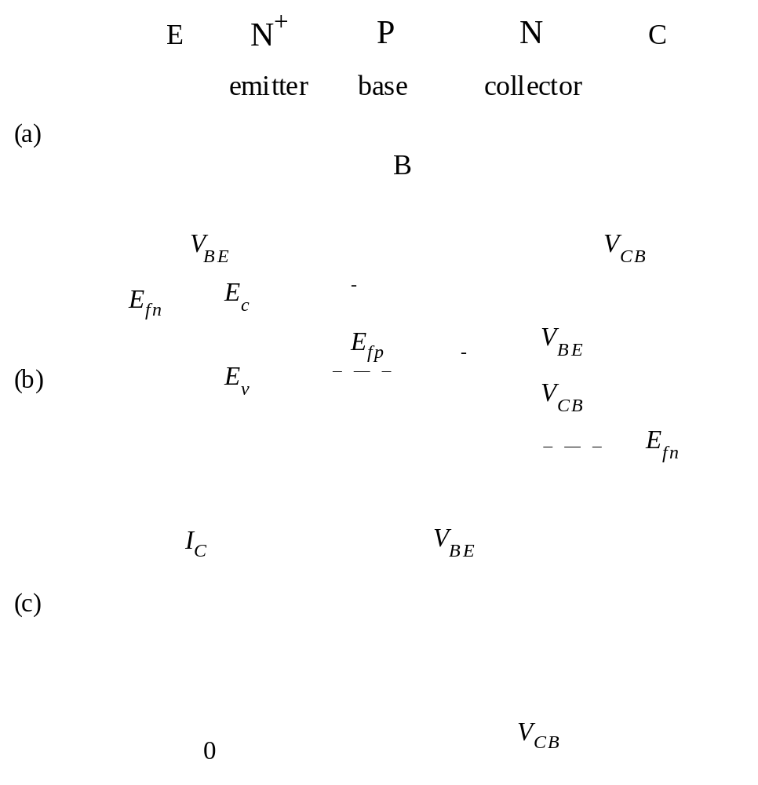
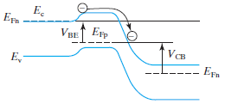
8.1 Introduction to the BJT
NPN BJT:
B
E
C
N⁺
P
N
Emitter
Base
Collector
V_{BE}
V_{CB}
I_{C} is an exponential function of forward V_{BE} and independent of reverse V_{CB}.
Modern Semiconductor Devices for Integrated Circuits (C. Hu)
Slide 8-<number>

Slide 3
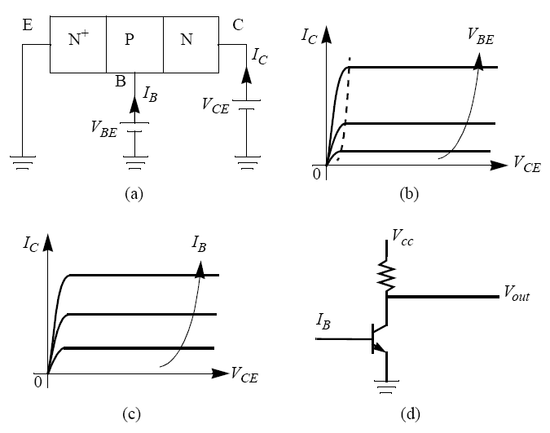
Common-Emitter Configuration
Question: Why is I_{B} often preferred as a parameter over V_{BE}?
Modern Semiconductor Devices for Integrated Circuits (C. Hu)
Slide 8-<number>

Slide 4
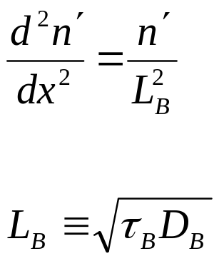
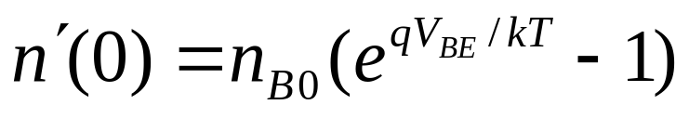
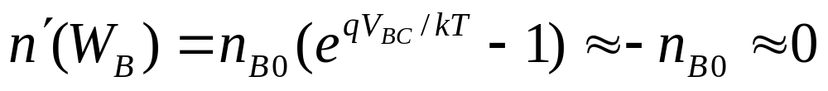
8.2 Collector Current
depletion layers
N
+
P
N
emitter
base
collector
x
0
W
B
τ_{B} : base recombination lifetime
D_{B} : base minority carrier (electron) diffusion constant
Boundary conditions :
Modern Semiconductor Devices for Integrated Circuits (C. Hu)
Slide 8-<number>

Slide 5
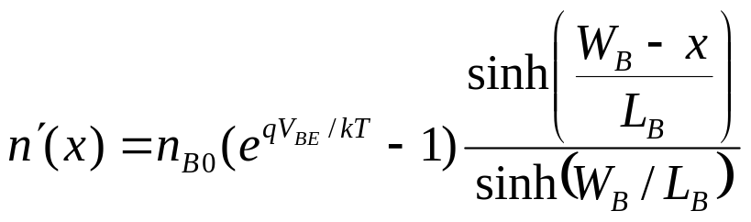
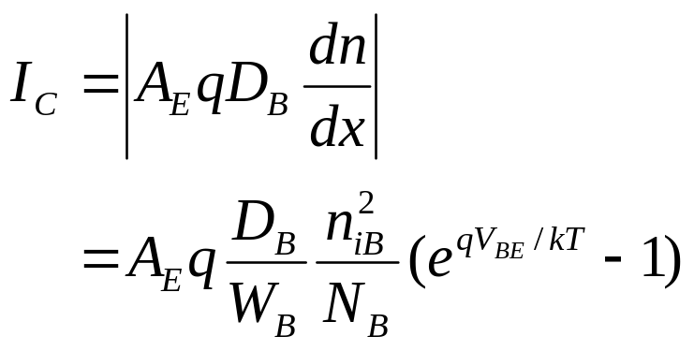

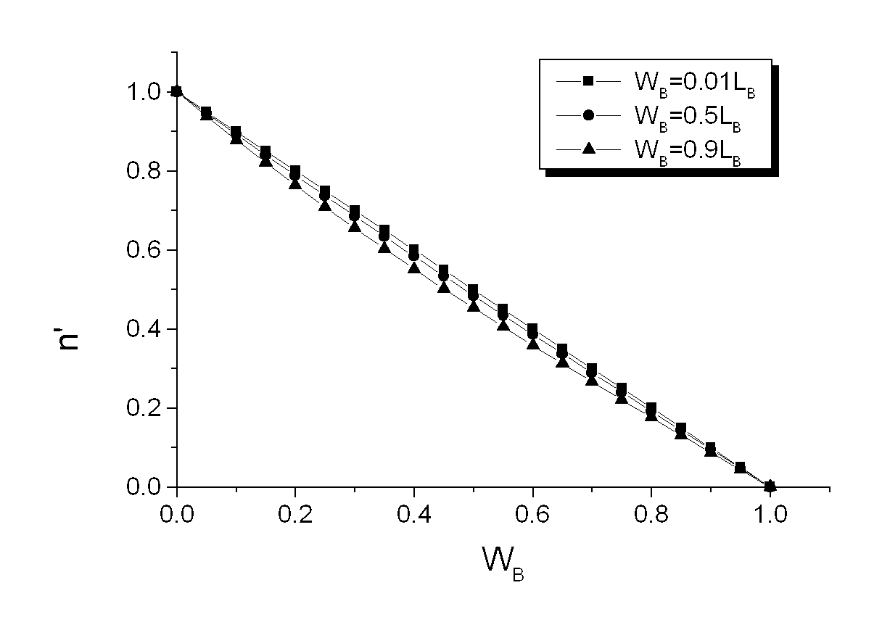
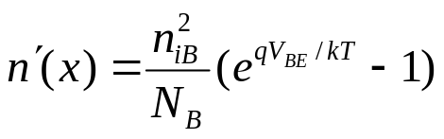

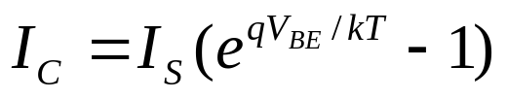
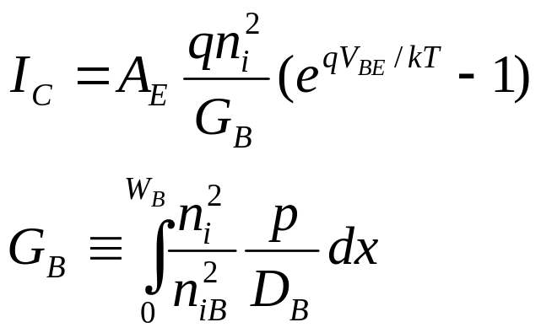
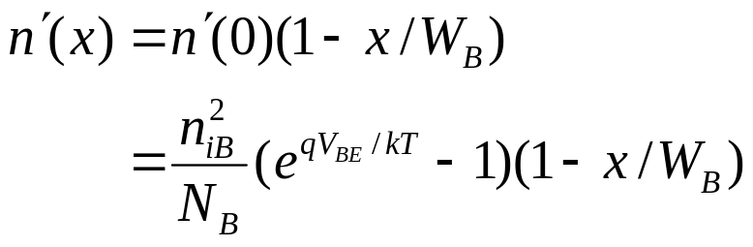
8.2 Collector Current
n
′
-------------
n
′
()
0
n
2
qV
⁄
kT
i
()
BE
1
-------e
–
1
N
B
It can be shown
0
x
/
x/
1
W
B
G_{B} (s·cm⁴) is the base Gummel number
Modern Semiconductor Devices for Integrated Circuits (C. Hu)
Slide 8-<number>

Slide 6


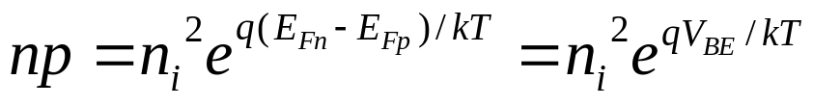
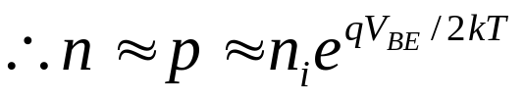
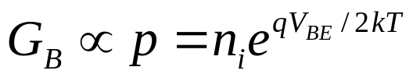
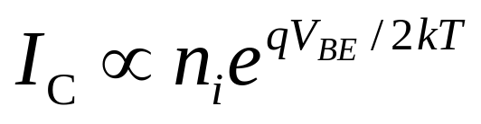
8.2.1 High Level Injection Effect
At low-level injection,
inverse slope is 60 mV/decade
10⁻²
I_{kF}
High-level injection effect :
10⁻⁴
)
A
10⁻⁶
At large V_{BE,}
(
I
C
60 mV/decade
10⁻⁸
10⁻¹⁰
10⁻¹²
0
0.2
0.4
0.6
0.8
1.0
V
BE
When p > N_{B} , inverse slope is 120mV/decade.
Modern Semiconductor Devices for Integrated Circuits (C. Hu)
Slide 8-<number>

Slide 7
8.3 Base Current
Some holes are injected from the P-type base into the N⁺ emitter.
The holes are provided by the base current, I_{B} .
(
a
)
contact
emitter
base
collector
contact
electron flow
–
I
I
E
hole flow
C
+
I
B
p
'
n
'
E
B
(b)
W
E
W
B
Modern Semiconductor Devices for Integrated Circuits (C. Hu)
Slide 8-<number>

Slide 8
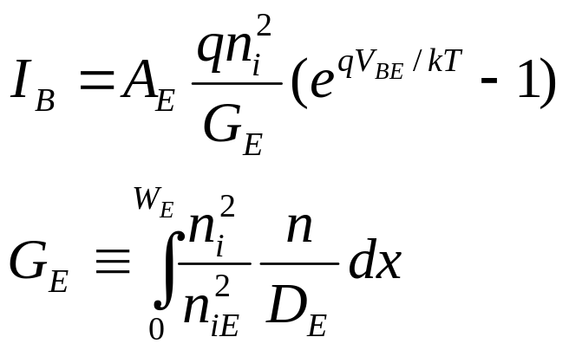
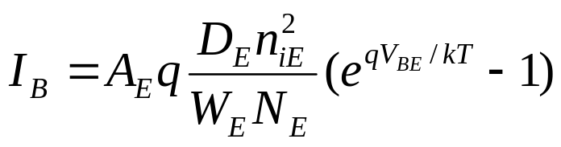
8.3 Base Current
(
a
)
contact
emitter
base
collector
contact
electron flow
–
I
I
E
C
hole flow
+
I
B
For a uniform emitter,
Is a large I_{B} desirable? Why?
Modern Semiconductor Devices for Integrated Circuits (C. Hu)
Slide 8-<number>

Slide 9
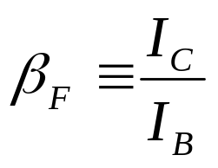
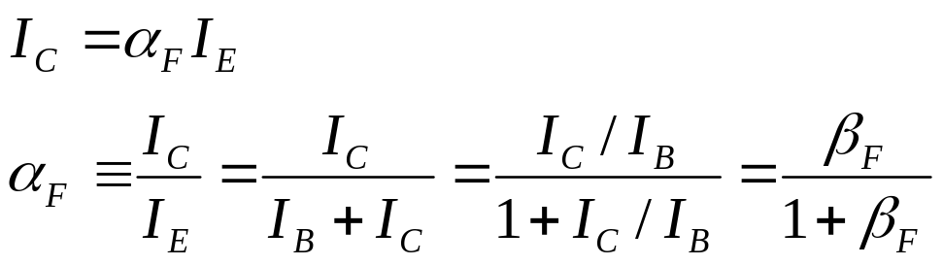
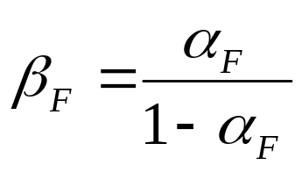
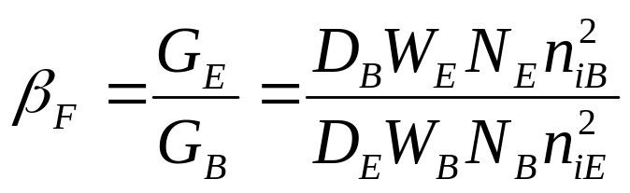
8.4 Current Gain
Common-emitter current gain, β_{F} :
Common-base current gain:
It can be shown that
How can β_{F} be maximized?
Modern Semiconductor Devices for Integrated Circuits (C. Hu)
Slide 8-<number>

Slide 10
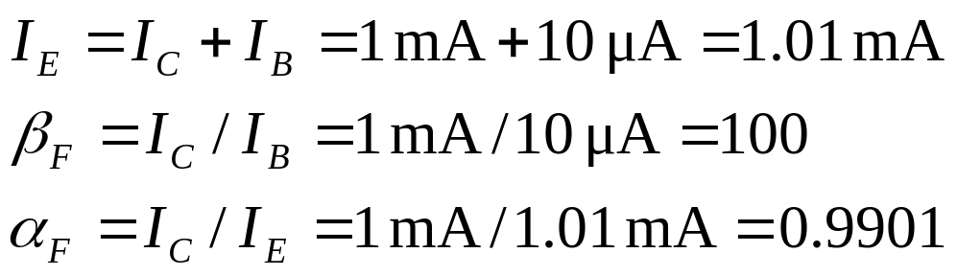
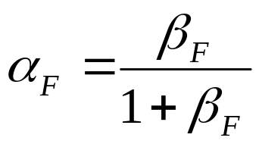
EXAMPLE: Current Gain
A BJT has I_{C} = 1 mA and I_{B} = 10 μA. What are I_{E}, β_{F} and α_{F}?
Solution:
We can confirm
and
Modern Semiconductor Devices for Integrated Circuits (C. Hu)
Slide 8-<number>

Slide 11
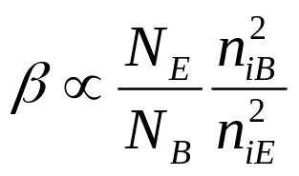
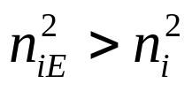
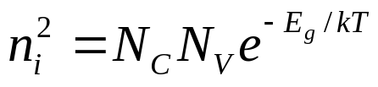
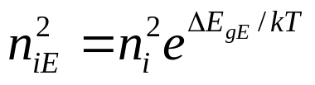
8.4.1 Emitter Bandgap Narrowing
To raise β_{F}, N_{E} is typically very large. Unfortunately, large N_{E} makes
(heavy doping effect).
Since n_{i} is related to E_{g} , this effect is also known as band-gap
narrowing.
ΔE_{gE} is negligible for N_{E} < 10¹⁸ cm⁻³,
is 50 meV at 10¹⁹cm⁻³, 95 meV at 10²⁰cm⁻³,
and 140 meV at 10²¹ cm⁻³.
Emitter bandgap narrowing makes it difficult to raise β_{F} by doping the emitter very heavily.
Modern Semiconductor Devices for Integrated Circuits (C. Hu)
Slide 8-<number>

Slide 12
8.4.2 Narrow-Bandgap Base and Heterojuncion BJT
To further elevate β_{F} , we can raise n_{iB} by using an epitaxial Si_{1-η}Ge_{η} base.
With η = 0.2, E_{gB} is reduced by 0.1eV and n_{iE}² by 30x.
Modern Semiconductor Devices for Integrated Circuits (C. Hu)
Slide 8-<number>

Slide 13
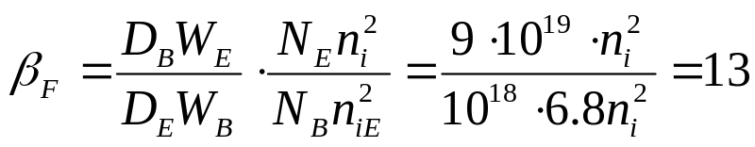




EXAMPLE: Emitter Bandgap Narrowing and SiGe Base
Assume D_{B} = 3D_{E} , W_{E} = 3W_{B} , N_{B} = 10¹⁸ cm⁻³, and n_{iB}² = n_{i}². What is β_{F} for (a) N_{E} = 10¹⁹ cm⁻³, (b) N_{E} = 10²⁰ cm^{-3,} and (c) N_{E} = 10²⁰ cm⁻³ and a SiGe base with ΔE_{gB} = 60 meV ?
(a) At N_{E} = 10¹⁹ cm⁻³, ΔE_{gE} ≈ 50 meV,
(b) At N_{E} = 10²⁰ cm⁻³, ΔE_{gE} ≈ 95 meV
(c)
Modern Semiconductor Devices for Integrated Circuits (C. Hu)
Slide 8-<number>

Slide 14
8.4.3 Poly-Silicon Emitter
A high-performance BJT typically has a layer of As-doped N⁺ poly-silicon film in the emitter.
β_{F} is larger due to the large W_{E} , mostly made of the N⁺ poly-silicon. (A deep diffused emitter junction tends to cause emitter-collector shorts.)
N
+
-poly-Si
emitter
SiO
2
P-base
N-collector
Modern Semiconductor Devices for Integrated Circuits (C. Hu)
Slide 8-<number>

Slide 15
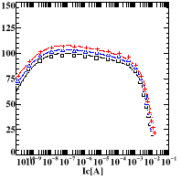
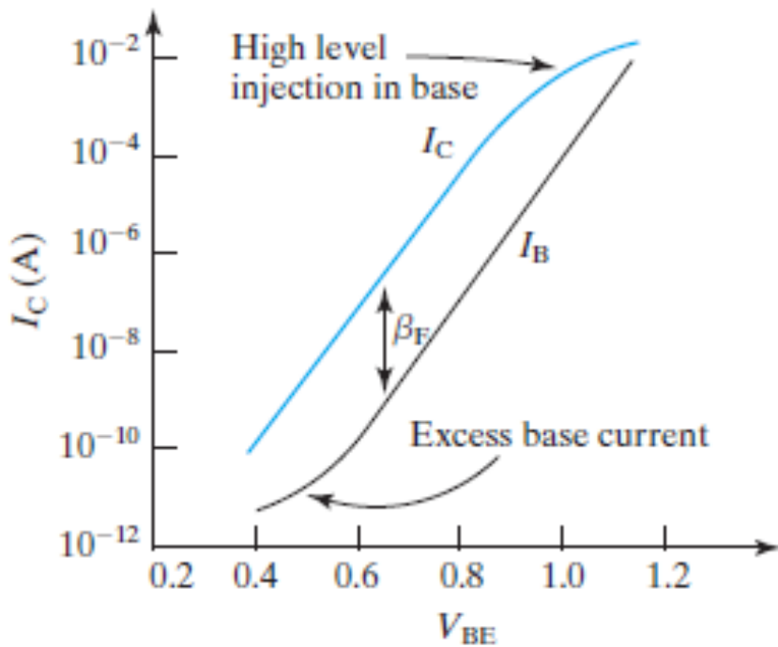
8.4.4 Gummel Plot and β_{F} Fall-off at High and Low I_{c}
β_{F}
SCR BE current
From top to bottom:
V_{BC} = 2V, 1V, 0V
Why does one want to operate BJTs at low I_{C} and high I_{C}?
Why is β_{F} a function of V_{BC} in the right figure?
Hint: See Sec. 8.5 and Sec. 8.9.
Modern Semiconductor Devices for Integrated Circuits (C. Hu)
Slide 8-<number>

Slide 16
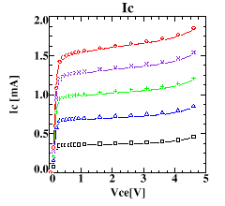
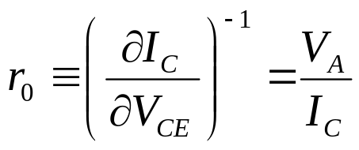
8.5 Base-Width Modulation by Collector Voltage
Output resistance :
I_{C}
I_{B3}
Large V_{A} (large r_{o} ) is desirable for a large voltage gain
I_{B2}
V_{A} : Early Voltage
I_{B1}
V
0
V
CE
A
Modern Semiconductor Devices for Integrated Circuits (C. Hu)
Slide 8-<number>

Slide 17
8.5 Base-Width Modulation by Collector Voltage
V
BE
N
+
P
N
V
CE
emitter
base
collector
W
}
B
3
W
B
2
V
<
V
<
V
W
CE
1
CE
2
CE
3
B
1
n'
x
How can we reduce the base-width modulation effect?
Modern Semiconductor Devices for Integrated Circuits (C. Hu)
Slide 8-<number>

Slide 18
8.5 Base-Width Modulation by Collector Voltage
V
BE
N
+
P
N
The base-width modulation
effect is reduced if we
(A) Increase the base width,
(B) Increase the base doping
concentration, N_{B} , or
(C) Decrease the collector doping
concentration, N_{C} .
Which of the above is the most acceptable action?
V
emitter
base
collector
CE
W
}
B
3
W
B
2
V
<
V
<
V
W
CE
1
CE
2
CE
3
B
1
n'
x
Modern Semiconductor Devices for Integrated Circuits (C. Hu)
Slide 8-<number>

Slide 19
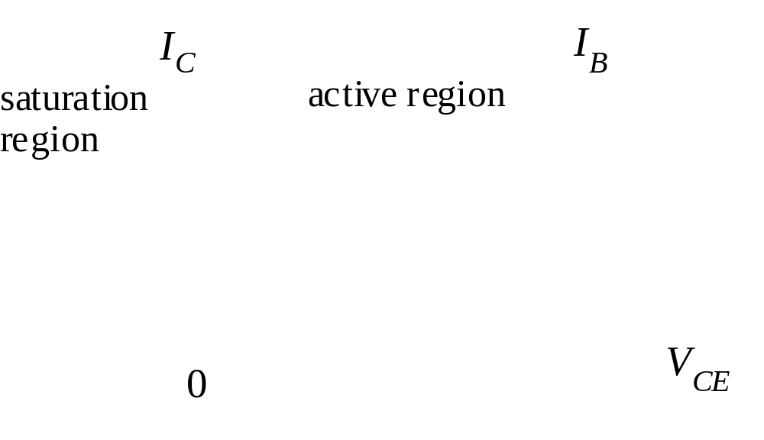
8.6 Ebers-Moll Model
The Ebers-Moll model describes both the active and the saturation regions of BJT operation.
Modern Semiconductor Devices for Integrated Circuits (C. Hu)
Slide 8-<number>

Slide 20
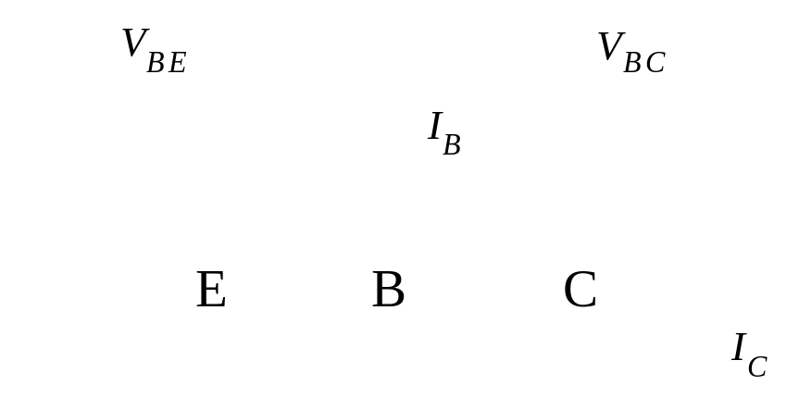
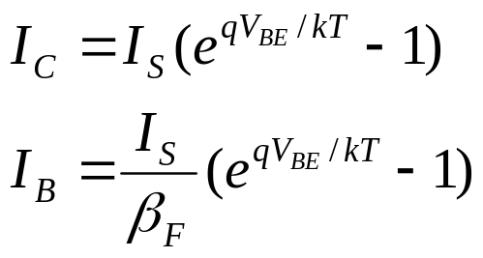
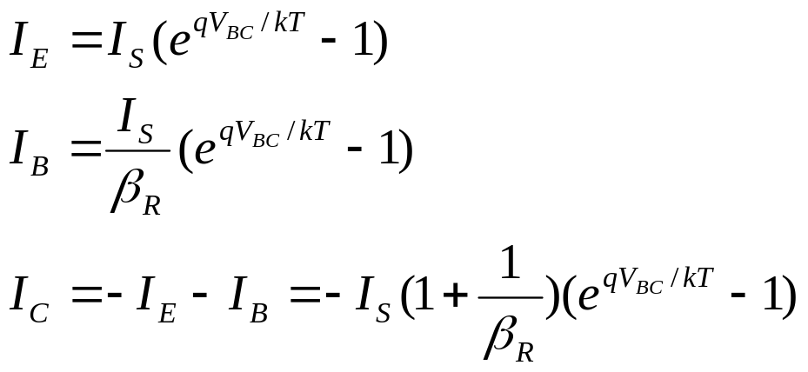
8.6 Ebers-Moll Model
I_{C} is driven by two two forces, V_{BE} and V_{BC} .
When only V_{BE} is present :
Now reverse the roles of emitter and collector.
When only V_{BC} is present :
β_{R} : reverse current gain
β_{F} : forward current gain
Modern Semiconductor Devices for Integrated Circuits (C. Hu)
Slide 8-<number>

Slide 21
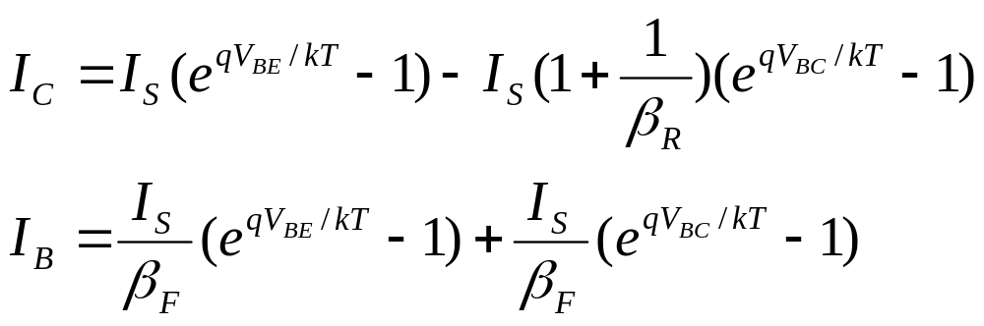
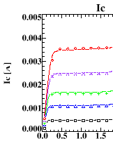
8.6 Ebers-Moll Model
In general, both V_{BE} and V_{BC} are present :
In saturation, the BC junction becomes forward-biased, too.
V_{BC} causes a lot of holes to be injected into the collector. This uses up much of I_{B}. As a result, I_{C} drops.
V_{CE} (V)
Modern Semiconductor Devices for Integrated Circuits (C. Hu)
Slide 8-<number>

Slide 22
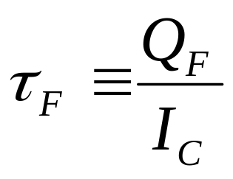
8.7 Transit Time and Charge Storage
When the BE junction is forward-biased, excess holes are stored
in the emitter, the base, and even in the depletion layers.
Q_{F} is all the stored excess hole charge
τ_{F} is difficult to be predicted accurately but can be measured.
τ_{F} determines the high-frequency limit of BJT operation.
Modern Semiconductor Devices for Integrated Circuits (C. Hu)
Slide 8-<number>

Slide 23
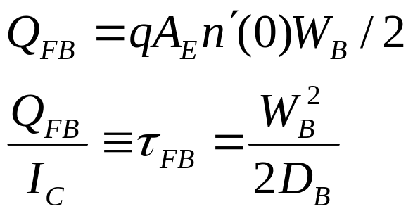
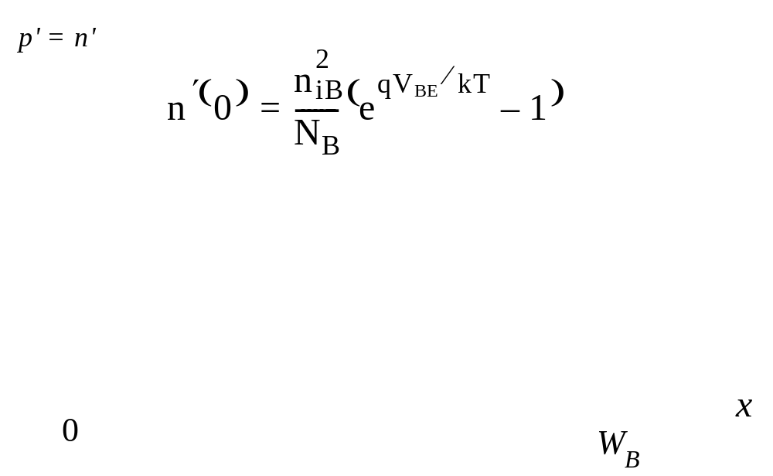

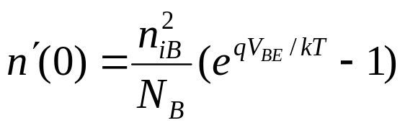
8.7.1 Base Charge Storage and Base Transit Time
Let’s analyze the excess hole charge and transit time in
the base only.
Modern Semiconductor Devices for Integrated Circuits (C. Hu)
Slide 8-<number>

Slide 24
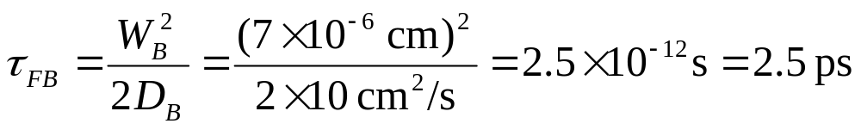
EXAMPLE: Base Transit Time
What is τ_{FB} if W_{B} = 70 nm and D_{B} = 10 cm²/s?
Answer:
2.5 ps is a very short time. Since light speed is 3×10⁸ m/s, light travels only 1.5 mm in 5 ps.
Modern Semiconductor Devices for Integrated Circuits (C. Hu)
Slide 8-<number>

Slide 25
8.7.2 Drift Transistor–Built-in Base Field
The base transit time can be reduced by building into the base a drift field that aids the flow of electrons. Two methods:
Fixed E_{gB} , N_{B} decreases from emitter end to collector end.
E
-
B
C
E_{c}
E_{f}
E_{v}
Fixed N_{B} , E_{gB} decreases from emitter end to collector end.
E
-
B
C
1
dE
E
=
c
E_{c}
E_{f}
q
dx
E_{v}
Modern Semiconductor Devices for Integrated Circuits (C. Hu)
Slide 8-<number>

Slide 26
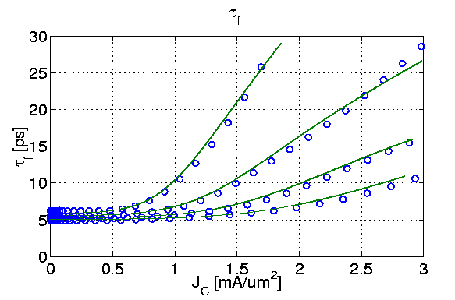
8.7.3 Emitter-to-Collector Transit Time and Kirk Effect
To reduce the total transit time, emitter and depletion layers must be thin, too.
Kirk effect or base widening: At high I_{C} the base widens into the collector. Wider base means larger τ_{F} .
Top to bottom :
V_{CE} = 0.5V, 0.8V,
1.5V, 3V.
Modern Semiconductor Devices for Integrated Circuits (C. Hu)
Slide 8-<number>

Slide 27

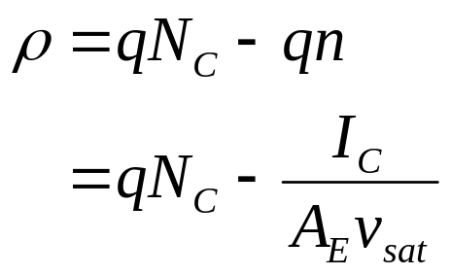
Base Widening at Large I_{c}
−
E
N
N
+
base
collector
collector
x
base
depletion
width
layer
−
E
N
N
+
dE
base
collector
collector
=
ρ
/
ε
dx
s
x
“base
depletion
width”
layer
Modern Semiconductor Devices for Integrated Circuits (C. Hu)
Slide 8-<number>

Slide 28
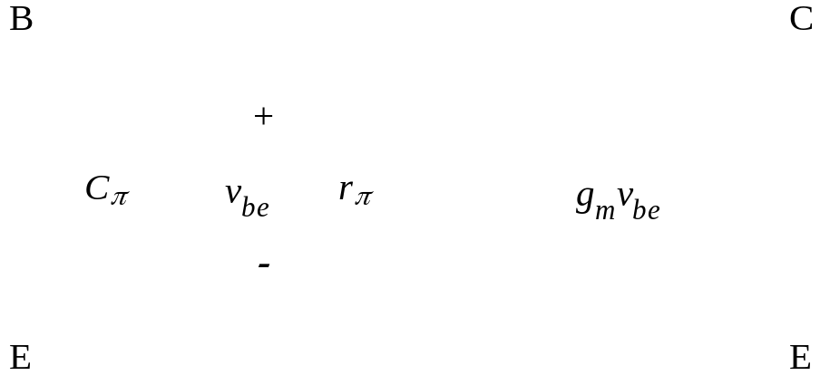
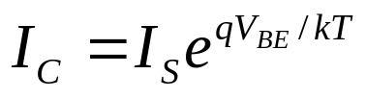

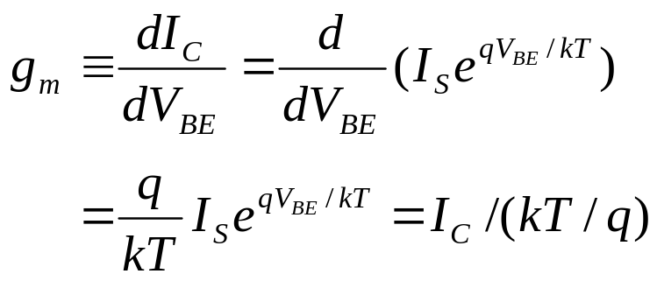

8.8 Small-Signal Model
Transconductance:
At 300 K, for example, g_{m}=I_{C} /26mV.
Modern Semiconductor Devices for Integrated Circuits (C. Hu)
Slide 8-<number>

Slide 29




8.8 Small-Signal Model
This is the charge-storage capacitance, better known as the diffusion capacitance.
Add the depletion-layer capacitance, C_{dBE} :
Modern Semiconductor Devices for Integrated Circuits (C. Hu)
Slide 8-<number>

Slide 30


EXAMPLE: Small-Signal Model Parameters
A BJT is biased at I_{C} = 1 mA and V_{CE} = 3 V. β_{F}=90, τ_{F}=5 ps, and T = 300 K. Find (a) g_{m} , (b) r_{π} , (c) C_{π} .
Solution:
(a)
(b)
(c)
Modern Semiconductor Devices for Integrated Circuits (C. Hu)
Slide 8-<number>

Slide 31


Once the model parameters are determined, one can analyze circuits with arbitrary source and load impedances.
The parameters are routinely
determined through comprehensive
measurement of the BJT AC
and DC characteristics.
Modern Semiconductor Devices for Integrated Circuits (C. Hu)
Slide 8-<number>

Slide 32





8.9 Cutoff Frequency
The load is a short circuit. The signal source is a current source,
i_{b} , at frequency, f. At what frequency does the current gain
fall to unity?
Modern Semiconductor Devices for Integrated Circuits (C. Hu)
Slide 8-<number>

Slide 33

8.9 Cutoff Frequency
f_{T} = 1/2π(τ_{F} + C_{dBE}kT/qI_{C})
f_{T} is commonly used to compare the speed of transistors.
Why does f_{T} increase with increasing I_{C}?
Why does f_{T} fall at high I_{C}?
Modern Semiconductor Devices for Integrated Circuits (C. Hu)
Slide 8-<number>

Slide 34

BJT Structure for Minimum Parasitics and High Speed
Poly-Si emitter
Thin base
Self-aligned poly-Si base contact
Narrow emitter opening
Lightly-doped collector
Heavily-doped epitaxial subcollector
Shallow trench and deep trench for electrical isolation
Modern Semiconductor Devices for Integrated Circuits (C. Hu)
Slide 8-<number>

Slide 35



8.10 Charge Control Model
For the DC condition,
I_{C}(t) = Q_{F}(t)/τ_{F}
In order to sustain an excess hole charge in the transistor,
holes must be supplied through I_{B} to susbtain recombination at the above rate.
What if I_{B} is larger than ?
Step 1: Solve it for any given I_{B}(t) to find Q_{F}(t).
Step 2: Can then find I_{C}(t) through I_{C}(t) = Q_{F}(t)/τ_{F} .
Modern Semiconductor Devices for Integrated Circuits (C. Hu)
Slide 8-<number>

Slide 36



Visualization of Q_{F}(t)
I
B
(
t
)
Q
F
(
t
)
Q
F
/
τ
F
β
F
Modern Semiconductor Devices for Integrated Circuits (C. Hu)
Slide 8-<number>

Slide 37




EXAMPLE : Find I_{C}(t) for a Step I_{B}(t)
The solution of is
n
E
B
C
t
What is
Q_{F}
Modern Semiconductor Devices for Integrated Circuits (C. Hu)
Slide 8-<number>

Slide 38


8.11 Model for Large-Signal Circuit Simulation
Compact (SPICE) model contains dozens of parameters, mostly determined from measured BJT data.
Circuits containing tens of thousands of transistors can be simulated.
Compact model is a “contract” between device/manufacturing engineers and
circuit designers.
Modern Semiconductor Devices for Integrated Circuits (C. Hu)
Slide 8-<number>

Slide 39
8.11 Model for Large-Signal Circuit Simulation
A commonly used BJT compact model is the Gummel-Poon model, consisting of
Ebers-Moll model
Current-dependent beta
Early effect
Transit times
Kirk effect
Voltage-dependent capacitances
Parasitic resistances
Other effects
Modern Semiconductor Devices for Integrated Circuits (C. Hu)
Slide 8-<number>

Slide 40
8.12 Chapter Summary
The base-emitter junction is usually forward-biased while the base-collector is reverse-biased. V_{BE} determines the collector current, I_{C} .
G_{B} is the base Gummel number, which represents all the subtleties of BJT design that affect I_{C}.
Modern Semiconductor Devices for Integrated Circuits (C. Hu)
Slide 8-<number>

Slide 41


8.12 Chapter Summary
The base (input) current, I_{B} , is related to I_{C} by the common-emitter current gain, β_{F} . This can be related to the common-base current gain, α_{F} .
The Gummel plot shows that β_{F} falls off in the high I_{C} region due to high-level injection in the base. It also falls off in the low I_{C} region due to excess base current.
Base-width modulation by V_{CB} results in a significant slope of the I_{C} vs. V_{CE} curve in the active region (known as the Early effect).
Modern Semiconductor Devices for Integrated Circuits (C. Hu)
Slide 8-<number>

Slide 42




8.12 Chapter Summary
Due to the forward bias V_{BE} , a BJT stores a certain amount of excess carrier charge Q_{F} which is proportional to I_{C}.
τ_{F} is the forward transit time. If no excess carriers are stored outside the base, then
, the base transit time.
The charge-control model first calculates Q_{F}(t) from I_{B}(t) and then calculates I_{C}(t).
Modern Semiconductor Devices for Integrated Circuits (C. Hu)
Slide 8-<number>

Slide 43



8.12 Chapter Summary
The small-signal models employ parameters such as transconductance,
input capacitance,
and input resistance.
Modern Semiconductor Devices for Integrated Circuits (C. Hu)
Slide 8-<number>

