Slide 1
Complex variables 2019 DFT, FFT
2019. 5. 15
Doug Young Suh

Slide 2
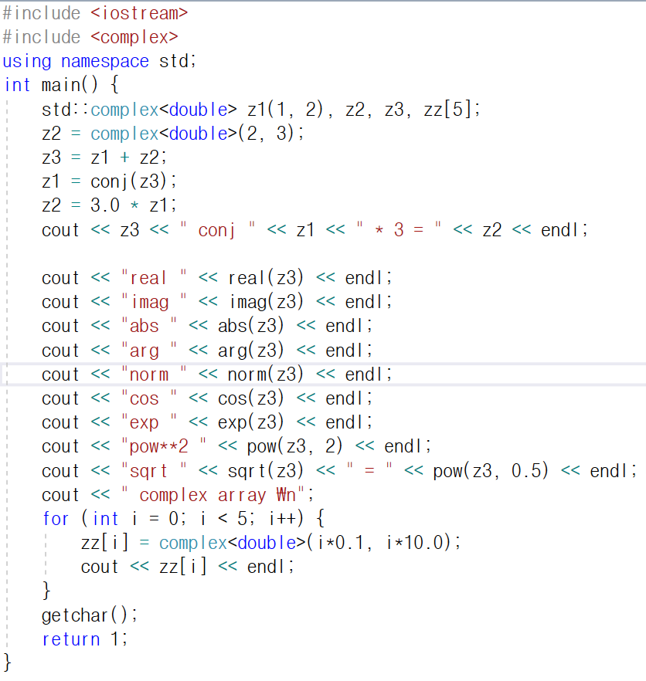
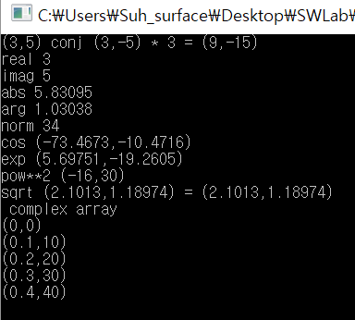









template
$$z=x+jy$$
$$ﮮz≈π/3$$
Re{$z\}=x, Im\left\{z\right\}=y$
|$z|=\sqrt{x^{2}+y^{2}}$
$${\text{|}z|}^{2}=x^{2}+y^{2}$$
$${\cos\left(z\right)=(e}^{jz}+e^{−jz})/2$$
$$e^{z}$$
$$z^{2}$$
$$z^{0.5}=\sqrt{z}$$

Slide 3
DFT
DFT.h
Member data
int N
complex x[N], X[N]
Member functions
forwardDFT( )
inverseDFT( )

Slide 4
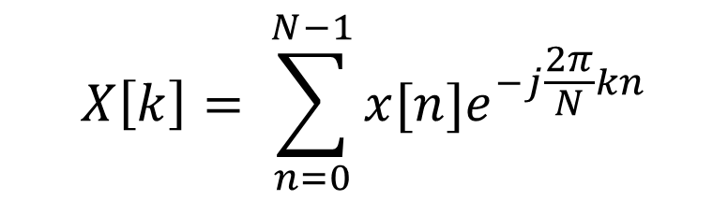

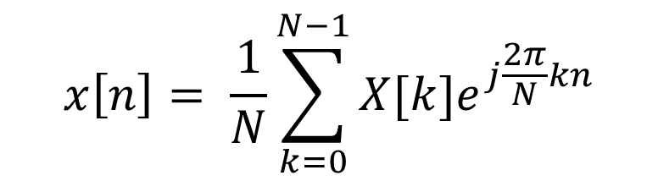
Assignment
Implement Fourier transform
←→
N = 128
$x\left[n\right]=\left\{\begin{matrix}1 & n<10, n>118 \\ 0 & otherwise\end{matrix}\right.$
$x\left[n\right]=cos⁡(\frac{8π}{N}n)$
$x\left[n\right]=sin(\frac{16π}{N}n)$
$$x\left[n\right]= \frac{1}{N}\sum_{k=0}^{N−1}{X[k]e^{j\frac{2π}{N}kn}}$$
$$X\left[k\right]= \sum_{n=0}^{N−1}{x[n]e^{−j\frac{2π}{N}kn}}$$

Slide 5
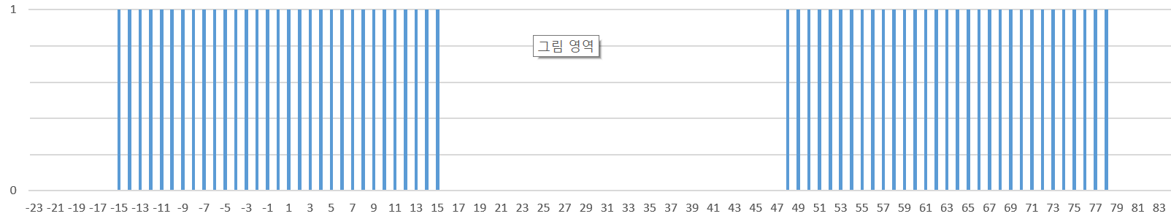


DFT example : forward DFT
square → sinc
…
…
N=64
$$n$$
$$x\left[n\right] for n=0\sim N−1$$

Slide 6


DFT example : inverse DFT
sinc ← square
…
…
N=64
$$k$$
$$X\left[k\right] for k=0\sim N−1$$

Slide 7
Complexity
2019. 3. 7
Doug Young Suh

Slide 8
Contents
Big O : complexity measure
Assignment
Compare complexity of DFT and FFT for various N

Slide 9
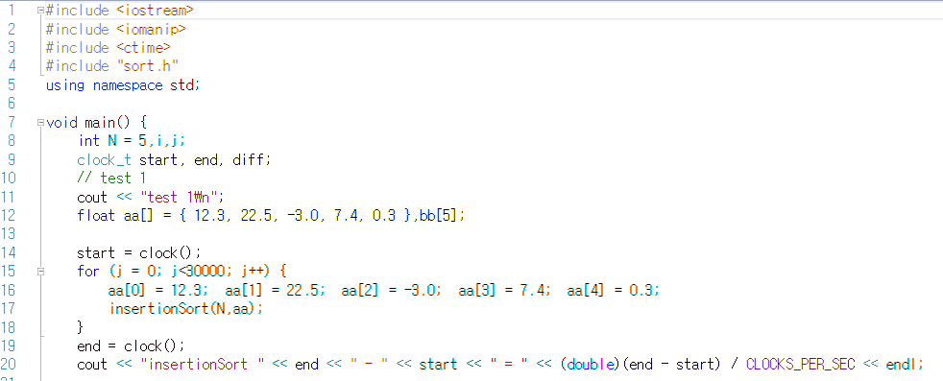
Complexity ~ computation time
“Do something”
t
start
end

Slide 10
DFT
FFT
DFT.h
Member data
int N
complex x[N], X[N]
Member functions
forwardDFT( )
inverseDFT( )
FFT.h
Member data
int N
complex x[N], X[N]
Member functions
forwardFFT( )
inverseFFT( )

Slide 11
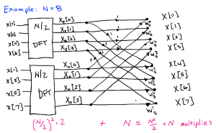
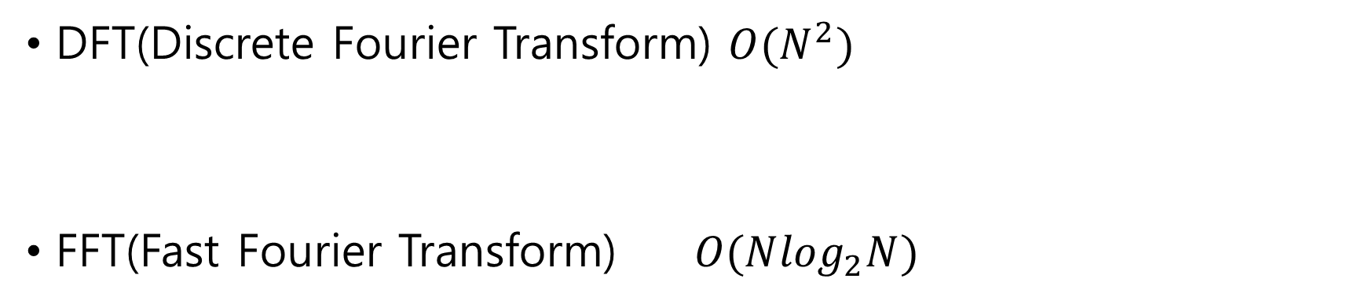
DFT and FFT
DFT(Discrete Fourier Transform) $O(N^{2})$
FFT(Fast Fourier Transform) $O(N\log_{2}N)$
$$X\left[k\right]=\sum_{n=0}^{N−1}{x[n]e^{−j\frac{2πkn}{N}}} for k=0,…,N−1 N^{2} complex multiplications O(N^{2})$$
$${2(2(\frac{N}{4})}^{2}+\frac{N}{2})+N$$

Slide 12
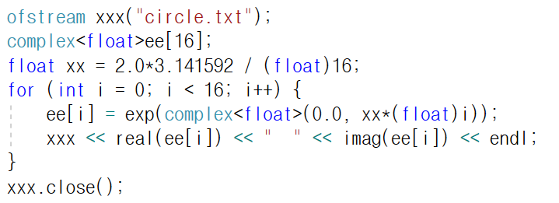
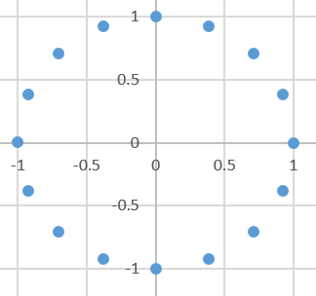

Hint: to save CPU time
complex<float>ee[N];
float xx = 2.0*3.141592/(float)N;
for(int i=0;i<N;i++)ee[i] = exp(complex<float>(0.0,xx*(float)i));
$$e^{j\frac{2π}{N}kn}$$
ee[(k*n) % N]

